Slide 1

Linux Operating System Kernel
許 富 皓

Slide 2
Sharing Process Address Space
Reduce memory usage
  e.g. editor.
Explicitly requested by processes
  e.g. shared memory for interprocess communication.
mmap() system call allows part of a file or the memory residing on a device to be mapped into a part of a process address space.

Slide 3
Race Condition
When the outcome of some computation depends on how two or more processes are scheduled, the code is incorrect. We say that there is a race condition.
Example:
  Variable v contains the number of available resources.

Slide 4
Critical Region
Any section of code that should be finished by each process that begins it before another process can enter it is called a critical region.

Slide 5
Synchronization
Atomic Operation:
  a single, non-interruptible operation
  not suitable for complex operation
    e.g. delete a node from a linked list.

Slide 6
Synchronization – Non-preemptive Kernels
When a process executes in kernel mode, it cannot be arbitrarily suspended and substituted with another process.
Therefore on a uniprocessor system, all kernel data structures that are not updated by interrupts or exception handlers are safe for the kernel to access.
Ineffective in multiprocessor system.

Slide 7
Synchronization - Interrupt Disabling
Disabling interrupts before entering critical region and restoring the interrupts after leaving the region.
Not efficient
Not suitable for multiprocessors.

Slide 8
Synchronization - Semaphore
Consist of
  an integer variable,
  a list of waiting processes,
  and
  two atomic methods down() and up().
Will block process; therefore, it is not suitable for interrupt handler.

Slide 9
Synchronization – Spin Lock
For multiprocessor system:
  When time to update the data protected by semaphores is short, then semaphores are not efficient.
  When a process finds the lock closed by another process, it spins around repeatedly, executed a tight instruction loop until the lock becomes open.

Slide 10
Synchronization
Avoid deadlock.

Slide 11
Signals
Linux uses signals to notify processes system events.
Each event has its own signal number, which is usually referred to by a symbolic constant such as SIGTERM.

Slide 12
Signal Notification
Asynchronous notifications
  For instance, a user can send the interrupt signal SIGINT to a foreground process by pressing the interrupt keycode (usually Ctrl-C) at the terminal.
Synchronous notifications
  For instance, the kernel sends the signal SIGSEGV to a process when it accesses a memory location at an invalid address.

Slide 13
Processes’ Responses to Signals
Ignore.
Asynchronously execute a signal handler.
  Signal SIGKILL and SIGSTOP cannot be directly handled by a process or ignored.

Slide 14
Kernel Default Actions to Signals
When a process doesn’t define its response to a signal, then kernel will utilize the default action of the signal to handle it.
Each signal has its own kernel default action.

Slide 15
Kernel Default Actions to Signals
Terminate the process.
Core dump and terminate the process
Ignore
Suspend
Resume, if it was stopped.

Slide 16
Process Management-related System Calls
fork()
  Duplicate a copy of the caller process.
  Caller → parent
  New process → child
_exit()
  Send a SIGCHLD signal to the exiting process’s parent process.
  The signal is ignored by default
exec()

Slide 17
How Can a Parent Process Inquire about Termination of Its Children?
The wait4( ) system call allows a process to wait until one of its children terminates; it returns the process ID (PID) of the terminated child.
When executing this system call, the kernel checks whether a child has already terminated.
A special zombie process state is introduced to represent terminated processes: a process remains in that state until its parent process executes a wait4( ) system call on it.

Slide 18
system Call wait4( )
The system call handler extracts data about resource usage from the process descriptor fields.
The process descriptor may be released once the data is collected.
If no child process has already terminated when the wait4( ) system call is executed, the kernel usually puts the process in a wait state until a child terminates.

Slide 19
Process init_{[LSAG]}
init is a special system process which is created during system initialization.
  /etc/inittab
  getty
  login shell
If a parent process terminates before its child process(es) does (do), then init becomes the parent process of all those child process(es).
The init process
  monitors the execution of all its children
  and
  routinely issues wait4( ) system calls, whose side effect is to get rid of all orphaned zombies.

Slide 20
Shell
Also called a command line interpreter.
When you login a system, it displays a prompt on the screen and waits for you to enter a commend.
A running shell is also a process.
Some of the famous shells
  Bourne shell (/bin/sh)
  Bourne Again shell (/bin/bash)
  Korn Shell (/bin/ksh)
  C-shell (/bin/csh)

Slide 21
Memory Addressing

Slide 22
Logical Addresses
Logical address:
  Used in machine language instructions to specify the address of an instruction or an operand.
  A logical address ← segment base address + offset
    offset: the distance from the start of the segment to the actual address.
    In an assembly language instruction, the segment base address part is stored in a segment register and is usually omitted, because most segments are specified by default segment registers:
    e.g. code segments use cs register.
mov es:[eax],ecx ≡ 268908 (larger instruction)
mov [eax],ecx ≡ 8908

Slide 23
Default Segment Register _{[Aki Suihkonen]}
mov esi, [ebp + 542] ; // uses ss:
mov esi, [esp + 123] ; // uses ss: too
mov eax, [eax + esp] ; // uses ds, because eax is the base
// and esp is the scalable register (with scale==1)
It's not the property of assembler, but of the processor.
To override it, there's a one byte segment override prefix before the instruction.
mov es:[eax],ecx ≡ 268908 (larger instruction)
mov [eax],ecx ≡ 8908

Slide 24
Linear Addresses
Linear Address (Virtual Address)
  In a IA-32 architecture, it is a unsigned 32-bit integer.
  2³² = 4 Giga bytes
  From 0x00000000 to 0xffffffff

Slide 25
Physical Address
Physical address
  Used to address memory cells in memory chips.
  Signals appear on the address bus and CPU’s address pins.
  Physical addresses are also represented by a 32-bit unsigned integer.

Slide 26
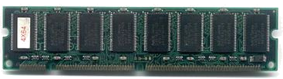
Physical Memory Addresses
Memory chips consist of memory cells.
Each memory cell has a unique address.
Each memory cell is one byte long.
Memory cells may contain instructions or data.

Slide 27
int hippo;
int giraffe=100;
main()
{ int a,b;
:
for(a=0;a<100;a++)
:
}
int food(int koala)
{ int zoo;
:
zoo=animal(“panda”);
:
}
int animal(*char str)
{
:
}
bss segment
data segment
4 G
code segment
compiler
application program
happy_zoo.c
process virtual address space
a.out

Slide 28
a.out
bss segment
data segment
4 G
Save
code segment
Hard Disk
process virtual address space
a.out

Slide 29
Memory Addresses Used in a Program – Logical Addresses
Programs use a memory address to access the content of a memory cell.
The address used by physical memory is different from the address used in a program, even though both are 32-bit unsigned integers.

Slide 30
Logical Address Example
main()
{
int a,b;
a=3;
b=2;
}
main:
pushl %ebp
movl %esp, %ebp
subl $8, %esp
andl $-16, %esp
movl $0, %eax
subl %eax, %esp
movl $3, -4(%ebp)
movl $2, -8(%ebp)
leave
ret
offset

Slide 31
Address Transformation
Segmentation Unit
  A hardware circuit
  Transform a logical address into a virtual address.
Paging Unit:
  A hardware circuit
  Transform a virtual address into a physical address.

Slide 32

Address Translation
Segmentation Unit
Paging Unit
inside a CPU

Slide 33
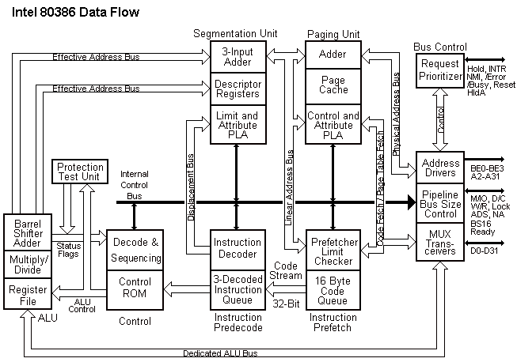
Intel 80386 Data Flow

Slide 34
Memory Arbitrator
When multiple processors could access the same memory chips, a memory arbitrator guarantees that at any instance only one processor could access a chip.
  A multiprocessor system
  DMA
Resides between
  the address bus
  and
  memory chips.

Slide 35
CPU Mode
Starting for 80386, IA-32 provides two logical address translation method.
  Real Mode
    Compatibility with older processors
    bootstrap
  Protected Mode
    In this chapter we only discuss this mode.

Slide 36
Segmentation Unit
A logical address is decided by
  a16-bit segment selector (segment identifier)
  and
  a 32-bit offset within the segment identified by the segment selector.

Slide 37
Segment Registers
An IA-32 processor has 6 segment registers (cs, ss, ds, es, fs, gs)
Each segment register holds a segment selector.
  cs: points to a code segment
  ss: points to a stack segment
  ds: points to a data segment.
  es, fs, and gs: general purpose segment register may point to arbitrary data segments.

Slide 38
CPU Privilege Levels
The cs register includes a 2-bit field that specifies the Current Privilege Level (CPL) of the CPU.
  The value 0 denotes the highest privilege level, while the value 3 denotes the lowest one.
Linux uses only levels 0 and 3, which are respectively called Kernel Mode and User Mode.

Slide 39
Segment Descriptors
The addresses used by a program are divided into several different areas (segments).
Items used by a program with similar properties are saved in the same segment.
Each segment is represented by an 8-byte Segment Descriptor that describes the segment characteristics.

Slide 40
GDT vs. LDT
Segment Descriptors are stored either in the Global Descriptor Table (GDT ) or in the Local Descriptor Table (LDT ).
Usually only one GDT is defined, while each process is permitted to have its own LDT if it needs to create additional segments besides those stored in the GDT.

Slide 41

gdtr and ldtr
The CPU register gdtr contains the address of the GDT in main memory.
  "The gdtr register holds the base address (32 bits in protected mode) and the 16-bit table limit for the GDT.
  The base address specifies the linear address of byte 0 of the GDT; the table limit specifies the number of bytes in
  the table.“ (Intel)
The CPU register ldtr contains the address of the LDT of the currently used LDT.

Slide 42
Segment Descriptor Format
Base field (32): the linear address of the first byte of the segment.
G granularity flag (1): 0 (byte); 1 (4K bytes).
Limit field (20).
S system flag (1): 0 (system segment); 1 (normal segment).
Type field (4): segment type and its access rights.
DPL (Descriptor privilege level) (2):
Segment-present flag
D/B flag
Reserved bit
AVL flag

Slide 43
Frequently Used Segment Descriptor Types
Code Segment Descriptor.
Data Segment Descriptor.
  P.S.: Stack Segments are implemented by means of Data Segment Descriptors.
Task State Segment Descriptor (TSSD)
  A TSSD describes a Task State Segment (TSS) which is used to store the contents of a process registers.
Local Descriptor Table Descriptor (LDTD)

Slide 44
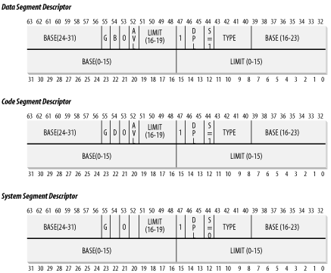
Segment Descriptors

Slide 45

Segment Selector Format

Slide 46
Segment Registers
Each segment register contains a segment selector.
  13-bit index
  1-bit TI (Table Indicator) flag.
  2-bit RPL (Requestor Privilege Level)
    The cs register’s RPL also denotes the current privilege level of the CPU.
    0 represents the highest privilege. Linux uses 0 to represent the kernel mode and 3 to represent the user mode.
Associated with each segment register is an additional nonprogrammable register which contain the segment descriptor specified by the segment selector.

Slide 47
DPL (Descriptor Privilege Level)
2-bit field of a segment descriptor used to restrict access to the segment.
It represents the minimal CPU privilege level requested for accessing the segment.

Slide 48
Locate the Segment Descriptor Indicated by Segment Selector
address=(gdtr/ldtr) + index*8.
The first entry of the GDT is always 0.
The maximum number of segment descriptors that the GDT can have is 2¹³-1.

Slide 49
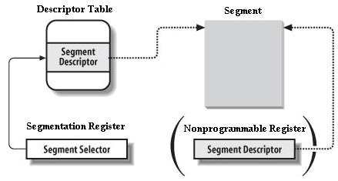
Fast Access to Segment Descriptor

Slide 50
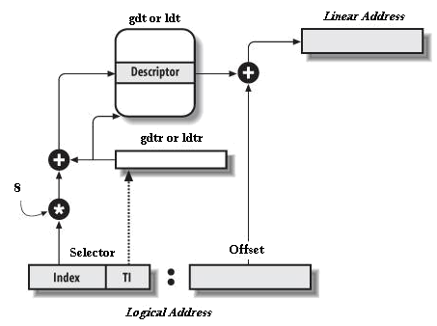
Translation of a Logical Address
Selector
Offset

Slide 51
Segmentation in x84-64 _{[Intel-1][Intel-2]}

Slide 52

GDTR of x86-64
The GDTR register holds the base address (64 bits in IA-32e mode) and the 16-bit table limit for the GDT.

Slide 53
LDTR of x86-64
The LDTR register holds
  the 16-bit segment selector
  base address (64 bits in IA-32e mode)
  segment limit
  descriptor attributes for the LDT.
Segment Selector

Slide 54
Segmentation in IA-32e Mode
In IA-32e mode of Intel 64 architecture, the effects of segmentation depend on whether the processor is running in
  compatibility mode
  or
  64-bit mode.

Slide 55
Segmentation in Compatibility Mode
In compatibility mode, segmentation functions just as it does using legacy 16-bit or 32-bit protected mode semantics.

Slide 56
Segmentation in 64-bit Mode (1)
In 64-bit mode, segmentation is generally (but not completely) disabled, creating a flat 64-bit linear-address space.
The processor treats the segment base of CS, DS, ES, SS as zero, creating a linear address that is equal to the effective address.

Slide 57
Segmentation in 64-bit Mode (2)
The FS and GS segments are exceptions.
These segment registers (which hold the segment base) can be used as an additional base registers in linear address calculations.
Note that the processor does not perform segment limit checks at runtime in 64-bit mode.

Slide 58
Logical Address Translation
In IA-32e mode, an Intel 64 processor uses the steps described in x32 architecture to translate a logical address to a linear address.
In 64-bit mode, the offset and base address of the segment are 64-bits instead of 32 bits.

Slide 59
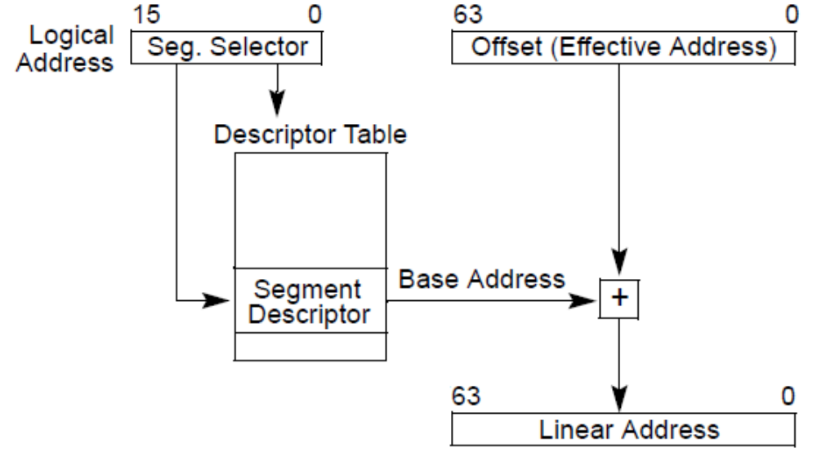
Translation of a Logical Address

Slide 60
Linear Address
The linear address format is also 64 bits wide and is subject to the canonical form requirement.

Slide 61
Segment Registers ES, DS, SS (1)
Because ES, DS, and SS segment registers are not used in 64-bit mode, their fields (base, limit, and attribute) in segment descriptor registers are ignored.

Slide 62
Segment Registers ES, DS, SS (2)
Some forms of segment load instructions are also invalid (for example, LDS, POP ES).
Address calculations that reference the ES, DS, or SS segments are treated as if the segment base is zero.

Slide 63
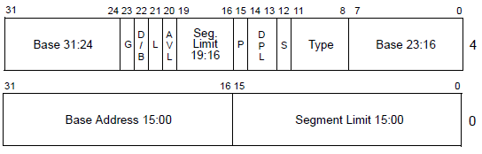
Segment Descriptors

Slide 64
Code Segment Descriptor and Selectors
Code segment descriptors and selectors are needed in IA-32e mode to establish the processor’s operating mode and execution privilege-level.
In IA-32e mode, the CS descriptor’s DPL is used for execution privilege checks (as in legacy 32-bit mode).

Slide 65
Code Segment Descriptor
Code segments continue to exist in 64-bit mode even though, for address calculations, the segment base is treated as zero.
Some code-segment (CS) descriptor content (the base address and limit fields) is ignored;
The remaining fields function normally (except for the readable bit in the type field).

Slide 66
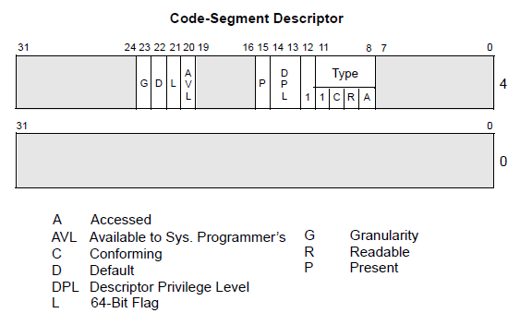
Fields of Code Segment Descriptors

Slide 67
L bit of Code Segment Descriptor
Each code segment descriptor provides an L bit.
This bit allows a code segment to execute 64-bit code or legacy 32-bit code by code segment.

Slide 68
L Flag
In IA-32e mode, bit 21 of the second doubleword of the segment descriptor indicates whether a code segment contains native 64-bit code.
  A value of 1 indicates instructions in this code segment are executed in 64-bit mode.
  A value of 0 indicates the instructions in this code segment are executed in compatibility mode.

Slide 69
Segment Descriptor Tables in IA-32e Mode
In IA-32e mode, a segment descriptor table can contain up to 8192 (2¹³) 8-byte descriptors.
An entry in the segment descriptor table can be 8 bytes.
System descriptors are expanded to 16 bytes (occupying the space of two entries).

Slide 70
Expanded System Descriptors
Call gate descriptors
IDT gate descriptors
LDT and TSS descriptors

Slide 71
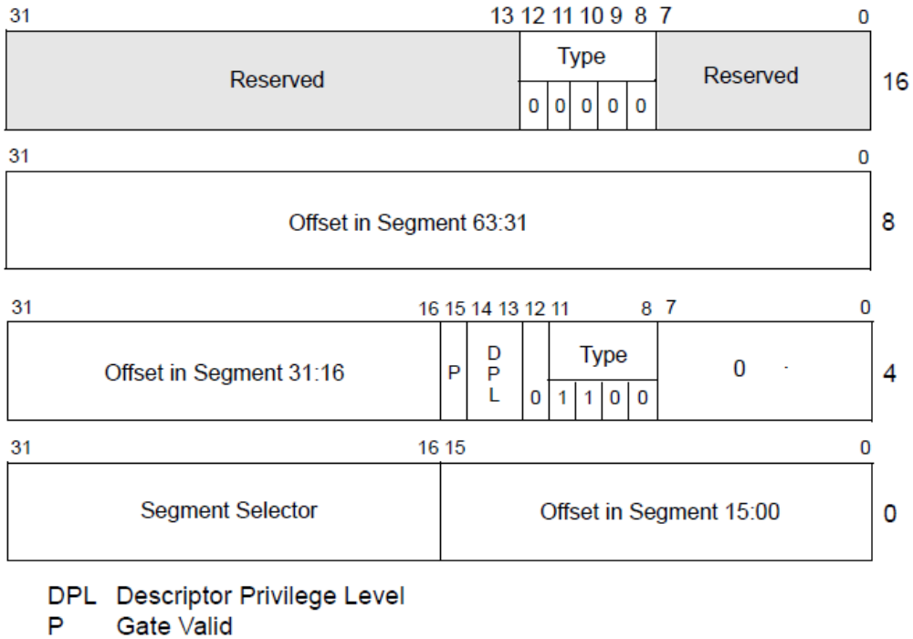
Call-Gate Descriptor in IA-32e Mode

Slide 72
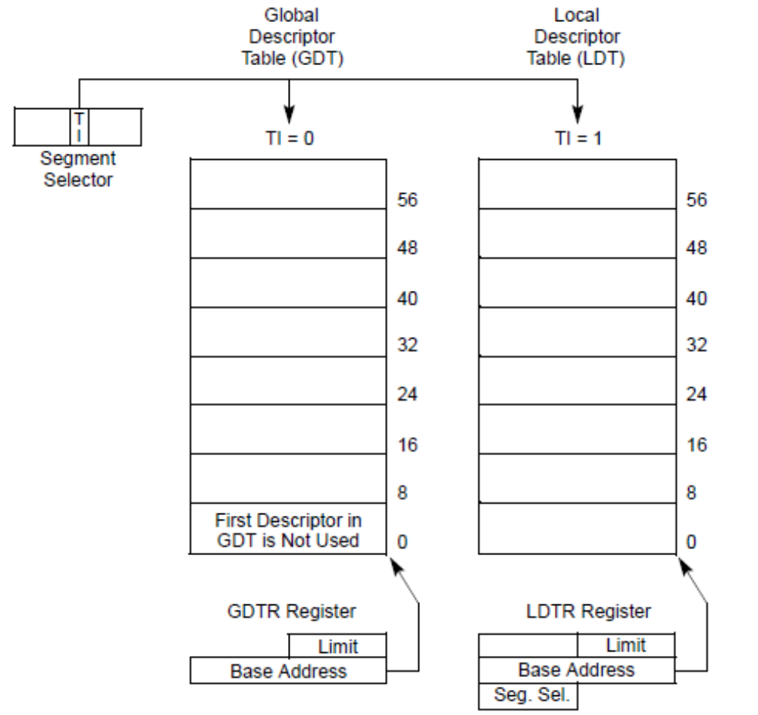
Global and Local Descriptor Tables

Slide 73
Segmentation in Linux

Slide 74
Segmentation in Linux
All Linux processes running in User Mode use the same pair of segments to address instructions and data.
  These segments are called user code segment and user data segment, respectively.
Similarly, all Linux processes running in Kernel Mode use the same pair of segments to address instructions and data:
  they are called kernel code segment and kernel data segment, respectively.
Under the above design, it is possible to store all segment descriptors in the GDT.

Slide 75
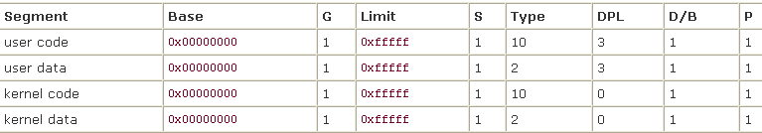
Values of the Segment Descriptor Fields for the Four Main Linux Segments
The corresponding Segment Selectors are defined by the macros __USER_CS, __USER_DS, __KERNEL_CS, and __KERNEL_DS, respectively.
  To address the kernel code segment, for instance, the kernel just loads the value yielded by the __KERNEL_CS macro into the cs segmentation register.

Slide 76
Linux Logic Addresses and Linear Addresses
The linear addresses associated with such segments all start at 0 and reach the addressing limit of 2³² -1. This means that all processes, either in User Mode or in Kernel Mode, may use the same logical addresses.
Another important consequence of having all segments start at 0x00000000 is that in Linux, logical addresses coincide with linear addresses; that is, the value of the Offset field of a logical address always coincides with the value of the corresponding linear address.

Slide 77
Privilege Level Change
The RPL of CS register determine the current privilege level of a CPU.
From user mode to kernel mode:
  Linux 2.4: when the CS is changed all corresponding DS, SS registers must also be changed, i.e. load DS, ES with __KERNEL_DS.
  Linux 2.6 : Load DS, ES with __USER_DS _{[李志敏] [Bomb250][Grip2]}

Slide 78
The Linux GDT

Slide 79
The Linux GDT
In uniprocessor systems there is only one GDT, while in multiprocessor systems there is one GDT for every CPU in the system.
All GDTs are stored in the per-CPU gdt_page variable, while the addresses and sizes of the GDTs (used when initializing the gdtr registers) are stored in the per-CPU early_gdt_descr_{[]][2][3]} variable.

Slide 80
GDT Layout
Each GDT includes
  21 segment descriptors
  and
  11 null, unused, or reserved entries.
Unused entries are inserted on purpose so that Segment Descriptors usually accessed together are kept in the same 32-byte line of the hardware cache.

Slide 81
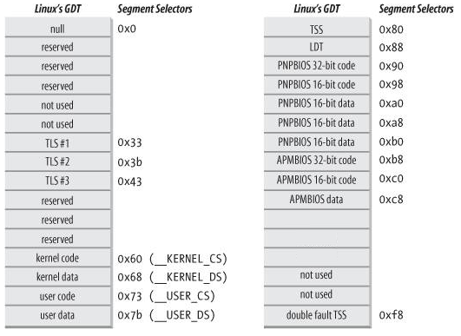
Linux’s GDT
Linux’s GDT
Linux’s GDT
ESPFIX small SS
per-cpu
stack_canary-20

Slide 82
Data Structure of a GDT Entry
In Linux, the data type of a GDT entry is struct desc_struct.
struct desc_struct {
union {
struct {
unsigned int a;
unsigned int b;
};
struct {
u16 limit0;
u16 base0;
unsigned base1: 8, type: 4, s: 1, dpl: 2, p: 1;
unsigned limit: 4, avl: 1, l: 1, d: 1, g: 1, base2: 8;
};
};
} __attribute__((packed));

Slide 83
Unnamed struct/union fields within structs/unions _{[GNU]}
As permitted by ISO C11 and for compatibility with other compilers, GCC allows you to define a structure or union that contains, as fields, structures and unions without names.

Slide 84
Example _{[GNU]}
struct {
int a;
union {
int b;
float c;
};
int d;
} foo;
In this example, you are able to access members of the unnamed union with code like ‘foo.b’.
  Note that only unnamed structs and unions are allowed, you may not have, for example, an unnamed int.

Slide 85
Task State Segment
In Linux, each processor has only one TSS.
The virtual address space corresponding to each TSS is a small subset of the liner address space corresponding to the kernel data segment.

Slide 86
Task State Segment
All the TSSs are sequentially stored in the per-CPU init_tss variable
struct tss_struct {
/*
* The hardware state:
*/
struct x86_hw_tss x86_tss;
/*
* The extra 1 is there because the CPU will access an
* additional byte beyond the end of the IO permission
* bitmap. The extra byte must be all 1 bits, and must
* be within the limit.
*/
unsigned long io_bitmap[IO_BITMAP_LONGS + 1];
/*
* .. and then another 0x100 bytes for the emergency kernel stack:
*/
unsigned long stack[64];
} ____cacheline_aligned;
A TSS

Slide 87
struct x86_hw_tss
struct x86_hw_tss {
unsigned short back_link, __blh;
unsigned long sp0;
unsigned short ss0, __ss0h;
unsigned long sp1;
/* ss1 caches MSR_IA32_SYSENTER_CS: */
unsigned short ss1, __ss1h;
unsigned long sp2;
unsigned short ss2, __ss2h;
unsigned long __cr3;
unsigned long ip;
unsigned long flags;
unsigned long ax;
unsigned long cx;
unsigned long dx;
unsigned long bx;
unsigned long sp;
unsigned long bp;
unsigned long si;
unsigned long di;
unsigned short es, __esh;
unsigned short cs, __csh;
unsigned short ss, __ssh;
unsigned short ds, __dsh;
unsigned short fs, __fsh;
unsigned short gs, __gsh;
unsigned short ldt, __ldth;
unsigned short trace;
unsigned short io_bitmap_base;
} __attribute__((packed));

Slide 88
Task State Segment Descriptor_{[1]}
The TSS descriptor for the n^{th} CPU
  The Base field: point to the n^{th} component of the per-CPU init_tss variable.
  G flag: 0
  Limit field: the size of the TSS_{[1][2]}
  DPL: 0

Slide 89
Initialize the Content of TSS Descriptor
void __cpuinit cpu_init(void)
{
int cpu = smp_processor_id();
struct task_struct *curr = current;
struct tss_struct *t = &per_cpu(init_tss, cpu);
...
set_tss_desc(cpu, t);
...
}

Slide 90
Thread-Local Storage (TLS) Segments
Three Thread-Local Storage (TLS) segments: this is a mechanism that allows multithreaded applications to make use of up to three segments containing data local to each thread.
The set_thread_area( ) and get_thread_area( ) system calls, respectively, create and release a TLS segment for the executing process.

Slide 91
Other Special Segments
Three segments related to Advanced Power Management (APM ).
Five segments related to Plug and Play (PnP ) BIOS services.
A special TSS segment used by the kernel to handle "Double fault " exceptions.

Slide 92
GDTs of Different CPUs
There is a copy of the GDT for each processor in the system.
All copies of the GDT store identical entries, except for a few cases:
  First, each processor has its own TSS segment, thus the corresponding GDT's entries differ.
  Moreover, a few entries in the GDT may depend on the process that the CPU is executing (LDT and TLS Segment Descriptors).
  Finally, in some cases a processor may temporarily modify an entry in its copy of the GDT;
    this happens, for instance, when invoking an APM's BIOS procedure.

Slide 93
Default Local Descriptor Table (LDT)
After Linux 2.6.18, there is no default LDT that is shared by ALL processes _{[1]}.

Slide 94
Contents of GDT for Processor n-1
per-CPU init_tss
Linux’s GDT
Linux’s GDT
n-1
ESPFIX small SS
per-cpu
stack_canary-20

Slide 95
Per-CPU Variables _{[thinkiii]}

Slide 96
typeof Operator _{[IBM]}
The typeof operator returns the type of its argument, which can be an expression or a type.
The language feature provides a way to derive the type from an expression.
The typeof operator is a language extension provided for handling programs developed with GNU C.
  The alternate spelling of the keyword, __typeof__, is recommended.
Given an expression e, __typeof__(e) can be used anywhere a type name is needed,
  for example in a declaration or in a cast.

Slide 97
Example (1)
int e;
__typeof__(e + 1) j; /* the same as declaring int j; */
e = (__typeof__(e)) f; /* the same as casting e = (int) f; */

Slide 98
Example (2)
Given
int T[2];
int i[2];
you can write
__typeof__(i) a; /* all three constructs have the same meaning */
__typeof__(int[2]) a;
__typeof__(T) a;
The behavior of the code is as if you had declared
int a[2];.

Slide 99
Comma Expressions
A comma expression contains two operands of any type separated by a comma and has left-to-right associativity.
The left operand is fully evaluated, possibly producing side effects, and its value, if there is one, is discarded.
The right operand is then evaluated.
The type and value of the result of a comma expression are those of its right operand, after the usual unary conversions.

Slide 100
Example (1)
The following statements are equivalent:
r = (a,b,...,c);
a; b; r = c;

Slide 101
Example (2)
&(a, b)
a, &b

