Slide 1

Linux Operating System
許 富 皓

Slide 2
Memory Addressing

Slide 3
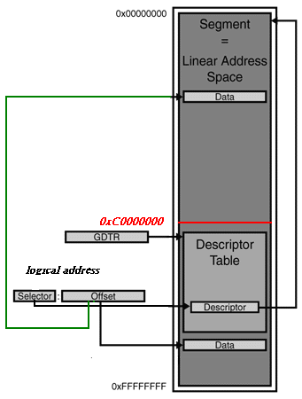
Linux Memory Segmentation under IA-32
or

Slide 4
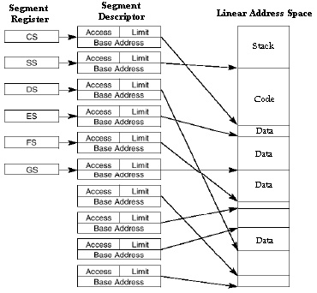
Segments and Linear Address Space

Slide 5
The Paging Unit

Slide 6
The Paging Unit
A hardware circuit.
Translates linear addresses into physical ones.
Checks the requested access type against the access rights of the linear address.
  If the memory access is not valid, it generates a Page Fault exception

Slide 7
Page
Contiguous linear addresses are grouped in fixed-length intervals called pages.
The term “page” is also refer to:
  A set of linear addresses
  The data contained in this group of addresses.

Slide 8
Page Frame
The paging unit thinks of all RAM as partitioned into fixed-length page frames (physical pages).
The size of a page is equal to the size of a page frame.
  Usually the size of a page frame is 4KB; however, sometimes a larger page frame size may also be used.

Slide 9
Page vs. Page Frame
Page Frame:
  A constituent of main memory
  A storage area
Page:
  A block of data that can be stored in a page frame.

Slide 10
Enable Paging
Starting with the 80386, all 80x86 processors support paging; paging is enabled by setting the PG flag of the control register cr0.
When PG flag=0, a virtual address is equal to a physical address.
Paging mechanism is used in protected mode.

Slide 11
Division of a Virtual Address
A 32-bit virtual address is divided into 3 parts:
  Directory: the 10 most significant bits.
  Table: the 10 intermediate bits
  Offset: the 12 least significant bits.
Directory (10) Table (10) Offset (12)

Slide 12
Translation Tables
The translation of linear addresses is accomplished in two steps, each based on a type of translation tables.
The first translation table is called the Page Directory, and the second is called the Page Table.
  P.S.: In the discussion that follows:
    the lowercase "page table" term denotes any page storing the mapping between linear and physical addresses
    the capitalized "Page Table" term denotes a page in the last level of page tables.
page table = Page Table ∪ Page Directory

Slide 13
Translation Table Types
Page Directory
  Each process has only ONE page directory table.
Page Table.
Both of the above tables are located in main memory.
Are initialized by kernel, before paging mechanism is activated.

Slide 14
Translation Table Allocation
Each active process must have a Page Directory assigned to it.
  The physical address of the Page Directory of the active process is stored in the control register cr3.
Allocating page frames to a page table occurs only when the process needs to access it.

Slide 15
Paging of 80x86 -- The Directory Field
The Directory field within the virtual address determines the entry in the Page Directory that points to the proper page table.
  Hence, there are 2¹⁰ entries in a page directory.
  Because each entry’s size is 4 bytes; a Page Directory uses 4 KB.

Slide 16
Paging of 80x86 -- The Table Field
The address’s Table filed, in turn, determines the entry in the Page Table that contains the physical address of the page frame containing the page.
  Similarly, each Page Table contains 2¹⁰ entries.
  Because each entry’s size is 4 bytes; a Page Table uses 4 KB.

Slide 17
Paging of 80x86 -- The Offset Field
The offset field determines the relative position within the page frame.
  Each page frame consists of 4096 (i.e. 2¹²) bytes of data.

Slide 18
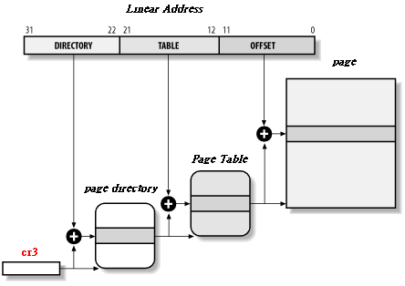
Paging by 80x86 Processors

Slide 19
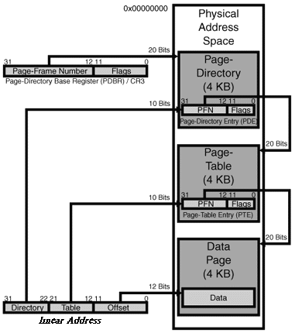
Double-Layered Paging with 4-KB Pages

Slide 20
Why Use a Two-Level Scheme ?
Reduce the amount of RAM required for per-process page tables.
  Assume a process’s maximum virtual address space is 4 GB.
    For a single level scheme, 2²⁰ entries are needed.
    If each translation table entry requires 4 bytes, then each process needs 2²⁰*4=4MB memory to store its translation table.
  For a two-level scheme, translation tables are used only for those virtual memory regions actually used by a process
    P.S.: For most processes, most virtual memory regions are not used.

Slide 21

Structures of Page Directories And Page Tables Entries
Both Page Directory entries and Page Tables have the same structure.
  Present flag
  Field containing the 20 most significant bits of a page frame physical address.
  Access flag
  Dirty flag
  Read/write flag
  User/Supervisor flag
  PCD and PWT flags
  Page size flag
  Global flag

Slide 22
Entry Fields (1):
Present flag:
  1: yes
  0: no.
    Save the virtual address → cr2
    Issue the Page Fault Exception.
20-bit physical address field:
  Contain the 20 most significant bits of a page frame physical address.
  The size of Page Directories, Page Tables, and page frame are all 4k bytes; therefore, the first physical address of the above entities is a multiple of 4 KB.
  In other words, the physical address’s least 12 significant bits are always zero and there is no need to store these 12 bits.
Paging Unit

Slide 23
Entry Fields (2):
Accessed flag:
  Set each time the paging unit addresses the corresponding page frame.
  When swapping out a page frame is needed, OS uses this flag as a parameter to decide which page frame should be swapped out.
Dirty flag.
  Apply to Page Table entries only.
  When a write operation is performed on a page frame, its corresponding Page Table entry’s Dirty flag is set.
  As the Accessed flag, this flag is also used by OS when determining choosing which page frame to swap out.
The paging unit never resets the above two flags; this must be done by the operating system.

Slide 24
Entry Fields (3):
Read/Write flag:
  Contain the access right (Read/Write or Read) of the page or the Page Table.
User/Supervisor flag:
  Contains the privilege level required to access the page or Page Table.

Slide 25

Entry Fields (4):
PCD and PWT flags:
  Controls the way the page or Page Table is handled by the hardware cache.
Page Size flag:
  Apply only to Page Directory entries:
    If it is set, the entry refers to a 2 MB– or 4 MB-long page frame.
Global flag:
  Applies to Page Table entries only to prevent frequently used pages from being flushed from the TLB cache.
  Is used with the Page Global Enable (PGE) flag of cr4 register.

Slide 26
virtual address space
physical memory
low address
process 1
process 2
:
high address

Slide 27
Extended Paging

Slide 28
Why Extended Paging Is Introduced ?
Introduced starting from the Pentium model.
Allows page frames to be 4 MB instead of 4 KB in size.
Extended paging is used to translate large contiguous linear address ranges into corresponding physical ones.
In these cases, the kernel can do without intermediate Page Tables and thus save memory and preserve TLB entries.

Slide 29
Enable Extended Paging
Is enabled by
  setting the Page Size flag of a Page Directory entry.
  setting the PSE flag of the cr4 processor register.

Slide 30
Virtual Address Layout under Extended Paging
Under extended paging, the paging unit divides the 32 bits of a linear address into two fields:
  Directory (10 bits).
  Offset (22 bits; P.S.: 2²²=4MB)
Directory Offset

Slide 31
New Futures of Page Directory Entries under Extended Paging
Under extended paging, the structure of a Page Directory and the entries inside it are the same as those in regular paging, except:
  The Page Size flag is set.
  Only the 10 most significant bits of the 20-bit physical address field are significant.

Slide 32
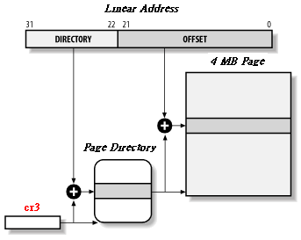
Extended Paging

Slide 33
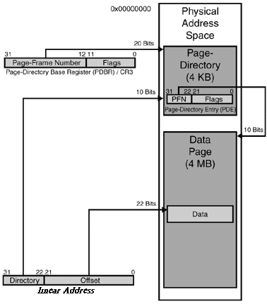
Single-Layered Paging with 4-MB Pages

Slide 34
Hardware Protection Scheme

Slide 35
Privilege Levels
The segmentation unit uses four possible privilege levels to protect a segment (the two-bit request privilege levels, 0 for kernel mode, 3 for user mode).
The paging unit uses a different strategy to protect Page Tables and page frames → the User/Supervisor flag.
  0 → CPU’s CPL must be less than 3 (i.e. for Linux, when the processor is in kernel mode.)
  1 → the corresponding Page Table or page frame can always be accessed.

Slide 36
Access Rights
Instead of the three types of access rights (Read, Write, Execute) associated with segments (determined by the type field of a segment descriptor), only two types of access rights (Read, Write) are associated with page tables and pages and are determined by the Read/Write flags of corresponding page tables entries.
  Read/Write flag:
    0: can be read.
    1: can be read and write.

Slide 37
The Physical Address Extension (PAE) Paging Mechanism

Slide 38
Physical Address Extension (PAE) Paging Mechanism (1)
Starting with the Pentium Pro, all Intel processors have 36 address lines; therefore, they are now able to address 2³⁶=64GB of RAM when is in PAE mode.
PAE is activated by setting the Physical Address Extension (PAE) flag in the cr4 control register.
Question: CPU registers such as EIP, ESP, are still 32 bits; thus, how to transfer a 32-bit virtual address into a 36-bit physical one?
Answer: Introduce a new paging mechanism.

Slide 39
Physical Address Extension (PAE) Paging Mechanism (2)
The 64 GB (= 2²⁴x2¹²) of RAM are split into 2²⁴ 4-KB page frames.
The entry size of Page Directories or Page Tables is increased from 4 bytes to 8 bytes; thus, each 4-KB page frame contains 512 (=2⁹) entries instead of 1024 entries.
The address field of each page table entry is increased form 20 bits to 24 bits; therefore, the address field can point to any of the 2²⁴ 4-KB page frames.
A new level of page table is introduced --- the Page Directory Pointer Table (PDPT)

Slide 40
Physical Address Extension (PAE) Paging Mechanism (3)
Each PDPT entry is 8 byte long.
The PDPT has only 4 entries.
The base address of a PDPT is store in cr3 control register.
The PDPT is located in the first 4 GB of RAM (i.e. the 4 most significant bits are 0) and aligned to 32 bytes (2⁵); therefore, the cr3 only needs 27 bits to point a PDPT (4+27+5=36.)

Slide 41
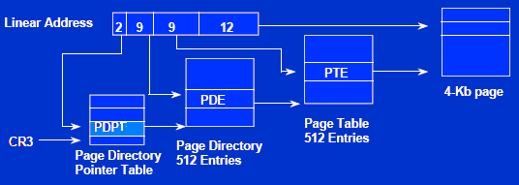
Physical Address Extension (PAE) Paging Mechanism (4)
When PAE is activated, and the PS flag in Page Directory is cleared (i.e. each page frame is 4KB), a virtual address is split into the following four fields PDPT(2 bits), PD(9 bits), PT(9 bits), Offset(12 bits).

Slide 42
Physical Address Extension (PAE) Paging Mechanism (5)
When PAE is activated, and the PS flag in Page Directory is set (i.e. each page frame is 2MB(=2²¹), a virtual address is split into the following three fields PDPT(2 bits), PD(9 bits), Offset(21 bits).

Slide 43
Physical Address Extension (PAE) Paging Mechanism (6)
The contribution of the PAE paging mechanism:
  Without the new mechanism, no matter how many RAM a system has, at most, the system can only access the first 4 GB of RAM.
  With the new mechanism, for a system with 64 GB of RAM, a system can access any subset of page frames of the 64 GB RAM. And the size of the subset is 4 GB.
Question: When internal registers’ size is only 32 bits, how could a process address more than 4GB Physical addresses?

Slide 44
Paging for 64-bit Architectures
All hardware paging systems for 64-bit processors make use of additional paging levels. The number of levels used depends on the type of processor.

Slide 45
Paging Levels in Some 64-bit Architectures
platform name | page size | number of address bits used | number of paging levels | Linear address splitting
alpha | 8 KB | 43 | 3 | 10 + 10 + 10 + 13
ia64 | 4 KB | 39 | 3 | 9 + 9 + 9 + 12
ppc64 | 4 KB | 41 | 3 | 10 + 10 + 9 + 12
sh64 | 4 KB | 41 | 3 | 10 + 10 + 9 + 12
x86_64 | 4 KB | 48 | 4 | 9 + 9 + 9 + 9 + 12

Slide 46
Locality Types
Temporal locality
  The concept that a resource that is referenced at one point in time will be referenced again sometime in the near future.
Spatial locality
  The concept that likelihood of referencing a resource is higher if a resource near it was just referenced.
Sequential locality
  The concept that memory is accessed sequentially.

Slide 47
Locality Principle
Locality principle holds for both data structures and programs, because of
  the cyclic structure of programs
  and
  the packing of related data into adjacent area.

