Slide 1

Linux Operating System
許 富 皓

Slide 2
Memory Addressing

Slide 3
Hardware Cache
There is a significant speed gap between
  the CPU speed (could be several gigahertz)
  and
  memory access speed (maybe only hundreds of clock cycles which run at 66 MHz).
Based on the locality principle, a high speed memory called cache is build inside the CPU to store recently accessed data or instructions; hence, when a CPU is going to access data or instructions, it can check the cache first before it access the main memory to get the items.

Slide 4
Cache Page
Main memory is divided into equal pieces called cache pages.
  A cache page is not associated with a memory page in page mode. The word page has several different meaning when referring to a PC architecture.
The size of a cache pages is dependent on
  the size of the cache
  and
  how the cache is organized.

Slide 5
Cache Line
A cache page is broken into smaller pieces, each called a cache line.
The size of a cache line is determined by both
  the processor
  and
  the cache design.
A cache line is the basic unit of data transferred between the main memory and CPU.
Usually a line consists of a few dozen of contiguous bytes.

Slide 6
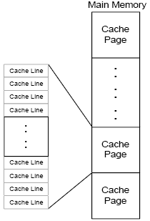
Relationship between Cache Pages and Cache Lines

Slide 7
How to Find Whether the Content of Certain Address Is inside a Cache?
Cache controller
  Stores an array of entries, one entry for each line of the cache memory.
  Each entry contains a tag and a few flags that describe the status of the cache line.
If the content of a physical address is stored inside the cache, the CPU has a cache hit; otherwise, it has a cache miss.

Slide 8
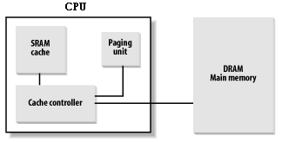
Processor Hardware Cache

Slide 9
Hardware Cache Types
According to where a memory line is stored in the cache, there are three different types of caches:
  Fully associative.
  Direct mapped.
  Degree N-way set associative.

Slide 10
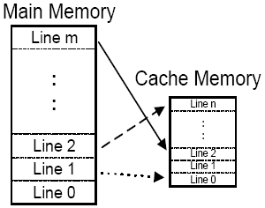
Fully Associative
Main memory and cache memory are both divided into lines of equal size.
This organizational scheme allows any line in main memory to be stored at any location in the cache.

Slide 11
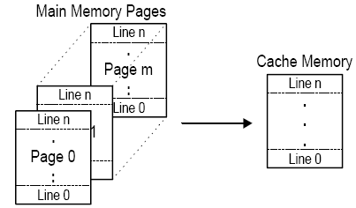
Direct Mapped
Direct Mapped cache is also referred to as 1-Way set associative cache.
In this scheme, main memory is divided into cache pages. The size of each page is equal to the size of a cache. Unlike the fully associative cache, the direct map cache may only store a specific memory line of a cache page within the same cache line of the cache.

Slide 12
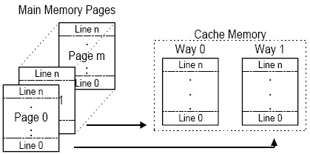
Degree N-way Set Associative
A set-associate scheme works by dividing the cache SRAM into equal sections (2 or 4 sections typically) called cache ways. The cache page size is equal to the size of the cache way.
A memory line w of a cache page can only be stored in the cache line w of one of the cache ways.

Slide 13
Cache Type Summary
  Fully associative: a memory line can be stored at any cache line.
  Direct mapped: a memory line is always stored at the same cache line.
  Degree N-way set associative: Cache lines are divided into N sets, a memory line can be in any set of the N sets. But inside a set, the memory line is stored into the same cache line. This is the most popular cache type.

Slide 14
After a Cache Hit (Read)
For a read operation, the controller read the data from the cache line and transfer it to CPU without any access to the RAM.
In this case the CPU save access time.

Slide 15
After a Cache Hit (Write)
For a write operation, two actions may be taken:
  Write-through: the controller write the data into both the cache line and the RAM memory.
  Write-back: the controller only change the content of the cache line that contains the corresponding data.
    Then the controller writes the cache line back into RAM only
      when the CPU executes an instruction requiring a flush of cache entries
      or
      when a FLUSH hardware signal occurs.

Slide 16
Control the Cache
The CD flag of the cr0 register is used to enable (0) or disable (1) the cache circuitry.
The NW flag of the cr0 register specifies whether the write-through or the writhe-back is used for the cache.

Slide 17
After a Cache Miss (Read)
For a read operation:
  the data is read from the main memory
  and
  Is stored a copy in the cache.

Slide 18
After a Cache Miss (Write)
For a write operation:
  the data is written into the main memory
  and
  the correct line is fetched from the main memory into the cache.

Slide 19
An Interesting Feature of the Pentium Cache
It lets an OS associate a different cache management policy with each page frame.
  For this purpose, each translation table has two flags PCD (Page Cache Disable) and PWT (Page Write-Through.)
    The former specifies whether the cache must be enabled or disable when access data inside the corresponding page frame.
    The later specifies whether the write-back or the write-through strategy must be applied while writing data into the corresponding page frame.
Linux enables caching and uses write-back strategy for all page frame access.

Slide 20
PWT & PCD vs. CD _{[csie.NTU]}
PWT flag: If the CD flag of cr0 is set (1), this flag is ignored.
PCD flag: If the CD flag of cr0 is set (1), this flag is ignored.

Slide 21
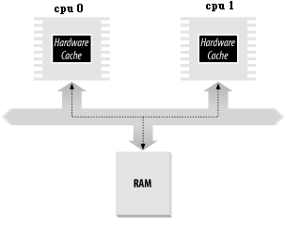
Cache in Multiple Processors
Cache snooping: in a multiple processor system, each processor has its own local cache; therefore, when a processor modifies certain data item in its cache, then all other processors whose caches have the same data item must be notified and modify their corresponding data item also.

Slide 22
Translation Lookaside Buffers (TLB)
When a virtual address is used, the paging unit of a CPU transfers it into a physical one and saves the result in its TLB; therefore, next time when the same virtual address is used, it physical address could be obtained directly by accessing the TLB without any modification.
  Using this hardware to save time spending on paging.
When the cr3 of a CPU is modified, the hardware automatically invalidates all entries of local TLB.
  Recall that cr3 control register points to the base address of a page directory.

Slide 23
Paging in Linux

Slide 24
Level Number of Linux Paging Model
Linux adopts a common paging model that fits both 32-bit and 64-bit architectures.
Two paging levels are sufficient for 32-bit architectures, while 64-bit architectures require a higher number of paging levels.
Up to version 2.6.10, the Linux paging model consisted of three paging levels.
Starting with version 2.6.11, a four-level paging model has been adopted.

Slide 25
Type of Linux Translation Tables
The four types of page tables are called:
  Page Global Directory
  Page Upper Directory
  Page Middle Directory
  Page Table
This change has been made to fully support the linear address bit splitting used by the x86_64 platform.

Slide 26
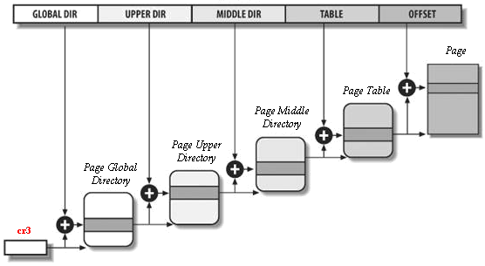
The Linux Paging Model

Slide 27
Advantages of Paging
Assign different physical address space to each process.
A page could be mapped into one page frame, then after the page frame is swapped out, then the same page could be mapped into a different page frame.

Slide 28
4-Level Paging Model on a 2-Level Paging System
The Pentium uses a 2-level paging system.
Linux uses a 4-level paging model; however, for 32-bit architectures with no Physical Address Extension, two paging levels are sufficient.
Linux essentially eliminates the Page Upper Directory and the Page Middle Directory fields by saying that they contain 0 bits
  The kernel keeps a position for the Page Upper Directory and the Page Middle Directory by setting the number of entries in them to 1 and mapping these two entries into the proper entry of the Page Global Directory.

Slide 29
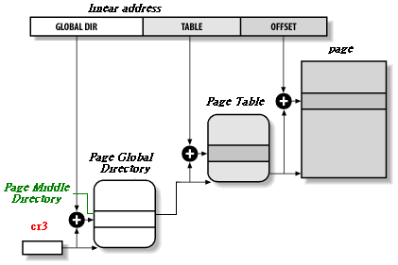
The Linux Paging Model under IA-32
Page Upper Directory
Page Middle Directory

Slide 30
When Linux Uses PAE Mechanism
The Linux Page Global Table ←→ the 80x86’s Page Directory Pointer Table
The Linux Page Upper Table ←→ eliminated
The Linux Page Middle Table ←→ the 80x86’s Page Directory
The Linux Page Table ←→ the 80x86’s Page Table

Slide 31
Processes and Page Global Directories
Each process has its own Page Global Directory and its own set of page tables.
When a process switch occurs, Linux saves _{[kkto]} the cr3 control register in the descriptor of the process previously in execution and then loads cr3 with the value stored in the descriptor of the process to be executed next.
Thus, when the new process resumes its execution on the CPU, the paging unit refers to the correct set of page tables.

Slide 32
What is BIOS?
BIOS stands for Basic Input/Output System which includes a set of basic I/O and low-level routines that
  communicate between the software and hardware
  and
  handle the hardware devices that make up a computer.
The BIOS is built-in software that determines what a computer can do without accessing programs from a disk.
On PCs, the BIOS contains all the code required to control
  the keyboard
  display screen
  disk drives
  serial communications
  and
  a number of miscellaneous functions.

Slide 33
Memory Types of BIOS
ROM
Flash memory
  Contents could be updated by software.
  PnP (Plug-and-Play) BIOSes use this memory type.

Slide 34
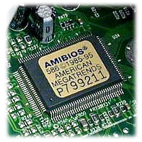
Address Ranges of BIOSes
The main motherboard BIOS uses the physical address range from 0xF0000 to 0xFFFFF.
However some other hardware components, such as graphics cards and SCSI cards, have their own BIOS chips located at different addresses.
    The address range of a graphic card BIOS is from 0xc0000 to 0xc7fff.

Slide 35
Functions of BIOS
Managing a collection of settings for the HDs, clock, etc.
  The settings are stored in a CMOS chip.
A Power-On Self-Test (POST) for all of the different hardware components in the system to make sure everything is working properly.
Activating other BIOS chip on different cards installed in the computer, such as SCSI and graphic cards.
Booting the OS.
Providing a set of low-level routines that the OS uses to interface to different hardware devices.
  Once initialized, Linux doesn’t use BIOS, but uses its own device drivers for every hardware device on the computer.

Slide 36
Execution Sequence of BIOS
Check the CMOS Setup for custom settings
Initialize address Table for the interrupt handlers and device drivers
Initialize registers and power management
Perform the power-on self-test (POST)
Display system settings
Determine which devices are bootable
Initiate the bootstrap sequence

Slide 37
After Turning on the Power…(1)
Power on → CPU RESET pin → the microprocessor automatically begins executing code at 0xF000:FFF0. It does this by setting the Code Segment (CS) register to segment 0xF000, and the Instruction Pointer (IP) register to 0xFFF0.
  real mode.
  A BIOS chip is also located in the area includes this address.
The first instruction is just a jump instruction which jumps to a BIOS routine to start the system startup procedure.

Slide 38
After Turning on the Power…(2)
Check the CMOS setup for custom settings
Perform the Power-On Self-Test (POST)
  System check:
    Test individual functions of the processor, its register and some instructions.
    Test the ROMs by computing checksum.
    Each chip on the main board goes through tests and initialization.
  Peripheral testing:
    Test the peripherals (keyboard, disk drive, etc.)

Slide 39
After Turning on the Power…(3)
Initialize Hardware Device:
  Guarantee that all hardware devices operate without conflicts on the IRQ lines and I/O ports.
  At the end of this phase, a table of installed PCI devices is displayed.
  Initialize the BIOS variables and Interrupt Vector Table (IVT).
    The BIOS routines must create, store, and modify variables.
    It stores these variable in the lower part of memory starting at address 0x400 (BIOS DATA AREA (BDA).)
Display system settings
Initiate the bootstrap sequence.

Slide 40
Physical Memory Layout of a PC
physical address range | real-mode address range | memory type | use
0- 3FF | 0000:0000-0000:03FF | RAM | real-mode interrupt vector table (IVT)
400- 4FF | 0040:0000-0040:00FF |  | BIOS data area (BDA)
500- 9FBFF | 0050:0000-9000:FBFF |  | free conventional memory (below 1 M)
9FC00- 9FFFF | 9000:FC00-9000:FFFF |  | extended BIOS data area (EBDA)
A0000- BFFFF | A000:0000-B000:FFFF | video RAM | VGA frame buffers
C0000- C7FFF | C000:0000-C000:7FFF | ROM | video BIOS (32K is typical size)
C8000- EFFFF | C800:0000-E000:FFFF | NOTHING
F0000- FFFFF | F000:0000-F000:FFFF | ROM | motherboard BIOS (64K is typical size)
100000- FEBFFFFF |  | RAM | free extended memory (1M and above)
FEC00000- FFFFFFFF |  | various | motherboard BIOS, PnP NVRAM, ACPI, etc.
640K
1M
Is this area accessible in real mode?

Slide 41
Descriptor Cache Registers _{[Robert Collins]}
Whether in real or protected mode, the CPU stores the base address of each segment in hidden registers called descriptor cache registers.
Each time the CPU loads a segment register, the segment base address, segment size limit, and access attributes (access rights) are loaded, or "cached," ) into these hidden registers.

Slide 42
Why the Area between 0xffff0000 and 0xffffffff Is Accessible in Real Mode _{[1][2][3]}? (1)
On CPU reset the descriptor cache for CS is loaded with 0xffff0000 and IP with 0xfff0.
This results in instructions being fetched from physical location 0xfffffff0.
As soon as you do anything to reload CS, normal real mode addressing rules will apply.
Before the reload of CS, it's still real mode, but CS "magically" points to the top 64KB of the
4GB address space, even though the value in CS is still 0xf000.

Slide 43
Why the Area between 0xffff0000 and 0xffffffff Is Accessible in Real Mode _{[1][2]}? (2)
What this allows is for a system where
  the initial boot code is in ROM at a convenient out-of-the-way location
    P.S.: you could have boot code at physical addresses 0xffff0000 through 0xffffffff
  and
  you can execute code in real mode in that area as long as you do not reload CS.
If you did nothing in that code but switch into protected mode, that would be a good thing.

Slide 44
Why the Area between 0xffff0000 and 0xffffffff Is Accessible in Real Mode _{[1][2]}? (3)
But compatibility issues (notably the requirement to support a real mode BIOS and boot sequence) prevent a PC from doing that.
So essentially all motherboards map the boot ROM to both areas - 0xffff0000 *and* 0x000f0000.
So when that "jmp 0xf000:xxxx" is executed, control moves to the copy of the ROM at the traditional location.
A system not constrained by PC compatibility could execute a few dozen instructions in the high-address real mode and then switch into a protected mode "BIOS," and never look back to real mode.

Slide 45
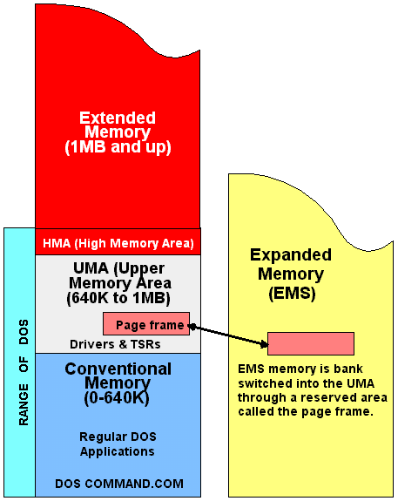
Memory Types _{[answers.com]}
64k
1M

Slide 46
Extended Memory (XMS) _{[pcguide]}
All of the memory above the first megabyte is called extended memory. This name comes from the fact that this memory was added as an extension to the base 1 MB that represented the limits of memory addressability of the original PC's processor, the Intel 8088.
With the exception of the first 64KB (High Memory Area), extended memory is not directly accessible to a PC when running in real mode.
  This means that under normal DOS operation, extended memory is not available at all.
  For HMA:
    0xffff0+0xffff=0x10ffef
    0x10ffef-0x10000=0xffef = 64k - 17
Protected mode must be used to access extended memory directly.

Slide 47
Access XMS _{[pcguide] [wiki]}
There are two ways that extended memory is normally used.
  A true, full protected mode OS like Windows NT, can access extended memory directly.
  However, operating systems or applications that run in real mode, including (1) DOS programs that need access to extended memory, (2) Windows 3.x, and (3) Windows 95, must coordinate their access to extended memory through the use of an extended memory manager.
    The most commonly used manager is HIMEM.SYS, which sets up extended memory according to the extended memory specification (XMS).
A protected-mode operating system such as Windows can also run real-mode programs and provide expanded memory to them.

Slide 48
EMS
In modern systems, the memory that is above 1 MB is used as extended memory (XMS).
  Extended memory is the most "natural" way to use memory beyond the first megabyte, because it can be addressed directly and efficiently.
  This is what is used by all protected-mode operating systems (including all versions of Microsoft Windows) and programs such as DOS games that use protected mode.
There is, however, an older standard for accessing memory above 1 MB which is called expanded memory. It uses a protocol called the Expanded Memory Specification or EMS.
EMS was originally created to overcome the 1 MB addressing limitations of the first generation 8088 and 8086 CPUs.
With the creation of newer processors that support extended memory above 1 MB, expanded memory is very obsolete.

Slide 49
EMS Requirements _{[pcguide]}
To use EMS, a special adapter board was added to the PC containing additional memory and hardware switching circuits.
The memory on the board was divided into 16 KB logical memory blocks, called pages or banks.

Slide 50
Expanded Memory _{[wikipedia]}
Expanded Memory was a trick invented around 1984 that provided more memory to byte-hungry, business-oriented MS-DOS programs.
The idea behind expanded memory was to use part of the remaining 384 KB, normally dedicated to communication with peripherals, for program memory as well.
In order to fit potentially much more memory than the 384 KB of free address space would allow, a banking scheme was devised, where only selected portions of the additional memory would be accessible at the same time.
Originally, a single 64 KB window of memory was possible; later this was made more flexible. Applications had to be written in a specific way in order to access expanded memory.

Slide 51
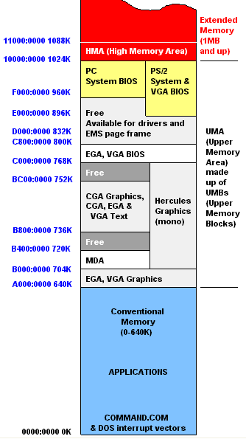
Memory Allocation in a PC _{[CDE]}

Slide 52
I/O Ports _{[text book]}
Each device connected to the I/O bus has its own set of I/O addresses, which are usually called I/O ports.
In the IBM PC architecture, the I/O address space provides up to 65,536 8-bit I/O ports.
  Two consecutive 8-bit ports may be regarded as a single 16-bit port, which must start on an even address.
  Similarly, two consecutive 16-bit ports may be regarded as a single 32-bit port, which must start on an address that is a multiple of 4.

Slide 53
I/O Related Instructions _{[text book]}
Four special assembly language instructions called in, ins, out, and outs allow the CPU to read from and write into an I/O port.
While executing one of these instructions, the CPU selects the required I/O port and transfers the data between a CPU register and the port.

Slide 54
I/O Shared Memory _{[text book]}
I/O ports may also be mapped into addresses of the physical address space.
The processor is then able to communicate with an I/O device by issuing assembly language instructions that operate directly on memory (for instance, mov, and, or, and so on).
Modern hardware devices are more suited to mapped I/O, because it is faster and can be combined with DMA.

Slide 55
Physical Addresses Map
During the initialization phase the kernel must build a physical addresses map that specifies
  which physical address ranges are usable by the kernel
  and
  which are unavailable
    either because they map hardware devices' I/O shared memory
    or because the corresponding page frames contain BIOS data.
P.S.:
  For most devices connected to the ISA bus
    The I/O shared memory is usually mapped into the 16-bit physical addresses ranging from 0xa0000 to 0xfffff; this gives rise to the "hole" between 640 KB and 1 MB.
  For devices connected to the PCI bus
    The I/O shared memory is mapped into 32-bit physical addresses near the 4 GB boundary. This kind of device is much simpler to handle.

Slide 56
Reserved Page Frames
The kernel considers the following page frames as reserved :
  Those falling in the unavailable physical address ranges
  Those containing the kernel's code and INITIALIZED data structures
A page contained in a reserved page frame can never be
  dynamically assigned
  or
  swapped to disk.

Slide 57
Number of Page Frames Used by Kernel
The total number of page frames required for Linux kernel depends on how the kernel is configured (what device drivers it includes, what functions it installs).
A typical configuration yields a kernel that needs about 7 MBs of RAM for Linux 3.9.

Slide 58
Default Physical Addresses Used by Kernel _{[1]}
The Linux kernel is installed in RAM starting from the physical address 0x01000000 (16M) by default.
Why?
Answer:
  When a PC computer is turned on, before Linux is loaded into memory and takes the control of the system,
    the hardware test
    hardware investigation
    OS booting
    and
    some hardware initialization work
  are performed by BIOS at real mode, which has special memory requirements at fixed memory addresses.

Slide 59
Why the First Megabyte of RAM Is Not Available for Linux Kernel?
Page frame 0 is used by BIOS to store the system hardware configuration detected during Power-On Self-Test (POST).
  The BIOS of many laptops write data on this page frame even after the system is initialized.
Physical addresses ranging from 0x000a0000 (i.e. 640k) to 0x000fffff are usually reserved
to BIOS routines
and
to map the internal memory of ISA graphic card.
  The above area is the well-known hole from 640KB to 1MB in all IBM-compatible PCs.
Additional page frames within the first megabyte may be reserved by specific computer models. E.g. the IBM ThinkPad maps the 0xa0 page into the 0x9f one.

Slide 60
Get the Size of Physical Memory
In the early stage of the boot sequence, kernel queries the BIOS to learn the size of physical memory_{[1][2]}.
  P.S.: Now the kernel is still in real mode.
In recently computers, the kernel also invokes a BIOS procedure to build
  a list of physical address ranges
  and
  the corresponding memory types.

Slide 61
machine_specific_memory_setup( )
Later, the kernel executes the machine_specific_memory_setup( ) function, which builds the physical addresses map (see Table in the following slide for an example).
  The kernel is in protected mode now.
Of course, the kernel builds this table on the basis of the BIOS list, if this is available; otherwise the kernel builds the table following the conservative default setup: all page frames with numbers from 0x9f (LOWMEMSIZE( )) to 0x100 (HIGH_MEMORY) are marked as reserved.
  P.S.:
    Page frame 0 is the first page frame.
    The address of the last byte of page frame 0x09f is (0x000a0000-1) (i.e. 640K-1).
    The address of the first byte of the page frame 0x100 is 0x00100000 (i.e. 1M).
0xa0?
0xff?

Slide 62
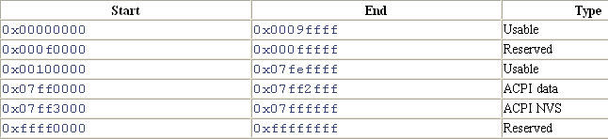
Example of BIOS-provided Physical Addresses Map
A typical configuration for a computer having 128 MB (0x00000000 ~ 0x07ffffff ) of RAM is shown in the following table.
1M
640k -1
960k
( the 1 MBth byte)
128M
( the 128 MBth byte)
information about the hardware devices of the system written by the BIOS in POST phase; during initialization phase, the kernel copies such information in a suitable kernel data structure, and then considers these page frames usable.
Mapped on ROM chips of the hardware devices.
mapped by the hardware to the BIOS's ROM chip

Slide 63
Advanced Configuration and Power Interface (ACPI)
The Advanced Configuration and Power Interface (ACPI) specification is an open industry standard first released in December 1996 developed by HP, Intel, Microsoft, Phoenix and Toshiba that defines common interfaces for
  hardware recognition
  motherboard and device configuration
  and
  power management.

Slide 64
The First Megabyte of RAM Is Not Available for Linux Kernel
To avoid loading the kernel into groups of noncontiguous page frames, Linux prefers to skip the first several megabytes of RAM.
However, page frames not reserved by the PC architecture will be used by Linux to store dynamically assigned pages.

Slide 65
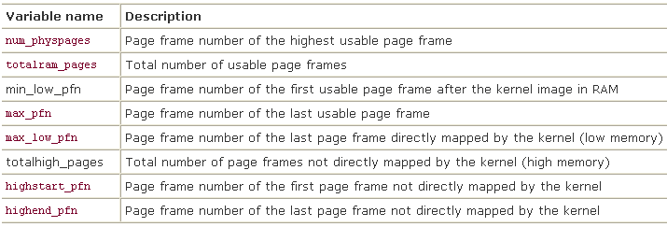
Function setup_memory( )
The setup_memory( ) function is invoked right after machine_specific_memory_setup( ): it analyzes the table of physical memory regions and initializes a few variables that describe the kernel's physical memory layout as shown in the following table.

Slide 66
Address Spaces for Different Modes
Linear addresses from 0x00000000 to 0xbfffffff can be addressed when the process is in either User or kernel Mode.
Linear addresses from 0xc0000000 to 0xffffffff can be addressed only when the process is in kernel mode.
Macro → # define PAGE_OFFSET 0xc0000000

