Slide 1

Linux Operating System
許 富 皓

Slide 2
Processes

Slide 3
Definition
A process is usually defined as
  an instance of a program in execution.
Hence, you might think of a process as the collection of data structures that fully describes how far the execution of the program has progressed.
  If 16 users are running vi at once, there are 16 separate processes (although they can share the same executable code).
From the kernel's point of view, the purpose of a process is to act as an entity to which system resources (CPU time, memory, etc.) are allocated.

Slide 4
Synonym of Processes
Processes are often called tasks or threads in the Linux source code.

Slide 5
Lifecycle of a Process
Processes are like human beings:
  they are generated,
  they have a more or less significant life,
  they optionally generate one or more child processes,
  eventually they die.
A small difference is that sex is not really common among processes — each process has just one parent.

Slide 6
Child Process’s Heritage from Its Parent Process
When a process is created,
  it is almost identical to its parent
  it receives a (logical) copy of the parent's address space
  it executes the same code as the parent
    beginning at the next instruction following the process creation system call.
Although the parent and child may share the pages containing the program code (text), they have separate copies of the data (stack and heap), so that changes by the child to a memory location are invisible to the parent (and vice versa).

Slide 7
Lightweight Processes and Multithreaded Application
Linux uses lightweight processes to offer better support for multithreaded applications.
Basically, two lightweight processes may share some resources, like the address space, the open files, and so on.
  Whenever one of them modifies a shared resource, the other immediately sees the change.
  Of course, the two processes must synchronize themselves when accessing the shared resource.

Slide 8
Using Lightweight Processes to Implement Threads
A straightforward way to implement multithreaded applications is to associate a lightweight process with each thread.
  In this way, the threads can access the same set of application data structures by simply
    sharing the same memory address space
    the same set of open files
    and so on.
  At the same time, each thread can be scheduled independently by the kernel so that one may sleep while another remains runnable.

Slide 9
Examples of Lightweight Supporting Thread Library
Examples of POSIX-compliant pthread libraries that use Linux's lightweight processes are
  LinuxThreads,
  Native POSIX Thread Library (NPTL), and
  IBM's Next Generation POSIX Threading Package (NGPT).

Slide 10
Thread Groups
POSIX-compliant multithreaded applications are best handled by kernels that support "thread groups."
In Linux a thread group is basically a set of lightweight processes that
  implement a multithreaded application
  and
  act as a whole with regards to some system calls such as
    getpid( )
    kill( )
    and
    _exit( ).

Slide 11
Why a Process Descriptor Is Introduced?
To manage processes, the kernel must have a clear picture of what each process is doing.
It must know, for instance,
  the process's priority
  whether
    it is running on a CPU
    or
    blocked on an event
  what address space has been assigned to it
  which files it is allowed to address, and so on.
This is the role of the process descriptor a task_struct type structure whose fields contain all the information related to a single process.

Slide 12
Brief Description of a Process Descriptor
As the repository of so much information, the process descriptor is rather complex.
In addition to a large number of fields containing process attributes, the process descriptor contains several pointers to other data structures that, in turn, contain pointers to other structures.

Slide 13
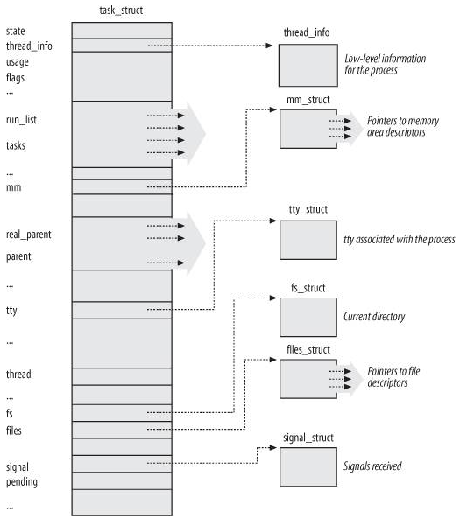
Brief Layout of a Process Descriptor

Slide 14
Process State
As its name implies, the state field of the process descriptor describes what is currently happening to the process.
It consists of an array of flags, each of which describes a possible process state.

Slide 15
Types of Process States
TASK_RUNNING
TASK_INTERRUPTIBLE
TASK_UNINTERRUPTIBLE
__TASK_STOPPED
__TASK_TRACED
/* in tsk->exit_state */
EXIT_ZOMBIE
EXIT_DEAD
/* in tsk->state again */
TASK_DEAD
TASK_WAKEKILL
TASK_WAKING
TASK_PARKED
TASK_STATE_MAX

Slide 16
TASK_RUNNING
The process is
  either executing on a CPU
  or
  waiting to be executed.

Slide 17
TASK_INTERRUPTIBLE
The process is suspended (sleeping) until some condition becomes true.
Examples of conditions that might wake up the process (put its state back to TASK_RUNNING) include
  raising a hardware interrupt
  releasing a system resource the process is waiting for
  or
  delivering a signal.

Slide 18
TASK_UNINTERRUPTIBLE
Like TASK_INTERRUPTIBLE, except that delivering a signal to the sleeping process leaves its state unchanged.
This process state is seldom used.
It is valuable, however, under certain specific conditions in which a process must wait until a given event occurs without being interrupted.
  For instance,
    this state may be used when
      a process opens a device file
      and
      the corresponding device driver starts probing for a corresponding hardware device.
      The device driver must not be interrupted until the probing is complete, or the hardware device could be left in an unpredictable state.

Slide 19
__TASK_STOPPED
Process execution has been stopped.
A process enters this state after receiving a
  SIGSTOP signal
    Stop Process Execution
  SIGTSTP signal
    SIGTSTP is sent to a process when
      the suspend keystroke (normally ^Z) is pressed on its controlling tty
      and
      it's running in the foreground.
  SIGTTIN signal
    Background process requires input
  SIGTTOU signal.
    Background process requires output

Slide 20
Signal SIGSTOP _{[Linux Magazine]}
When a process receives SIGSTOP, it stops running.
It can't ever wake itself up (because it isn't running!), so it just sits in the stopped state until it receives a SIGCONT.
The kernel never sends a SIGSTOP automatically; it isn't used for normal job control.
This signal cannot be caught or ignored; it always stops the process as soon as it's received.

Slide 21
Signal SIGCONT _{[Linux Magazine] [HP]}
When a stopped process receives SIGCONT, it starts running again.
This signal is ignored by default for processes that are already running.
SIGCONT can be caught, allowing a program to take special actions when it has been restarted.

Slide 22
__TASK_TRACED
Process execution has been stopped by a debugger.
When a process is being monitored by another (such as when a debugger executes a ptrace( ) system call to monitor a test program), each signal may put the process in the __TASK_TRACED state.

Slide 23
Fatal Signals _{[Bovet et al.]} (1)
A signal is fatal for a given process if delivering the signal causes the kernel to kill the process.
The SIGKILL signal is always fatal.
Each signal whose default action is “Terminate” and which is not caught by a process is also fatal for that process.

Slide 24
Fatal Signals _{[Bovet et al.]} (2)
Notice, however, that a signal caught by a process and whose corresponding signal-handler function terminates the process is NOT fatal, because the process chose to terminate itself rather than being killed by the kernel.

Slide 25
TASK_WAKEKILL _{[IBM]}
TASK_WAKEKILL is designed to wake the process on receipt of fatal signals.
#define TASK_KILLABLE (TASK_WAKEKILL | TASK_UNINTERRUPTIBLE)
#define TASK_STOPPED (TASK_WAKEKILL | __TASK_STOPPED)
#define TASK_TRACED (TASK_WAKEKILL | __TASK_TRACED)

Slide 26
TASK_KILLABLE _{[IBM]}
The Linux Kernel version 2.6.25 introduces a new process sleeping state, TASK_KILLABLE:
  If a process is sleeping killably in this new state, it works like TASK_UNINTERRUPTIBLE with the bonus that it can respond to fatal signals.

Slide 27
TASK_WAKEKILL vs.
TASK_KILLABLE _{[IBM]}
TASK_UNINTERRUPTIBLE
+
TASK_WAKEKILL
=
TASK_KILLABLE

Slide 28
New States Introduced in Linux 2.6.x
Two additional states of the process can be stored both in the state field and in the exit_state field of the process descriptor.
As the field name suggests, a process reaches one of these two states ONLY when its execution is terminated.

Slide 29
EXIT_ZOMBIE
Process execution is terminated, but the parent process has not yet issued a wait4( ) or waitpid( ) system call to return information about the dead process.
Before the wait( )-like call is issued, the kernel cannot discard the data contained in the dead process descriptor because the parent might need it.

Slide 30
EXIT_DEAD
The final state: the process is being removed by the system because the parent process has just issued a wait4( ) or waitpid( ) system call for it.

Slide 31
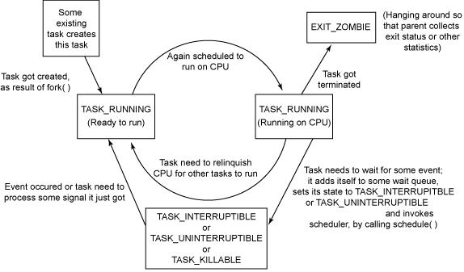
Process State Transition_{[Kumar]}

Slide 32
Set the state Field of a Process
The value of the state field is usually set with a simple assignment.
  For instance: p->state = TASK_RUNNING;
The kernel also uses the _set_task_state and _set_current_state macros: they set
  the state of a specified process
  and
  the state of the process currently executed,
respectively.

Slide 33
Execution Context and Process Descriptor
As a general rule, each execution context that can be independently scheduled must have its own process descriptor.
Therefore, even lightweight processes, which share a large portion of their kernel data structures, have their own task_struct structures.

Slide 34
Identifying a Process
The strict one-to-one correspondence between the process and process descriptor makes the 32-bit address of the task_struct structure a useful means for the kernel to identify processes.
These addresses are referred to as process descriptor pointers.
Most of the references to processes that the kernel makes are through process descriptor pointers.

Slide 35
Lifetime and Storage Location of Process Descriptors
Processes are dynamic entities whose lifetimes range from a few milliseconds to months.
Thus, the kernel must be able to handle many processes at the same time
Process descriptors are stored in dynamic memory rather than in the memory area permanently assigned to the kernel.

Slide 36
thread_info, Kernel Mode Stack, and Process Descriptor
For each process, Linux packs two different data structures in a single per-process memory area:
  a small data structure linked to the process descriptor, namely the thread_info structure
  and
  the Kernel Mode process stack.

Slide 37
Length of Kernel Mode Stack and Structure thread_info
The length of the structure thread_info and kernel mode stack memory area of a process is 8,192 bytes (two page frames) after Linux 2.6.37_{[1]}.
For reasons of efficiency the kernel stores the 8-KB memory area in two consecutive page frames with the first page frame aligned to a multiple of 2¹³.

Slide 38
Kernel Mode Stack
A process in Kernel Mode accesses a stack contained in the kernel data segment, which is different from the stack used by the process in User Mode.
Because kernel control paths make little use of the stack, only a few thousand bytes of kernel stack are required. Therefore, 8 KB is ample space for the stack and the thread_info structure.

Slide 39
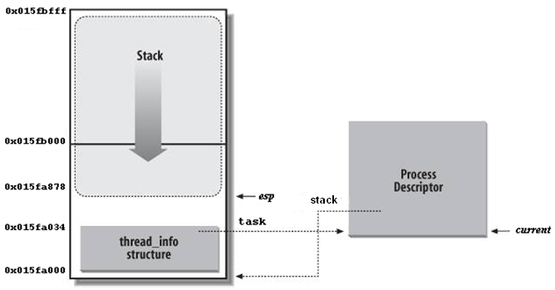
Process Descriptor And Process Kernel Mode Stack
The two data structures are stored in the 2-page (8 KB) memory area.
The thread_info structure resides at the beginning of the memory area, and the stack grows downward from the end.
The figure also shows that the thread_info structure and the task_struct structure are mutually linked by means of the fields task and stack, respectively.

Slide 40
esp Register
The esp register is the CPU stack pointer, which is used to address the stack's top location.
On 80x86 systems, the stack starts at the end and grows toward the beginning of the memory area.
Right after switching from User Mode to Kernel Mode, the kernel stack of a process is always empty, and therefore the esp register points to the byte immediately following the stack.
The value of the esp is decreased as soon as data is written into the stack.
Because the thread_info structure is 52 bytes long, the kernel stack can expand up to 8,140 bytes.

Slide 41
Declaration of a Kernel Stack and Structure thread_info
The C language allows the thread_info structure and the kernel stack of a process to be conveniently represented by means of the following union construct:
union thread_union
{ struct thread_info thread_info;
unsigned long stack[2048];
/* 1024 for 4KB stacks */
};

Slide 42
Macro Current
before Linux 2.6.22

Slide 43
Identifying the current Process
The close association between the thread_info structure and the Kernel Mode stack offers a key benefit in terms of efficiency: the kernel can easily obtain the address of the thread_info structure of the process currently running on a CPU from the value of the esp register.
In fact, if the thread_union structure is 8 KB (2¹³ bytes) long, the kernel masks out the 13 least significant bits of esp to obtain the base address of the thread_info structure.
On the other hand, if the thread_union structure is 4 KB long, the kernel masks out the 12 least significant bits of esp.

Slide 44
Function current_thread_info( )
This is done by the current_thread_info( ) function, which produces assembly language instructions like the following:
movl $0xffffe000,%ecx
/*or 0xfffff000 for 4KB stacks*/
andl %esp,%ecx
movl %ecx,p
After executing these three instructions, p contains the thread_info structure pointer of the process running on the CPU that executes the instruction.

Slide 45
Get the task_struct Address of Current Process
static __always_inline struct task_struct * get_current(void)
{
return current_thread_info()->task;
}
#define current get_current()

Slide 46
Macro Current
after and including Linux 2.6.22

Slide 47
current : the task_struct Address of Current Process
Linux stores the task_struct address of current process in the per-CPU variable current_task.
DEFINE_PER_CPU(struct task_struct *, current_task) ____cacheline_aligned = &init_task;
#define this_cpu_read_stable(var) percpu_from_op("mov", var, "p" (&(var)))
static __always_inline struct task_struct *get_current(void)
{
return this_cpu_read_stable(current_task);
}
#define current get_current()

Slide 48
Macro percpu_from_op _{[1][2][3]}
#define __percpu_arg(x) __percpu_prefix "%P" #x
#define percpu_from_op(op, var, constraint) \
({ typeof(var) pfo_ret__; \
switch (sizeof(var)) { \
case 1: \
asm(op "b "__percpu_arg(1)",%0" \
: "=q" (pfo_ret__) \
: constraint); \
break; \
…
case 4: \
asm(op "l "__percpu_arg(1)",%0" \
: "=r" (pfo_ret__) \
: constraint); \
break; \
case 8: \
asm(op "q "__percpu_arg(1)",%0" \
: "=r" (pfo_ret__) \
: constraint); \
break; \
default: __bad_percpu_size(); \
} \
pfo_ret__; \
})

Slide 49
When will the Content of current_task be Set_{[1]}?
current_task is a per-CPU variable.
The value of current_task will be set at the following two situations:
  Variable Initialization
  Context switch

Slide 50
Set the Value of current_task at Variable Initialization
DEFINE_PER_CPU(struct task_struct *, current_task) = &init_task;

Slide 51
Set a New Value of current_task at Context Switch
When making a context switch at __switch_to to switch CPU to a different process (next_p), __switch_to invokes this_cpu_write to store the task_struct address of next_p in the per-CPU current_task variable of related CPU.
this_cpu_write(current_task, next_p);

Slide 52
Linked List

Slide 53

Non-circular Doubly Linked Lists
A sequence of nodes chained together through two kinds of pointers:
  a pointer to its previous node
  and
  a pointer to its subsequent node.
Each node has two links:
  one points to the previous node, or points to a null value or empty list if it is the first node
  and
  one points to the next, or points to a null value or empty list if it is the final node.

Slide 54
Problems with Doubly Linked Lists
The Linux kernel contains hundred of various data structures that are linked together through their respective doubly linked lists.
  Drawbacks:
    a waste of programmers' efforts to implement a set of primitive operations, such as,
      initializing the list
      inserting and deleting an element
      scanning the list.
    a waste of memory to replicate the primitive operations for each different list.

Slide 55
Data Structure struct list_head
Therefore, the Linux kernel defines the struct list_head data structure, whose only fields next and prev represent the forward and back pointers of a generic doubly linked list element, respectively.
It is important to note, however, that the pointers in a list_head field store
  the addresses of other list_head fields
  rather than
  the addresses of the whole data structures in which the list_head structure is included.

Slide 56
A Circular Doubly Linked List with Three Elements
data structure 1
data structure 1
data structure 1
list_head
list_head
list_head
list_head
next
next
next
next
prev
prev
prev
prev

Slide 57
Macro LIST_HEAD(name)
A new list is created by using the LIST_HEAD(name) macro.
  it declares a new variable named name of type list_head, which is a dummy first element that acts as a placeholder for the head of the new list.
  and
  it initializes the prev and next fields of the list_head data structure so as to point to the name variable itself.

Slide 58
Code of Macro LIST_HEAD(name)
struct list_head
{
struct list_head *next, *prev;
};
#define LIST_HEAD_INIT(name) { &(name), &(name) }
#define LIST_HEAD(name) \
struct list_head name = LIST_HEAD_INIT(name)

Slide 59
An Empty Doubly Linked List
LIST_HEAD(my_list)
next
prev
struct list_head my_list

Slide 60
Macro LIST_HEAD_INIT
#define LIST_HEAD_INIT(name) /
{ &(name), &(name) }

Slide 61
Relative Functions and Macros (1)
list_add(n,p)
list_add_tail(n,p)
list_del(p)
list_empty(p)
n
p
. . .
1
2
n

Slide 62
Relative Functions and Macros (2)
list_for_each(pos, head)
list_for_each_entry(p,h,m)
list_entry(ptr, type, member)
  Returns the address of the data structure of type type in which the list_head field that has the name member and the address ptr is included.

Slide 63
Example of list_entry(p,t,m)
sturct class{
char name[20];
char teacher[20];
struct student_pointer *student;
struct list_head link;
};
struct class grad_1A;
struct list_head *poi;
poi=&(grad_1A.link);
list_entry(poi,struct class,link)
→ &grad_1A
name
(20 bytes)
teacher
(20 bytes)
student
(4 bytes)
link next (4 bytes)
prev(4 bytes)

Slide 64
list_entry(ptr,type,member)
/**
* list_entry - get the struct for this entry
* @ptr: the &struct list_head pointer.
* @type: the type of the struct this is embedded in.
* @member: the name of the list_struct within the struct.
*/
#define list_entry(ptr, type, member) \
container_of(ptr, type, member)

Slide 65
Code of container_of
typedef unsigned int __kernel_size_t;
typedef __kernel_size_t size_t;
#define offsetof(TYPE, MEMBER) ((size_t) &((TYPE *)0)->MEMBER)
#define container_of(ptr, type, member)
({ const typeof( ((type *)0)->member ) *__mptr = (ptr); \
(type *)( (char *)__mptr - offsetof(type,member) );})

Slide 66
Explanation of list_entry(p,t,m)
offset
#define list_entry(ptr, type, member) \
((type *)((char *)(ptr)-(unsigned long)(&((type *)0)->member)))
list_entry(…)
name
(20 bytes)
teacher
(20 bytes)
student
(4 bytes)
link next (4 bytes)
prev(4 bytes)
poi
= list_entry()
offset
- offset
poi
list_entry(poi,struct class,link)
((struct class *)((char *)(poi)-(unsigned long)(&((struct class *)0)->link)))

Slide 67
hlist_head
The Linux kernel 3.9 supports another kind of doubly linked list, which mainly differs from a list_head list because it is NOT circular.
It can be used for hash tables.
The list head is stored in an hlist_head data structure, which is simply
  a pointer to the first element in the list (NULL if the list is empty).

Slide 68
hlist_node
Each element is represented by an hlist_node data structure, which includes
  a pointer next to the next element
  and
  a pointer pprev to the next field of the previous element.
Because the list is not circular, the pprev field of the first element and the next field of the last element are set to NULL.

Slide 69
A Non-circular Doubly Linked List
struct hlist_head
struct hlist_node
struct hlist_node *first
pprev next
pprev next
pprev next

Slide 70
Functions and Macro for hlist_head and hlist_node
The list can be handled by means of several helper functions and macros similar to those listed in previous sixth slide:
  hlist_add_head()
  hlist_del()
  hlist_empty()
  hlist_entry()
  hlist_for_each_entry(), and so on.

Slide 71
The Process List
The process list is a circular doubly linked list that links the process descriptors of all existing thread group leaders:
  Each task_struct structure includes a tasks field of type list_head whose prev and next fields point, respectively, to the previous and to the next task_struct element’s tasks field.

Slide 72
The Head of the Process List
The head of the process list is the init_task task_struct descriptor; it is the process descriptor of the so-called process 0 or swapper.
The tasks->prev field of init_task points to the tasks field of the process descriptor inserted last in the list.

Slide 73
Code for init_task
#define INIT_TASK(tsk) \
{ .state = 0, \
.stack = &init_thread_info, \
:
.prio = MAX_PRIO-20, \
:
.tasks = LIST_HEAD_INIT(tsk.tasks), \
:
.real_parent = &tsk, \
.parent = &tsk, \
.children = LIST_HEAD_INIT(tsk.children), \
.sibling = LIST_HEAD_INIT(tsk.sibling), \
.group_leader = &tsk, \
:
.thread = INIT_THREAD, \
.fs = &init_fs, \
.files = &init_files, \
.signal = &init_signals, \
.sighand = &init_sighand, \
.nsproxy = &init_nsproxy, \
:
.pids = { \
[PIDTYPE_PID] = INIT_PID_LINK(PIDTYPE_PID), \
[PIDTYPE_PGID] = INIT_PID_LINK(PIDTYPE_PGID), \
[PIDTYPE_SID] = INIT_PID_LINK(PIDTYPE_SID), \
}, \
.thread_group = LIST_HEAD_INIT(tsk.thread_group), \
:
}

Slide 74
Scans the Whole Process List with Macro for_each_process
#define next_task(p) \
list_entry_rcu((p)->tasks.next, struct task_struct, tasks)
#define for_each_process(p) \
for (p = &init_task ; (p = next_task(p)) != &init_task ; )
The macro starts by moving PAST init_task to the next task and continues until it reaches init_task again (thanks to the circularity of the list).
At each iteration, the variable p passed as the argument of the macro contains the address of the currently scanned process descriptor, as returned by the list_entry macro.

Slide 75
Example
Macro for_each_process scans the whole process list.
The macro is the loop control statement after which the kernel programmer supplies the loop.
  e.g. counter=1; /* for init_task */
  for_each_process(t)
  { if(t->state==TASK_RUNNING)
  ++counter;
  }

Slide 76
The Lists of TASK_RUNNING Processes – in Early Linux Version
When looking for a new process to run on a CPU, the kernel has to consider only the runnable processes (that is, the processes in the TASK_RUNNING state).
Earlier Linux versions put all runnable processes in the same list called runqueue.
Because it would be too costly to maintain the list ordered according to process priorities, the earlier schedulers were compelled to scan the whole list in order to select the "best" runnable process.
Linux 2.6 implements the runqueue differently.

Slide 77
Runqueue
in
Linux Versions 2.6 ~ 2.6.23

Slide 78
The Lists of TASK_RUNNING Processes – in Linux Versions 2.6 ~ 2.6.23
Linux 2.6 achieves the scheduler speedup by splitting the runqueue in many lists of runnable processes, one list per process priority.
Each task_struct descriptor includes a run_list field of type list_head.
If the process priority is equal to k (a value ranging between 0 and 139), the run_list field links the process descriptor into the list of runnable processes having priority k.

Slide 79
runqueue in a Multiprocessor System
Furthermore, on a multiprocessor system, each CPU has its own runqueue, that is, its own set of lists of processes.

Slide 80
Trade-off of runqueue
runqueue is a classic example of making a data structures more complex to improve performance:
  to make scheduler operations more efficient, the runqueue list has been split into 140 different lists!

Slide 81
The Main Data Structures of a runqueue
The kernel must preserve a lot of data for every runqueue in the system.
The main data structures of a runqueue are the lists of process descriptors belonging to the runqueue.
All these lists are implemented by a single prio_array_t (= struct prio_array ) data structure.

Slide 82
struct prio_array
struct prio_array
{ unsigned int nr_active;
unsigned long bitmap[BITMAP_SIZE];
struct list_head queue[MAX_PRIO];
};
  nr_active: the number of process descriptors linked into the lists.
  bitmap: a priority bitmap: each flag is set if and only if the corresponding priority list is not empty
  queue: the 140 heads of the priority lists.

Slide 83
The prio and array Field of a Process Descriptor
The prio field of the process descriptor stores the dynamic priority of the process.
The array field is a pointer to the prio_array_t data structure of its current runqueue.
  P.S.: Each CPU has its own runqueue.

Slide 84
Scheduler-related Fields of a Process Descriptor
unsigned int nr_active
unsigned long bitmap[5]
struct [0] list_head [1] queue[140][x]
prio_array_t
struct task_struct
struct task_struct
struct task_struct
:
int prio
struct prev list_head run_list next
prio_array_t *array
:
:
int prio
struct prev list_head run_list next
prio_array_t *array
:
.
.
.
:
int prio
struct prev list_head run_list next
prio_array_t *array
:

Slide 85
Function enqueue_task(p,array)
The enqueue_task(p,array) function inserts a process descriptor into a runqueue list; its code is essentially equivalent to:
list_add_tail(&p->run_list, &array->queue[p->prio]);
__set_bit(p->prio, array->bitmap);
array->nr_active++;
p->array = array;

Slide 86
Function dequeue_task(p,array)
Similarly, the dequeue_task(p,array) function removes a process descriptor from a runqueue list.

Slide 87
Linux 3.9 Scheduler

Slide 88
Linux Scheduler
Linux is a multi-tasking kernel.
Multiple processes exist at a system at the same time
The scheduler of a Linux kernel decided which process is executed by a CPU.

Slide 89
Linux Scheduler Entry Point _{[Volker Seeker]}
The main entry point into the Linux process scheduler is the kernel function schedule().

Slide 90
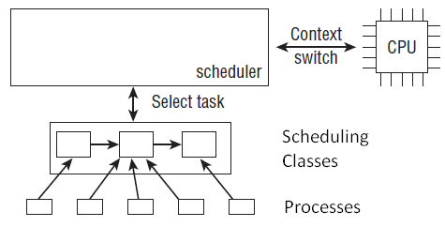
Overview of the Components of the Scheduling Subsystem

Slide 91
Scheduling Classes (1)
Scheduling classes are used to decide which task runs next.
The kernel supports different scheduling policies
  completely fair scheduling
  real-time scheduling
  scheduling of the idle task when there is nothing to do

Slide 92
Scheduling Classes (2)
Scheduling classes allow for implementing different scheduling policies in a modular way: Code from one class does not need to interact with code from other classes.
When the scheduler is invoked, it queries the scheduler classes which process is supposed to run next.

Slide 93
Scheduling Classes (3)
Scheduling classes are represented by a special data structure struct sched_class.
Each operation that can be requested by the scheduler is represented by one pointer.
This allows for creation of the generic scheduler without any knowledge about the internal working of different scheduler classes.

Slide 94
struct sched_class
struct sched_class {
const struct sched_class *next;
void (*enqueue_task) (struct rq *rq, struct task_struct *p, int flags);
void (*dequeue_task) (struct rq *rq, struct task_struct *p, int flags);
void (*yield_task) (struct rq *rq);
bool (*yield_to_task) (struct rq *rq, struct task_struct *p, bool preempt);
void (*check_preempt_curr) (struct rq *rq, struct task_struct *p, int flags);
struct task_struct * (*pick_next_task) (struct rq *rq);
void (*put_prev_task) (struct rq *rq, struct task_struct *p);
:
void (*set_curr_task) (struct rq *rq);
void (*task_tick) (struct rq *rq, struct task_struct *p, int queued);
void (*task_fork) (struct task_struct *p);
void (*switched_from) (struct rq *this_rq, struct task_struct *task);
void (*switched_to) (struct rq *this_rq, struct task_struct *task);
void (*prio_changed) (struct rq *this_rq,struct task_struct *task, int oldprio);
unsigned int (*get_rr_interval) (struct rq *rq, struct task_struct *task);
:
};

Slide 95
Flat Hierarchy of Scheduling Classes
An instance of struct sched_class must be provided for each scheduling class.
Scheduling classes are related in a flat hierarchy:
  Real-time processes are most important, so they are handled before completely fair processes, which are, in turn, given preference to the idle tasks that are active on a CPU when there is nothing better to do.

Slide 96
Connecting Different Linux Scheduling Classes
The next element connects the sched_class instances of the different scheduling classes in the described order.
Note that this hierarchy is already set up at compile time:
  There is no mechanism to add new scheduler classes dynamically at run time.

Slide 97
Priority of Linux Scheduling Classes (1) _{[Volker Seeker (1)]}
All existing scheduling classes in the kernel are in a list which is ordered by the priority of the scheduling class.
The first member in sched_class called next is a pointer to the next scheduling class with a lower priority in that list.

Slide 98
Priority of Linux Scheduling Classes (2) _{[Volker Seeker (1)]}
The list is used to prioritise processes of different types before others.
In the Linux versions described in this course, the complete list looks like the following:
stop_sched_class → rt_sched_class → fair_sched_class → idle_sched_class → NULL

Slide 99
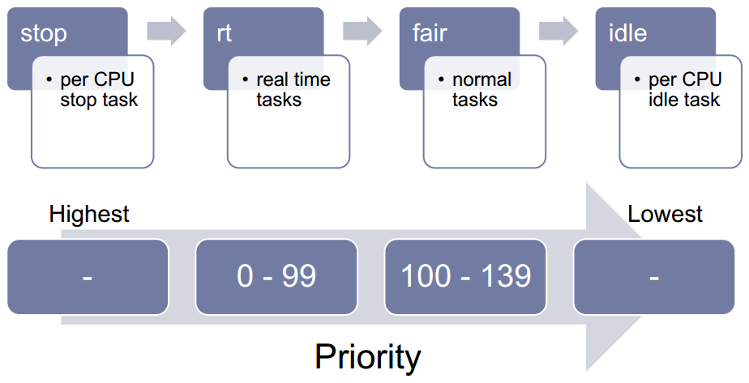
Priority of Linux Scheduling Classes (3) _{[Volker Seeker (1)]}

Slide 100
Stop and Idle Scheduling Classes _{[Volker Seeker (2)]}
Stop and Idle are special scheduling classes.
Stop is used to schedule the per-cpu stop task which pre-empts everything and can be pre-empted by nothing.
Idle is used to schedule the per-cpu idle task (also called swapper task) which is run if no other task is runnable.

Slide 101
stop_sched_class _{[tian_yufeng]}
The stop_sched_class is to stop cpu, using on SMP system, for
  load balancing
  and
  cpu hotplug.
This class have the highest scheduling priority.

Slide 102
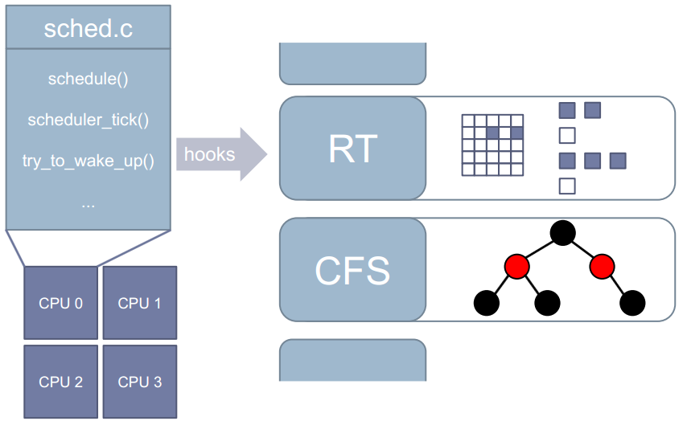
schedule() vs. Scheduling Classes _{[Volker Seeker (2)]}
RT run queue
CFS run queue

Slide 103
Runqueue
in
Linux Versions 2.64 ~ 3.9

Slide 104
Run Queues in Linux Versions 2.6.24 ~ 3.9
Each CPU has its own run queue, and each active process appears on just one run queue.
It is not possible to run a process on several CPUs at the same time.

Slide 105
struct rq
Run queues are implemented using the struct rq data structure.
struct rq {
raw_spinlock_t lock;
:
struct cfs_rq cfs;
struct rt_rq rt;
:
struct task_struct *curr, *idle, *stop;
unsigned long next_balance;
struct mm_struct *prev_mm;
:
};

Slide 106
Fields of struct rq
cfs and rt are the embedded sub-run queues for the completely fair scheduler and real-time scheduler, respectively.
curr points to the task_struct of the process currently running.
idle points to the task structure of the idle process called when no other runnable process is available.

Slide 107
runqueues array
All run queues of the system are held in the runqueues array, which contains an element for each CPU in the system.
On single-processor systems, there is, of course, just one element because only one run queue is required.
static DEFINE_PER_CPU_SHARED_ALIGNED(struct rq, runqueues);

Slide 108
Run Queue-related Macros
#define cpu_rq(cpu) (&per_cpu(runqueues, (cpu)))
static inline unsigned int task_cpu(const struct task_struct *p)
{ return task_thread_info(p)->cpu; }
#define task_rq(p) cpu_rq(task_cpu(p))
#define cpu_curr(cpu) (cpu_rq(cpu)->curr)

Slide 109
CFS Run Queue

Slide 110
Red-Black Tree _{[Wikipedia]}
A node is either red or black.
The root is black.
All leaves (NIL) are black. (All leaves are same color as the root.)
Every red node must have two black child nodes.
Every path from a given node to any of its descendant leaves contains the same number of black nodes.

Slide 111
Properties of a Red-Black Tree _{[Wikipedia]}
The path from the root to the furthest leaf is no more than twice as long as the path from the root to the nearest leaf.
The result is that the tree is roughly height-balanced.
This theoretical upper bound on the height allows red–black trees to be efficient in the worst case, unlike ordinary binary search trees.

Slide 112



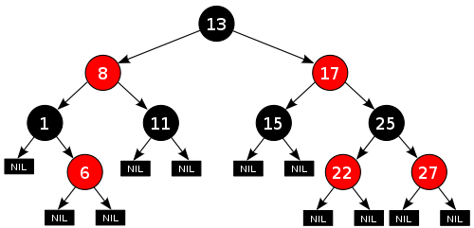

CFS Run Queue of a CPU
point to the scheduling class the process is in
struct task_struct
struct rq
struct sched_class *sched_class;
:
:
:
struct rb_node run_node;
struct cfs_rq cfs;
struct rb_root tasks_timeline;
:
struct sched_entity se;
struct rb_node *rb_leftmost;
u64 vruntime;
:
:
struct rt_rq rt;
vruntime used as key in
the RB-Tree
gravest need for CPU

Slide 113
struct cfs_rq
struct cfs_rq {
struct load_weight load;
unsigned int nr_running, h_nr_running;
u64 exec_clock;
u64 min_vruntime;
#ifndef CONFIG_64BIT
u64 min_vruntime_copy;
#endif
struct rb_root tasks_timeline;
struct rb_node *rb_leftmost;
:
}

Slide 114
Fields of struct cfs_rq
A CFS run queue is embedded into each per-CPU run queue of the generic scheduler.
nr_running counts the number of runnable processes on the queue.
tasks_timeline is the base element to manage all processes in a time-ordered red-black tree.
rb_leftmost is always set to the leftmost element of the tree, that is, the element that deserves to be scheduled most.

Slide 115
struct sched_entity
struct sched_entity {
struct load_weight load; /* for load-balancing */
struct rb_node run_node;
struct list_head group_node;
unsigned int on_rq;
u64 exec_start;
u64 sum_exec_runtime;
u64 vruntime;
u64 prev_sum_exec_runtime;
u64 nr_migrations;
:
:
}

Slide 116
Fields of struct sched_entity
run_node is a standard tree element that allows the entity to be sorted on a red-black tree.
on_rq denotes whether the entity is currently scheduled on a run queue or not.
The amount of time that has elapsed on the virtual clock during process execution is accounted in vruntime.

Slide 117
struct rb_node and struct rb_root
struct rb_node {
unsigned long __rb_parent_color;
struct rb_node *rb_right;
struct rb_node *rb_left;
} __attribute__((aligned(sizeof(long))));
/* The alignment might seem pointless, but allegedly CRIS needs it */
struct rb_root {
struct rb_node *rb_node;
};

Slide 118
Supplement Materials

Slide 119
Situations Resulting in Calling the Scheduler (1) _{[Volker Seeker]}
Regular runtime update of currently scheduled process:
  The function scheduler_tick() is called regularly by a timer interrupt.
  Its purpose is to update
    runqueue clock
    CPU load
    and
    runtime counters of the currently running process.

Slide 120
Situations Resulting in Calling the Scheduler (2) _{[Volker Seeker]}
Currently running process goes to sleep:
  A process which is going to sleep to wait for a specific event to happen will invoke schedule().

Slide 121
Situations Resulting in Calling the Scheduler (3) _{[Volker Seeker]}
Sleeping process wakes up:
  The code that causes the event the sleeping process is waiting for typically calls wake_up() on the corresponding wait queue which eventually ends up in the scheduler function try_to_wake_up().

