Slide 1
Task1 compare effects of different Bands on tone-vocoder
Process
Set the cut-off frequency of the Low-pass Filter to 50Hz
Define different N for the tone-vocoder, let N equals to 1,2,4,6,8 and let the signal passes the tone-vocoder
Save the proceed signal as audio wave and analyze the output audio by listening it
1
Notes:
1

Slide 2
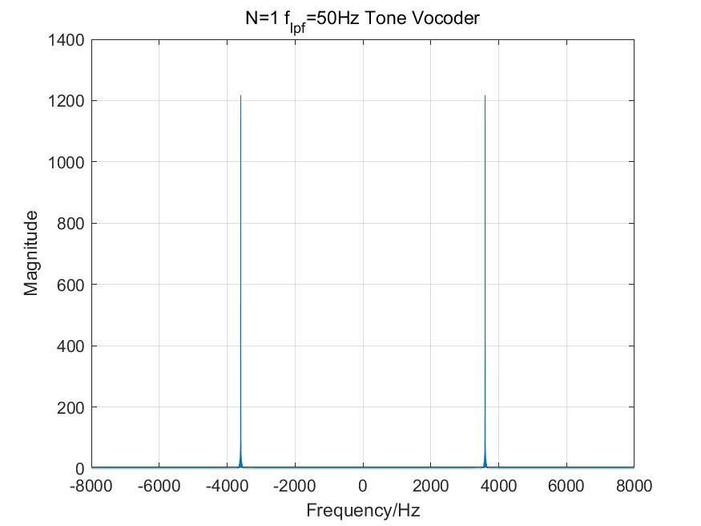
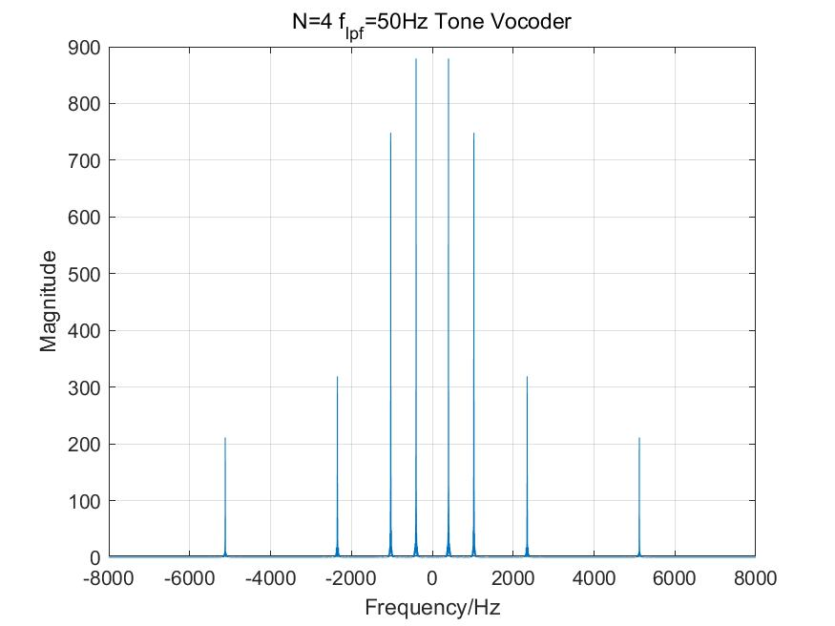
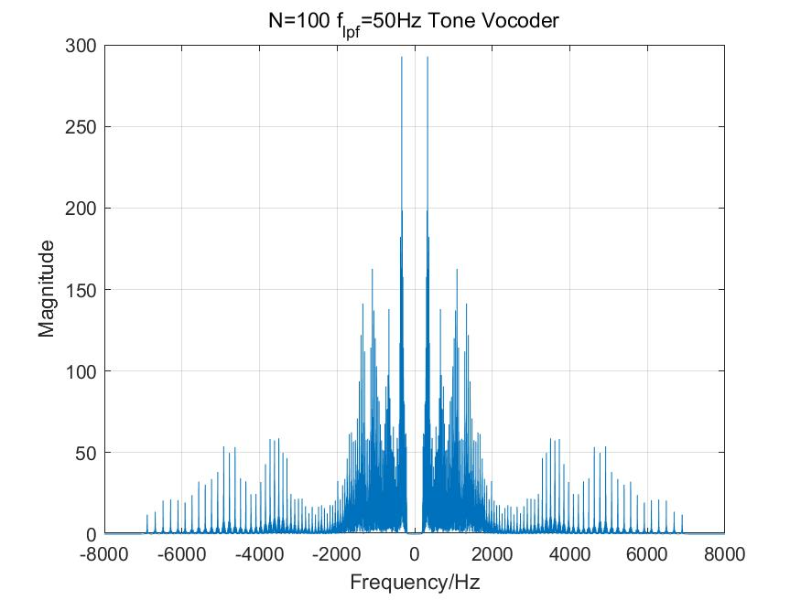
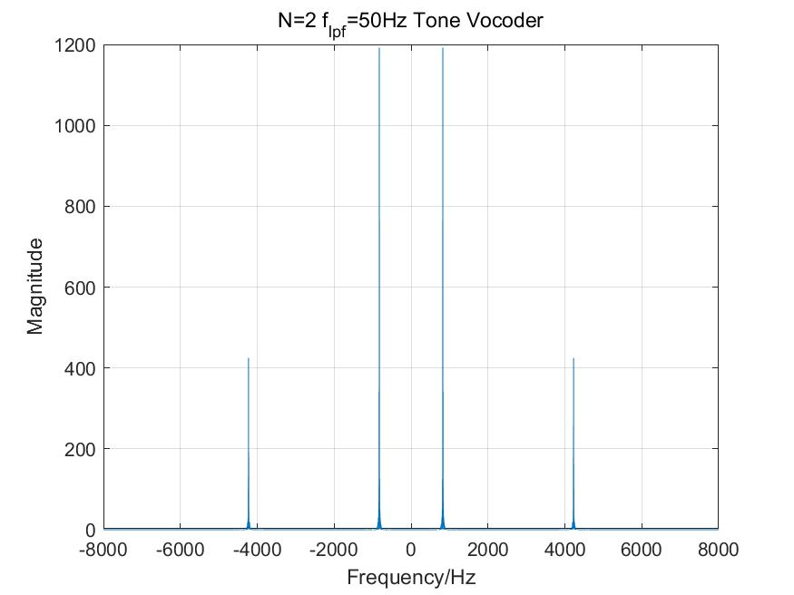
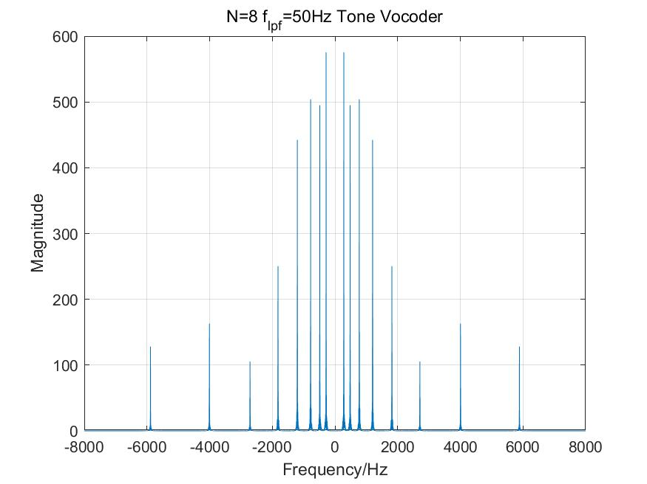
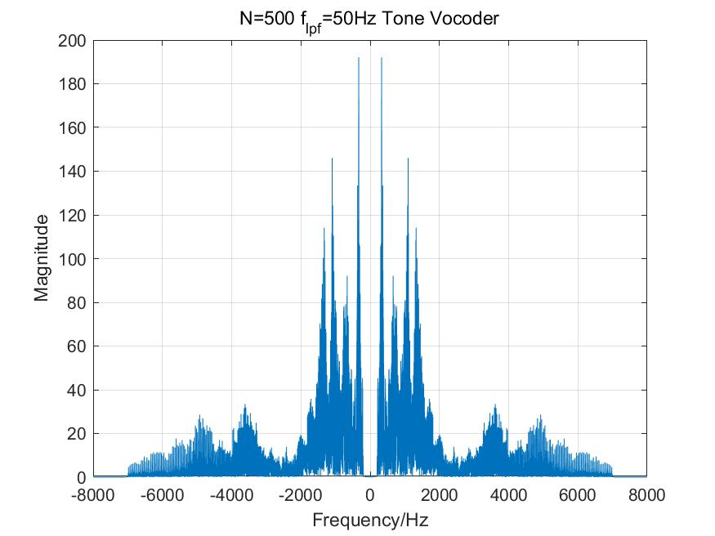
Task1 compare effects of different Bands on tone-vocoder
Output
C_01_01.wav
2
Notes:
2

Slide 3

Task1 compare effects of different Bands on tone-vocoder
Output
C_01_01.wav
3
Notes:
3

Slide 4
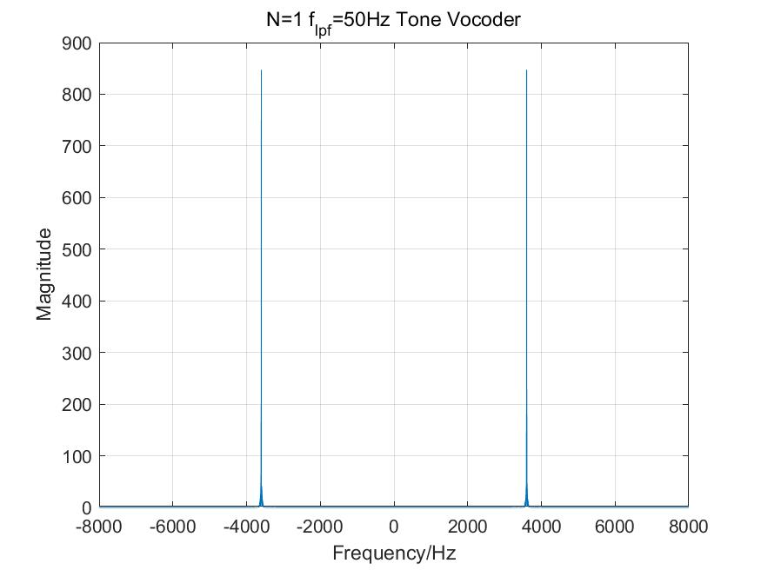
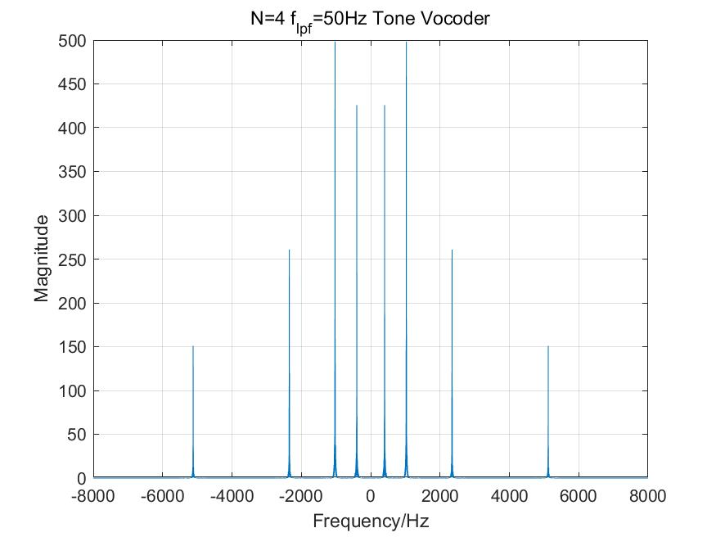
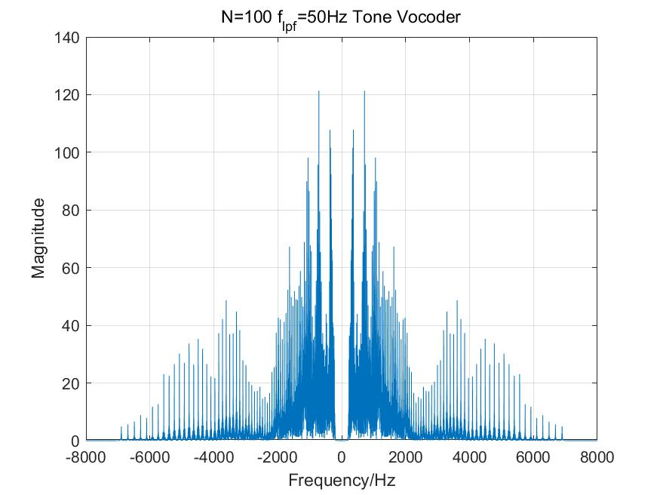
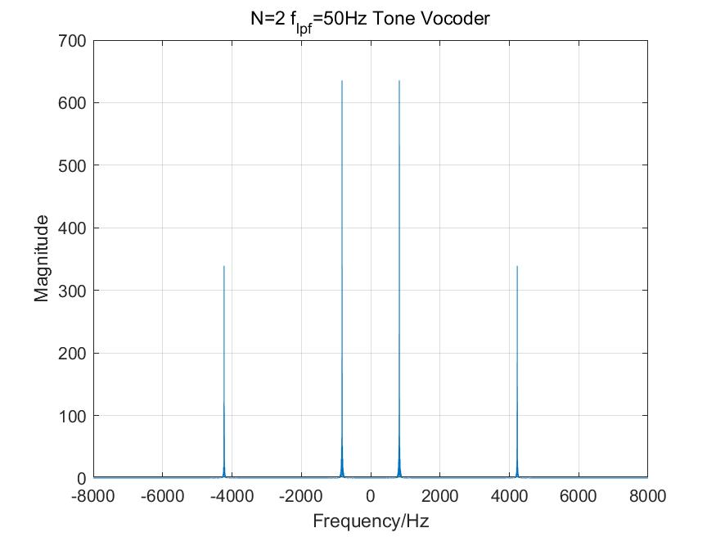
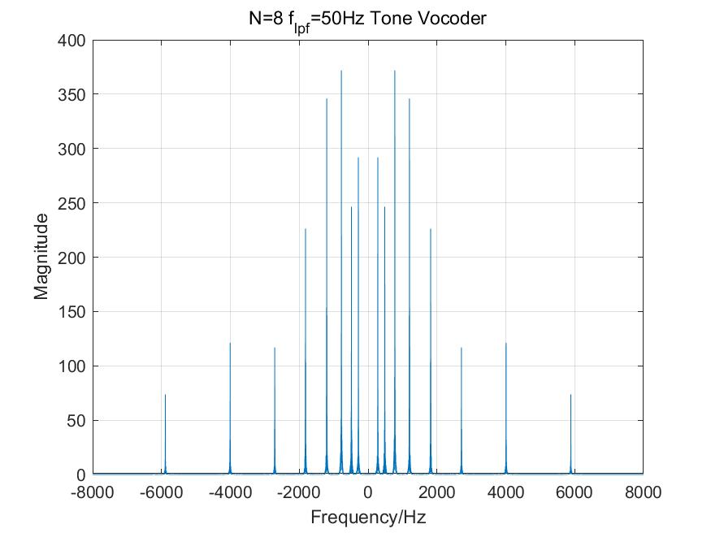
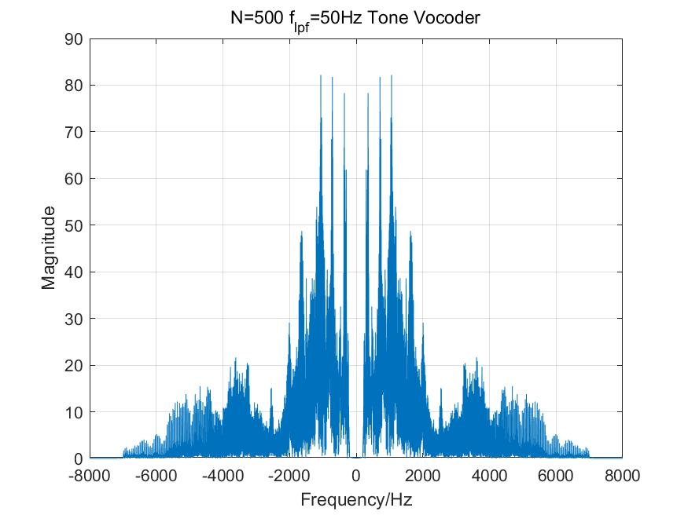
Task1 compare effects of different Bands on tone-vocoder
Output
C_01_02.wav
4
Notes:
4

Slide 5
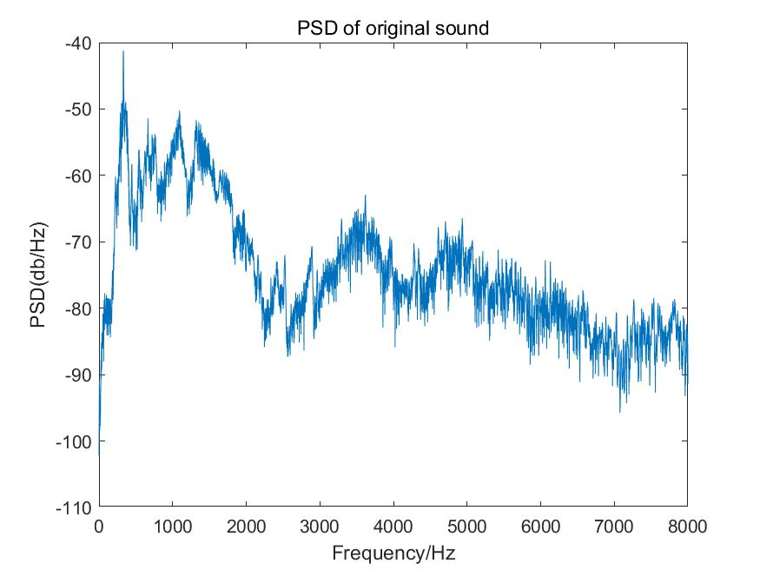
Task1 compare effects of different Bands on tone-vocoder
Output
C_01_01.wav
5
Notes:
5

Slide 6
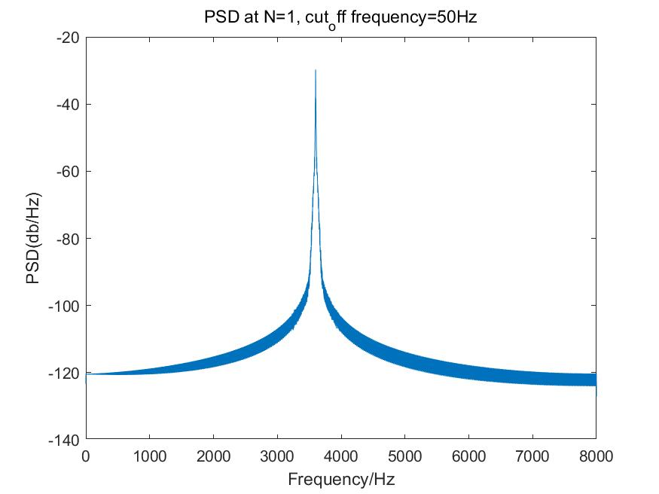
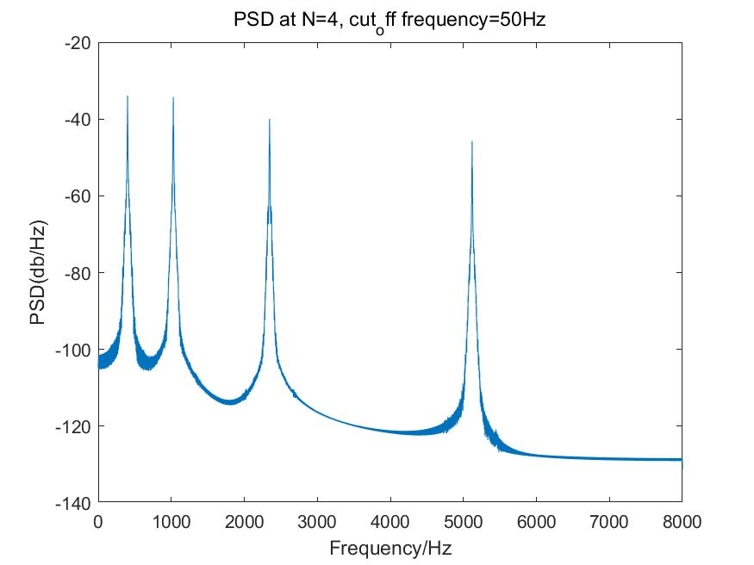
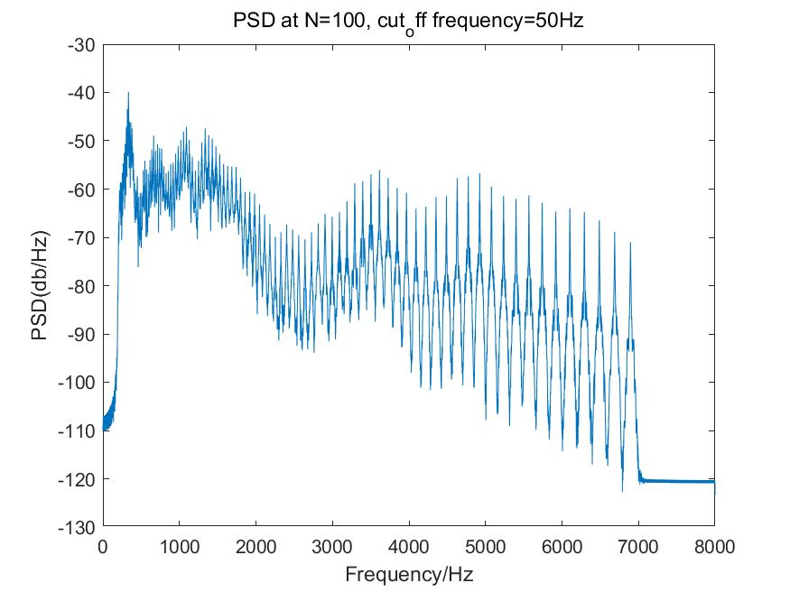
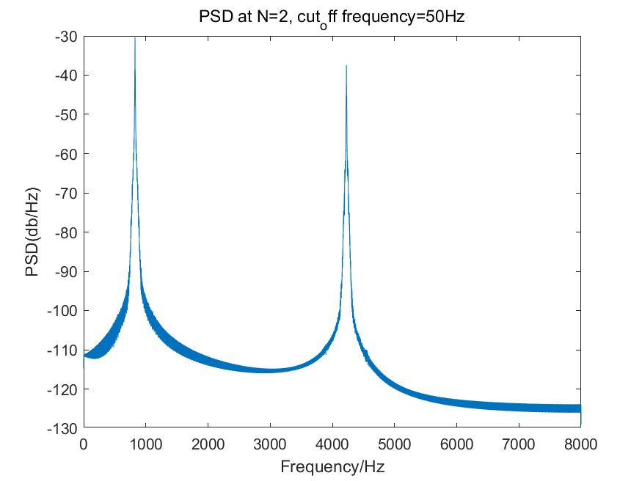
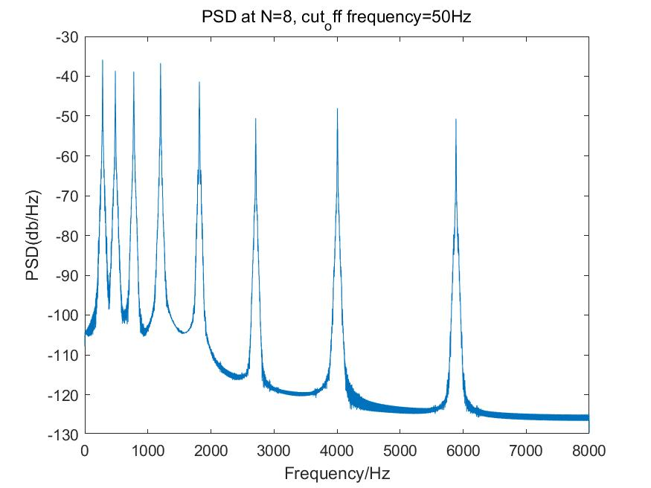
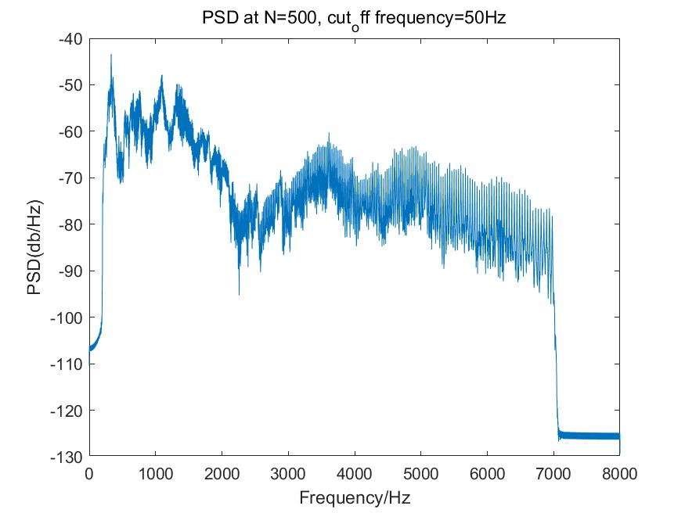
Task1 compare effects of different Bands on tone-vocoder
Output
C_01_01.wav
6
Notes:
6

