Slide 1
Notes
Assignment
2.10
2.11
2.22 (b) (e)
2.25
2.28 (a) (c) (e) (g)
Tutorial questions this week (Week 4)
Basic Problems with Answers 2.20
Basic Problems 2.29
Advanced Problems 2.40, 2.43, 2.47

Slide 2
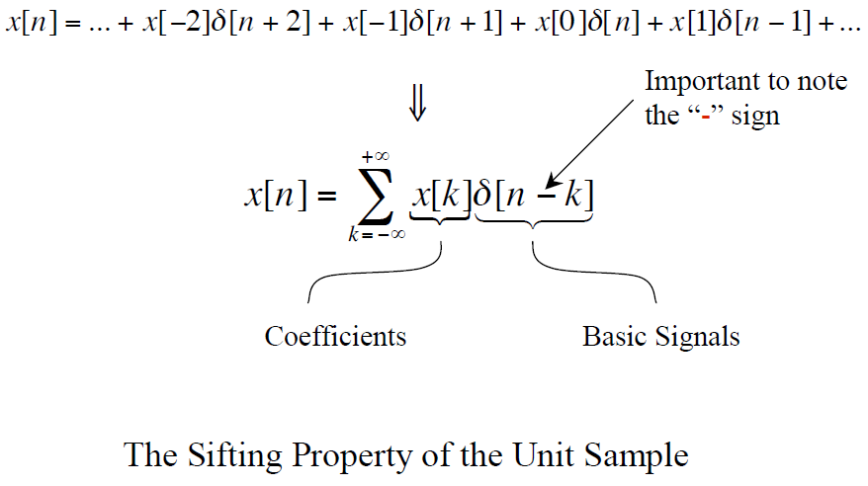
That is ...
Chapter 2 Review

Slide 3
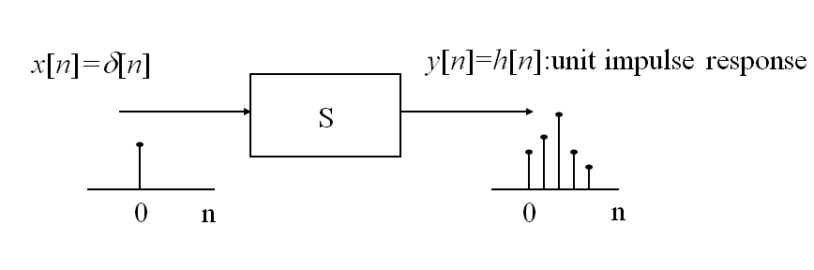
Unit Impulse Response
Chapter 2 Review

Slide 4
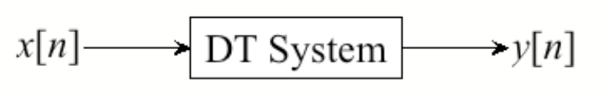
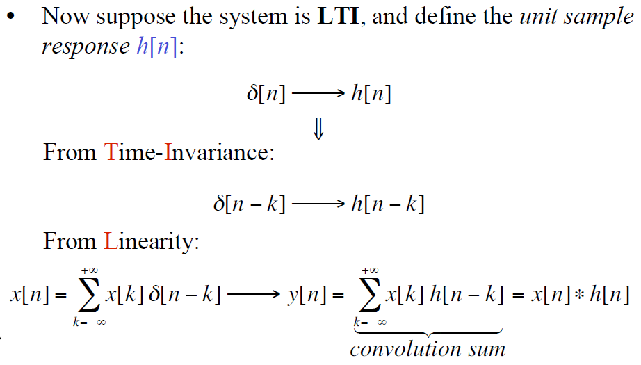
Response of DT LTI Systems
Chapter 2 Review
impulse

Slide 5
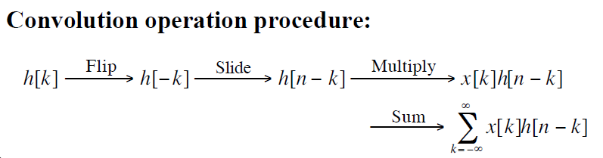
Chapter 2 Review
input signal
Contribution to the output signal at time n
flipped version of h[k] located at k = n
F S M S

Slide 6
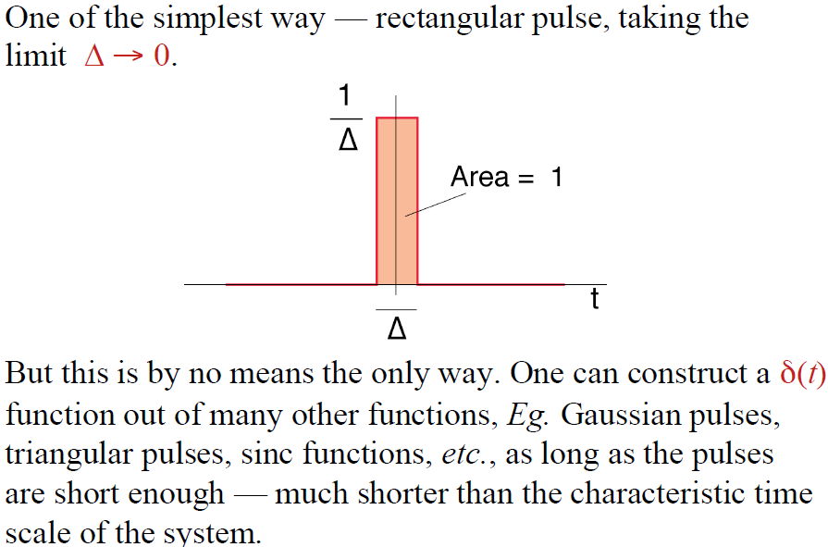
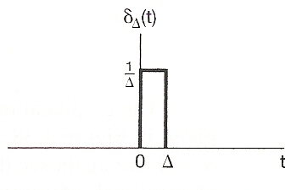

Construction of the Unit-impulse function δ(t)
Chapter 1 Review
Area=1
$$δ\left(t\right)=\lim_{Δ→0}{δ_{Δ}(t)}$$

Slide 7
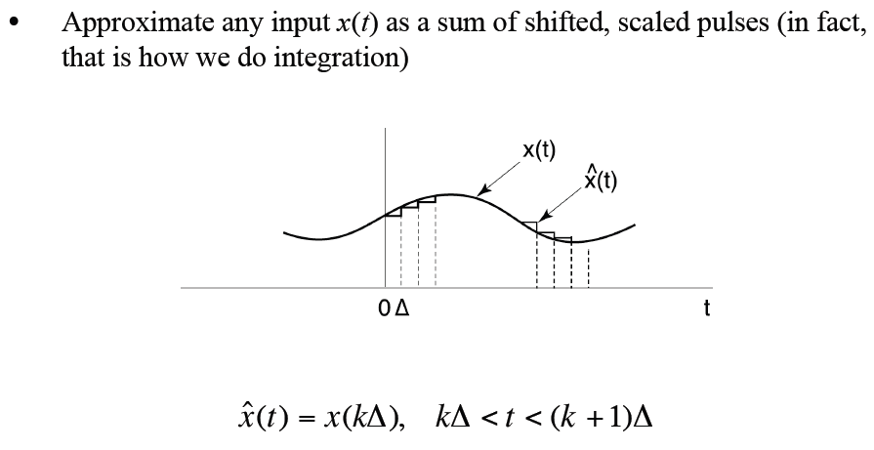

Representation of CT Signals
$$x\left(t\right)=\lim_{Δ→0}{\hat{x}(t)}$$

Slide 8
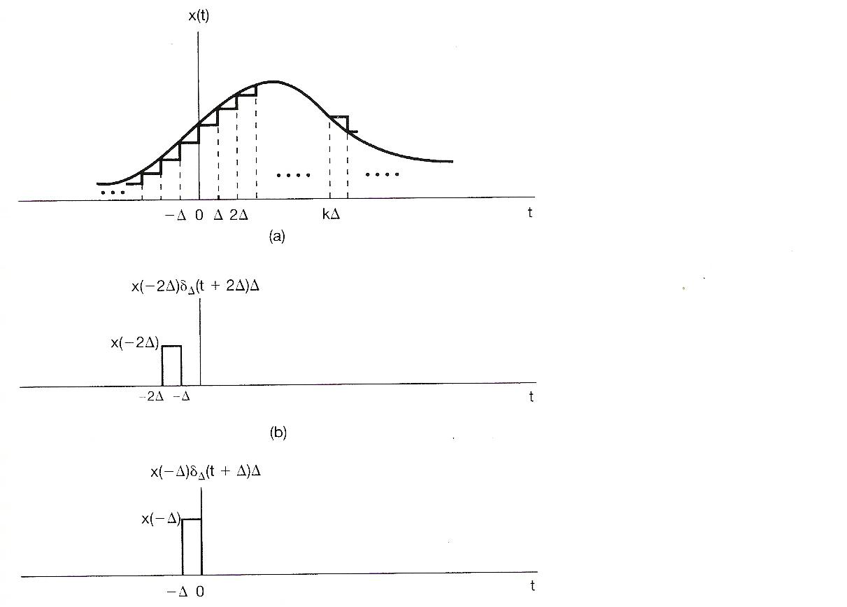


$$x\left(−2Δ\right)δ_{Δ}\left(t+2Δ\right)Δ$$
$$x\left(−Δ\right)δ_{Δ}\left(t+Δ\right)Δ$$

Slide 9
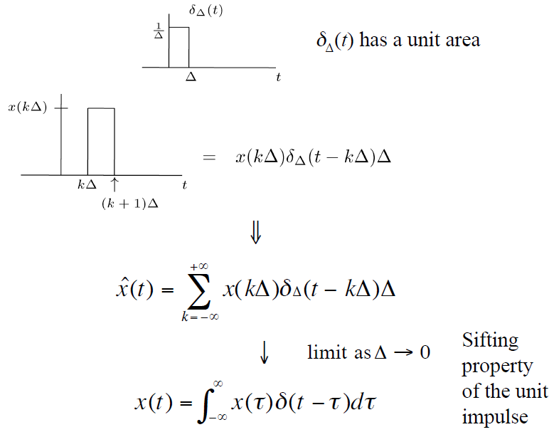

Representation of CT Signals (cont.)
$$x\left(kΔ\right)δ_{Δ}\left(t−kΔ\right)Δ$$
?

Slide 10
How to calculate the output of CT LTI systems?
Input: $x\left[n\right]=\sum_{k=−∞}^{+∞}{x\left[k\right]δ[n−k]}$ ➔ $x\left(t\right)=\int_{−∞}^{+∞}{x\left(τ\right)δ\left(t−τ\right)dτ}$
LTI: $δ\left[n\right]→h[n]$ ➔
Output: $y\left[n\right]=\sum_{k=−∞}^{+∞}{x\left[k\right]h[n−k]}$ ➔

Slide 11
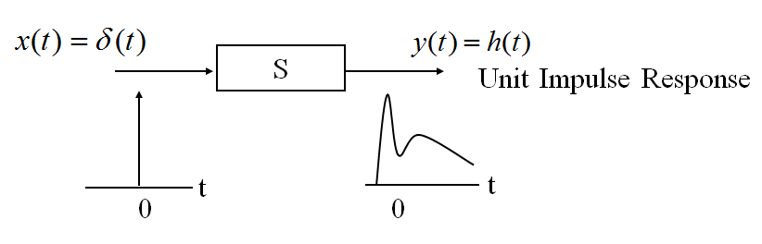
Unit Impulse Response

Slide 12
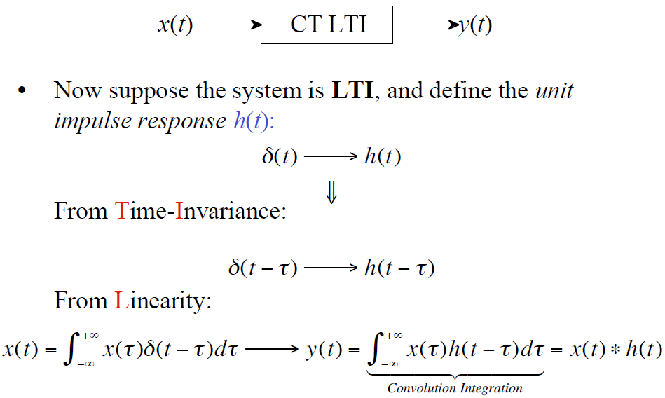
Response of a CT LTI System

Slide 13
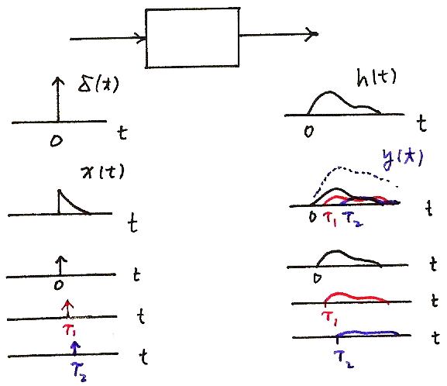
Response of a CT LTI System
x(t)
y(t)
CT LTI

Slide 14
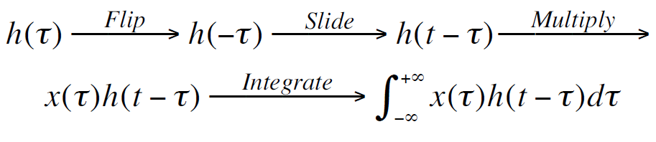
Summary
Input: $x\left[n\right]=\sum_{k=−∞}^{+∞}{x\left[k\right]δ[n−k]}$ ➔ $x\left(t\right)=\int_{−∞}^{+∞}{x\left(τ\right)δ\left(t−τ\right)dτ}$
LTI: $δ\left[n\right]→h[n]$ ➔ $δ\left(t\right)→h(t)$
Output: $y\left[n\right]=\sum_{k=−∞}^{+∞}{x\left[k\right]h[n−k]}$ ➔ $y\left(t\right)=\int_{−∞}^{+∞}{x\left(τ\right)h\left(t−τ\right)dτ}$
$=x\left[n\right]∗h\left[n\right]$ ➔ $=x\left(t\right)∗h(t)$

Slide 15
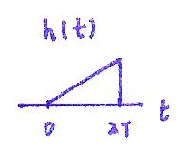
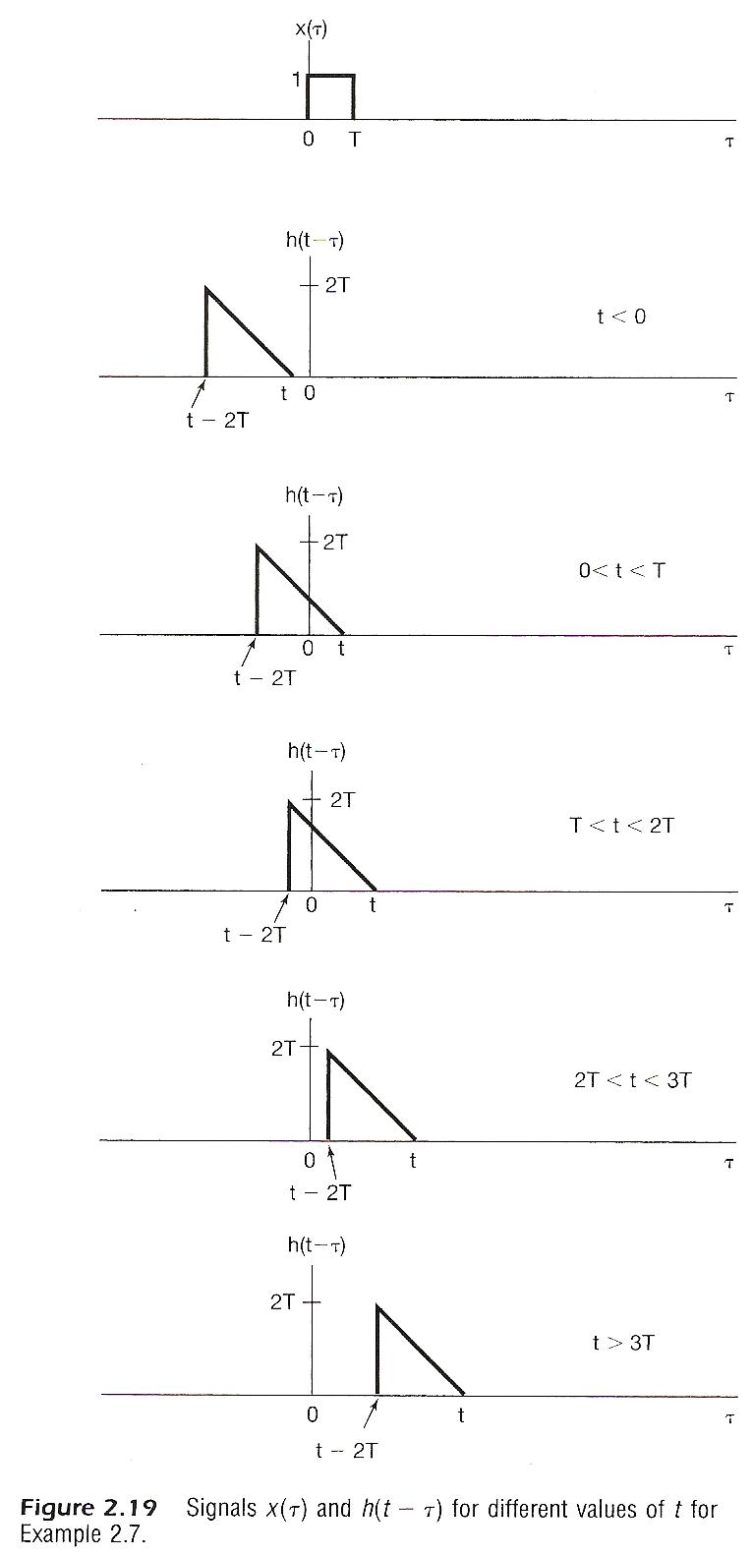

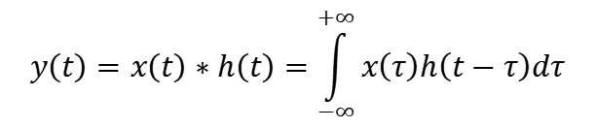



h($τ$)
2T
$$τ$$
2T
$$−2T$$
0
h(- $τ$)
$$y\left(t\right)=x\left(t\right)∗h\left(t\right)=\int_{−∞}^{+∞}{x\left(τ\right)h\left(t−τ\right)dτ}$$

Slide 16
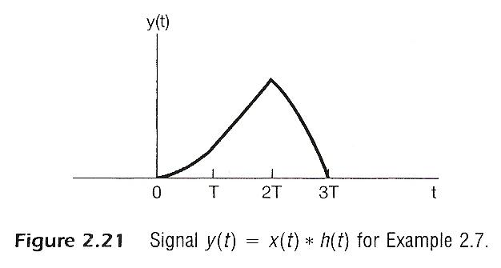
Flip, slide, multiply, and integrate

Slide 17
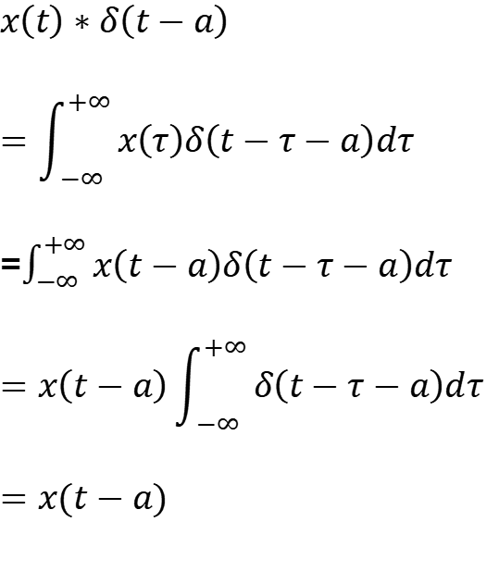
One Important Convolution
$$x\left(t\right)∗δ\left(t−a\right)$$
$$=\int_{−∞}^{+∞}{x\left(τ\right)δ\left(t−τ−a\right)dτ}$$
=$\int_{−∞}^{+∞}{x\left(t−a\right)δ\left(t−τ−a\right)dτ}$
$$=x\left(t−a\right)\int_{−∞}^{+∞}{δ\left(t−τ−a\right)dτ}$$
$$=x(t−a)$$
Similarly, $x\left[n\right]∗δ\left[n−k\right]=x[n−k]$

Slide 18
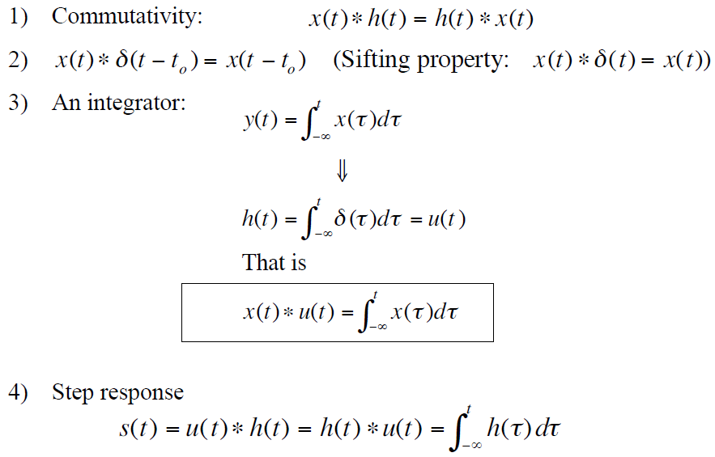
Property: Commutative
The role of input signal and unit impulse response is interchangeable, giving the same output signal
x(t)
h(t)
h(t)
x(t)

Slide 19
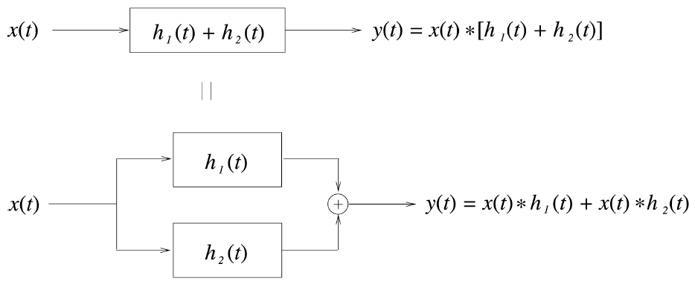
Property: Distributive

Slide 20
Property: Distributive (Cont.)
Problem 2.22 (b)
x(t)
0
2
5

Slide 21
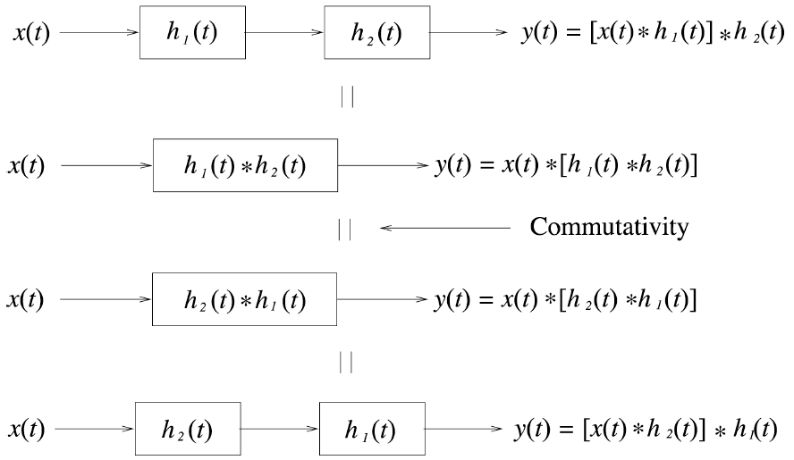
Properties: Associative

Slide 22
Properties: Associative (Cont.)
The order in which non-linear systems are cascaded cannot be changed.
e.g.
y=2x
y=x²
y=x²
y=2x

Slide 23
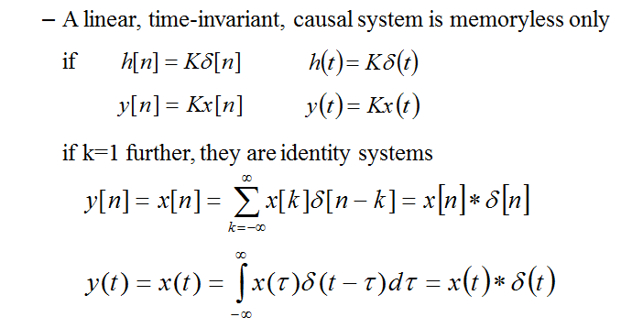
Property: Memory/Memoryless

Slide 24
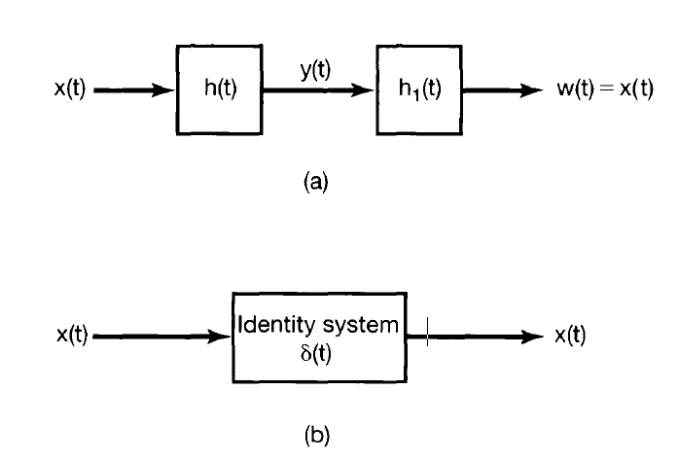
Property: Invertibility

Slide 25
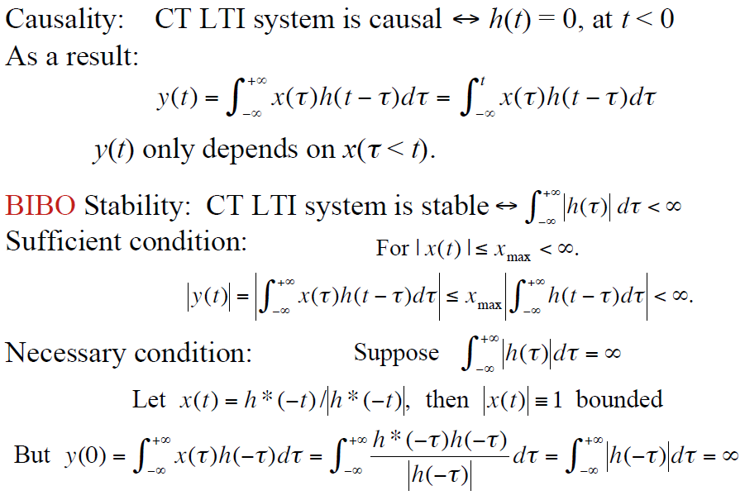
Property: Causality
This is because that the input unit impulse function δ(t)=0 at t<0
t – τ ≥ 0, or τ ≤ t

Slide 26
Property: Stability

Slide 27
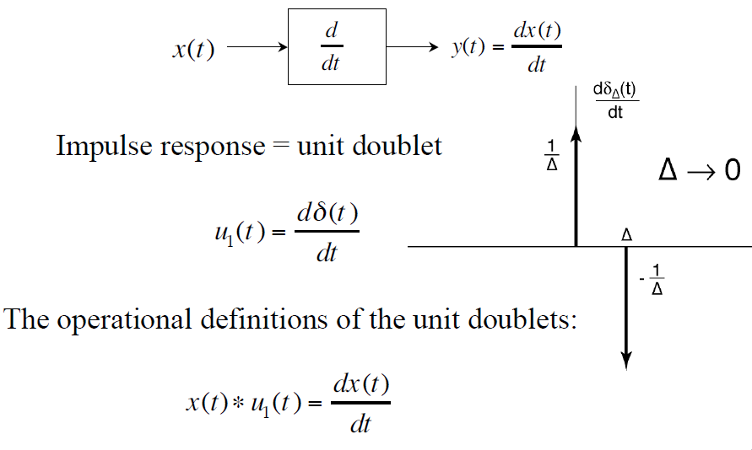
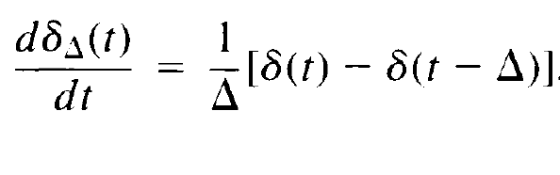
Differentiator

Slide 28
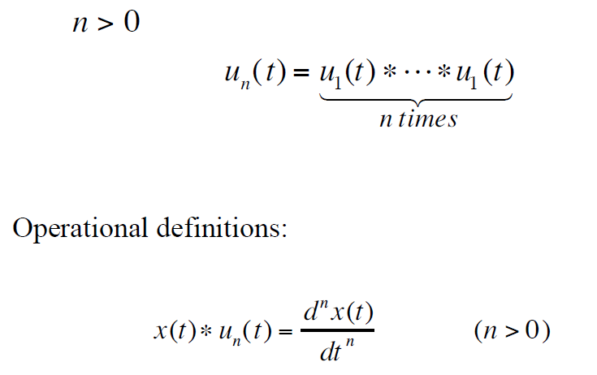
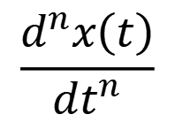


Triplets and beyond!
$$\frac{d^{n}x\left(t\right)}{dt^{n}}$$
$$x(t)$$
$$\frac{d}{dt}$$
$$\frac{d}{dt}$$
…
$$\frac{d}{dt}$$

Slide 29
Unit Step Response
unit step function → unit step response
x(t)=δ(t)
h(t)
h(t): unit impulse response
x(t)=u(t)
h(t)
s(t): unit step response
The relation between unit step function and unit impulse function

Slide 30
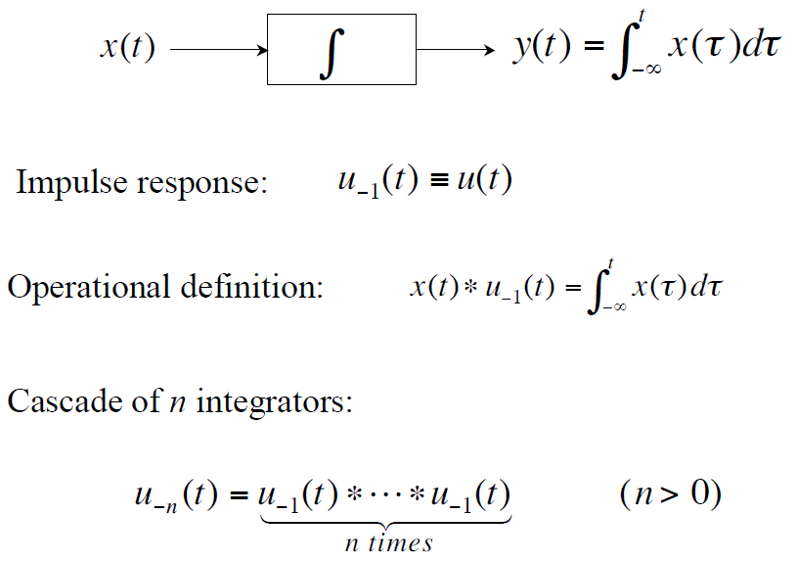
Integrators

Slide 31
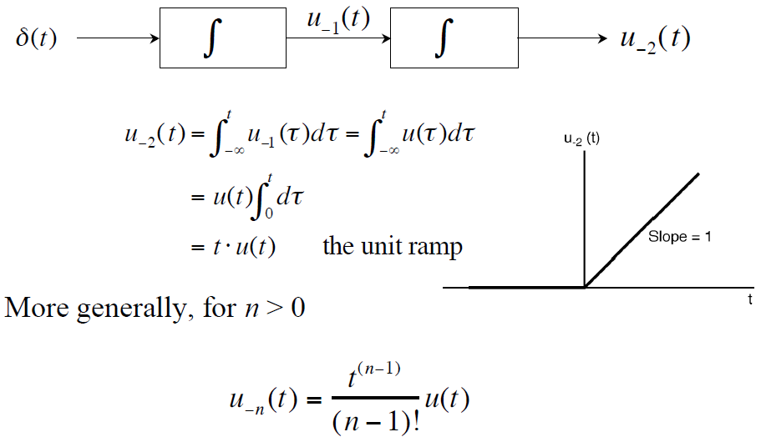
Integrators (Cont.)

Slide 32
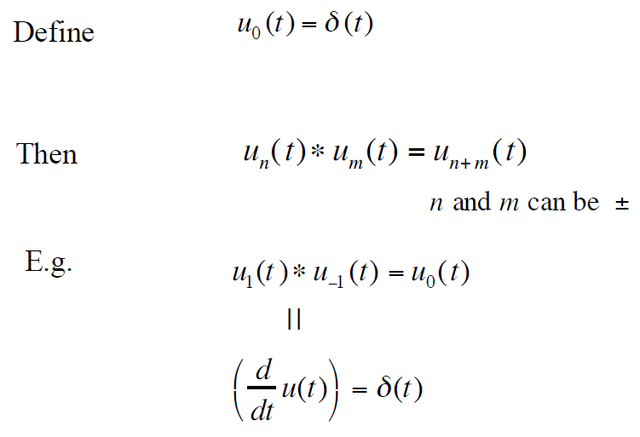
Notation

Slide 33






Block diagram representation - CT
$$x_{2}(t)$$
$$x_{1}(t)$$
+
$$x_{1}\left(t\right)+x_{2}(t)$$
$$x_{1}(t)$$
$$a$$
$${ax}_{1}(t)$$
$$\frac{dx_{1}\left(t\right)}{dt}$$
$$x_{1}(t)$$
d/dt
Problem 2.39

Slide 34





Block diagram representation - DT
$$x_{2}[n]$$
$$x_{1}[n]$$
+
$$x_{1}[n]+x_{2}[n]$$
$$x_{1}[n]$$
$$a$$
$${ax}_{1}[n]$$
Problem 2.38
$$x_{1}[n]$$
$$x_{1}\left[n−1\right]$$
D

Slide 35
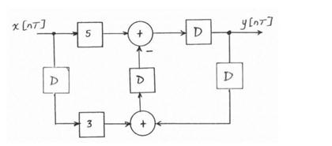
From block diagram to difference equation
x[n]
y[n]

