Slide 1
Notes
Assignments
3.3
3.21
3.22 (a) -> Figs. (b) (d) (f)
3.24
3.25
Tutorial problems
Basic Problems wish Answers 3.8
Basic Problems 3.34
Advanced Problems 3.40

Slide 2






Block diagram representation - CT
$$x_{2}(t)$$
$$x_{1}(t)$$
+
$$x_{1}\left(t\right)+x_{2}(t)$$
$$x_{1}(t)$$
$$a$$
$${ax}_{1}(t)$$
$$\frac{dx_{1}\left(t\right)}{dt}$$
$$x_{1}(t)$$
d/dt
Problem 2.39

Slide 3





Block diagram representation - DT
$$x_{2}[n]$$
$$x_{1}[n]$$
+
$$x_{1}[n]+x_{2}[n]$$
$$x_{1}[n]$$
$$a$$
$${ax}_{1}[n]$$
Problem 2.38
$$x_{1}[n]$$
$$x_{1}\left[n−1\right]$$
D

Slide 4
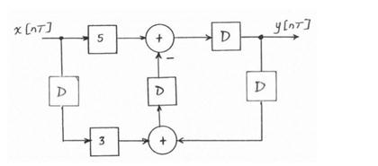
From block diagram to difference equation
x[n]
y[n]

Slide 5
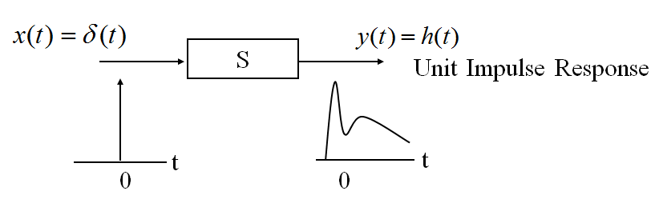
Review for Chapter 2
Why to introduce unit impulse response?
Why to introduce convolution?
(DT or CT) Signal can be represented by a linear combination of unit impulse function
When it goes through the system, the output is computed via convolution of input signal and unit impulse response

Slide 6
Chapter 3 Fourier Series Representation of Periodic Signals

Slide 7
Fourier Series – A Time-Frequency Analysis Perspective

Slide 8
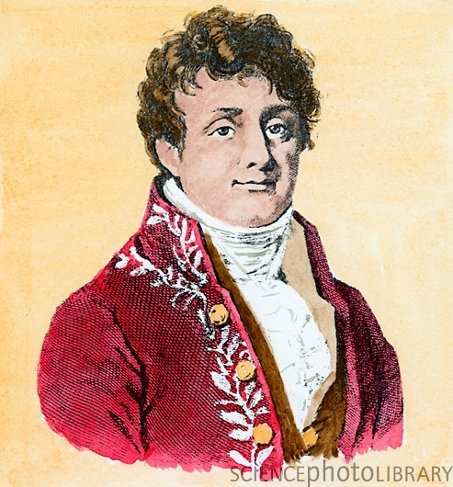
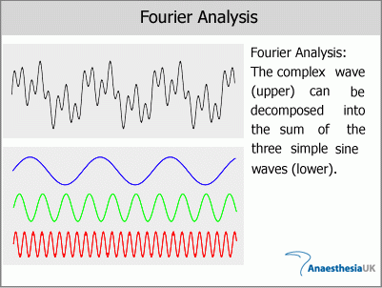
Joseph Fourier

Slide 9
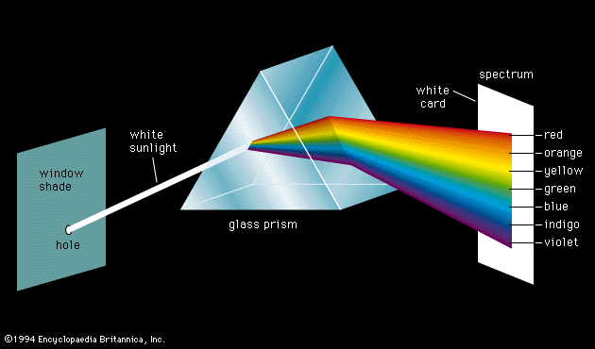
A Useful Analogy

Slide 10


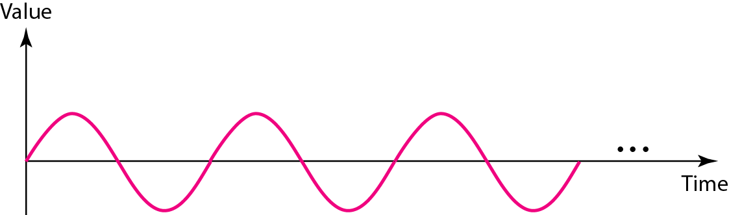
Note
Frequency and period are the inverse of each other.
T

Slide 11
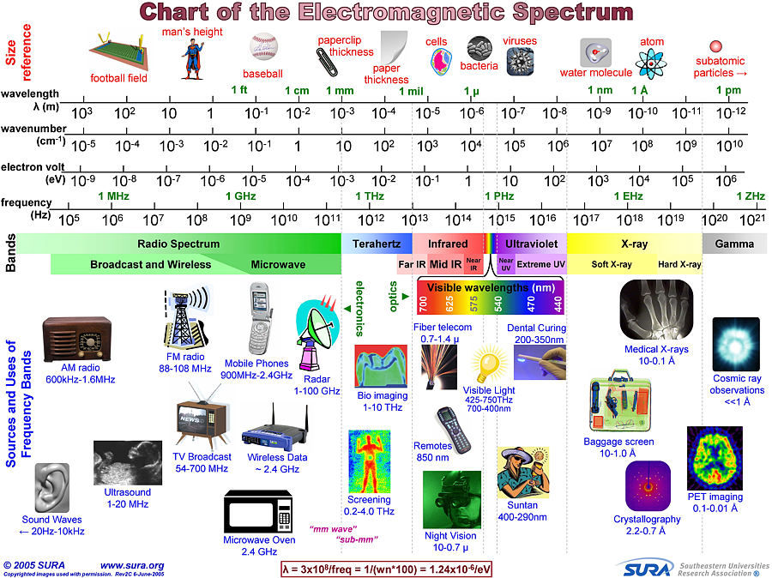
Example

Slide 12
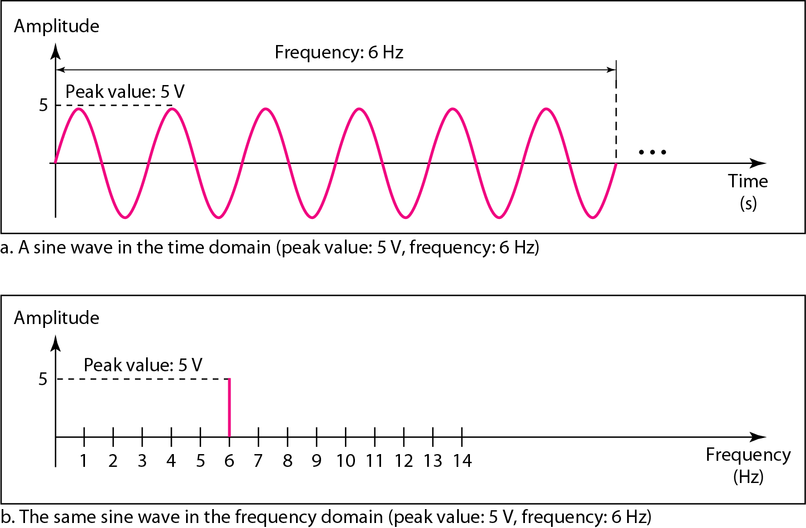
A complete sine wave in the time domain can be represented by one single spike in the frequency domain.

Slide 13
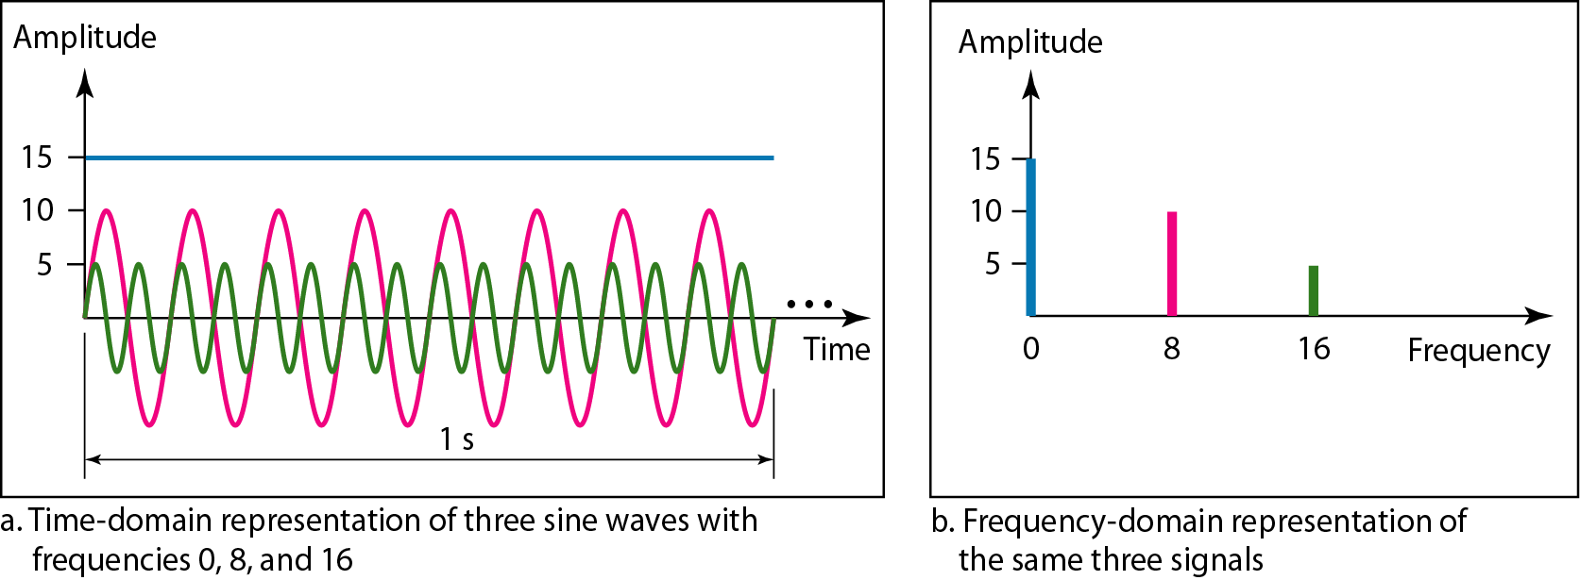
Example
The frequency domain is more compact and useful when we are dealing with more than one sine wave.
The time domain and frequency domain of three sine waves

Slide 14
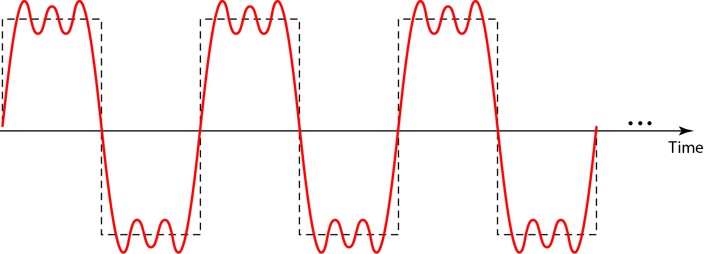
A composite periodic signal

Slide 15
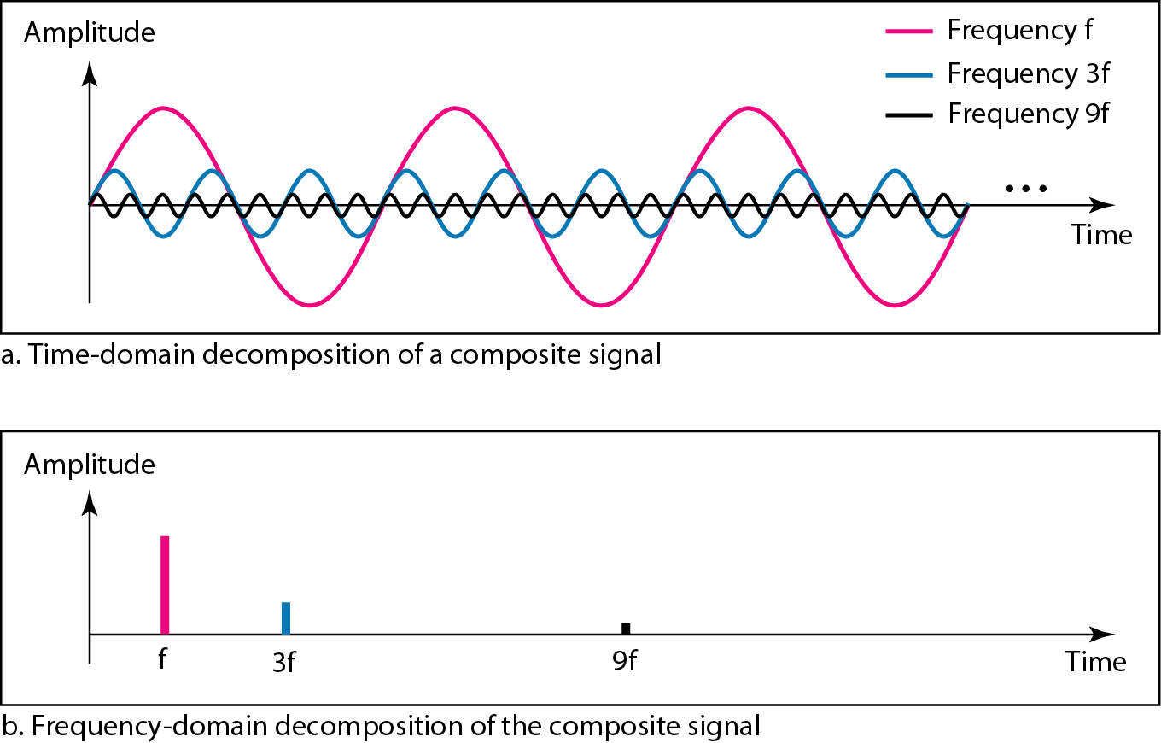
Decomposition of a composite periodic signal in the time and frequency domains

Slide 16
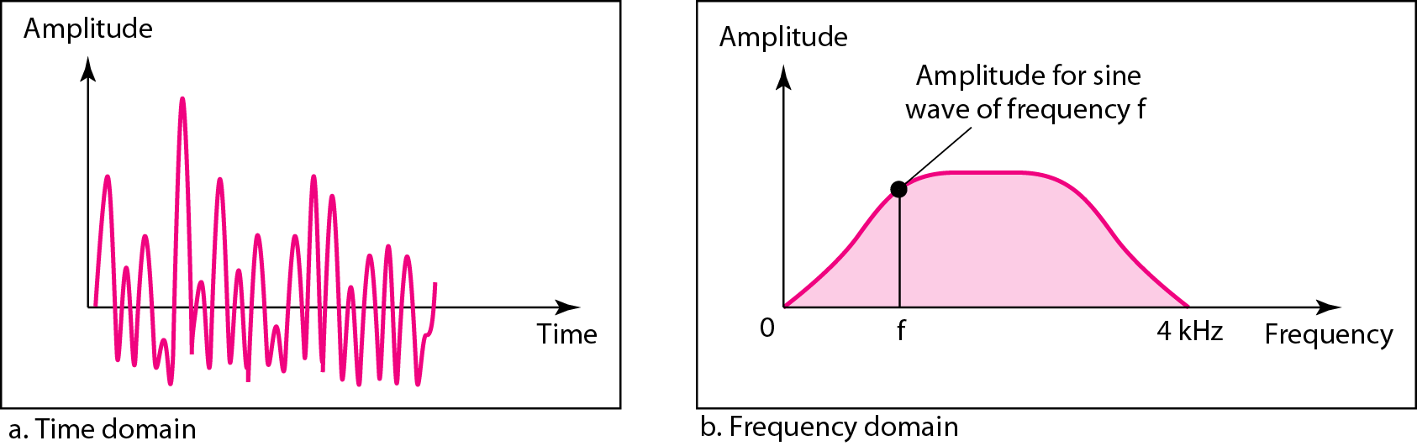
The time and frequency domains of an aperiodic signal
What is the difference between periodic and aperiodic signals?

Slide 17
Composite Signals and Periodicity
If the composite signal is periodic, the decomposition gives a series of signals with discrete frequencies.
If the composite signal is aperiodic, the decomposition gives a combination of sine waves with continuous frequencies.

Slide 18
Fourier Analysis
Fourier analysis is a tool that changes a time domain signal to a frequency domain signal and vice versa.

Slide 19
Overview on Frequency Analysis
Fourier Series
(Periodic/Discrete)
Fourier Transform
(Aperiodic/Continuous)
CT Fourier Series
CT Fourier Transform
DT Fourier Series
DT Fourier Transform
Continuous-Time
Domain
Discrete-Time
Domain

Slide 20
Fourier Series – An LTI System Analysis Perspective

Slide 21
How to represent signals in the study of LTI systems?
In chapter 2, based on unit impulse function and superposition property, we have:
1) The set of basic signals can be used to construct a broad and useful class of signals.
2) The response of an LTI system to each signal should be simple enough in structure, to provide us with a convenient representation for the response of the system to any signal constructed as a linear combination of the basic signals.
Any more basic function?

Slide 22
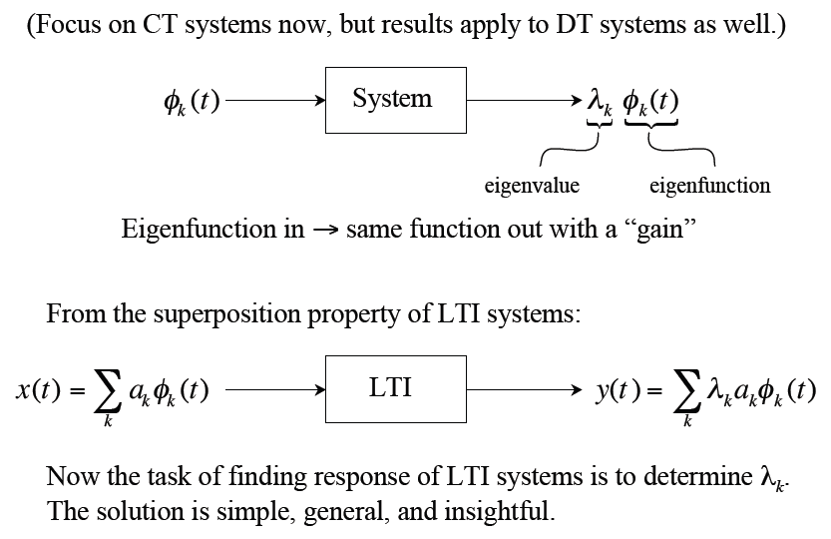
Eigenfunctions φ_{k}(t) and Their Properties

Slide 23
Two Key Questions
What are the eigenfunctions of a general LTI system?
What kinds of signals can be expressed as superpositions of these eigenfunctions?

Slide 24
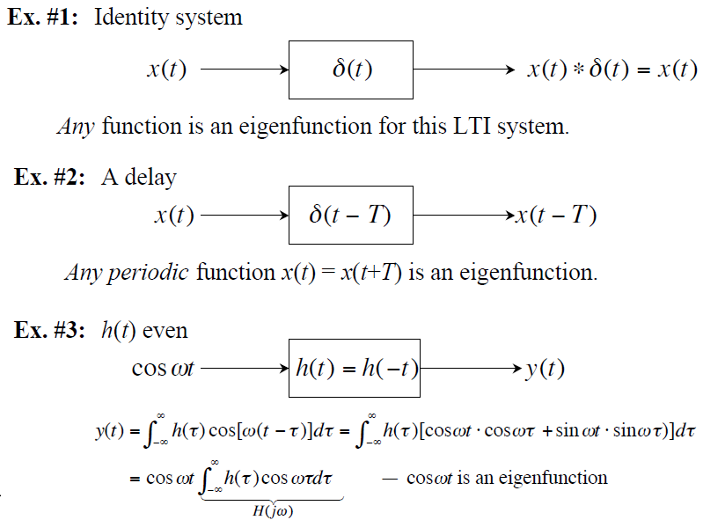
Various Eigenfunctions

Slide 25
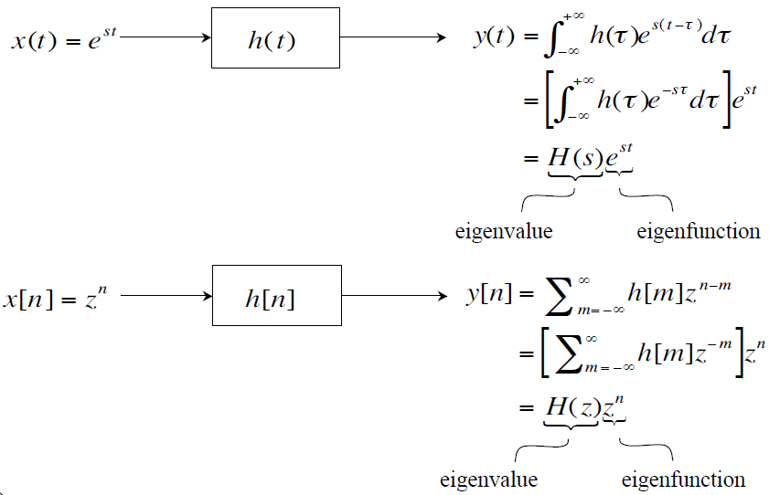
Complex Exponentials - The Only Eigenfunctions of Any LTI Systems

Slide 26
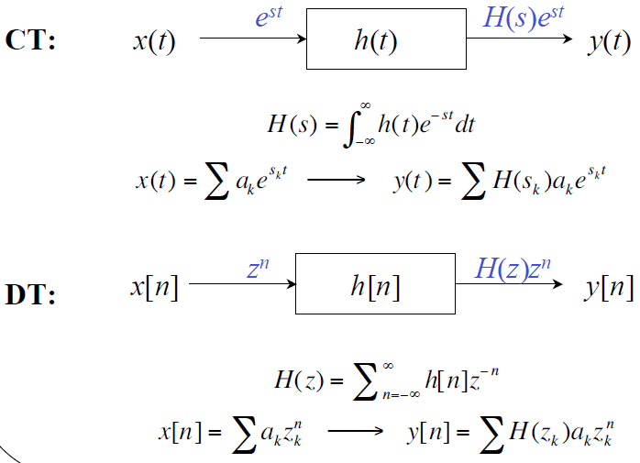
System Functions H(s) or H(z)

Slide 27
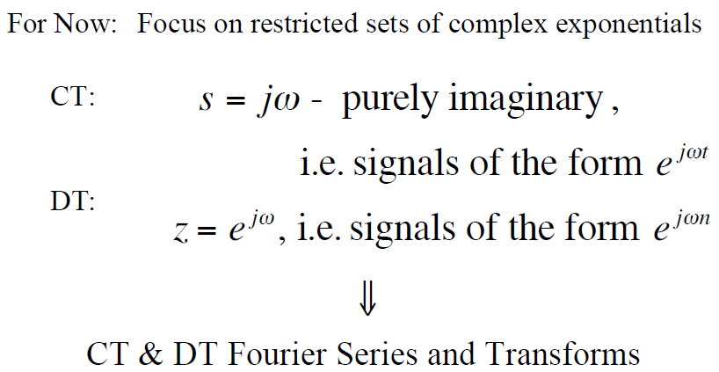
Question 2: What kinds of signals can we represent as “sums” of complex exponentials?
periodic
aperiodic

Slide 28
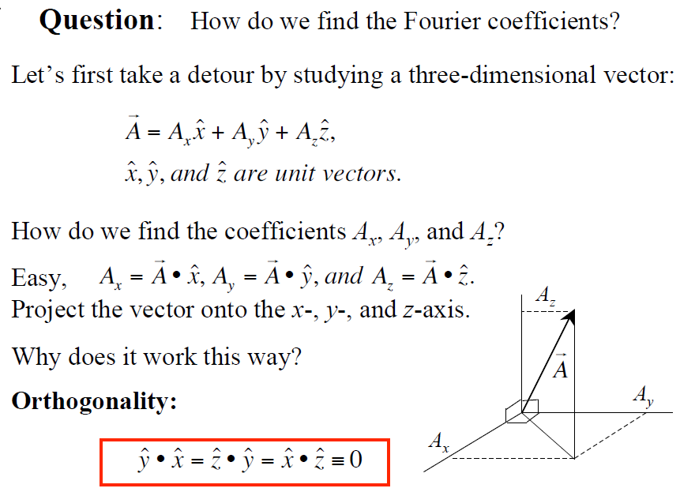

Slide 29
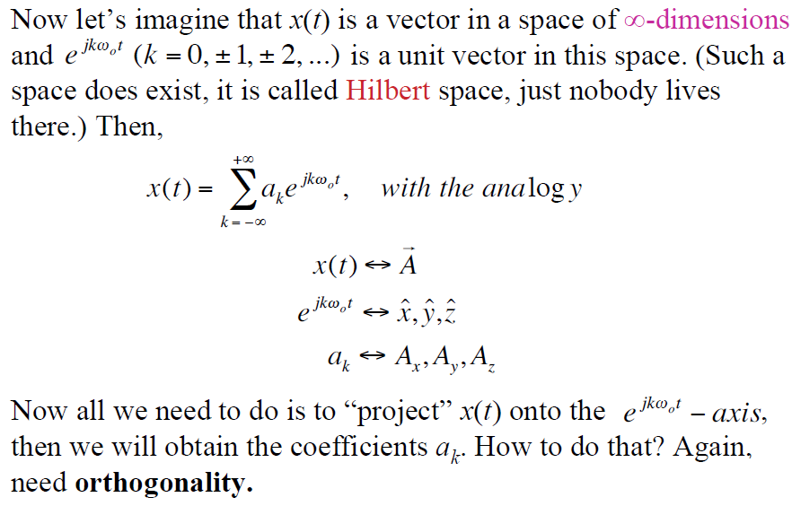
Back to Fourier Series

Slide 30
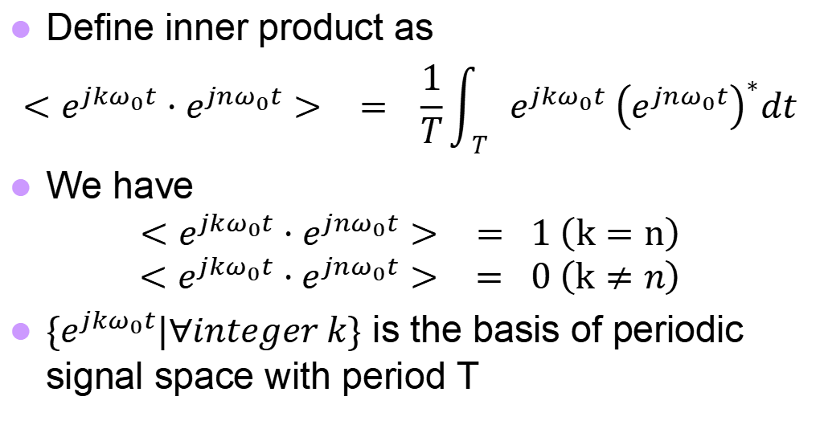
Inner Product of Exponential Signals
Define inner product as
$$<e^{jkω_{0}t}⋅e^{jnω_{0}t}> = \frac{1}{T}\int_{T}{e^{jkω_{0}t} {\left(e^{jnω_{0}t}\right)}^{∗}dt}$$
We have
$$<e^{jkω_{0}t}⋅e^{jnω_{0}t}> = 1 \left(k=n\right)$$
$$<e^{jkω_{0}t}⋅e^{jnω_{0}t}> = 0 \left(k≠n\right)$$
$\{e^{jkω_{0}t}|∀integer k\}$ is the basis of periodic signal space with period T

Slide 31
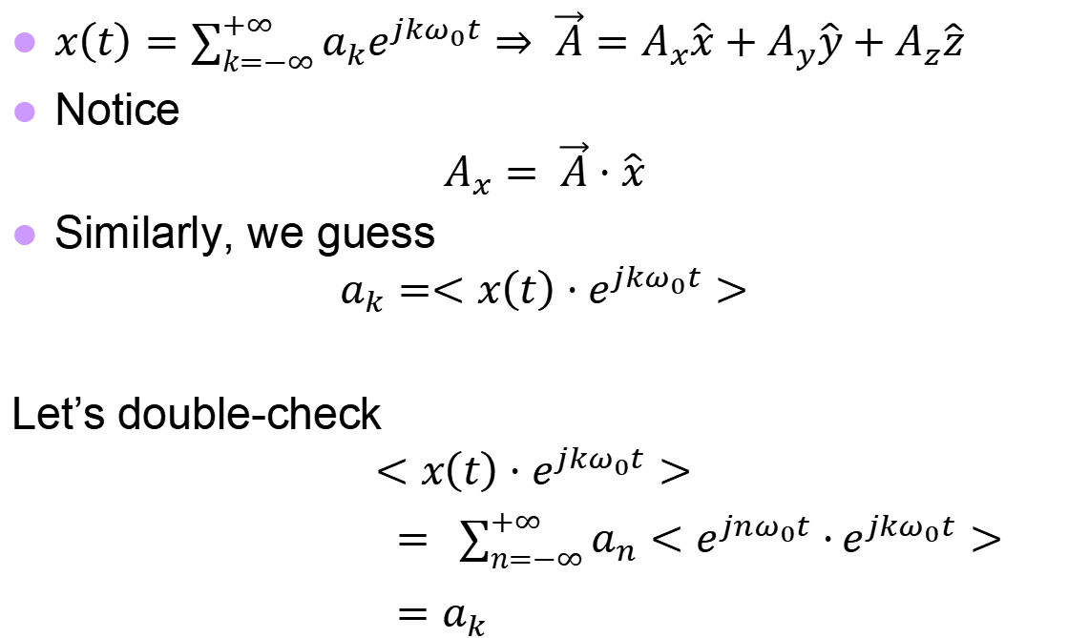
How to Obtain Fourier Coefficients
$x\left(t\right)=\sum_{k=−∞}^{+∞}{a_{k}e^{jkω_{0}t}}⇒ \vec{A}=A_{x}\hat{x}+A_{y}\hat{y}+A_{z}\hat{z}$
Notice
$$A_{x}= \vec{A}⋅\hat{x}$$
Similarly, we guess
$$a_{k}=<x\left(t\right)⋅e^{jkω_{0}t}>$$
Let’s double-check
$$<x\left(t\right)⋅e^{jkω_{0}t}>$$
$= \sum_{n=−∞}^{+∞}{a_{n}<e^{jnω_{0}t}⋅}e^{jkω_{0}t}>$
$=a_{k}$

Slide 32

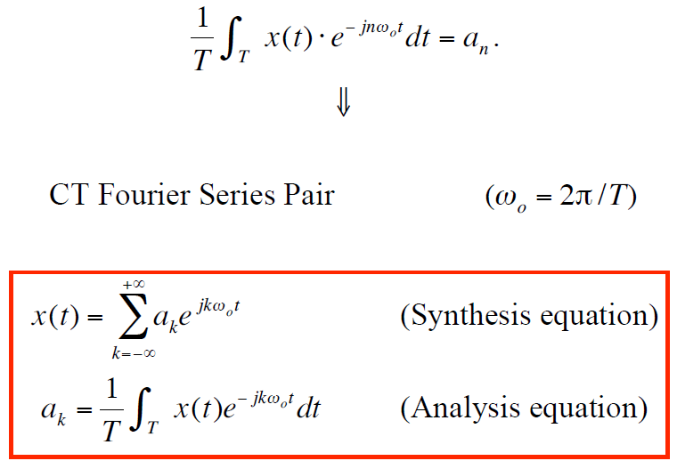
Finally…

Slide 33
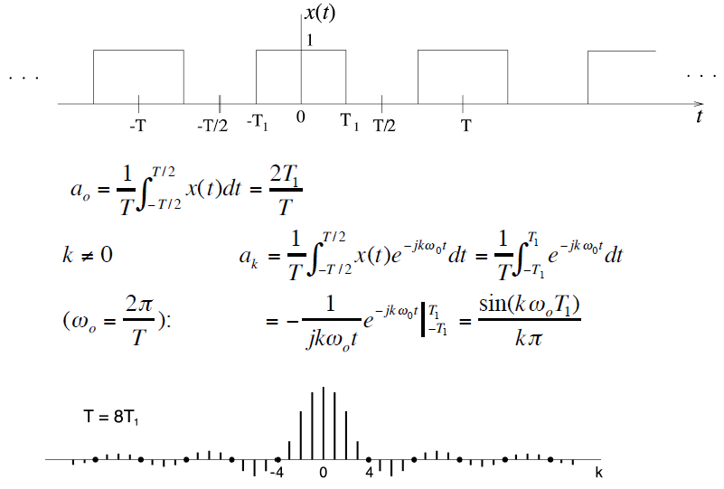
Example 3.5: Periodic Square Wave
T
a_{k}

Slide 34
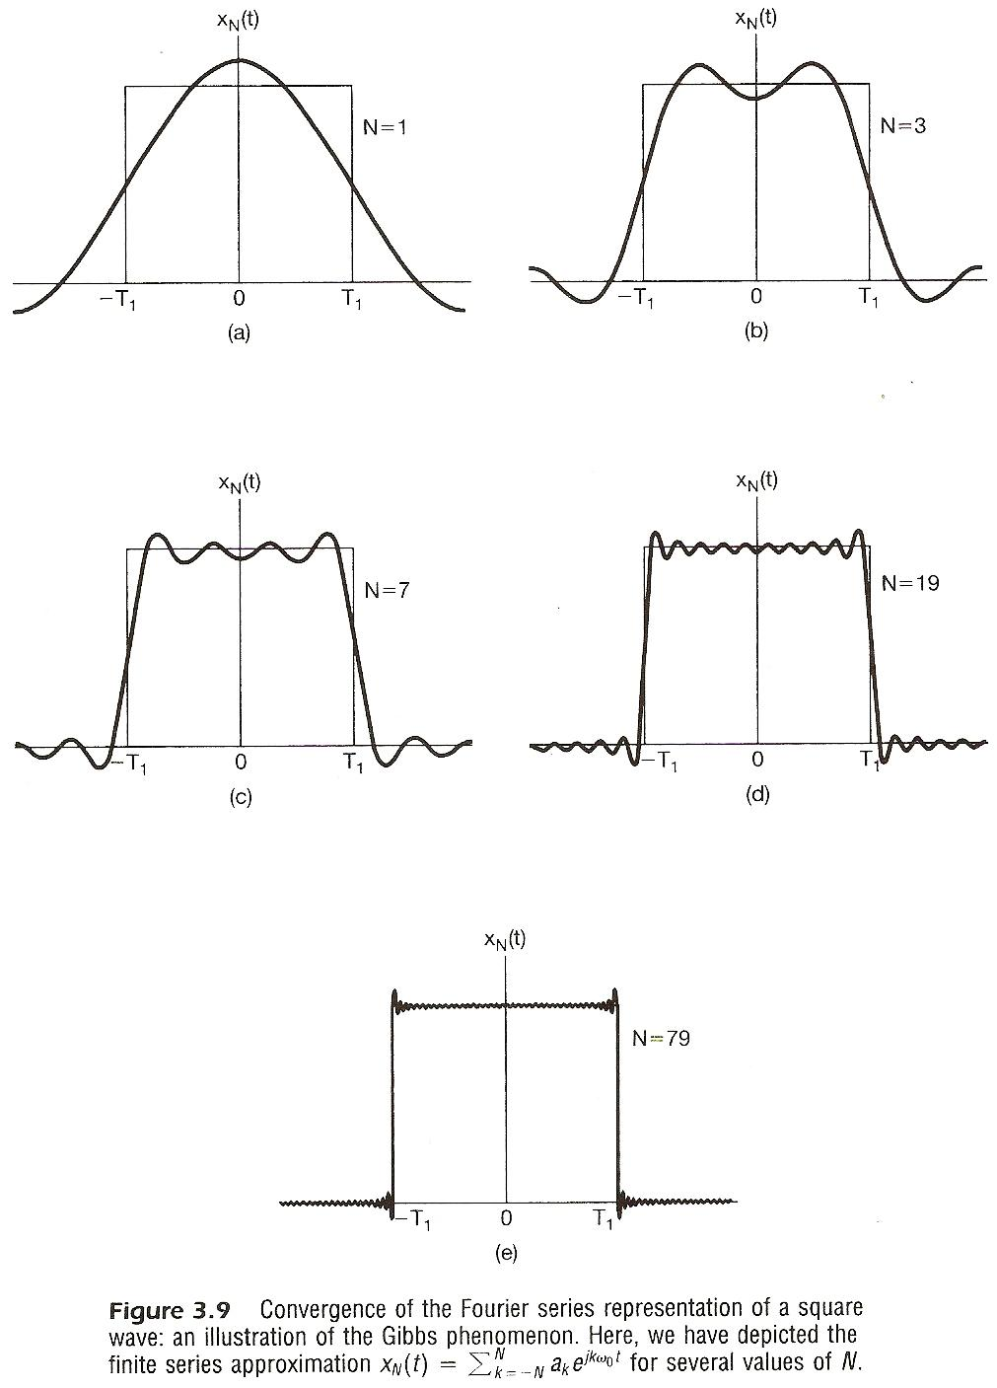
Example: Synthesis
Gibbs Phenomenon: the partial sum in the vicinity of the discontinuity exhibits ripples whose amplitude does not seem to decrease with increasing N
k=-1,0,1
k=-3,-2,-1,0,1,2,3
k=-7,-6, … ,6,7
k=-19,-18, … ,18,19
k=-79,-78, … ,78,79

Slide 35
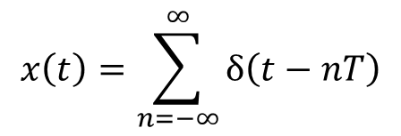
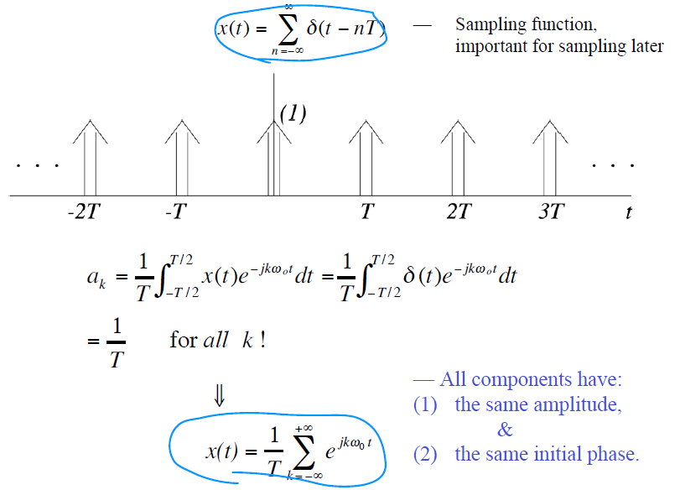
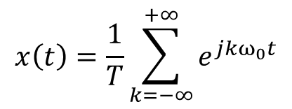
Periodic Impulse Train
0

Slide 36
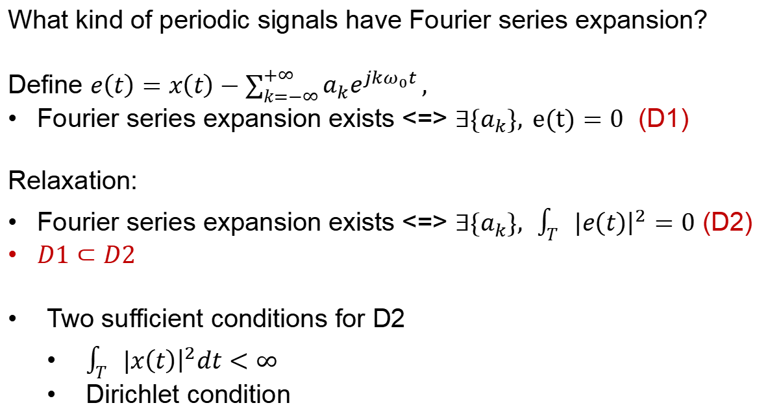
Convergence of CT Fourier Series
What kind of periodic signals have Fourier series expansion?
Define $e\left(t\right)=x\left(t\right)−\sum_{k=−∞}^{+∞}{a_{k}e^{jkω_{0}t}},$
Fourier series expansion exists <=> $∃{\{a}_{k}\}, e(t)=0$ (D1)
Relaxation:
Fourier series expansion exists <=> $∃{\{a}_{k}\}, \int_{T}{|{\left.​e\left(t\right)\right|}^{2}=0}$ (D2)
$D1⊂D2$
Two sufficient conditions for D2
$\int_{T}{|{\left.​x\left(t\right)\right|}^{2}dt<∞}$
Dirichlet condition

Slide 37
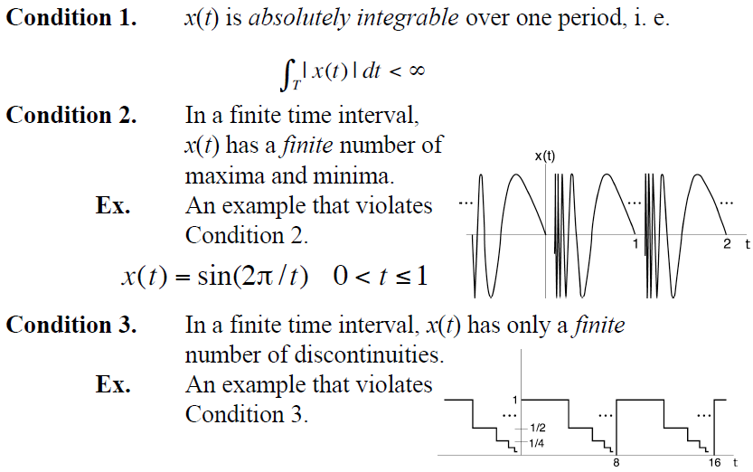
Dirichlet Conditions

Slide 38
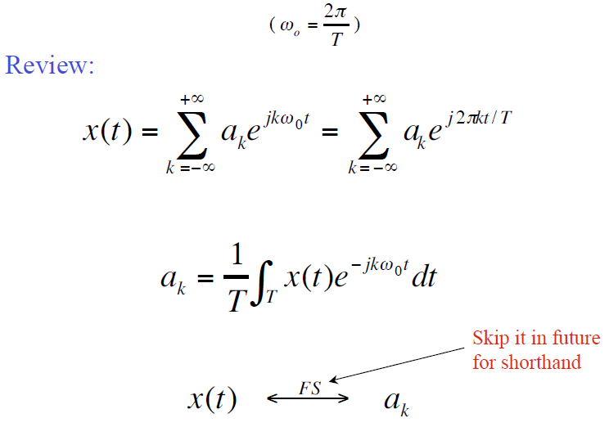
CT Fourier Series Pairs

Slide 39
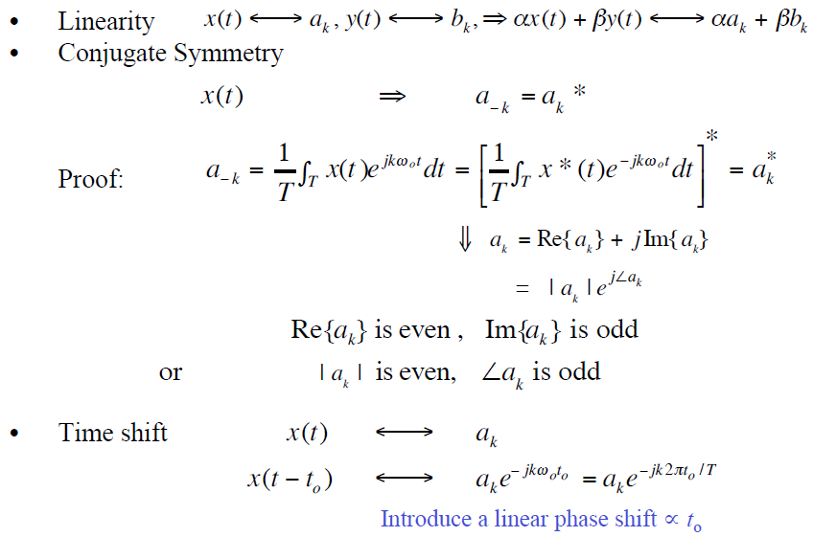
(A Few ) Properties of CT Fourier Series
real

Slide 40
Time Reversal
the effect of sign change for x(t) and a_{k} are identical
Example: x(t): … a₋₂ a₋₁ a₀ a₁ a₂ …
x(-t): … a₂ a₁ a₀ a₋₁ a₋₂ …
Time Scaling
positive real number
periodic with period T/α and fundamental frequency αw₀
a_{k} unchanged, but x(αt) and each harmonic component are different

Slide 41
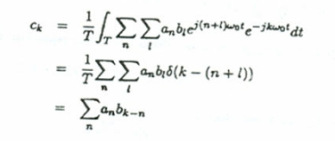
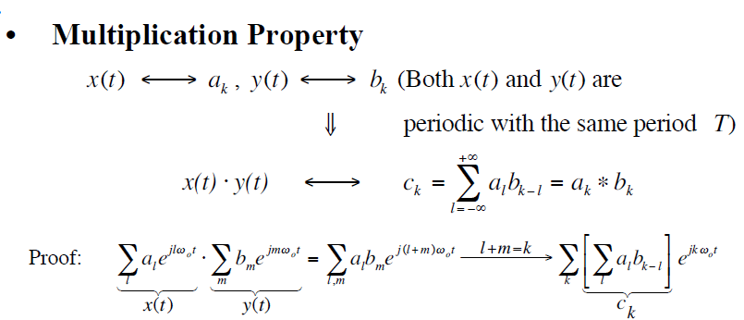

Slide 42
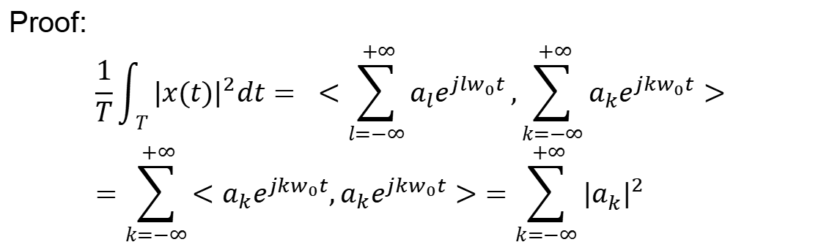

Parseval Relation
$$\underset{Average Signal Power}{\underbrace{\frac{1}{T}\int_{T}^{ }{{|x(t)|}^{2}dt}}}=\sum_{k=−∞}^{∞}{\underset{\begin{aligned} \\ Power of component e^{jkω_{0}t}\end{aligned}}{\underbrace{{|a_{k}^{ }|}^{2}}}}$$
Observation: power is the same whether measured in the time-domain or the frequency-domain
Proof:
$$\frac{1}{T}\int_{T}^{ }{{|x(t)|}^{2}dt= <\sum_{l=−∞}^{ +∞}{a_{l}e^{jlw_{0}t}},\sum_{k=−∞}^{ +∞}{a_{k}e^{j{kw}_{0}t}}>}=\sum_{k=−∞}^{ +∞}{<a_{k}e^{jkw_{0}t},a_{k}e^{j{kw}_{0}t}>}=\sum_{k=−∞}^{ +∞}{{|a_{k}^{ }|}^{2}}$$

Slide 43
More
Note:
x(t) is periodic with
fundamental frequency ω₀
Frequency shifting
Differentiation
Integration

Slide 44
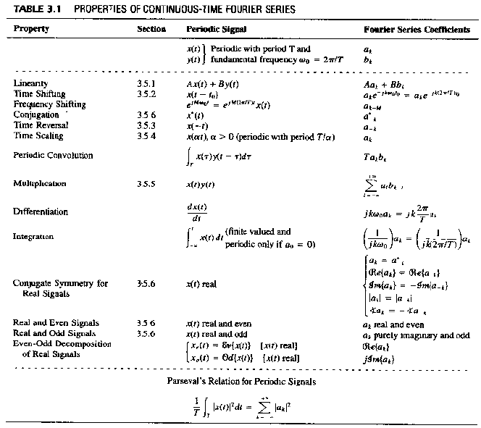

Slide 45
Summary
Difference between periodic and aperiodic signals
Eigenfunction and eigenvalue
Fourier series for periodic signal
Analysis and synthesis equations
Properties
More: Gibbs phenomenon, Dirichlet conditions

Slide 46
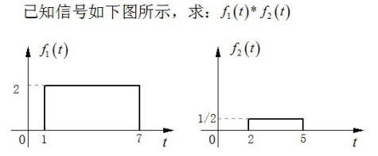
Quiz

Slide 47
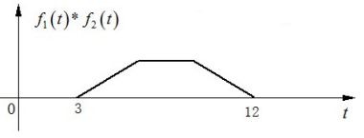
Answer

