Slide 1
PWM(TIM3)

Slide 2
一、PWM

Slide 3
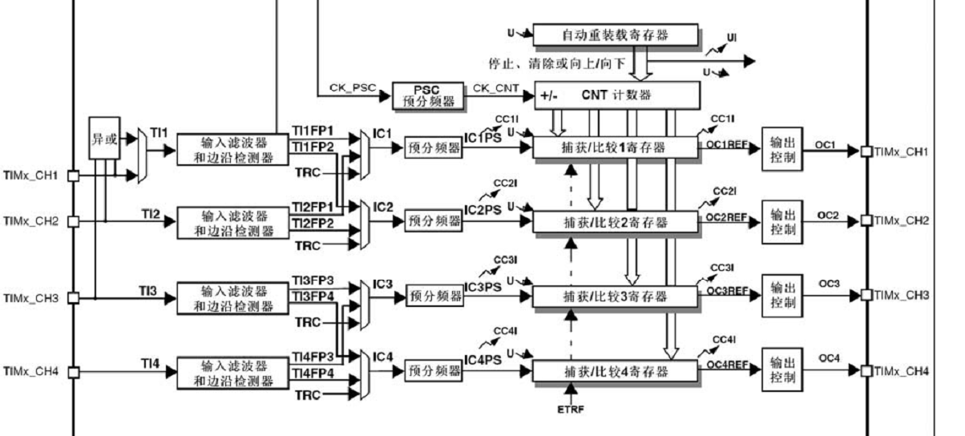

Slide 4
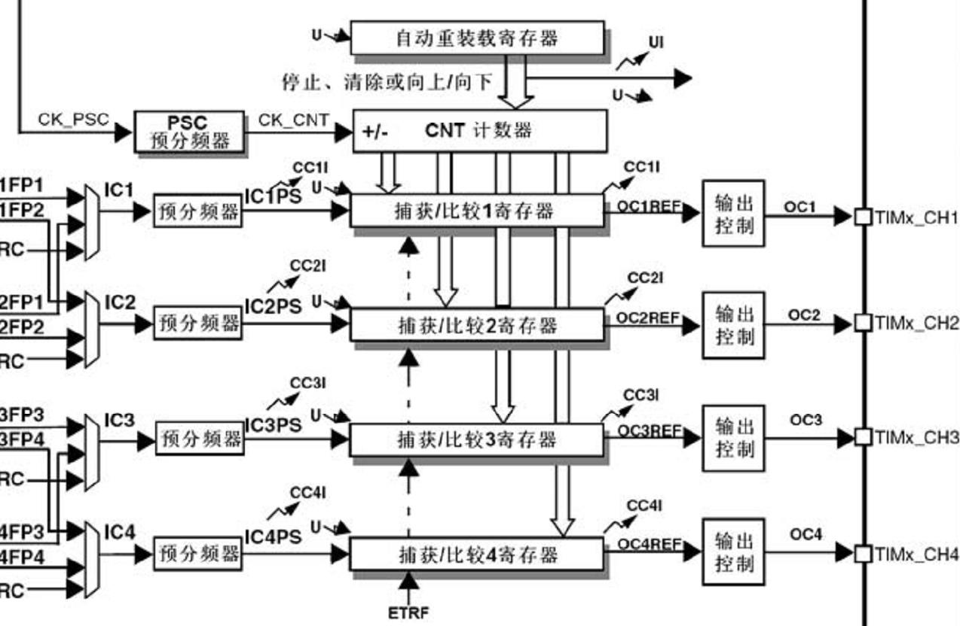

Slide 5
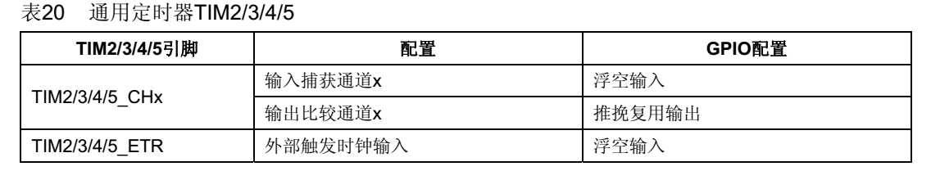
二、引脚与配置模式

Slide 6
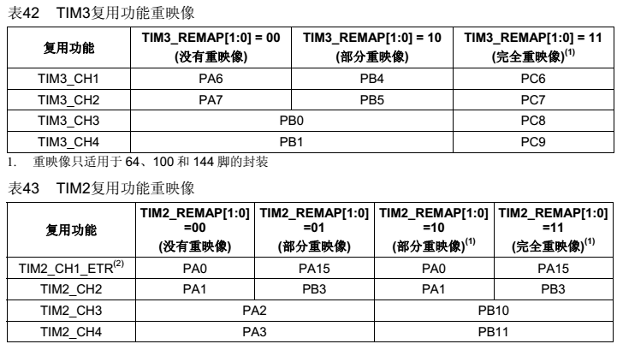

Slide 7
三、基本步骤
（1）使能IO和TIM时钟
RCC_APB1PeriphClockCmd(RCC_APB1Periph_TIM3, ENABLE);
RCC_APB2PeriphClockCmd(RCC_APB2Periph_GPIOA | RCC_APB2Periph_GPIOB, ENABLE);

Slide 8
（2）IO配置
GPIO_InitStructure.GPIO_Pin = GPIO_Pin_6 | GPIO_Pin_7;
GPIO_InitStructure.GPIO_Mode = GPIO_Mode_AF_PP;
GPIO_InitStructure.GPIO_Speed = GPIO_Speed_50MHz;
GPIO_Init(GPIOA, &GPIO_InitStructure);

Slide 9
GPIO_InitStructure.GPIO_Pin = GPIO_Pin_0 | GPIO_Pin_1;
GPIO_Init(GPIOB, &GPIO_InitStructure);

Slide 10
（3）时基结构体配置
u16 CCR1_Val = 500;
u16 CCR2_Val = 375;
u16 CCR3_Val = 250;
u16 CCR4_Val = 125;
TIM_TimeBaseInitTypeDef TIM_TimeBaseStructure;
TIM_OCInitTypeDef TIM_OCInitStructure;

Slide 11
TIM_TimeBaseStructure.TIM_Period =1000-1; TIM_TimeBaseStructure.TIM_Prescaler = 0; TIM_TimeBaseStructure.TIM_ClockDivision = TIM_CKD_DIV1 ; TIM_TimeBaseStructure.TIM_CounterMode = TIM_CounterMode_Up;
TIM_TimeBaseInit(TIM3, &TIM_TimeBaseStructure);

Slide 12
（4）OC结构体设置
TIM_OCInitStructure.TIM_OCMode = TIM_OCMode_PWM1; TIM_OCInitStructure.TIM_OutputState = TIM_OutputState_Enable;
TIM_OCInitStructure.TIM_Pulse = CCR1_Val; TIM_OCInitStructure.TIM_OCPolarity = TIM_OCPolarity_High;
TIM_OC1Init(TIM3, &TIM_OCInitStructure);
TIM_OC1PreloadConfig(TIM3, TIM_OCPreload_Enable);

Slide 13
TIM_OCInitStructure.TIM_OutputState = TIM_OutputState_Enable;
TIM_OCInitStructure.TIM_Pulse = CCR2_Va
TIM_OC2Init(TIM3, &TIM_OCInitStructure);
TIM_OC2PreloadConfig(TIM3, TIM_OCPreload_Enable);

Slide 14
TIM_ARRPreloadConfig(TIM3, ENABLE);
TIM_Cmd(TIM3, ENABLE);

Slide 15
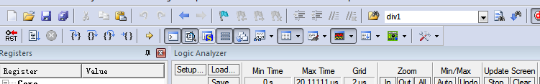
四、仿真设置
输入PORTA.6 回车
同样………………

Slide 16
