Slide 1
Nop Report
非线性中国式报表引擎

Slide 2
报表模型作为Excel模型的扩展
Workbook
WorkbookModel
Sheet
Sheet Model
Row
RowModel
Cell
CellModel

Slide 3
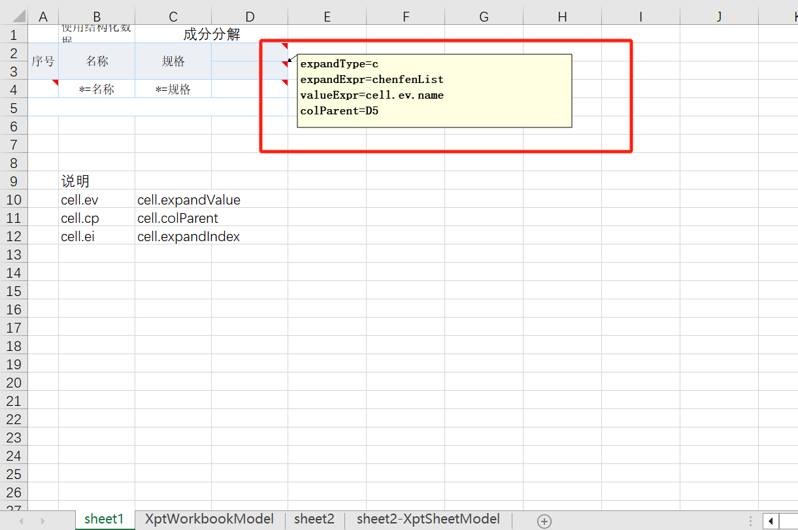
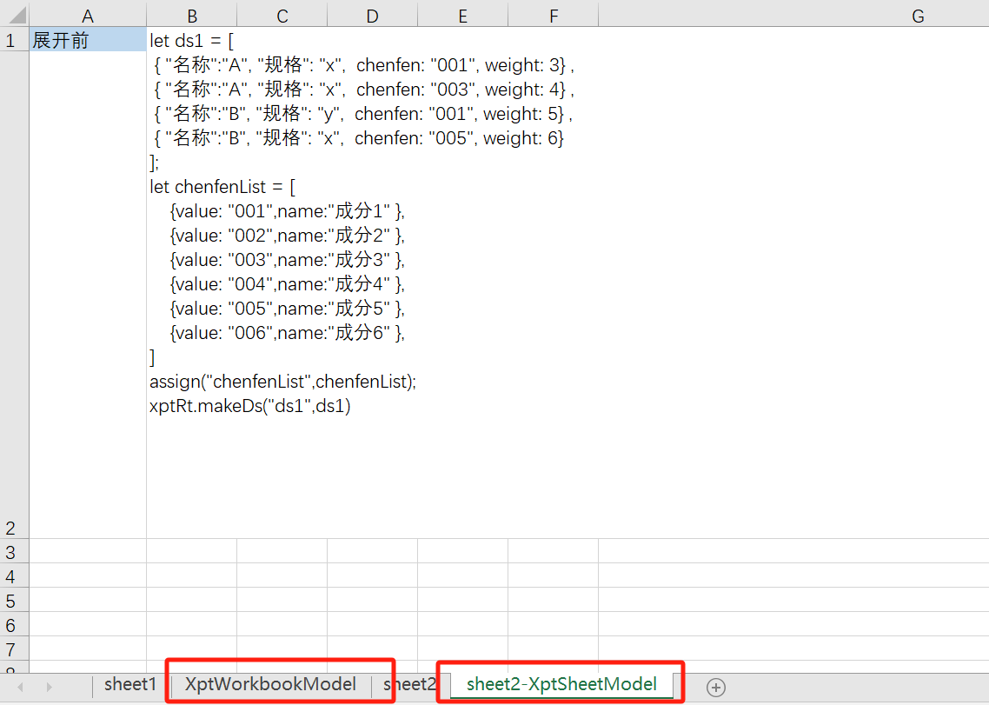
利用Excel内置的机制实现可视化
利用Comment定义CellModel
插入额外的Sheet定义扩展模型

Slide 4
ORM引擎的独特价值
关系数据库的秘密：关系数据库中无关系
重新认识主键和外键:
EQL = SQL + AutoJoin
Row => Entity

Slide 5
通用的横纵变换
1. 将属性访问语法扩展到一对多子表
entity.subList.a == entity.subList.find(sub=>sub.name==‘a’)
2. 通过别名隐藏属性路径
entity.ext_a = entity.subList.a

Slide 6
纵表的SQL转换
Select * from MyEntity o
where substr(o.extFields.a.string,1) = ‘1’
order by o.extFields.b.int
Select * from MyEntity o
join ExtFields e1 on e1.entityName = ‘MyEntity’
and e1.fieldName = ‘a’
left Join ExtFIelds e2 on e2.entityName = ‘MyEntity’
and e2.fieldName = ‘b’
Where substr(e1.stringValue,1) = ‘1’
Order by e2.intValue

Slide 7
纵表的SQL转换
Select * from MyEntity o
where substr(o.extFields.a,1) = ‘1’
order by o.extFields.b
Select * from MyEntity o
join ExtFields e1 on e1.entityName = ‘MyEntity’
and e1.fieldName = ‘a’
Left Join ExtFIelds e2 on e2.entityName = ‘MyEntity’
and e2.fieldName = ‘b’
Where substr(e1.value,1) = ‘1’
Order by e2.value

Slide 8
N+1问题
聚合根，主题对象
Entity ：数据的聚合
BizObject: 行为的聚合
GraphQL ：对象的组合和选择

Slide 9
Nop平台中的DDD
聚合根，主题对象
Entity ：数据的聚合
BizObject: 行为的聚合
GraphQL ：对象的组合和选择

