Slide 1

NER Survey AND Classification
学习模式
SL（Supervised learning）的学习模式
SSL(Semi-Supervised learning)的学习模式
UL(UnSupervised learning)的学习模式
特征空间对于NER分类
词层特征
列表查找特征
文档和语料库特征

Slide 2
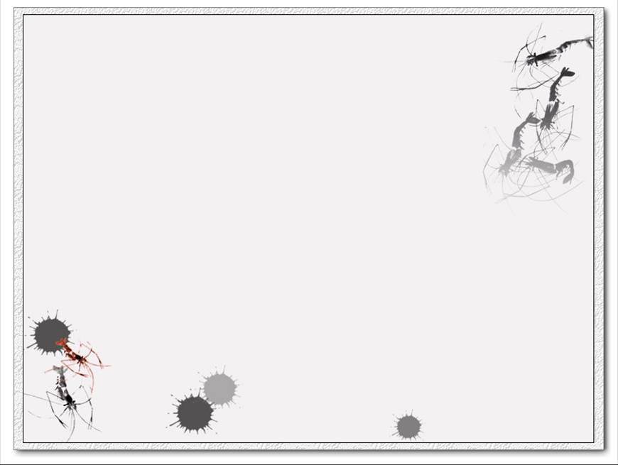
NER Survey AND Classification
NERC的评价
MUC评价
提取匹配评价
ACE评价

Slide 3
NER中 SL 的学习模式
SL（Supervised learning）的定义
Supervised learning is the machine learning task of inferring
a function from labeled training data.
SL（Supervised learning）的发展
1、HMM（Hidden Markov Models）,作者D.Bikel et al.1997
2、DT（Decision Trees）,作者S.Sekine.1998
3、ME（Maximum Entropy Model）,作者A.Borthwick.1998
4、SVM（Support Vector Machines）作者M.Asahara &
Matsumoto.2003
5、CRF（Conditional Random Field）作者A.McCallum&
Li2003
SL（Supervised learning）的要求
1、需要标注的语料库、存储实体列表、创建无歧义的规则
2、训练语料库、测试语料库

Slide 4
NER中 SL 的学习模式
SL（Supervised learning）的结果
1997年在MUC-6 training data中person的
vocabulary transfer为13%；Vocabulary transfer is a good
indicator of the recall (number of entities identified over the
total number of entities)
1999年MUC-7 training data中person的recall为
26%，准确率范围在70%-90%；
2003年识别的准确率为76%，recall为48%

Slide 5
NER中 SSL 的学习模式
Semi-supervised learning is a class of supervised learning tasks and
techniques that also make use of unlabeled data for training - typically
a small amount of labeled data with a large amount of unlabeled data.
SSL（Semi-Supervised learning）的发展史
S. Brin (1998)通过正则表达式用词汇特征
M. Collins and Singer (1999)从语法上分析一个完整的语料库
M. Collins and Singer and R. Yangarber et al. (2002)，证实了
一个想法：learning several types of NE simultaneously allows
the finding of negative evidence (one type against all) and
reduces over-generation.
S. Cucerzan and Yarowsky (1999)

Slide 6
NER中 SSL 的学习模式
SSL（Semi-Supervised learning）的发展史
E. Riloff and Jones (1999)引入mutual bootstrapping（互相
引导法）；
A. Cucchiarelli and Velardi (2001)用syntactic relations（句法
关系）
M. Pasca et al. (2006)用mutual bootstrapping和同义词
J. Heng and Grishman(2006)solve the problem of
unlabelled data selection

Slide 7
NER中 UL 的学习模式
UL （UnSupervised learning）的发展史
E. Alfonseca and Manandhar(2002)study the problem of labeling
an input word with an appropriate NE type.实体类型是
从词汇网络提取例如location>country,animate>person,
animate>animal, etc
R. Evans (2003),
Y. Shinyama and Sekine (2004)
O. Etzioni et al. (2005)

Slide 8
特征空间对于NER分类
词级特征
词级特征就是和字符串的组成相关，如数字模型、连词特征如St.
、part-of-speech词性等
列表查找特征
list是专有的特征对于NER分类，list经常用的术语有“gazetteer”,
“lexicon” and “dictionary”
文档和语料库特征
文档特征有文档内容和文档格式组成；

Slide 9
NERC的评价
MUC evaluations
(COR)the number of correct answers ,
(ACT) the number of actual system guesses
(POS)the number of possible entities in the solution .
COR = 4 (2 TYPE + 2TEXT)；
ACT = 10 (5 TYPE + 5 TEXT);
POS = 10 (5 TYPE + 5 TEXT).
Exact-match evaluations
IREX and CONLL share a simple scoring protocol,we call
it"“exact-match evaluation”"
Exact-match evaluations

