Slide 1
Information Extract

Slide 2

Information Extract main flow

Slide 3
Present Signification
The present significance of IE pertains to(relate to) the growing amount of information available in unstructured form

Slide 4
Tasks and subtasks
Intent
create a structured view of the information present in free text
create a more easily machine-readable text to process the sentences
Task
Named entity recognition
Coreference resolution
Relationship extraction
Semi-structured information extraction
Language and vocabulary analysis
Audio extraction

Slide 5
Task--Named entity recognition
Subtask
named entity detection

Slide 6
Task--Coreference resolution
detection of coreference and anaphoric links between text entities
For example:
"International Business Machines" and "IBM" refer to the same real-world entity. If we take the two sentences "M. Smith likes fishing. But he doesn't like biking", it would be beneficial to detect that "he" is referring to the previously detected person "M. Smith".

Slide 7
Task--Relationship extraction
identification of relations between entities
PERSON works for ORGANIZATION (extracted from the sentence "Bill works for IBM.")
PERSON located in LOCATION (extracted from the sentence "Bill is in France.")

Slide 8
Task--Language and vocabulary analysis
Terminology (术语) extraction: finding the relevant terms for a given corpus

Slide 9
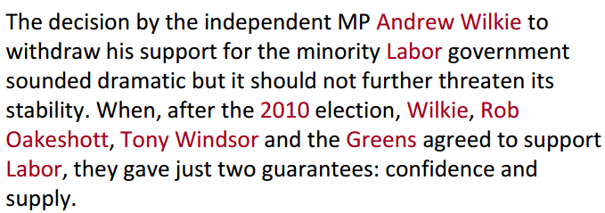
Named Entity Recognition (NER)
A very important sub-task:
Find names in text

Slide 10
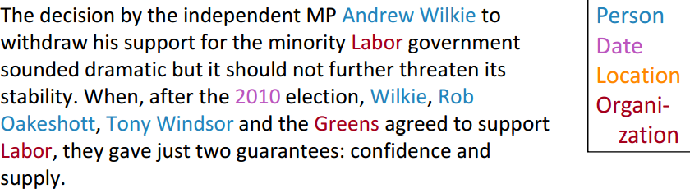
Named Entity Recognition (NER)
A very important sub-task:
Classify names in text

Slide 11
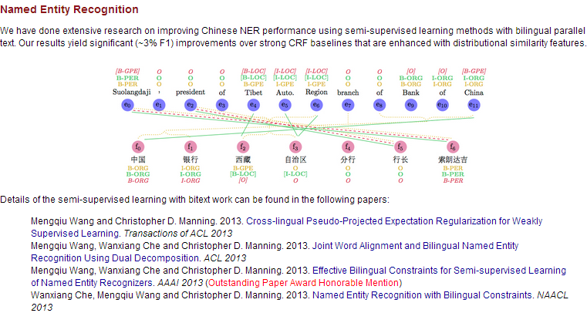
Chinese Named Entity Recognition (NER)
current situation
Part-of-Speech Tagging
Its overall accuracy is 93.65% and the unknown word accuracy is 84.84%
Chinese NER

Slide 12
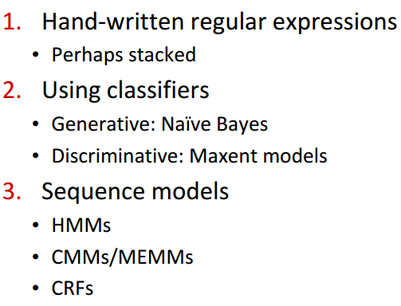
Three standard approaches to NER (and IE)

Slide 13
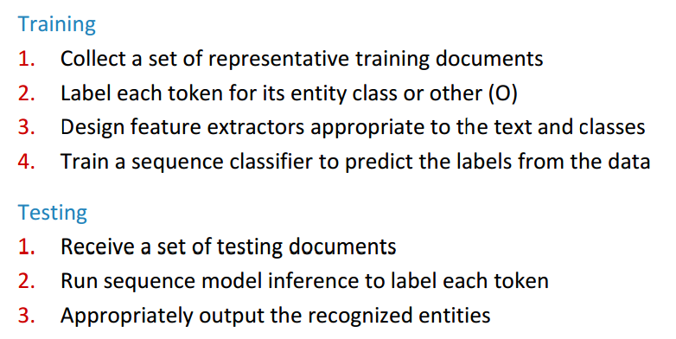
The ML sequence model approach to NER

Slide 14
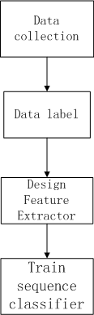
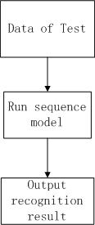
The ML sequence model approach to NER-Flow
Training: Testing:

Slide 15
The ML sequence model approach to NER--question
Sequence problems
sequence model: Conditional Random Fields
Maximum entropy Markov models
Maximum entropy Markov models

Slide 16
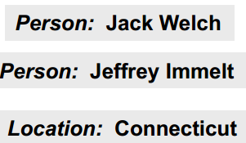
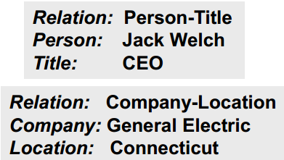
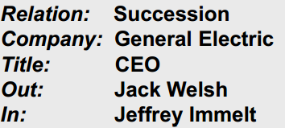
Arity(参数数量) of Entity Relation
Single entity
For example
Binary relationship
For example
N-ary record
For example

Slide 17
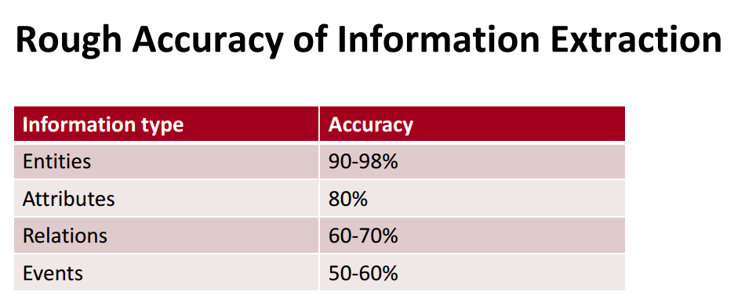
Entity Relation results-Stanford

Slide 18
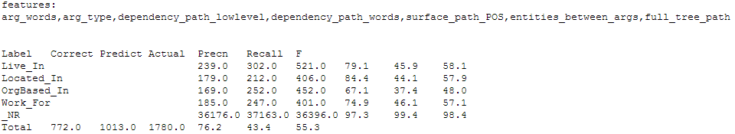
Stanford Relation Extractor

Slide 20
Standford Research

Slide 21
Information Extraction
Explain:
Extraction of structured information from unstructured text. This includes identifying named entities, resolving anaphora, linking them to a global namespace, and identifying relations between the entities.
Application
Named Entity Recognition (NER) and Information Extraction (IE)
Biological Process Extraction
Coreference Resolution
Knowledge Base Population
Natural Logic

Slide 22
Biological Process Extraction
Overview
We are working on modeling biological processes as structures, and using these structures for question answering in a reading comprehension task. We have shown that using process structures improves reading comprehension compared to shallower approaches.
Link
http://nlp.stanford.edu/software/bioprocess/

Slide 23
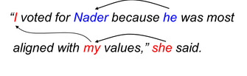
Coreference Resolution
Overview
Coreference resolution is the task of finding all expressions that refer to the same entity in a text. It is an important step for a lot of higher level NLP tasks that involve natural language understanding such as document summarization, question answering, and information extraction.
For example

Slide 24
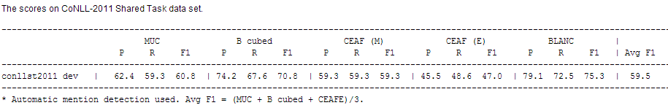
Coreference Resolution Result
Link
http://nlp.stanford.edu/projects/coref.shtml

Slide 25
Knowledge Base Population (KBP)
Overview
Knowledge Base Population is the task of taking an incomplete knowledge base (e.g., Freebase, or the structured information in Wikipedia infoboxes), and a large corpus of text (e.g., Wikipedia), and completing the incomplete elements of the knowledge base. That is, the computer has to "read" the text and get information out of it.

Slide 26
Knowledge Base Population-subtask
Slotfilling
the task is to complete all known information about a given query entity. For instance, given the query "Barack Obama", the system's goal is to collect Barack Obama's birthplace, birthdate, occupation, spouse, etc.
Entity Linking
entities are ambiguous when described in text. For example, "George Bush" may refer to either George Bush Sr. or George Bush Jr. Or, the acronym ACL may refer to the Association for Computational Linguistics, or the ACL music festival in Austin. Entity linking aims to take these ambiguous mentions, and "link" them with concrete entities in the knowledge base.

Slide 27
Natural Logic in NLP
Overview
The NatLog project aims to develop an approach to natural language inference based on a model of natural logic, which identifies valid inferences by their lexical and syntactic features, without full semantic interpretation. Traditionally, Stanford has used natural logic for textual entailment; recently, however, the group has been looking at natural logic in the context of inference for recursive neural networks, and as a means of performing light, large-scale inference over a knowledge base of common sense facts.
Link
http://nlp.stanford.edu/projects/natlog.shtml

Slide 28
Semantic Parsing
Explain
We are interested in mapping utterances to deep meaning representations that take into account the compositional and quantification structure of language.
Application
Question answering on Freebase

Slide 29
Question answering on Freebase
SEMPRE: Semantic Parsing with Execution
SEMPRE is a toolkit for training semantic parsers, which map natural language utterances to denotations (answers) via intermediate logical forms.
an example for querying databases
Utterance: Which college did Obama go to?
Logical form: (and (Type University) (Education BarackObama))
Denotation: Occidental College, Columbia University
example for programming via natural language
Utterance: Compute three plus four.
Logical form: (call + 3 4)
Denotation: 7

Slide 30
Text to 3D Scene Generation
Explain
We are interested in how to automatically generate 3D scenes from a natural text description. This involves the grounding of object references, resolving spatial terms, and inferring implicit knowledge about how objects are typically arranged.
Application
Text to Scene Generation

Slide 31
Sentiment and Social Meaning
Explain
We are interested the extraction of sentiment and other kinds of social meaning, including politeness, bias, friendliness, and flirtation, from speech and text.
Application
Extraction of Sentiment and Social Meaning

Slide 32
Extraction of Sentiment and Social Meaning
Overview
We are interested in the automatic extraction of sentiment and other areas of social meaning including politeness, bias, friendliness, flirtation, and romantic interest, from both speech and text.
Link
http://nlp.stanford.edu/projects/social.shtml

Slide 33
Dropout Learning and Feature Noising
Explain
Algorithms that aim to preventing feature co-adaptation using fast dropout training by sampling from or integrating a Gaussian approximation, or equivalently as adaptive regularizers, which can be generalized to semi-supervised learning settings.
Application
Dropout Learning

Slide 34
Deep Learning in Natural Language Processing
Explain
The use of continuous-space distributed representations (neural nets) for tackling various problems in natural language processing and vision, including parsing, sentiment analysis and paraphrase detection.
Application
Deep Learning in Natural Language Processing

Slide 35
Parsing & Tagging
Explain
Algorithms for assigning part of speech and syntactic structure, emphasizing probabilistic and discriminative models
Application
Probabilistic Parsing

Slide 36
Probabilistic Parsing
Overview
Probabilistic parsing is using dynamic programming algorithms to compute the most likely parse(s) of a given sentence, given a statistical model of the syntactic structure of a language. Research at Stanford has focused on improving the statistical models used as well as the algorithms. Models have been developed for parsing in several languages other than English, including Chinese, Arabic, and German.
Usage
implementation of The Stanford Parser

Slide 37
Explain
Language modeling, re-ordering models, phrase extraction techniques, syntactic methods, and better training for statistical machine translation
Application
Machine Translation

Slide 38
Machine Translation
Overview
Machine Translation (MT) is the task of automatically converting one natural language into another, preserving the meaning of the input text, and producing fluent text in the output language. While machine translation is one of the oldest subfields of artificial intelligence research, the recent shift towards large-scale empirical techniques has led to very significant improvements in translation quality. The Stanford Machine Translation group's research interests lie in techniques that utilize both statistical methods and deep linguistic analyses.
Descriptions of our NIST 2nd best systems:
2008 Chinese-English system
2009 Arabic-English system

Slide 39
Dialog and Speech Processing
Explain
Research in dialog modeling and speech processing
Application
Dialog Modeling
Speech Recognition and Synthesis

Slide 40
Unsupervised and Semisupervised Learning of Linguistic Structure
Explain
Probabilistic and other corpus-based algorithms for learning linguistic structures from corpora
Application
Unsupervised Parsing & Grammar Induction
Time Expressions
Morphology & Phonology Induction
Semantic Taxonomy Induction
Inducing Narratives and Event Representations
Cross-lingual Expectation Projection and Regularization

Slide 41
Multilingual NLP
Explain
A variety of NLP investigations in Chinese, Arabic, and German, including tagging, segmentation, probabilistic syntactic parsing, and semantic role parsing, as well as work on speech processing.
Application
Chinese NLP and Speech
Arabic NLP
German NLP
Universal Stanford Dependencies

Slide 42
Past Projects
Mimir Project: What Drives the Dynamics of Science
Narratives and Event Representations
Semantic Taxonomy Induction
Personalized PageRank algorithms
Computational Lexicography: Kirrkirr
Text Categorization
The Stanford Edinburgh Entity Recognition (SEER) Project
The Edinburgh And Stanford Information Extraction (EASIE) Project
Shallow Semantic Parsing
Question Answering (QA)
The NLKR Project: solving natural-language logic puzzles
Word Sense Disambiguation (WSD)
Part-of-speech (POS) tagging
Detecting Contradictions in Text

Slide 44
Entity Relation

Slide 45
Information Extract five tasks
Named entity recognition (NE)
Finds and classifies names, places, etc.
Coreference resolution (CO)
Identifies identity relations between entities.
Template element construction (TE)
Adds descriptive information to NE results (using CO).
Template relation construction (TR)
Finds relations between TE entities.
Scenario template production (ST)
Fits TE and TR results into specified event scenarios.
Notes:
Information Extraction, Automatic

Slide 46
Extract the relations between entities
For Example
Located in
employed by
part of
married to

Slide 47
Relation part types
Affiliations
PER PER ; e.g. :XX married to XX
PER ORG; e.g. : XX president of XX
PER ART(artifactual) e.g. XX owns ART
Geopolitical
LOC LOC eg: XX near XX
LOC LOC eg: XX southeast of XX
Part-Of
ORG ORG eg: XX a unit og ORG

Slide 48
Relation types from ACE 2003
ROLE: relates a person to an organization or a geopolitical entity
subtypes: member, owner, affiliate, client, citizen
PART: generalized containment
subtypes: subsidiary, physical part-of, set membership
AT: permanent and transient locations
subtypes: located, based-in, residence
SOCIAL: social relations among persons
subtypes: parent, sibling, spouse, grandparent, associate

Slide 49
Relation extraction: 5 methods
1. Hand-built patterns
2. Bootstrapping methods
3. Supervised methods
4. Distant supervision
5. Unsupervised methods

Slide 50

A hand-built extraction rule

Slide 51
Patterns for learning hyponyms(下义词)
Hearst’s lexico-syntactic patterns
Y such as X ((, X)* (, and/or) X)
such Y as X…
X… or other Y
X… and other Y
Y including X…
Y, especially X…

Slide 52
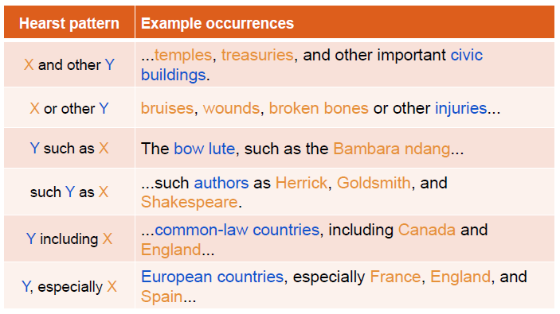
Examples of the Hearst patterns

Slide 53
Bootstrapping(自助) approaches
If you don’t have enough annotated text to train on …
But you do have:
o some seed instances of the relation
o (or some patterns that work pretty well)
o and lots & lots of unannotated text (e.g., the web)
… can you use those seeds to do something useful?
Bootstrapping can be considered semi-supervised
依靠自己的努力获得成功

Slide 54
Bootstrapping example
Target relation: burial place
Seed tuple: [Mark Twain, Elmira]
Grep/Google for “Mark Twain” and “Elmira”
“Mark Twain is buried in Elmira, NY.”
→ X is buried in Y
“The grave of Mark Twain is in Elmira”
→ The grave of X is in Y
“Elmira is Mark Twain’s final resting place”
→ Y is X’s final resting place
Use those patterns to search for new tuple

Slide 55
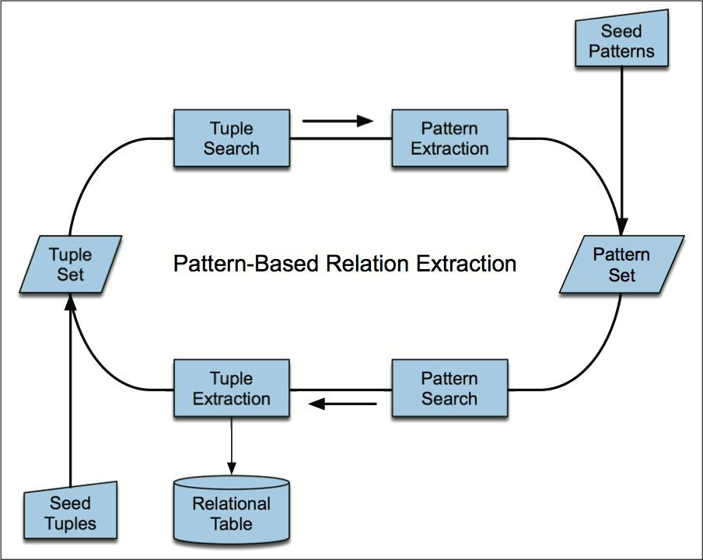
Bootstrapping relations

Slide 56
Bootstrapping problems
Requires that we have seeds for each relation
Sensitive to original set of seeds
Big problem of semantic drift at each iteration
Precision tends to be not that high
Generally have lots of parameters to be tuned
No probabilistic interpretation
Hard to know how confident to be in each result

Slide 57
Supervised relation extraction
The supervised approach requires:
Defining an inventory of output labels
Relation detection: true/false
Relation classification: located-in, employee-of,
inventor-of, …
Collecting labeled training data: MUC, ACE, …
Defining a feature representation: words, entity
types, …
Choosing a classifier: Naïve Bayes, MaxEnt, SVM,…
Evaluating the results

Slide 58
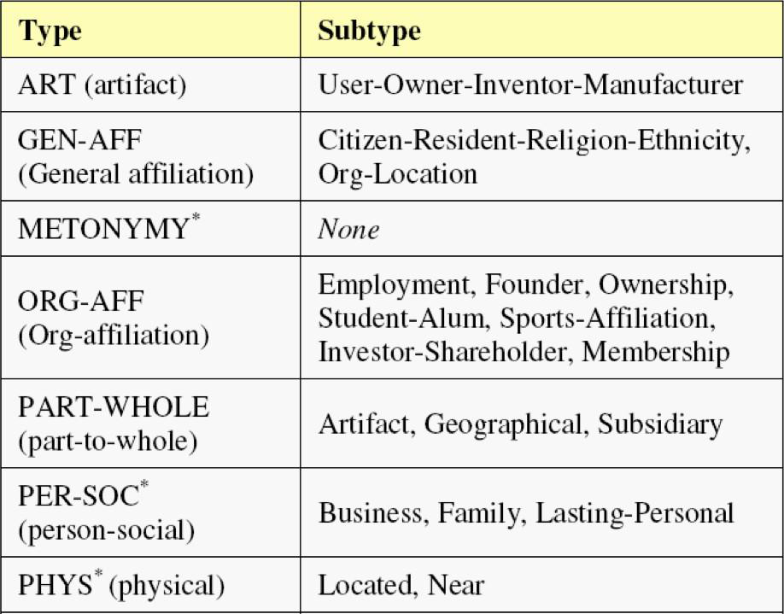
ACE 2008: relations

Slide 59
Features
Lightweight features — require little pre-processing
Bags of words & bigrams between, before, and after the entities
Stemmed versions of the same
The types of the entities
The distance (number of words) between the entities
Medium-weight features — require base phrase chunking
Base-phrase chunk paths
Bags of chunk heads
Heavyweight features — require full syntactic parsing
Dependency-tree paths
Constituent-tree paths
Tree distance between the entities
Presence of particular constructions in a constituent structure

Slide 60
Title： Probabilistic Reasoning for Entity & Relation Recognition
Author： Dan Roth& Wen-tau Yih
Conference： ProceedingCOLING '02 Proceedings of the 19th international conference on Computational linguistics
Time：2002

Slide 61
Contents
Background
main content
simulation result
my thinking

Slide 62
Background
Recognizing and classifying entities and relations in text data is a key task
Information exteract(IE)
Question Answer(QW)
Story Comprehension(情节的理解)
Textual Entailment
文本蕴涵(Textual entailment) 是指两个文本片段有指向关系。当认为一个文本片段真实时，可以推断出另一个文本片断的真实性。
Coreference Resolution

Slide 63
main content
1、defines the problem in a formal way
2、describes our approach to this problem
Introduce how we learn the classifiers
the belief network(贝叶斯网络) we use to reason for global predictions
3、records preliminary experiments we ran and exhibits some promising results
4、some of the open problems and future work

Slide 64

Defines the problem
Define1.1（ Sentence & Entity ）
A sentence S is a linked list which consists of words w and entities E. An entity can be a single word or a set of consecutive words with a predefined boundary. Entities in a sentence are labeled as E1;E2; …according to their order, and they take values that range over a set of entity types CE
For example
The sentence in Figure 2 has three entities: E1 = “Dole”, E2 = “Elizabeth”, and E3 = “Salisbury,N.C.”

Slide 65
Defines the problem
Definition 1.2 (Relation)
A (binary) relation Rij = (Ei;Ej) represents the relation between Ei and Ej ,where Ei is the first argument and Ej is the second. In addition, Rij can range over a set of entity types CR.
For example
In the sentence given in Figure 2, there are six relations between the entities: R12 = (“Dole”, “Elizabeth”), R21 = (“Elizabeth”, “Dole”), R13 = (“Dole”,“Salisbury, N.C.”), R31 = (“Salisbury, N.C.”, “Dole”), R23 = (“Elizabeth”, “Salisbury, N.C.”), and R32 =(“Salisbury, N.C.”, “Elizabeth”)

Slide 66
Defines the problem
Definition 1.3 (Classes)
We denote the set of predefined entity classes and relation classes as CE and CR respectively. CE has one special element other ent, which represents any unlisted entity class. Similarly, CR also has one special element other rel, which means the involved entities are irrelevant or the relation class is undefined
For example
Suppose CE = f other ent, person, location g and CR = f other rel, born in, spouse of g. For the entities in Figure 2, E1 and E2 belong to person and E3 belongs to location. In addition, relation R23 is born in, R12 and R21 are spouse of. Other relations are other rel.

Slide 67
Defines the problem
Definition 2.4 (Constraint)
A constraint C is a 3-tuple(R; E1; E2), where R 2 CR and E1; E2 2 CE. If the class label of a relation is R, then the legitimate class labels of its two entity arguments are E1 and E2 respectively.
For example
constraints are: (born in, person, location), (spouse of, person, person), and (murder, person, person)

Slide 68
our approach to this problem- classifiers
two basic classifiers for entities and relations are first learned
named entity classifier
relation classifier

Slide 69
our approach to this problem- belief network
compute the Prob(Ejobservations) and Prob(Rjobservations), and use the belief network to compute the most probable global predictions of the class labels.
For instance
node Rij has two incoming links from nodes Ei and Ej . The conditional probabilities P(Rij jEi;Ej) encodes the constraints as in Property 1.

Slide 70
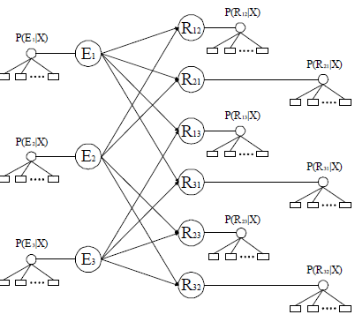
our approach to this problem- belief network
Step1
Step2
Step3

Slide 71
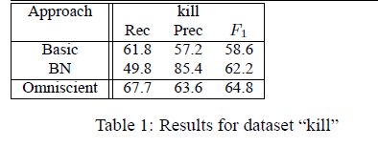
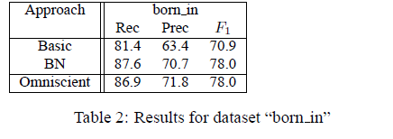
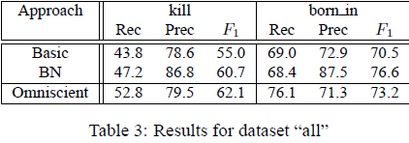
simulation result

Slide 72
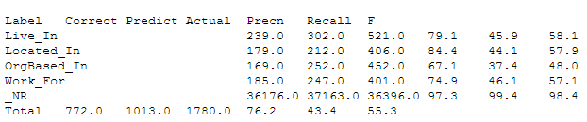
My thinking
1、chinese ner
We have chances that we can improve it
Its part-of-speech accuracy is 93.65% and unknown word accuracy is 84.84%.
2、entity relation
StanFord Model result：

Slide 73
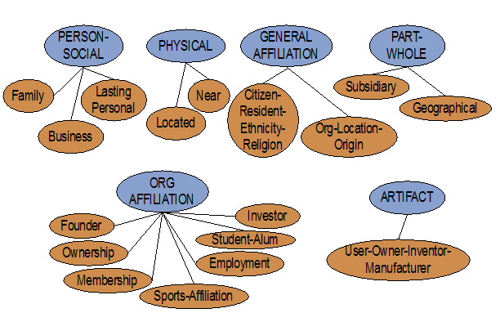
Some relations
3、2008 Automated Content Extraction (ACE) 17 sub-relation

Slide 74

My thinking
Country and country relation
Politician person and country
Web site and web site
Mul-language Translate
Otrer NE ; for example Environment and plant(NE) relation because of polution
Sina

