Slide 1
WEEKLY_REPORT
Time:2015-02-06
Reporter:HaitaoCui

Slide 2
Tense Based Feature
Simple_Aux and Compound Tense

Slide 3
Simple_Aux and Compound Tense
present continuous tense
Feature:
VP→Be(am/is/are)+VBG
present tense
Feature:
VP→VBP
Simple Future Tense
Feature:
VP→ Will/shall + VB Or be(am/is/are)+going
past future tense
Feature:
VP→ Would+ VB Or be(was/were)+going

Slide 4
Simple_Aux and Compound Tense
Simple Future Tense
Feature:
VP→ Will/shall + VB Or be(am/is/are)+going
VP→be+about Or Be to + VB Or be due to+动词原形
past future tense
Feature:
VP→ Would+ VB Or be(was/were)+going
simple past tense
Feature:
VP→VBD
past continuous tense
Feature:
VP→ be(was/were) + VBG

Slide 5
Simple_Aux and Compound Tense
present perfect tense
Feature:
VP→ Have/Has + VBD
past perfect tense
Feature:
VP→ Had + VBD

Slide 6
Solve Tense Processing and Thought

Slide 7
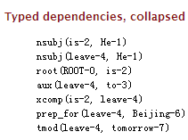
Tense Some Aspects
Some question
fixed structure ; for example : be due to + vb
Time Aspects ; for example : tomorrow
Task other situations

Slide 8
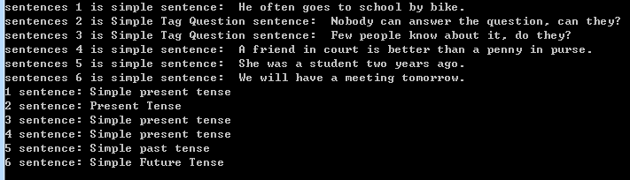
Now Tense Result

Slide 9
Thanks For listening

