Slide 1
Weekly Report
Report：崔海涛
Time：2014-04-27
Professor:黄超(研究员)

Slide 2
Content
一、Working Last Week
二、Working Next Step

Slide 3
Working Last Week
subject clause
predicative clause
object clause
appositive clause

Slide 4
Working Next Step
attributive clause
adverbial clause

Slide 5
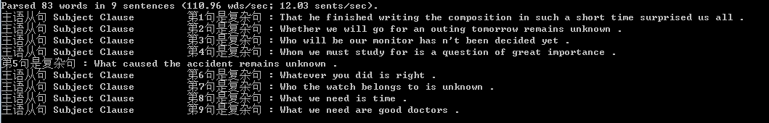
Some Question
Result Exhibit

Slide 6
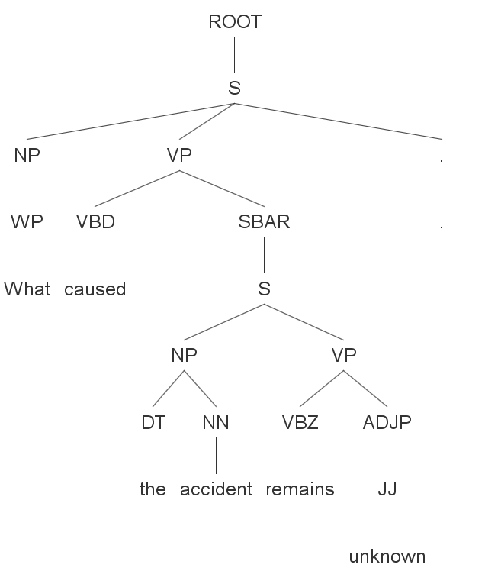
Question
What caused the accident remains unknown .

Slide 7
Solve
向上面的问题需要特殊考虑

