Slide 2
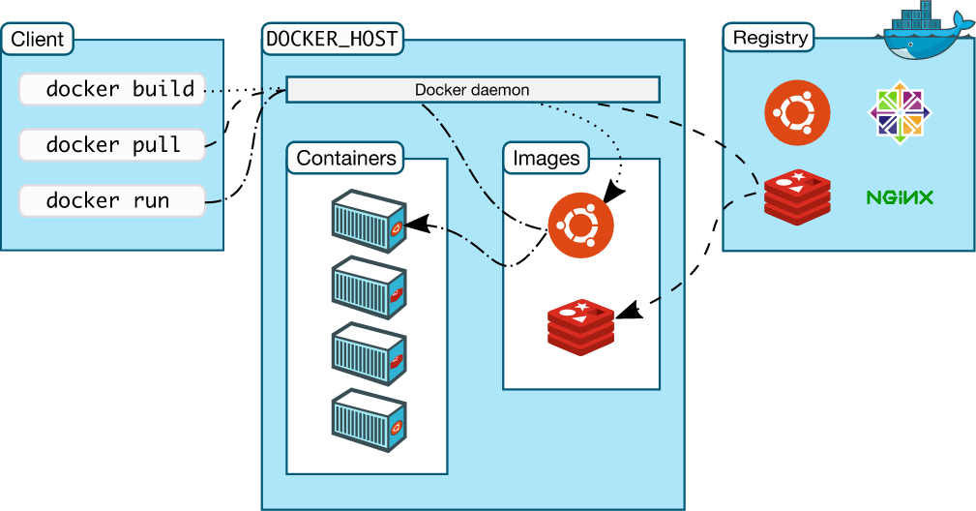
Architecture

Slide 3
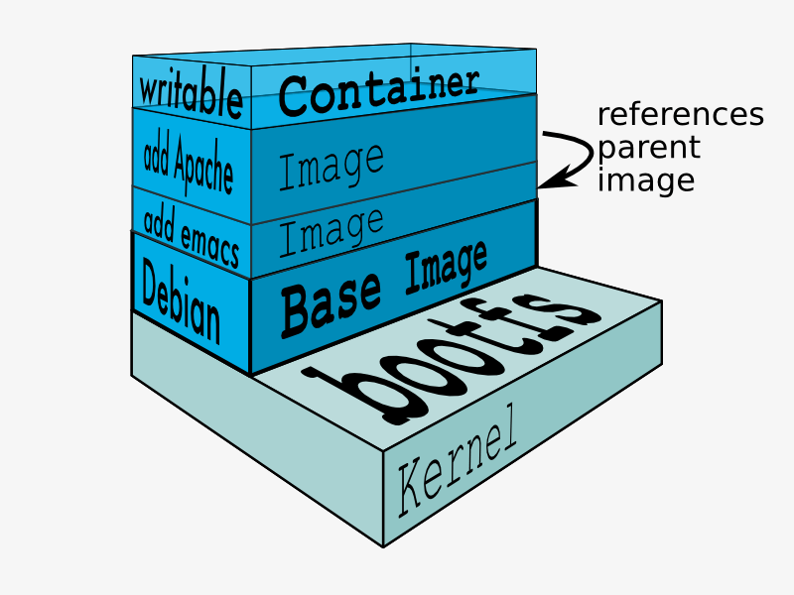
Image layer

Slide 4
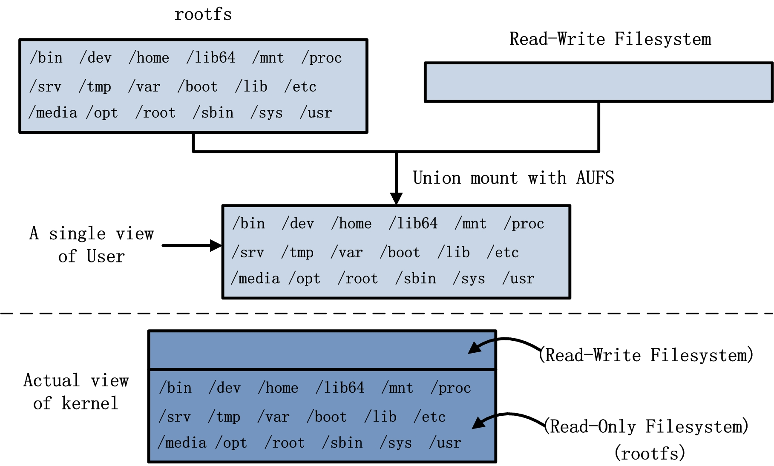
Image

Slide 5
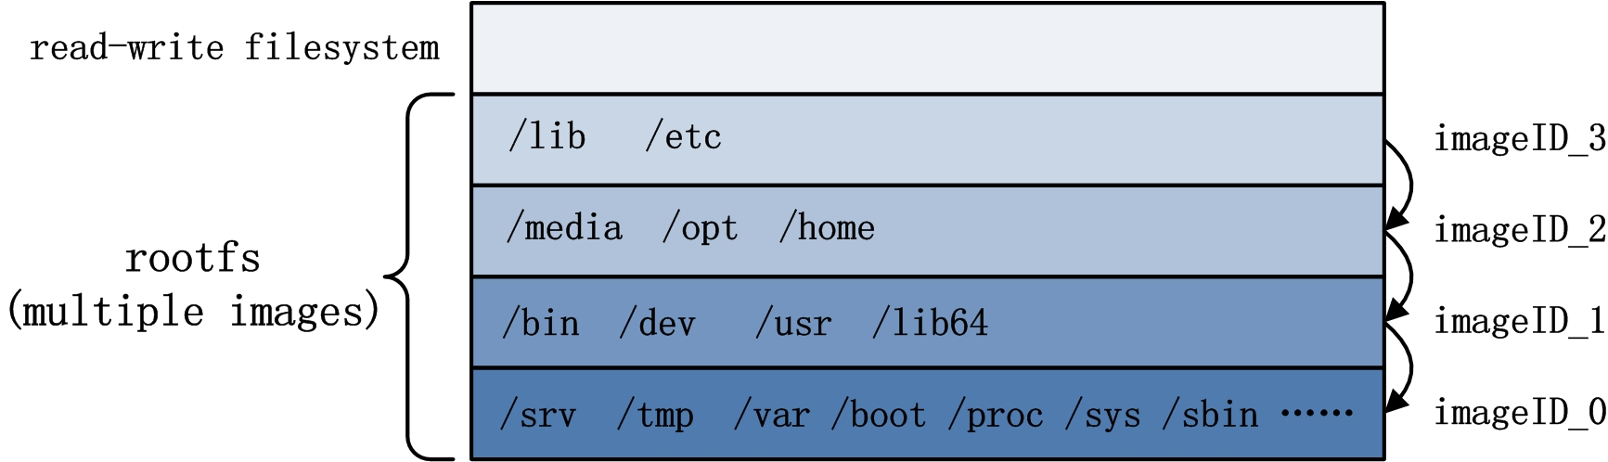
Image Layer

Slide 6
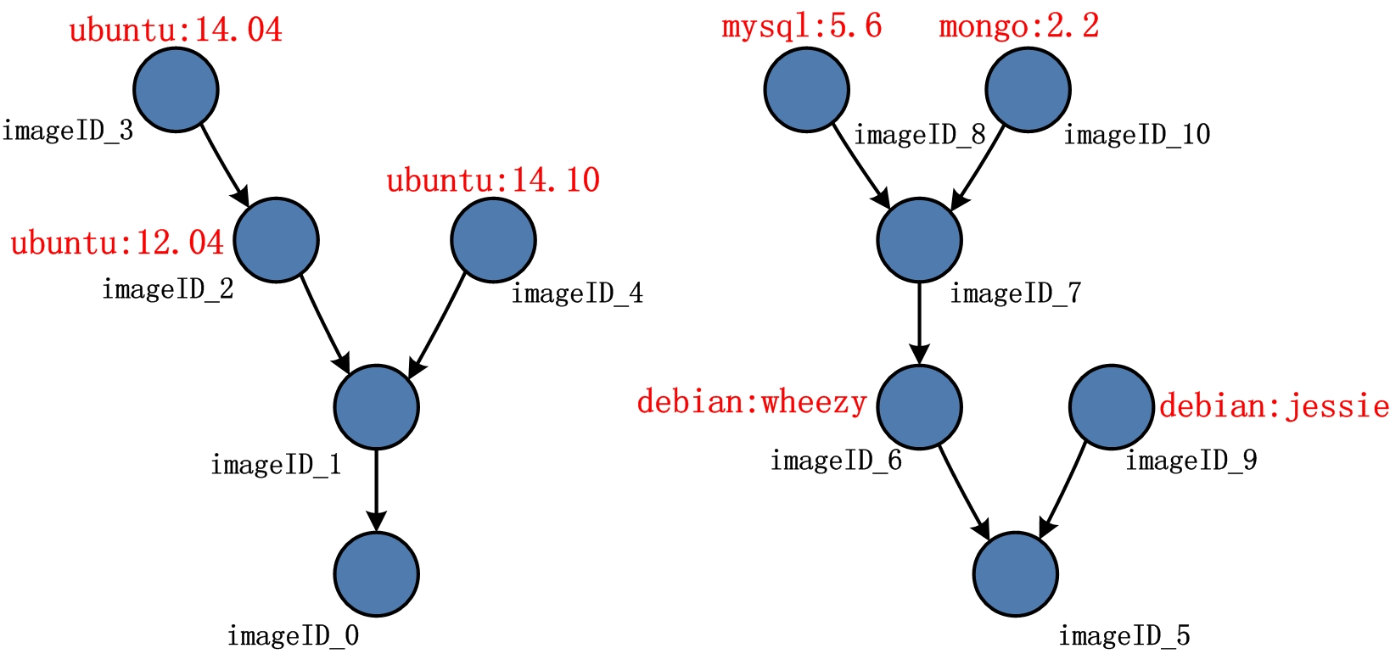
Image layer

Slide 7
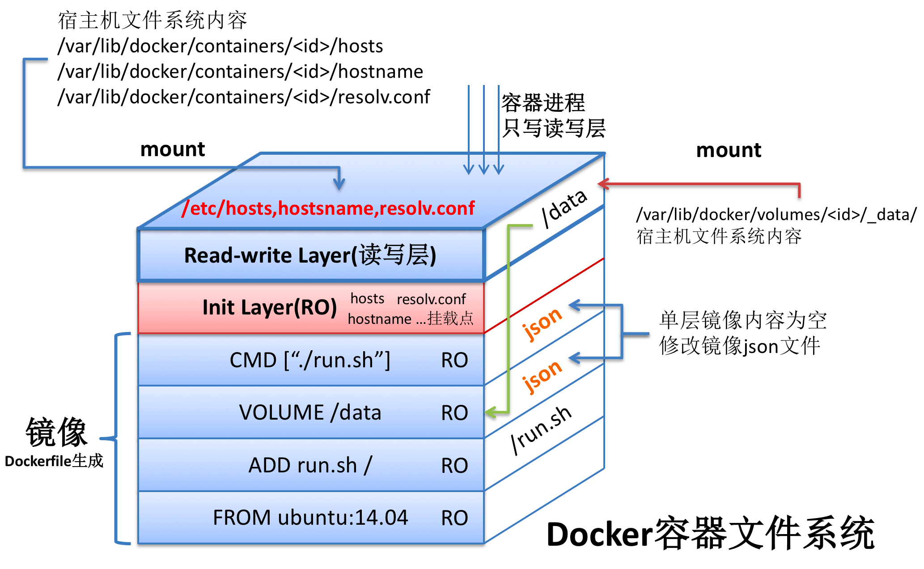
Container

Slide 8
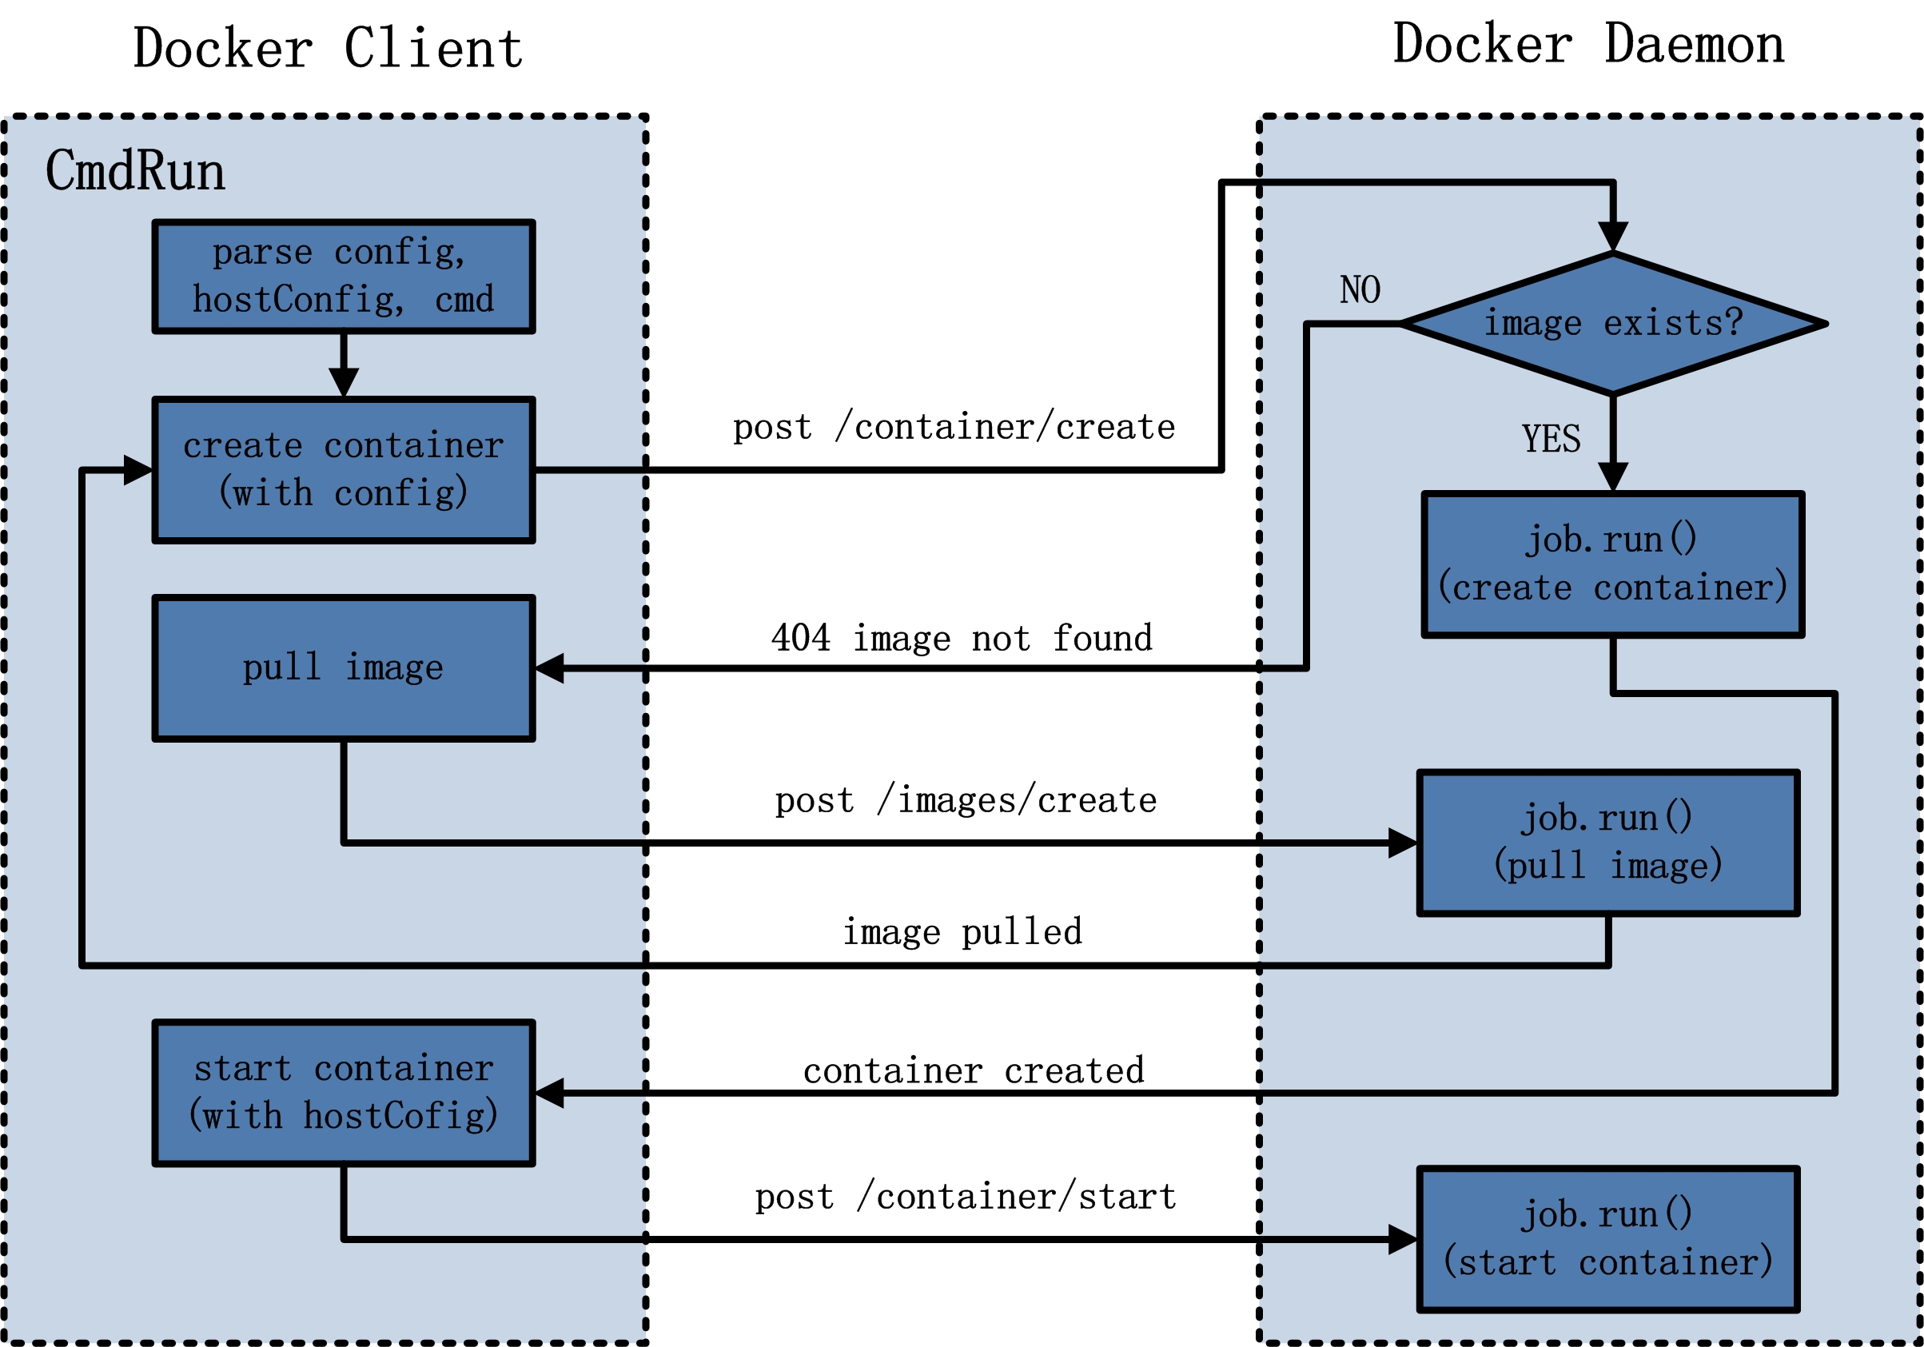
CmdRun

Slide 9
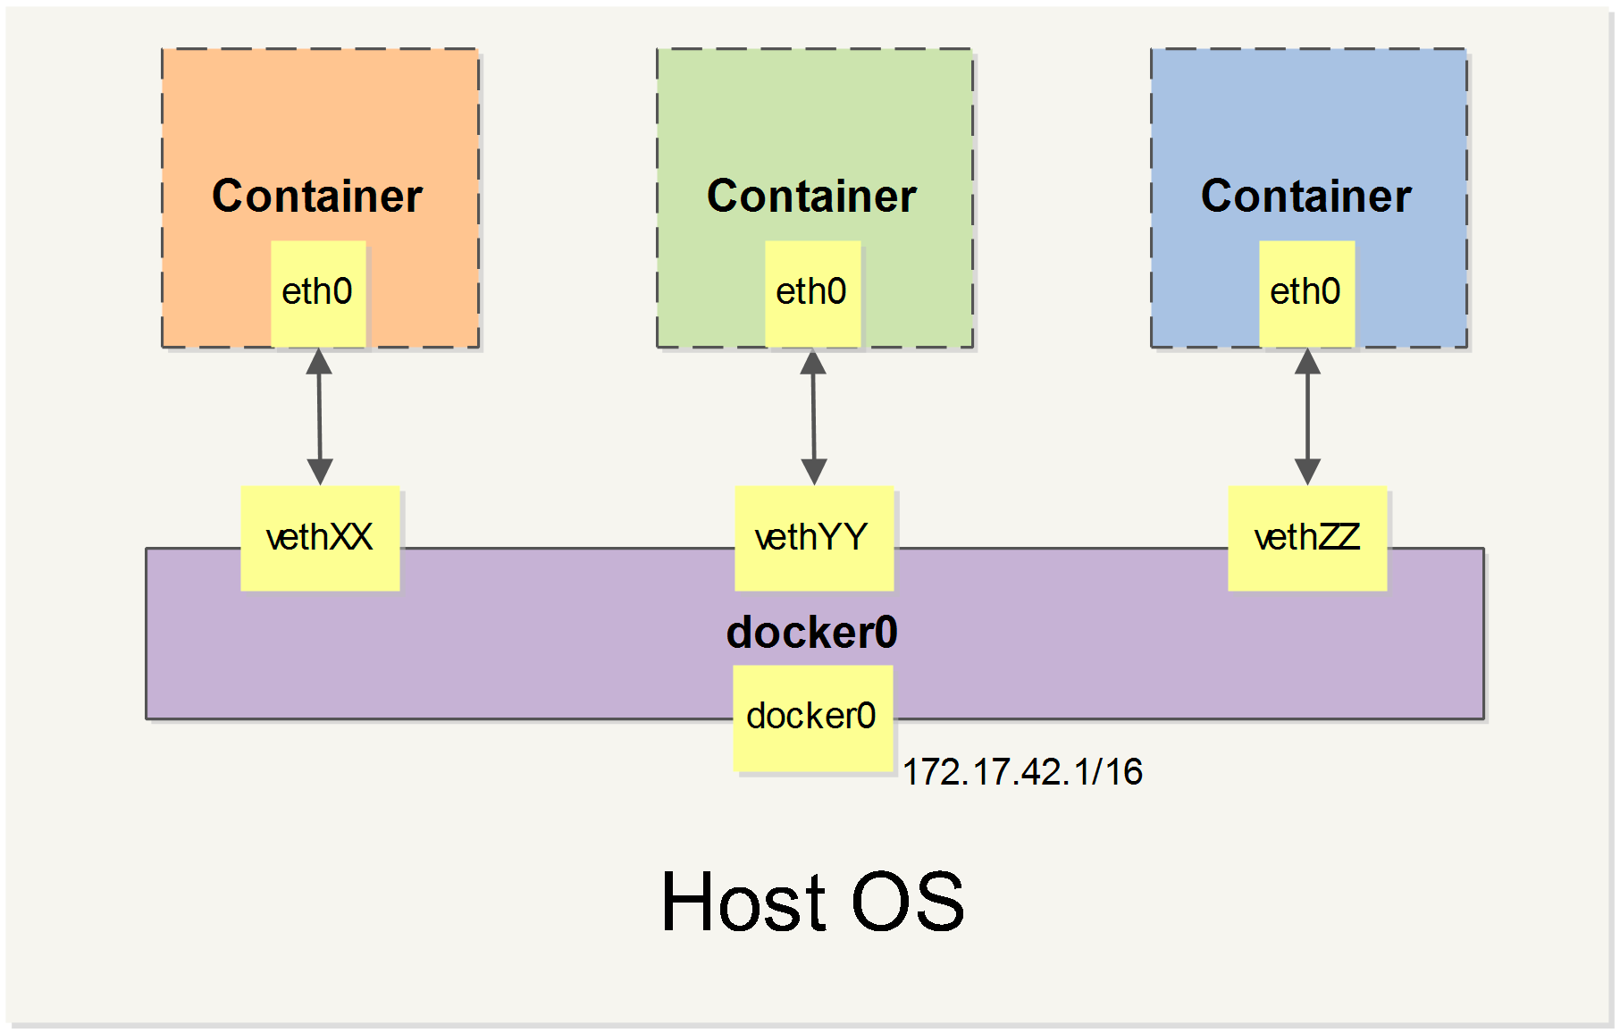
Daemon Network

Slide 10
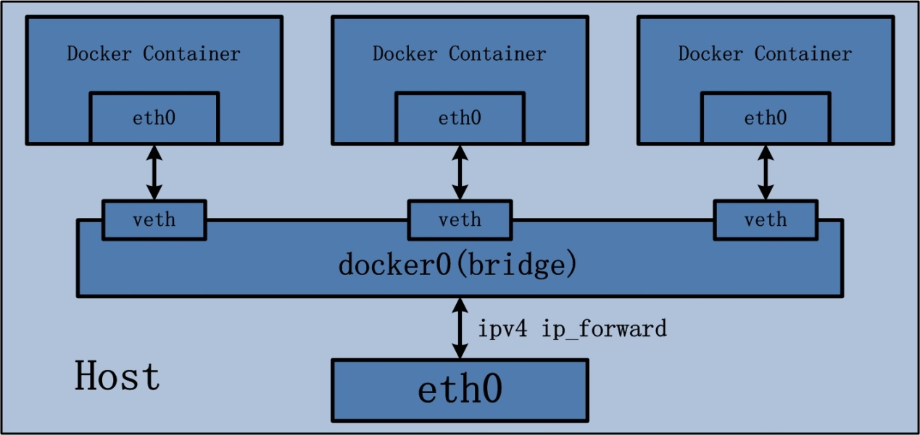
Daemon Network

Slide 11
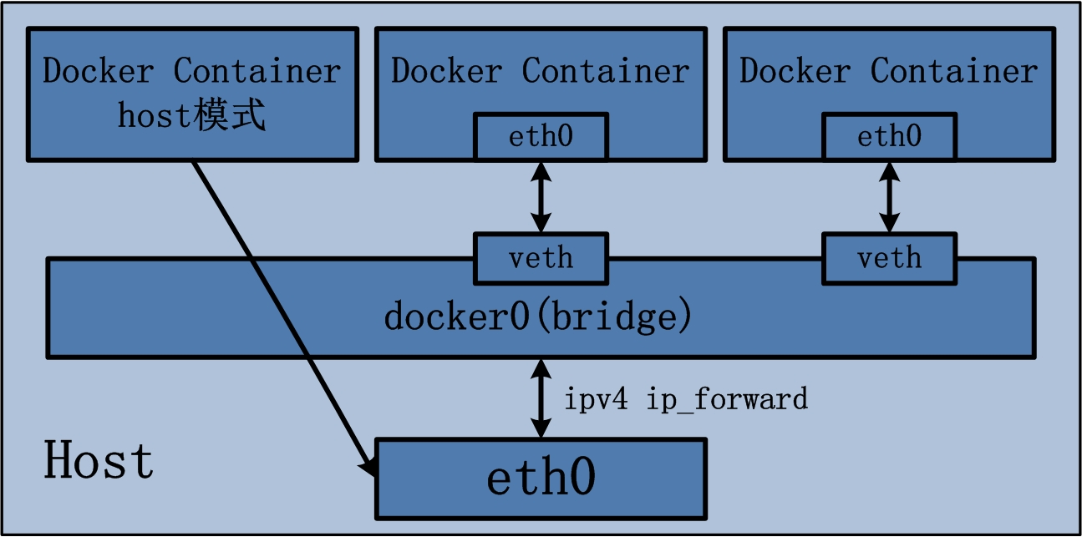
Container Host模式

Slide 12
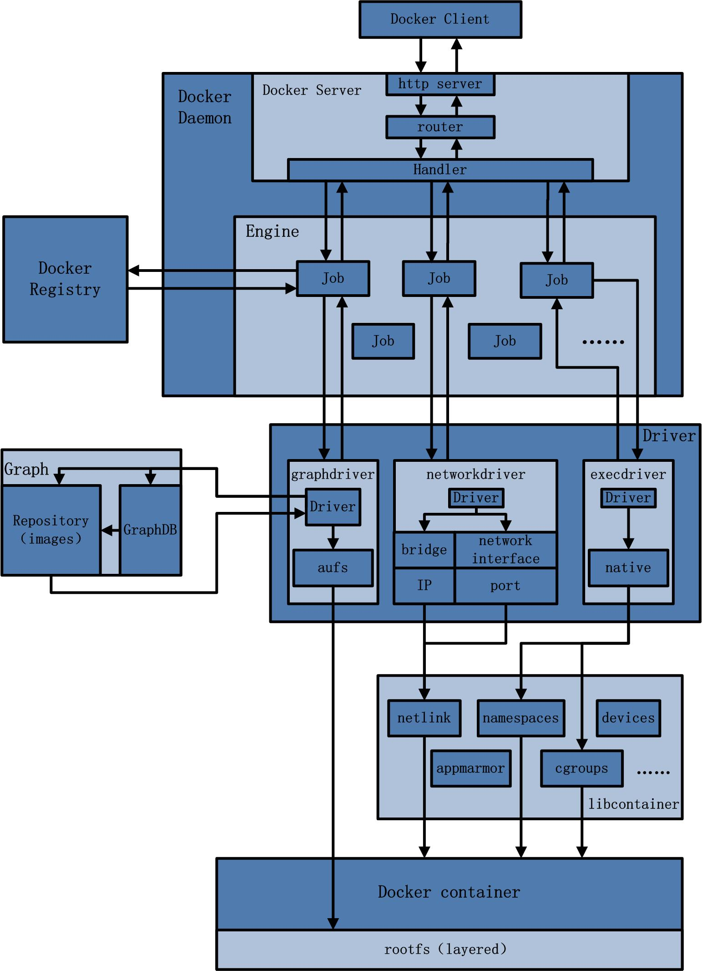
Code Arch

Slide 13
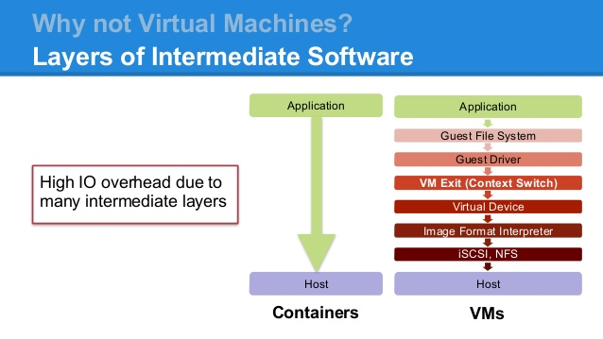
VMs vs. Containers

Slide 14
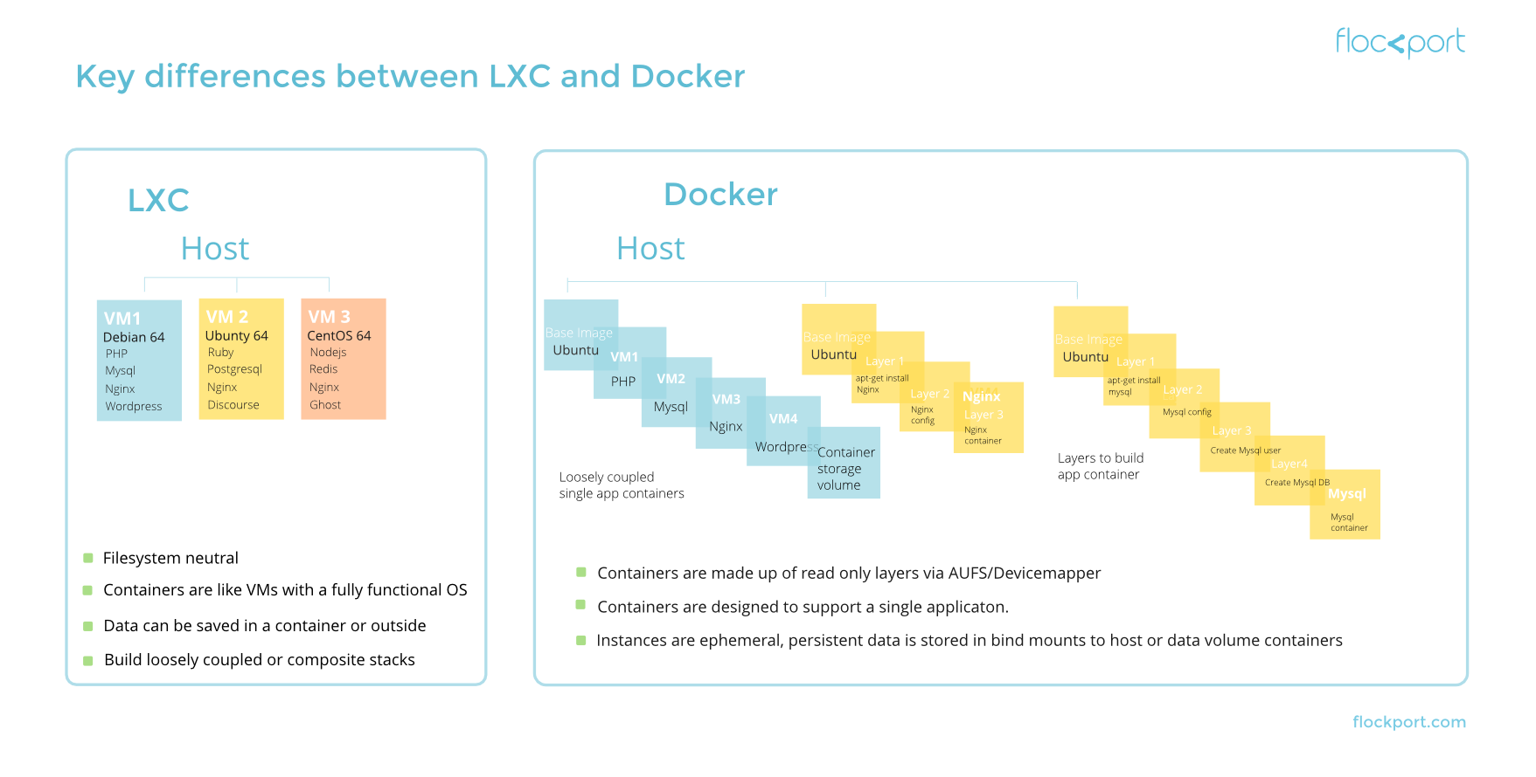
LXC vs.Docker

Slide 15
https://github.com/docker
https://github.com/docker-library/
https://github.com/docker-library/mysql

