Slide 1
Lecture 07 – Benchmarks
Baojian Zhou
DATA130030.01 (自然语言处理)
School of Data Science Fudan University
10/29/2025
Largely Adopted from Anoop Sarkar
Notes:
Pretrained and Fine-Tuning

Slide 2
Outline
GLUE/SuperGLUE
SWAG/HellaSWAG
Lambada
Other datasets
Datasets by task types

Slide 3
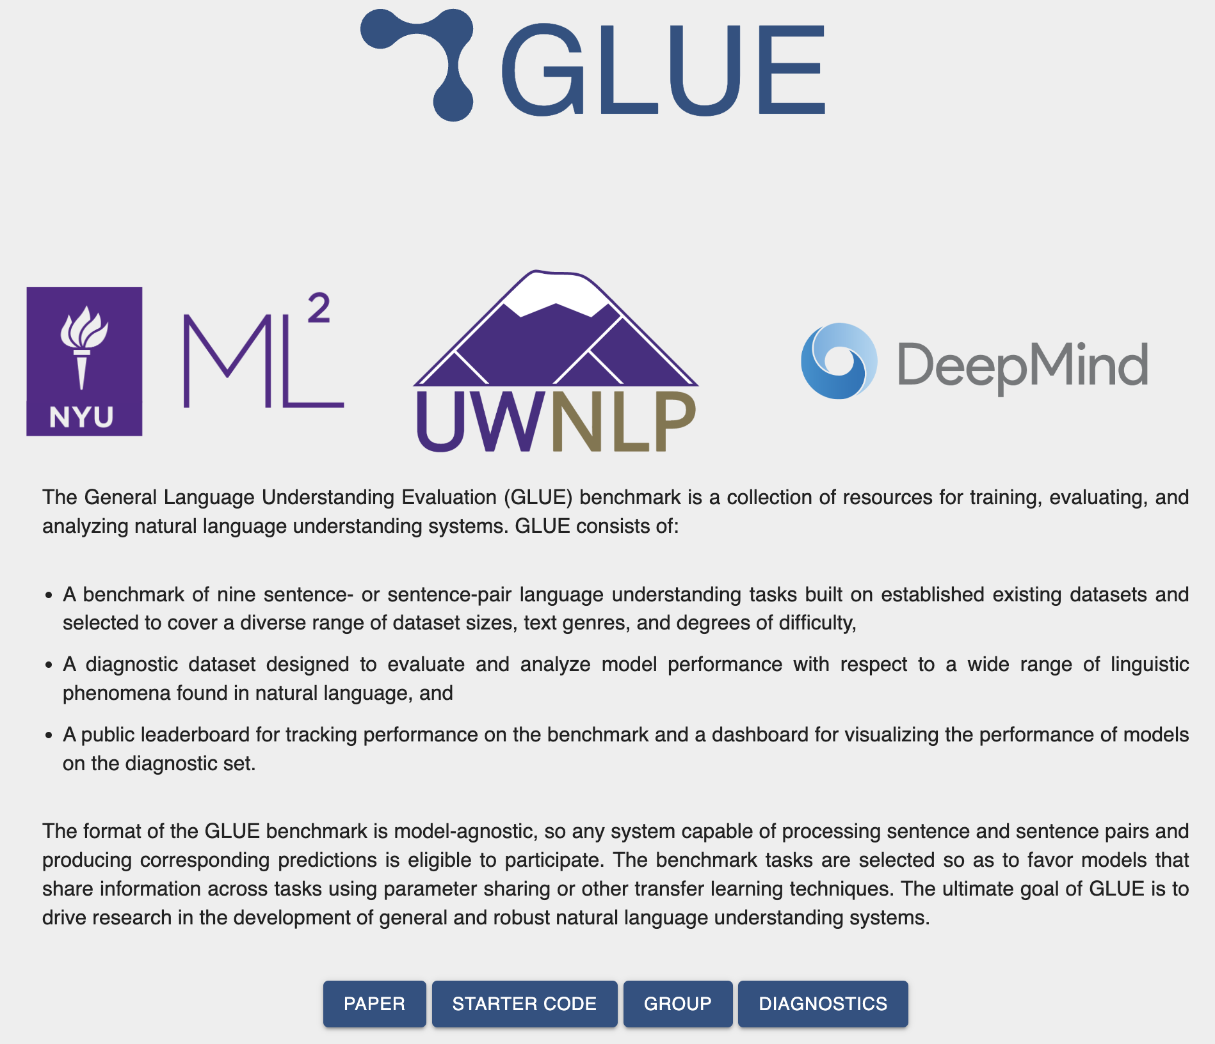
GLUE https://gluebenchmark.com/
General Language Understanding Evaluation (GLUE) benchmark
  A collection of NLU tasks including QA, sentiment analysis, and textual entailment, and an associated online platform for model evaluation, comparison, and analysis.
Wang, Alex, Amanpreet Singh, Julian Michael, Felix Hill, Omer Levy, and Samuel R. Bowman. “GLUE: A multi-task benchmark and analysis platform for natural language understanding.”, 2018
https://huggingface.co/datasets/nyu-mll/glue
Notes:
GLUE 是2018由DeepMind 华盛顿大学 以及纽约大学开发的，它是一个包含自然语言理解（NLU）任务的集合，包括QA、情感分析和文本蕴含，以及一个用于模型评估、比较和分析的在线平台。

Slide 4
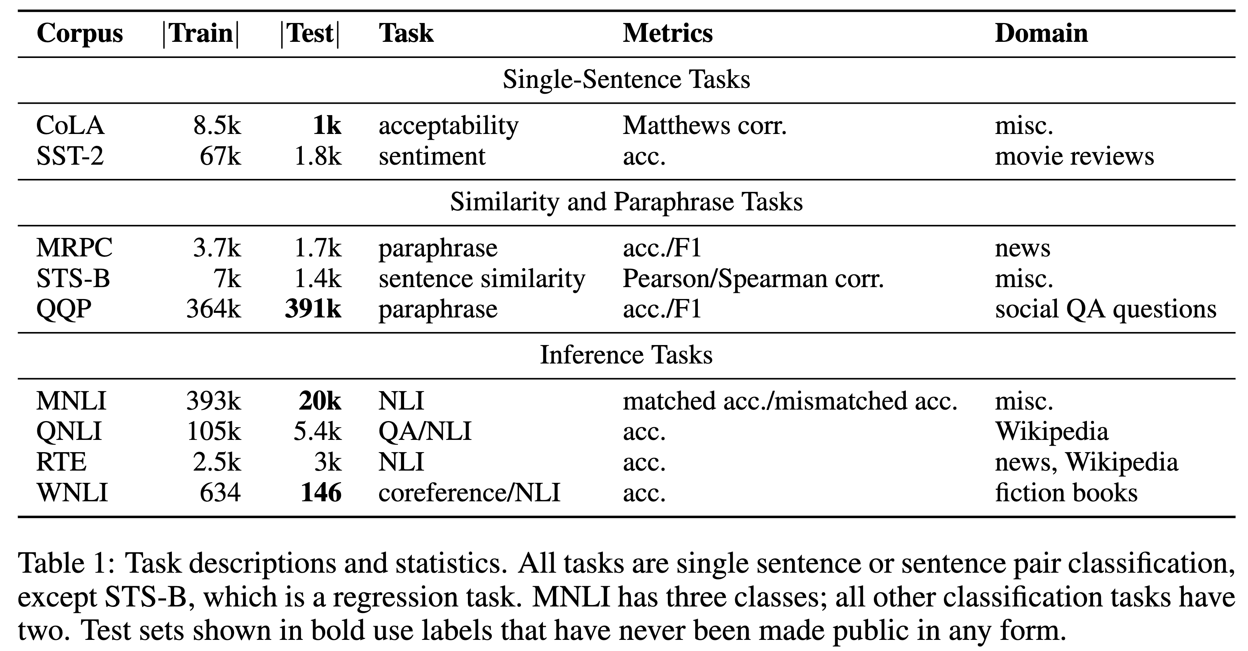
GLUE https://gluebenchmark.com/
https://huggingface.co/datasets/nyu-mll/glue
Notes:
GLUE包含了9个任务，每一个任务都有对应的训练集和测试集合，以及具体的任务内容、模型评估指标。下面将依次介绍一下每一个任务。

Slide 5
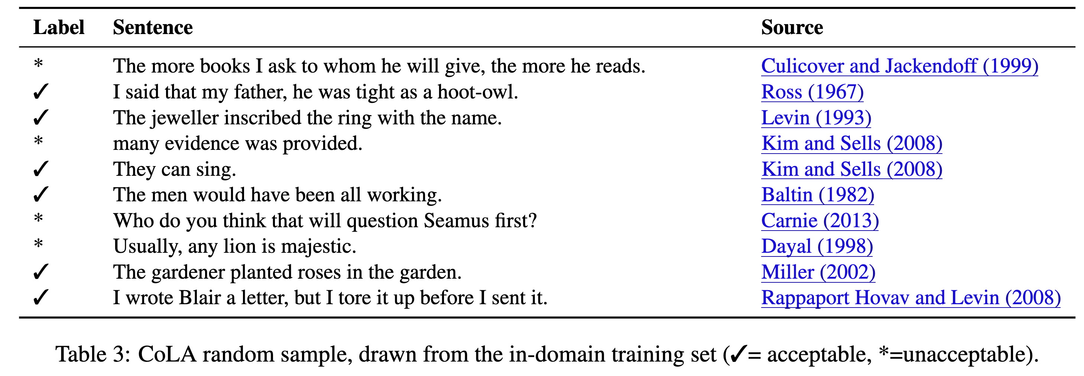
GLUE 1. Single-sentence tasks
Corpus of Linguistic Acceptability (CoLA)
  English acceptability judgments drawn from books and journal articles on linguistic theory
  Each example is a sequence of words annotated with whether it is a grammatical English sentence. Score is between [-1,1]
https://huggingface.co/datasets/nyu-mll/glue
Notes:
CoLA，语言可接受性语料库（The Corpus of Linguistic Acceptability）： CoLA 语料库包括来自 23 篇语言学出版物的 10,657 个句子，由原作者根据可接受性（即语法性）进行了专业标注。GLUE提供的版本包含用于训练和验证集的 9,594 个句子，排除了属于保留测试集的 1,063 个句子。
主要从语言学理论的书籍和期刊文章中收集的英语句子，对每一个句子的可接受性进行判断。
每个示例都是一个词序列，并标注其是否为符合语法的英文句子。评分范围为 [-1, 1]。
评估指标是 Matthews 相关系数（MCC）分数。MCC是一种用于评估不平衡二分类器的指标。它是皮尔逊相关系数在boolean变量上的一种特例。它衡量的是两个布尔分布之间的相关性，取值范围在 -1 到 1 之间。平均而言，任何两个不相关的分布的 MCC 都为 0，无论类别是否不平衡。相比之下，准确率（accuracy）和 F1 分数更偏向于多数类倾斜的分类器。
域内数据（In-Domain）：这些句子来自与训练数据在风格、主题和复杂度等方面高度一致的来源。换句话说，这些示例代表了模型最常处理的数据类型，用于评估模型在熟悉语境中的表现。例如，如果训练数据主要由文学英语或标准编辑文本构成，那么域内测试数据也将来自类似的来源。

Slide 6
GLUE 1. Single-sentence tasks
The Stanford Sentiment Treebank (SST-2)
  Sentences from movie reviews and human annotations of their sentiment. The task is to predict the sentiment of a given sentence. We use the two-way (positive/negative) class split, and use only sentence-level labels.
    uneasy mishmash of styles and genres
    it's also heavy-handed and devotes too much time to bigoted views
    waydowntown is by no means a perfect film, but its boasts a huge charm factor and smacks of originality
    a remarkable 179-minute meditation on the nature of revolution
    starts off with a bang , but then fizzles like a wet stick of dynamite at the very end
https://huggingface.co/datasets/nyu-mll/glue
Notes:
句子来自电影评论，并附有人类对其情感倾向的标注。该任务旨在预测给定句子的情感倾向。我们采用二分类（正面/负面）的方式，并仅使用句子级别的标签。
风格和流派的令人不安的混杂
它也很严厉，花太多时间在偏执的观点上
《waydowntown》绝不是一部完美的电影，但它拥有巨大的魅力和原创性
长达 179 分钟的对革命本质的非凡思考
开始时发出一声巨响，但最后却像一根湿炸药棒一样嘶嘶作响

Slide 7
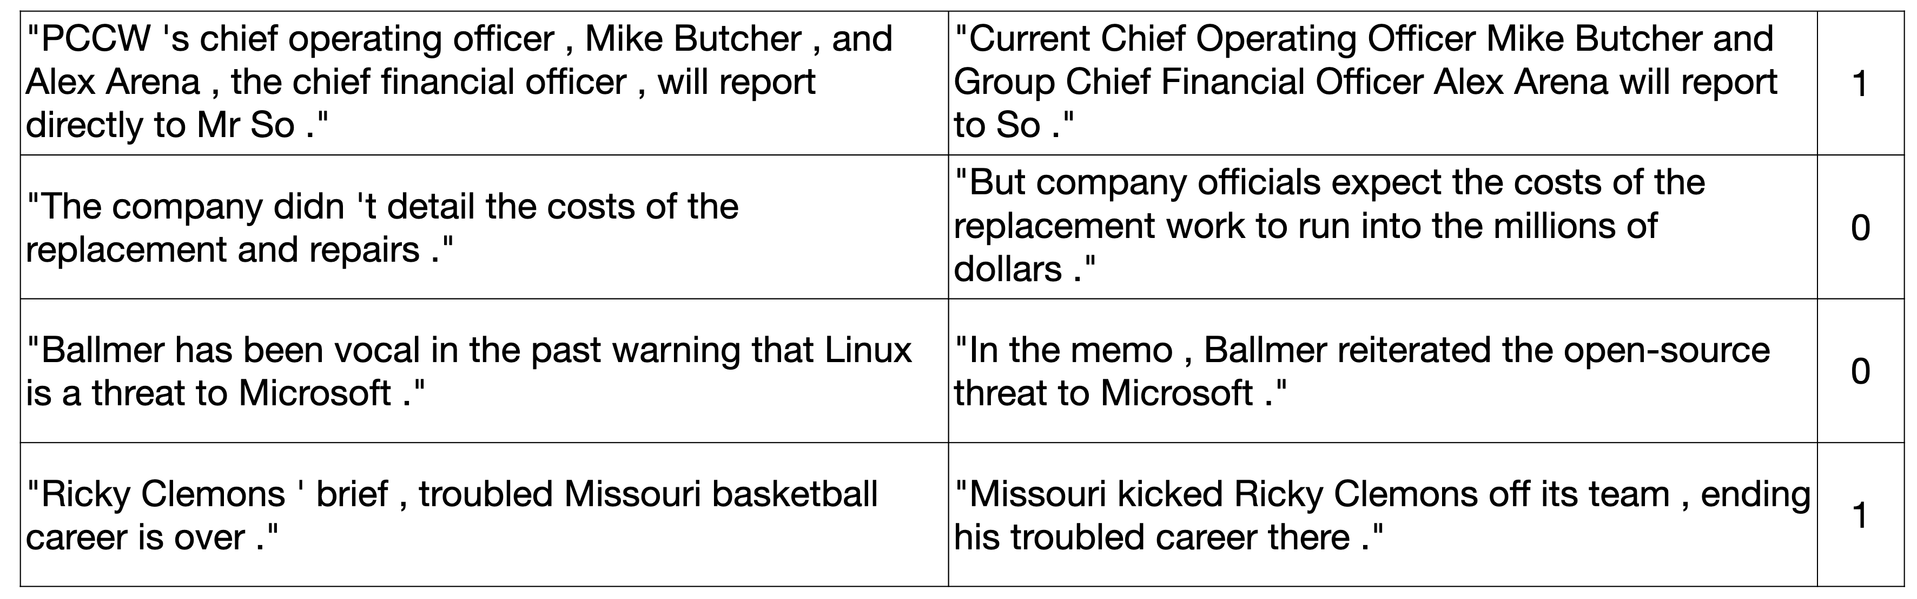
GLUE 2. Similarity and Paraphrase Tasks
Microsoft Research Paraphrase Corpus (MRPC)
  Sentence pairs with human annotations whether sentences are semantically equivalent
  Classes are imbalanced (68% positive)
https://huggingface.co/datasets/nyu-mll/glue
Notes:
微软研究院释义语料库（Microsoft Research Paraphrase Corpus，MRPC）
该语料库由成对的句子组成，并附有人类对句子语义是否等价的标注。
类别分布不均衡（68% 为正类），因此评估时同时报告准确率（Accuracy）和 F1 分数。

Slide 8
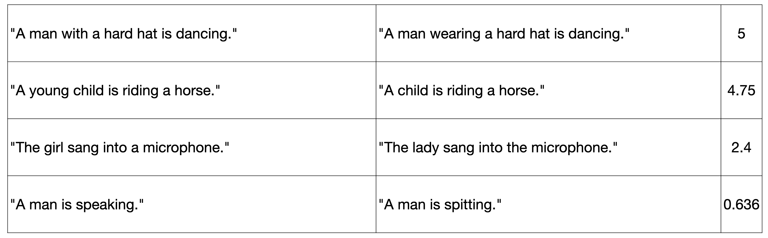
GLUE 2. Similarity and Paraphrase Tasks
The Semantic Textual Similarity Benchmark (STS-B)
  Sentence pairs drawn from various sources, human annotated with similarity score from 1 to 5
  Task: predict [1,5]. Report Pearson and Spearman correlation coefficients

Slide 9
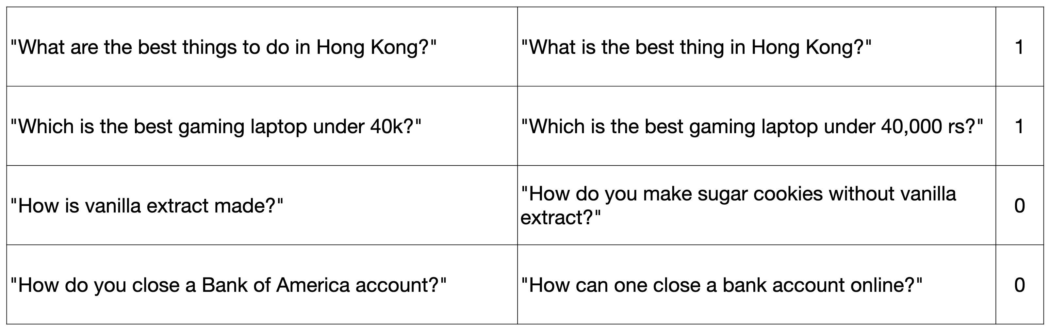
GLUE 2. Similarity and Paraphrase Tasks
Quora Question Pairs (QQP)
  Question pairs from community QA website, Quora
  Classes are imbalanced (63% negative) so accuracy and F1 score is reported

Slide 10
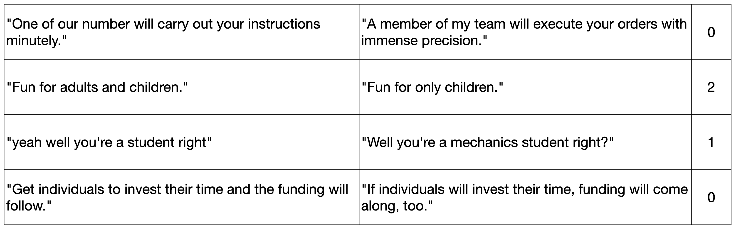
GLUE 3. Inference Tasks
Multi-Genre Natural Language Inference Corpus (MNLI)
  Crowd-sourced sentence pairs with entailment annotations: entailment (0), contradiction (2) and neutral (1)
  Task: predict these three labels
Notes:
多领域自然语言推理语料库（Multi-Genre Natural Language Inference Corpus，MNLI）
该语料库收集（众包）的句子对组成，并标注了推理关系：蕴含（entailment，0）、矛盾（contradiction，2）和中性（neutral，1）。
任务目标是预测这三类标签，评估指标为准确率（accuracy）。

Slide 11
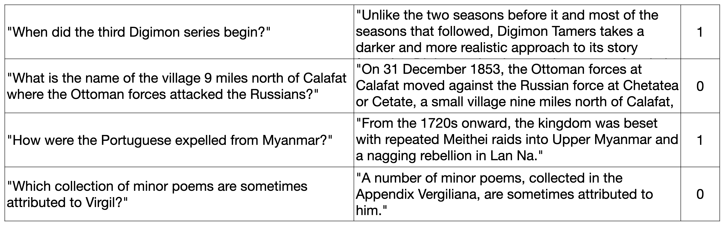
GLUE 3. Inference Tasks
The Stanford Question Answering Dataset (QNLI based on SQuAD)
  Task converted into sentence pair classification by forming a pair between each question and each sentence in the corresponding context, and filtering out pairs with low lexical overlap between the question and the context sentence
  Task: predict yes (0) or no (1), the context sentence contains the answer to the question
Notes:
斯坦福问答数据集（The Stanford Question Answering Dataset，QNLI，基于 SQuAD）
该任务被转换为句子对分类任务：将每个问题与对应语境中的每个句子配对，并过滤掉与问题在词汇上重合度较低的句子对。
任务目标是预测“是（yes，0）”或“否（no，1）”，即判断该语境句子是否包含问题的答案。
一些小诗被收录在《维吉尔附录》中，有时被认为是他写的。

Slide 12
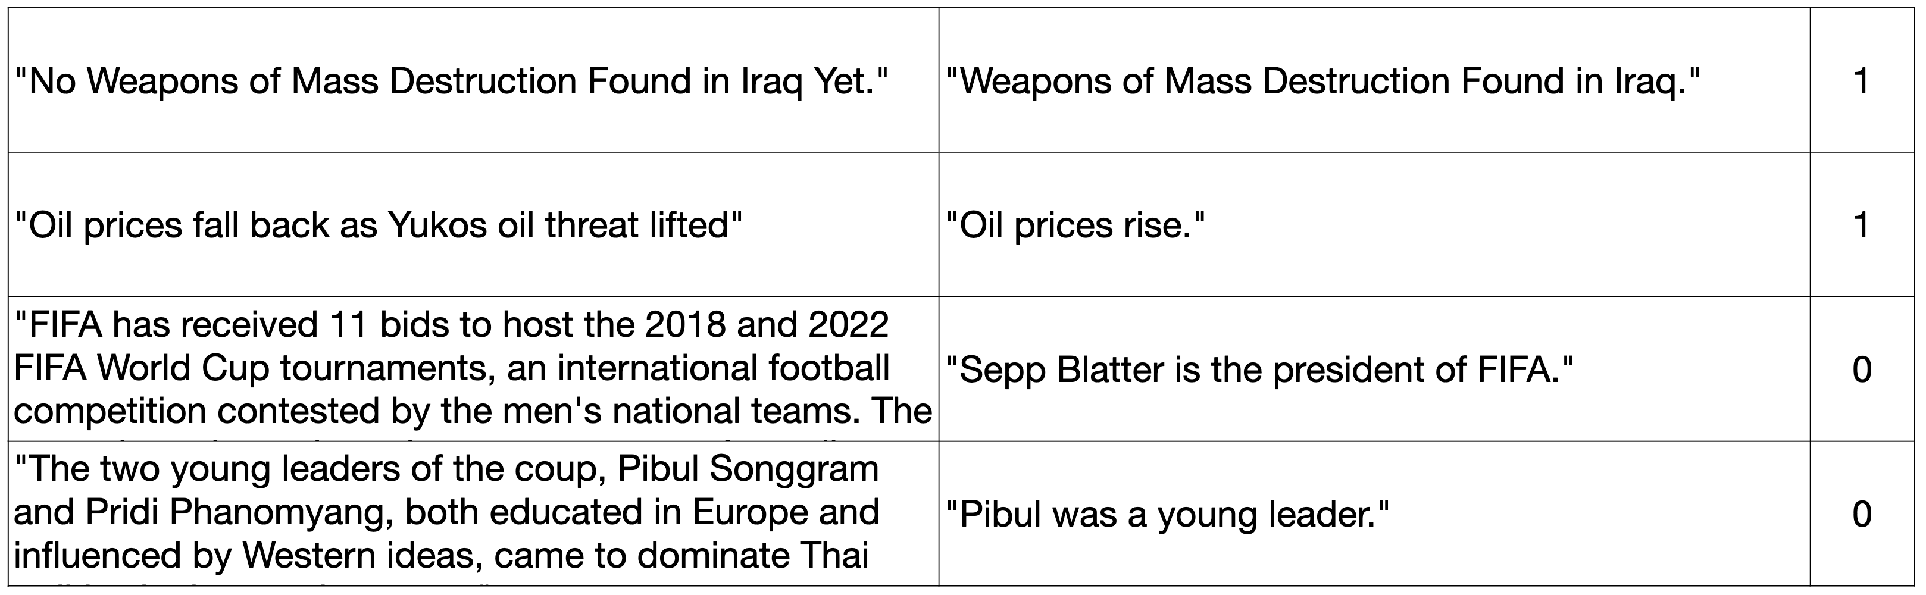
GLUE 3. Inference Tasks
The Recognizing Textual Entailment (RTE)
  The task is to predict entailment (0) or not entailment (1) between pairs of sentences
Notes:
文本蕴含识别任务（Recognizing Textual Entailment，RTE）
该任务旨在判断句子对之间是否存在蕴含关系，预测结果为“蕴含（entailment，0）”或“非蕴含（not entailment，1）”。
尤科斯石油公司（OJSC “Yukos Oil Company”）是一家总部位于俄罗斯莫斯科的石油天然气公司。

Slide 13
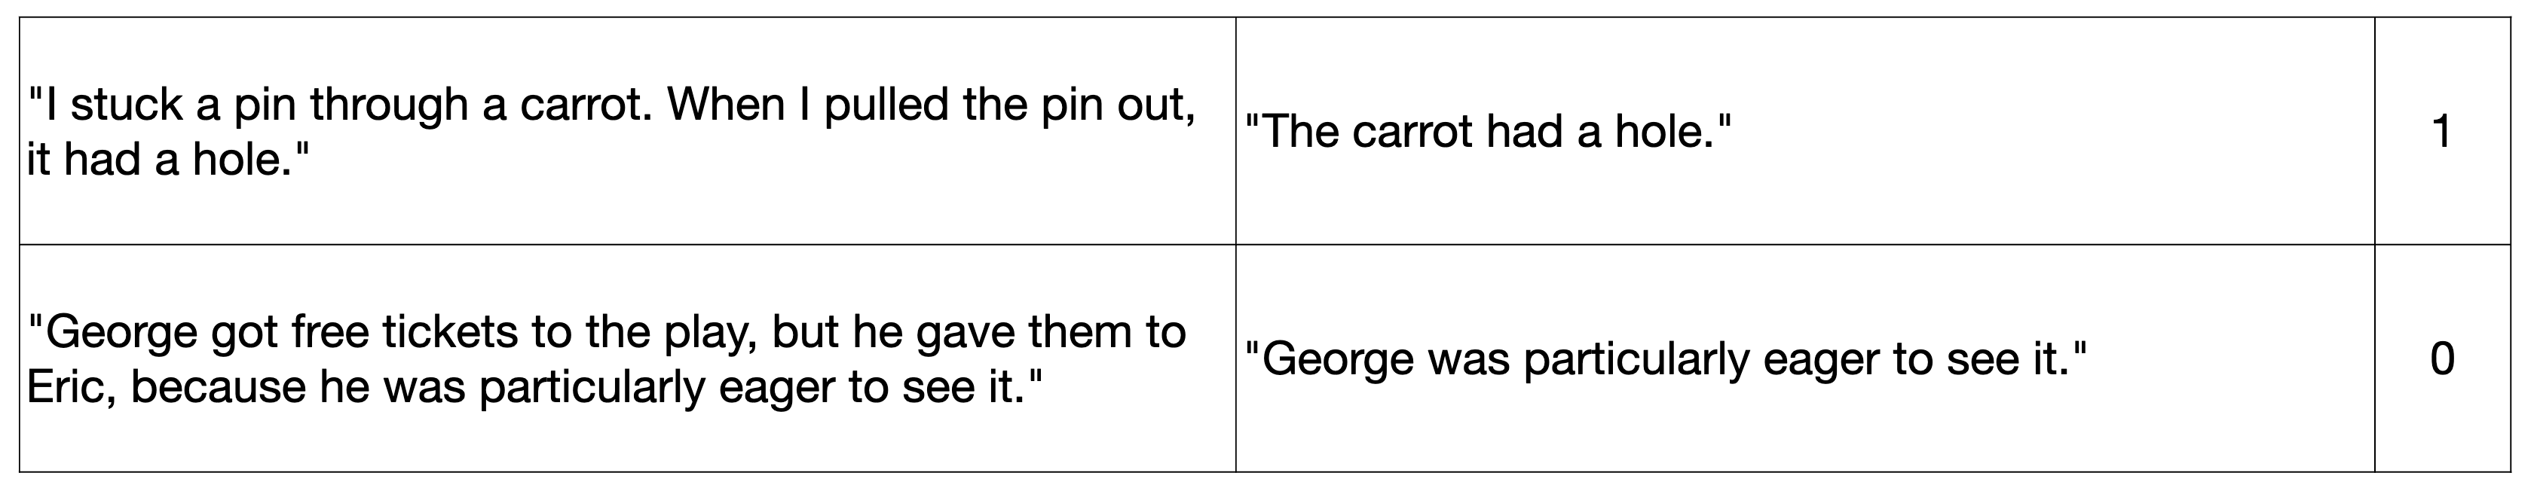
GLUE 3. Inference Tasks
The Winograd Schema Challenge (WNLI)
  Reading comprehension task to identify referent of a pronoun using entailment between two sentences (one has pronoun reference explicit)
  Predict 1 (entailment) or 0 (not entailment)
  Designed to fool simple statistical techniques
  Test set is imbalanced (65% not entailment) and dev set is adversarial (memorization will hurt performance)
Notes:
The Winograd Schema Challenge，WNLI：阅读理解任务，旨在通过判断两个句子之间的蕴含关系来识别代词的指代对象（其中一个句子明确指代对象）。
任务目标是预测 1（存在蕴含关系）或 0（不存在蕴含关系）。
该任务旨在迷惑简单的统计方法。
测试集类别不平衡（65% 为非蕴含），开发集具有对抗性，依赖记忆的模型会表现不佳。

Slide 14
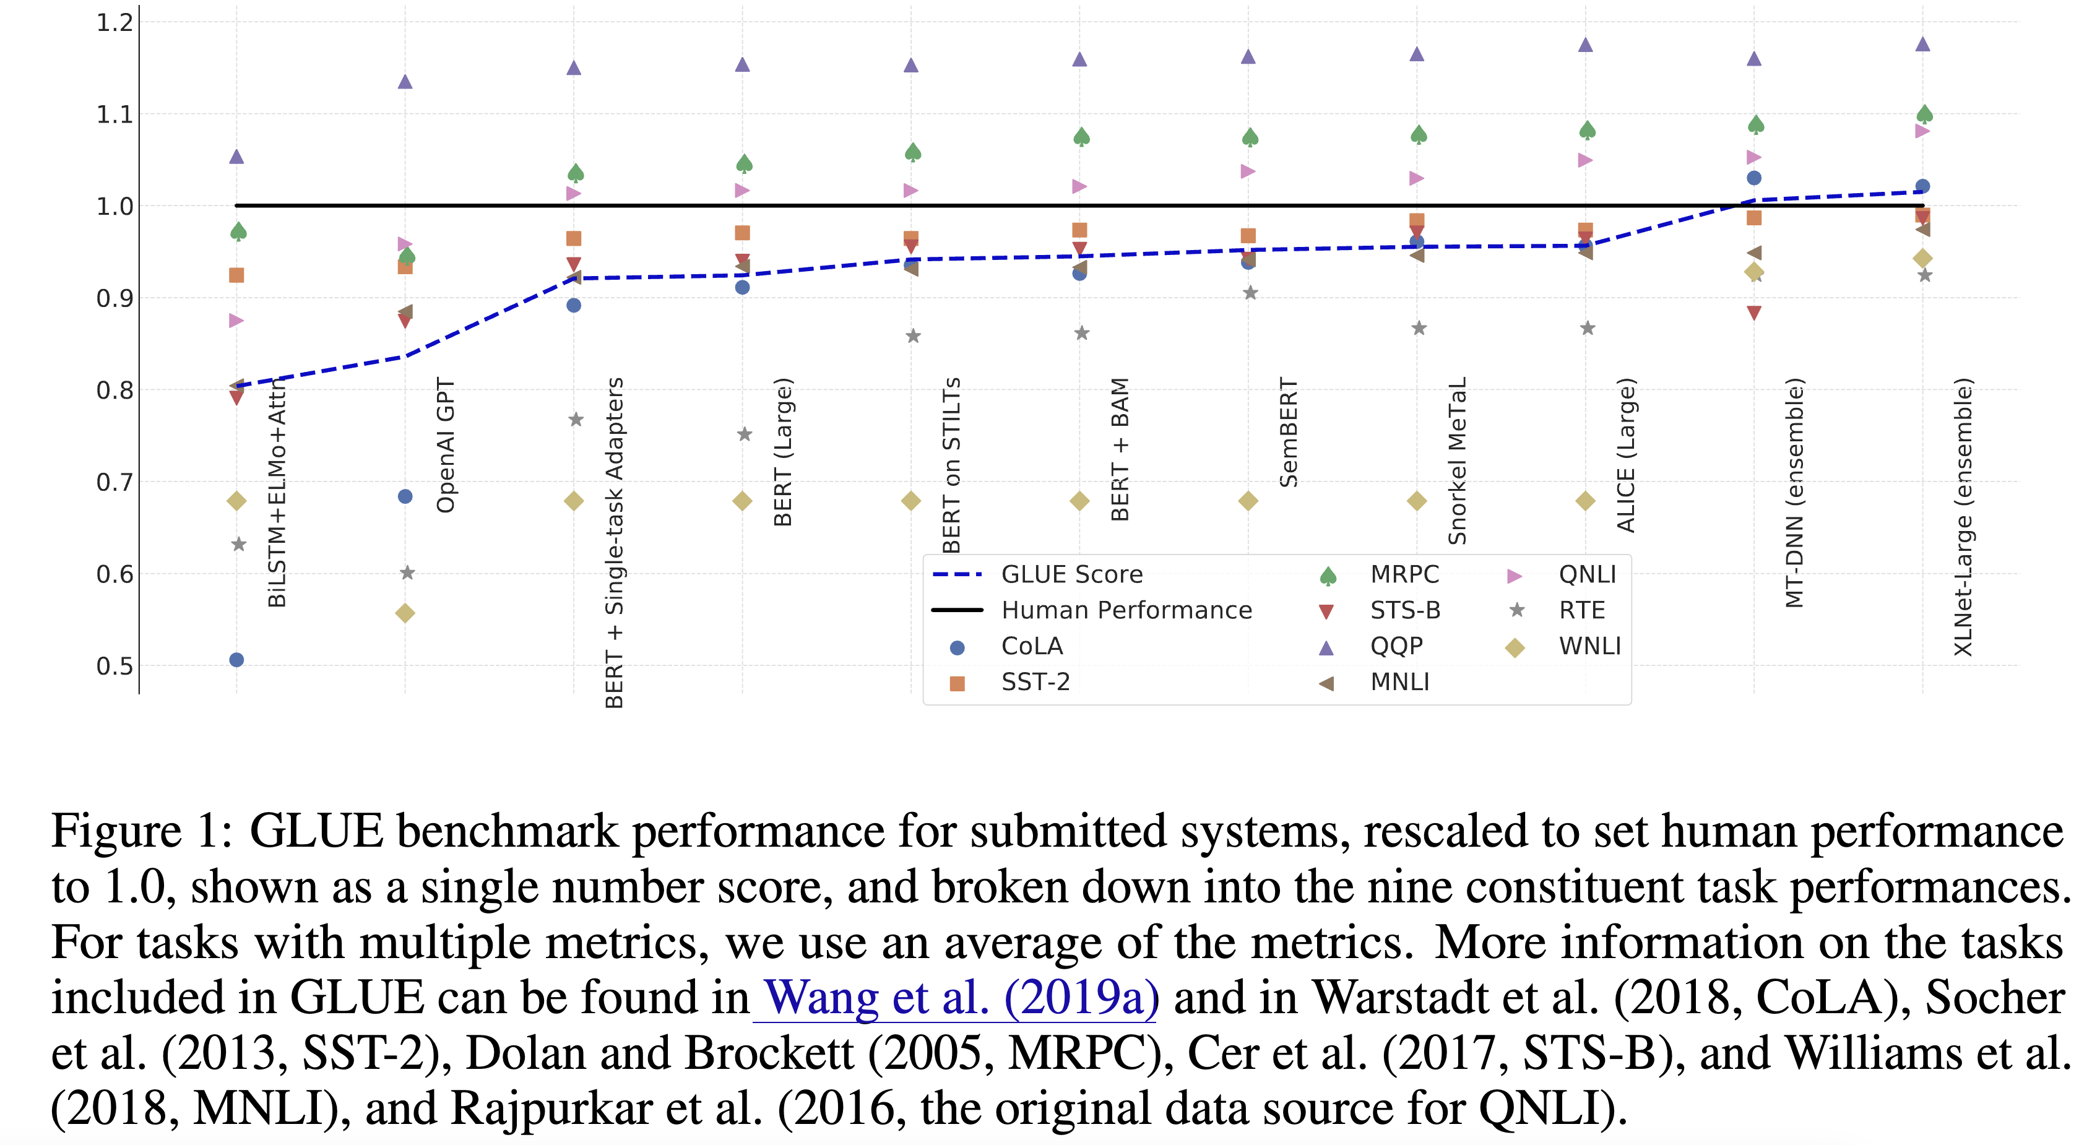
GLUE benchmark performance

Slide 15
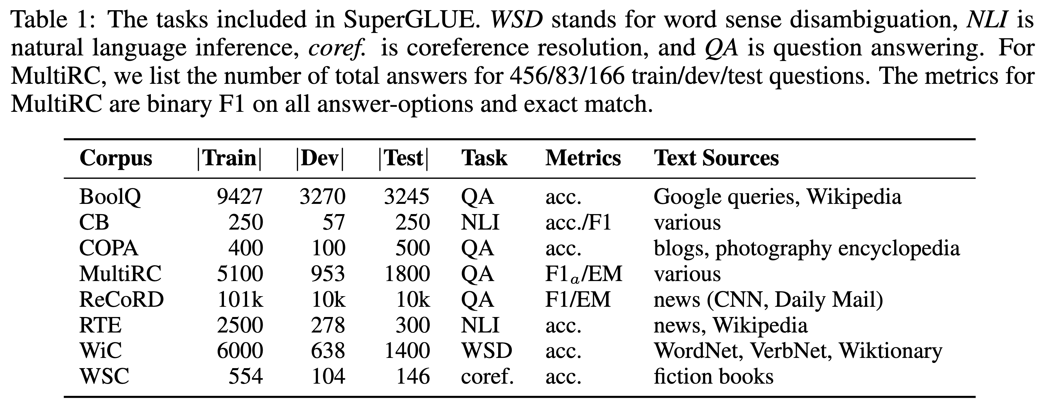
SuperGLUE https://super.gluebenchmark.com/
GLUE was too easy for LLMs after July 2019
SuperGLUE is a more rigorous test of NLU
https://huggingface.co/datasets/aps/super_glue
Notes:
SuperGLUE 所包含的任务。WSD 词义消歧（word sense disambiguation），NLI 自然语言推理（natural language inference），coref. 表示指代消解（coreference resolution），QA 表示问答（question answering）。对于 MultiRC，列出了训练集、开发集和测试集问题所对应的总回答数，分别为 456/83/166。MultiRC 的评估指标为：所有答案选项上的二分类 F1 分数和完全匹配（exact match）分数。

Slide 16
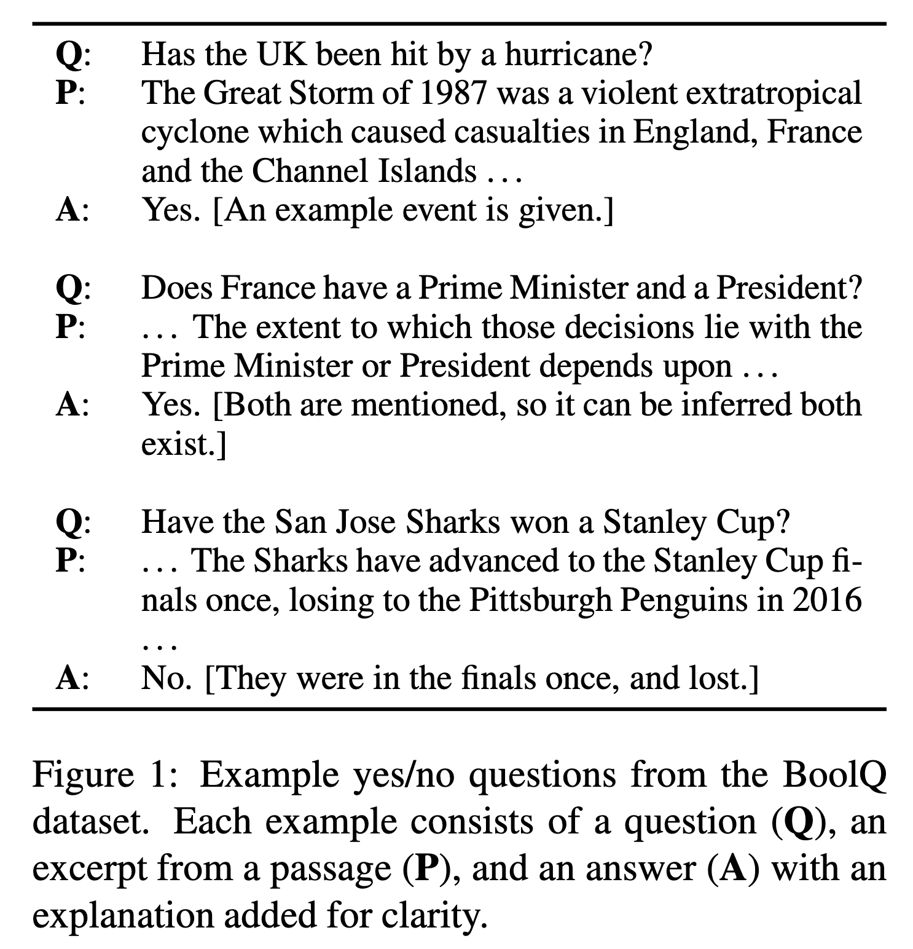
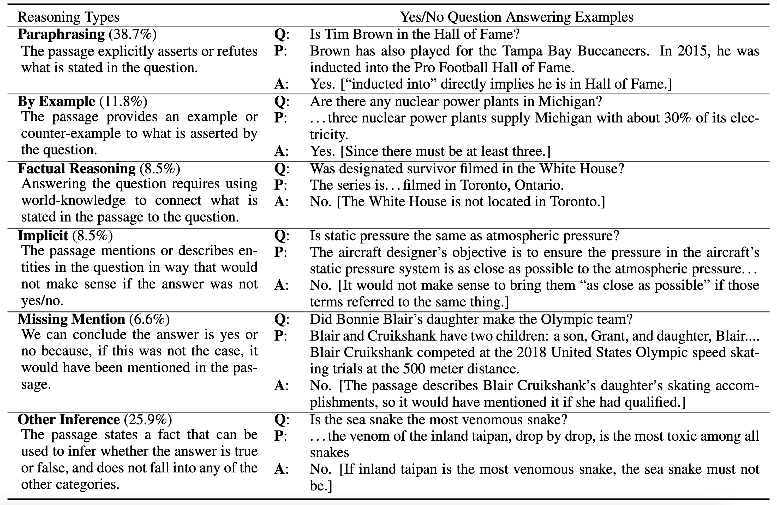
SuperGLUE 1. BoolQ
Boolean Questions, QA task with yes/no answers (BoolQ)
Kinds of reasoning needed in the BoolQ dataset
https://huggingface.co/datasets/aps/super_glue
Notes:
inducted into : to admit as a member

Slide 17
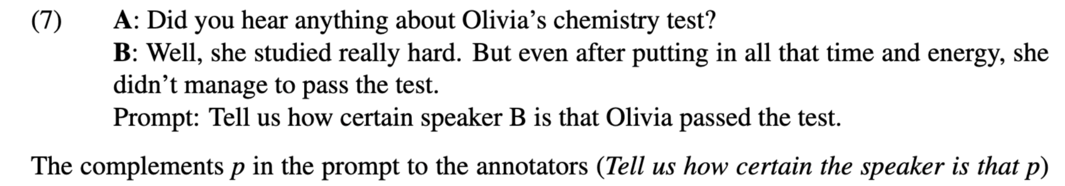
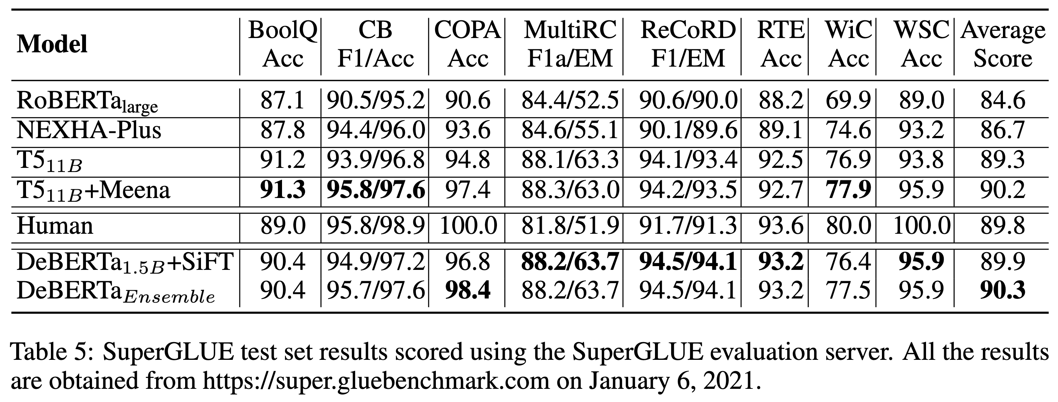
SuperGLUE 2. CB
CommitmentBank (CB): Is author committed to truth of embedded clause? Each example consists of a premise containing an embedded clause and the corresponding hypothesis is the extraction of that clause.
Notes:
CommitmentBank（CB）：判断作者是否对嵌套从句的真实性表达了承诺。每个示例由一个包含嵌套从句的前提句组成，其对应的假设则是从该从句中提取出来的内容。

Slide 18
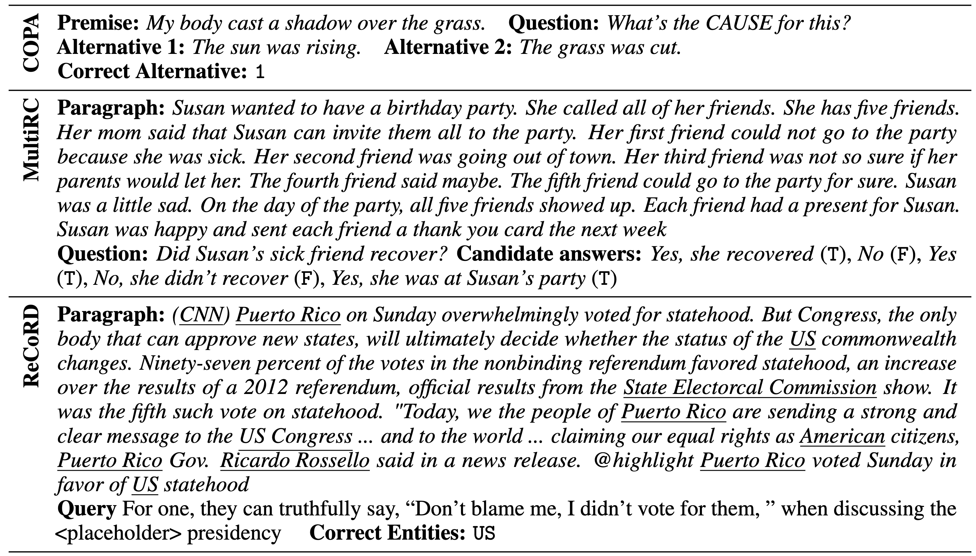
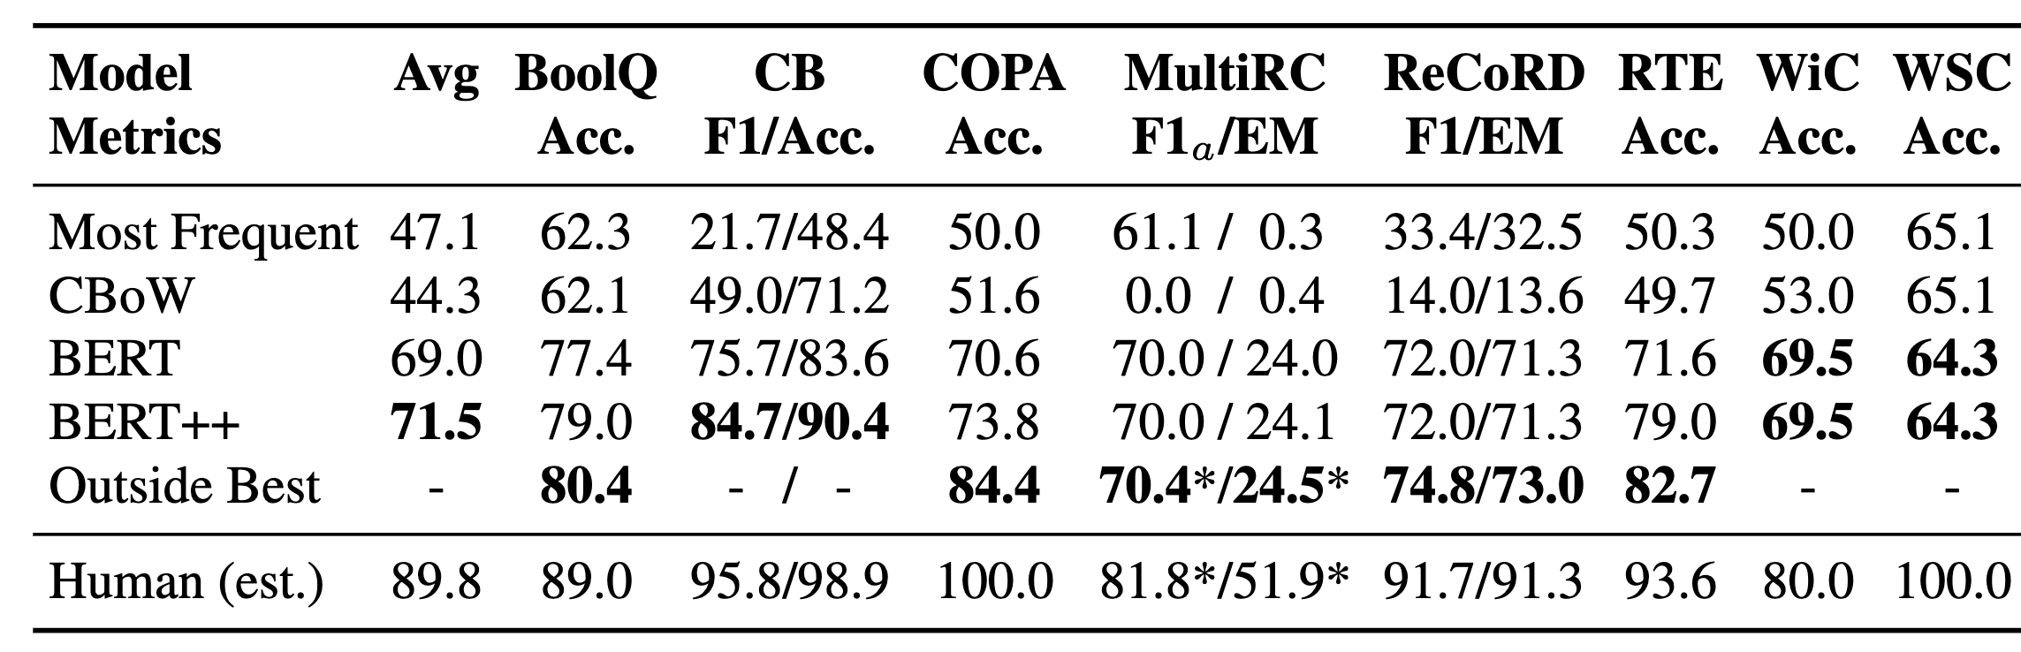
SuperGLUE 3. COPA
Choice of Plausible Alternatives, causal reasoning task
Notes:
合理选项选择任务（Choice of Plausible Alternatives），是一项因果推理任务。

Slide 19
SuperGLUE 4. MultiRC
Multi-Sentence Reading Comprehension

Slide 20
SuperGLUE 5. ReCoRD
Reading Comprehension with Commonsense Reasoning Dataset

Slide 21
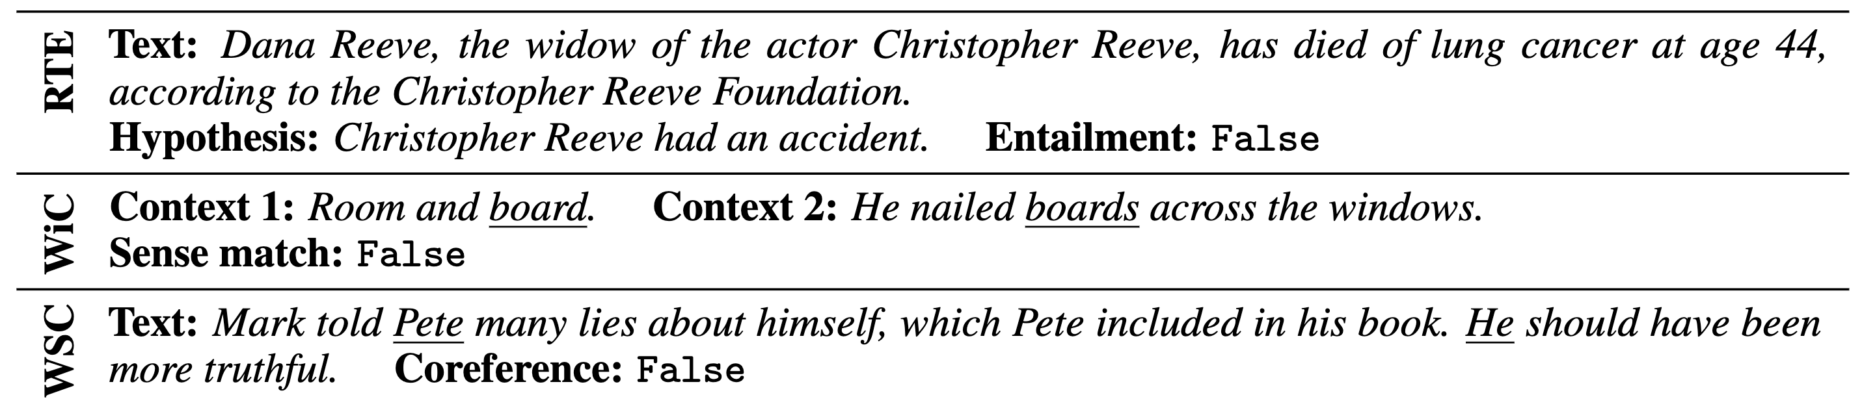
SuperGLUE 6. RTE
Recognizing Textual Entailment
  RTE1
  RTE3
  RTE5

Slide 22
SuperGLUE 7. WiC
Word-In-Context: word sense disambiguation task cast as binary classification of sentence pairs
Notes:
在WiC的例子里面，
语境 1：食宿。
语境 2：他在窗户上钉上了木板。
词义匹配：否（False）

Slide 23
SuperGLUE 8. WSC
Coreference resolution task in which examples consist of a sentence with a pronoun and a list of noun phrases from the sentence
Notes:
指代消解任务（Coreference resolution task），每个示例由一个包含代词的句子以及该句子中的名词短语列表组成。

Slide 24
Outline
GLUE/SuperGLUE
SWAG/HellaSWAG
Lambada
Other datasets
Datasets by task types

Slide 25
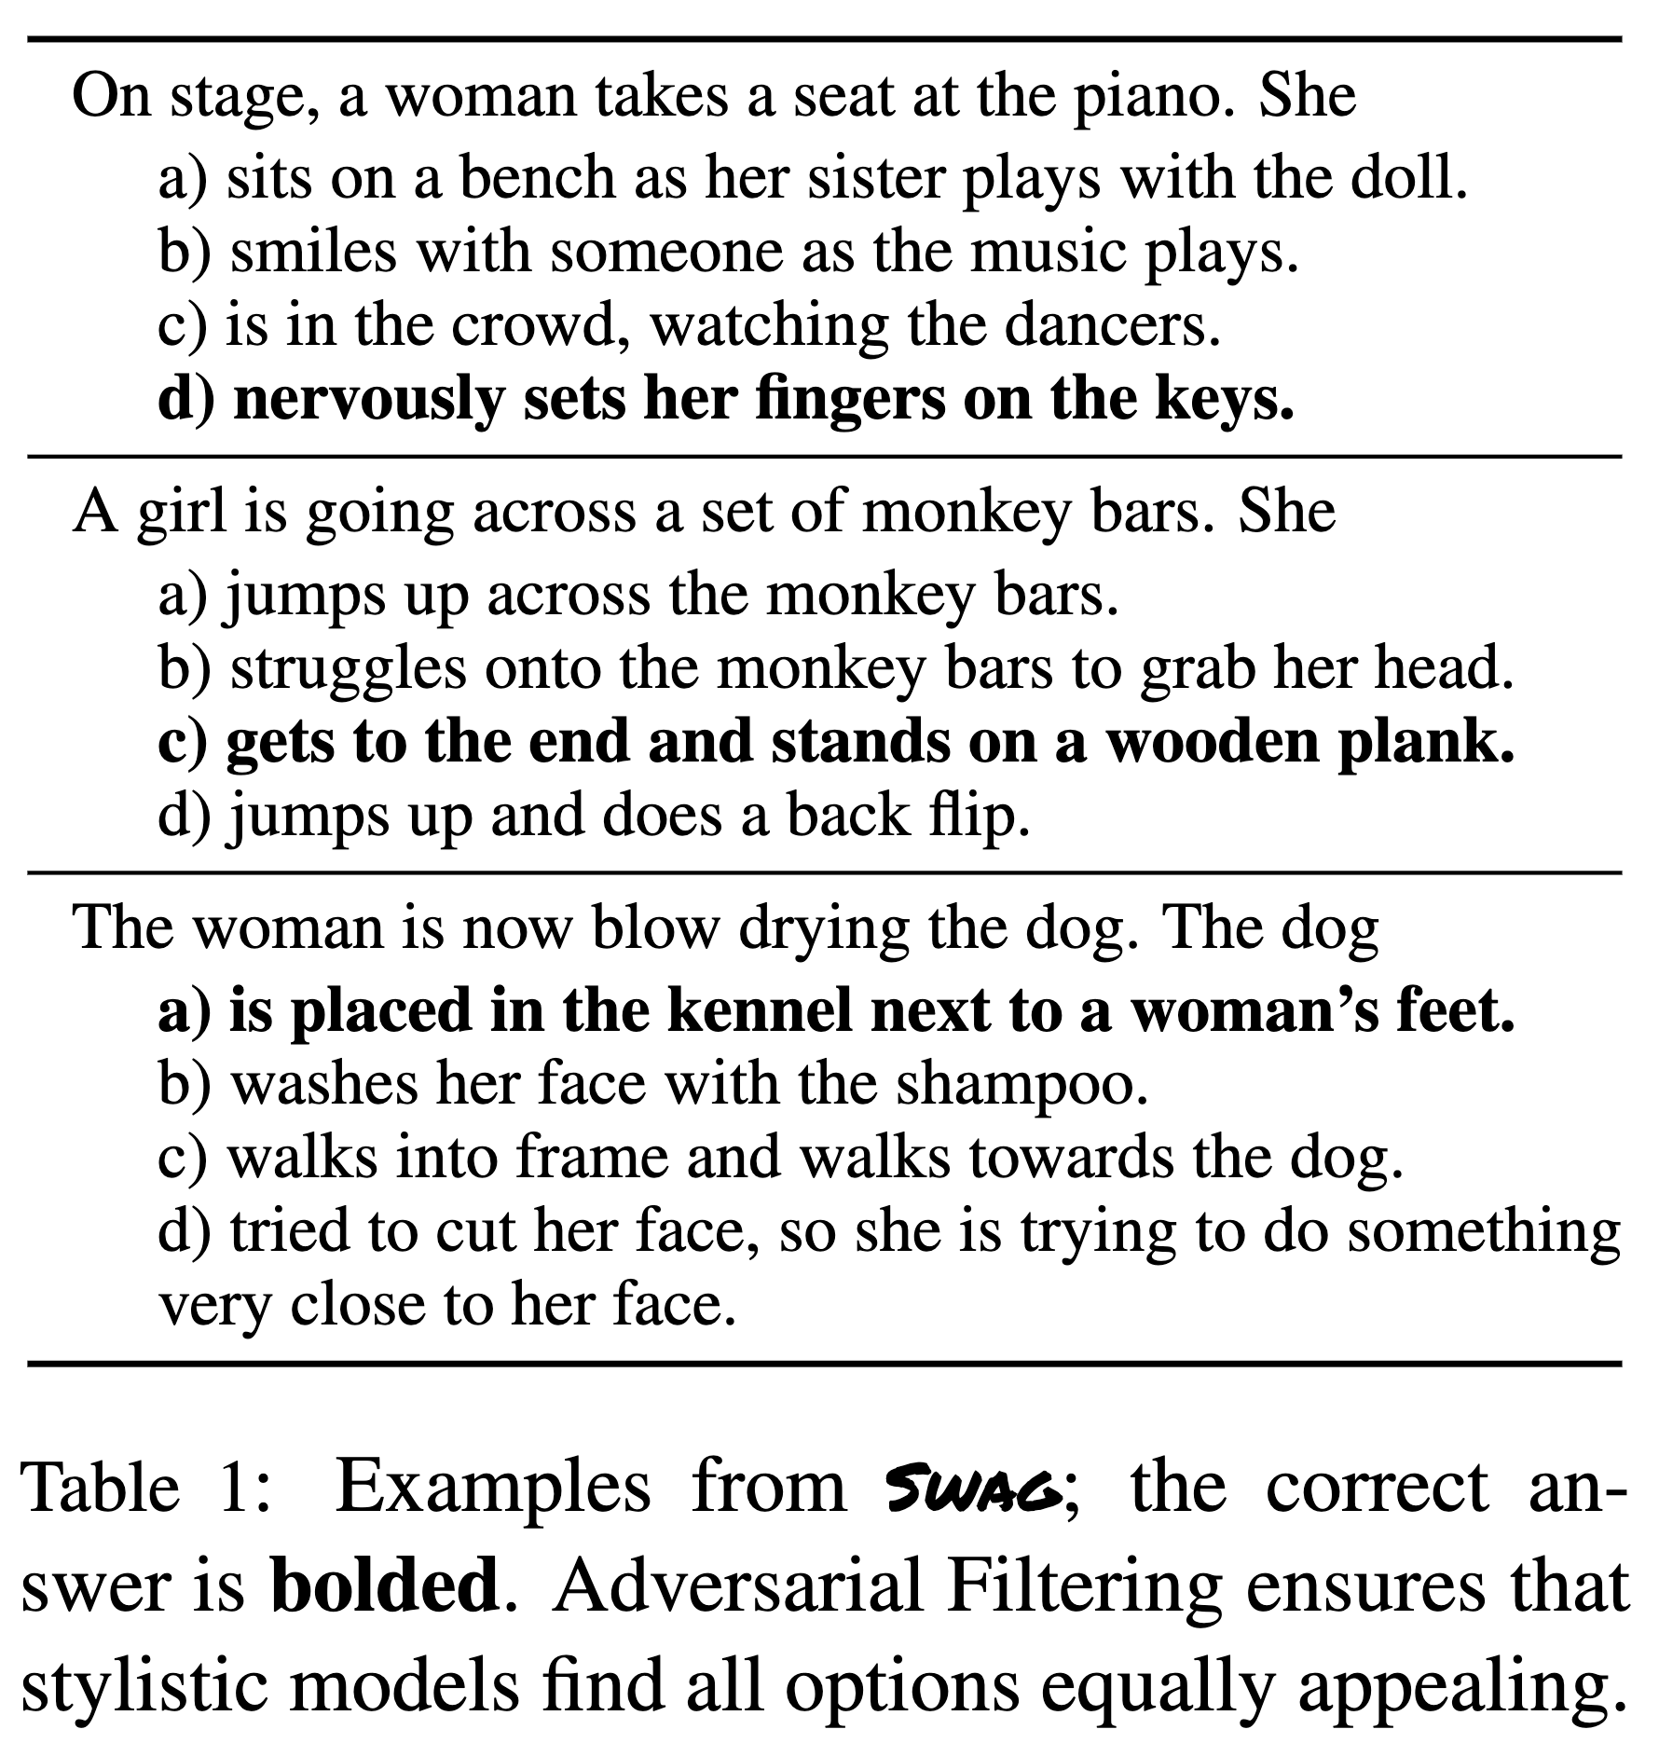
SWAG Situations With Adversarial Generations (SWAG)
Large-scale adversarial dataset for grounded commonsense inference
  A new dataset with 113k multiple choice questions about a rich spectrum of grounded situations
• Given a partial description: "she opened the hood of the car"
• Humans can reason: "then, she examined the engine"
• Dataset constructed using Adversarial Filtering to identify the answers that are meaning-based rather than based on vocabulary overlap
• "on stage, a woman takes a seat at the piano". What next?
https://huggingface.co/datasets/allenai/swag
Notes:
SWAG（Situations With Adversarial Generations）是一个用于常识推理的大规模对抗性数据集。
该新数据集包含 11.3 万道多项选择题，涵盖了丰富多样的具体情境。
给出一个不完整的描述：“她打开了汽车的引擎盖”，我们可以推理出：“然后，她检查了发动机”
该数据集通过对抗性过滤（Adversarial Filtering）构建，以识别那些基于语义而非词汇重叠的答案。示例：“在舞台上，一位女士坐到了钢琴前。”接下来会发生什么？
在舞台上，一位女士坐到了钢琴前。她接下来：
a) 坐在长椅上，而她的妹妹在玩洋娃娃。
b) 随着音乐的响起与某人微笑互动。
c) 坐在人群中观看舞者表演。
d) 紧张地把手指放在琴键上。
一个女孩正在穿越一组单杠。她接下来会：
a) 跳起来穿过单杠。
b) 吃力地爬上单杠去抓她的头。
c) 到达末端并站在一块木板上。
d) 跳起来做了一个后空翻。

Slide 26
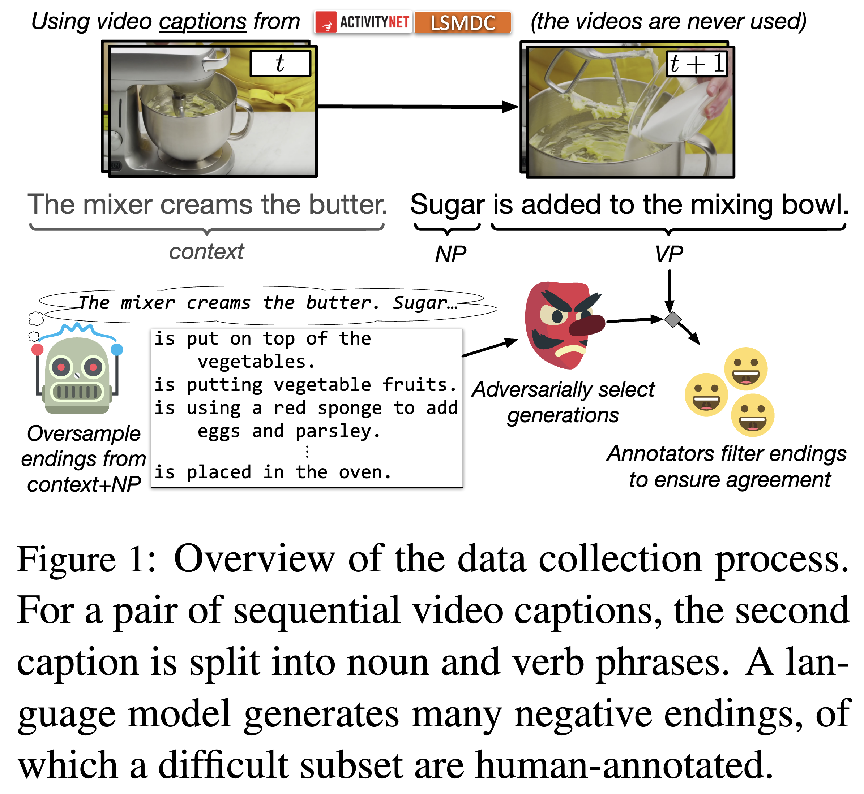
SWAG https://rowanzellers.com/swag/
Our corpus consists of 113k multiple choice questions (73k training, 20k validation, 20k test) and is derived from pairs of consecutive video captions from ActivityNet Captions and and the Large Scale Movie Description Challenge
For each pair of captions, we use a constituency parser to split the second sentence into noun and verb phrases
Each question has a human-verified gold ending and 3 distractors
Soon after release BERT models fine-tuned on Swag obtain 86% accuracy. DeBERTa-large gets 94.12% accuracy
https://huggingface.co/datasets/allenai/swag
Notes:
我们的语料库由 11.3 万道多项选择题组成（包括 7.3 万条训练数据，2 万条验证数据，2 万条测试数据），来源于 ActivityNet Captions 和 Large Scale Movie Description Challenge 中一对对连续的视频字幕。
对于每对字幕，我们使用成分句法分析器将第二句拆分为名词短语和动词短语。
每个问题都包含一个由人工验证的正确结尾（gold ending）和三个干扰选项（distractors）。

Slide 27
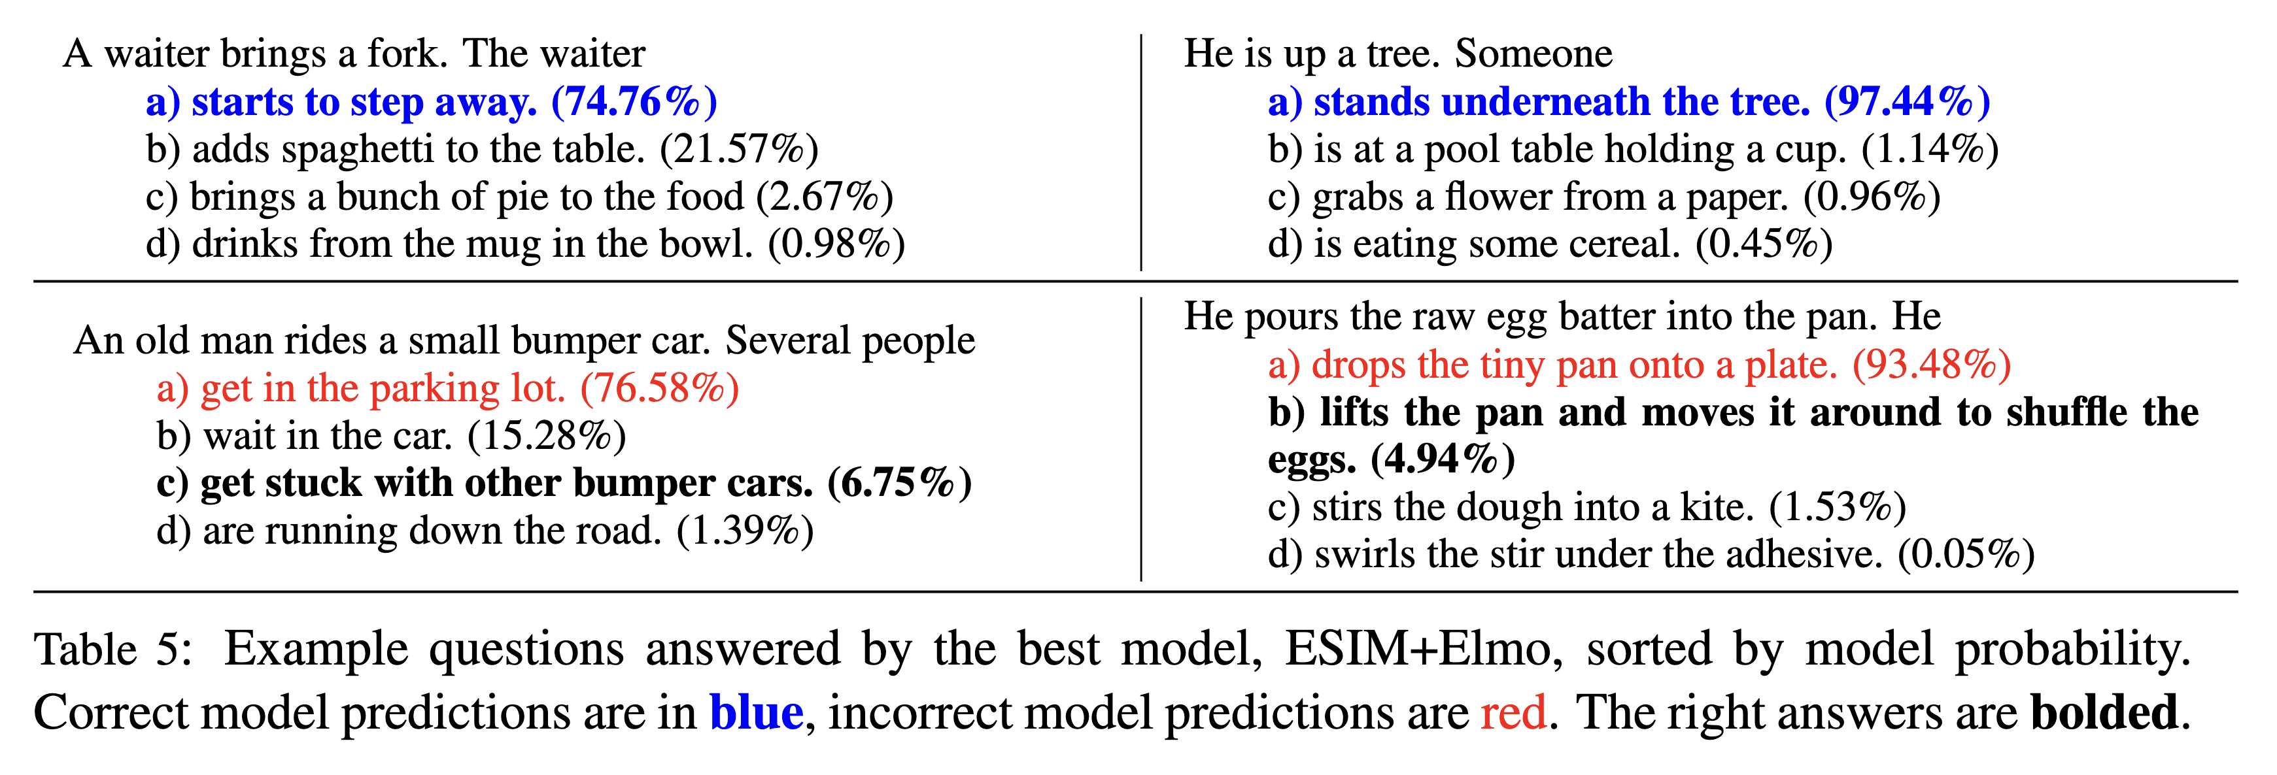
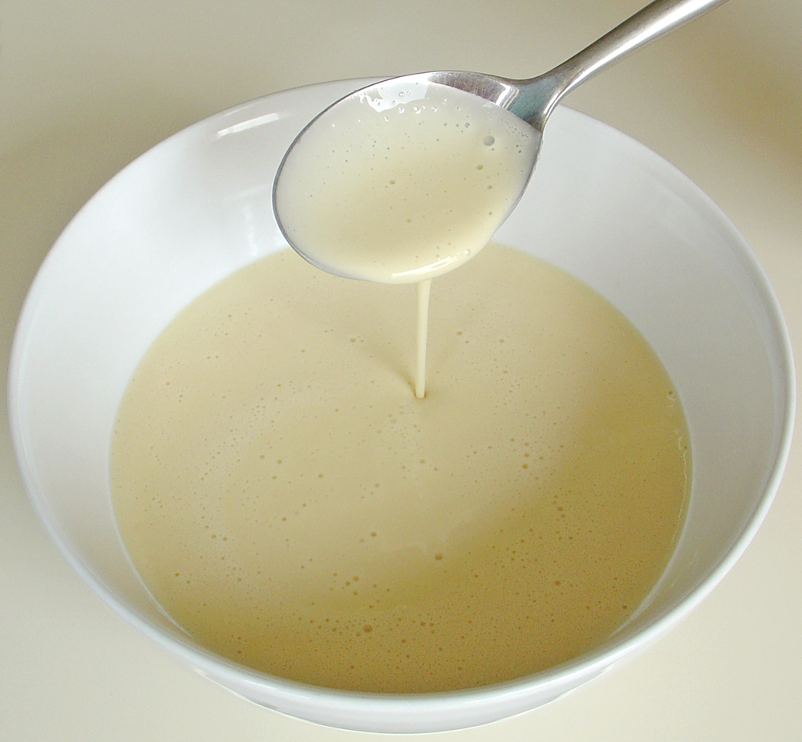
SWAG https://rowanzellers.com/swag/
batter
Answering “An old man rides …” requires knowledge about bumper cars and how they differ from regular cars: bumper cars are tiny, don’t drive on roads, and don’t work in parking lots
Answering “He pours the raw egg …” requires intuitive physical reasoning about what happens next in making an omelet.
Notes:
一位服务员拿来了一把叉子。服务员接下来：
a) 开始转身离开。（74.76%）
b) 往桌上添加了意大利面。（21.57%）
c) 把一堆馅饼端到了食物旁。（2.67%）
d) 从碗里的杯子里喝水。（0.98%）
一位老人正在驾驶一辆小型碰碰车。几个人接下来：
a) 进入停车场。（76.58%）
b) 在车里等待。（15.28%）
c) 被其他碰碰车卡住了。（6.75%）
d) 正在沿着马路奔跑。（1.39%）
他把生鸡蛋糊倒进锅里。他接下来：
a) 把小锅倒扣在盘子上。（93.48%）
b) 拿起锅晃动，使鸡蛋在锅中移动。（4.94%）
c) 把面团搅拌成风筝状。（1.53%）
d) 在粘合剂下搅动搅拌器。（0.05%）

Slide 28
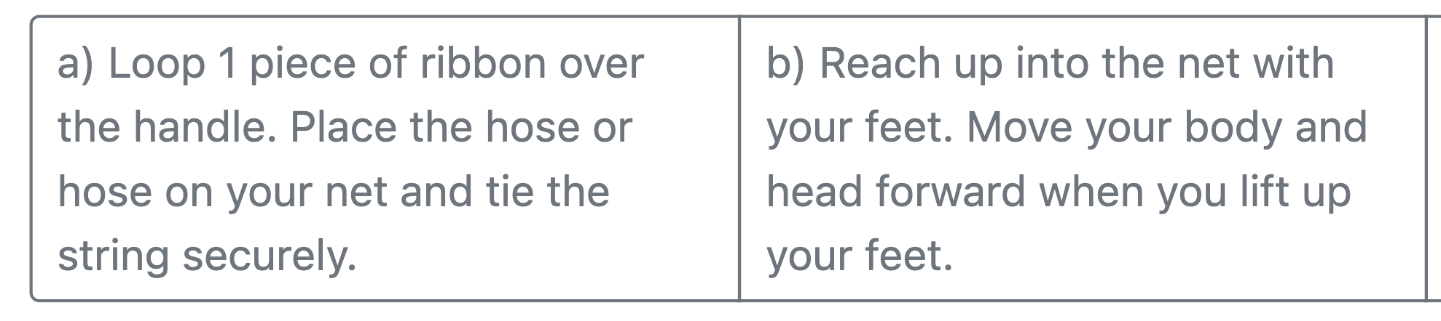
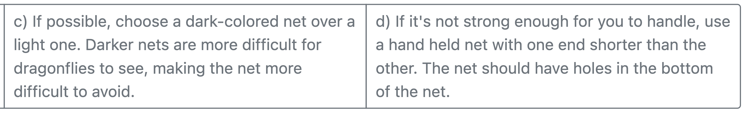
HellaSWAG https://rowanzellers.com/hellaswag/
Can a Machine Really Finish Your Sentence?
Pick the best ending to the context
  How to catch dragonflies. Use a long-handled aerial net with a wide opening. Select an aerial net that is 18 inches (46 cm) in diameter or larger. Look for one with a nice long handle. …
https://huggingface.co/datasets/Rowan/hellaswag
Notes:
模型可以帮你补全句子吗？ 请为以下语境选择一个最合适的结尾：
如何捉蜻蜓：使用带长柄、开口大的中空捕虫网。选择一个直径为 18 英寸（46 厘米）或更大的捕虫网。寻找一款手柄足够长的……
a) 将一段丝带绕过手柄一圈。将软管或软管放在网兜上，并用绳子牢牢绑好。
b) 用双脚伸入网兜。当你抬起双脚时，身体和头部向前移动。
c) 如果可能的话，选择深色的网兜而不是浅色的。深色网兜对蜻蜓来说更难被看见，因此也更难躲避。
d) 如果网兜不够结实，无法让你轻松操作，可以使用一端比另一端短的手持网兜。网兜的底部应有一些小孔。

Slide 29
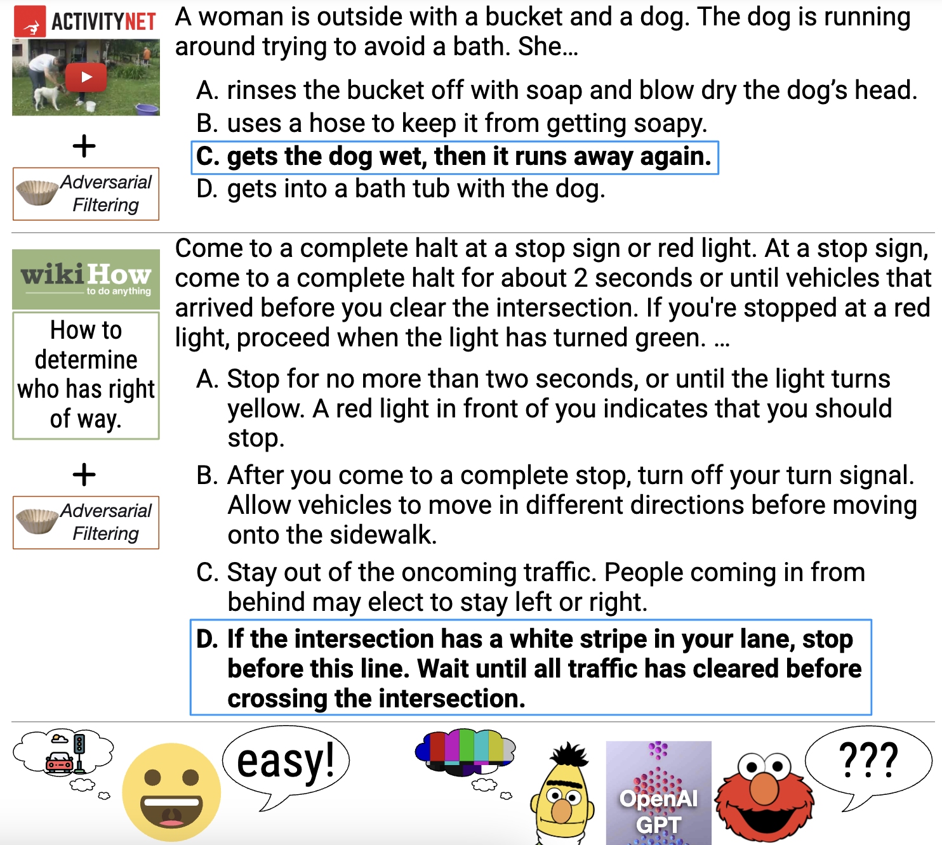
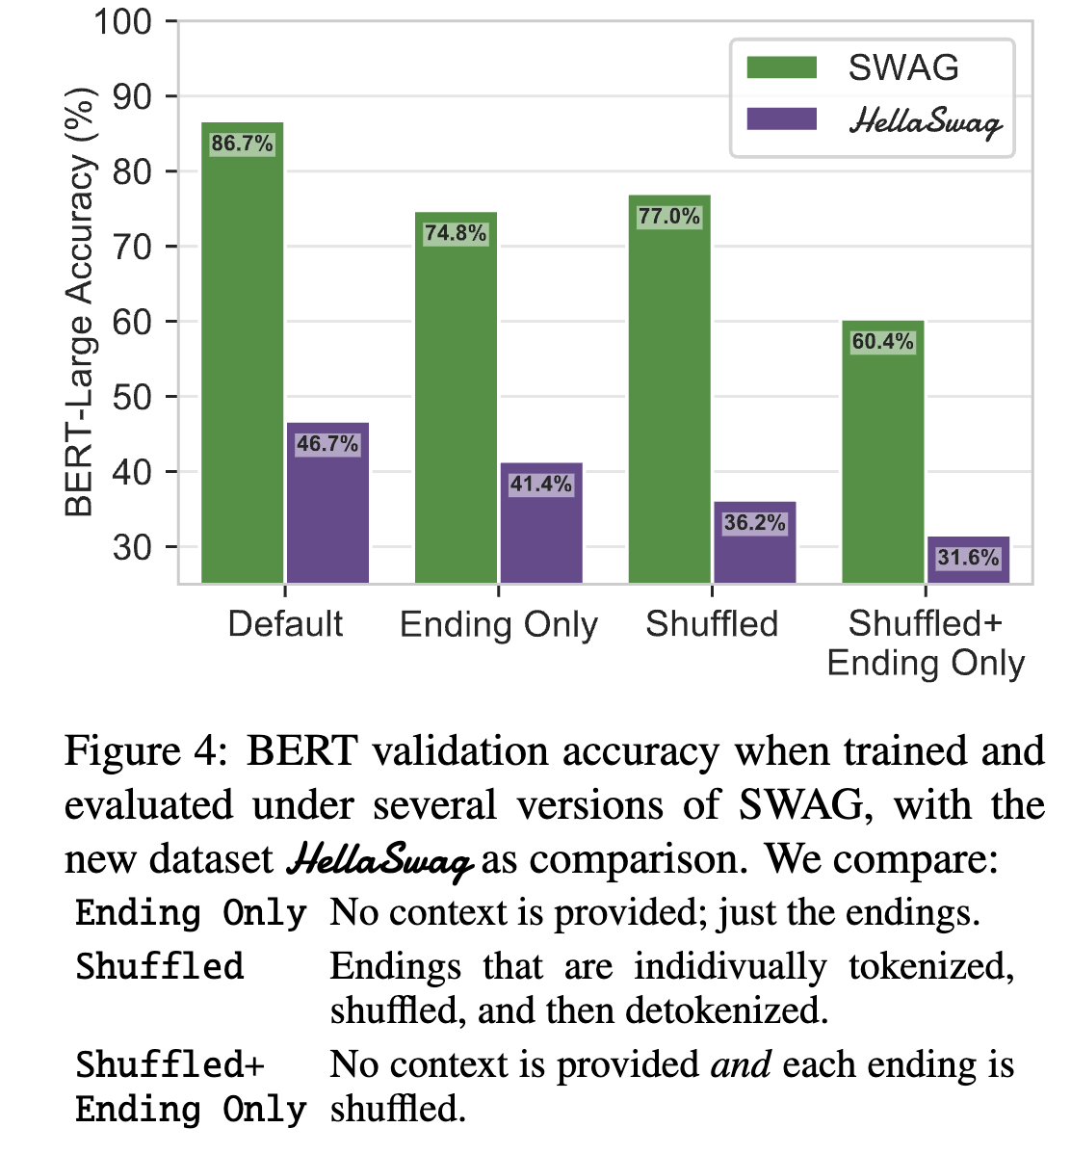
HellaSWAG https://rowanzellers.com/hellaswag/
https://huggingface.co/datasets/Rowan/hellaswag
Notes:
例如，下面的一个例子，
一位女士在户外，身边有一个水桶和一只狗。狗在四处奔跑，试图躲避洗澡。她……
A. 用肥皂冲洗水桶，并用吹风机吹干狗的头。
B. 用水管冲水，以防狗弄得全身是泡沫。
C. 把狗弄湿了，然后狗又跑开了。
D. 和狗一起进了浴缸。

Slide 30
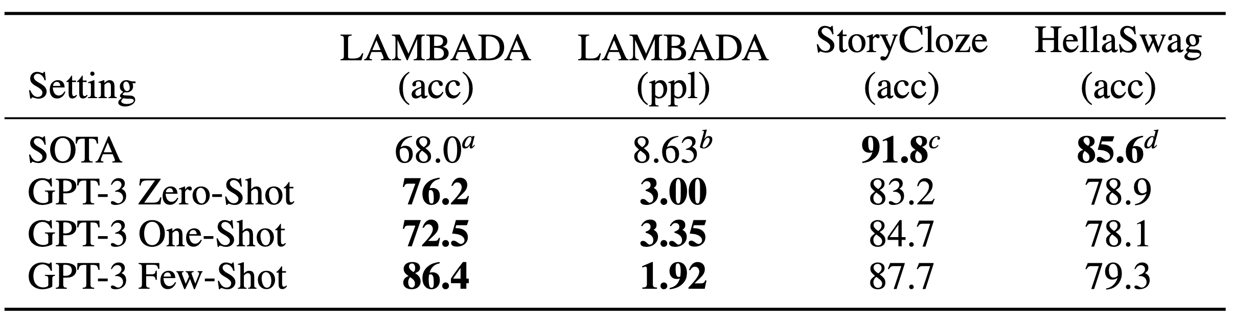
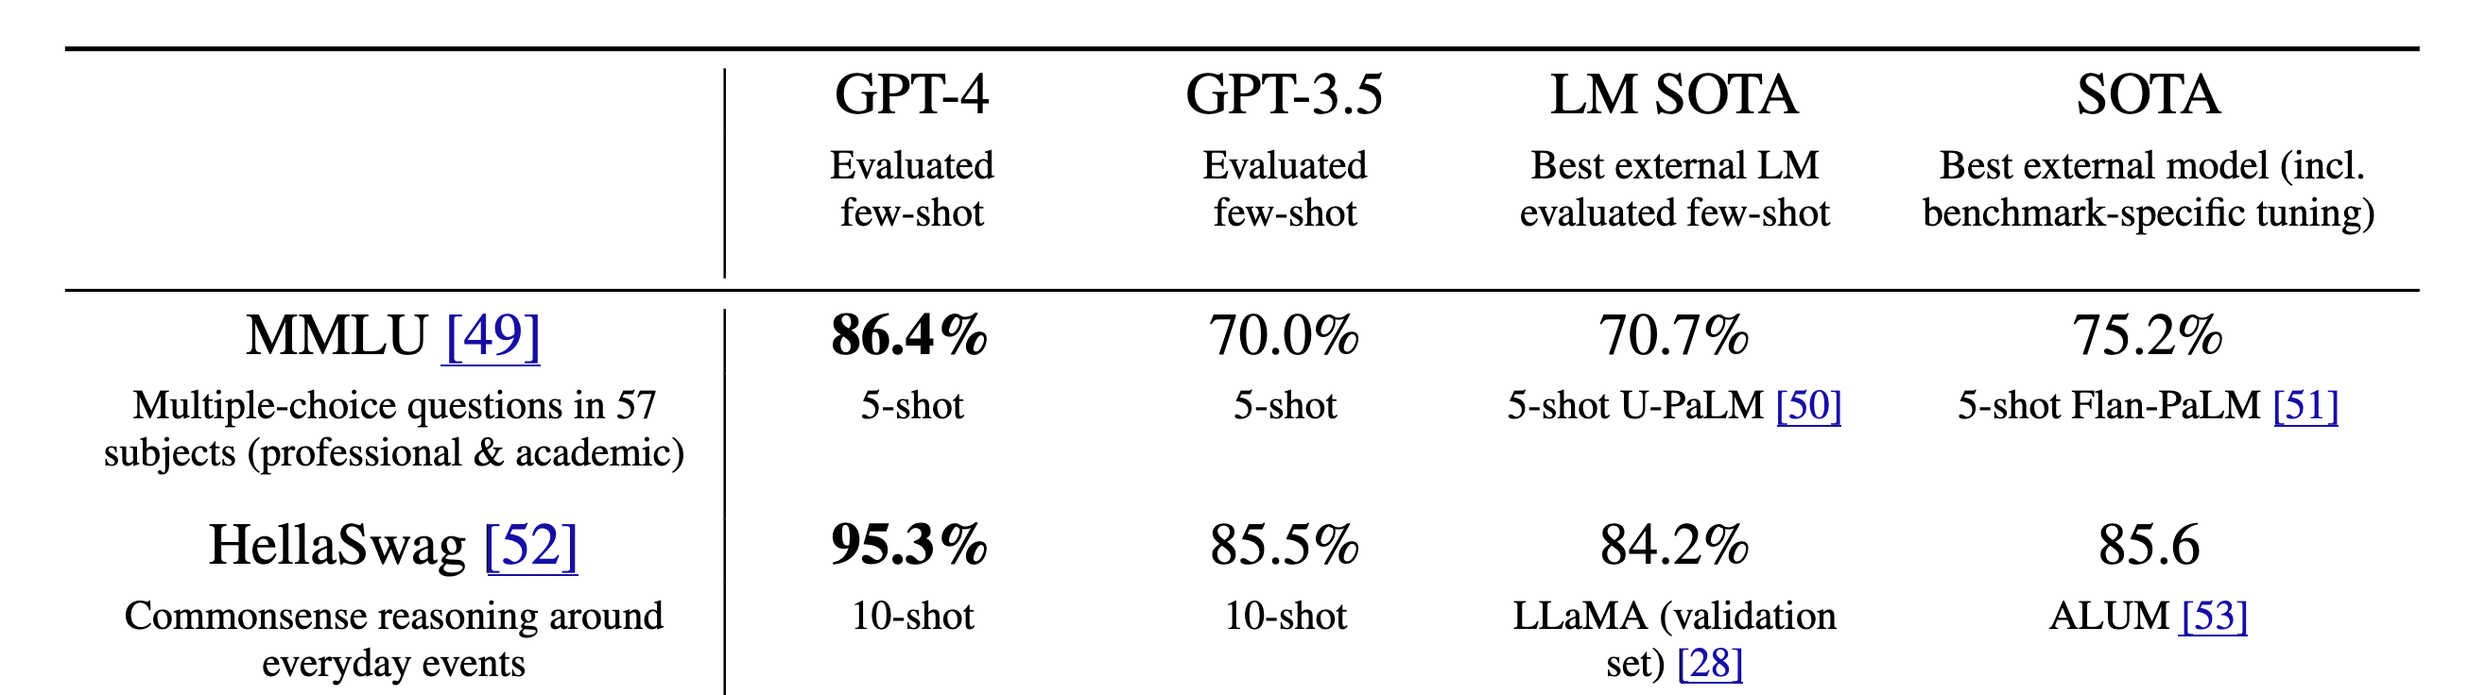
HellaSWAG https://rowanzellers.com/hellaswag/
GPT 3 gets 85.5% accuracy (10-shot learning)
GPT 4 gets 95.3% accuracy (10-shot learning)
https://huggingface.co/datasets/Rowan/hellaswag

Slide 31
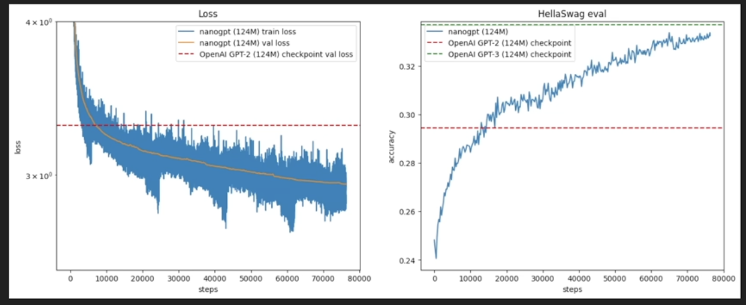
HellaSWAG
https://huggingface.co/datasets/Rowan/hellaswag

Slide 32
Outline
GLUE/SuperGLUE
SWAG/HellaSWAG
Other datasets
Datasets by task types

Slide 33
Other Datasets
MMLU - Multiple choice questions in 57 subjects (professional & academic)
ARC - AI2 Reasoning Challenge, grade school multiple choice science quiz
WinoGrande - bigger version of the Winograd Schema Challenge from GLUE
DROP - Reading comprehension & arithmetic
GSM-8K - Grade school math questions
BLiMP - Benchmark of minimal linguistic pairs; new version of CoLA
HumanEval - Evaluating large language models trained on code

Slide 34
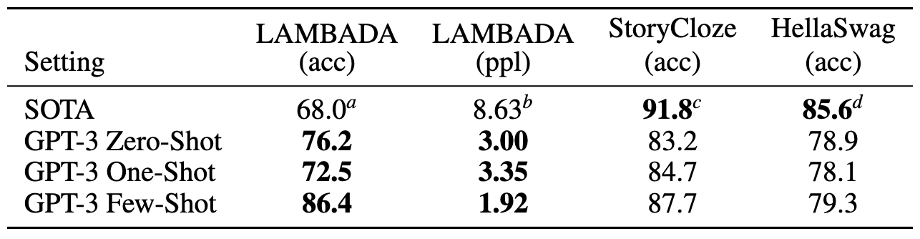
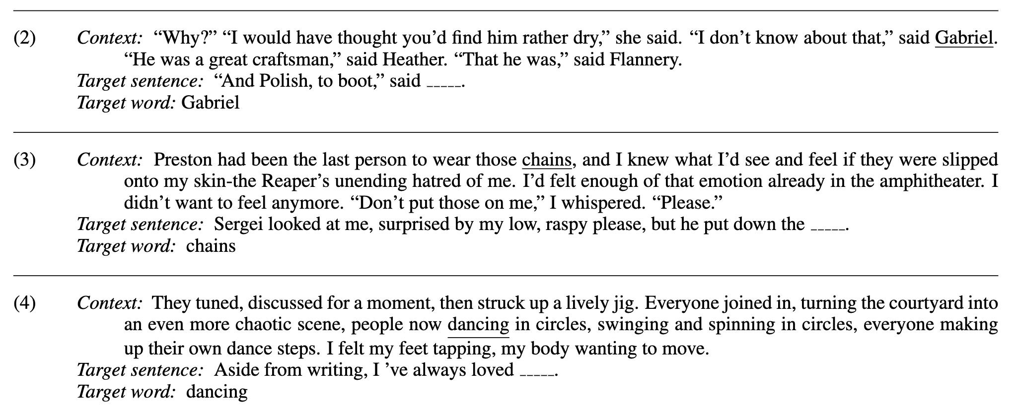
Other Datasets Lambada
Lambada dataset
https://zenodo.org/records/2630551
https://huggingface.co/datasets/cimec/lambada
Notes:
这是一个词语预测任务。LAMBADA 是一个叙述性文本片段的集合，其特点是：如果人类读者能够看到整个段落，他们通常能猜出最后一个词；但如果他们只能看到目标词前的最后一句话，则无法做出准确预测。
该数据集由一系列叙述性文本片段组成，任务是预测最后一个词。
人类读者在通读整个段落的情况下可以猜出该词，但如果只看到包含该词的最后一句，则难以预测。
训练数据来自 BookCorpus，包括 1 万个段落。
该任务通过预测最后一个词来评估模型对长距离依赖的建模能力，旨在测试模型对文本中长程依赖关系的处理能力。
语境：
“为什么？”“我原以为你会觉得他有点乏味，”她说。
“我不这么认为，”加布里埃尔说。
“他是个伟大的工匠，”希瑟说。
“确实如此，”弗兰纳里说。
目标句：
“而且还是波兰人，”__说。
目标词应该是 Gabriel

Slide 35
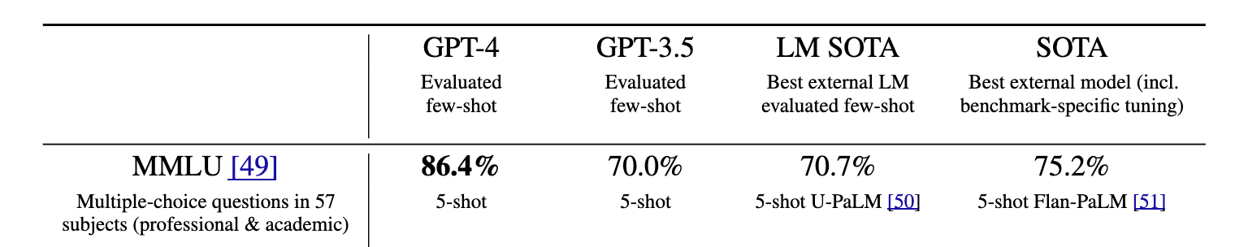
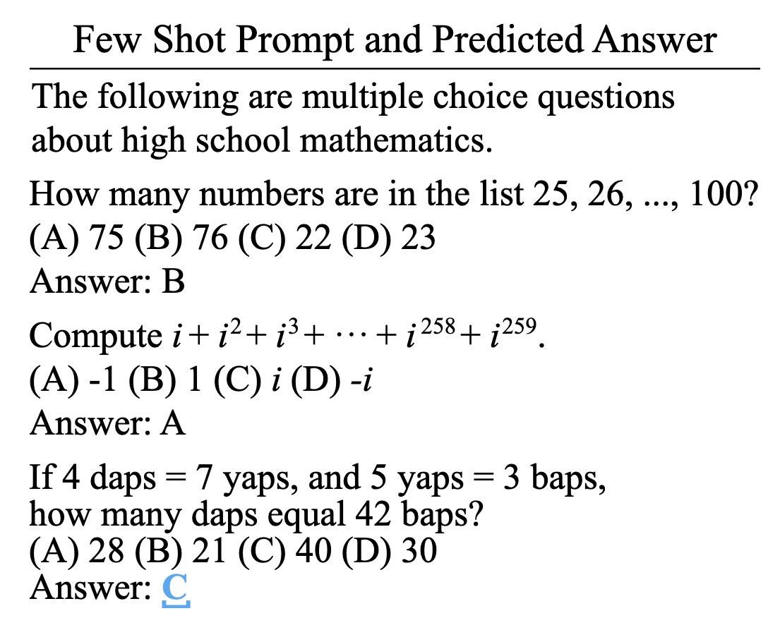
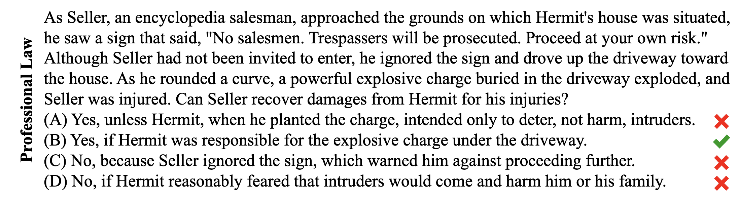
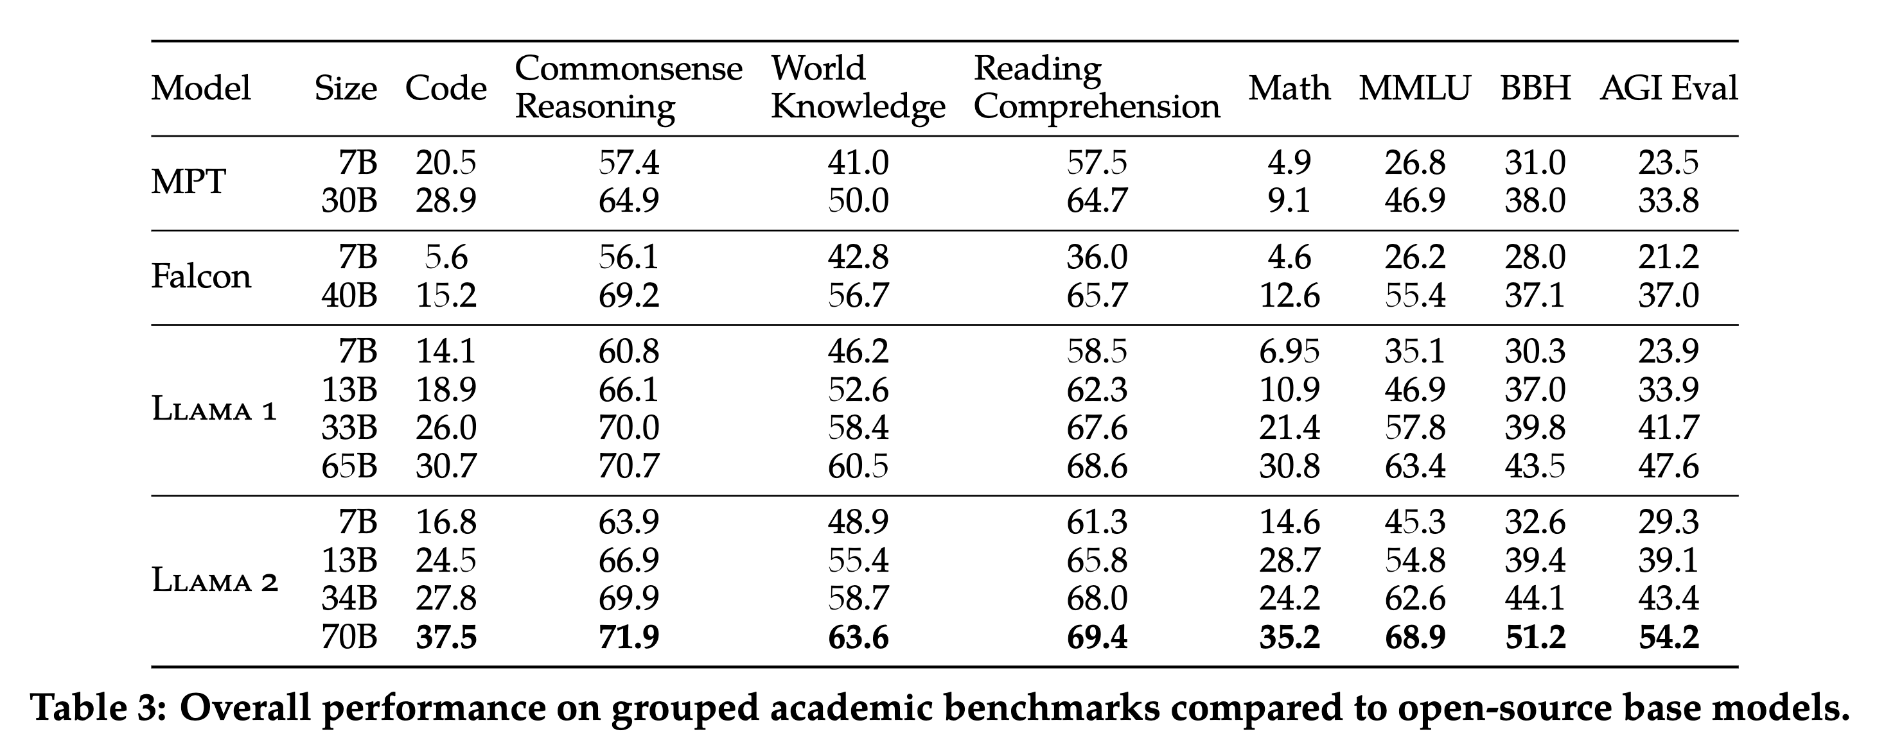
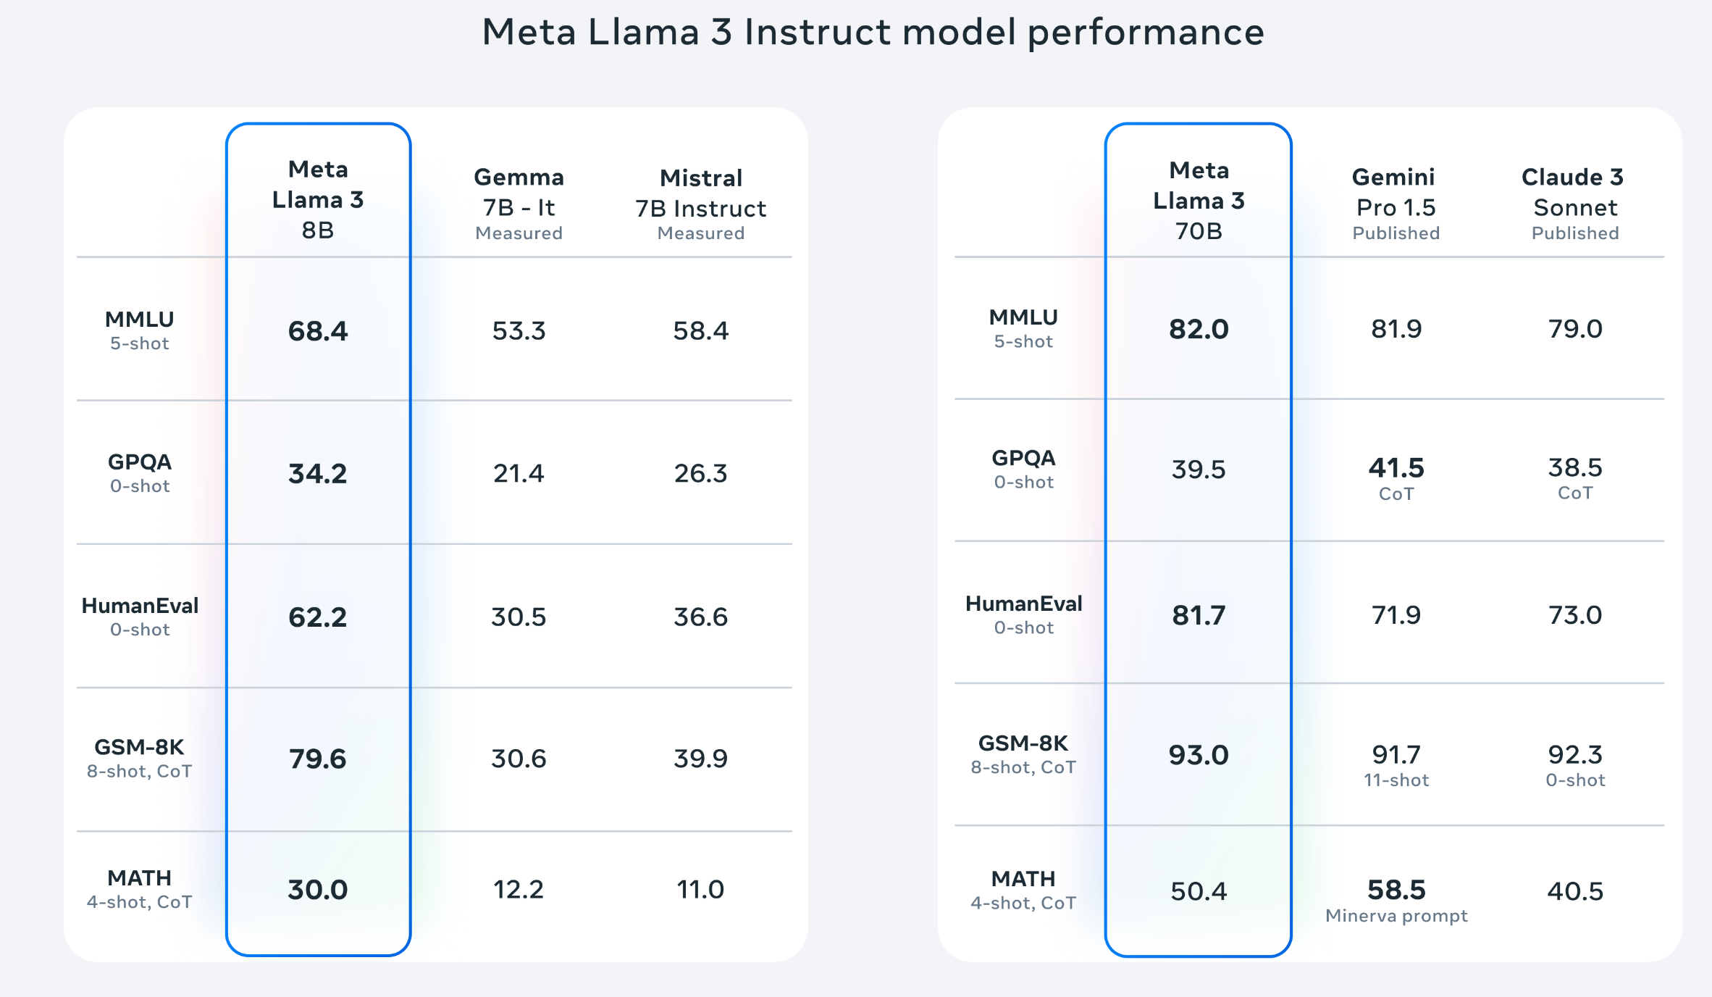
Other Datasets MMLU
Measuring Massive Multitask Language Understanding (MMLU)
Multiple choice questions in 57 subjects (professional & academic)
Notes:
大规模多任务语言理解评测（Measuring Massive Multitask Language Understanding，MMLU）：
涵盖 57 个学科（包括专业类和学术类）的多项选择题。

Slide 36
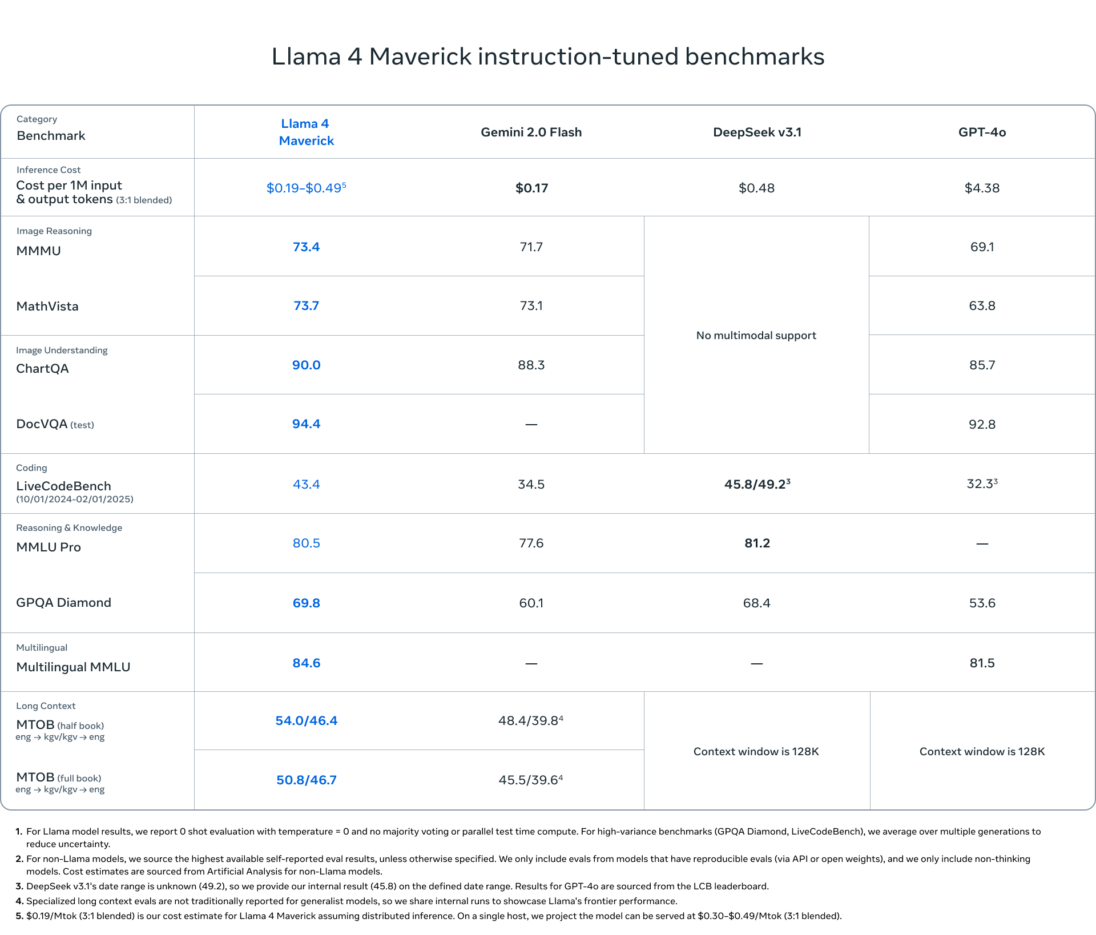
Other Datasets MMLU

Slide 37
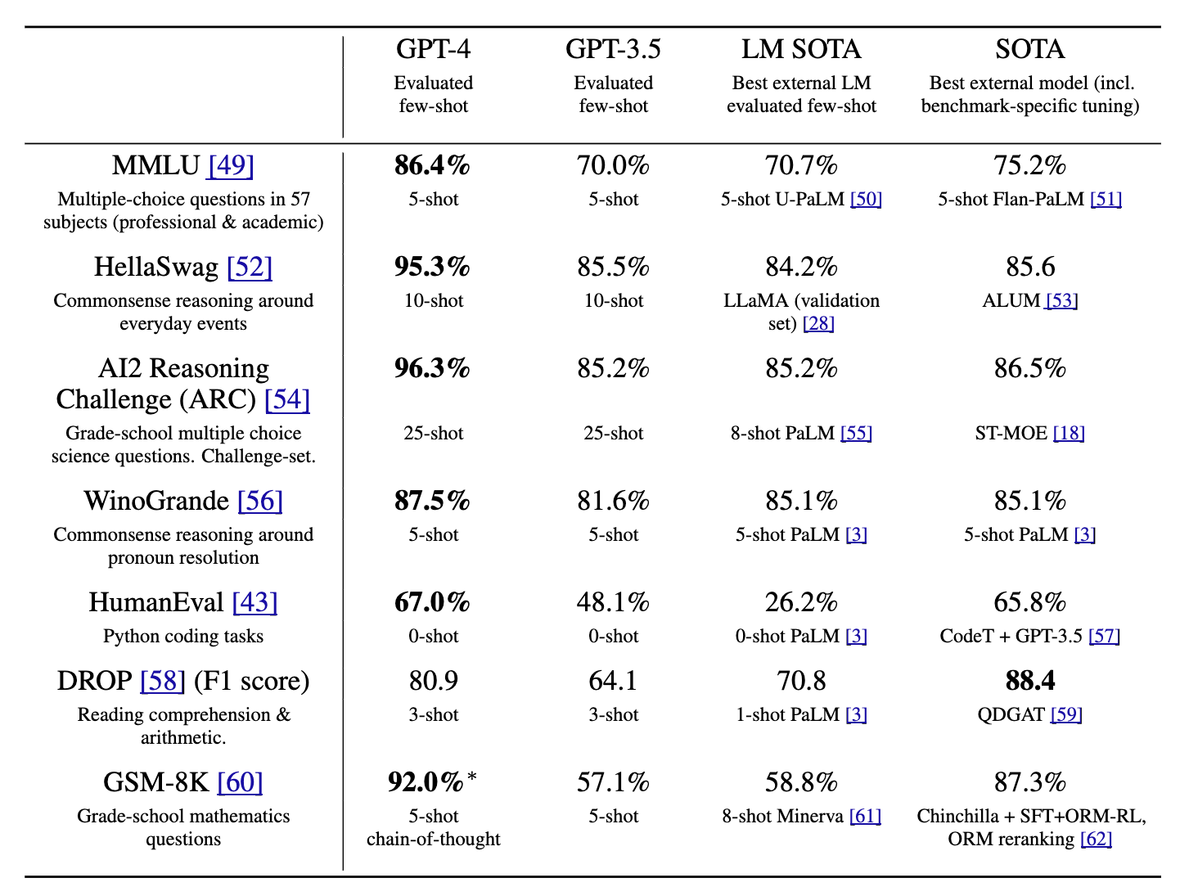
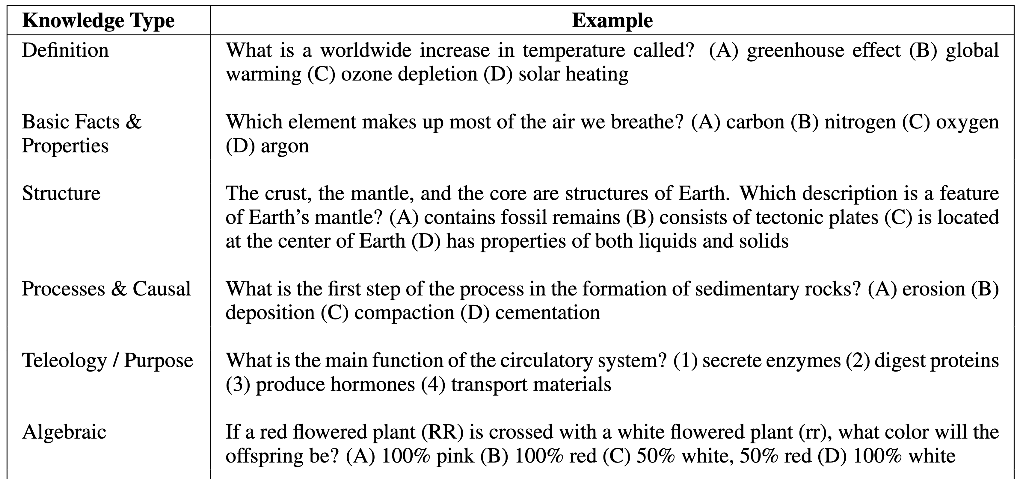
Other Datasets ARC
AI2 Reasoning Challenge, grade school multiple choice science quiz (ARC)
https://huggingface.co/datasets/allenai/ai2_arc
Notes:
AI2 推理挑战（AI2 Reasoning Challenge，ARC）：
一项面向小学阶段的多项选择题科学测验任务。

Slide 38
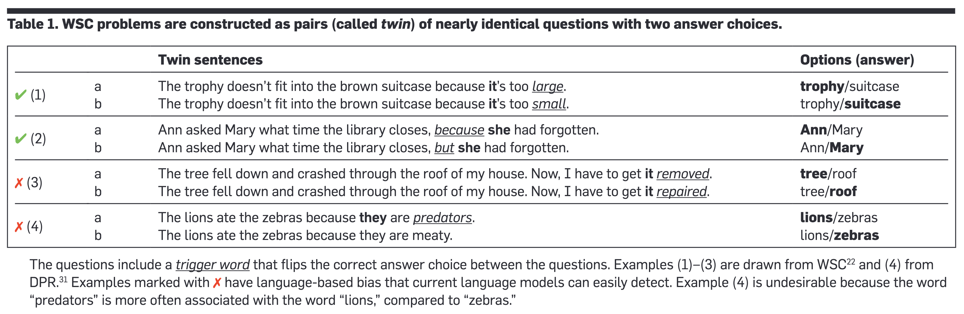
Other Datasets WinoGrande
Commonsense reasoning around pronoun resolution (WinoGrande)
https://huggingface.co/datasets/allenai/winogrande
Notes:
围绕代词消解的常识推理任务（WinoGrande）。

Slide 39
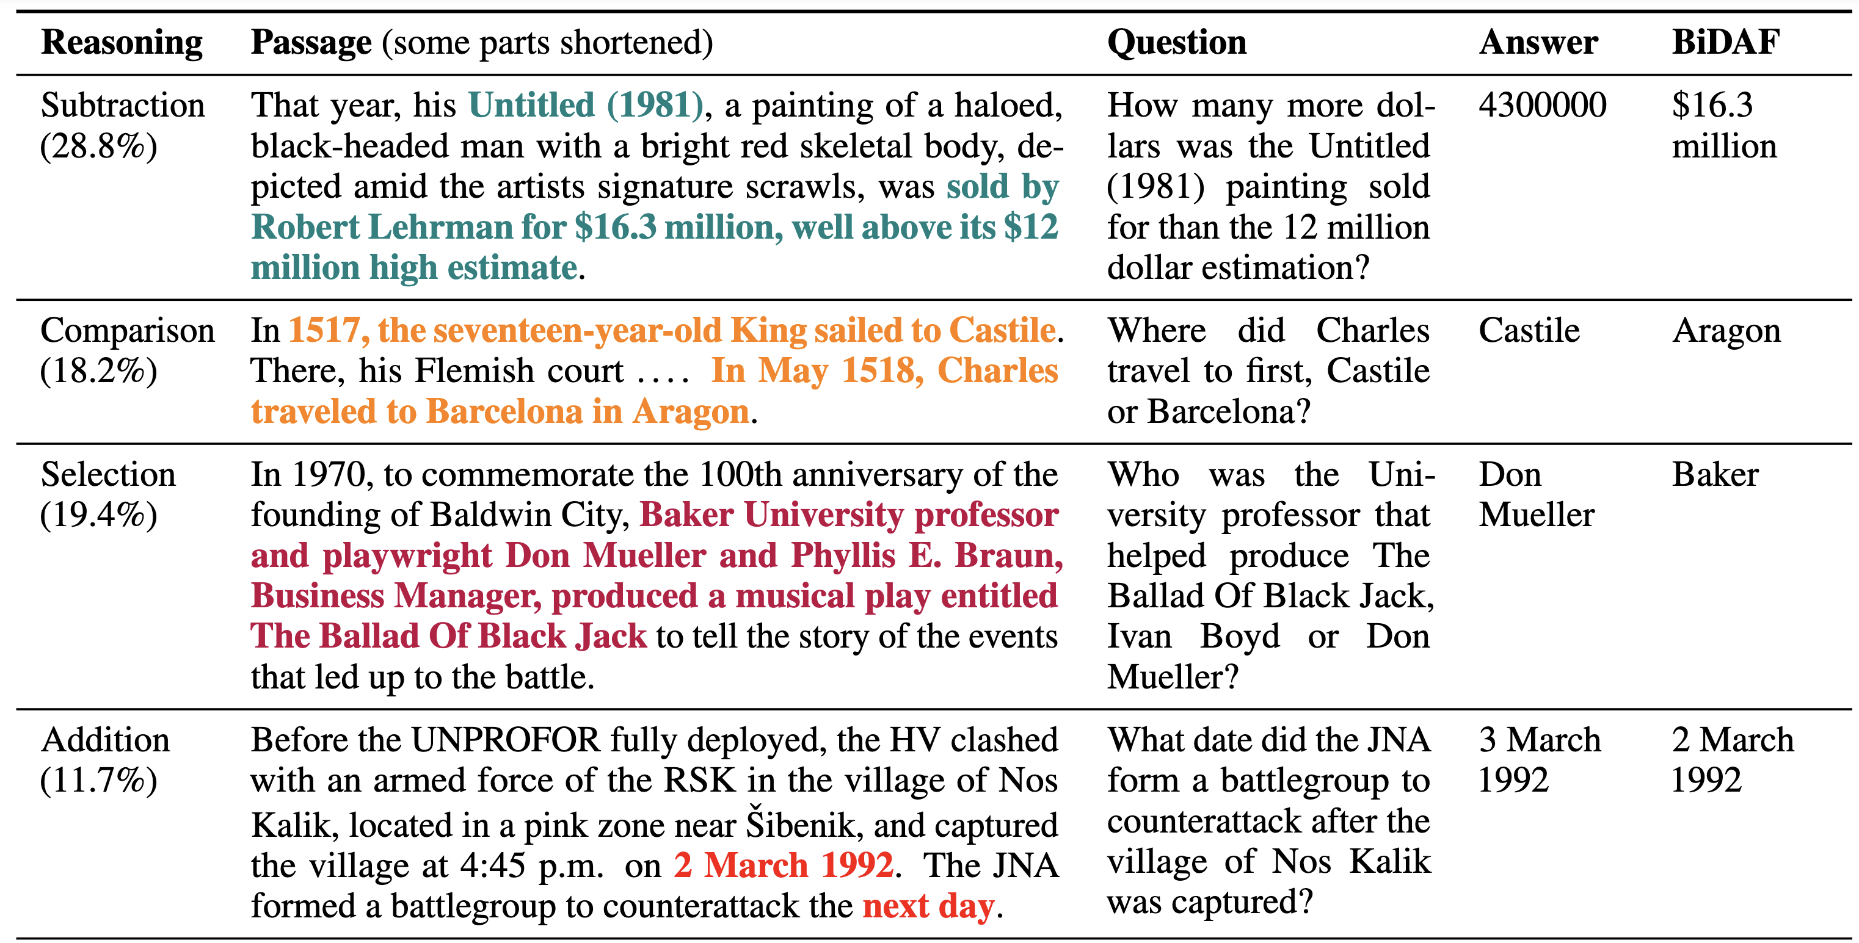
Other Datasets DROP
Discrete Reasoning Over the content of Paragraphs (DROP)
https://huggingface.co/datasets/ucinlp/drop
The reference model is BiDAF model
Notes:
对段落内容进行离散推理的任务（DROP，Discrete Reasoning Over the content of Paragraphs）。

Slide 40
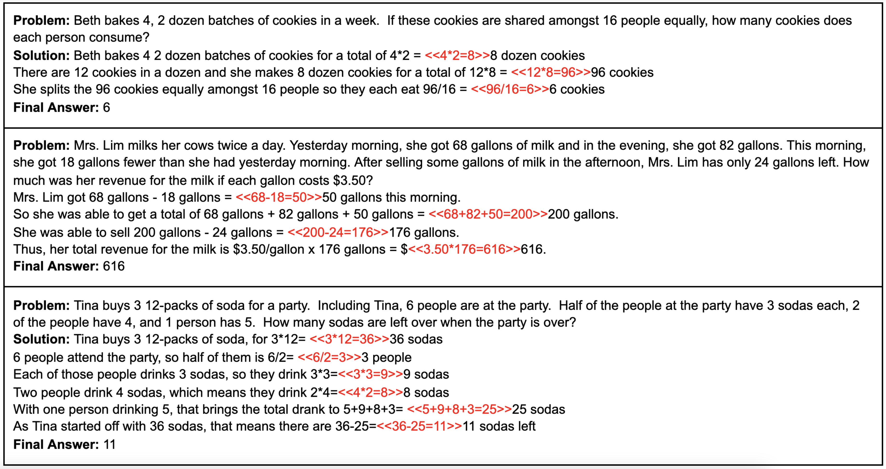
Other Datasets GSM-8K
Grade school math word problems (GSM-8K)
https://huggingface.co/datasets/openai/gsm8k

Slide 41
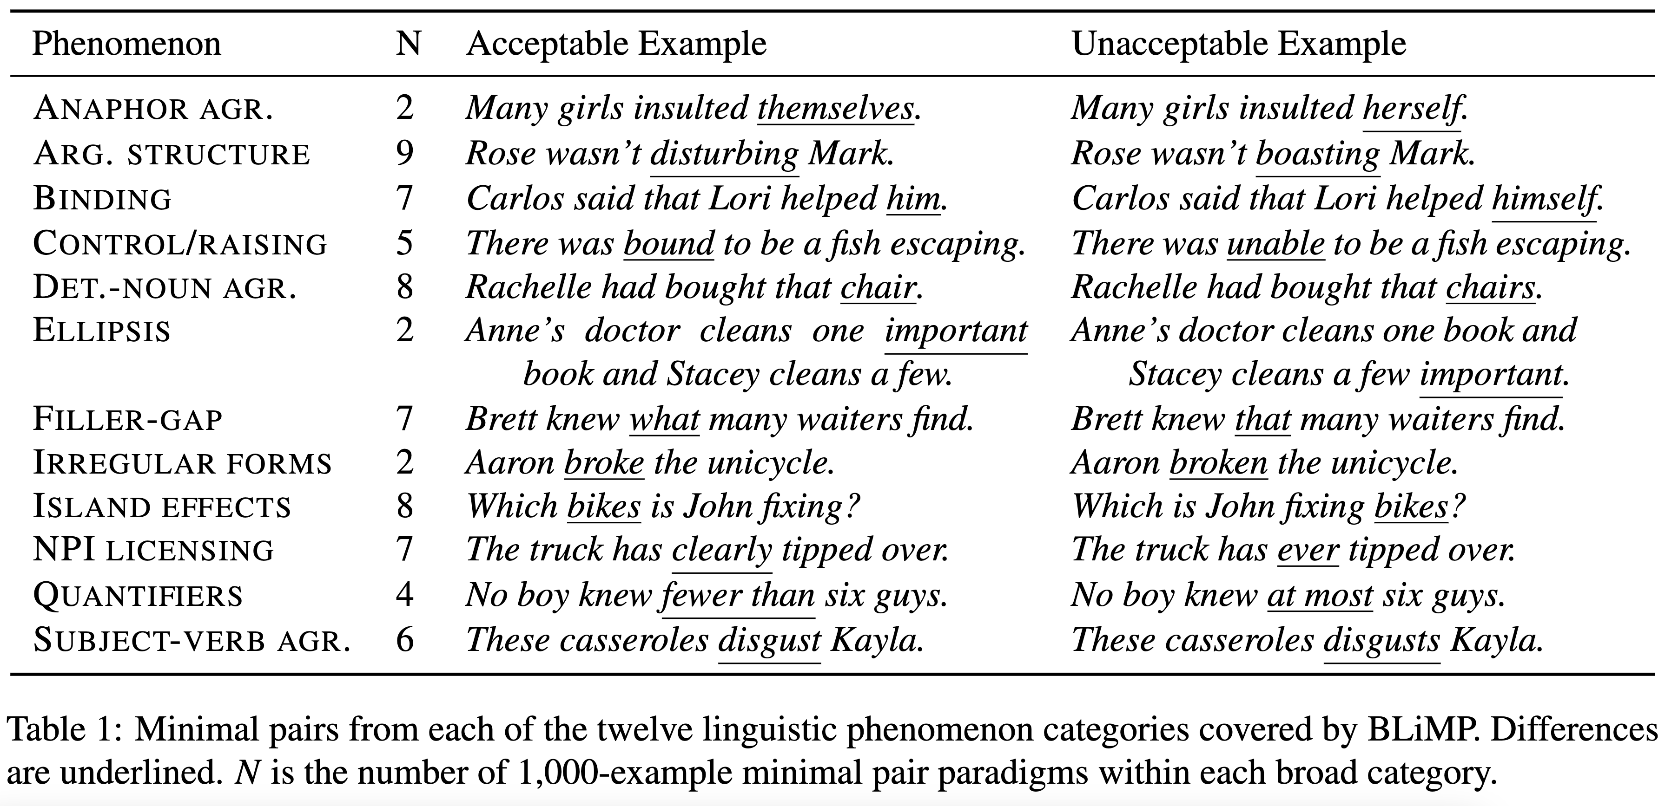
Other Datasets BLiMP
The Benchmark of Linguistic Minimal Pairs (BLiMP)
  A challenge set for evaluating the linguistic knowledge of language models (LMs) on major grammatical phenomena in English
Notes:
语言最小对立基准集（The Benchmark of Linguistic Minimal Pairs，BLiMP）：
一个用于评估语言模型（LMs）在英语主要语法现象上的语言知识的挑战性数据集。

Slide 42
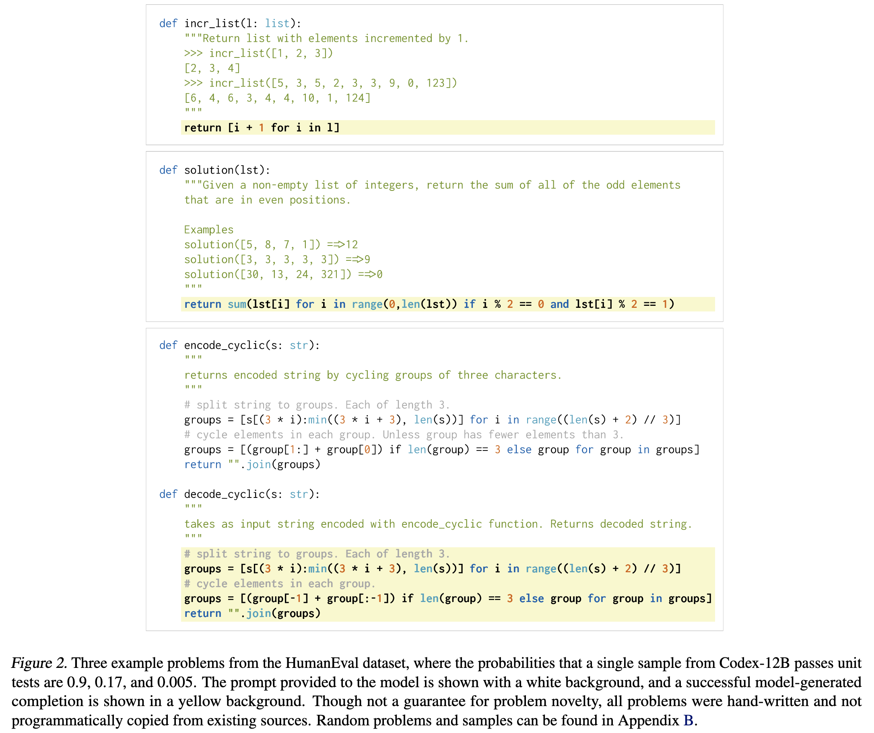
Other Datasets HumanEval
The task of generating standalone Python functions from docstrings, and evaluate the correctness of code samples automatically through unit tests.
To accurately benchmark our model, we create a dataset of 164 original programming problems with unit tests.
These problems assess language comprehension, algorithms, and simple mathematics, with some comparable to simple software interview questions.

Slide 43
Outline
GLUE/SuperGLUE
SWAG/HellaSWAG
Lambada
Other datasets
Datasets by task types

Slide 44
Question Answering
Natural Questions (Natural Questions)
Web Questions (WebQuestions)
TriviaQA - Large Scale Dataset for Reading Comprehension and Question Answering
COQA - Conversational Question Answering Challenge

Slide 45
Summarization
CNN-Daily Mail (Hugging Face location)
BookSum (Booksum Github)
NYT dataset (Paperswithcode)
DUC dataset (from NIST, Paperswithcode)
Natural Language Generation
E2E (Link)
WebNLG (Hugging Face location)
DART (Hugging Face location)

Slide 46
Translation
FLORES-200 (Link)
WMT 2014 (Link)
OPUS-MT (Link)
LORELEI (low-resource languages, Link)

Slide 47
Structured Prediction
CoNLL-2000 to CoNLL 2018 shared tasks (Link)
Entity linking to Wikipedia: AIDA-CoNLL (Link)
Entity linking to other ontologies like UMLS (biomedical): MedMentions (Link)
Dependency tree and Phrase Structure Parsing (Penn Treebank; PropBank, Link)
Morphological analysis of word constructions from morphemes (Morphophon, Link)
Wikipron (word pronunciation modelling for 165 languages, Link)

Slide 48
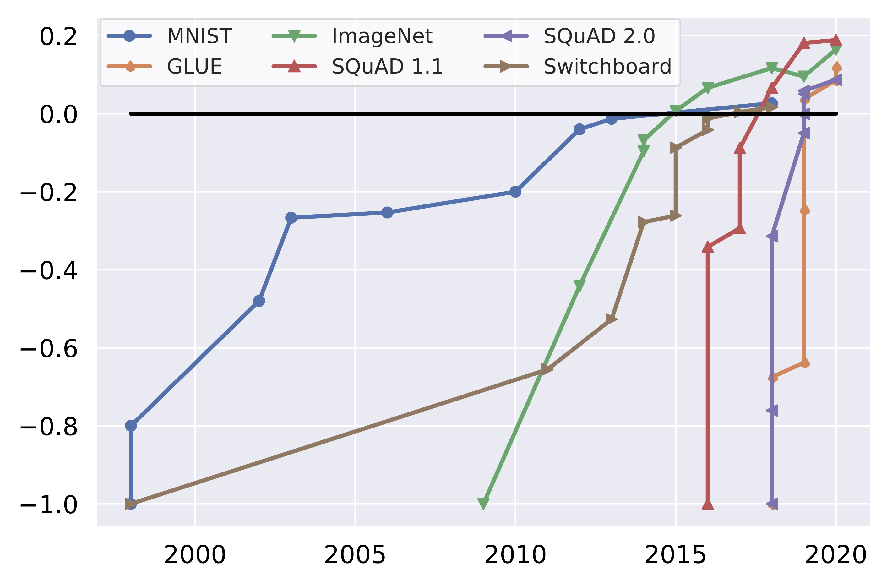
Dynabench: Rethinking Benchmarking in NLP
Benchmark saturation over time for popular benchmarks, normalized with initial performance at minus one and human performance at zero.
https://arxiv.org/pdf/2104.14337

Slide 49
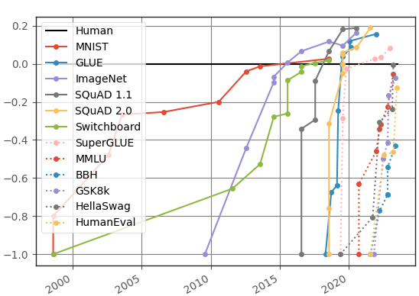
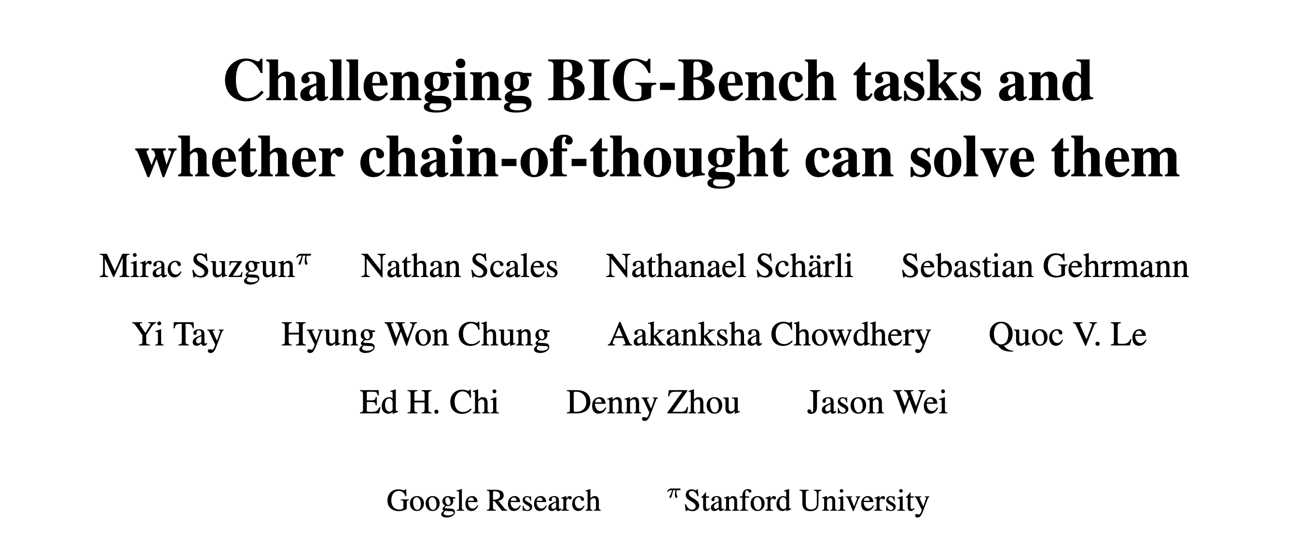
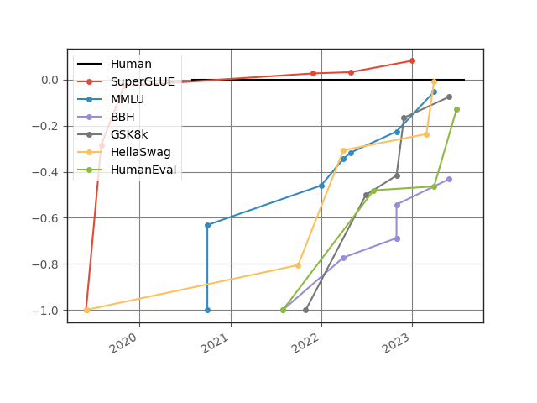
https://contextual.ai/plotting-progress-in-ai/
BIG-Bench Hard (BBH)
https://arxiv.org/pdf/2210.09261

Slide 50
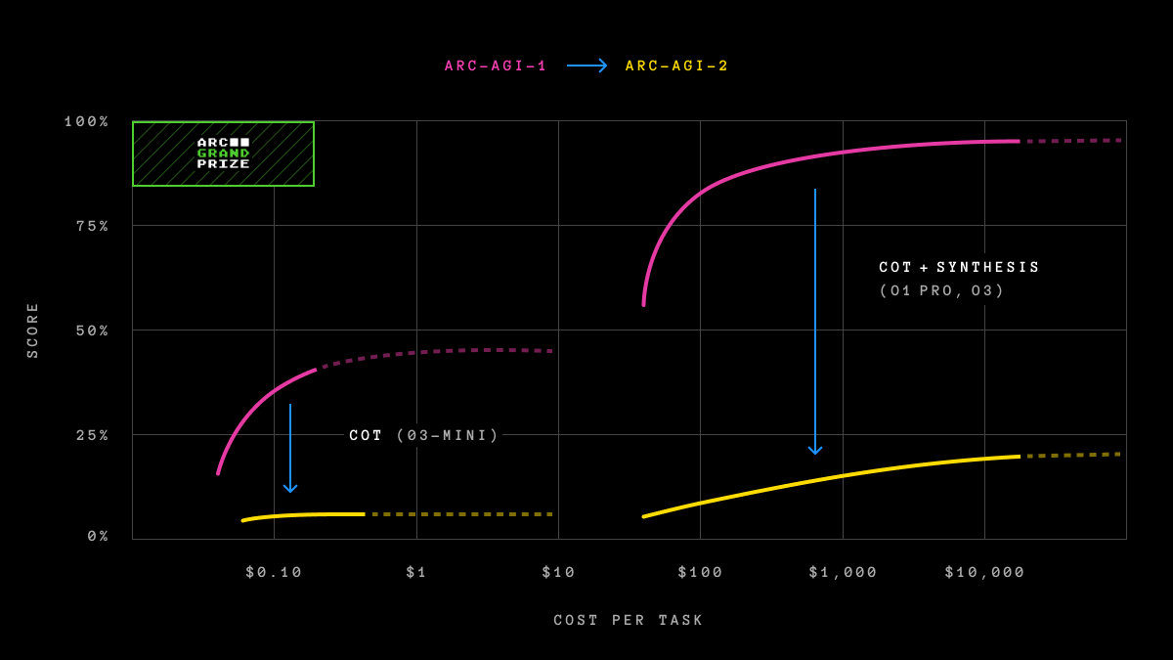
https://arcprize.org/

Slide 51

Reasoning

Slide 52
References
[1] Slides from Anoop Sarkar
[2] A Survey on Evaluation of Large Language Models
[3] https://decanlp.com/
[4] GPT-4 https://arxiv.org/pdf/2303.08774
[5] https://rowanzellers.com/hellaswag/
[6] https://rowanzellers.com/swag/
[7] https://allenai.org/data/arc
[8] https://winogrande.allenai.org/
[9] https://allenai.org/data/drop
[10] https://crfm.stanford.edu/helm/mmlu/latest/#/leaderboard
Next topic: LLMs

