Slide 1
Assignment2
21012723 FeiFan He
21012726 Fangxiao Cui
21012718 Yiqing Li
21012730 Haochen Tang

Slide 2
CONTENTS
1
2
3
Design Decisions
Game Architecture
Java Classes
4
5
Challenge and Improvement
Game Video

Slide 3
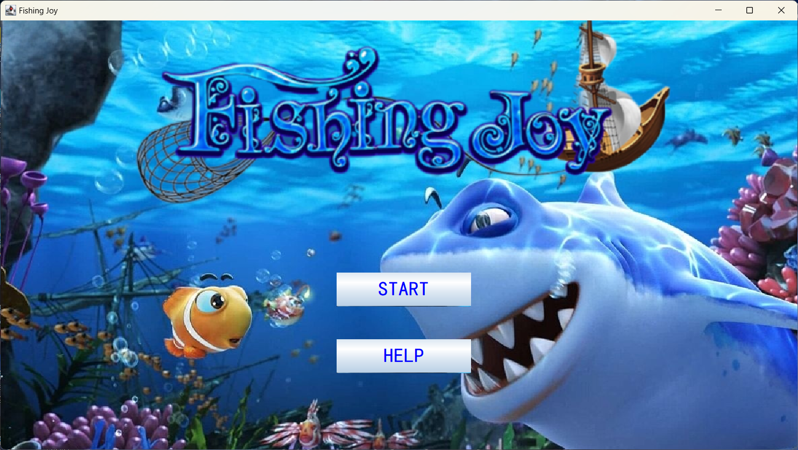

Slide 4
01
Design Decisions

Slide 5
Game Introduction
“Fishing Joy" is a casual game based on fishing, with the ocean as the background and fishing as the core content, creating a happy and colorful ocean world through realistic and gorgeous graphics as well as easy gameplay. The game is very simple. Use the battery to fish and score points on the premise of having gold coins until the target.
Game Design
• Battery
• Fish
• Game Balance

Slide 6
02
Game Architecture

Slide 7
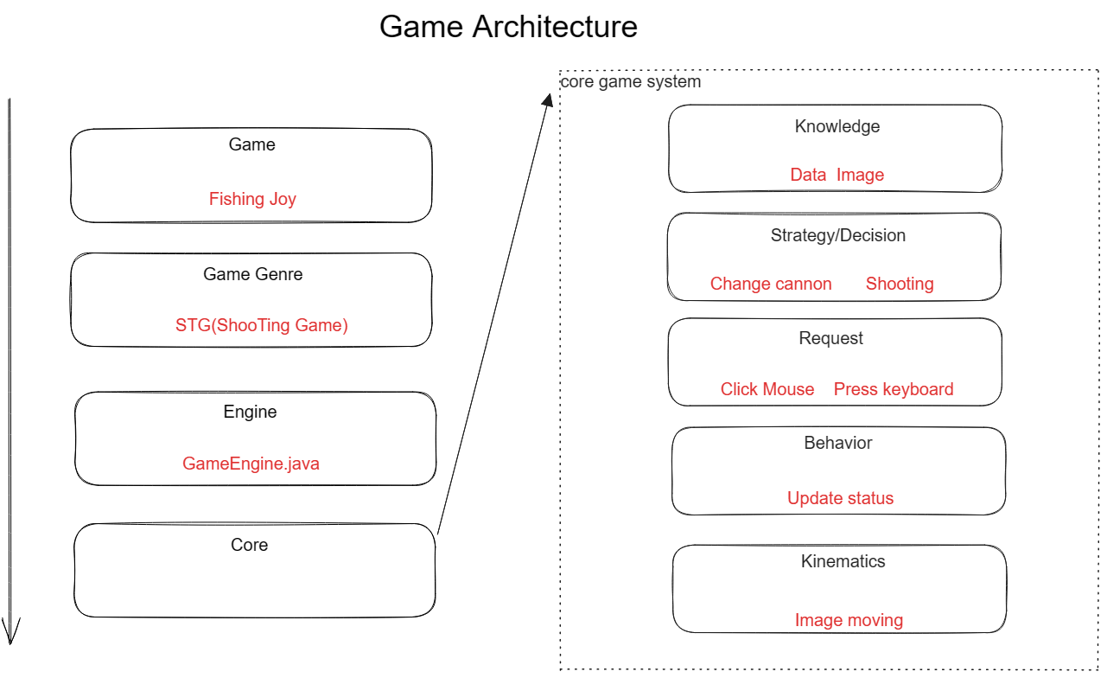
Generally speaking, the architecture of the game is divided into four layers: game layer, game genre layer, engine layer and core layer. The game layer is for the name of the game which is Fishing Joy. the game genre is STG aka shooting game. and the game engine we used is the what provided on the Stream, GameEngine.java file.
The core layer is divided into another five layers. The Knowledge layer is for storing pictures and various data such as scores and number of gold coins. Strategy layer is for updating decisions, means player want to make a decision such as switching cannons and shooting. Request layer is for sending requests, in which players need to press keys on the keyboard to switch the levels of cannons and click mouse to shoot. The Behavior layer is used to receive requests and generate output, such as the sound after firing a bullet and the corresponding decrease in the number of gold coins. Finally, there is the kinematic layer, which shows the final animations like fish swimming and bullet tracks.

Slide 8
03
Java Classes

Slide 9
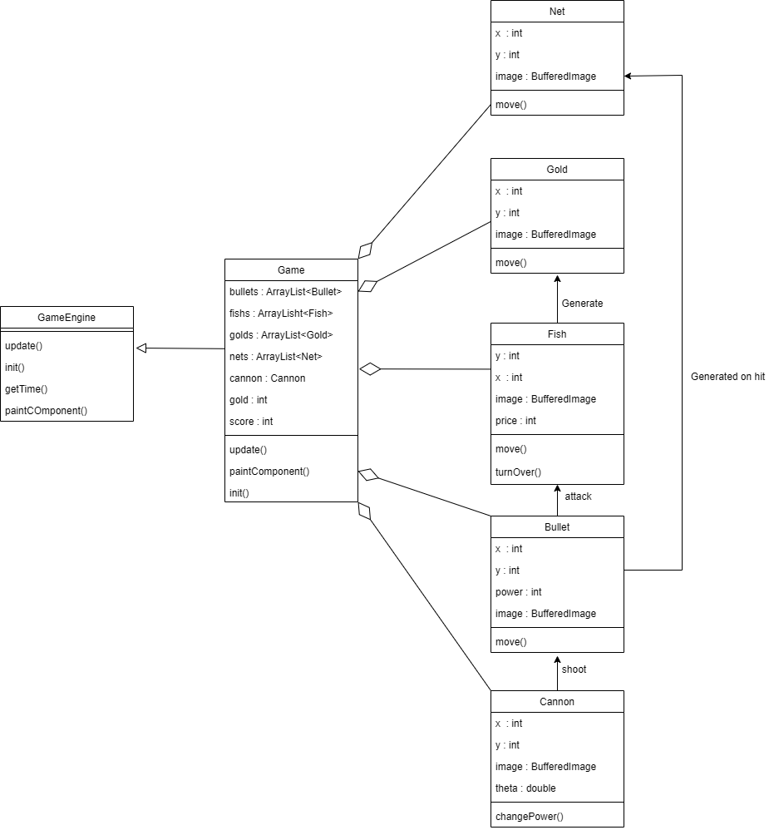

Slide 10
04
Challenge and Improvement

Slide 11
Challenges faced during the project
The challenge was with the class "GameEngine" which is a single thread. When a fish is caught, two images alternate with each other. However, if the "Thread.sleep()" function is not called, the twitching of the fish happens so quickly that the user cannot see it. Later, I thought of solving this problem by using time.
How to improve it in future
• Fish swimming direction: Currently, we can only make fish swim in fixed directions. We hope that in the future, fish can swim from various directions.
• Fish waves: Introduce different waves of fish, with varying sizes and swimming speeds, to make the game more challenging for players.
• Boss battles: Introduce powerful boss fish that require special tactics to defeat.

Slide 12
05
Game Video

Slide 13


Slide 14
THANK YOU

