Slide 1

Databases and Database Systems
Le Duy Dung (Andrew)

Slide 2
Advanced SQL

Slide 3
LEARNING OBJECTIVES (1)
To understand reasons for using the SQL ALTER statement
To use the SQL ALTER statement
To understand the need for the SQL MERGE statement
To use the SQL MERGE statement
To understand the need for additional types of SQL queries
To use SQL outer join queries
To use SQL correlated subqueries
To use SQL queries on recursive relationships

Slide 4
LEARNING OBJECTIVES (2)
To understand the reasons for using SQL set operators
To use SQL set operators
To understand the reasons for using SQL views
To use SQL statements to create and use SQL views
To understand SQL/Persistent Stored Modules (SQL/PSM)
To use SQL statements to create and use SQL user-defined functions

Slide 5
SQL Correlated Subqueries
A correlated subquery works very differently than a regular subquery.
  A regular subquery processes from the bottom up whereas a correlated subquery takes a value from the table in the query and compares it to every row in the subquery and then repeats for the next value in the main query.
  A correlated subquery will use the same table in both the main and subquery and only differentiate them by using a version.
  Example:
    SELECT E1.EmployeeNumber, E1.FirstName, E1.LastName
    FROM EMPLOYEE AS E1
    WHERE E1.LastName IN
    (SELECT E2.LastName
    FROM EMPLOYEE AS E2
    WHERE E1.LastName = E2.LastName
    AND E1.EmployeeNumber <> E2.EmployeeNumber);
    What is the result of this SQL statement?

Slide 6
SQL Subqueries Using the EXISTS and NOT EXISTS Comparison Operators
The use of EXISTS and NOT EXISTS creates another form of a correlated subquery.
These operators simply test whether there are any values returned by the subquery, which indicates there are values meeting the conditions of the subquery.
  If one or more values are returned, then values from the subquery are used to run the top-level query.
  If no values are returned, the top-level query produces an empty set as the result.
  Example:
    SELECT E1.EmployeeNumber, E1.FirstName, E1.LastName
    FROM EMPLOYEE AS E1
    WHERE EXISTS
    (SELECT E2.LastName
    FROM EMPLOYEE AS E2
    WHERE E1.LastName = E2.LastName
    AND E1.EmployeeNumber <> E2.EmployeeNumber);
    What is the result of this SQL statement?

Slide 7
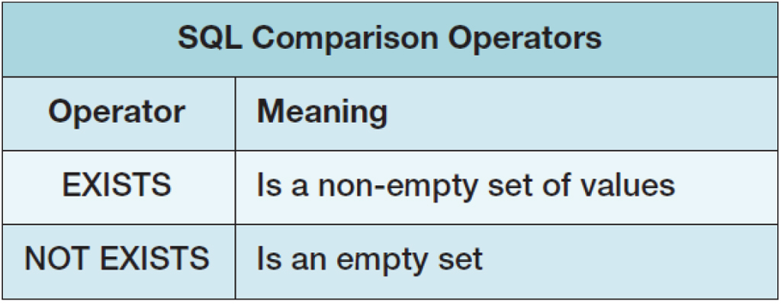
SQL Subqueries Using the EXISTS and NOT EXISTS Comparison Operators

Slide 8
SQL Queries on Recursive Relationships
Recursive relationships use the same technique we just used in correlated subqueries. This gives two virtual tables with the queries using them written just the same as we would any other query.
The following query will show which employees are supervisors (represented by an “s”) and which employees (represented by an “e”) they supervise.
  SELECT S.FirstName AS SupervisorFirstName,
  S.LastName AS SupervisorLastName,
  E.FirstName AS EmployeeFirstName,
  E.LastName AS EmployeeLastName
  FROM EMPLOYEE S JOIN EMPLOYEE E
  ON S.EmployeeNumber = E.Supervisor
  ORDER BY S.EmployeeNumber;

Slide 9
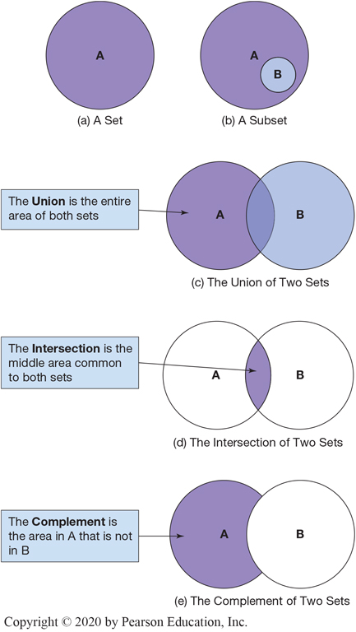
SQL Set Operators
Mathematicians use the term set theory to describe mathematical operations on sets, where a set is defined as a group of distinct items.
Venn diagrams are the standard method of visualizing sets and their relationships. Some definitions of sets are:
  A set is represented by a labeled circle.
  A subset is a portion of a set that is contained entirely within the set.
  The union of two sets represents the two sets together to get a set that contains all values in both sets. This is equivalent to an OR logical operation (A OR B).
  The intersection of two sets represents the area common to both sets. This is equivalent to an AND logical operation (A AND B).
  The complement of set B in set A represents everything in set A that is not in set B. This is equivalent to a logical operation using A AND (NOT B). It is equivalent to the set difference (A – B).

Slide 10
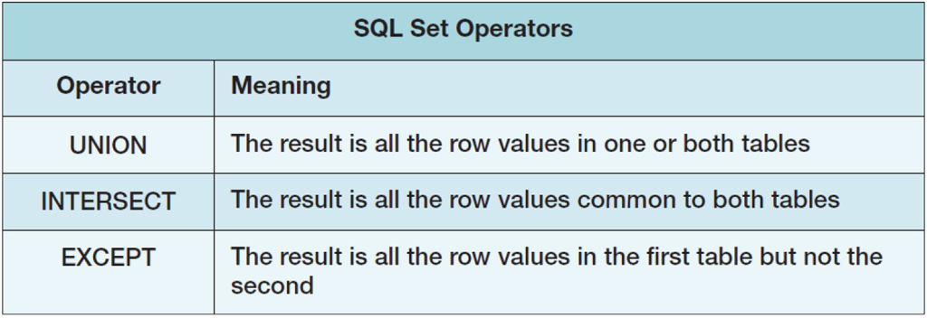
Notes:
Long Description:
The table has three rows and two columns. The column headings are Operator and Meaning. The table data are as follows:
Operator, UNION. Meaning, The result is all the row values in one or both tables.
Operator, INTERSECT. Meaning, The result is all the row values common to both tables.
Operator, EXCEPT. Meaning, The result is all the row values in the first table but not the second.

Slide 11
Creating and Working with SQL Views
An SQL view is a virtual table that is constructed from other tables or views.
  A view has no data of its own but uses data stored in tables or other views.
  Views are created using SQL SELECT statements and then used in other SELECT statements as just another table.
  The only limitation on the SQL statements that create the views is that they cannot contain ORDER BY clauses.
  If the results of a query using a view need to be sorted, the sort order must be provided by the SELECT statement that processes the view.

Slide 12
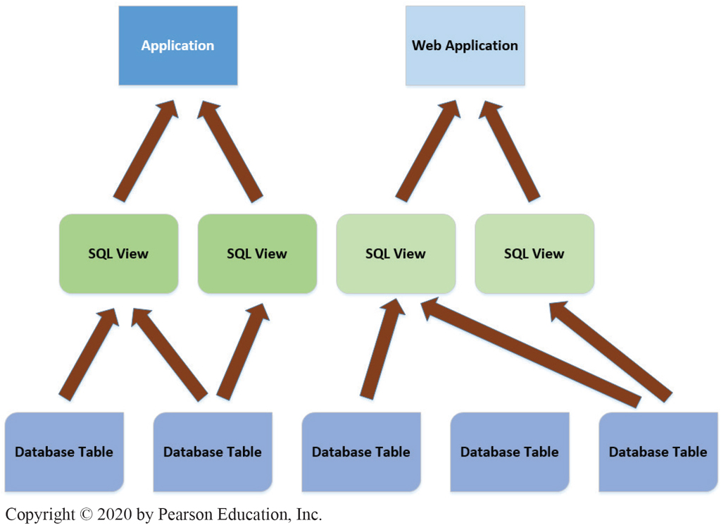
Creating and Working with SQL Views

Slide 13
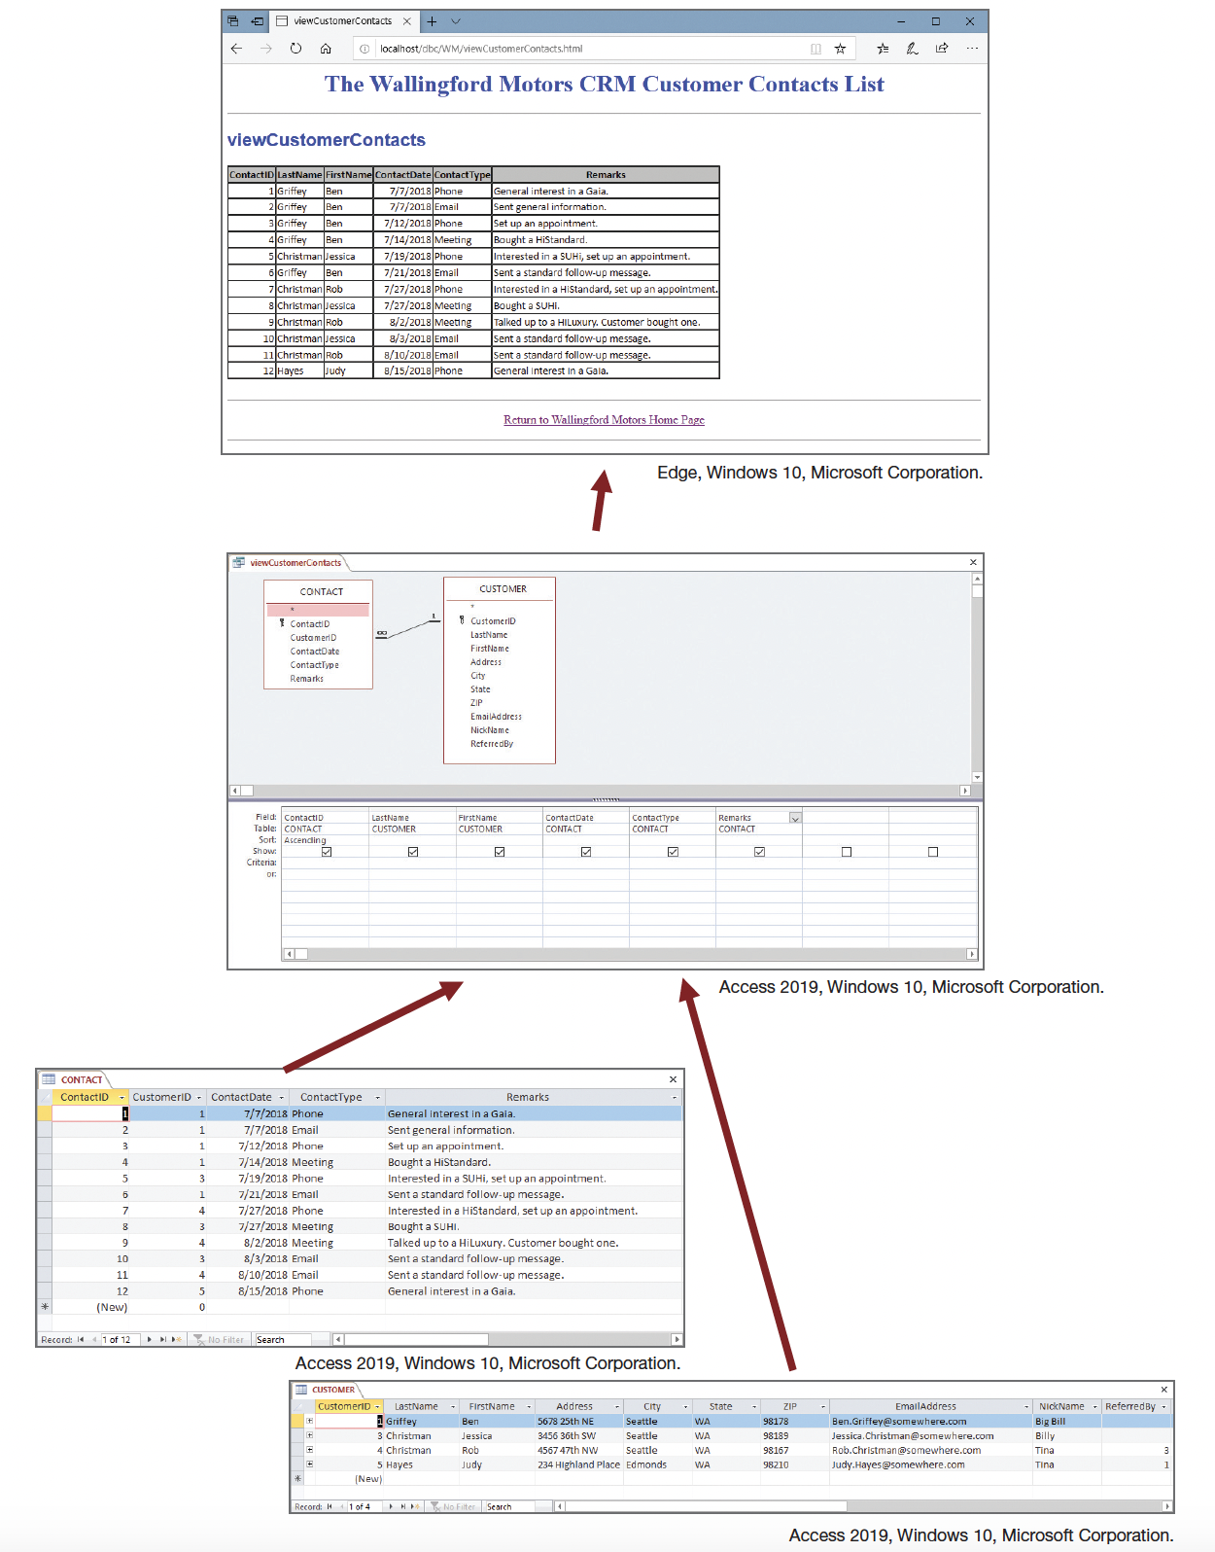

Slide 14
Creating SQL Views
The SQL CREATE VIEW statement is used to create view structures. The syntax of this statement is:
  CREATE VIEW {ViewName} AS
  {SQL SELECT statement};
The view below (EmployeePhoneView) is based on the EMPLOYEE table in the WP database.
  CREATE VIEW EmployeePhoneView AS
  SELECT FirstName, LastName, OfficePhone AS EmployeePhone
  FROM EMPLOYEE;

Slide 15
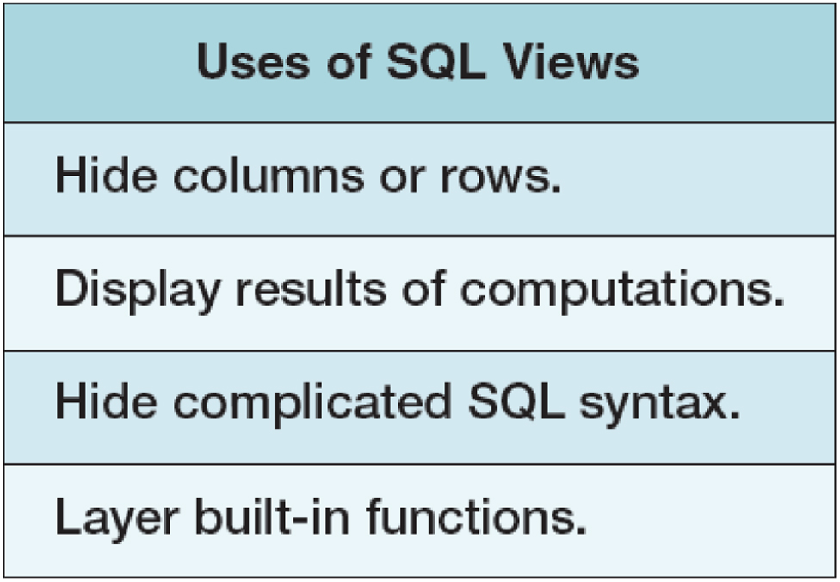
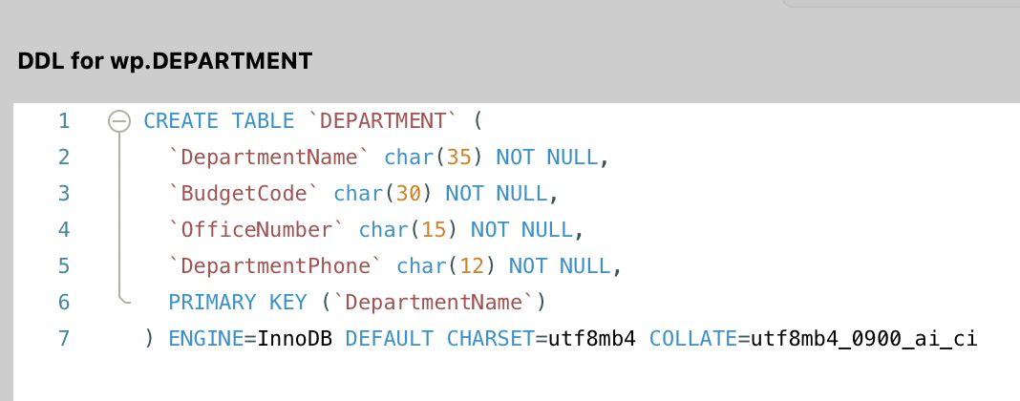
Some Uses of SQL Views
CREATE VIEW BasicDepartmentDataView AS
SELECT DepartmentName, DepartmentPhone
FROM DEPARTMENT;

Slide 16
Some Uses of SQL Views
CREATE VIEW ProjectHoursToDateView AS
SELECT PROJECT.ProjectID, ProjectName, MaxHours AS ProjectMaxHours,
SUM(HoursWorked) AS ProjectHoursWorkedToDate
FROM PROJECT JOIN ASSIGNMENT
ON PROJECT.ProjectID = ASSIGNMENT.ProjectID
GROUP BY PROJECT.ProjectID;
CREATE VIEW EmployeeProjectHoursWorkedView AS
  SELECT ProjectName, FirstName, LastName, HoursWorked
  FROM EMPLOYEE AS E JOIN ASSIGNMENT AS A
ON E.EmployeeNumber = A.EmployeeNumber
JOIN PROJECT AS P
ON A.ProjectID = P.ProjectID
ORDER BY P.ProjectID, A.EmployeeNumber;

Slide 17
Some Uses of SQL Views
/* create the view */
CREATE VIEW ProjectHoursToDateView AS
SELECT PROJECT.ProjectID, ProjectName, MaxHours AS ProjectMaxHours,
SUM(HoursWorked) AS ProjectHoursWorkedToDate
FROM PROJECT JOIN ASSIGNMENT
ON PROJECT.ProjectID = ASSIGNMENT.ProjectID
GROUP BY PROJECT.ProjectID;
/* write SQL queries on the created view*/
SELECT ProjectID, ProjectName, ProjectMaxHours, ProjectHoursWorkedToDate
FROM ProjectHoursToDateView
WHERE ProjectHoursWorkedToDate > ProjectMaxHours
ORDER BY ProjectID;
/*layering can be continued*/
CREATE VIEW ProjectsOverAllocatedMaxHoursView AS
SELECT ProjectID, ProjectName, ProjectMaxHours, ProjectHoursWorkedToDate
FROM ProjectHoursToDateView
WHERE ProjectHoursWorkedToDate > ProjectMaxHours;
/* perform further calculation*/
SELECT ProjectID, ProjectName, ProjectMaxHours, ProjectHoursWorkedToDate,
(ProjectHoursWorkedToDate - ProjectMaxHours) AS HoursOverMaxAllocated
FROM ProjectsOverAllocatedMaxHoursView
ORDER BY ProjectID;

Slide 18

QnA!

