Slide 1

Databases and Database Systems​
Le Duy Dung (Andrew)

Slide 2
LEARNING OBJECTIVES (1)
To understand reasons for using the SQL ALTER statement
To use the SQL ALTER statement
To understand the need for the SQL MERGE statement
To use the SQL MERGE statement
To understand the need for additional types of SQL queries
To use SQL outer join queries
To use SQL correlated subqueries
To use SQL queries on recursive relationships

Slide 3
LEARNING OBJECTIVES (2)
To understand the reasons for using SQL set operators
To use SQL set operators
To understand the reasons for using SQL views
To use SQL statements to create and use SQL views
To understand SQL/Persistent Stored Modules (SQL/PSM)
To use SQL statements to create and use SQL user-defined functions

Slide 4
SQL/ Persistent Stored Module (SQL/PSM)
The SQL/ Persistent Stored Module is a feature which provides users the ability to add their own extensions to the standard SQL.
  With SQL/PSM, users can write procedural code and functions
  It allows control-of-flow language such as BEGIN .. END blocks, IF…THEN…ELSE logic structures and LOOPs, as well as the ability to provide usable output to users.
Notes:
which provides users the ability to add their own extensions to the standard SQL

Slide 5
SQL/ Persistent Stored Module (SQL/PSM)
But most importantly, SQL/PSM allows the code that implements these features in a database to be contained in that databases
  Persistent = Remain available overtime
  Stored = Stored for reuse in the database
  Module = Written as a self-contained block of code, and there are three main module types:
    User-defined function (1)
    Triggers (2)
    Stored procedures (3)

Slide 6
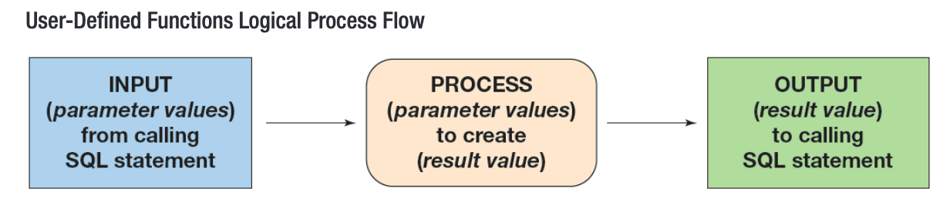
User-defined functions (stored functions)
The User-defined function is a stored-set of SQL statements that:
  Is called by name from another SQL statement
  May have input parameters passed to it by the calling SQL statement
  Returns an output value to the SQL statement that called the function.
  Basically, they are similar to built-in functions like MIN(), MAX(), COUNT(), etc… except that, we can create them ourselves to perform specific task we need to do.

Slide 7
User-defined functions – Example 1
Example: One of the common task you have to do is concatenate FirstName and LastName of demographics data.
  SELECT
  CONCAT(RTRIM(LastName),', ',RTRIM(FirstName))
  AS EmployeeName,
  EmailAddress, Phone
  FROM qacs.EMPLOYEE
  ORDER BY EmployeeName;

Slide 8
User-defined functions – Example 1
Example: Instead of writing that chunk of code every time you need to concatenate First and Last Name, you can define a simpler and reusable function.
DELIMITER //
CREATE FUNCTION NameConcatenation
(
FirstName CHAR(25),
LastName CHAR(25)
)
RETURNS VARCHAR(60) DETERMINISTIC
BEGIN
DECLARE FullName VARCHAR(60);
SET FullName = CONCAT(LastName,',', FirstName);
RETURN FullName;
END
//
DELIMITER ;
- The default delimiter is ;
- By running DELIMITER // , we signify that in this chunk of code, our delimiter is // not ;
- As such, MySQL will know that we passing this whole chunk of code as a module.
- If we didn’t re-define our delimiter, MySQL will interpret the 3 statement within BEGIN…END individually, thus raising an error since standing alone, each of these statement is not a complete instruction to MySQL
- After defining the procedure, we use the delimiter // to signify that this is the end of our module, and reset the DELIMITER to ;
** Note: You can use other symbols for delimiter as well, $$, %% are examples of valid options

Slide 9
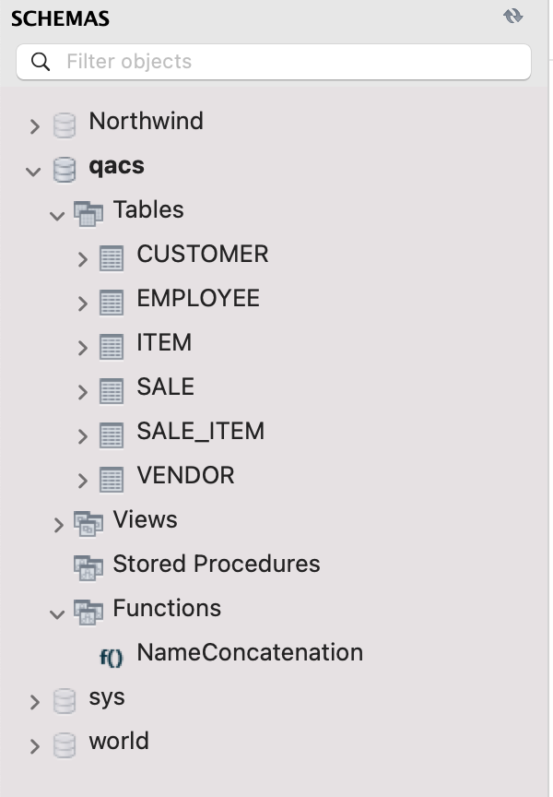
User-defined functions – Example 1
If set up correctly, you can see your function in the qacs database, under the Functions tab.
Now you can use this whenever you need without recreating the code
You can also test your defined function:
SELECT
NameConcatenation(FirstName, LastName)
AS EmployeeName,
EmailAddress, Phone
FROM qacs.EMPLOYEE
ORDER BY EmployeeName;

Slide 10
User-defined functions – A General Formula
Generally, a user– defined function has this form
DELIMITER $$ --Set the delimiter to other values so that ; can be used within the function
CREATE FUNCTION() -- Define the function name and its input
RETURNS -- Define the data type of output
BEGIN -- Begin the definition of your procedures
RETURN -- Define the output of your function
END $$ -- Signify that the function ends here
DELIMITER ; -- Reset the delimiter so that ; can be used as per usual

Slide 11
User-defined functions – More examples
Practice questions: Write a function that
Capitalizes all the vowels in a column
Convert the date from ‘yyyy-mm-dd’ to ‘dd/mm/yyyy’ format

Slide 12
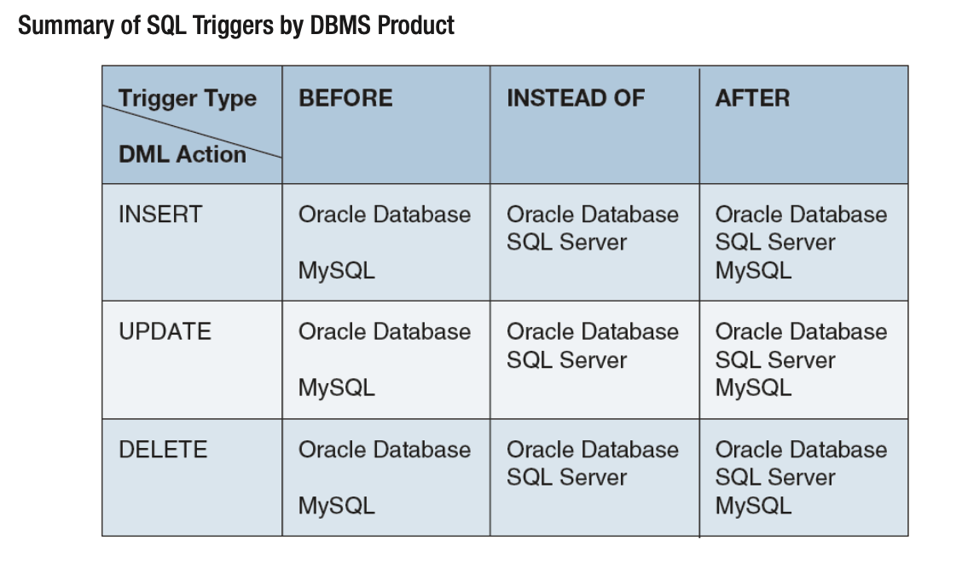
Triggers
Triggers is a stored program that is executed by the DBMS whenever a specified event occurs.
A trigger is attached to a table or a view. A table or a view may have many triggers, but a trigger is associated with just one table or view. A trigger is invoked by an SQL DML INSERT, UPDATE, or DELETE request on the table or view to which it is attached
BEFORE triggers are executed before the DBMS processes the insert, update, or delete request.
AFTER triggers are executed after the insert, update, or delete request has been processed.

Slide 13
Triggers
Common use case of triggers included
  Providing default values.
  Enforcing data constraints.
  Updating SQL views.
  Performing referential integrity actions.

Slide 14
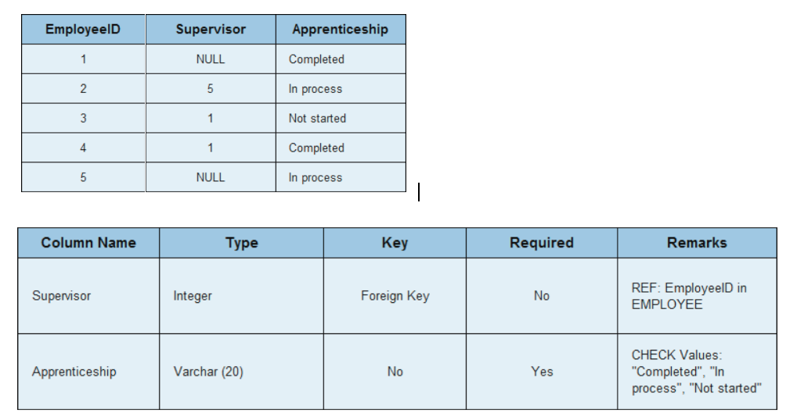
Triggers - Example
Example: Add a column to the EMPLOYEE table named Apprenticeship, which will contain data showing the apprenticeship status for each employee. Refer to the details below to create Apprenticeship column. Then create a trigger to ensure that only the values of Completed, In process, or Not started are allowed as data in the Apprenticeship column

Slide 15
Triggers - Example
Add column apprenticeship into our employee table
  alter table EMPLOYEE
  add Apprenticeship varchar(20);
Create a trigger which is equivalent to SQL CHECK constraint, ensure that this column contains only these values “Not started”, “Completed”, “In Progress”
  With a SQL CHECK we can do this. How about triggers?
  alter table EMPLOYEE
  add constraint Required check
  (Apprenticeship in ("Completed", "In process", "Not started"));

Slide 16
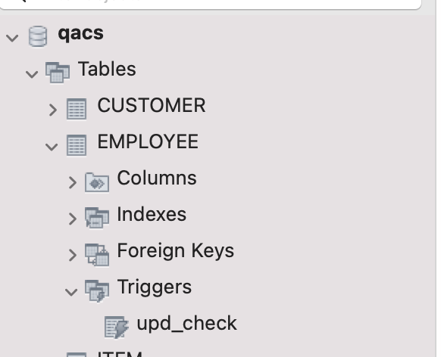
Triggers - Example
2. Our trigger can look like this. If set up correctly, you can see the triggers from the table
delimiter //
CREATE TRIGGER upd_check BEFORE UPDATE ON EMPLOYEE
FOR EACH ROW
BEGIN
IF NEW.Apprenticeship like '%Completed%' THEN
SET NEW.Apprenticeship = 'Completed';
ELSEIF NEW.Apprenticeship like '%In process%' THEN
SET NEW.Apprenticeship = 'In process';
ELSEIF NEW.Apprenticeship like '%Not started%' THEN
SET NEW.Apprenticeship = 'Not started';
END IF;
END;//
delimiter ;

Slide 17
Triggers - Example
3. Run this script to test our trigger, you can see the values are auto-corrected to abide with rules defined in our trigger
update EMPLOYEE
set Apprenticeship = case EmployeeID
when 1 then "Completed. "
when 2 then ”4In processasd"
when 3 then "3Not started"
when 4 then "asdCompleted"
when 5 then "In processedd"
end;

Slide 18
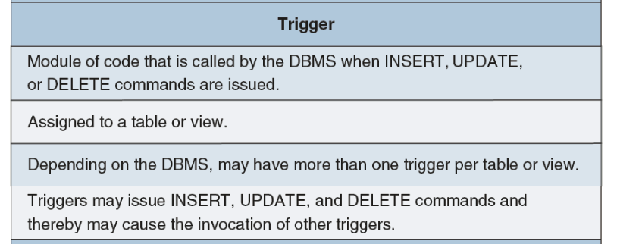
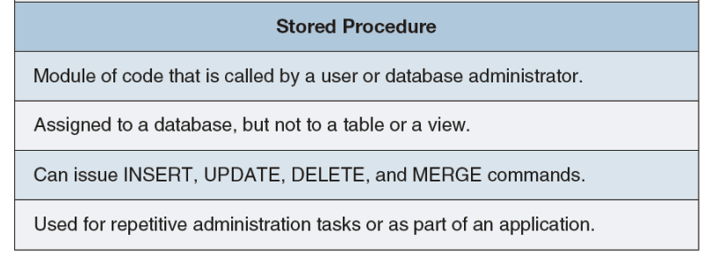
Stored Procedures
Stored Procedures is a program that is stored within the database and compiled when used.
Stored procedures can receive input parameters and return results. Unlike triggers, which are attached to a given table or view, stored procedures are attached to the database. They can be executed by any process using the database that has permission to use the procedure
Stored procedures are used for many purposes. Although database administrators use them to perform common administration tasks, their primary use is within database applications.

Slide 19
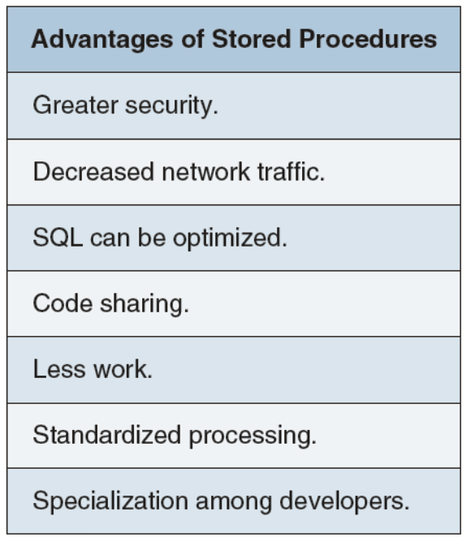
Stored Procedures
Advantages of stored procedures included:

Slide 20
Stored Procedures – Example
Example: Refer to table SALE, write a stored procedure that outputs the total value of all the sales made by each employee. The stored procedure will take an employee ID as input and return the total value of sales* made by him.
Note: Total value of sales can be interpreted as sum(Total) as in the SALE table

Slide 21
Stored Procedures – Example
Start with CREATE PROCEDURE to determine named of the procedure, and its input datatype
CREATE PROCEDURE SaleReport(IN eid INT)
Then define the task you want the procedure to carry out. This definition is contained within the BEGIN…END statement. This usually looks like a normal query. Remember to end the query with ;, before using END to signify the end of the procedure definition
BEGIN
select sum(Total) as 'Total Sales made'
from qacs.SALE
where EmployeeID in (eid);
END

Slide 22
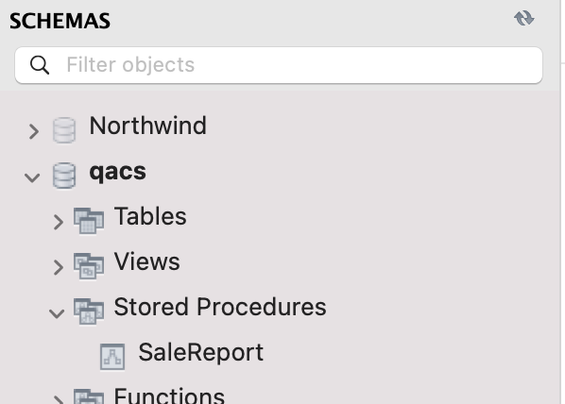
Stored Procedures – Example
If you set up correctly, the stored procedure will appear under qacs database schema like this.
To use the stored procedure, you have to explicit call it. Try the following call to understand its mechanism
  call SaleReport(1);
  call SaleReport(0);
  call SaleReport(‘1’);
  call SaleReport(1,2);
5. Can you adjust the procedure so that it can take a list of EmployeeID as input and return the total value of sales made by all of those employees?

Slide 23

QnA!

