Slide 1

Databases and Database Systems
Le Duy Dung (Andrew)

Slide 2
Advanced SQL

Slide 3
LEARNING OBJECTIVES (1)
To understand reasons for using the SQL ALTER statement
To use the SQL ALTER statement
To understand the need for additional types of SQL queries
To use SQL outer join queries
To use SQL correlated subqueries
To use SQL queries on recursive relationships

Slide 4
LEARNING OBJECTIVES (2)
To understand the reasons for using SQL set operators
To use SQL set operators
To understand the reasons for using SQL views
To use SQL statements to create and use SQL views
To understand SQL/Persistent Stored Modules (SQL/PSM)
To use SQL statements to create and use SQL user-defined functions

Slide 5
SQL ALTER TABLE Statement
The SQL ALTER TABLE statement is used to modify the structure of a table once it has been created in a database.
  Can be used to add, modify, and drop columns and constraints
  Very useful to modify the AUTO_INCREMENT starting value in MySQL 8.0
  Example:
  /* *** EXAMPLE CODE – THIS STATEMENT HAS ALREADY BEEN RUN *** */
  ALTER TABLE CATALOG_SKU_2017 AUTO_INCREMENT = 20170001;

Slide 6
ALTER TABLE – Adding a Column to an Existing Table
The SQL ALTER TABLE statement can be used to add a column to an. existing table as seen below.
  ALTER TABLE {TableName}
  ADD {ColumnName} {DataType} {OptionalColumnConstraints};
  Example:
  ALTER TABLE PRODUCTION_ITEM
  ADD ApprovalDate DATE NULL;

Slide 7
ALTER TABLE – Adding a Column to an Existing Table
The SQL ALTER TABLE statement can be used to add a column to an. existing table as seen below.
  ALTER TABLE {TableName}
  ADD {ColumnName} {DataType} {OptionalColumnConstraints};
Note that the SQL COLUMN keyword is not used in an ADD {COLUMN} clause. MySQL does allow it but is not required!
The above statement is sufficient if adding a column that allows NULL values. If a NOT NULL column constraint exists then the following steps must be used:
  Add the column as column that allows NULL values.
  Update all table rows with data values in the new column.
  Modify the column to see the NOT NULL constraint.

Slide 8
Adding a Table Constraint to an Existing Table
To use the SQL ALTER statement
The SQL ALTER TABLE statement can be used to add a table constraint to an existing table. The basic syntax is:
  ALTER TABLE {TableName}
  ADD CONSTRAINT {ConstraintName} {TableConstraint};
Note that the SQL CONSTRAINT keyword is used in an ADD CONSTRAINT clause
Note the addition of the CHECK constraint below.
  ALTER TABLE PRODUCTION_ITEM
  ADD CONSTRAINT CheckProductionDate CHECK
  (ApprovalDate < ProductionStartDate);

Slide 9
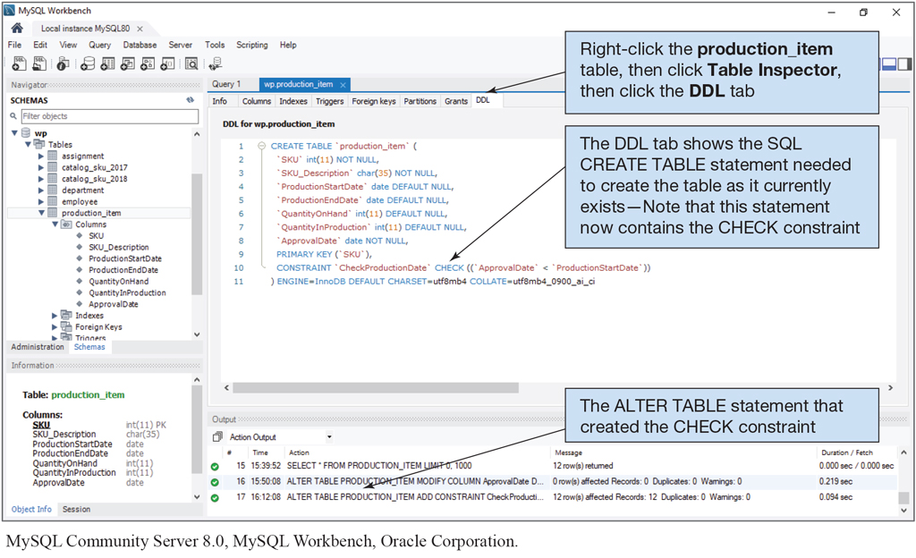
Adding a Table Constraint to an Existing Table
To use the SQL ALTER statement
The SQL ALTER TABLE statement can be used to add a table constraint to an existing table. The basic syntax is:
  ALTER TABLE {TableName}
  ADD CONSTRAINT {ConstraintName} {TableConstraint};
Note that the SQL CONSTRAINT keyword is used in an ADD CONSTRAINT clause
Note the addition of the CHECK constraint below.
  ALTER TABLE PRODUCTION_ITEM
  ADD CONSTRAINT CheckProductionDate CHECK
  (ApprovalDate < ProductionStartDate);

Slide 10
Adding a Referential Integrity Constraint to an Existing Table
The SQL ALTER TABLE statement can be used to add a referential integrity constraint to an existing table. The basic syntax is:
  ALTER TABLE {TableName}
  ADD CONSTRAINT {ConstraintName} FOREIGN KEY({ColumnName})
  REFERENCES {TableName}({PrimaryKeyColumn})
  {Optional ON UPDATE clause}
  {Optional ON DELETE clause};
  ALTER TABLE CATALOG_SKU_2018
  ADD CONSTRAINT CAT16_PROD_ITEM_FK FOREIGN KEY(SKU)
  REFERENCES PRODUCTION_ITEM(SKU)
  ON UPDATE NO ACTION
  ON DELETE NO ACTION;

Slide 11
Removing a Table Column/Constraint from an Existing Table
The SQL ALTER TABLE statement can be used to remove a column from a table. Note that the SQL COLUMN keyword is used in the DROP COLUMN clause. The basic syntax is:
  ALTER TABLE {TableName}
  DROP COLUMN {ColumnName};
The SQL ALTER TABLE statement can be used to remove a table constraint. Note that the SQL CONSTRAINT keyword is used in the DROP CONSTRAINT clause. The basic syntax is:
  ALTER TABLE {TableName}
  DROP CONSTRAINT {ConstraintName};

Slide 12

QnA!

