Slide 1
GR05 / INDUSTRIAL ANALYTICS
INTRODUCTION
Every cycle tells a story.
• GR05 · Predictive Maintenance
• Aircraft engine Remaining Useful Life
• Selçuk Ata Aksoy · Denzel Gregory Pragassa
• HFU · Industrial Analytics · WS 2026/27
Creators: GR05 (AI-assisted draft) | Presenter proposed: Selçuk Ata Aksoy
01 / 40
Evidence: Supplied Project Tasks V6.0, pp. 1–2 (9 Nov 2026); milestone comments handout.
Notes:
Slide 1: Every cycle tells a story.
Proposed presenter: Selçuk Ata Aksoy (confirm with team).
Opening: We study whether operating and sensor data can estimate how many flight cycles remain before simulated end-of-life. Today we present business understanding, data, preparation and descriptive findings. We have not trained an RUL model. The progress/preparation session is 12 November. The milestone presentation is Thursday 19 November, as stated on lecturer overview slide 9. Confirm class time and allowed speaking duration separately.
Evidence: Supplied Project Tasks V6.0, pp. 1–2 (9 Nov 2026); milestone comments handout.
Draft assembly: GR05 with documented AI assistance; team content review pending.

Slide 2
GR05 / INDUSTRIAL ANALYTICS
INTRODUCTION
Our question and scope
• Can simple regression estimate RUL better than a transparent baseline?
• Prediction point: end of each completed flight.
• Scope: local DS01 + DS02; offline simulated-data study.
• Deliverable now: explainable evidence and prepared inputs.
Creators: GR05 (AI-assisted draft) | Presenter proposed: Selçuk Ata Aksoy
02 / 40
Evidence: Supplied Project Tasks V6.0, pp. 1–2 (9 Nov 2026); milestone comments handout.
Notes:
Slide 2: Our question and scope
Proposed presenter: Selçuk Ata Aksoy (confirm with team).
RUL means remaining flight cycles, not a binary failure alarm. The full fleet history is available retrospectively, but predictor construction uses current and earlier flights only. We aim for a manageable two-student comparison; deep learning and deployment are outside initial scope.
Evidence: Supplied Project Tasks V6.0, pp. 1–2 (9 Nov 2026); milestone comments handout.
Draft assembly: GR05 with documented AI assistance; team content review pending.

Slide 3
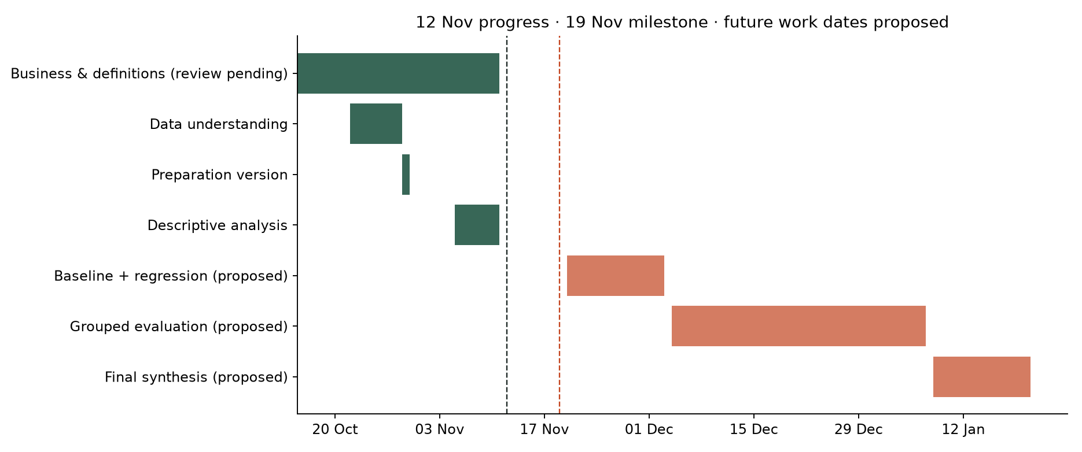
GR05 / INDUSTRIAL ANALYTICS
PROJECT PLAN
From question to evidence
• October: Tasks 1–4 → definition,
business, understanding,
preparation.
• 5–11 Nov: Task 5 → descriptive
analysis, review and completion.
• 12 Nov: progress/preparation; 19
Nov: milestone presentation.
• Next: baseline → regressors →
grouped evaluation → 21 Jan final.
Creators: GR05 (AI-assisted draft) | Presenter proposed: Selçuk Ata Aksoy
03 / 40
Evidence: Supplied Project Tasks V6.0, pp. 1–2 (9 Nov 2026); milestone comments handout.
Notes:
Slide 3: From question to evidence
Proposed presenter: Selçuk Ata Aksoy (confirm with team).
Walk the audience through the timeline without claiming the historical schedule was met on every date. The lecturer overview explicitly dates the milestone 19 November; the preceding week is preparation. Final 21 January is from the existing project plan; dates after the milestone are team targets, not new lecturer deadlines.
Evidence: Supplied Project Tasks V6.0, pp. 1–2 (9 Nov 2026); milestone comments handout.
Draft assembly: GR05 with documented AI assistance; team content review pending.

Slide 4
GR05 / INDUSTRIAL ANALYTICS
DELIVERABLES
What exists and what comes next
• Executed notebooks: understanding, preparation, descriptive analysis.
• Versioned local inputs, fitted preprocessing, audit CSVs and charts.
• Reports and local static pages: findings, preparation, analysis dashboard.
• Pending: human review, model training, MAE/RMSE and business evaluation.
Creators: GR05 (AI-assisted draft) | Presenter proposed: Selçuk Ata Aksoy
04 / 40
Evidence: Task 4 manifest: task4-v1-f8ab427897d5; docs/06-data-preparation.md.
Notes:
Slide 4: What exists and what comes next
Proposed presenter: Selçuk Ata Aksoy (confirm with team).
Name the concrete artifacts and distinguish saved preprocessing from a trained predictive model. A clean, finite input matrix does not imply accurate forecasts. The deck itself is an AI-assisted draft requiring team review.
Evidence: Task 4 manifest: task4-v1-f8ab427897d5; docs/06-data-preparation.md.
Draft assembly: GR05 with documented AI assistance; team content review pending.

Slide 5
GR05 / INDUSTRIAL ANALYTICS
THEORY 01 / 10
Why maintenance planning is uncertain
• Equipment condition changes during operation.
• Planners balance intervention lead time against continued operation.
• Sensor records can inform that decision, but uncertainty remains.
Creators: GR05 (AI-assisted draft) | Presenter proposed: Selçuk Ata Aksoy
05 / 40
Evidence: Arias Chao et al. (2021), Data 6(1), 5. https://doi.org/10.3390/data6010005
Notes:
Slide 5: Why maintenance planning is uncertain
Proposed presenter: Selçuk Ata Aksoy (confirm with team).
This frames the business problem qualitatively. We do not have observed repair costs or verified savings. Explain that maintenance planning uses several inputs; an RUL estimate would be one supporting signal, not a standalone safety decision.
Evidence: Arias Chao et al. (2021), Data 6(1), 5. https://doi.org/10.3390/data6010005
Draft assembly: GR05 with documented AI assistance; team content review pending.

Slide 6
GR05 / INDUSTRIAL ANALYTICS
THEORY 02 / 10
Three maintenance strategies
• Reactive: act after a fault or failure is detected.
• Preventive: intervene at scheduled intervals.
• Predictive: use condition/history to estimate future needs.
Creators: GR05 (AI-assisted draft) | Presenter proposed: Selçuk Ata Aksoy
06 / 40
Evidence: Supplied Project Tasks V6.0, pp. 1–2 (9 Nov 2026); milestone comments handout.
Notes:
Slide 6: Three maintenance strategies
Proposed presenter: Selçuk Ata Aksoy (confirm with team).
Use an everyday machinery example to explain the contrast. These are conceptual categories, not a claim that one strategy is always cheapest or safest. Our offline research explores the predictive component; it does not replace approved maintenance schedules.
Evidence: Supplied Project Tasks V6.0, pp. 1–2 (9 Nov 2026); milestone comments handout.
Draft assembly: GR05 with documented AI assistance; team content review pending.

Slide 7
GR05 / INDUSTRIAL ANALYTICS
THEORY 03 / 10
Degradation is a process
• A history records evolving condition rather than isolated failures.
• Different engines can have different initial health and lifetimes.
• Operating profiles can affect the signals we observe.
Creators: GR05 (AI-assisted draft) | Presenter proposed: Selçuk Ata Aksoy
07 / 40
Evidence: Arias Chao et al. (2021), Data 6(1), 5. https://doi.org/10.3390/data6010005
Notes:
Slide 7: Degradation is a process
Proposed presenter: Selçuk Ata Aksoy (confirm with team).
The supplied preprint describes simulated degradation with engine-to-engine variability. Avoid implying that a raw sensor signal maps uniquely to wear. The dataset gives run-to-failure histories, allowing retrospective labels.
Evidence: Arias Chao et al. (2021), Data 6(1), 5. https://doi.org/10.3390/data6010005
Draft assembly: GR05 with documented AI assistance; team content review pending.

Slide 8
GR05 / INDUSTRIAL ANALYTICS
THEORY 04 / 10
Condition monitoring: what is observed?
• Flight context: altitude, speed, throttle and inlet temperature.
• Response: temperatures, pressures, shaft speeds and fuel flow.
• Together they describe the engine operating under a mission.
Creators: GR05 (AI-assisted draft) | Presenter proposed: Selçuk Ata Aksoy
08 / 40
Evidence: Arias Chao et al. (2021), Data 6(1), 5. https://doi.org/10.3390/data6010005
Notes:
Slide 8: Condition monitoring: what is observed?
Proposed presenter: Selçuk Ata Aksoy (confirm with team).
Draw a simple input-to-response story: the flight puts demands on the engine, and sensor channels describe its response. Measured is the simulator channel label; the readings are not observed real engine failures.
Evidence: Arias Chao et al. (2021), Data 6(1), 5. https://doi.org/10.3390/data6010005
Draft assembly: GR05 with documented AI assistance; team content review pending.

Slide 9
GR05 / INDUSTRIAL ANALYTICS
THEORY 05 / 10
Diagnosis and prognosis answer different questions
• Diagnosis: what condition or fault may exist now?
• Prognosis: how might condition evolve, or how long remains?
• GR05 targets prognosis through continuous RUL regression.
Creators: GR05 (AI-assisted draft) | Presenter proposed: Selçuk Ata Aksoy
09 / 40
Evidence: Supplied Project Tasks V6.0, pp. 1–2 (9 Nov 2026); milestone comments handout.
Notes:
Slide 9: Diagnosis and prognosis answer different questions
Proposed presenter: Selçuk Ata Aksoy (confirm with team).
The retrospective simulator health state can help explain data, but would give privileged information to a physical-sensor model. We exclude it from predictors. A health-class label is not the same as a numerical remaining-life estimate.
Evidence: Supplied Project Tasks V6.0, pp. 1–2 (9 Nov 2026); milestone comments handout.
Draft assembly: GR05 with documented AI assistance; team content review pending.

Slide 10
GR05 / INDUSTRIAL ANALYTICS
THEORY 06 / 10
RUL is a countdown in flight cycles
• Observed label: final cycle − current cycle.
• Example: final 100, current 30 → RUL 70 cycles.
• Final cycle is used to audit y, never supplied in X.
Creators: GR05 (AI-assisted draft) | Presenter proposed: Selçuk Ata Aksoy
10 / 40
Evidence: Task 3 executed notebook + reports/results/task3_summary.json; figures generated from local DS01/DS02.
Notes:
Slide 10: RUL is a countdown in flight cycles
Proposed presenter: Selçuk Ata Aksoy (confirm with team).
The example illustrates the convention, not a forecast. All engine-flight labels in Task 3 obeyed the countdown. Different engines have different final cycles, so cycle index alone is not a universal timer.
Evidence: Task 3 executed notebook + reports/results/task3_summary.json; figures generated from local DS01/DS02.
Draft assembly: GR05 with documented AI assistance; team content review pending.

Slide 11
GR05 / INDUSTRIAL ANALYTICS
THEORY 07 / 10
A prediction needs a clock
• At flight end: the current completed flight is known.
• Previous flights are known; future flights are not.
• Our summaries and rolling features respect that boundary.
Creators: GR05 (AI-assisted draft) | Presenter proposed: Selçuk Ata Aksoy
11 / 40
Evidence: Task 4 manifest: task4-v1-f8ab427897d5; docs/06-data-preparation.md.
Notes:
Slide 11: A prediction needs a clock
Proposed presenter: Selçuk Ata Aksoy (confirm with team).
Use the engine diary explanation. A centered rolling window or normalization by final lifetime would violate the boundary. A flight-end prediction contract is essential before selecting features or comparing models.
Evidence: Task 4 manifest: task4-v1-f8ab427897d5; docs/06-data-preparation.md.
Draft assembly: GR05 with documented AI assistance; team content review pending.

Slide 12
GR05 / INDUSTRIAL ANALYTICS
THEORY 08 / 10
The two directions of error matter
• Optimistic RUL: estimates more remaining life than the label.
• Pessimistic RUL: estimates less remaining life than the label.
• Possible implications: delayed vs premature maintenance.
Creators: GR05 (AI-assisted draft) | Presenter proposed: Selçuk Ata Aksoy
12 / 40
Evidence: Supplied Project Tasks V6.0, pp. 1–2 (9 Nov 2026); milestone comments handout.
Notes:
Slide 12: The two directions of error matter
Proposed presenter: Selçuk Ata Aksoy (confirm with team).
These are possible planning consequences, not observed costs. We will report error distributions and optimistic errors alongside average metrics. We have not designed a deployable intervention threshold.
Evidence: Supplied Project Tasks V6.0, pp. 1–2 (9 Nov 2026); milestone comments handout.
Draft assembly: GR05 with documented AI assistance; team content review pending.

Slide 13
GR05 / INDUSTRIAL ANALYTICS
THEORY 09 / 10
CRISP-DM makes the work traceable
• Business → data understanding → preparation.
• Modeling → evaluation → business implications.
• Each stage can send us back to improve an earlier decision.
Creators: GR05 (AI-assisted draft) | Presenter proposed: Selçuk Ata Aksoy
13 / 40
Evidence: Supplied Project Tasks V6.0, pp. 1–2 (9 Nov 2026); milestone comments handout.
Notes:
Slide 13: CRISP-DM makes the work traceable
Proposed presenter: Selçuk Ata Aksoy (confirm with team).
Relate the course tasks to the process. A new variable definition or a leakage concern can require a new preparation version. We are at the descriptive milestone, moving toward modeling rather than claiming the whole lifecycle is finished.
Evidence: Supplied Project Tasks V6.0, pp. 1–2 (9 Nov 2026); milestone comments handout.
Draft assembly: GR05 with documented AI assistance; team content review pending.

Slide 14
GR05 / INDUSTRIAL ANALYTICS
THEORY 10 / 10
Context shift challenges generalization
• A signal can change with mission as well as degradation.
• DS02 development has class 3; test also has classes 1 and 2.
• A result on repeated flights may not generalize to unseen engines.
Creators: GR05 (AI-assisted draft) | Presenter proposed: Selçuk Ata Aksoy
14 / 40
Evidence: Task 3 executed notebook + reports/results/task3_summary.json; figures generated from local DS01/DS02.
Notes:
Slide 14: Context shift challenges generalization
Proposed presenter: Selçuk Ata Aksoy (confirm with team).
Explain domain shift using short versus long missions. This is a coverage observation, not a measured failure of a model. The small number of engine groups limits confidence and motivates group-aware evaluation.
Evidence: Task 3 executed notebook + reports/results/task3_summary.json; figures generated from local DS01/DS02.
Draft assembly: GR05 with documented AI assistance; team content review pending.

Slide 15
GR05 / INDUSTRIAL ANALYTICS
BUSINESS 01 / 05
Who would use the output?
• Maintenance planners: lead time and intervention timing.
• Reliability engineers: degradation patterns and error interpretation.
• Operations: downtime and premature-maintenance trade-offs.
• Our users today: students and lecturer reviewing evidence.
Creators: GR05 (AI-assisted draft) | Presenter proposed: Selçuk Ata Aksoy
15 / 40
Evidence: Supplied Project Tasks V6.0, pp. 1–2 (9 Nov 2026); milestone comments handout.
Notes:
Slide 15: Who would use the output?
Proposed presenter: Selçuk Ata Aksoy (confirm with team).
Distinguish hypothetical industrial stakeholders from actual project participants. We have not interviewed or deployed to an airline. Their interests frame the business case, while the academic users assess reproducibility and understanding.
Evidence: Supplied Project Tasks V6.0, pp. 1–2 (9 Nov 2026); milestone comments handout.
Draft assembly: GR05 with documented AI assistance; team content review pending.

Slide 16
GR05 / INDUSTRIAL ANALYTICS
BUSINESS 02 / 05
The proposed value is decision support
• Input: observed operating/sensor histories.
• Output later: an RUL estimate with documented error.
• Potential use: inform planning discussions.
• Value remains hypothetical until validated independently.
Creators: GR05 (AI-assisted draft) | Presenter proposed: Selçuk Ata Aksoy
16 / 40
Evidence: Supplied Project Tasks V6.0, pp. 1–2 (9 Nov 2026); milestone comments handout.
Notes:
Slide 16: The proposed value is decision support
Proposed presenter: Selçuk Ata Aksoy (confirm with team).
Explain that the dataset lacks actual economic outcomes. We cannot infer numerical savings from a temperature correlation. Do not present the work as an approved aircraft maintenance system.
Evidence: Supplied Project Tasks V6.0, pp. 1–2 (9 Nov 2026); milestone comments handout.
Draft assembly: GR05 with documented AI assistance; team content review pending.

Slide 17
GR05 / INDUSTRIAL ANALYTICS
BUSINESS 03 / 05
How will success be assessed?
• MAE: typical absolute error in flight cycles.
• RMSE: highlights larger cycle errors.
• Compare against constant training-RUL baselines.
• Also show per-engine and macro-average errors.
Creators: GR05 (AI-assisted draft) | Presenter proposed: Selçuk Ata Aksoy
17 / 40
Evidence: https://scikit-learn.org/stable/modules/model_evaluation.html#regression-metrics (accessed 11 Nov 2026).
Notes:
Slide 17: How will success be assessed?
Proposed presenter: Selçuk Ata Aksoy (confirm with team).
Define MAE as the average magnitude of error and RMSE as the square root of average squared error. Both remain in cycles. A mean constant is squared-error optimal; a median constant is absolute-error optimal. These are proposed comparisons, not results. Do not invent a numerical success threshold.
Evidence: https://scikit-learn.org/stable/modules/model_evaluation.html#regression-metrics (accessed 11 Nov 2026).
Draft assembly: GR05 with documented AI assistance; team content review pending.

Slide 18
GR05 / INDUSTRIAL ANALYTICS
BUSINESS 04 / 05
Make the scope feasible for two students
• Start with simple baselines and classical regression.
• Use the 20-column baseline selection before 50 candidates.
• Evaluate on separate engine groups.
• No deep learning or live aircraft deployment in initial scope.
Creators: GR05 (AI-assisted draft) | Presenter proposed: Selçuk Ata Aksoy
18 / 40
Evidence: Task 4 manifest: task4-v1-f8ab427897d5; docs/06-data-preparation.md.
Notes:
Slide 18: Make the scope feasible for two students
Proposed presenter: Selçuk Ata Aksoy (confirm with team).
Task 4 integrated both collections with source identity and conservative grouping. A DS01-only refit is an appropriate sensitivity comparison later. Complexity should be justified by development-engine performance, not the desire to use more algorithms.
Evidence: Task 4 manifest: task4-v1-f8ab427897d5; docs/06-data-preparation.md.
Draft assembly: GR05 with documented AI assistance; team content review pending.

Slide 19
GR05 / INDUSTRIAL ANALYTICS
BUSINESS 05 / 05
Team responsibilities: proposed, not assumed
• Selçuk: present data preparation and linear regression overview.
• Denzel: present descriptive findings and random forest overview.
• Both: review business claims, rehearse and understand all evidence.
• Confirm presenter allocation and individual contributions together.
Creators: GR05 (AI-assisted draft) | Presenter proposed: Denzel Gregory Pragassa
19 / 40
Evidence: Supplied Project Tasks V6.0, pp. 1–2 (9 Nov 2026); milestone comments handout.
Notes:
Slide 19: Team responsibilities: proposed, not assumed
Proposed presenter: Denzel Gregory Pragassa (confirm with team).
This is a proposed speaking allocation for readiness, not an invented statement about who completed all implementation. Existing git evidence credits Denzel with the Task 5 draft; the log records AI-assisted completion. Individual grading means each student must understand and explain their algorithm and contributions.
Evidence: Supplied Project Tasks V6.0, pp. 1–2 (9 Nov 2026); milestone comments handout.
Draft assembly: GR05 with documented AI assistance; team content review pending.

Slide 20
GR05 / INDUSTRIAL ANALYTICS
DATA SOURCE
Two local subsets, one lineage
• NASA N-CMAPSS → Kaggle redistribution → local HDF5.
• DS01-005 and DS02-006; approximately 4.958 GiB combined.
• 2020 local preprint differs from 2021 journal description.
• Current source labels recorded; original download-version match unproven.
Creators: GR05 (AI-assisted draft) | Presenter proposed: Selçuk Ata Aksoy
20 / 40
Evidence: Arias Chao et al. (2021), Data 6(1), 5. https://doi.org/10.3390/data6010005
Notes:
Slide 20: Two local subsets, one lineage
Proposed presenter: Selçuk Ata Aksoy (confirm with team).
Direct source link: https://www.kaggle.com/datasets/bishals098/nasa-cmapss-2-engine-degradation . Scientific reference: https://doi.org/10.3390/data6010005 . The paper declares CC0 for the dataset. Exact local hashes identify the files but do not verify upstream provenance. Raw files remain local.
Evidence: Arias Chao et al. (2021), Data 6(1), 5. https://doi.org/10.3390/data6010005
Draft assembly: GR05 with documented AI assistance; team content review pending.

Slide 21
GR05 / INDUSTRIAL ANALYTICS
DATA 01 / 05
Reading → flight → engine history
• 14,159,058 ordered readings.
• 1,542 dataset-engine-flight pairs.
• 19 dataset-scoped source histories.
• Across-subset independence is not established.
Creators: GR05 (AI-assisted draft) | Presenter proposed: Selçuk Ata Aksoy
21 / 40
Evidence: Task 3 executed notebook + reports/results/task3_summary.json; figures generated from local DS01/DS02.
Notes:
Slide 21: Reading → flight → engine history
Proposed presenter: Selçuk Ata Aksoy (confirm with team).
Say nineteen source histories rather than nineteen proven independent engines. Shared IDs are conservatively linked later. Many rows in a flight are not independent samples. Show a small raw row and a prepared flight row if asked.
Evidence: Task 3 executed notebook + reports/results/task3_summary.json; figures generated from local DS01/DS02.
Draft assembly: GR05 with documented AI assistance; team content review pending.

Slide 22
GR05 / INDUSTRIAL ANALYTICS
DATA 02 / 05
47 stored fields have different roles
• W 4 + X_s 14: physical channel candidates.
• X_v 14 + T 10: hidden or virtual simulator quantities.
• Y 1: target; A 4: metadata.
• Stored fields are not all legitimate predictors.
Creators: GR05 (AI-assisted draft) | Presenter proposed: Selçuk Ata Aksoy
22 / 40
Evidence: Task 3 executed notebook + reports/results/task3_summary.json; figures generated from local DS01/DS02.
Notes:
Slide 22: 47 stored fields have different roles
Proposed presenter: Selçuk Ata Aksoy (confirm with team).
Task 4 selected 17 of the 18 physical channels: P2 was excluded while unresolved in the older local source. The journal now confirms its definition; the feature representation stays unchanged; the metadata refresh creates a new version. Hidden health state, RUL and final lifetime are excluded from model inputs.
Evidence: Task 3 executed notebook + reports/results/task3_summary.json; figures generated from local DS01/DS02.
Draft assembly: GR05 with documented AI assistance; team content review pending.

Slide 23
GR05 / INDUSTRIAL ANALYTICS
DATA 03 / 05
A number can still be a category
• Unit ID: nominal label, despite float64 storage.
• Flight class: ordered category (short / medium / long).
• RUL: discrete ratio count; absolute temperature: continuous ratio.
• Units and statistical meaning guide valid comparisons.
Creators: GR05 (AI-assisted draft) | Presenter proposed: Selçuk Ata Aksoy
23 / 40
Evidence: Task 3 executed notebook + reports/results/task3_summary.json; figures generated from local DS01/DS02.
Notes:
Slide 23: A number can still be a category
Proposed presenter: Selçuk Ata Aksoy (confirm with team).
Use the lecturer Dataset Scales example. Engine 10 is not twice engine 5. RUL zero means no flight cycles remain under our verified convention. Altitude is treated relative to a datum; cycle is an ordered index. Avoid equating numeric dtype with ratio scale.
Evidence: Task 3 executed notebook + reports/results/task3_summary.json; figures generated from local DS01/DS02.
Draft assembly: GR05 with documented AI assistance; team content review pending.

Slide 24
GR05 / INDUSTRIAL ANALYTICS
DATA 04 / 05
Quality checks passed—with limits
• No NaN/inf in the full Task 3 numeric scan.
• RUL countdown and cycle logic checks passed.
• Adjacent and sampled exact-duplicate checks found zero.
• No proof of physical accuracy or all non-adjacent uniqueness.
Creators: GR05 (AI-assisted draft) | Presenter proposed: Selçuk Ata Aksoy
24 / 40
Evidence: Task 3 executed notebook + reports/results/task3_summary.json; figures generated from local DS01/DS02.
Notes:
Slide 24: Quality checks passed—with limits
Proposed presenter: Selçuk Ata Aksoy (confirm with team).
Cover six dimensions verbally: conformity, completeness, uniqueness, accuracy, timeliness and consistency. Finite data is not automatically correct data. Static simulation without timestamps prevents a calendar-freshness or gap-free-clock claim. Outlier fences are flags, not deletion instructions.
Evidence: Task 3 executed notebook + reports/results/task3_summary.json; figures generated from local DS01/DS02.
Draft assembly: GR05 with documented AI assistance; team content review pending.

Slide 25
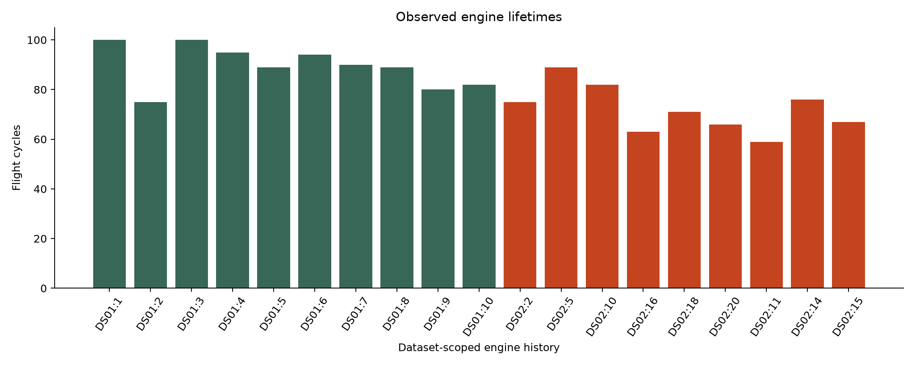
GR05 / INDUSTRIAL ANALYTICS
DATA 05 / 05
Engine lifetimes differ
• DS01 histories: 75–100 flight
cycles.
• DS02 histories: 59–89 flight cycles.
• Longer missions create more
readings, not more engines.
Creators: GR05 (AI-assisted draft) | Presenter proposed: Selçuk Ata Aksoy
25 / 40
Evidence: Task 3 executed notebook + reports/results/task3_summary.json; figures generated from local DS01/DS02.
Notes:
Slide 25: Engine lifetimes differ
Proposed presenter: Selçuk Ata Aksoy (confirm with team).
The structural chart includes supplied test histories for data description, not hypothesis selection. Distinguish flight-cycle lifetime from elapsed engine hours; there is no verified timestamp column in the local arrays.
Evidence: Task 3 executed notebook + reports/results/task3_summary.json; figures generated from local DS01/DS02.
Draft assembly: GR05 with documented AI assistance; team content review pending.

Slide 26
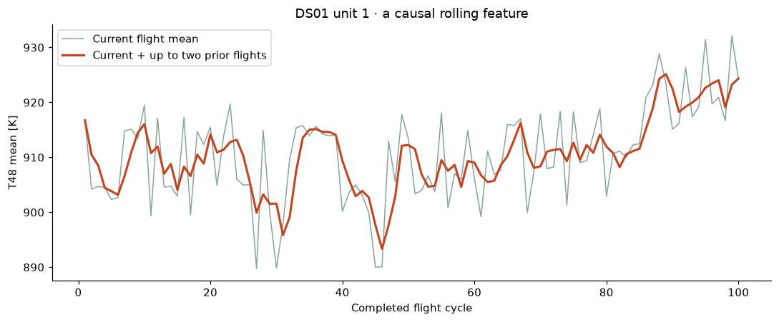
GR05 / INDUSTRIAL ANALYTICS
PREPARATION 01 / 03
From snapshots to one completed flight
• 17 channel means + 17
within-flight spreads + reading
count.
• 3 causal trailing means + 3
previous-flight differences.
• 4 physical combinations; 45
numeric candidates.
• Physical units: m, K, kPa, kg/s,
rpm.
Creators: GR05 (AI-assisted draft) | Presenter proposed: Selçuk Ata Aksoy
26 / 40
Evidence: Task 4 manifest: task4-v1-f8ab427897d5; docs/06-data-preparation.md.
Notes:
Slide 26: From snapshots to one completed flight
Proposed presenter: Selçuk Ata Aksoy (confirm with team).
Each feature is available by current flight end. Previous differences are missing on first observed flights; this is expected. Whole-flight means mix phases. Ratios of means are diagnostic candidates, not calibrated efficiencies.
Evidence: Task 4 manifest: task4-v1-f8ab427897d5; docs/06-data-preparation.md.
Draft assembly: GR05 with documented AI assistance; team content review pending.

Slide 27
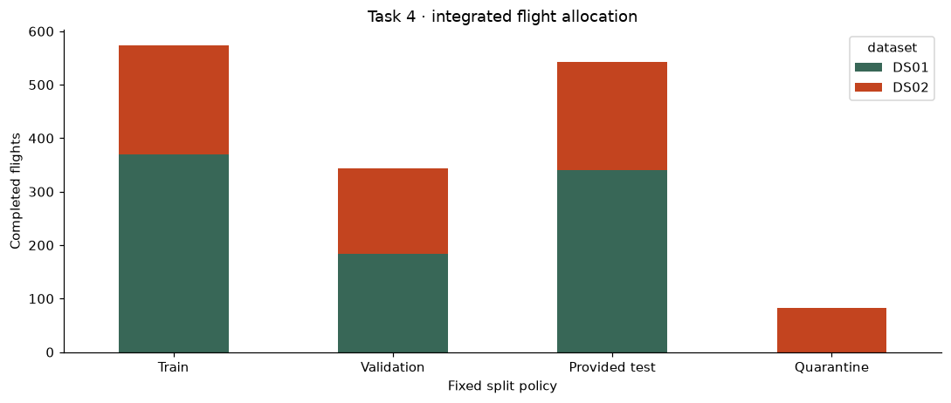
GR05 / INDUSTRIAL ANALYTICS
PREPARATION 02 / 03
Split first; learn transformations on training only
• 574 train · 343 validation · 543
provided test.
• 82 DS02 unit-10 flights
quarantined due to possible DS01
test link.
• Training medians + missing
indicators; training standardization.
• No validation/test fitting; shared
IDs grouped conservatively.
Creators: GR05 (AI-assisted draft) | Presenter proposed: Selçuk Ata Aksoy
27 / 40
Evidence: Task 4 manifest: task4-v1-f8ab427897d5; docs/06-data-preparation.md.
Notes:
Slide 27: Split first; learn transformations on training only
Proposed presenter: Selçuk Ata Aksoy (confirm with team).
Training has seven source histories but six conservative unit-ID groups. Equal-ID linking mitigates a risk, not proof of total independence. The imputer handles 57 expected first-difference gaps across all histories. Source DS01/DS02 becomes two one-hot columns.
Evidence: Task 4 manifest: task4-v1-f8ab427897d5; docs/06-data-preparation.md.
Draft assembly: GR05 with documented AI assistance; team content review pending.

Slide 28
GR05 / INDUSTRIAL ANALYTICS
PREPARATION 03 / 03
Raw and prepared are both available locally
• Raw HDF5: immutable originals, excluded from Git.
• Prepared CSVs: X inputs, y RUL, matching row identities.
• 50-column candidate matrices; 20-column baseline option.
• Hashes, config, code and package versions identify the version.
Creators: GR05 (AI-assisted draft) | Presenter proposed: Selçuk Ata Aksoy
28 / 40
Evidence: Task 4 manifest: task4-v1-f8ab427897d5; docs/06-data-preparation.md.
Notes:
Slide 28: Raw and prepared are both available locally
Proposed presenter: Selçuk Ata Aksoy (confirm with team).
Live-demo the current manifest and one prepared row, not a new 5 GB processing run. Dataset path comes from reports/results/task4/manifest.json. Saved preprocessor.joblib is a fitted transformer, not a predictive model. On GitHub Pages, raw/processed data are intentionally not public.
Evidence: Task 4 manifest: task4-v1-f8ab427897d5; docs/06-data-preparation.md.
Draft assembly: GR05 with documented AI assistance; team content review pending.

Slide 29
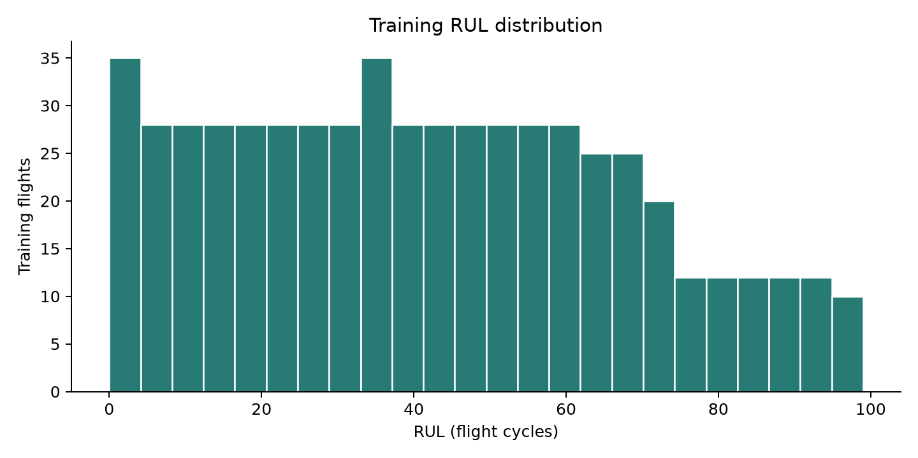
GR05 / INDUSTRIAL ANALYTICS
DESCRIPTIVE 01 / 05
The hypothesis-building sample
• 574 flights · 7 source histories · 6
conservative groups.
• Training RUL: 0–99 cycles; mean
41.83.
• No test/quarantine sensor
hypotheses.
• Validation is a descriptive check
already seen in review.
Creators: GR05 (AI-assisted draft) | Presenter proposed: Denzel Gregory Pragassa
29 / 40
Evidence: Executed Task 5 notebook; reports/results/task5/training_insights.json and accompanying CSV exports.
Notes:
Slide 29: The hypothesis-building sample
Proposed presenter: Denzel Gregory Pragassa (confirm with team).
The notebook now uses tracked reconstructed means by default and labels provenance. It also supports the hash-verified full Task 4 table. We do not claim a blinded preregistered confirmation because validation was already inspected.
Evidence: Executed Task 5 notebook; reports/results/task5/training_insights.json and accompanying CSV exports.
Draft assembly: GR05 with documented AI assistance; team content review pending.

Slide 30
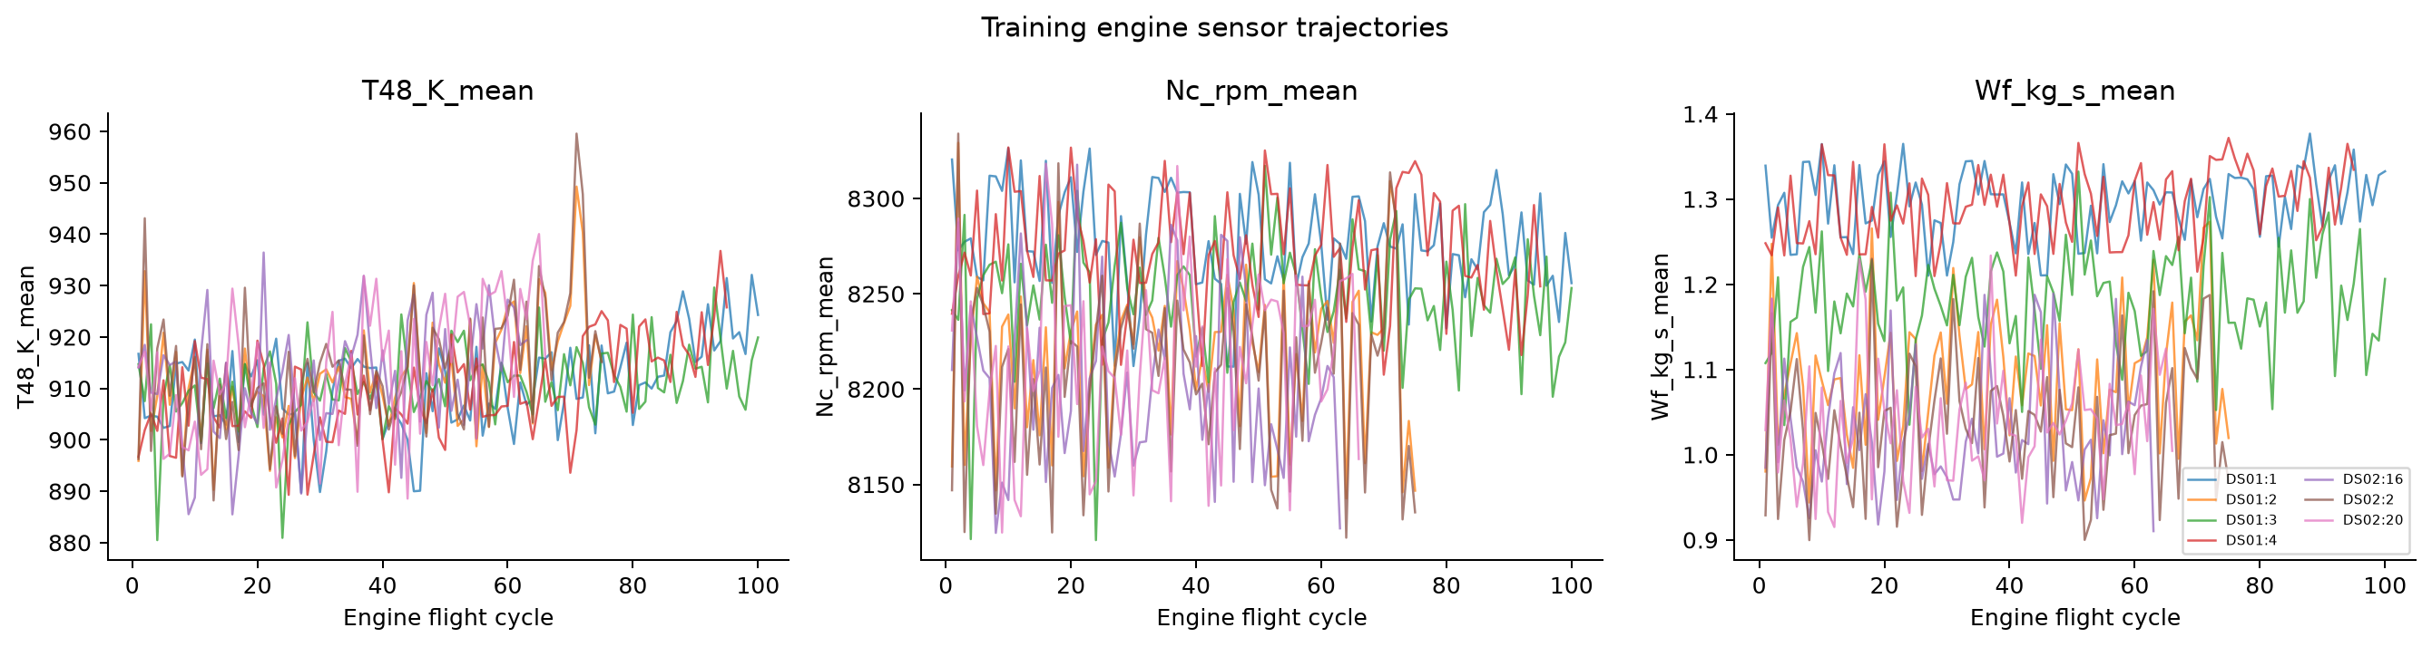
GR05 / INDUSTRIAL ANALYTICS
DESCRIPTIVE 02 / 05
T48 is consistently associated with RUL
• Within-history Pearson r: -0.540 to
-0.299.
• Negative in all 7 training source
histories.
• Higher temperature tends to
accompany lower historical RUL.
• Not a causal effect or
prediction-accuracy result.
Creators: GR05 (AI-assisted draft) | Presenter proposed: Denzel Gregory Pragassa
30 / 40
Evidence: Executed Task 5 notebook; reports/results/task5/training_insights.json and accompanying CSV exports.
Notes:
Slide 30: T48 is consistently associated with RUL
Proposed presenter: Denzel Gregory Pragassa (confirm with team).
Explain the negative sign: as RUL counts down, temperature tends to be higher. The magnitude differs across histories and a scatter/time trajectory includes mission variation. No p-values assuming independent flights are reported.
Evidence: Executed Task 5 notebook; reports/results/task5/training_insights.json and accompanying CSV exports.
Draft assembly: GR05 with documented AI assistance; team content review pending.

Slide 31
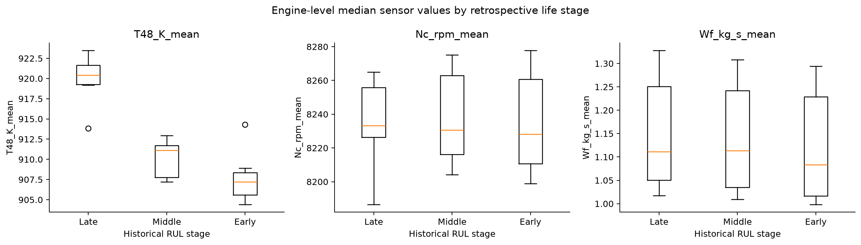
GR05 / INDUSTRIAL ANALYTICS
DESCRIPTIVE 03 / 05
Historical stage groups tell a clear story
• Late 0–20 · Middle 21–50 · Early
>50 cycles.
• Paired late−early engine-median
T48: +13.62 K median.
• Range 4.93–17.82 K across 7
histories.
• Groups require true RUL; never use
them as prediction inputs.
Creators: GR05 (AI-assisted draft) | Presenter proposed: Denzel Gregory Pragassa
31 / 40
Evidence: Executed Task 5 notebook; reports/results/task5/training_insights.json and accompanying CSV exports.
Notes:
Slide 31: Historical stage groups tell a clear story
Proposed presenter: Denzel Gregory Pragassa (confirm with team).
These are descriptive engine medians, not independent physical-engine treatment effects. The boxplot summarizes engine-stage medians; the separate condition plots are flight-weighted. Confounding remains possible. Grouping satisfies segmentation without claiming clustering.
Evidence: Executed Task 5 notebook; reports/results/task5/training_insights.json and accompanying CSV exports.
Draft assembly: GR05 with documented AI assistance; team content review pending.

Slide 32
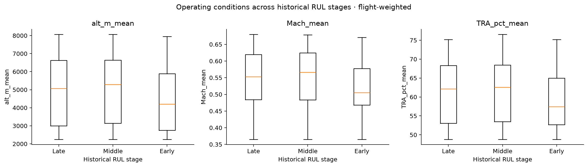
GR05 / INDUSTRIAL ANALYTICS
DESCRIPTIVE 04 / 05
Context and heterogeneity temper the conclusion
• Nc–RUL correlations span −0.153
to +0.199.
• Operating-condition medians differ
across RUL stages.
• Previous-flight changes show weak
pooled linear associations.
• H2 added predictive value and H3
causal effects remain untested.
Creators: GR05 (AI-assisted draft) | Presenter proposed: Denzel Gregory Pragassa
32 / 40
Evidence: Executed Task 5 notebook; reports/results/task5/training_insights.json and accompanying CSV exports.
Notes:
Slide 32: Context and heterogeneity temper the conclusion
Proposed presenter: Denzel Gregory Pragassa (confirm with team).
This is why the business story cannot be a universal temperature threshold. Changes can be noisy while long-term level is informative; only later grouped model validation can assess incremental predictive value. Do not describe H1–H4 as formally statistically validated.
Evidence: Executed Task 5 notebook; reports/results/task5/training_insights.json and accompanying CSV exports.
Draft assembly: GR05 with documented AI assistance; team content review pending.

Slide 33
GR05 / INDUSTRIAL ANALYTICS
DESCRIPTIVE 05 / 05
Observation → interpretation → next decision
• Observe: late-life T48 is higher in this historical sample.
• Interpret: temperature and mission context merit investigation.
• Decide next: compare baseline and simple regressors on held-out engines.
• Do not infer savings or maintenance actions from correlation alone.
Creators: GR05 (AI-assisted draft) | Presenter proposed: Denzel Gregory Pragassa
33 / 40
Evidence: Executed Task 5 notebook; reports/results/task5/training_insights.json and accompanying CSV exports.
Notes:
Slide 33: Observation → interpretation → next decision
Proposed presenter: Denzel Gregory Pragassa (confirm with team).
This is the required data-storytelling slide. In one minute: there is a repeatable descriptive signal; context and tiny group counts limit the inference; our next step is testable baseline-versus-regression evaluation. No model claim is hidden inside the story.
Evidence: Executed Task 5 notebook; reports/results/task5/training_insights.json and accompanying CSV exports.
Draft assembly: GR05 with documented AI assistance; team content review pending.

Slide 34
GR05 / INDUSTRIAL ANALYTICS
ALGORITHM / SELÇUK
Linear regression: a transparent starting model
• Predict RUL as an intercept plus weighted input features.
• Fit weights from training examples.
• Good first comparison: simple, inspectable coefficients.
• Proposed for next stage; not yet trained.
Creators: GR05 (AI-assisted draft) | Presenter proposed: Selçuk Ata Aksoy
34 / 40
Evidence: https://scikit-learn.org/stable/modules/linear_model.html#ordinary-least-squares (accessed 11 Nov 2026).
Notes:
Slide 34: Linear regression: a transparent starting model
Proposed presenter: Selçuk Ata Aksoy (confirm with team).
Proposed presenter: Selçuk. Explain a weighted sum using temperature and operating context as inputs. Coefficients are associations conditional on the other inputs, not causal effects. Regularization such as Ridge can be considered if correlated features make coefficients unstable. Do not claim fitted weights or accuracy.
Evidence: https://scikit-learn.org/stable/modules/linear_model.html#ordinary-least-squares (accessed 11 Nov 2026).
Draft assembly: GR05 with documented AI assistance; team content review pending.

Slide 35
GR05 / INDUSTRIAL ANALYTICS
ALGORITHM / SELÇUK
How we will check the linear model
• Start with 20 baseline columns and constant mean/median references.
• Use development-engine validation; fit preparation in each fold.
• Report MAE/RMSE, per-engine errors and optimistic RUL.
• Check extrapolation, correlated predictors and residual patterns.
Creators: GR05 (AI-assisted draft) | Presenter proposed: Selçuk Ata Aksoy
35 / 40
Evidence: https://scikit-learn.org/stable/modules/linear_model.html#ordinary-least-squares (accessed 11 Nov 2026).
Notes:
Slide 35: How we will check the linear model
Proposed presenter: Selçuk Ata Aksoy (confirm with team).
This is an experimental plan. A linear predictor may produce implausible negative RUL, so any clipping policy must be defined consistently and disclosed. Do not tune repeatedly to final test. Scalar errors should be shown in flight cycles.
Evidence: https://scikit-learn.org/stable/modules/linear_model.html#ordinary-least-squares (accessed 11 Nov 2026).
Draft assembly: GR05 with documented AI assistance; team content review pending.

Slide 36
GR05 / INDUSTRIAL ANALYTICS
ALGORITHM / DENZEL
Random forest regression: average many trees
• Trees split feature space into rule-based regions.
• Average predictions across randomized trees.
• Candidate for nonlinear relations and interactions.
• Proposed comparison, not an established improvement.
Creators: GR05 (AI-assisted draft) | Presenter proposed: Denzel Gregory Pragassa
36 / 40
Evidence: https://scikit-learn.org/stable/modules/ensemble.html#forest (accessed 11 Nov 2026).
Notes:
Slide 36: Random forest regression: average many trees
Proposed presenter: Denzel Gregory Pragassa (confirm with team).
Proposed presenter: Denzel. Explain one conceptual tree with an illustrative temperature/condition split, then the forest average. The example is not a fitted rule. Tree ensembles can fit source-specific patterns; the small number of engine groups is a serious constraint.
Evidence: https://scikit-learn.org/stable/modules/ensemble.html#forest (accessed 11 Nov 2026).
Draft assembly: GR05 with documented AI assistance; team content review pending.

Slide 37
GR05 / INDUSTRIAL ANALYTICS
ALGORITHM / DENZEL
Keep the forest comparison modest
• Predeclare a small depth/leaf-size search on development groups.
• Compare identical targets, splits and metrics with the baseline.
• Watch overfitting, collection effects and limited extrapolation.
• Feature importance would not prove causality.
Creators: GR05 (AI-assisted draft) | Presenter proposed: Denzel Gregory Pragassa
37 / 40
Evidence: https://scikit-learn.org/stable/modules/ensemble.html#forest (accessed 11 Nov 2026).
Notes:
Slide 37: Keep the forest comparison modest
Proposed presenter: Denzel Gregory Pragassa (confirm with team).
Keep tuning small and reproducible. More trees do not create more independent training engines. Random forests generally interpolate within observed target patterns; operating shift remains important. Compare a DS01-only refit as a sensitivity case if time permits.
Evidence: https://scikit-learn.org/stable/modules/ensemble.html#forest (accessed 11 Nov 2026).
Draft assembly: GR05 with documented AI assistance; team content review pending.

Slide 38
GR05 / INDUSTRIAL ANALYTICS
NEXT STEPS
The next decision is a fair model comparison
• 12 Nov progress; rehearse for the 19 Nov milestone.
• After milestone: constants + linear regression + random forest.
• Then: grouped validation, limitations, engine-wise errors.
• Final target: 21 January 2027, per existing course plan.
Creators: GR05 (AI-assisted draft) | Presenter proposed: Selçuk Ata Aksoy
38 / 40
Evidence: Supplied Project Tasks V6.0, pp. 1–2 (9 Nov 2026); milestone comments handout.
Notes:
Slide 38: The next decision is a fair model comparison
Proposed presenter: Selçuk Ata Aksoy (confirm with team).
Suggested team targets: baseline implementation in the next project session, simple-model comparison by late November, robustness/error analysis during December, final narrative and presentation rehearsal in January. These are proposals, not lecturer-approved deadlines. Source/version and independence questions stay documented.
Evidence: Supplied Project Tasks V6.0, pp. 1–2 (9 Nov 2026); milestone comments handout.
Draft assembly: GR05 with documented AI assistance; team content review pending.

Slide 39
GR05 / INDUSTRIAL ANALYTICS
READINESS / LIMITS
What we can defend—and what remains open
• Verified: data structure, label logic, preparation and descriptive findings.
• Limits: small fleet, regime confounding, download-version match, cross-subset independence.
• Now confirmed: P2 is fan-inlet total pressure (journal Table 5).
• Unknown: predictive accuracy, real-world performance and cost savings.
Creators: GR05 (AI-assisted draft) | Presenter proposed: Selçuk Ata Aksoy
39 / 40
Evidence: Arias Chao et al. (2021), Data 6(1), 5. https://doi.org/10.3390/data6010005
Notes:
Slide 39: What we can defend—and what remains open
Proposed presenter: Selçuk Ata Aksoy (confirm with team).
P2 remains excluded from the selected representation. The metadata refresh creates a new version; earlier artifacts remain intact. Both students must review the draft and be able to explain every chart. Prepared artifacts are available locally; no external system has been deployed. Do not claim human approval or individual authorship not established by the team.
Evidence: Arias Chao et al. (2021), Data 6(1), 5. https://doi.org/10.3390/data6010005
Draft assembly: GR05 with documented AI assistance; team content review pending.

Slide 40
GR05 / INDUSTRIAL ANALYTICS
SOURCES / QUESTIONS
Questions to carry into the next stage
• Can the descriptive signal improve held-out-engine RUL estimates?
• How much is operating context versus degradation?
• Would a simpler DS01-only model be more defensible?
• Sources and AI assistance are documented in the repository.
Creators: GR05 (AI-assisted draft) | Presenter proposed: Denzel Gregory Pragassa
40 / 40
Evidence: Arias Chao et al. (2021), Data 6(1), 5. https://doi.org/10.3390/data6010005
Notes:
Slide 40: Questions to carry into the next stage
Proposed presenter: Denzel Gregory Pragassa (confirm with team).
Supplied Project Tasks V6.0, pp. 1–2 (9 Nov 2026); milestone comments handout.
Arias Chao et al. (2021), Data 6(1), 5. https://doi.org/10.3390/data6010005
Task 3 executed notebook + reports/results/task3_summary.json; figures generated from local DS01/DS02.
Task 4 manifest: task4-v1-f8ab427897d5; docs/06-data-preparation.md.
Executed Task 5 notebook; reports/results/task5/training_insights.json and accompanying CSV exports.
https://scikit-learn.org/stable/modules/linear_model.html#ordinary-least-squares (accessed 11 Nov 2026).
https://scikit-learn.org/stable/modules/ensemble.html#forest (accessed 11 Nov 2026).
https://scikit-learn.org/stable/modules/model_evaluation.html#regression-metrics (accessed 11 Nov 2026).
AI disclosure: docs/ai-use-log.md. Notebook authorship/review caveats are in the Task 5 report. No full lecturer slides or raw datasets are embedded in this presentation.
Evidence: Arias Chao et al. (2021), Data 6(1), 5. https://doi.org/10.3390/data6010005
Draft assembly: GR05 with documented AI assistance; team content review pending.

