Slide 1
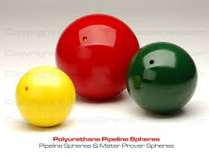
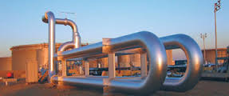
Basic concepts of Pipe Proving and Meter Factors

Slide 2
Objectives
Proving the need to Prove
Pipe Proving operation
Define Meter Factor

Slide 3
Proving Accuracy
There are many factors that require accuracy in the custody transfer process:
Paying Suppliers
Billing Buyers
Transportation Charges
Regulatory Requirements

Slide 4
Simplified Pipe Prover Flow
Flow Computer
Prover Pulse
Counter
T
P
T
P
Prover Flow
Section
T
P
Transfer Line
Flow Meter

Slide 5
Simplified Pipe Prover Flow
Flow Computer
Prover Pulse
Counter
T
P
T
P
Prover Flow
Section
Prover Flow
Section
T
P
Transfer Line
Flow Meter

Slide 6
Bi-directional Ball Prover
Flow Computer
Prover Pulse
Counter
T
P
T
P

Slide 7
Meter Factor
Meter Factor is the number used to correct the difference between the Flow Meter’s measurement and the measurement provided by the Prover.
(Meter Factor) x (Flow Meter Measurement) = Prover Measurement

Slide 8
Further Study
Here are some concepts that directly relate to the ones in this presentation. If you have a deeper interest you can find these topics on the internet:
K-factor
Measurement Uncertainty
Repeatability
Piston Provers
Unidirectional Provers
Bidirectional Provers

