Slide 1
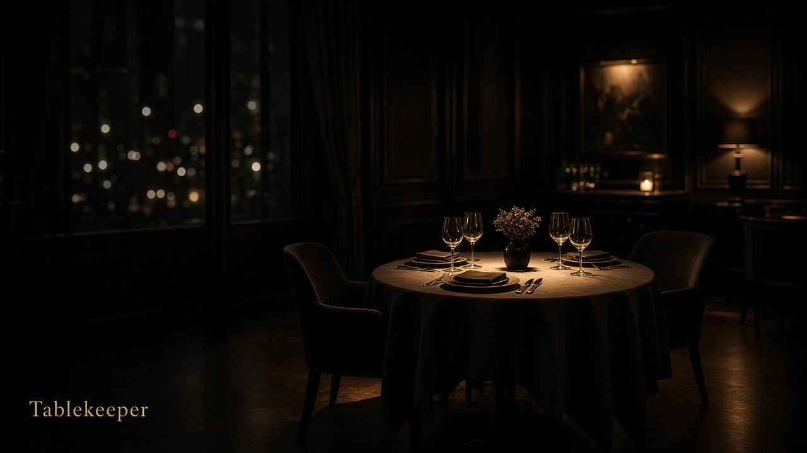

Slide 2
Tablekeeper
A restaurant booking app with three live AI agent seats
WeAreDevelopers x BAND Dark Factory hackathon · Tablekeeper track
Culltron (Pty) Ltd · Ashveer Ramlukan, founder
github.com/CulltronOrg/dark-factory-tablekeeper

Slide 3
The problem
• A guest wants a table. They should not have to phone, wait, or guess.
• Plans change. Moving or cancelling a booking is often harder than making one.
• The track asks for the full cycle: search, book, move, cancel.
• We also want to show that a small agent team can build and check that cycle.
Tablekeeper · Culltron (Pty) Ltd · 3/11

Slide 4
The product
• Search: find an open table for a date, time and party size
• Book: hold the table and confirm it to the guest
• Move: change the time or date of an existing booking
• Cancel: release the table so someone else can take it
Tablekeeper · Culltron (Pty) Ltd · 4/11

Slide 5
How a booking works
1. Guest searches for a table
2. Guest picks a slot and books it
3. Guest moves the booking when plans change
4. Guest cancels when they cannot make it
• Each step is a separate, testable action in the app
Tablekeeper · Culltron (Pty) Ltd · 5/11

Slide 6
Three agent seats
• Three agent seats comment on every action:
• Coordinator: says what the step was meant to do
• Implementer: says what the service did
• Reviewer: checks the outcome in plain language
• The booking engine stays the only authority; seat notes are advisory
Tablekeeper · Culltron (Pty) Ltd · 6/11

Slide 7
What is running now
• The app is live on Azure Container Apps
• Search, book, move and cancel all work end to end
• The three seats answer live through Azure OpenAI (gpt-5-mini) in about 2 seconds
• If the model is unavailable, the app keeps working with simulated seats
• 68 local tests pass; the public repo is open
Tablekeeper · Culltron (Pty) Ltd · 7/11

Slide 8
Honest limits
• This is not a judged Band room run; there is no room.json
• Bookings and accounts are held in memory and reset on restart
• One demo restaurant, The Late Room
• Agent notes describe each step; they do not make booking decisions
Tablekeeper · Culltron (Pty) Ltd · 8/11

Slide 9
What the judges will see
• A 2.5-minute video: youtu.be/6mPcC5qp_Og
• A live recording of a guest searching, booking, moving and cancelling a table
• The table stays selected through sign-up; no reference code to keep
• The live demo and test steps are in the repo README
• The code is in the public repo for anyone to check
Tablekeeper · Culltron (Pty) Ltd · 9/11

Slide 10
Who we are
• Culltron (Pty) Ltd, founded by Ashveer Ramlukan
• Bootstrapped
• No revenue, user or award claims; this is a hackathon build
Tablekeeper · Culltron (Pty) Ltd · 10/11

Slide 11
The ask
• Watch the video: youtu.be/6mPcC5qp_Og
• Try the live demo (link in the README)
• Judge the full guest cycle: search, book, move, cancel
• Read the repo: github.com/CulltronOrg/dark-factory-tablekeeper
Tablekeeper · Culltron (Pty) Ltd · 11/11

