Slide 1

FAMILY EXPENSE TRACKER
Submitted
in Partial Fulfillment of the Requirements
for the Degree of
Bachelor of Engineering
in
Computer Science & Engineering
by
Ishu Thakur
1711981124
COMPUTER SCIENCE & ENGINEERING
CHITKARA SCHOOL OF ENGINEERING & TECHNOLOGY
CHITKARA UNIVERSITY, HIMACHAL PRADESH, INDIA
18th April, 2019

Slide 2
Acknowledgement
The success and final outcome of this project required a lot of guidance and assistance from many people and I am extremely privileged to have got this all along the completion of my project. All that I have done is only due to such supervision and assistance and I would not forget to thank them.
I respect and thank Dr. Nitin Verma for providing me an opportunity to do the project work in Family Expense Tracker and giving us all support and guidance which made me complete the project duly. I am extremely thankful to him for providing such a nice support and guidance, although he had busy schedule managing the corporate affairs.
I owe my deep gratitude to our project guide Mr. Shankar Aggarwal, who took keen interest on our project work and guided us all along, till the completion of our project work by providing all the necessary information for developing a good system.
I am thankful to and fortunate enough to get constant encouragement, support and guidance from all Teaching staffs of CSE which helped us in successfully completing our project work.
Ishu Thakur.

Slide 3
Introduction
Budgeting is no longer an action limited to governments, corporations and authorities, but rather extends to include families as social entities with multiple socio-economic goals. Budgeting brings considerable benefits to the family, whether on daily basis, short term or long term benefits, where the family plans for both the present and future. Being extremely relevant to family's economic and social concerns, family budgeting is worthy to be studied. To this end, we are keen to provide a simple and clear explanation for budgeting process as well as its items, including expenditures, revenues, savings and investments.
Many families in the country are still reluctant to do a budget. As distasteful as the taste many seen, yet, it is important to map out our expenses and purchase so that we can see just where our money is going. It indicates the standard of living of the family as it represent an overall picture of income and expenditure, this can be done by establishing a good family budget.
Family budget is the surest way to get families out of financial mess or debt if budgeting can be done efficiently.

Slide 4
Overview
Budgeting for family income and expenses is often a lower priority for farm and ranch families than budgeting for the business.
Without budgeting, however, family living expenses may exceed the available income and jeopardize the overall financial goals of the farm and family.
Reasons producers do not devote more time to managing family finances.
The are not tax deductible
Family budgeting is difficult and time consuming
Compared to farm/ranch expenses, family living expenses are too small to worry about
Non-farm income pays for family expenses so it doesn’t matter

Slide 5
Family buget Objectives
Objective 1: Analyze Financial Situation
Objective 2: Cover Expenses
Objective 3 Create a Buffer
Objective 4: Plan for the Future
Objective 5 Avoid Conflict
Objective 6 Identify Waste
Objective 7: Reach Financial Goals
Objective 8: Prepare for Major Life Changes
Objective 9: Teach Children Financial Responsibility

Slide 6
Why Develop a Family Living Budget
Budgeting for family expenditures is the foundation of a sound financial management plan
When used in conjunction with records of actual spending, a family budget allows you to pinpoint unnecessary spending and areas where actual costs may be higher or lower than you previously thought
Managing a family budget can also allow you to discover ways to put your money to better use, such as debt reduction, retirement savings, or college savings

Slide 7
ANALYSIS

Slide 8
Family Goals and Standard of Living
Before developing your family budget, your must first determine your farm and family goals, and the standard of living your family desires.
It is important that all members of the family be involved in this goal setting process so that the goals reflect the perceptions and ambitions of each member of the family.
When establishing family goals, be as realistic as possible and consider all available income. Setting unattainable family goals will cause much unnecessary frustration and render the process less effective.
The financial goals of your family can be divided into two categories – short-term and long-term. Short-term goals are those you hope to achieve in the coming year, while long-term goals are those you hope to achieve further into the future and that usually require substantial financial resources.
The standard of living your family desires can be something you want now, or it can be a goal to strive for in the coming years.

Slide 9
Family Records
The best way to develop an accurate family budget is to be very familiar with your current and past expenses.
You may be doing one or a combination of the following: 1) drawing an amount from the farm checking account to pay family living expenses each month; and/or 2) using non-farm income to pay all or a portion of family living expenses.
After determining this amount, list the expenses you incur each month that are known, or fixed.
After establishing these amount, subtract the total of these known expenses from the total amount the family spent. The remainder will be those expenses that vary from month to month.
Next, based on your memory, cashed checks, and other records you may have, allocate the remainder to the family living expense categories that vary from month to month. As shown in
Table 1.1

Slide 10
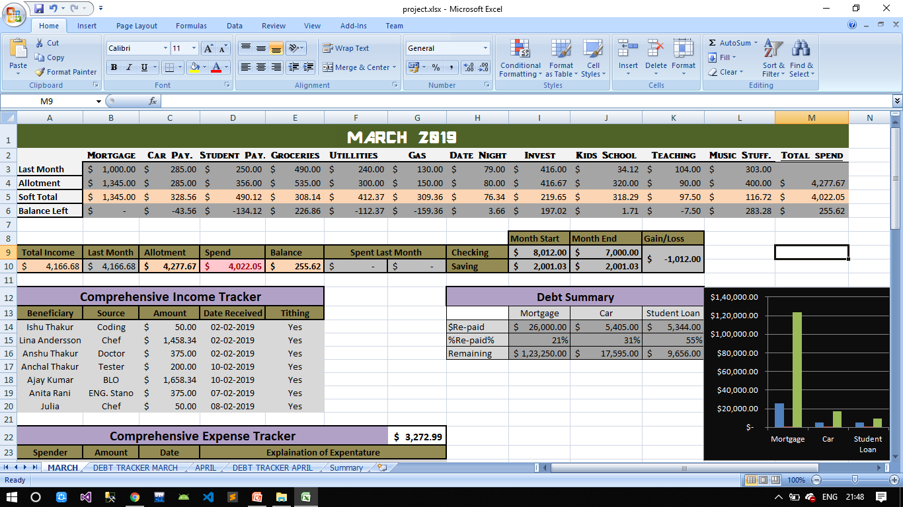
Table 1.1

Slide 11
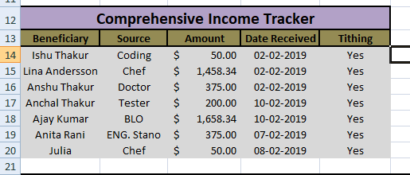
Budgeting Income
To begin, list all sources and estimated amounts of income you expect to have available for family expenses during the year.
These include salaries, interest income, rental income, dividends, non-farm business income, etc. As shown below
Table 1.2

Slide 12
Budgeting Expenses
Since there are so many types of family living expenses, so determine the categories that are meaningful to family.
For simplicity, they should be consistent with the categories you use in your record-keeping system.
The next step is to budget an amount for each of your expense categories that reflects the goals, lifestyle and desired standard of living your have established. As shown in
Table 1.3
Table 1.4

Slide 13
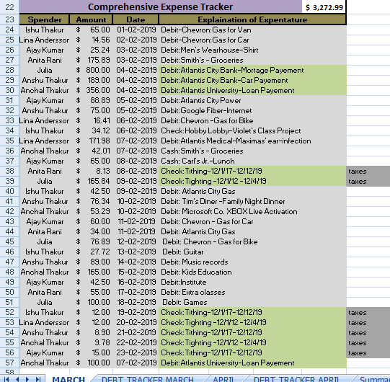
Table 1.3

Slide 14
EXPENDITURE CHART
Table 1.4

Slide 15
Budget Surplus or Deficit
Steps in determining if there is a budget surplus:
Make sure you have not underestimated some of your expenses or overestimated income.
Apply the surplus to debt.
Reinvest the surplus.
Invest the surplus in a retirement fund or college savings fund.
Increase your standard of living and/or family goals.
Steps in determining if there is a budget deficit:
Make sure you have not drastically overstated any of the expenses or underestimated income.
Re-evaluate your family’s goals and desired standard of living. You may need to lower them.
Determine whether you can decrease expenses while still meeting your goals and standard of living. You will more than likely have to make some tough choices to accomplish this.
Determine whether you can generate more income. If you can, then determine if it will be enough to cover the deficit. If it is more than enough, you will need to determine how you want to spend the excess (surplus).
AS SHOWN IN
Table 1.5

Slide 16
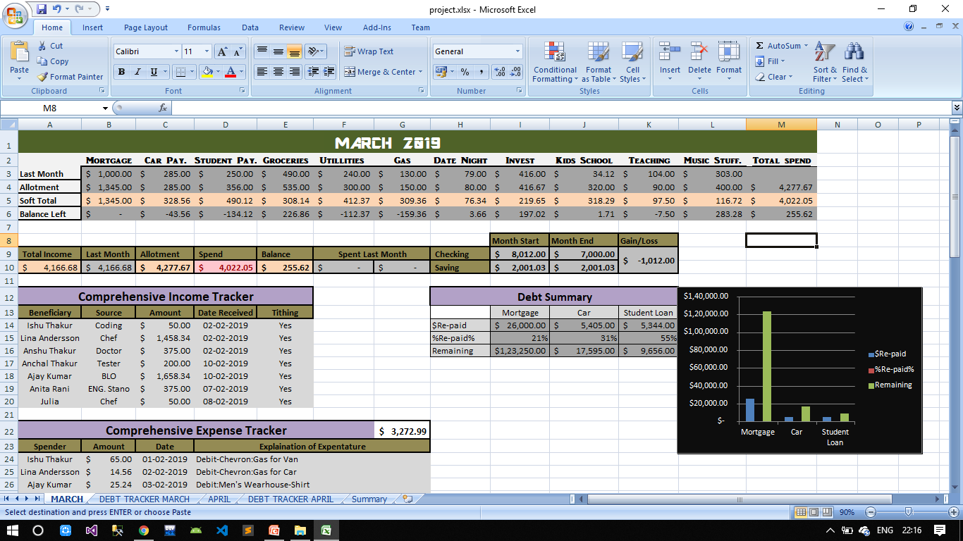
GAIN/LOSS Table
Table 1.5

Slide 17
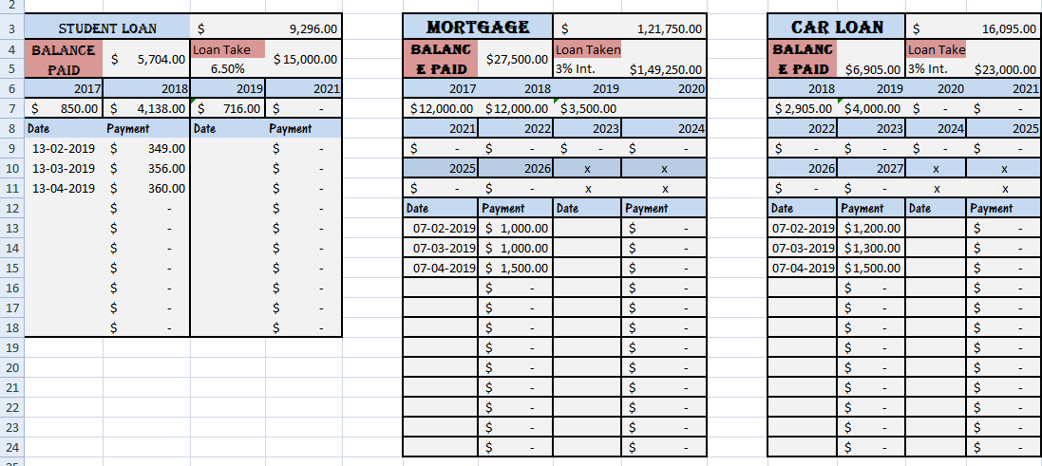
Debt Tracker
Table 1.6
Here we get to know how much debt the family is having and for what and how much they have paid and have to be paid per month or per year

Slide 18
COMPARISION OF BALANCE PAID
Table 1.7

Slide 19
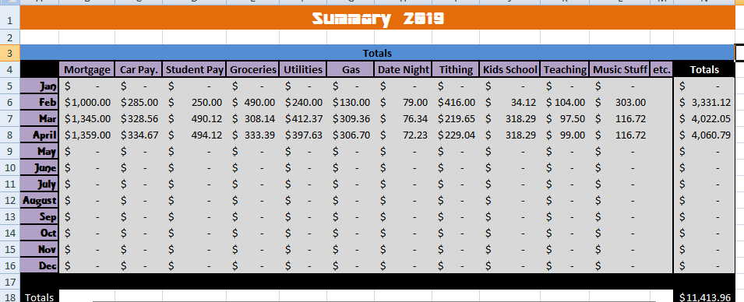
Table 1.8
In this table we get to know about on which thing we have spend much in which month and can also compare how we have spend on a particular month

Slide 20

QUESTIONS ?

