Slide 1
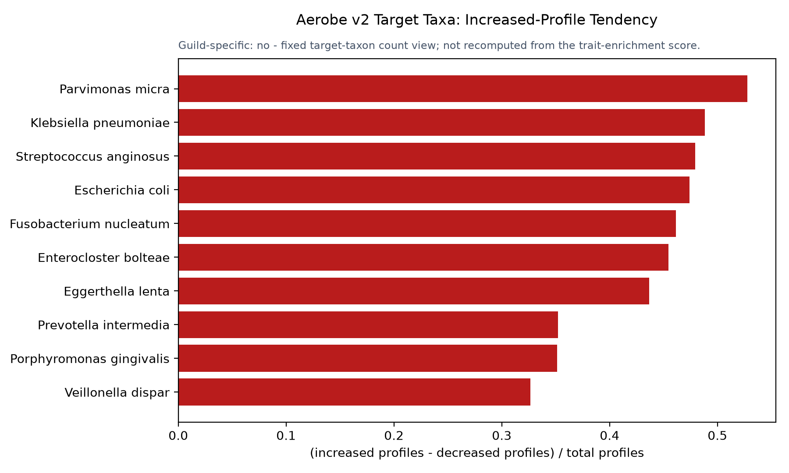
AEROBE V2 TRAIT ENRICHMENT IN INCREASED PROFILES
1/13
Target taxa most often reported in increased profiles

Slide 2
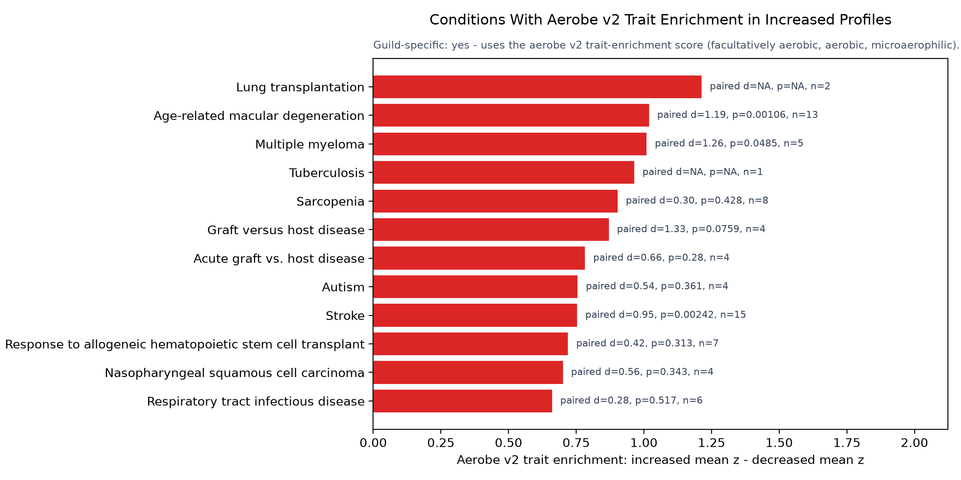
AEROBE V2 TRAIT ENRICHMENT IN INCREASED PROFILES
2/13
Conditions with aerobe v2 trait enrichment in increased profiles

Slide 3
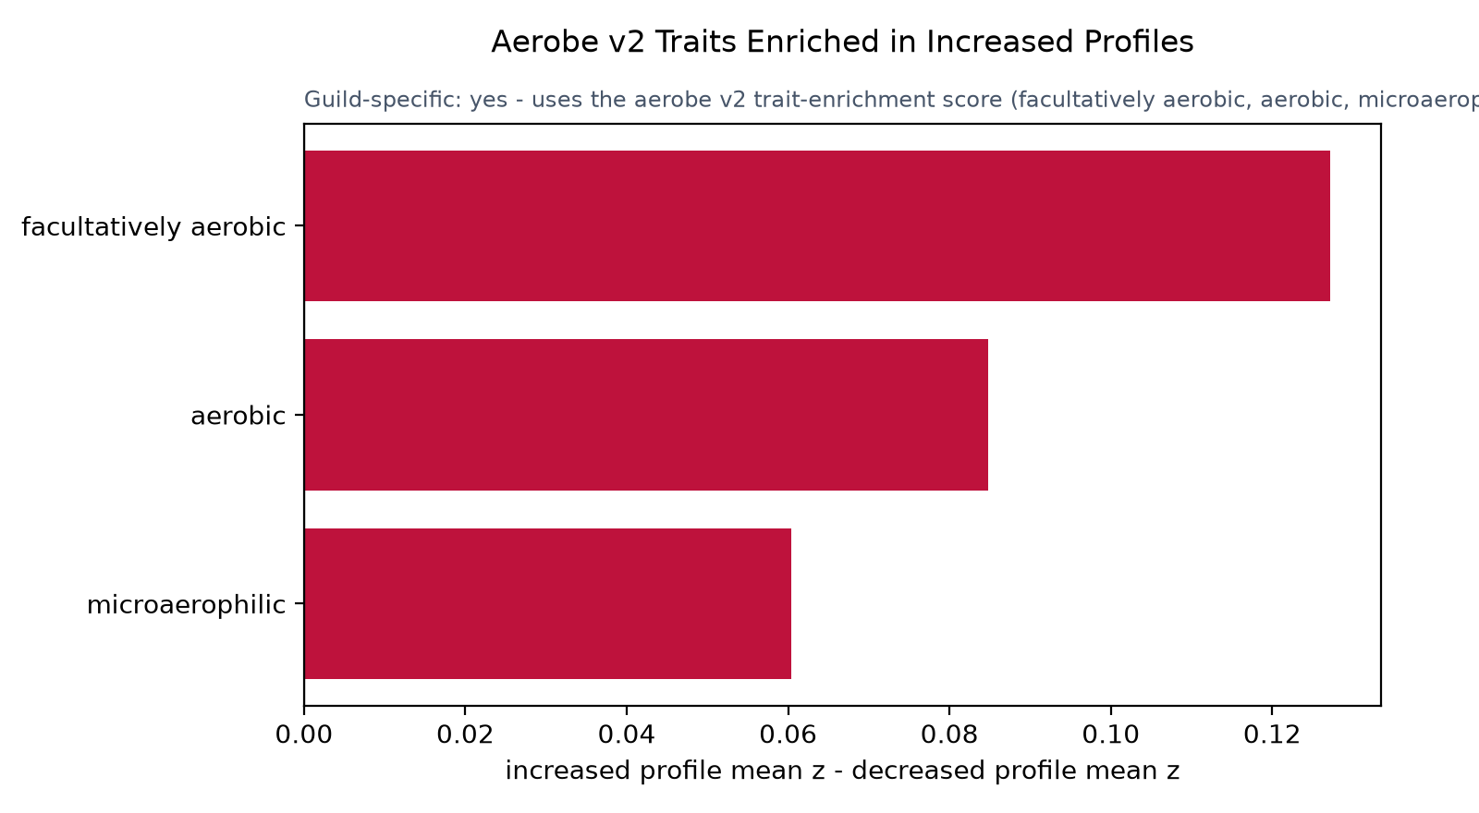
AEROBE V2 TRAIT ENRICHMENT IN INCREASED PROFILES
3/13
V2 traits enriched in increased profiles

Slide 4
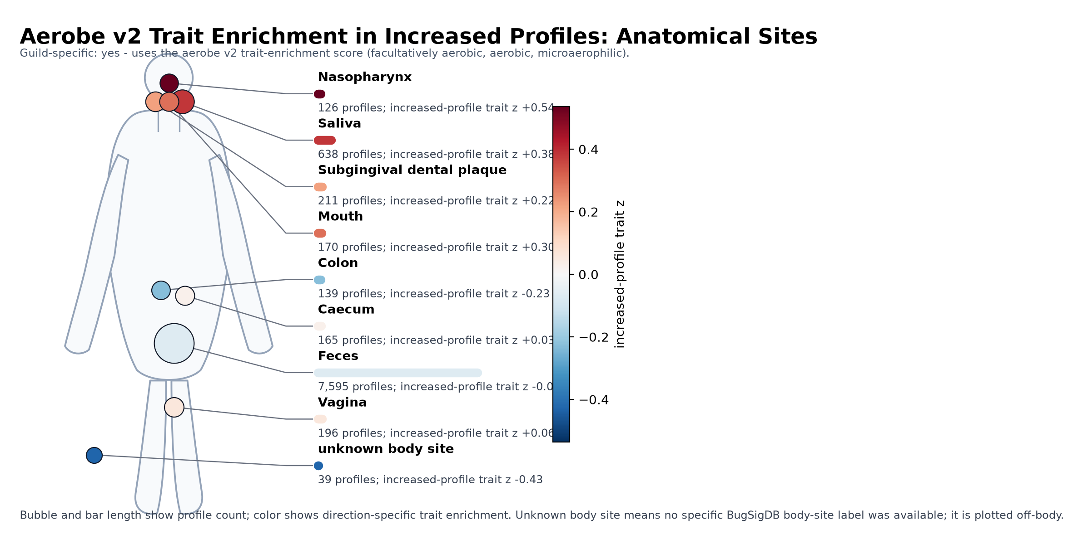
AEROBE V2 TRAIT ENRICHMENT IN INCREASED PROFILES
4/13
Anatomical sites for aerobe v2 trait enrichment in increased profiles

Slide 5
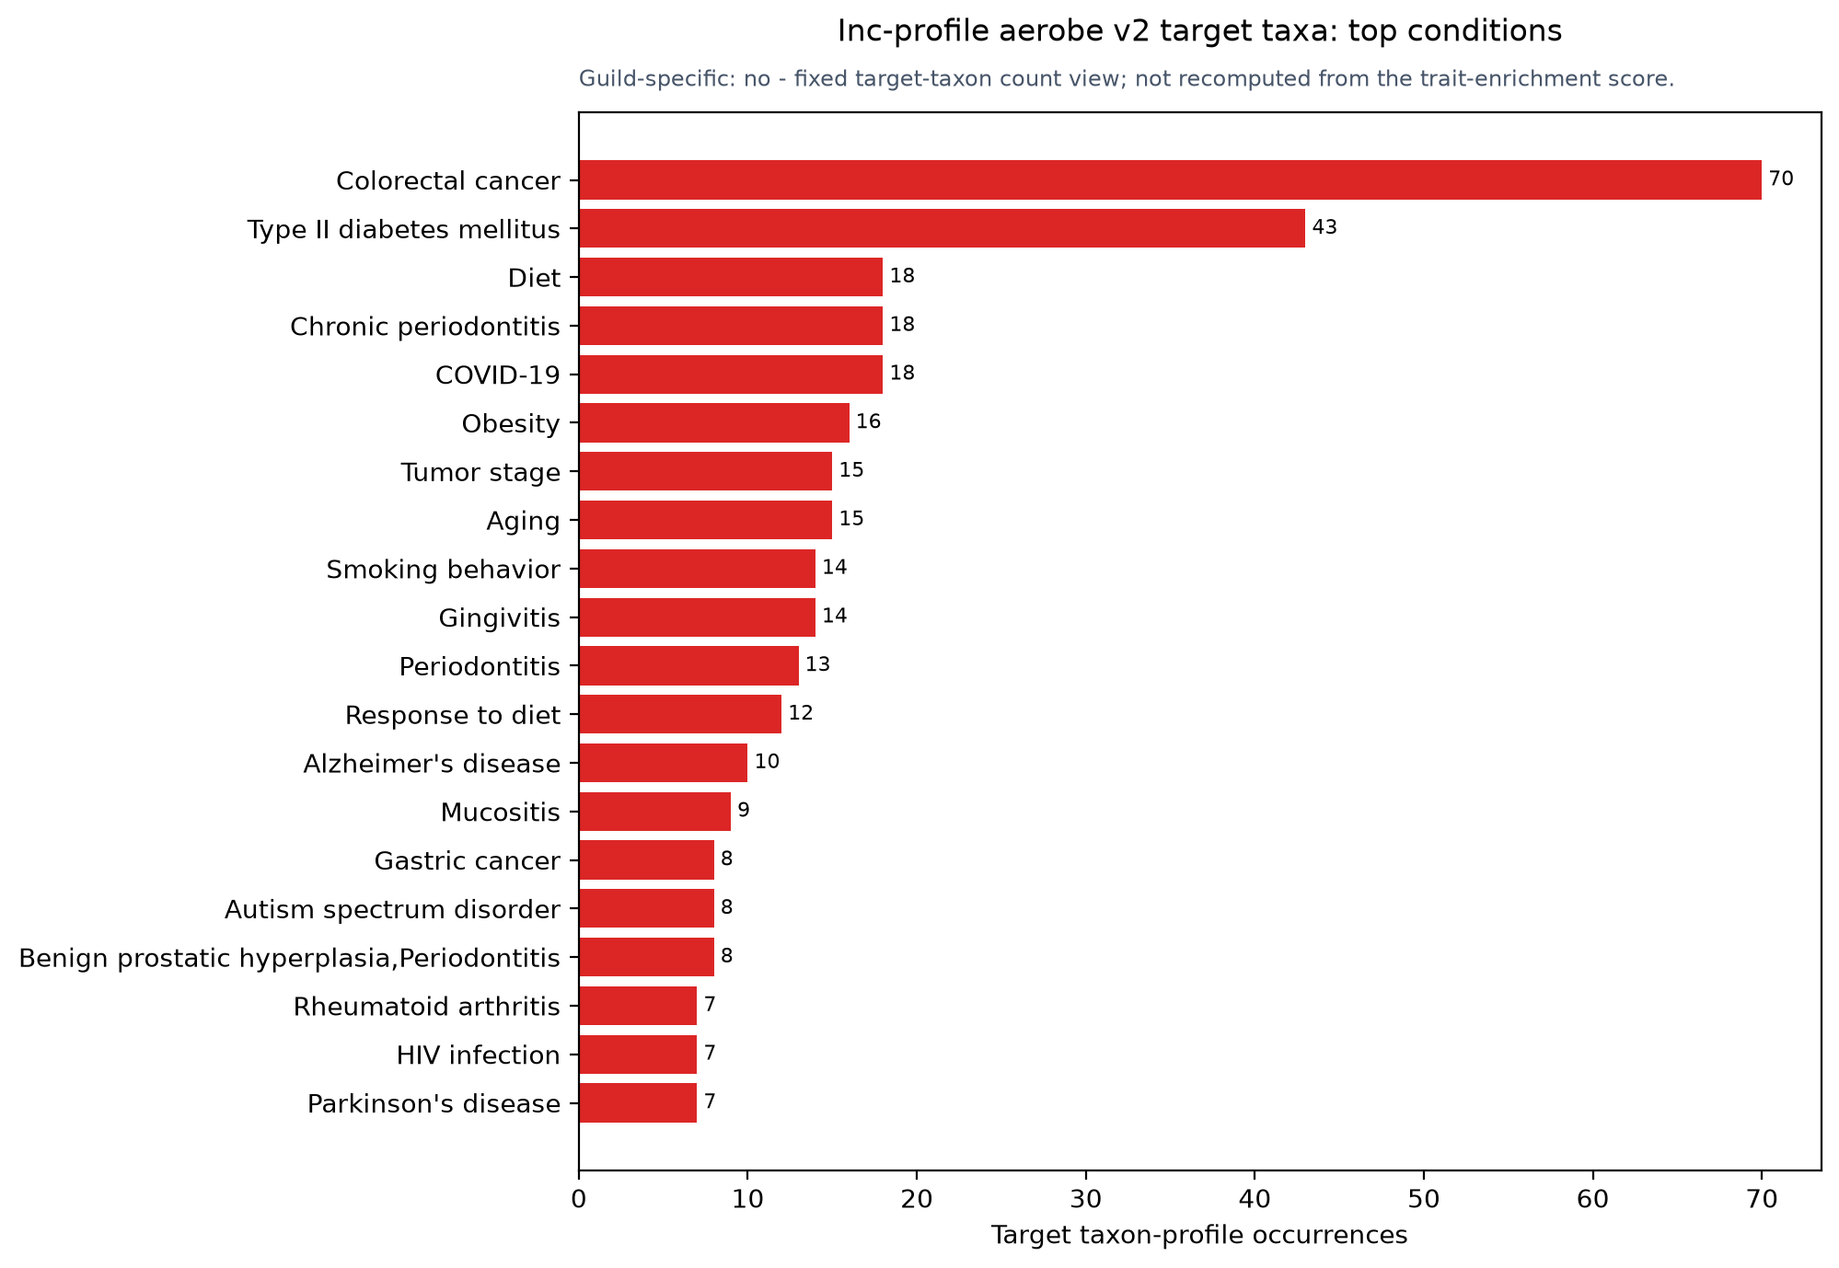
AEROBE V2 TRAIT ENRICHMENT IN INCREASED PROFILES
5/13
Top conditions for increased-profile target-taxon occurrences

Slide 6
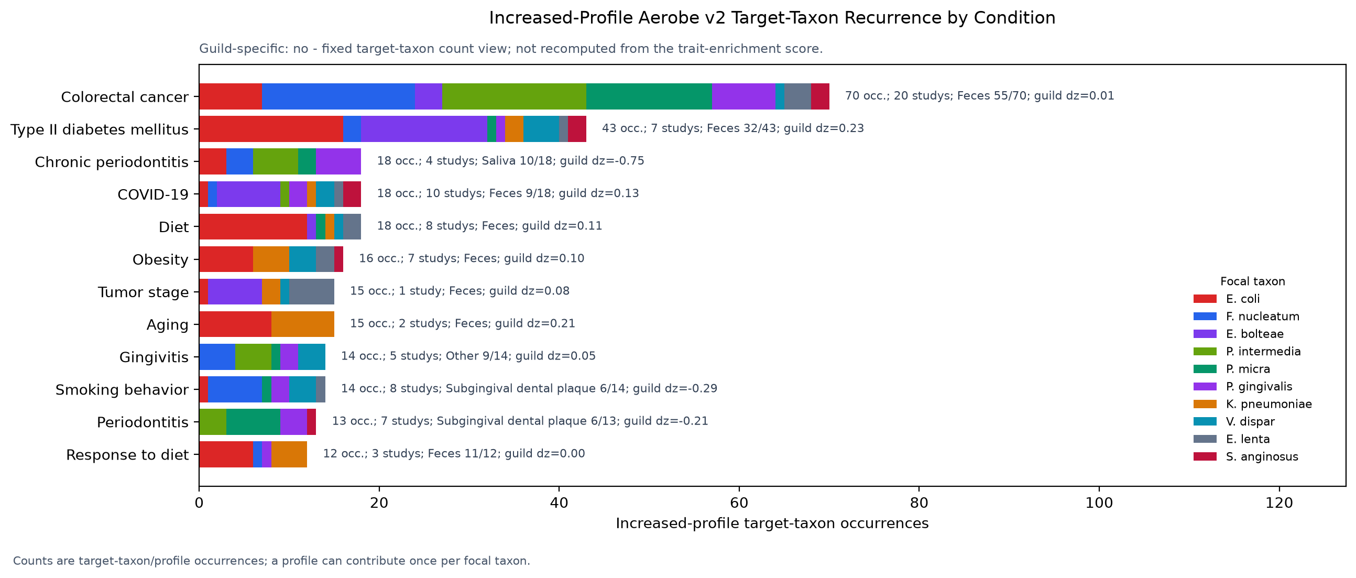
AEROBE V2 TRAIT ENRICHMENT IN INCREASED PROFILES
6/13
Stacked focal taxa by increased-profile condition

Slide 7
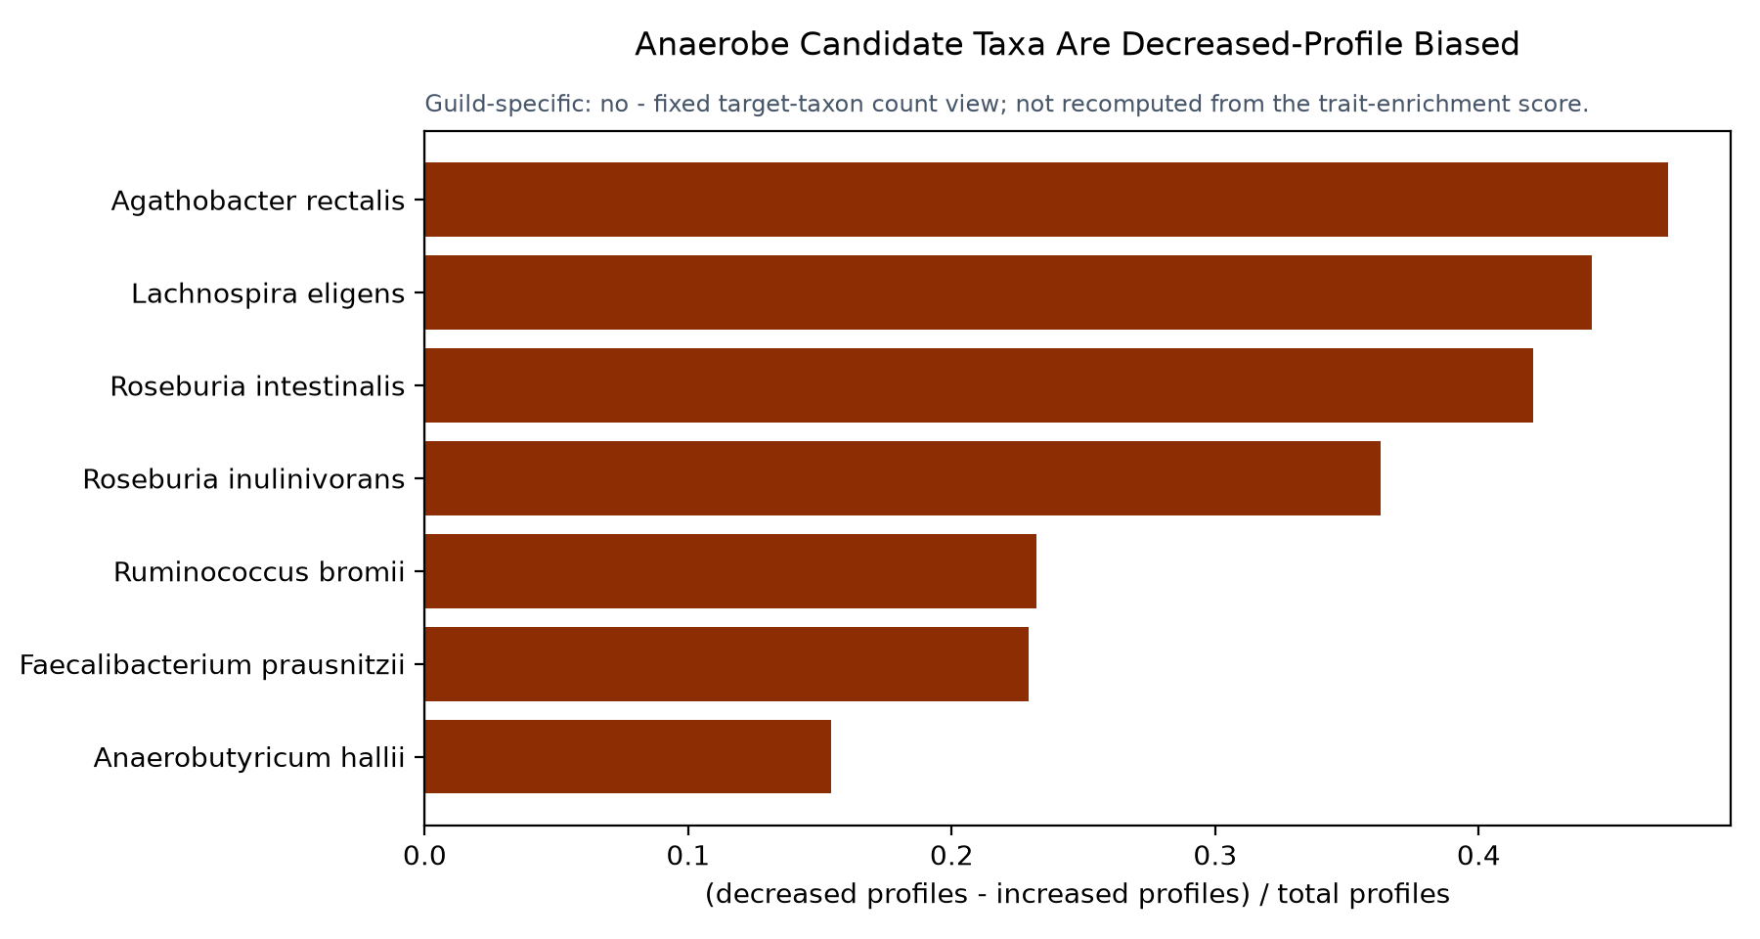
ANAEROBE V2 DEPLETION SIGNAL
7/13
Target taxa most often reported in decreased profiles

Slide 8
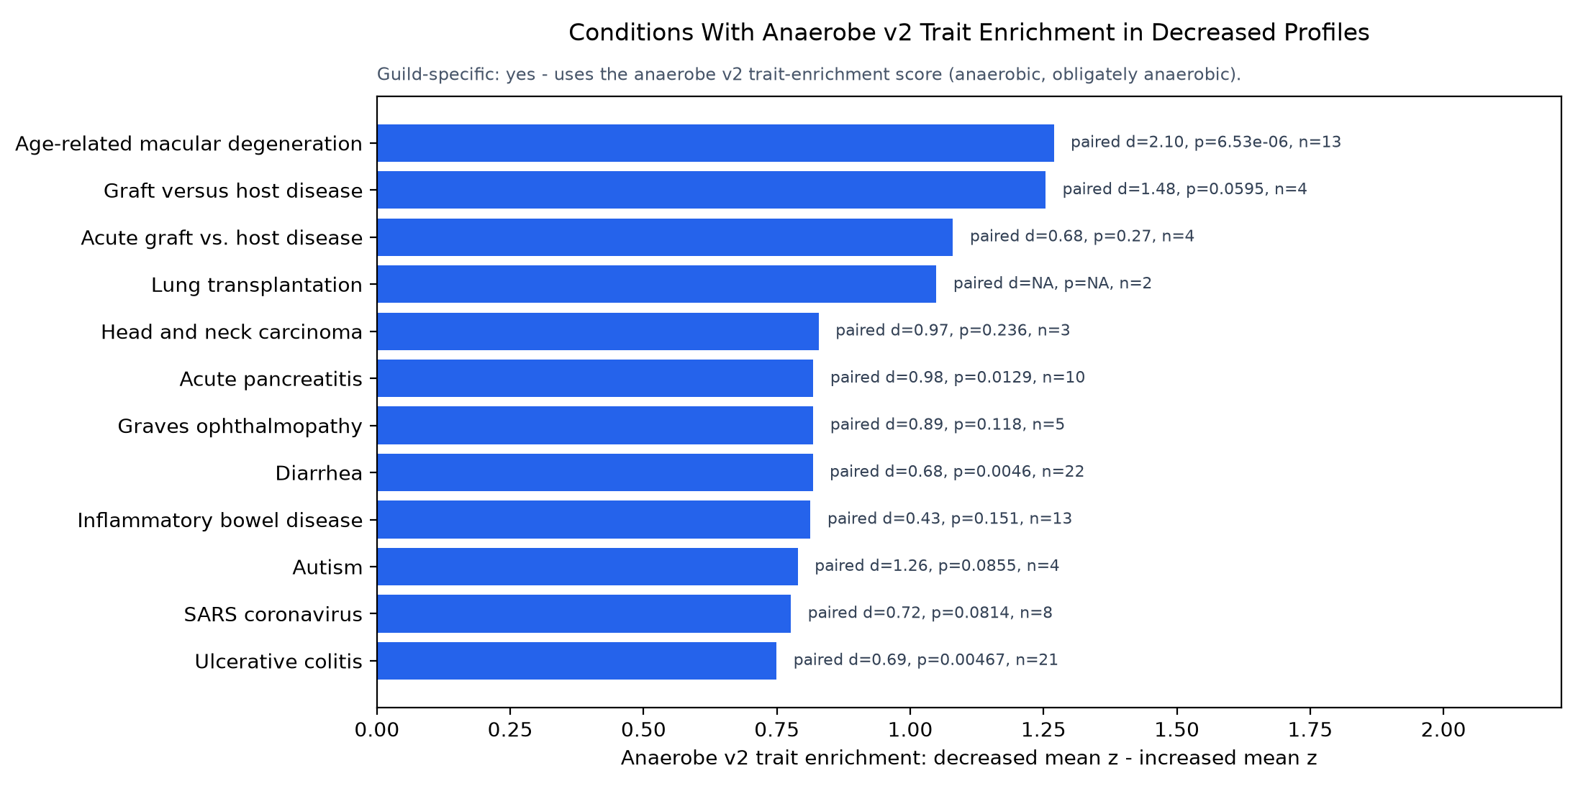
ANAEROBE V2 DEPLETION SIGNAL
8/13
Conditions with anaerobe v2 trait enrichment in decreased profiles

Slide 9
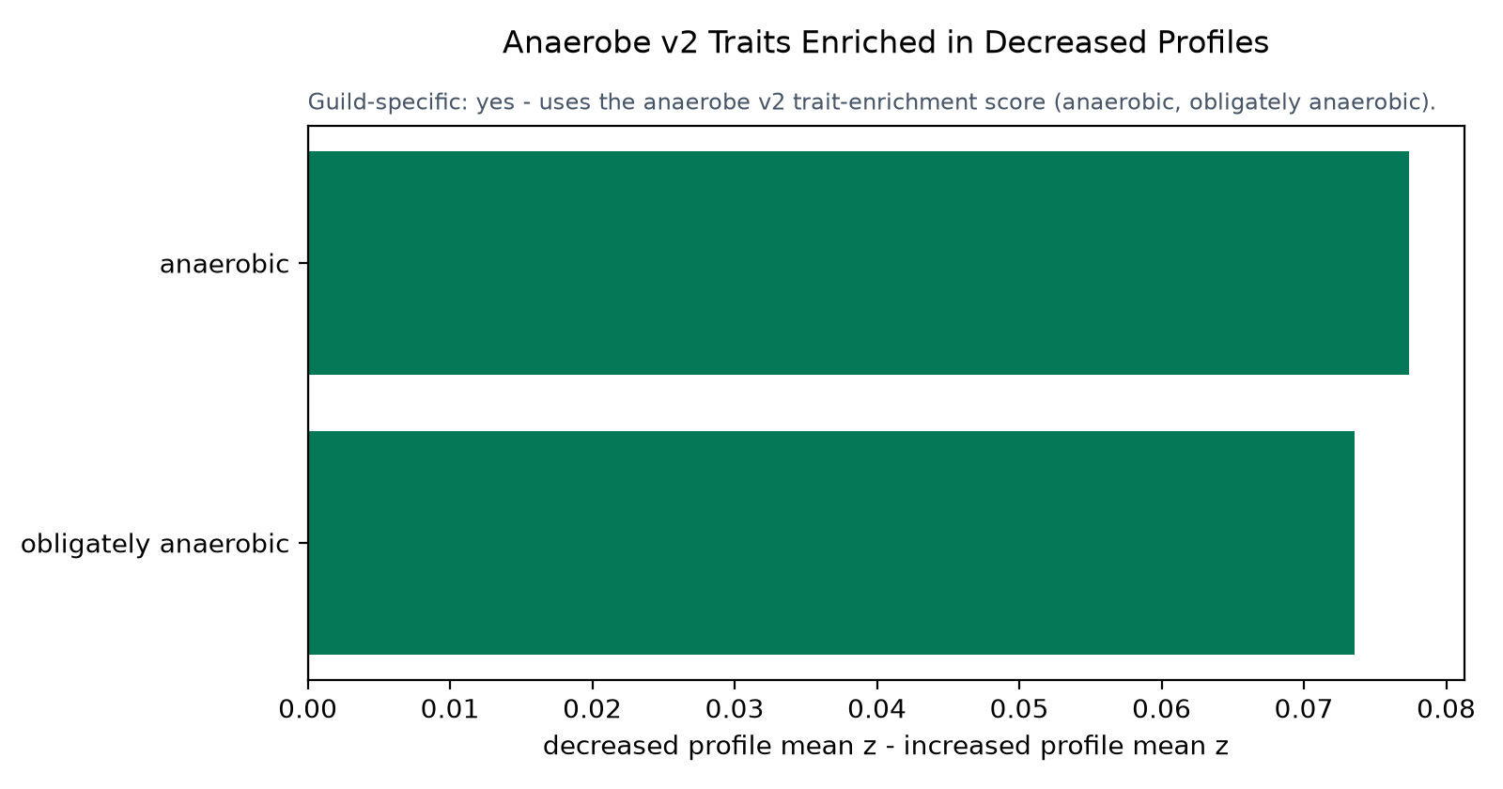
ANAEROBE V2 DEPLETION SIGNAL
9/13
V2 traits enriched in decreased profiles

Slide 10
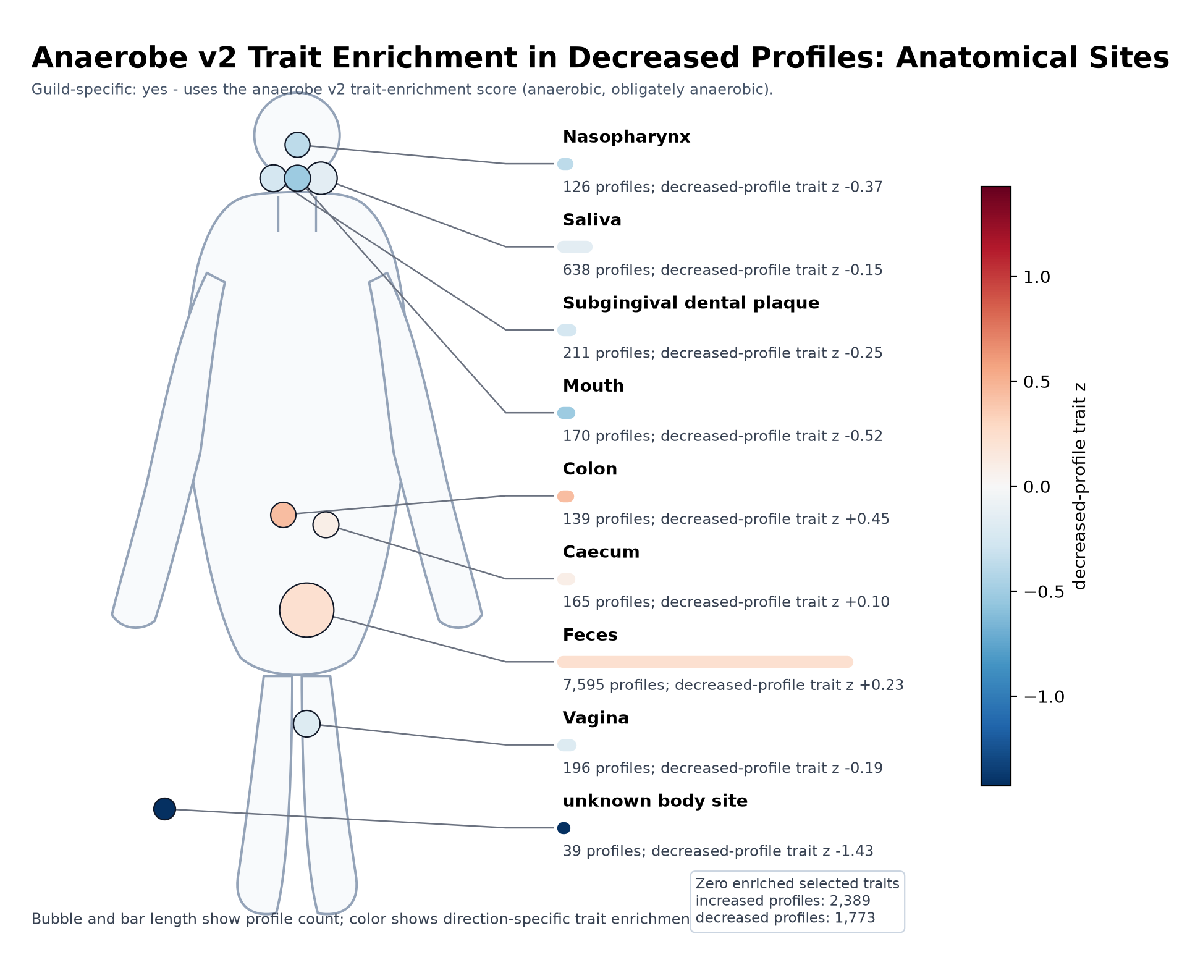
ANAEROBE V2 DEPLETION SIGNAL
10/13
Anatomical sites for anaerobe v2 trait enrichment in decreased profiles

Slide 11
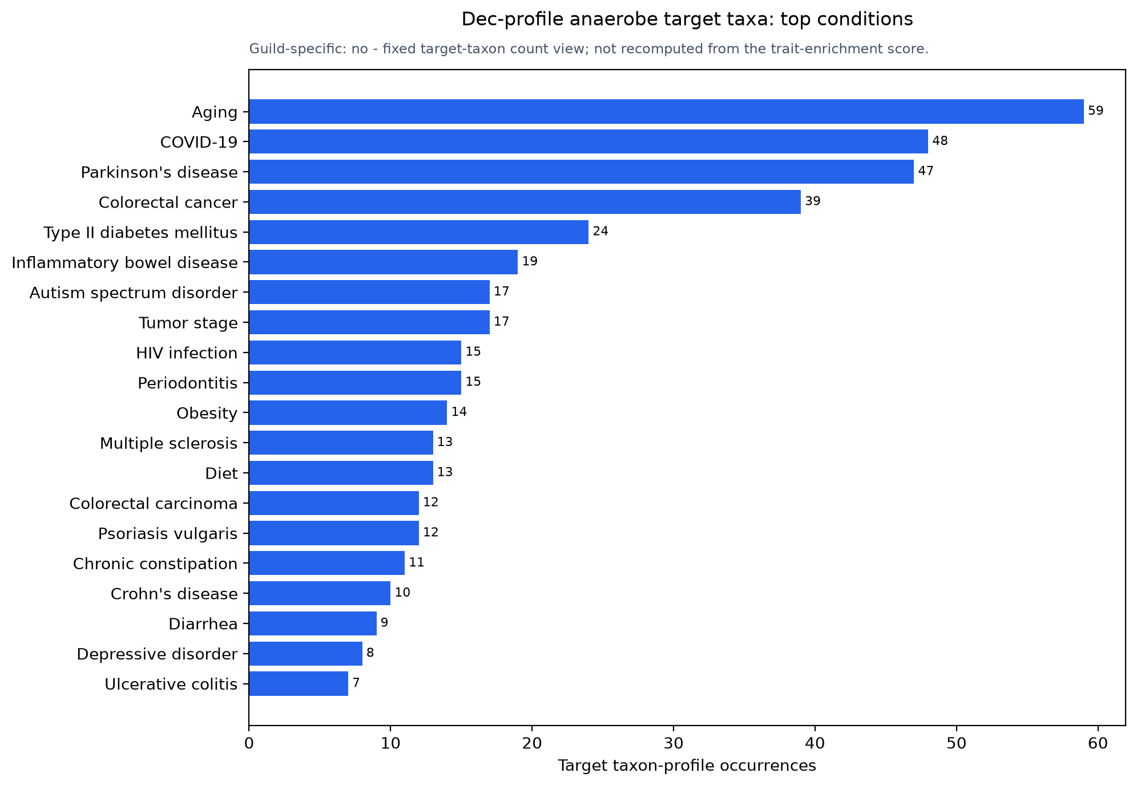
ANAEROBE V2 DEPLETION SIGNAL
11/13
Top conditions for decreased-profile target-taxon occurrences

Slide 12
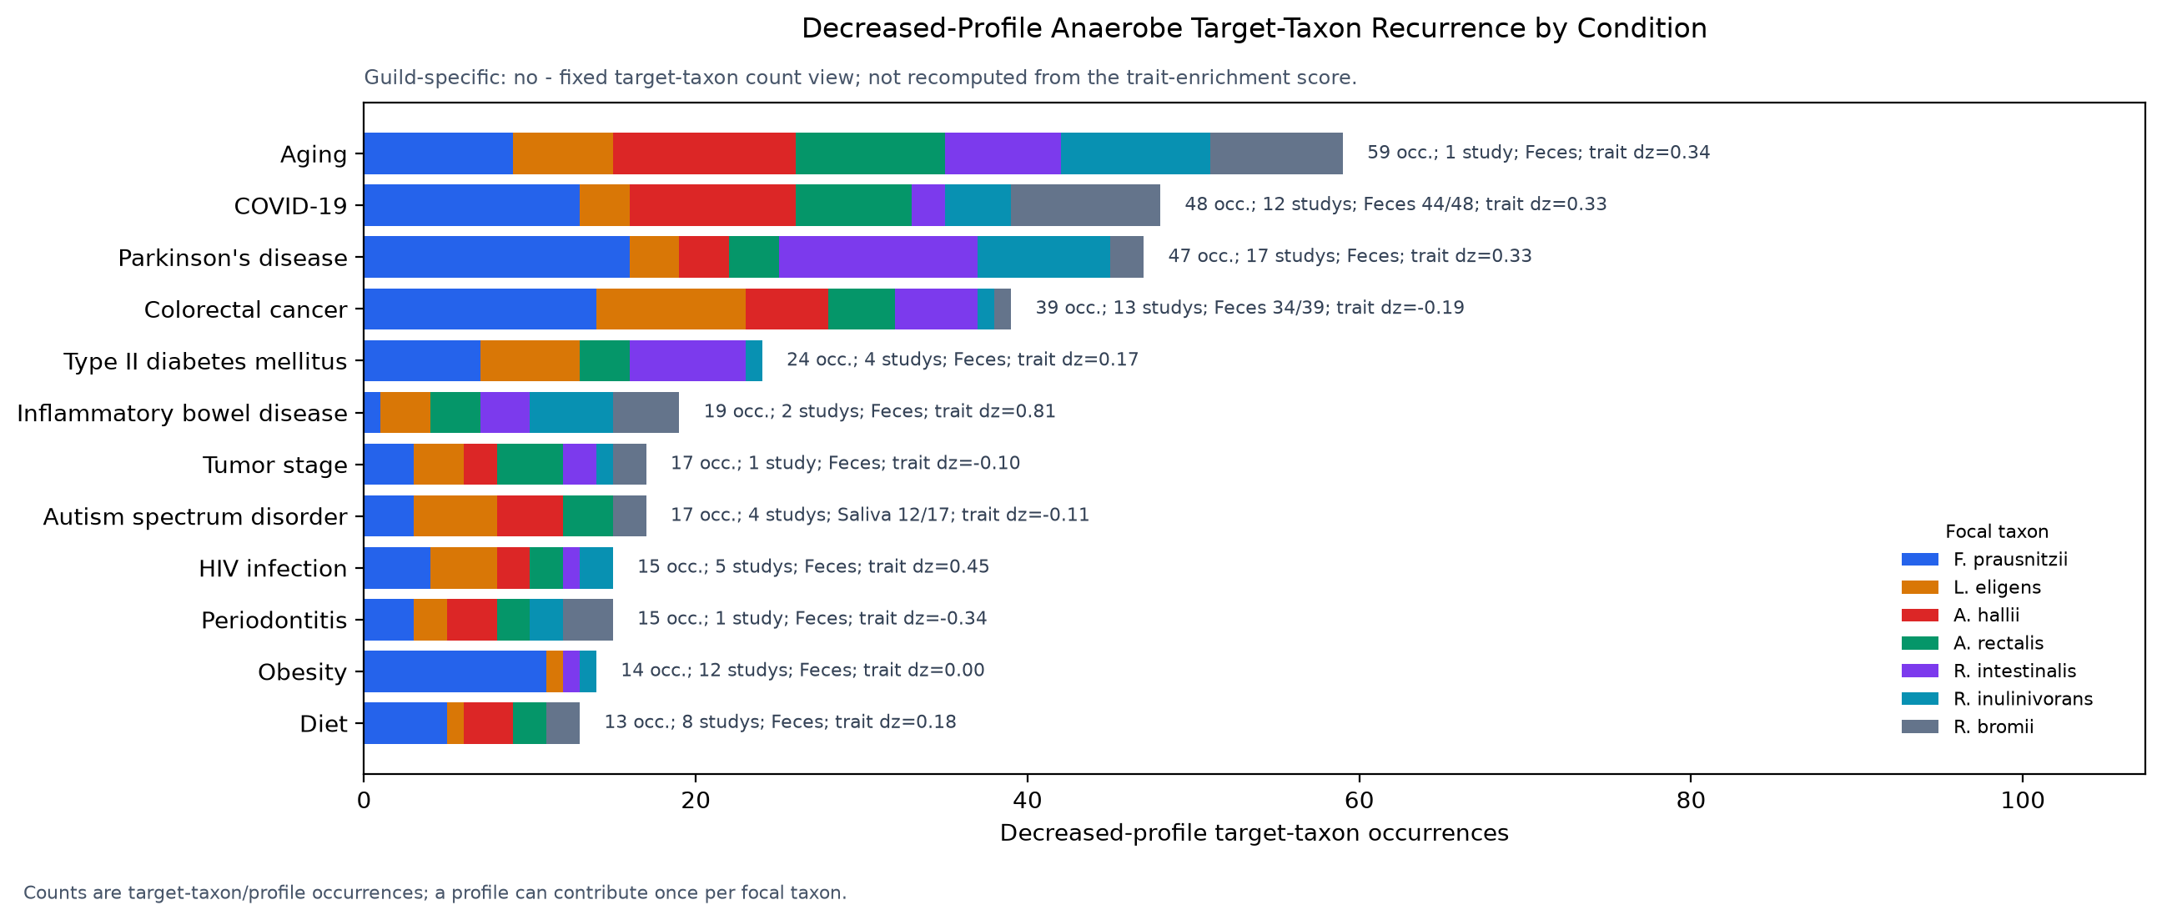
ANAEROBE V2 DEPLETION SIGNAL
12/13
Stacked focal taxa by decreased-profile condition

Slide 13
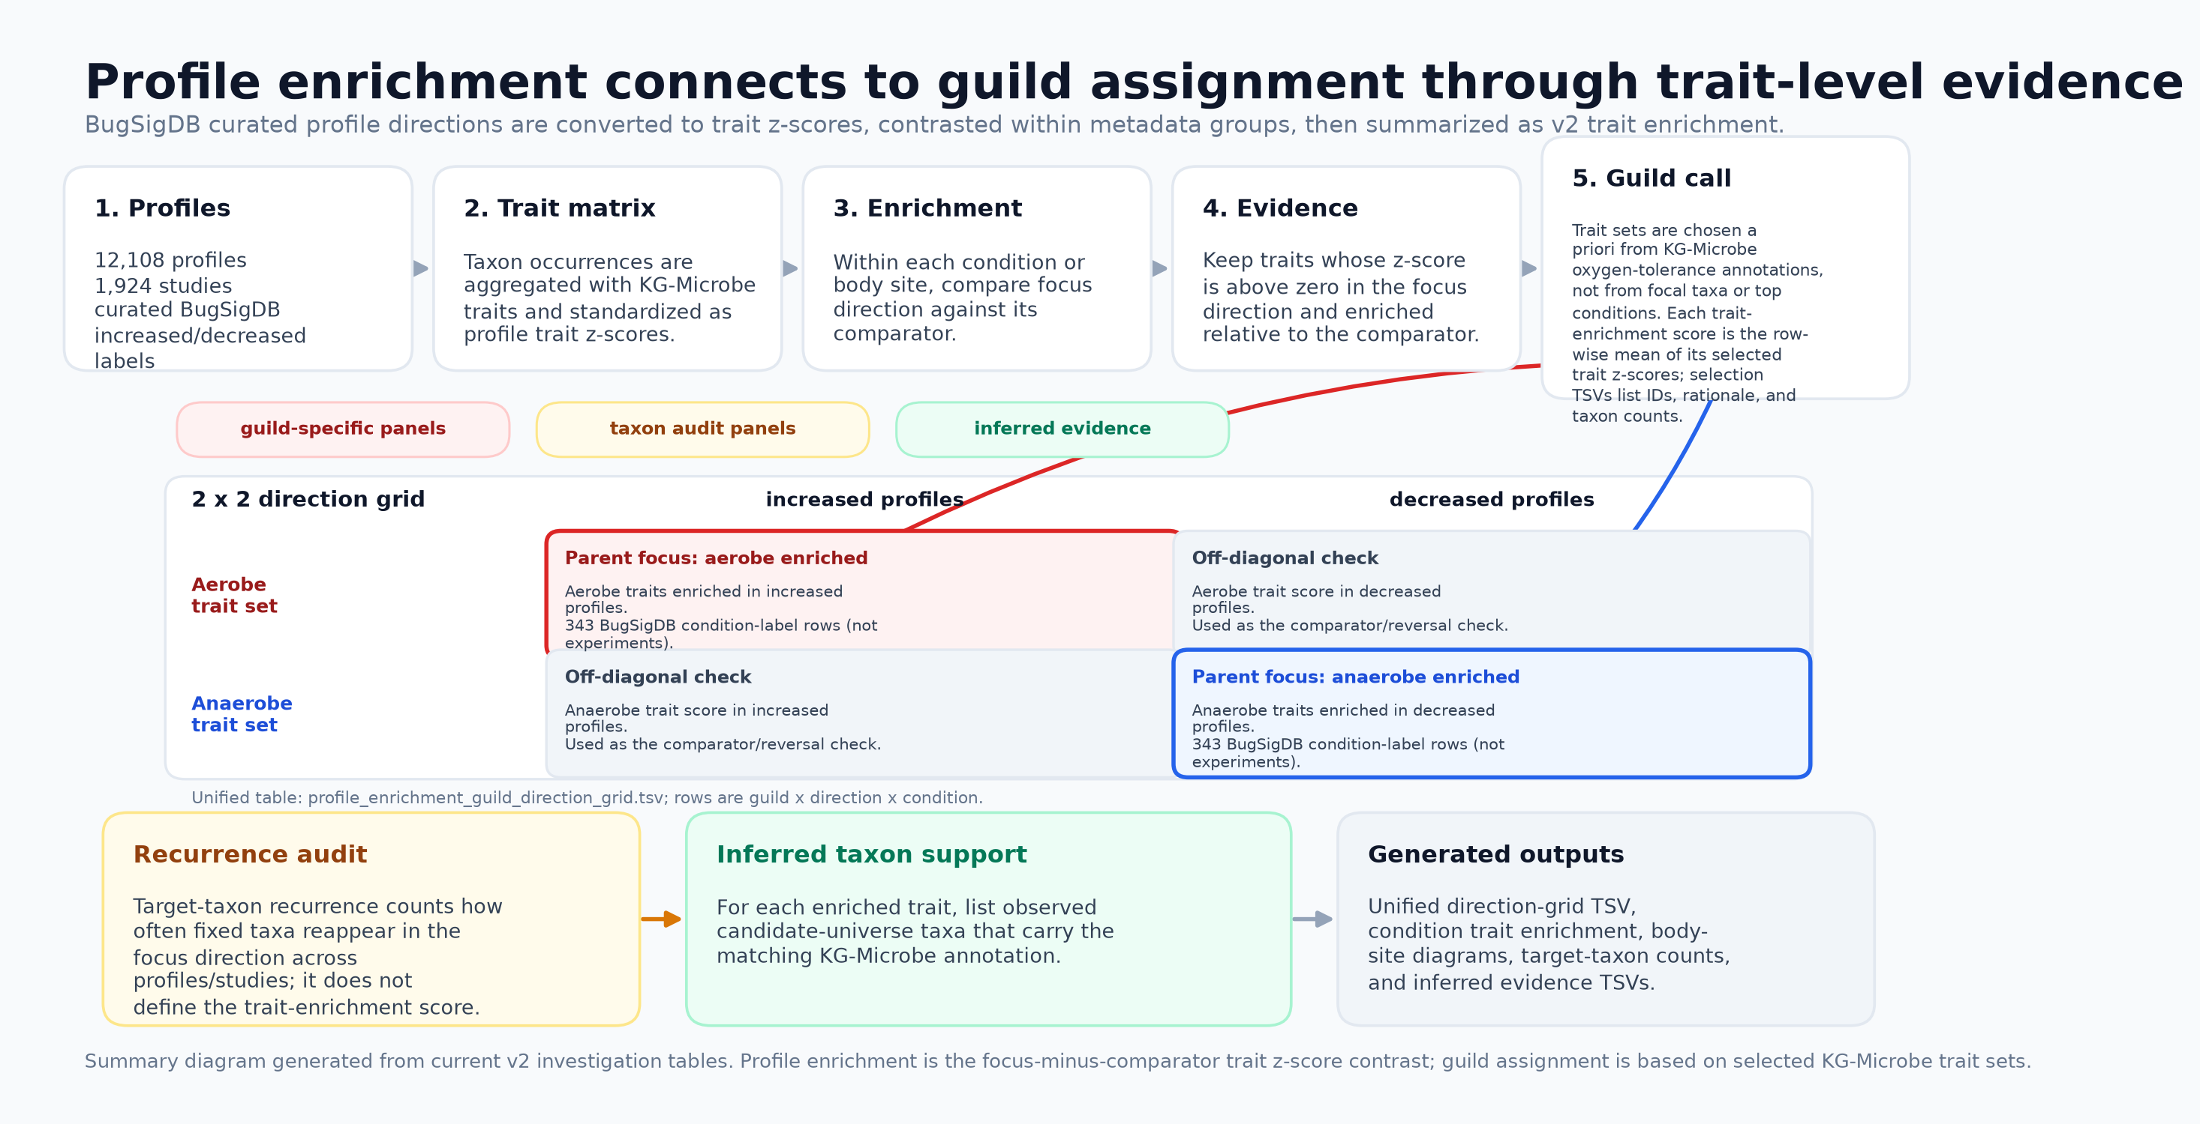
PROFILE ENRICHMENT TO GUILD ASSIGNMENT
13/13

