Slide 1
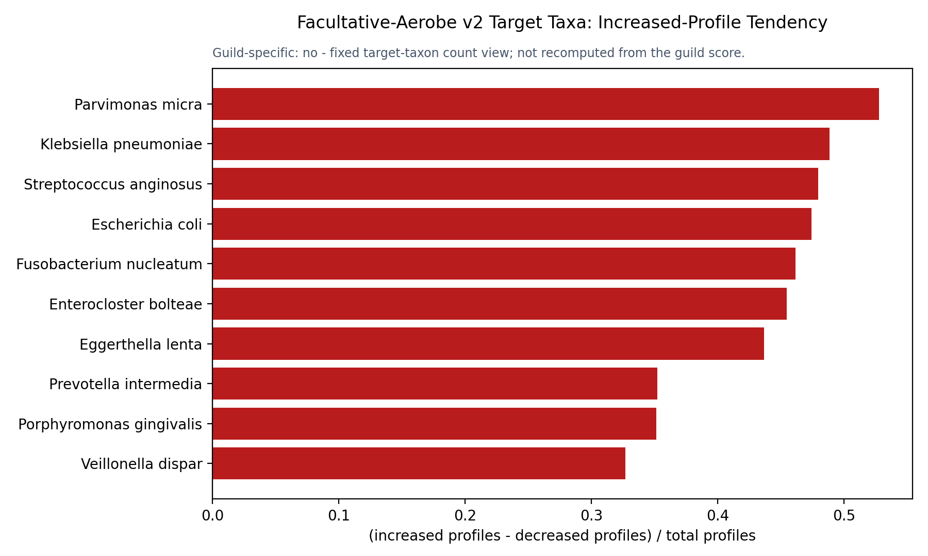
FACULTATIVE-AEROBE V2 INCREASED-PROFILE SIGNAL
1/11
Target taxa most often reported in increased profiles

Slide 2
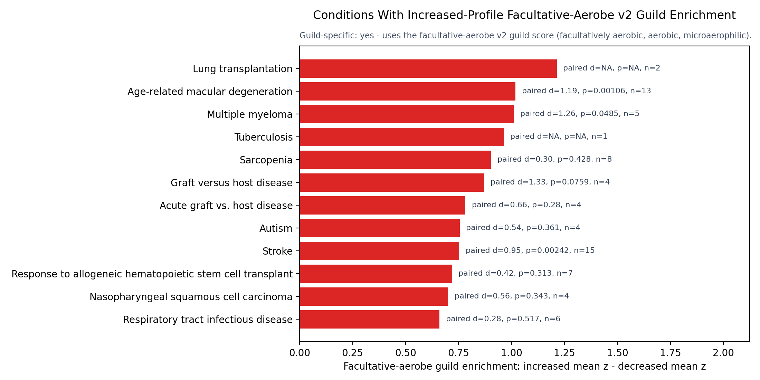
FACULTATIVE-AEROBE V2 INCREASED-PROFILE SIGNAL
2/11
Conditions with high increased-profile v2 guild signal

Slide 3
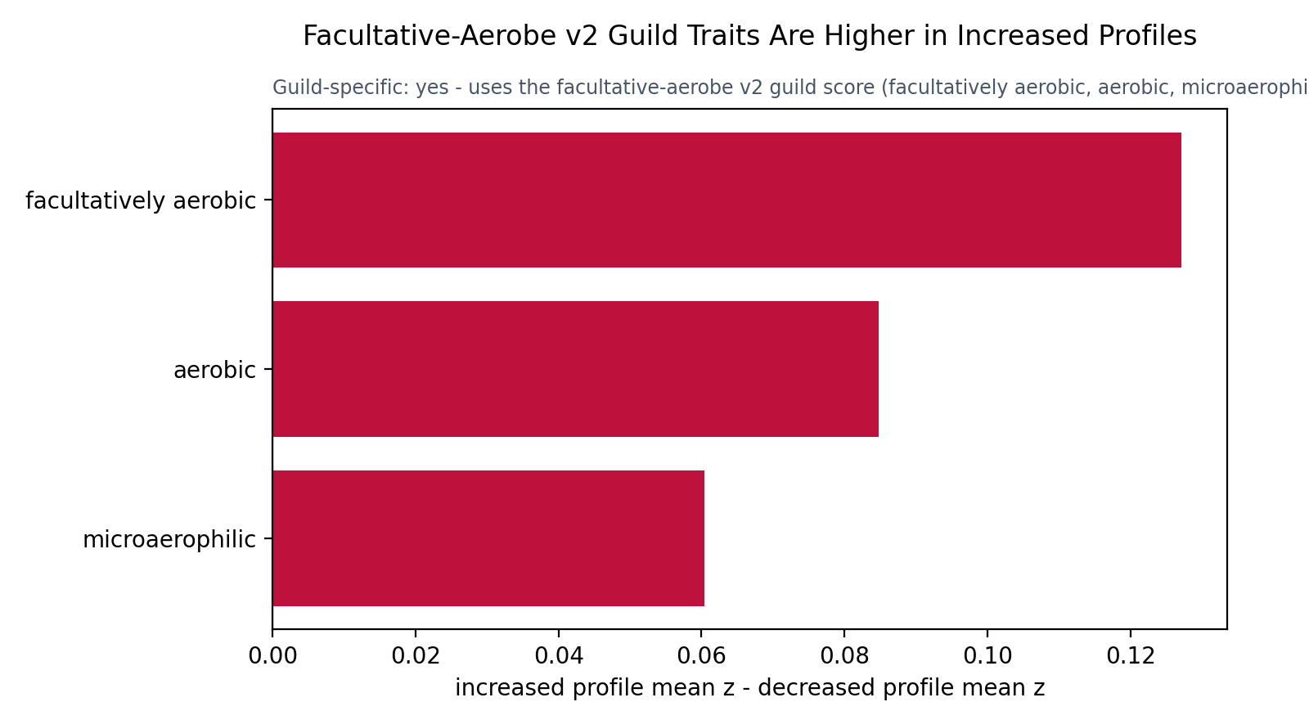
FACULTATIVE-AEROBE V2 INCREASED-PROFILE SIGNAL
3/11
V2 guild traits are higher in increased profiles

Slide 4
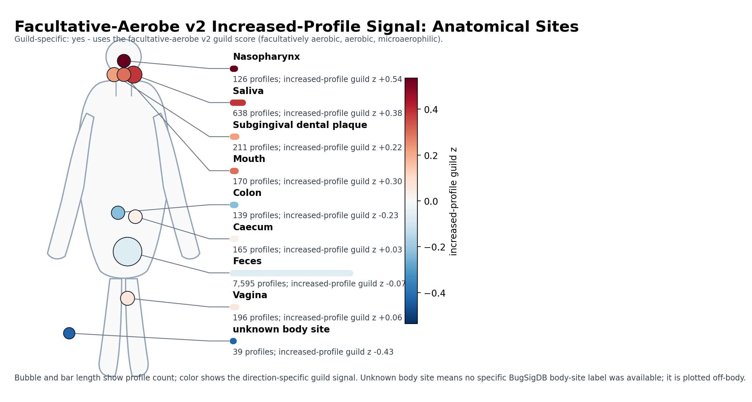
FACULTATIVE-AEROBE V2 INCREASED-PROFILE SIGNAL
4/11
Anatomical sites for increased-profile facultative-aerobe v2 signal

Slide 5
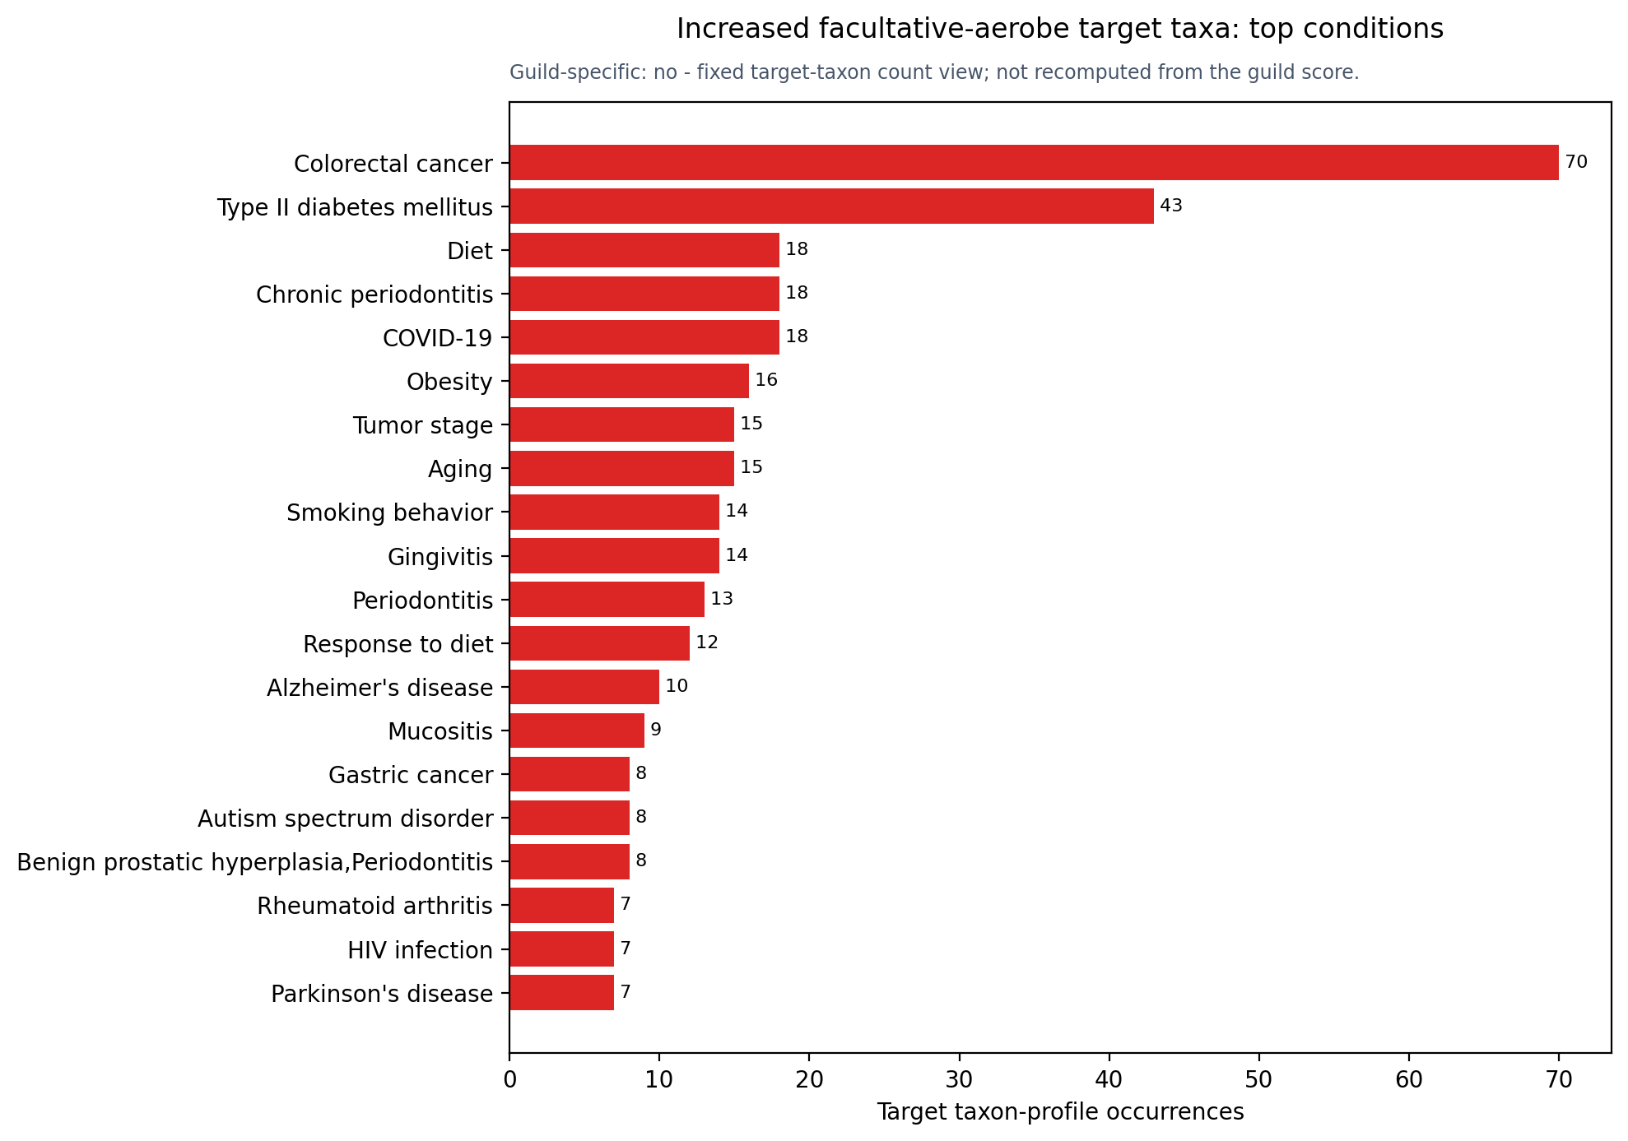
FACULTATIVE-AEROBE V2 INCREASED-PROFILE SIGNAL
5/11
Top conditions for increased target-taxon occurrences

Slide 6
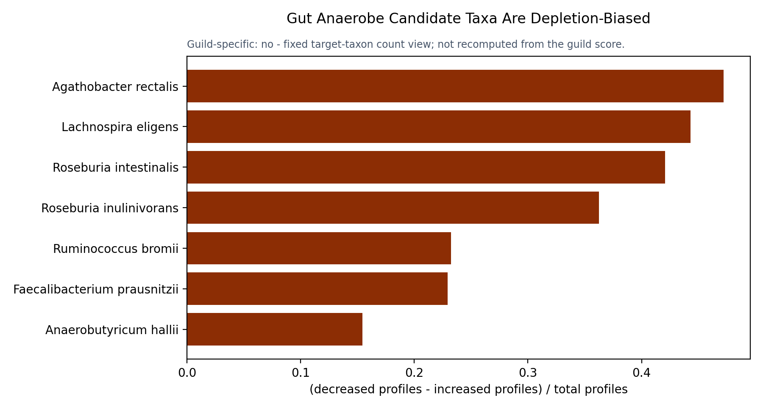
GUT ANAEROBE V2 DEPLETION
6/11
Target taxa most often reported in decreased profiles

Slide 7
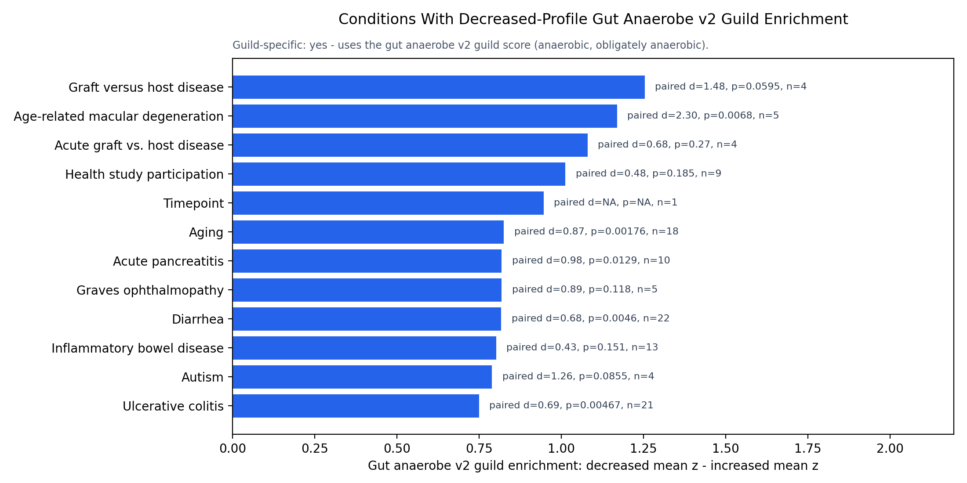
GUT ANAEROBE V2 DEPLETION
7/11
Conditions with high decreased-profile gut anaerobe v2 guild signal

Slide 8
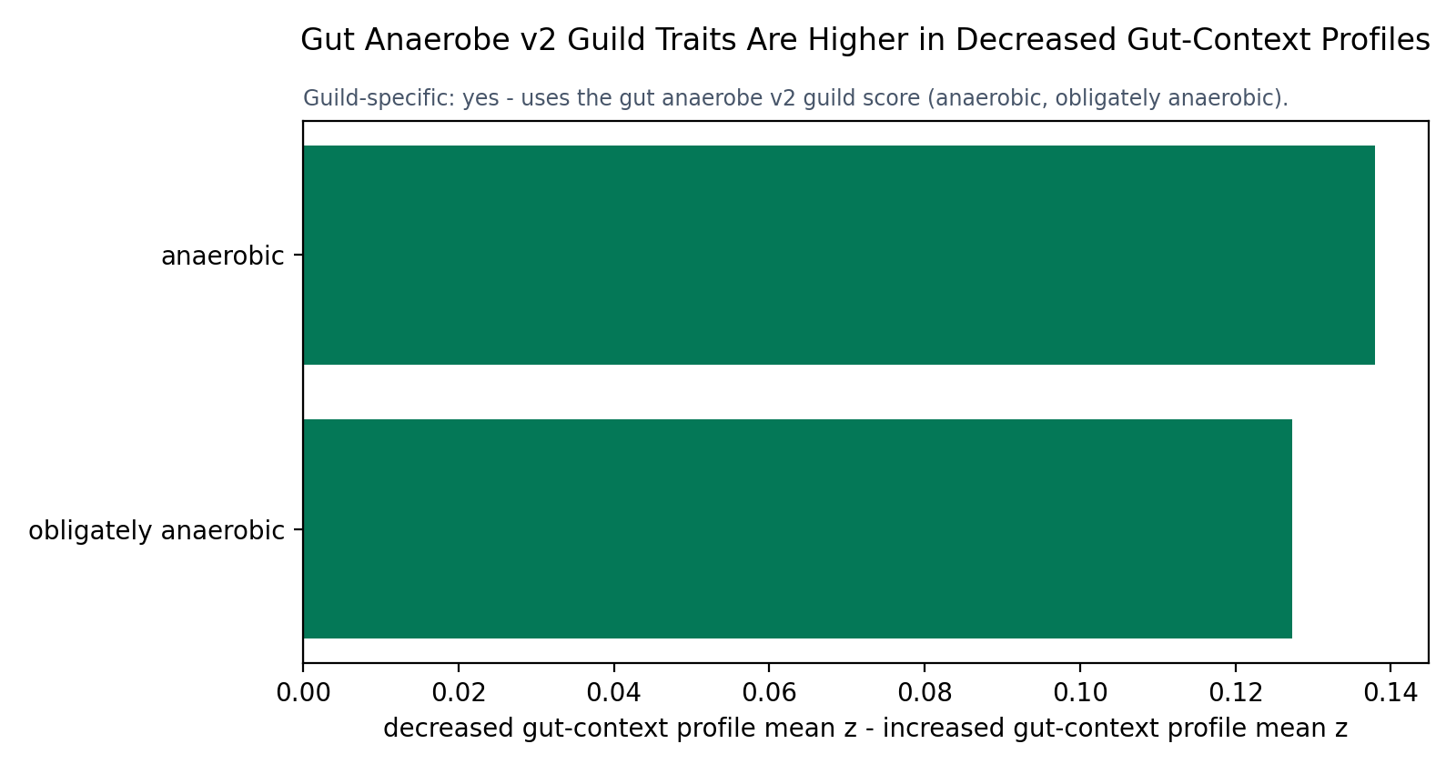
GUT ANAEROBE V2 DEPLETION
8/11
V2 guild traits are higher in decreased gut-context profiles

Slide 9
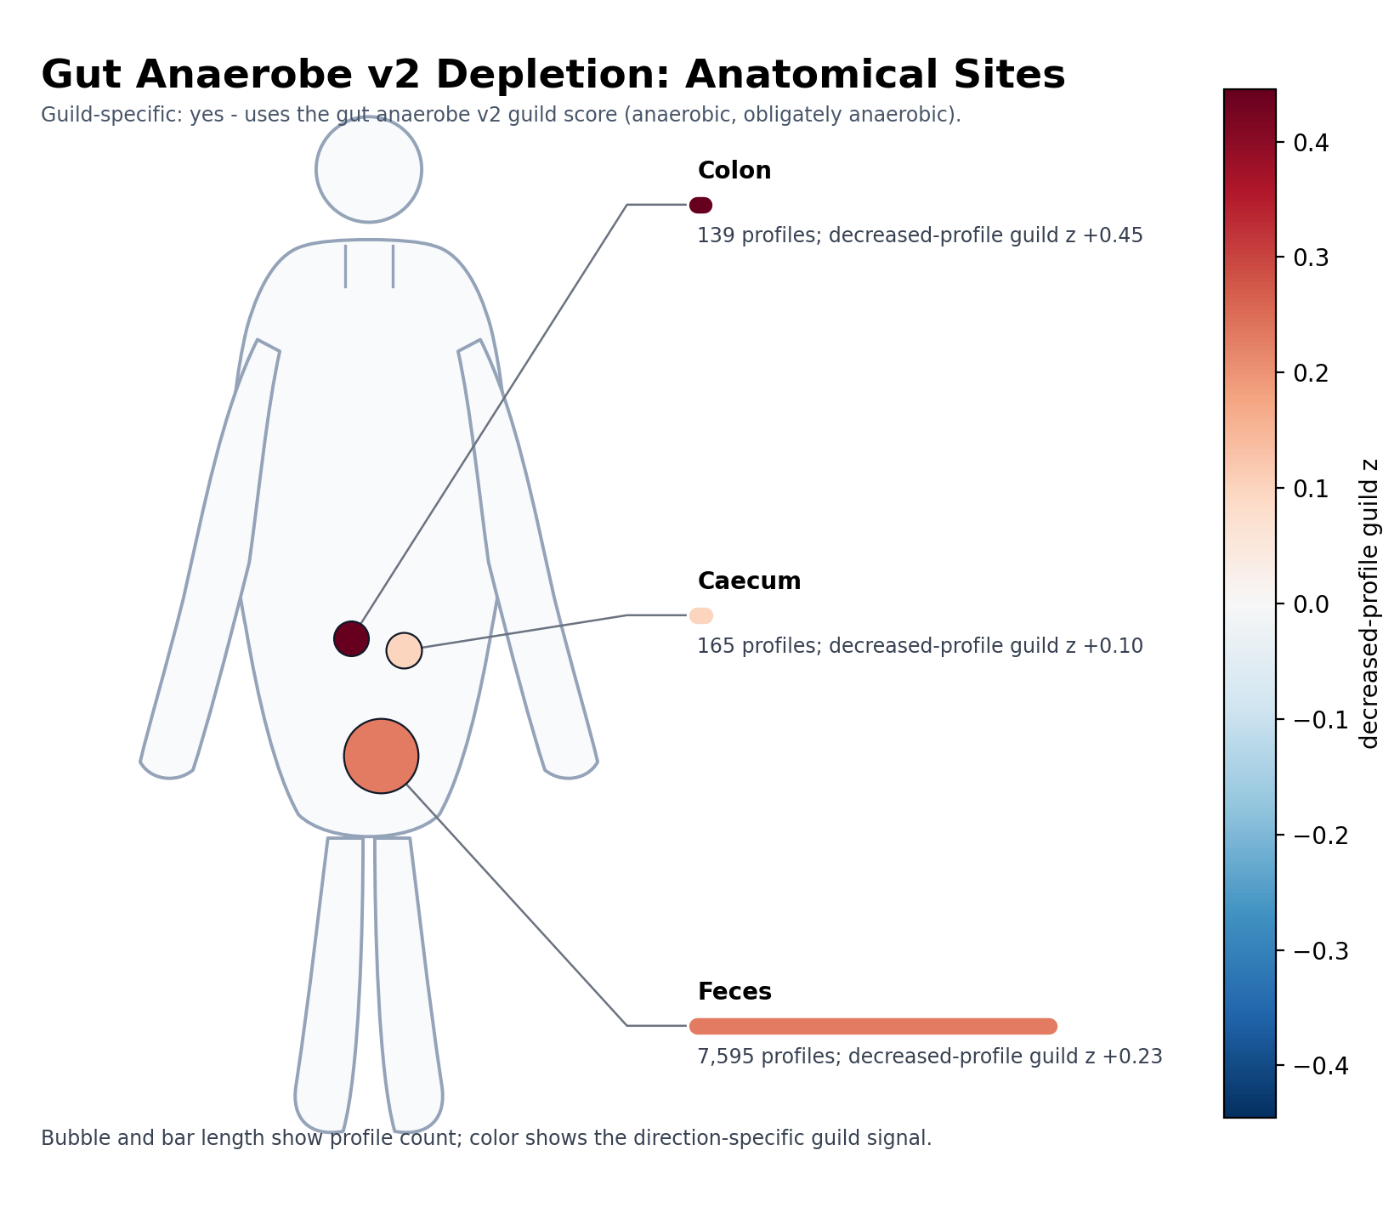
GUT ANAEROBE V2 DEPLETION
9/11
Anatomical sites for decreased-profile gut anaerobe v2 signal

Slide 10
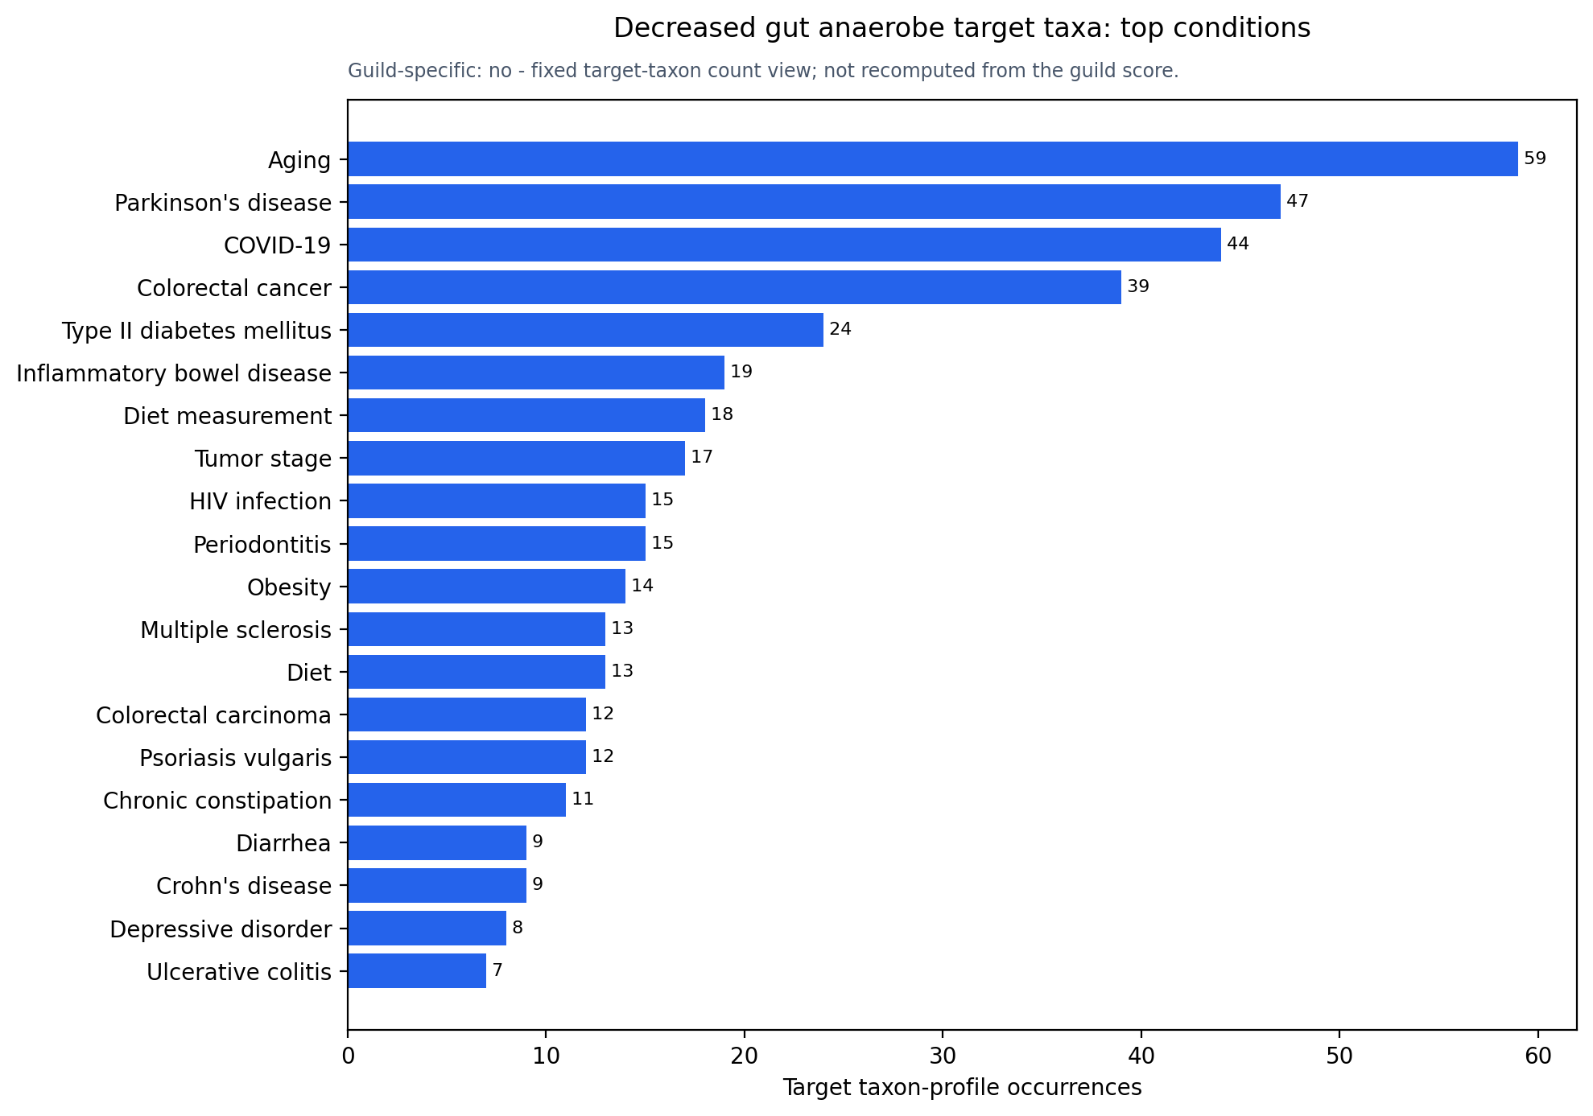
GUT ANAEROBE V2 DEPLETION
10/11
Top conditions for decreased target-taxon occurrences

Slide 11
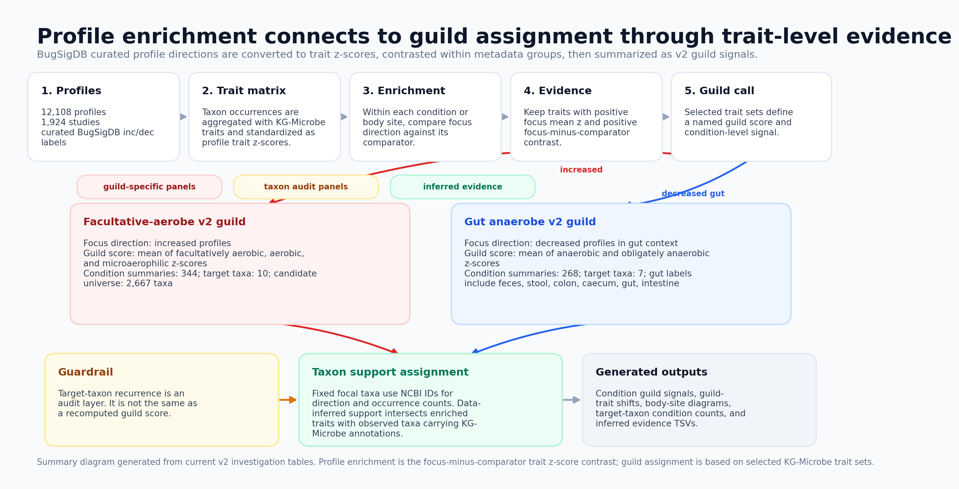
PROFILE ENRICHMENT TO GUILD ASSIGNMENT
11/11

