Slide 1
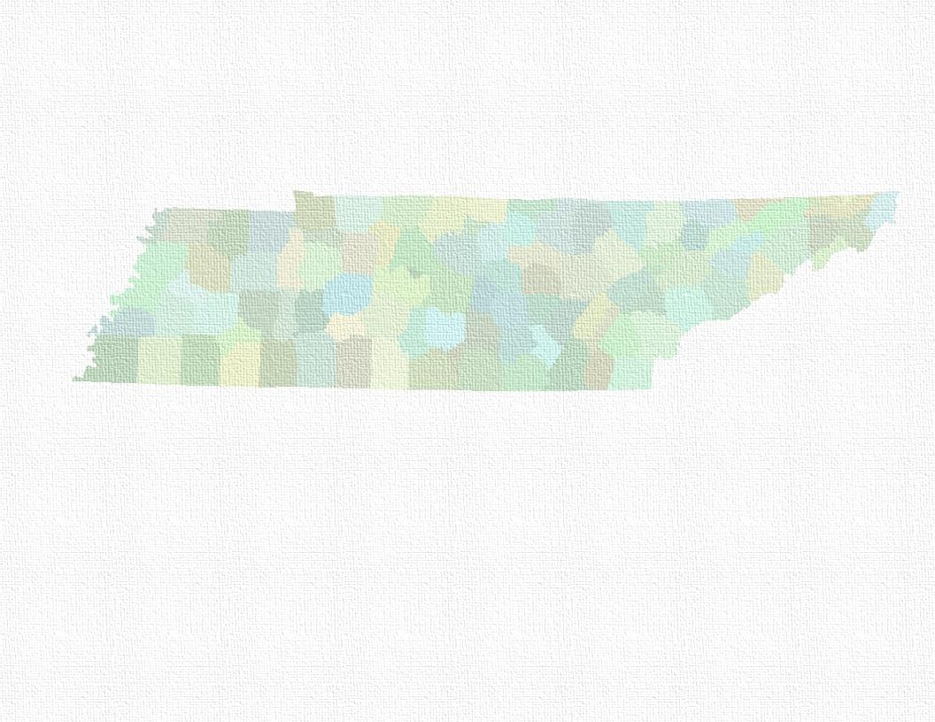
NEXT GENERATION 9-1-1 Tennessee Information for Public Safety
TIPS: 2015 Q1 Update
Presented by OIR-GIS Services

Slide 2
What it is and how it works
Next Generation 9-1-1

Slide 3


GIS and NG911
Tennessee Information for Public Safety (TIPS)
Conforms to National Emergency Number Association (NENA) Standards
Street Centerlines
Address Points
Emergency Service Number (ESN) Polys
Uniform GIS Platform
ESRI ArcGIS Based
Not using Arc at all Districts
Product provided is ArcGIS Based
Currently receiving weekly updates
All 100 Emergency Communications Districts (ECDs)
Notes:
TIPS

Slide 4
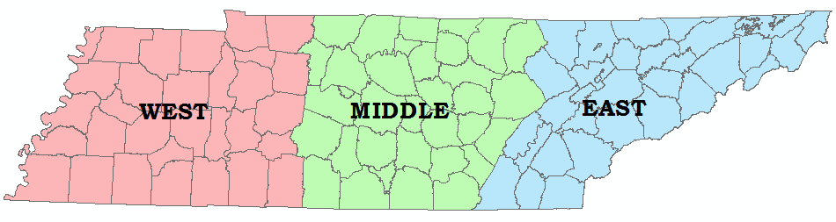
Regional Stats
TN ECDs
The Stats:
100 ECDs broken up by region
94 county ECDs
Overton and Pickett Co in Middle TN are combined into one district
6 municipal ECDs
5 of which are in East TN
1 in Middle TN

Slide 5
Next Gen vs. Current System
Critical parts in current system:
MSAG (Master Street Address Guide)
ALI (Automatic Location ID)
Separately maintained, apart from GIS
Provided by phone co – record of each phone line
Tied to addresses
Problems with current system
Separate records
Multi step process to update MSAG, ALI and GIS
Potential for missing addresses/streets in GIS
Solution: Next Generation 9-1-1
Next Gen employs seamless integration of GIS into 9-1-1
GIS is Everything
ECDs’ GIS data will be default “correct” dataset moving forward
Phone co records (ALI) will be validated against GIS data
Edit GIS data – Done!

Slide 6
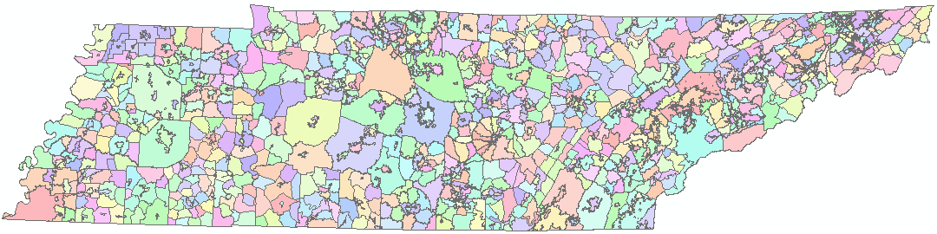
Emergency Service Numbers
All 100 ECDs have seamless call routing (ESN) boundaries in State GIS database
Nearly 2,000 ESN polygons within the State of TN
Did You Know?
TN has no “official” county boundaries
Each County (and ECD) maintains their own boundary
None match
TDOT maps and signs are simply “close approximations”
OIR GIS orchestrated Herculean task of matching all ESN (Emergency Service Number) boundaries
Used for call routing only
TN ESNs
Notes:
Stress that ESN boundaries are used for call routing only. Taxes, voting, etc. are not affected.

Slide 7
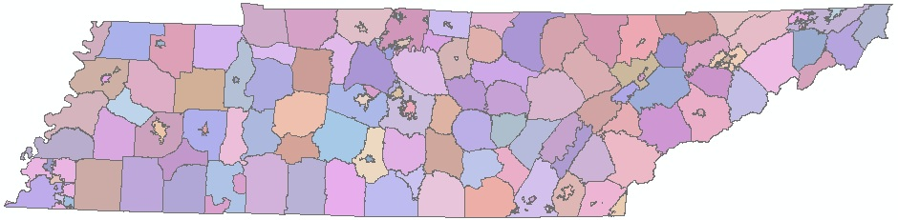
Public Safety Answering Points
PSAPs polygons are related to ESNs
Routing information is tied to the PSAPID field within ESNs
Call plots (Lat/Lon from ALI validated point)
Lat/Lon falls within a PSAP polygon
Call routes to that particular PSAP
For visual reference, ESNs are dissolved here on the PSAPID field
Some ECDs have multiple PSAPs
TN PSAPs
Notes:
Remember that TCS (Seattle) is validating the ALI records against the address points.

Slide 8

GIS for Next Gen 9-1-1: Update
Near Future
Statewide database will be replicated between Nashville and Seattle/Phoenix
Phoenix is backup database
Testing and vetting happening now
TCS, based in Seattle, validates the address and street data against ALI records
Data then sent back to TN for use in NetTN system
Used for initial call routing
Jackson area will be first to deploy
Should be live by sometime late Q1 of 2015

Slide 9
GIS for Next Gen 9-1-1
Functional relationships
TN Emergency Communications Board (ECB) contracted with OIR GIS Services to administer the GIS portion of the project
3 regional technicians were put in place to assist Emergency Communication Districts (ECD’s)
Standardized TIPS Schema allows easy integration into statewide DB
Data changes upload from ECDs to OIR
Change detection program has been installed to detect local changes which are sent weekly to OIR-GIS and loaded into a statewide DB
Why not replicate all ECDs’ data to OIR?
Not all ECDs using ArcGIS
State SFTP
Statewide Database
Working Database
Comparison Database
Change Files

Slide 10
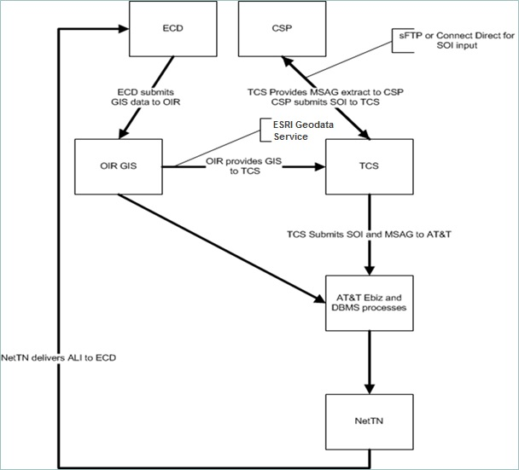
Data Life Cycle
Continued…
GIS data is sent to TCS and AT&T via Enterprise GIS
TeleCommunications Systems (TCS) uses GIS data to create ALI database
AT&T creates MSAG and delivers to NetTN System for use in live call routing
Location Validation Function
ESNs are used to route to Public Safety Answering Point (PSAP)

Slide 11
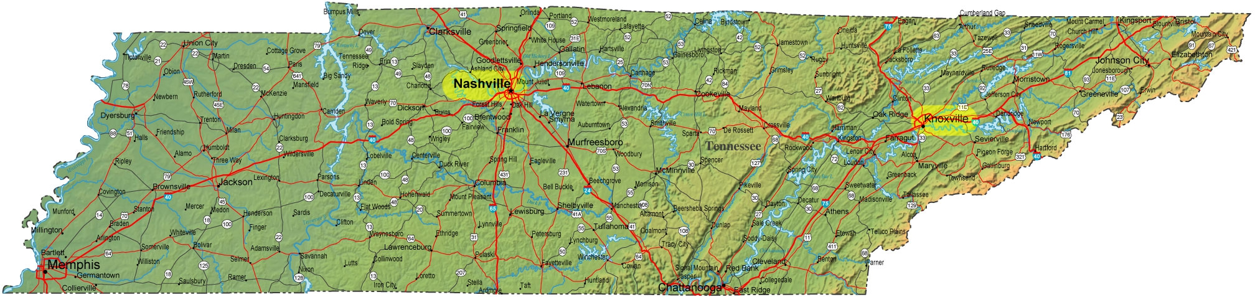
Next Gen: Data Centers
NetTN:
Data backups stored in Nashville and Knoxville
Regional hubs in Memphis, Nashville, Chattanooga, Knoxville, Tri-Cities
Each has a dedicated high speed connection to at least two other regional hubs
System Used for initial call routing
Call routing is not the same as dispatch
Dispatching is up to each district and separate from 9-1-1
Most districts take calls and perform dispatching

Slide 12
The 4-1-1 on 9-1-1 Call Processing
When GIS Based Routing is Deployed

Slide 13

Land Line: Using GIS
The Lat/Lon data is tied to the address point
If the point is in the GIS data, it will be found and the call sent to the appropriate PSAP
This is the goal – every point in the GIS data
Ensures fastest call routing
What if the point isn’t found?
We go to the next tier
Rely on centerline data
First, let’s look at an “ideal” example:

Slide 14
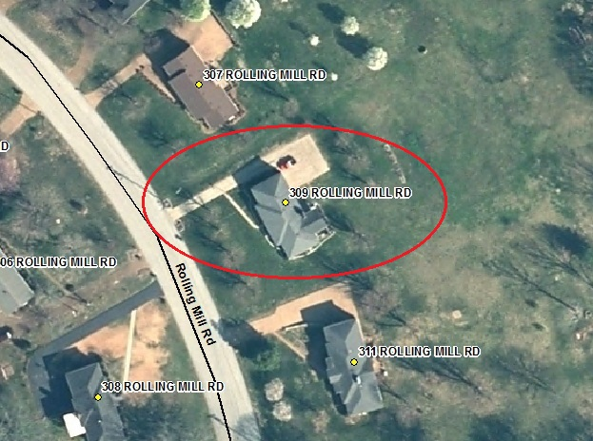
Land Line: Address Point
Example:
Call comes in from 309 Rolling Mill Rd
Address is in GIS data
Point is located and mapped
Call is sent to PSAP
9-1-1 is Done!
PSAP handles call from here
Dispatch, etc. is up to ECD

Slide 15
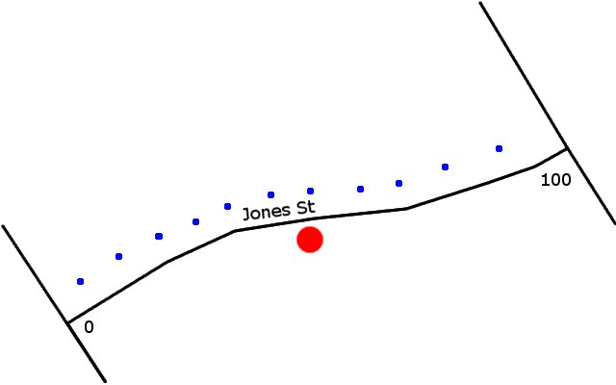
Land Line: Without Point
Second line of defense: Geocoding
Takes minimal additional time
Example: 50 Jones St
Address is geocoded halfway down on the right side
A standardized schema is essential for this to work correctly.
“Out-of-sequence” and “wrong side” addresses will not geocode correctly – but will likely still locate
Call is routed to appropriate PSAP
If centerline doesn’t exist, or range doesn’t exist, we go to third line of defense
Notes:
Schema refers to addressing schema
I say “will not geocode correctly” to say that they will not locate on the structure because it is out of sequence. But, as long as the centerline includes the range, it will geocode.

Slide 16
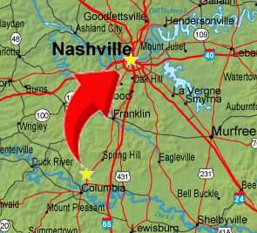
Land Line: Without Point – Worst Case
What happens if the call can’t be geocoded?
Goes to regional default data center
Hypothetical Example:
Call comes in from somewhere in Maury County
Unable to locate point
Geocode attempt
Unable to geocode
Doesn’t plot within an ESN
Sent to Nashville office
PSAP answers and transfers
Time delay!!
Avoid this scenario!

Slide 17
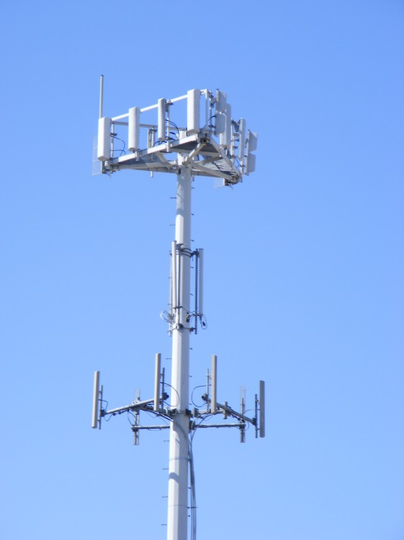
Cellular Phone Calls
Handled solely by location
No address information is involved as in land-line calls
AT&T bases locations off of cell tower triangulation
All other carriers use GPS location
All initialized phones have GPS receiver capability
When call is received:
Phase 1
Displays location at “handling tower”
Happens immediately
Phase 2
Refined location based on carrier method
Takes a few seconds for Phase 2 to come to PSAP
Maximum time delay dictated by FCC

Slide 18
QUALITY STANDARDS
Standards and QC Metrics

Slide 19
Feature Classes
Address Points and Centerlines
Maintained by ECDs
Updated via weekly upload to State
Conglomerated into single statewide DB
ESNs
Changes directed by ECDs via interactive website
Updated as needed
Edits maintained by State
Not all districts have ability to maintain topology
Calls will be routed based on poly
Essential that no gaps/overlaps are present

Slide 20
Quality Control Process
Primary automatic quality checks:
Data is checked and filtered prior to upload to State
Done via a new version of Change Detect Script (v2.0)
Several “pass/fail” fields
Other fields lumped together and checked for >2% error rate
If any of these parameters fail, the upload is stopped
Ensures that we maintain “clean” data in our statewide DB
Reports are generated, showing any errors that need to be addressed
ECDs are using these to improve the overall quality of their local GIS data
Point/poly analysis to ensure address point ESN value matches the ESN polygon where it resides
Reports of these errors are also generated for ECD benefit
Other manual periodic quality checks:
Topology
Compare ALI (Automatic Location ID) table to address points

Slide 21
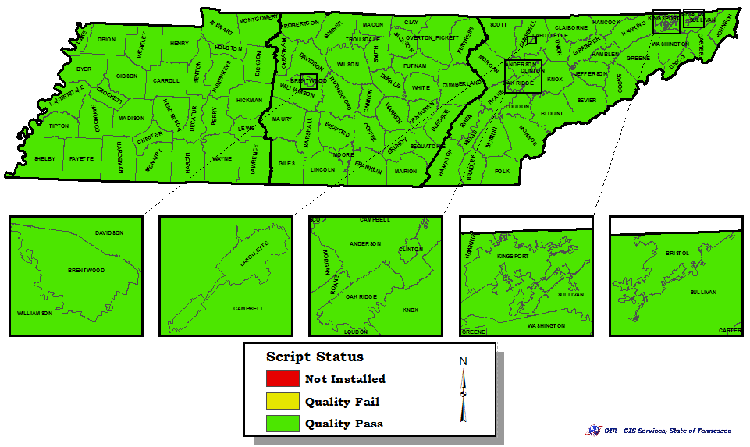
Data Quality Status
As of 12/15/2014: All 100 ECDs have data quality at 98% or higher

Slide 22
Questions?
Methaneous
Manager: Andrew Griswold (615)532-7830
West: Ryan Pittenger (731)421-6819
Middle: Michael Riter (615)770-1102
East: Kevin Williams (865)594-9424

