Slide 1
USGS 3D Elevation Program
Tennessee Department of Finance and Administration
Office for Information Resources – GIS Services
Dennis Pedersen, Director
Cumberland URISA January 23, 2015

Slide 2
GIS Background
OIR – GIS Services function:
Lead GIS coordination efforts at State level
Develop framework GIS datasets
Host / share geospatial data via TNMap
http://tnmap.tn.gov
Develop GIS applications for State agencies

Slide 3
USGS 3DEP Program Summary
Acquire nationwide high res. LiDAR elevation data
Backed by a comprehensive business plan (2011)
Estimated annual benefits of $1.2 billion nationwide
Goal to start data production in 2015
Looking to establish partnerships/collaboration on funding the program now (Broad Area Announcement)
USGS is proposing contributions up to 50%
Seeking proposals from 3DEP supporters at Fed, State, and local gov. levels
Notes:
3

Slide 4
Benefits for Top Business Uses
 |  | Annual Benefits
Rank |  | Conservative | Potential
1 | Flood Risk Management | $295M | $502M
2 | Infrastructure and Construction Management | $206M | $942M
3 | Natural Resources Conservation | $159M | $335M
4 | Agriculture and Precision Farming | $122M | $2,011M
5 | Water Supply and Quality | $85M | $156M
6 | Wildfire Management, Planning and Response | $76M | $159M
7 | Geologic Resource Assessment and Hazard Mitigation | $52M | $1,067M
8 | Forest Resources Management | $44M | $62M
9 | River and Stream Resource Management | $38M | $87M
10 | Aviation Navigation and Safety | $35M | $56M
:
20 | Land Navigation and Safety | $0.2M | $7,125M
 | Total for all Business Uses (1 – 27) | $1.2B | $13B
Notes:
The functional activity benefits were aggregated into 27 business uses. This slide shows the top business uses ranked by the total benefits identified by assessment participants. When benefits were identified as a range, the conservative number represents the lower end of the range and the potential number represents the high end of the range. With the exception of the potential benefit of $7 billion associated with Land Navigation and Safety, all of the dollar benefits represent immediate needs. The land navigation benefit is realized from vehicle fuel reductions that can be achieved by intelligent vehicle navigation systems that could begin to appear in the market place as early as 2014.

Slide 5

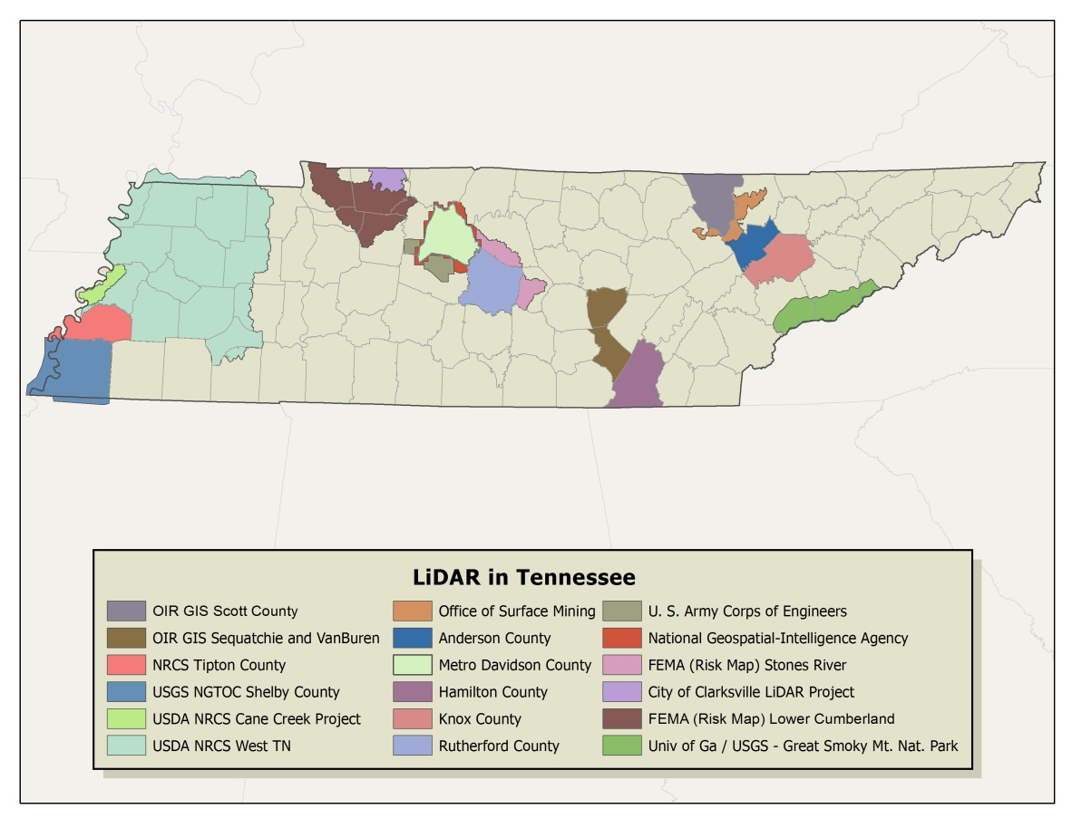
Existing LiDAR in TN
Approximately 20% coverage in the state
Estimated cost of remaining 80% is: $6 million
Map of existing
LiDAR coverage
http://gis.tn.gov/
Notes:
5

Slide 6
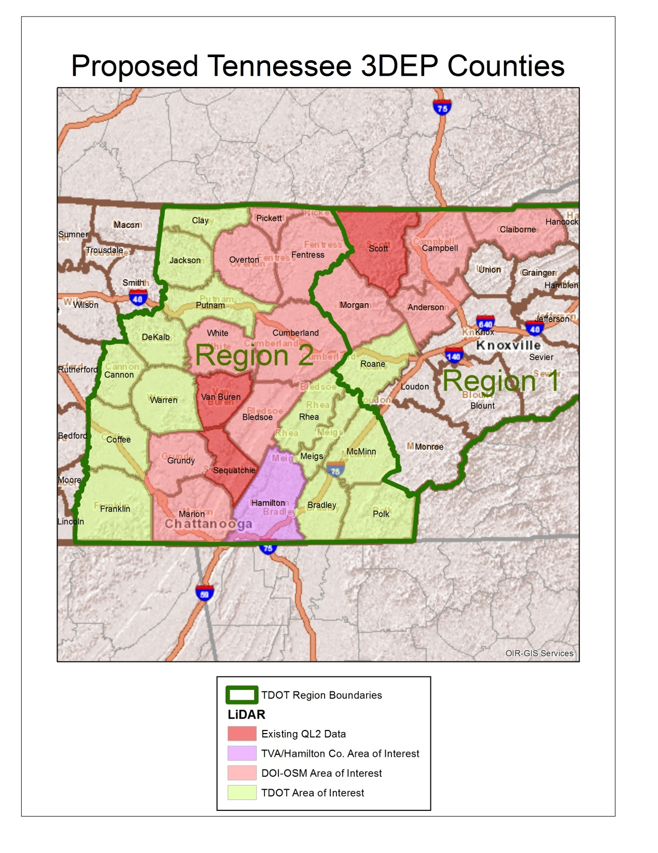

Slide 7
Proposed TN 3DEP Partnership Funding Model
TN Dept. of Transportation – 25%
US Dept. of Interior – Office of Surface Mining – 25%
Other government sources – 25%
USDA/NRCS
TVA
Hamiltion Co./City of Chattanooga
DOE – Oak Ridge Office
TN Dept of F&A – OIR-GIS Services
USACE / Wilson Co. consortium
Proposed USGS 3DEP Funding – 25% ($670,000)
Estimated 27 county total cost - $2.7 million
Notes:
7

Slide 8
Current Status:
Submitted Pre-Proposal (Due date: 11/7/14)
Submitted Full Proposal 12/12/14
Contract Negotiations between USGS and State
3DEP Award notifications ????
Winter/Spring 2015 begin acquisition ???
Existing LiDAR data available on TN Spatial Data Server: http://tngis.org/lidar.htm
Notes:
8

Slide 9
Other Current State GIS Efforts:
Next Generation 911 Status
GIS data used to support call routing and location validation
TIPS data QC scripts installed in 911 districts
Create GIS address point based MSAG
Rollout: Early 2015 goal for West TN
USDA NAIP Imagery
Beginning to acquire what is available from 2014 (1/4 of state)
Create image cache for TNMap enterprise GIS users
TDOT Ortho Imagery
22 of 24 counties received for middle TN (TDOT Region 3)
OIR - GIS delivering to local gov.
Creating image cache for TNMap enterprise GIS users
Notes:
9

Slide 10
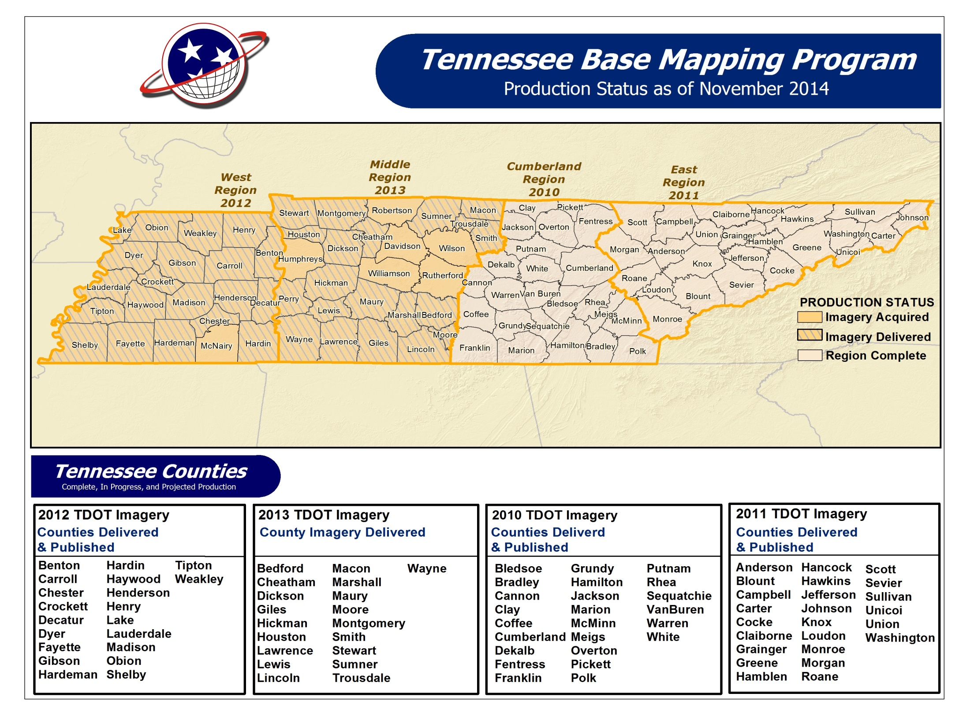

Slide 11
Questions???

