Slide 1
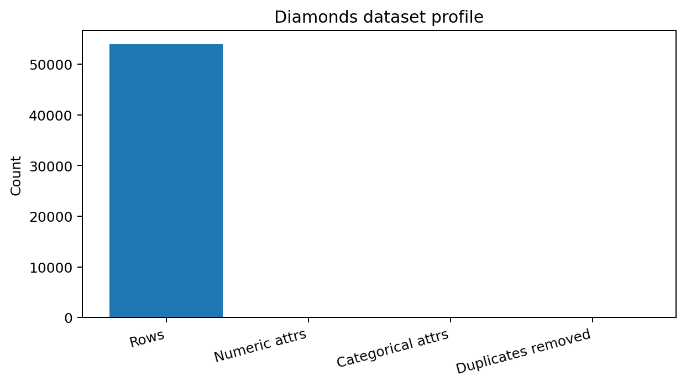
Diamonds Data Mining Project
Deliverable 4: Final Insights, Recommendations, and Presentation

Slide 2
Project Journey
Deliverable 1: data collection, cleaning, and EDA
Deliverable 2: regression modeling and feature engineering
Deliverable 3: classification, clustering, and pattern mining
Deliverable 4: final insights, recommendations, ethics, and presentation

Slide 3
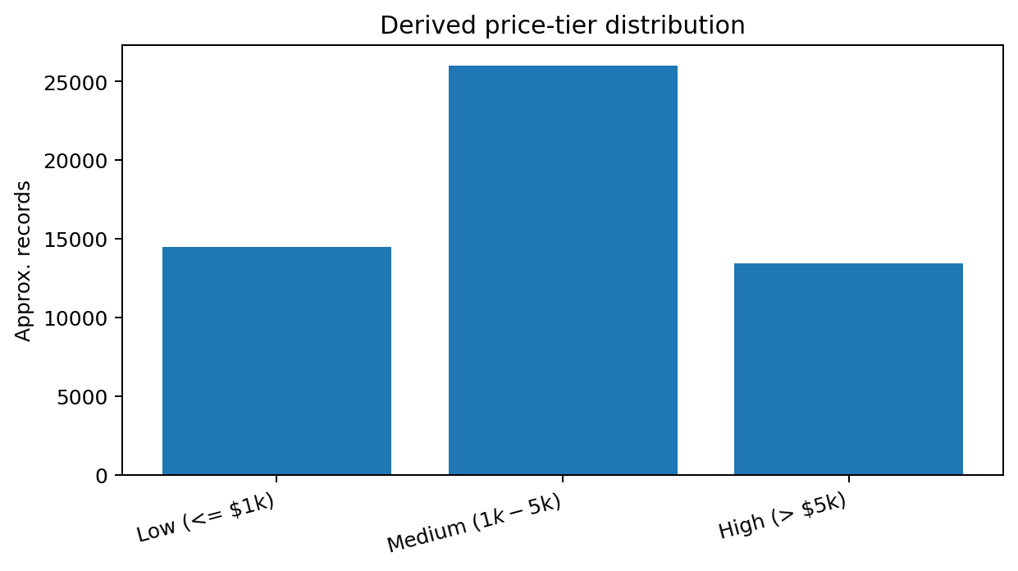
Dataset and Preparation
Diamonds dataset: 53,940 records and 10 attributes
No missing values found; 146 duplicate rows removed
Zero dimensions handled before calculating volume
Categorical grades encoded; numeric features scaled when needed

Slide 4
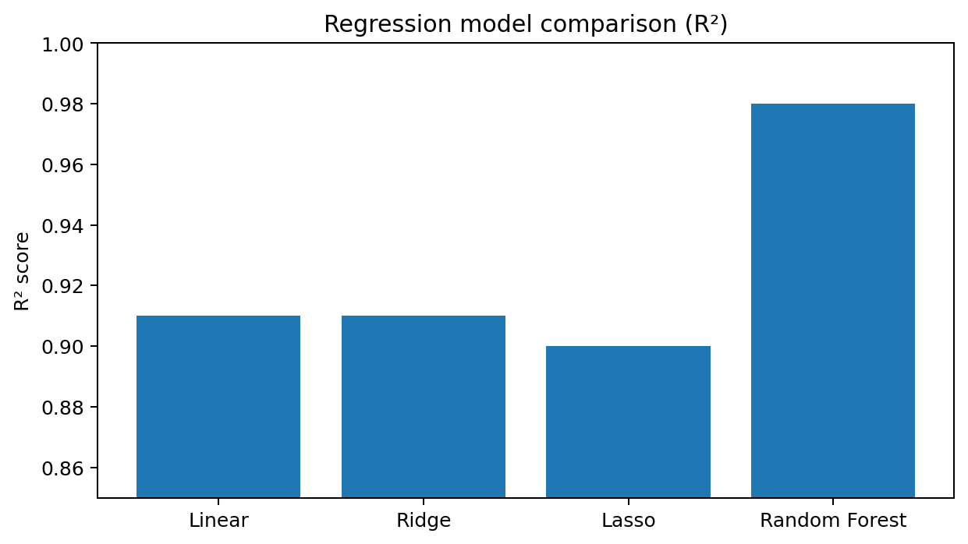
EDA and Feature Engineering Insights
Carat and volume were the strongest size-based price drivers
Price was right-skewed, so log transforms improved stability
Quality features were most useful in combination: clarity + color + size
Created price_tier to support classification and association rules

Slide 5
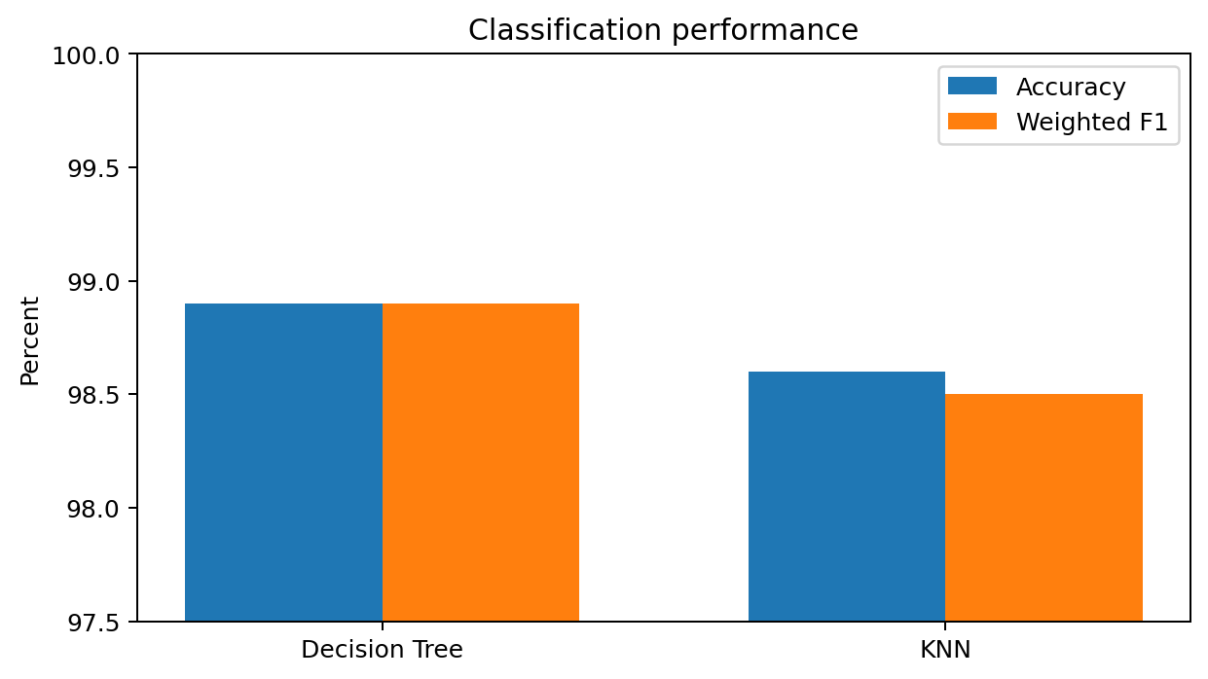
Modeling Results
Regression: strong price prediction with size and quality features
Decision Tree: ~98.9% accuracy and weighted F1
KNN: ~98.6% accuracy and ~98.5% weighted F1
Tuned shallower tree performed as well as deeper models

Slide 6
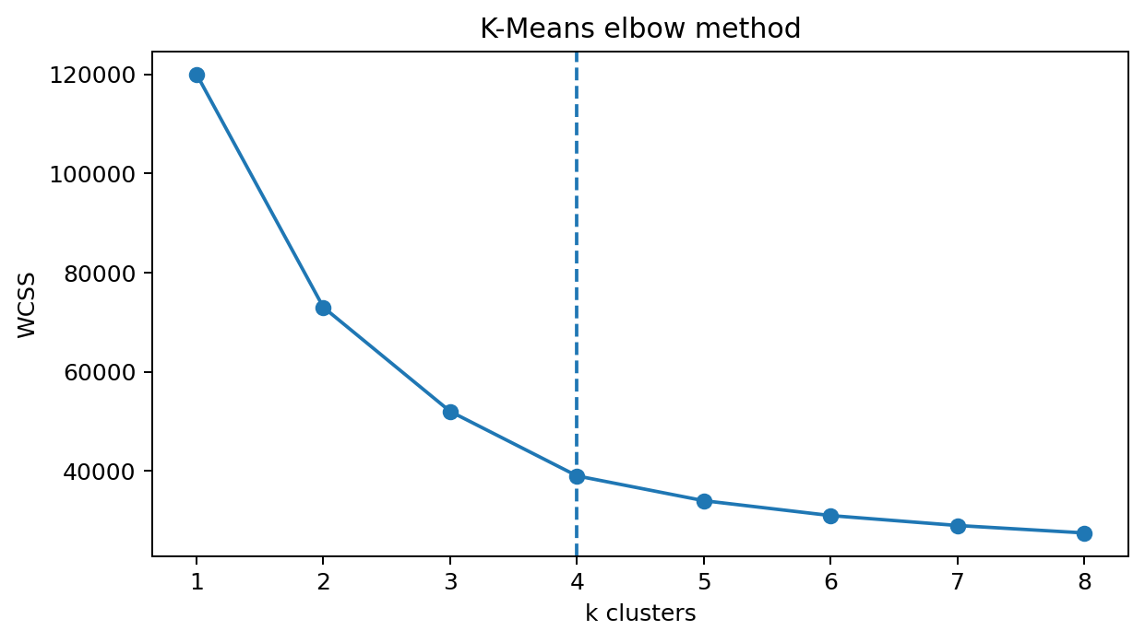
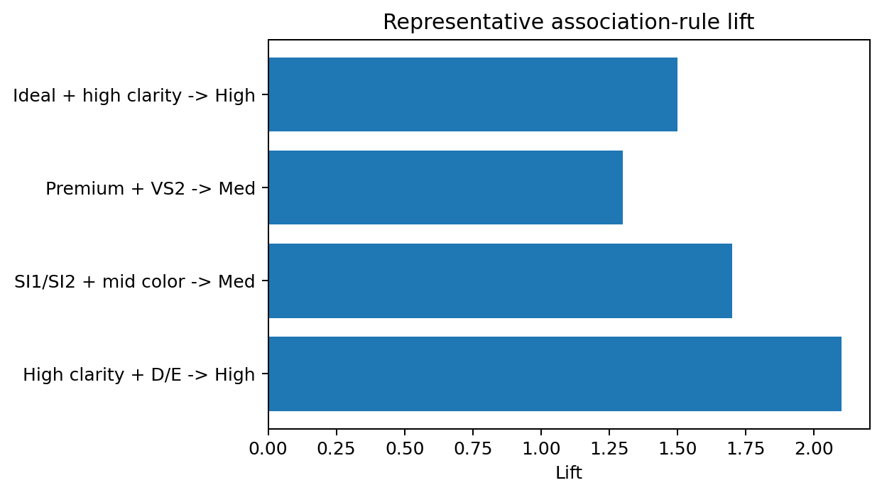
Segmentation and Pattern Mining
K-Means elbow supported k=4 for segmentation
Clusters separated diamonds by size and quality combinations
FP-Growth found interpretable rules linking clarity/color to price tier
Cut alone was weaker than combinations of clarity, color, and size

Slide 7
Ethics and Responsible Use
No direct personal data, but market data can still contain historical bias
Price-derived labels can inflate classification performance
Automated pricing should be explainable and reviewed for rare stones
Document assumptions, validate externally, and avoid overstating generalizability

Slide 8
Recommendations and Future Work
Use tier classification for inventory triage and product search
Review high-value predictions manually before business use
Add certificate lab, seller type, date, and market variables
Validate on newer external market data before deployment

