Slide 1
Spring 2021
DATS 501 Fundamentals of Data Science
Hasan Demirtaş
hasan.demirtas@yeditepe.edu.tr (hdemirtas.academic@gmail.com)
Cumhur Baştürk
cbasturk.academic@gmail.com (basturkc@gmail.com)

Slide 2
Conditional Probability

Slide 3
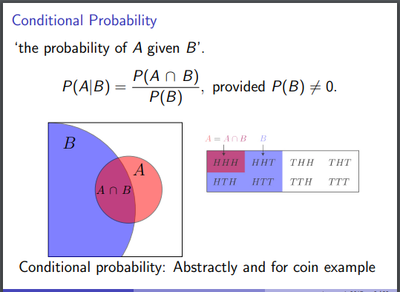
Conditional Probability

Slide 4
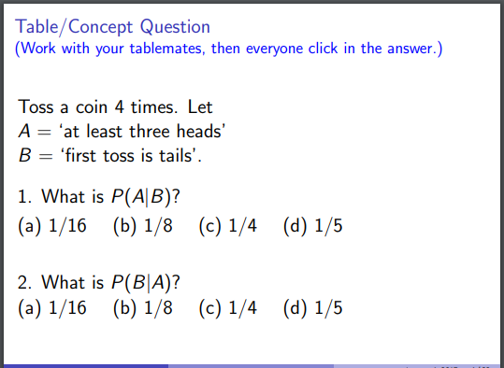
Conditional Probability

Slide 5
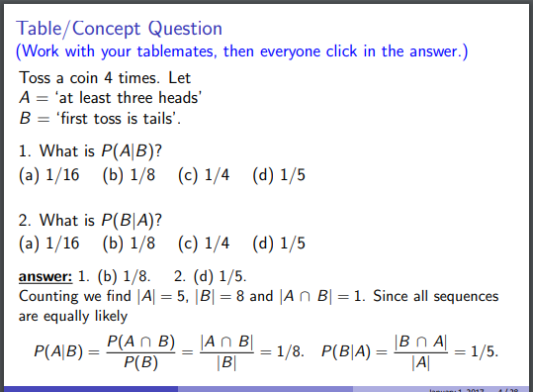
Conditional Probability

Slide 6
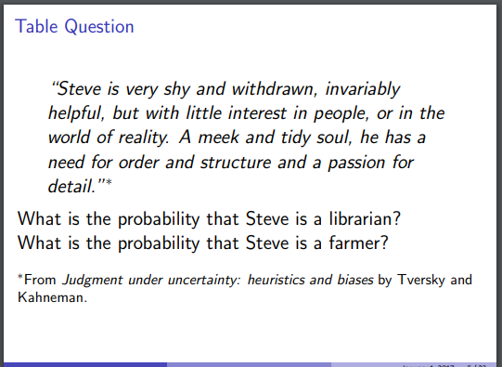
Importance of prior probability

Slide 7
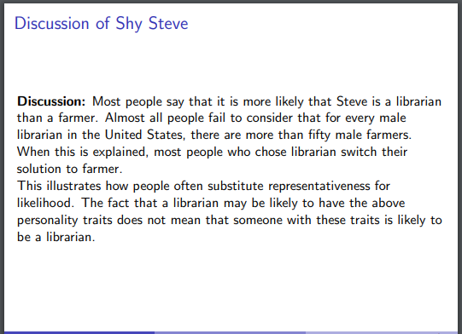
Importance of prior probability

Slide 8
A Quick Glance on Probability Distribution Function & Cumulative Distribution Function

Slide 9
Density vs Mass
When the distribution is continuous, density is used
When the distribution is discrete, mass is used

Slide 10
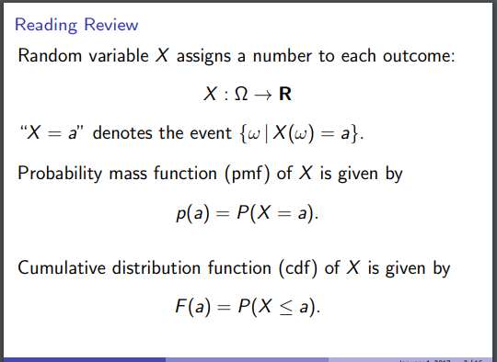
Probability Mass Function & Cumulative Distribution Function

Slide 11
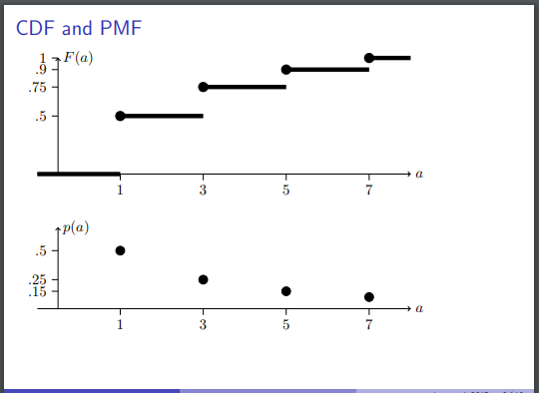
PMF & CDF

Slide 12
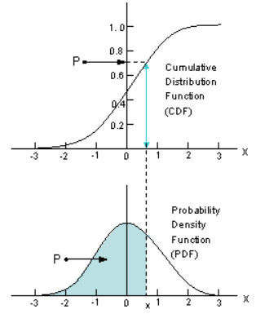
PDF & CDF

Slide 13
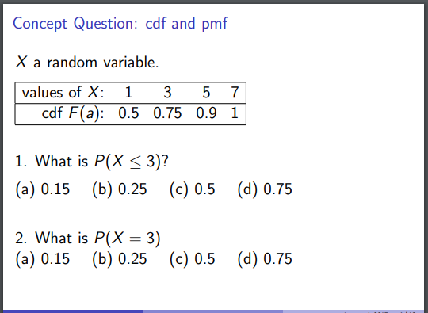
An example

Slide 14
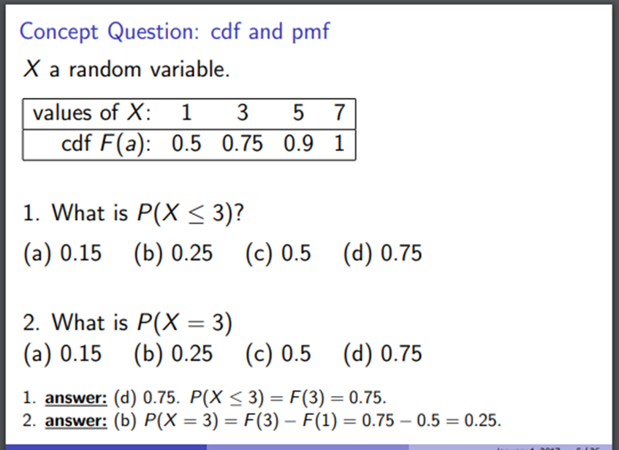
Solution

Slide 15
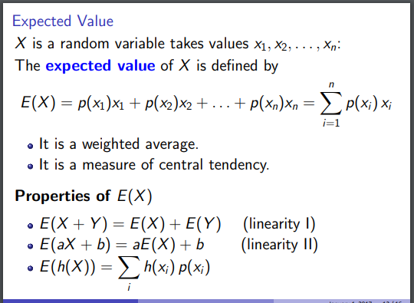
Expected value and pmf connection

Slide 16
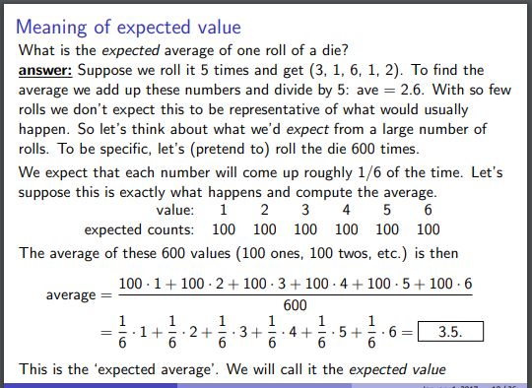
Expected value and pmf connection

Slide 17
Expected value and pmf connection

Slide 18
A Quick Glance on Variance and PMF Relation

Slide 19
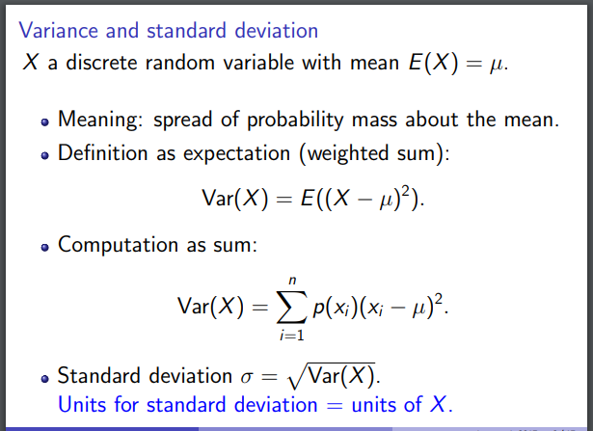
Formulas

Slide 20
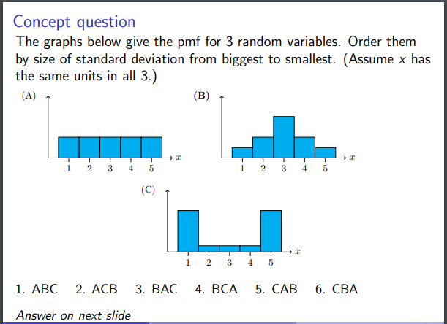
An example

Slide 21
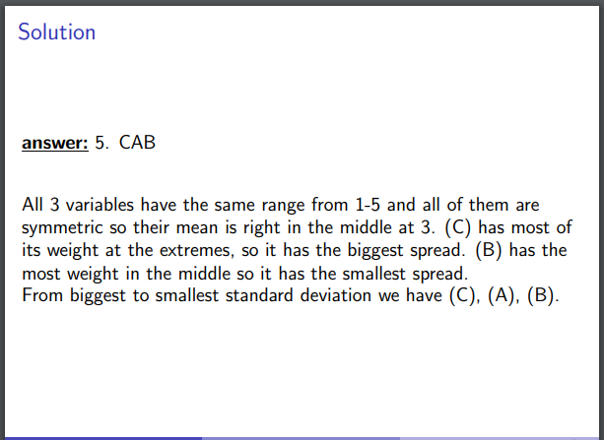
The Solution

Slide 22
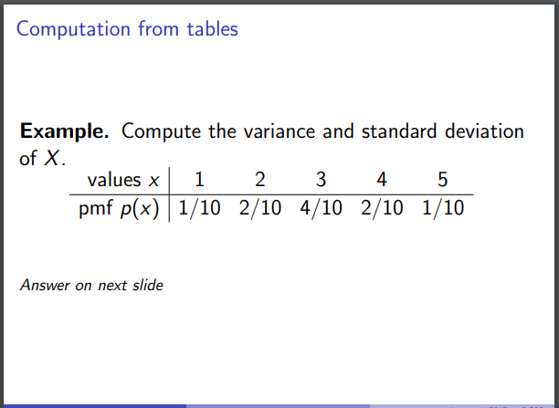
An example

Slide 23
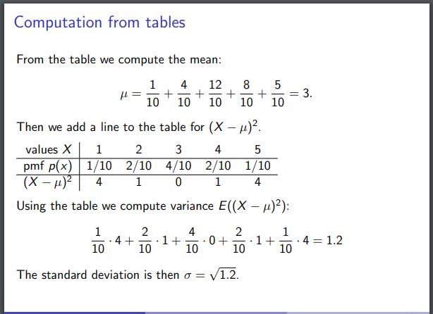
The Solution

Slide 24
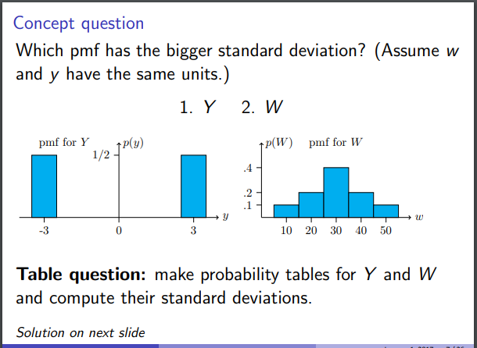
An example

Slide 25
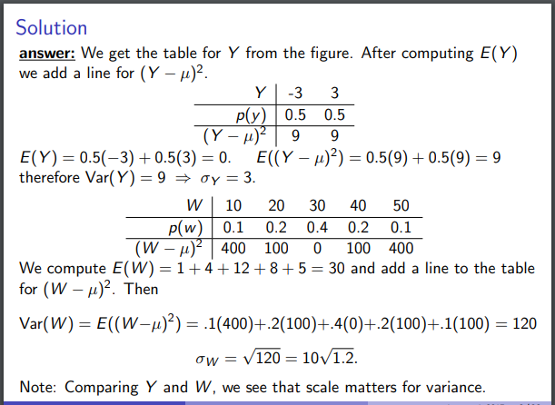
The Solution

Slide 26
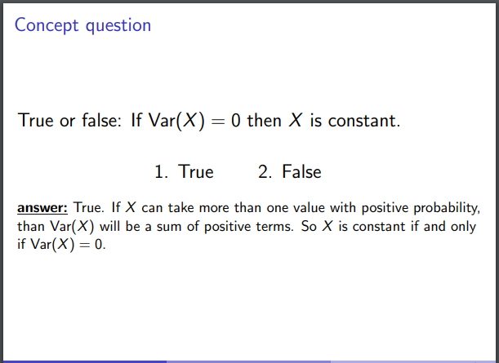
The Solution

Slide 27
Covariance

Slide 28
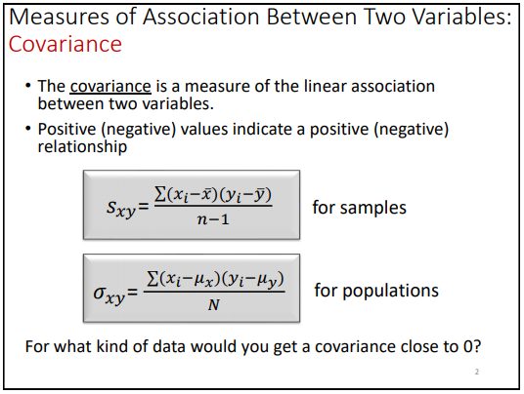
Covariance

Slide 29
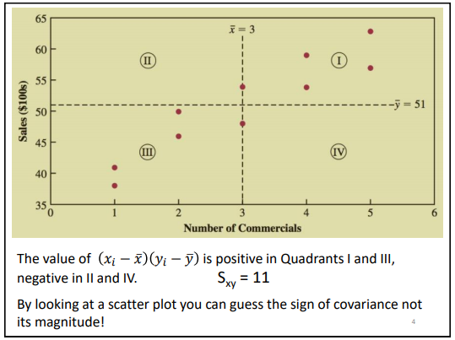
Covariance

Slide 30
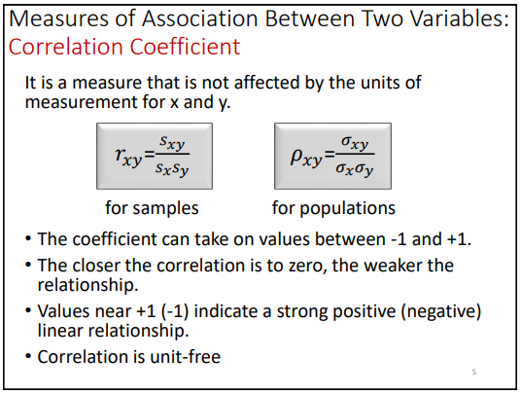
Correlation Coefficient

Slide 31
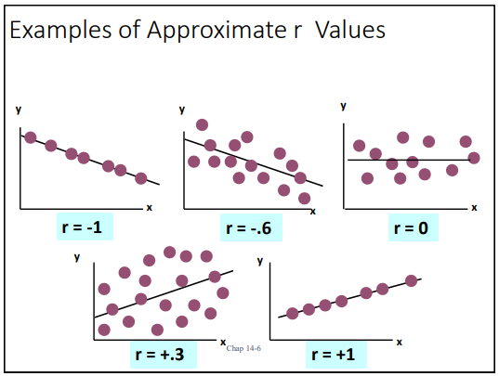
Correlation Coefficient

Slide 32
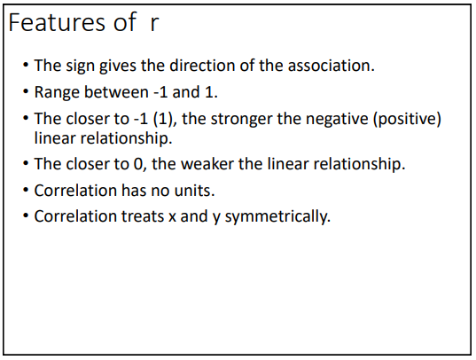
Correlation Coefficient

Slide 33
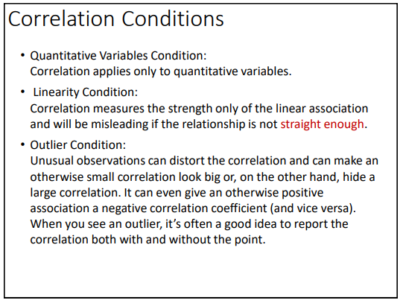
Correlation Coefficient

Slide 34
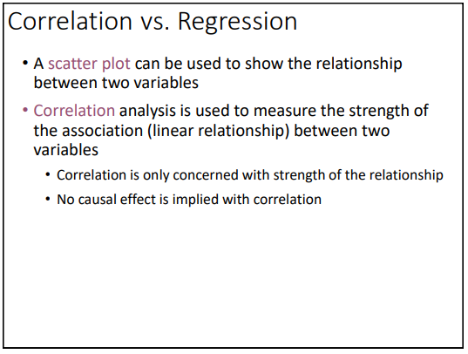
Correlation Coefficient

