Slide 1
Spring 2021
DATS 501 Fundamentals of Data Science
Hasan Demirtaş
hasan.demirtas@yeditepe.edu.tr (hdemirtas.academic@gmail.com)
Cumhur Baştürk
basturkc.academic@gmail.com

Slide 2
PRESCRIPTIVE ANALYTICS

Slide 3
Linear Optimization Models

Slide 4
Optimization
Optimization problems:
Maximize or minimize some function, called the objective function, and have a set of restrictions known as constraints.
Can be linear or nonlinear.
Can be used to support and improve managerial decision making.

Slide 5
Typical Applications of Optimization
Manufacturing: A manufacturer wants to develop a production schedule and an inventory policy that will satisfy demand in future periods and at the same time minimize the total production and inventory costs
Investment: A financial analyst would like to establish an investment portfolio from a variety of stock and bond investment alternatives that maximizes the return on investment
Marketing: A marketing manager wants to determine how best to allocate a fixed advertising budget among alternative advertising media such as web, radio, television, newspaper, and magazine that maximizes advertising effectiveness

Slide 6
Key Features of Optimization Problems
Each example has a clear objective
Each problem has constraints that limit the degree to which the objective can be pursued

Slide 7
A Simple Maximization Problem

Slide 8
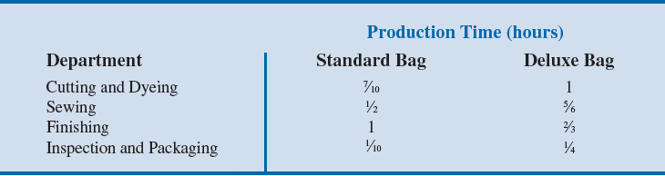
A Simple Maximization Problem
Operations involved in manufacturing a golf bag:
Cutting and dyeing the material
Sewing
Finishing (inserting umbrella holder, club separators, etc.)
Inspection and packaging
Production requirement per golf bag:

Slide 9
A Simple Maximization Problem
Estimated total time available for the next three months to perform different operations:
Required Profit contribution
Standard bag: $10/unit
Deluxe bag: $9/unit
Department | Number of hours
Cutting and Dyeing | 630
Sewing | 600
Finishing | 708
Inspection and Packaging | 135

Slide 10
A Simple Maximization Problem
Task: Develop a mathematical model of the company’s problem to determine the number of standard bags and the number of deluxe bags to produce to maximize total profit contribution.
Problem formulation or modeling: Process of translating the verbal statement of a problem into a mathematical statement (or model).
General guidelines for problem formulation:
Understand the problem thoroughly.
Describe the objective: Maximize total contribution to profit.

Slide 11
A Simple Maximization Problem
Constraints:
Constraint | Constraint
1 | Number of hours of cutting and dyeing time used must be less than or equal to the number of hours of cutting and dyeing time available.
2 | Number of hours of sewing time used must be less than or equal to the number of hours of sewing time available.
3 | Number of hours of finishing time used must be less than or equal to the number of hours of finishing time available.
4 | Number of hours of inspection and packaging time used must be less than or equal to the number of hours of inspection and packaging time available.

Slide 12
A Simple Maximization Problem
General guidelines for problem formulation
Define the decision variables.
S = number of standard bags
D = number of deluxe bags
Write the objective in terms of the decision variables.
If the corp. makes $10 for every standard and $9 for every deluxe bag:
Total profit contribution = 10S + 9D = Objective function
Objective: Max 10S + 9D

Slide 13
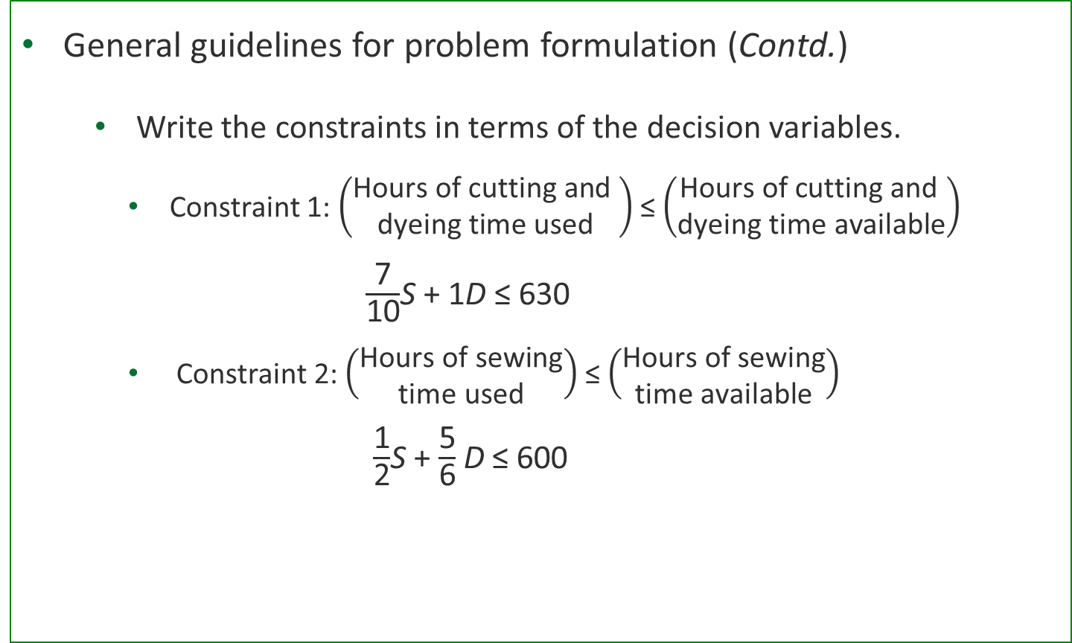
A Simple Maximization Problem
General guidelines for problem formulation (Contd.)
Write the constraints in terms of the decision variables.
Constraint 1: $\left(\begin{aligned}\text{Hours} \text{of} \text{cutting} \text{and} \\ \text{dyeing} \text{time} \text{used}\end{aligned}\right)$ ≤ $\left(\begin{aligned}\text{Hours} \text{of} \text{cutting} \text{and} \\ \text{dyeing} \text{time} \text{available}\end{aligned}\right)$
$\frac{\text{7}}{\text{10}}$S + 1D ≤ 630
Constraint 2: $\left(\begin{aligned}\text{Hours} \text{of} \text{sewing} \\ \text{time} \text{used}\end{aligned}\right)$ ≤ $\left(\begin{aligned}\text{Hours} \text{of} \text{sewing} \\ \text{time} \text{available}\end{aligned}\right)$
$\frac{\text{1}}{\text{2}}$S + $\frac{\text{5}}{\text{6}}$D ≤ 600

Slide 14
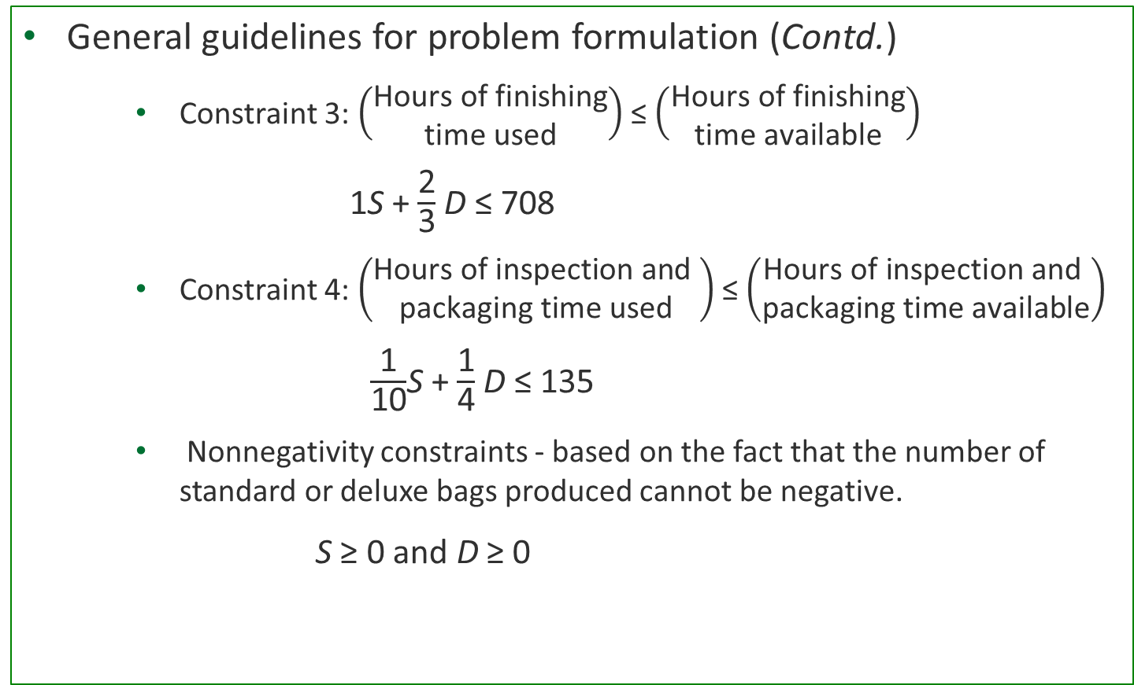
A Simple Maximization Problem
General guidelines for problem formulation (Contd.)
Constraint 3: $\left(\begin{aligned}\text{Hours} \text{of} \text{finishing} \\ \text{time} \text{used}\end{aligned}\right)$ ≤ $\left(\begin{aligned}\text{Hours} \text{of} \text{finishing} \\ \text{time} \text{available}\end{aligned}\right)$
1S + $\frac{\text{2}}{\text{3}}$D ≤ 708
Constraint 4: $\left(\begin{aligned}\text{Hours} \text{of} \text{inspection} \text{and} \\ \text{packaging} \text{time} \text{used}\end{aligned}\right)$ ≤ $\left(\begin{aligned}\text{Hours} \text{of} \text{inspection} \text{and} \\ \text{packaging} \text{time} \text{available}\end{aligned}\right)$
$\frac{\text{1}}{\text{10}}$S + $\frac{\text{1}}{\text{4}}$D ≤ 135
Nonnegativity constraints - based on the fact that the number of standard or deluxe bags produced cannot be negative.
S ≥ 0 and D ≥ 0

Slide 15
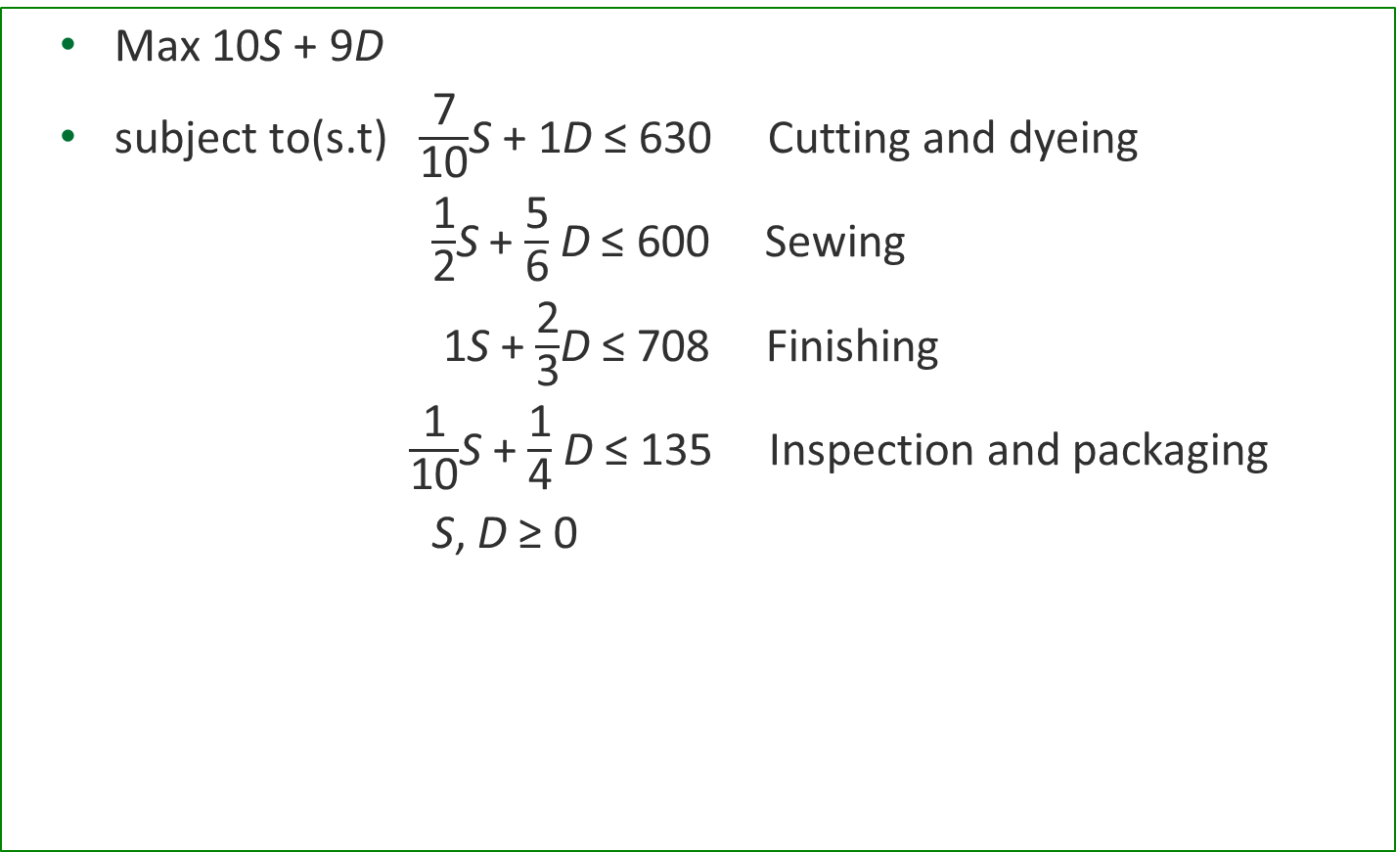
A Simple Maximization Problem
Max 10S + 9D
subject to(s.t) $\frac{\text{7}}{\text{10}}$S + 1D ≤ 630 Cutting and dyeing
$\frac{\text{1}}{\text{2}}$S + $\frac{\text{5}}{\text{6}}$D ≤ 600 Sewing
1S + $\frac{\text{2}}{\text{3}}$D ≤ 708 Finishing
$\frac{\text{1}}{\text{10}}$S + $\frac{\text{1}}{\text{4}}$D ≤ 135 Inspection and packaging
S, D ≥ 0

Slide 16
A Simple Maximization Problem
This is a linear programming model because the objective function and all constraint functions are linear functions of the decision variables.
Linear function: Mathematical function in which each variable appears in a separate term and is raised to the first power.

Slide 17
Solving the Problem

Slide 18
A Simple Maximization Problem
Solving linear programs with Excel Solver
Corp1_Bags

Slide 19
A Simple Maximization Problem
To find the optimal solution to the problem modeled as a linear program:
The optimal solution must have the highest objective function value.
The optimal solution must be a feasible solution.
A feasible solution is a setting of the decision variables that satisfies all of the constraints of the problem.
Search over the feasible region which is a set of all possible solutions.
Find the solution that gives the best objective function value.

Slide 20
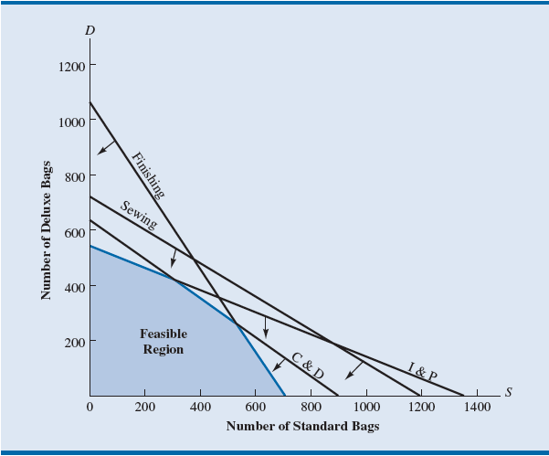
A Simple Maximization Problem
Feasible Region for problem

Slide 21
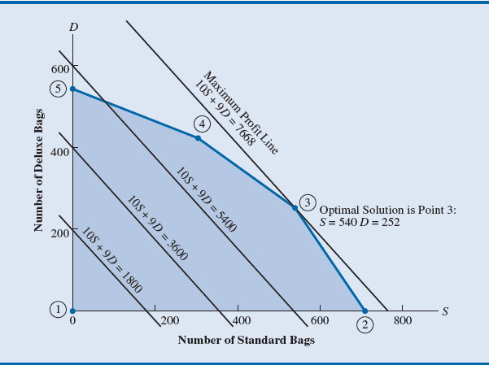
A Simple Maximization Problem
Optimal solution

Slide 22
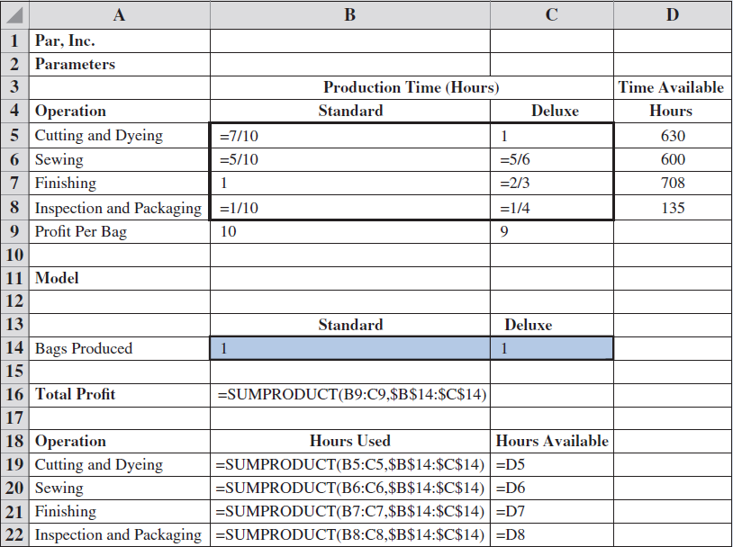
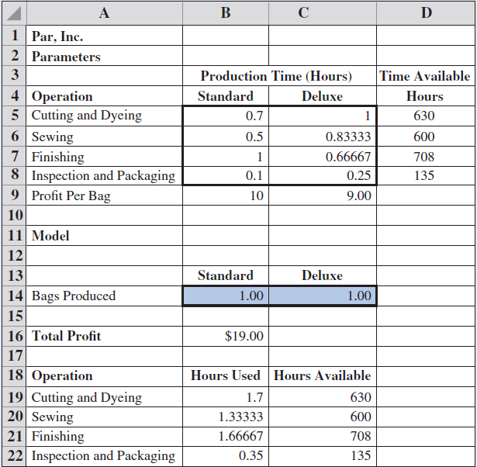
A Simple Maximization Problem
Before solver

Slide 23
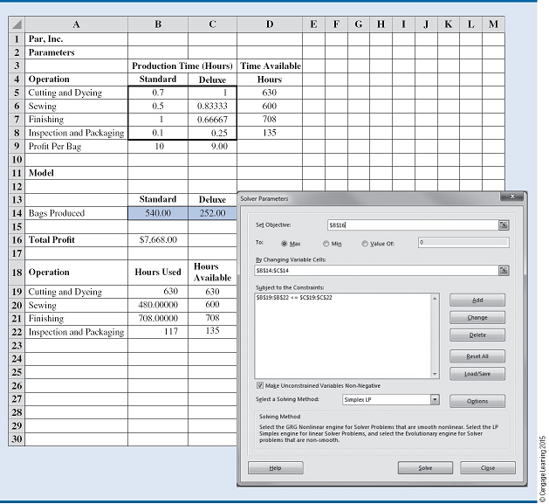
A Simple Maximization Problem
Solver

Slide 24
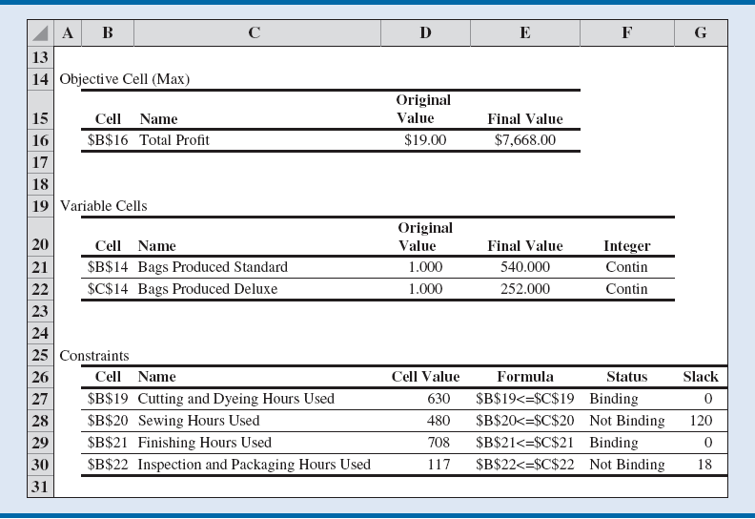
A Simple Maximization Problem
Summary

Slide 25
A Simple Minimization Problem

Slide 26
A Simple Minimization Problem
Corp2_Chemicals

Slide 27
A Simple Minimization Problem
Production requirements for Corp2 Chemicals:
The combined production for products A and B must total at least 350 gallons.
Separately a major customer’s order for 125 gallons of product A must also be satisfied.
Processing time:
Product A: 2 hours/gallon
Product B: 1 hour/gallon
For the coming month, 600 hours of processing time are available.

Slide 28
A Simple Minimization Problem
Production cost:
Product A: $2/gallon; Product B: $3/gallon
Objective: Minimizing the total production cost
Problem formulation: To find the minimum-cost production schedule.
Decision variables:
A = number of gallons of product A
B = number of gallons of product B
Objective function = 2A + 3B

Slide 29
A Simple Minimization Problem
Linear program for the Corp2 Chemicals problem:
Min 2A + 3B
s.t.
1A ≥ 125 - Demand for product A
A + B ≥ 350 - Total production
2A + 1B ≤ 600 - Processing time
A, B ≥ 0

Slide 30
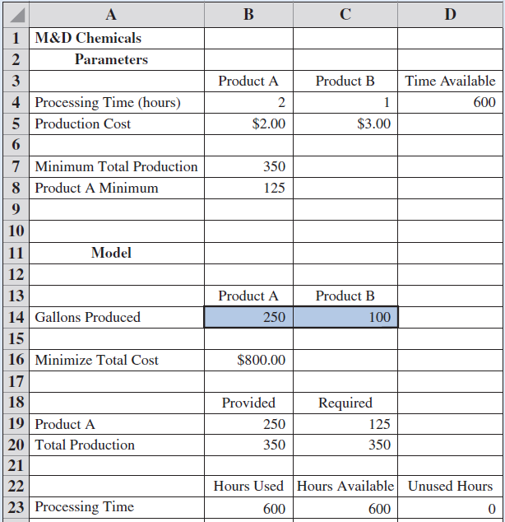
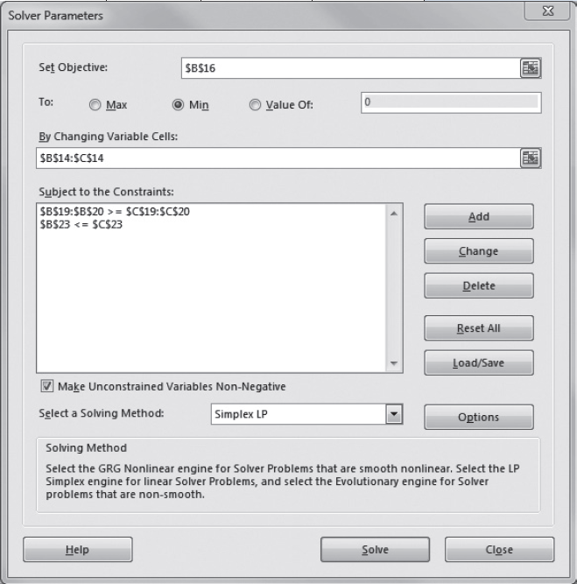
A Simple Minimization Problem

Slide 31
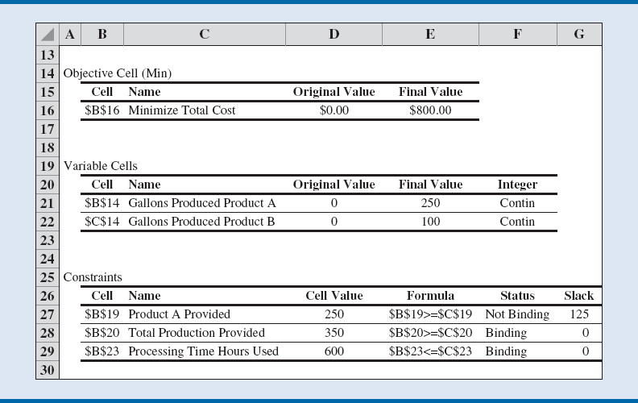
A Simple Minimization Problem

Slide 32
Special Cases of Linear Program Outcomes

Slide 33
Multiple solutions case
Where the optimal objective function contour line coincides with one of the binding constraint lines on the boundary of the feasible region
In these situations, more than one solution provides the optimal value for the objective function

Slide 34
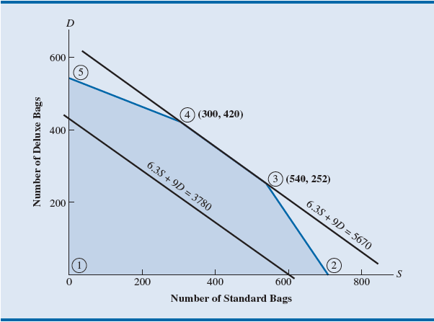
Multiple solutions case
Any point on the line between 4 to 3 is a solution

Slide 35
Infeasibility
Means no solution to the linear programming problem
No points satisfy all the constraints and the nonnegativity conditions simultaneously.
Graphically, a feasible region does not exist.
Infeasibility occurs because
Management’s expectations are too high.
Or, because too many restrictions have been placed on the problem.

Slide 36
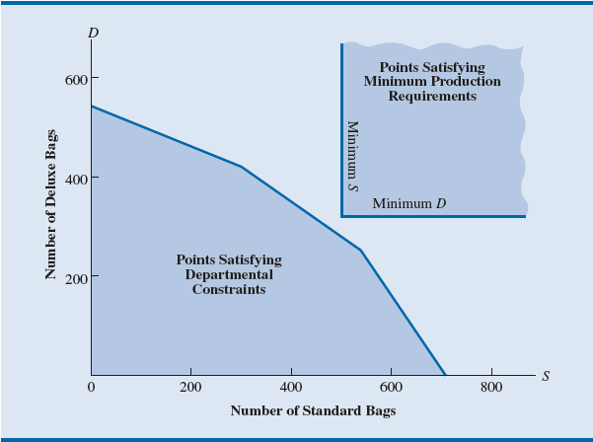
Infeasibility
Requirements and constraints do not intersect

Slide 37
Unbounded
The situation in which the value of the solution
May be made infinitely large - for a maximization linear programming
May be made infinitely small - for a minimization linear programming
Without violating any of the constraints

Slide 38
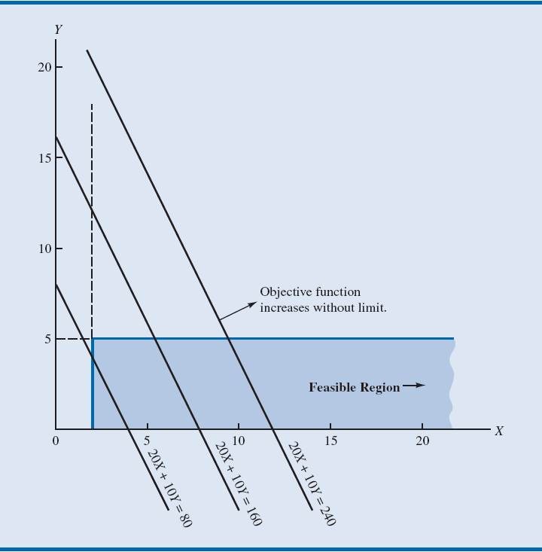
Unbounded
It seems like the result of a not well-defined case

Slide 39
Sensitivity Analysis

Slide 40
Sensitivity
Interpreting Excel Solver sensitivity report
Consider the Corp2_Chemicals problem:
A = number of gallons of product A
B = number of gallons of product B
Min 2A + 3B
s.t. 1A ≥ 125 - Demand for product A
1A + 1B ≥ 350 - Total production
2A + 1B ≤ 600 - Processing time
A, B ≥ 0

Slide 41
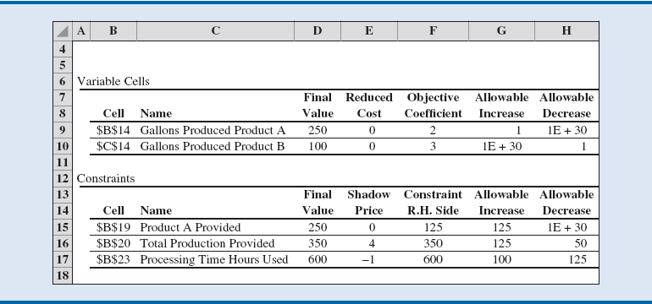
Sensitivity

Slide 42
Sensitivity
Classical sensitivity analysis:
Based on the assumption that only one piece of input data has changed
It is assumed that all other parameters remain as stated in the original problem
When interested in what would happen if two or more pieces of input data are changed simultaneously:
The easiest way to examine the effect of simultaneous changes is to make the changes and rerun the model

Slide 43
Integer Linear Optimization Models

Slide 44
Integer linear programs
Problems that are modeled as linear programs with the additional requirement that one or more variables must be integer
The objective is to provide an applications-oriented introduction to integer linear programming

Slide 45
Types of Integer Linear Optimization Models
All-integer linear program: If all variables are required to be integer.
Mixed-integer linear program: If some, but not necessarily all, variables are required to be integer.
Binary integer linear program: The integer variables may take on only the values 0 or 1.
LP Relaxation (linear programming relaxation) of the integer linear program: The linear program that results from dropping the integer requirements.

