Slide 1
Spring 2021
DATS 501 Fundamentals of Data Science
Hasan Demirtaş
hasan.demirtas@yeditepe.edu.tr (hdemirtas.academic@gmail.com)
Cumhur Baştürk
basturkc.academic@gmail.com

Slide 2
PRESCRIPTIVE ANALYTICS

Slide 3
Integer Programming

Slide 4
Corp3_RealEstate
Corp3_RealEstate has $2 million available for the purchase of new rental property
After an initial screening, Corp3_RealEstate reduced the investment alternatives to townhouses and apartment buildings
Each townhouse can be purchased for $282,000
Only five are available
Each apartment building can be purchased for $400,000
The developer will construct as many buildings as Corp3_RealEstate wants to purchase

Slide 5
Corp3_RealEstate
Corp3_RealEstate’s property manager can devote up to 140 hours per month to these new properties.
Each townhouse is expected to require 4 hours per month.
Each apartment building is expected to require 40 hours per month.

Slide 6
Corp3_RealEstate
Annual cash flow estimated to be:
$10,000 per townhouse.
$15,000 per apartment building.
After deducting mortgage payments and operating expenses.
Corp3_RealEstate’s owner would like to determine the number of townhouses and the number of apartment buildings to purchase to maximize annual cash flow.

Slide 7
Corp3_RealEstate
Defining the decision variables:
T = number of townhouses
A = number of apartment buildings
Objective function for cash flow (in thousands of dollars):
Max 10T + 15A
Three constraints must be satisfied:
282T + 400A ≤ 2000 Funds available ($1000s)
4T + 40A ≤ 140 Manager’s time (hours)
T ≤ 5 Townhouses available

Slide 8
Corp3_RealEstate
The variables T and A must be nonnegative.
In addition, the purchase of a fractional number of townhouses and/or a fractional number of apartment buildings is unacceptable.
T and A must be integer.

Slide 9
Corp3_RealEstate
Model for the Corp3_RealEstate problem:
Max 10T + 15A
s.t.
282T + 400A ≤ 2000
4T + 40A ≤ 140
T ≤ 5
T, A ≥ 0 and integer
This is a linear all-integer program

Slide 10
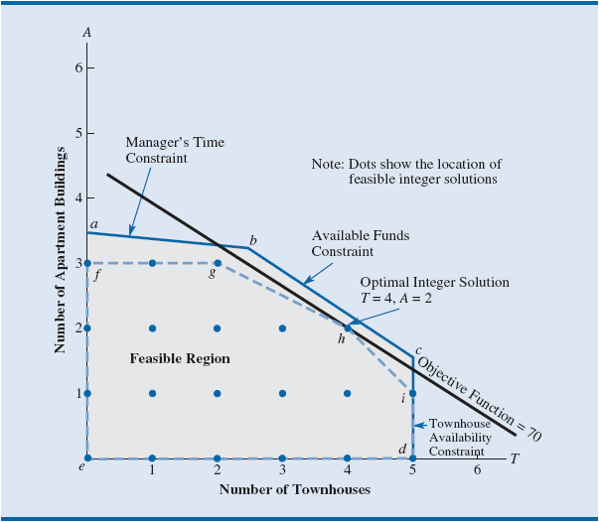
Corp3_RealEstate
Geometry of the problem

Slide 11
Corp3_RealEstate - Details for the Solution - 1
The shaded region is the feasible region of the LP Relaxation.
The optimal linear programming solution is:
Point b: The intersection of the Managers Time constraint and the Available Funds constraint.
T = 2.479 townhouses and A = 3.252 apartment buildings.
The optimal value of the objective function is 73.574.
Indicates an annual cash flow of $73,574.
Unfortunately, Corp3_RealEstate cannot purchase fractional numbers of townhouses and apartment buildings.
Further analysis is necessary.

Slide 12
Corp3_RealEstate - Details for the Solution - 2
In many cases, a non-integer solution can be rounded to obtain an acceptable integer solution.
For instance, a linear programming solution to a production scheduling problem might call for the production of 15,132.4 cases of breakfast cereal and the rounded integer solution of 15,132 cases would probably have minimal impact on the value of the objective function and the feasibility of the solution.
A near-optimal solution is fine.
However, rounding may not always be a good strategy.
When the decision variables take on small values that have a major impact on the value of the objective function or feasibility, an optimal integer solution is needed.

Slide 13
Corp3_RealEstate - Details for the Solution - 3
Optimal solution to the LP Relaxation for Corp3_RealEstate:
T = 2.479 townhouses and A = 3.252 apartment buildings.
Rounding to an integer solution can be expected to have a substantial economic impact on the problem:
Because each townhouse costs $282,000 and each apartment building costs $400,000.

Slide 14
Corp3_RealEstate - Details for the Solution - 4
Suppose, round the solution to the LP Relaxation:
Integer solution: T = 2 and A = 3.
Objective function value: 10(2) + 15(3) = 65.
The annual cash flow of $65,000 is substantially less than the annual cash flow of $73,574 provided by the solution to the LP Relaxation

Slide 15
Corp3_RealEstate - Details for the Solution - 5
Do other rounding possibilities exist?
Exploring other rounding alternatives:
Integer solution: T = 3 and A = 3.
Objective function value: $282,000(3) + $400,000(3) = $3,738,000.
Infeasible.
Because $3,738,000 > $2,000,000, the available funds with Corp3_RealEstate.

Slide 16
Corp3_RealEstate - Details for the Solution - 6
The rounded solution of T = 2 and A = 4 is also infeasible for the same reason.
At this point, the best feasible integer solution to the problem:
Rounding to two townhouses and three apartment buildings.
With an annual cash flow of $65,000.
Unfortunately, it is not known if this solution is the best integer solution to the problem.

Slide 17
Corp3_RealEstate - Details for the Solution - 7
Rounding to an integer solution is a trial-and-error approach.
Each rounded solution must be evaluated for feasibility as well as for its impact on the value of the objective function.
Even when a rounded solution is feasible, there is no guarantee that the optimal integer solution has been found.

Slide 18
Corp3_RealEstate - Details for the Solution - 8
What is the true feasible region for the Corp3_RealEstate problem?
As shown in Figure, the feasible region is the set of integer points that lie within the feasible region of the LP Relaxation
There are 20 such feasible solutions (designated by blue dots in the figure)
The region bounded by the dashed lines is known as the convex hull of the set of feasible integer solutions

Slide 19
Corp3_RealEstate - Details for the Solution - 9
The worksheet formulation and solution for integer linear programs is similar to that for linear programming problems.
But some additional information must be provided when setting up the Solver Parameters and Options dialog boxes.
Constraints must be added in the Solver Parameters dialog box to identify the integer variables.
In addition, the value for Tolerance in the Integer Options dialog box may need to be adjusted to obtain a solution.

Slide 20
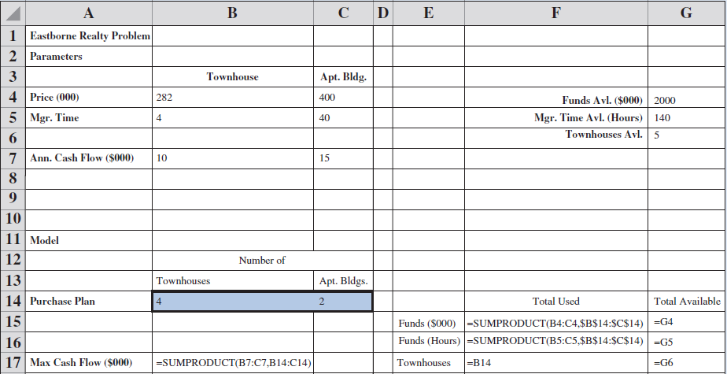
Corp3_RealEstate - Details for the Solution - 10

Slide 21
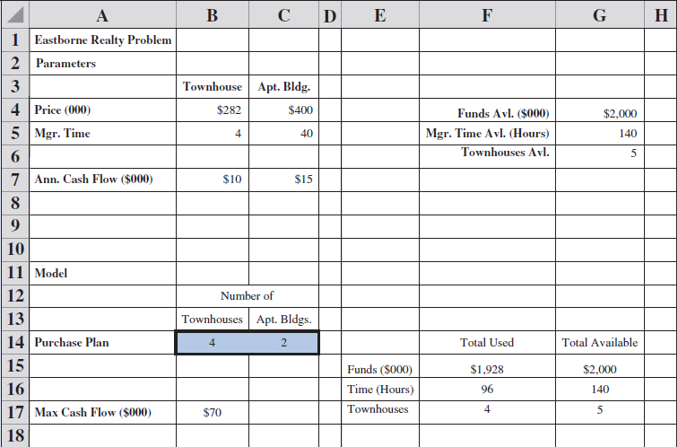
Corp3_RealEstate - Details for the Solution - 11

Slide 22
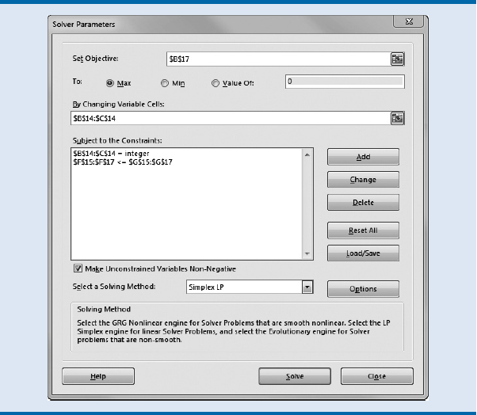
Corp3_RealEstate - Details for the Solution - 12

Slide 23
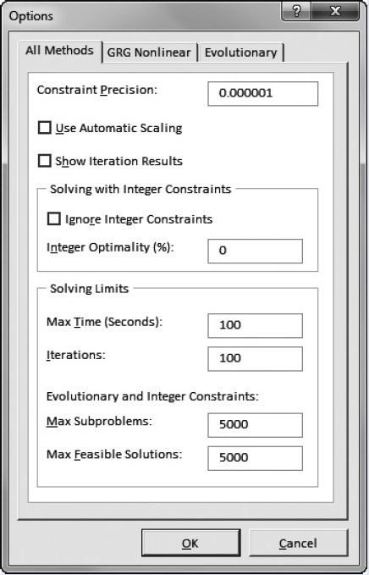
Corp3_RealEstate - Details for the Solution - 13

Slide 24
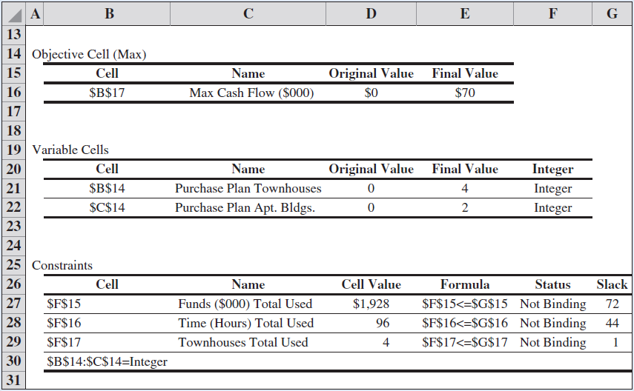
Corp3_RealEstate - Details for the Solution - 14

Slide 25
Corp3_RealEstate - Details for the Solution - 15
A cautionary note about sensitivity analysis
Sensitivity analysis often is more crucial for integer linear programming problems than for linear programming problems.
A small change in one of the coefficients in the constraints can cause a relatively large change in the value of the optimal solution.

Slide 26
Binary Integer Programming

Slide 27
Corp4_Fridge
Capital budgeting problem: A binary integer programming problem that involves choosing which possible projects or activities provide the best investment return.
In a capital budgeting problem, the objective function is to maximize the net present value of the capital budgeting projects.
The Corp4_Fridge is considering investing in several projects that have varying capital requirements over the next four years.
Faced with limited capital each year, management would like to select the most profitable projects that it can afford.

Slide 28
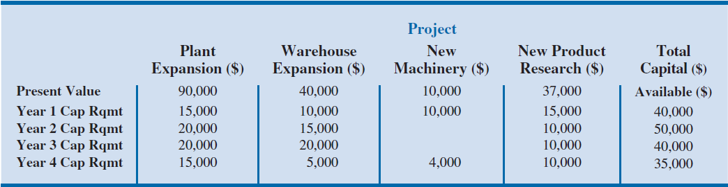
Corp4_Fridge
Let us define four binary decision variables:
P = 1 if the plant expansion project is accepted; 0 if rejected
W = 1 if the warehouse expansion project is accepted; 0 if rejected
M = 1 if the new machinery project is accepted; 0 if rejected
R = 1 if the new product research project is accepted; 0 if rejected
This problem has four constraints:
One for the funds available in each of the next four years.

Slide 29
Corp4_Fridge
A binary integer linear programming model (thousands of dollars):
Max 90P + 40W + 10M + 37R
s.t.
15P + 10W + 10M + 15R ≤ 40 (Year 1 capital available)
20P + 15W + 10R ≤ 50 (Year 2 capital available)
20P + 20W + 10R ≤ 40 (Year 3 capital available)
15P + 5W + 4M + 10R ≤ 35 (Year 4 capital available)
P, W, M, R = 0, 1

Slide 30
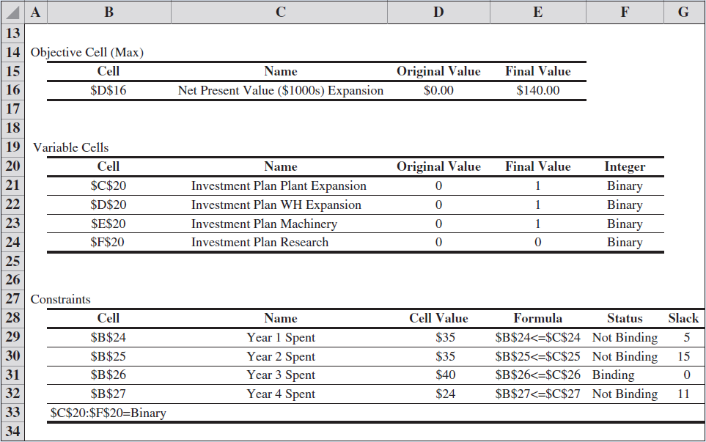
Corp4_Fridge

