Slide 1
Spring 2021
DATS 501 Fundamentals of Data Science
Hasan Demirtaş
hasan.demirtas@yeditepe.edu.tr (hdemirtas.academic@gmail.com)
Cumhur Baştürk
basturkc.academic@gmail.com

Slide 2
Nonlinear Optimization

Slide 3
Introduction
Nonlinear optimization problem: Any optimization problem with at least one objective term or a constraint nonlinear.
Examine a production problem in which the objective function is a nonlinear function of the decision variables.
A nonlinear model for facility location.
The Nobel Prize–winning Markowitz model for managing the risk-return trade-off in the construction of an investment portfolio.
A well-known model that effectively forecasts sales or adoptions of a new product.

Slide 4
Markowitz Portfolio Model

Slide 5
Figure 7.11 - Gambrell Manufacturing Component Ordering Model
VLOOKUP: This function allows the user to pull a subset of data from a larger table of data based on some criterion.
General form =VLOOKUP(value, table, index, range)
where,
value = the value to search for in the first column of the table
table = the cell range containing the table
index = the column in the table containing the value to be returned
range = TRUE if looking for the first approximate match of value and FALSE if looking for an exact match of value

Slide 6
Markowitz portfolio Model
Markowitz mean-variance portfolio: It is a portfolio optimization model used to construct a portfolio that minimizes risk subject to a constraint requiring a minimum level of return.
A key trade-off in financial planning is that between risk and return.
For a chance to earn greater returns, the investor must also accept greater risk.
In most portfolio optimization models, the return used is the expected (or average) return of the possible outcomes, and the risk is some measure of variability in these possible outcomes.

Slide 7
Markowitz portfolio Model
Let us consider the case of Hauck Investment Services.
Hauck Investment Services designs annuities, IRAs, 401(k) plans, and other investment vehicles for investors with a variety of risk tolerances. Hauck would like to develop a portfolio model that can be used to determine an optimal portfolio involving a mix of six mutual funds.
Table 10.2 shows the annual return (percent) for five 1-year periods for the six mutual funds.

Slide 8
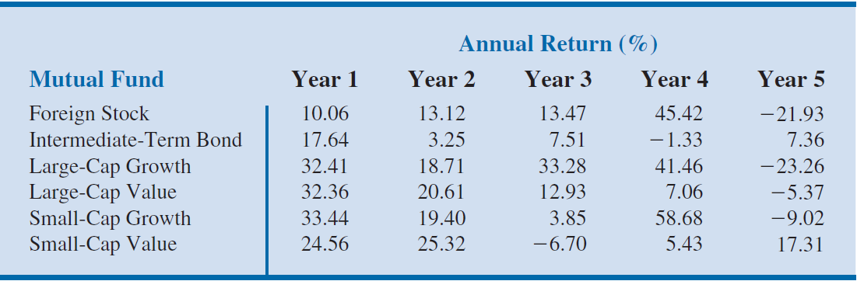
Table 10.2 - Mutual Fund Performances In Five Selected Years (Used As Planning Scenarios For The Next 12 Months)

Slide 9
Markowitz portfolio Model
The following decision variables:
FS = Proportion of portfolio invested in the foreign stock mutual fund
IB= Proportion of portfolio invested in the intermediate-term bond fund
LG= Proportion of portfolio invested in the large-cap growth fund
LV= Proportion of portfolio invested in the large-cap value fund
SG= Proportion of portfolio invested in the small-cap growth fund
SV= Proportion of portfolio invested in the small-cap value fund

Slide 10
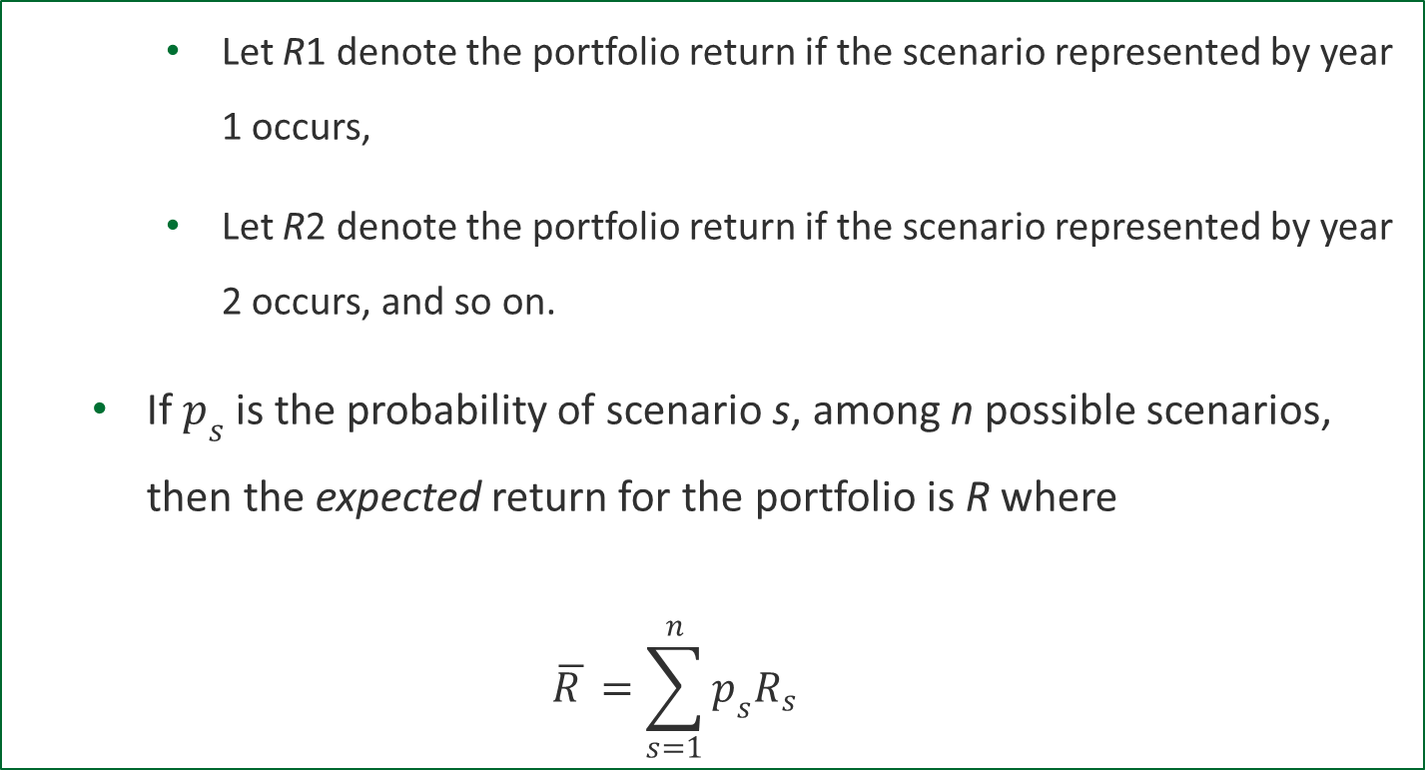
Markowitz portfolio Model
Let R1 denote the portfolio return if the scenario represented by year 1 occurs,
Let R2 denote the portfolio return if the scenario represented by year 2 occurs, and so on.
If$p_{s}$ is the probability of scenario s, among n possible scenarios, then the expected return for the portfolio is R where
$$\overline{R }=\sum_{s=1}^{n}{p_{s}R_{s}}$$

Slide 11
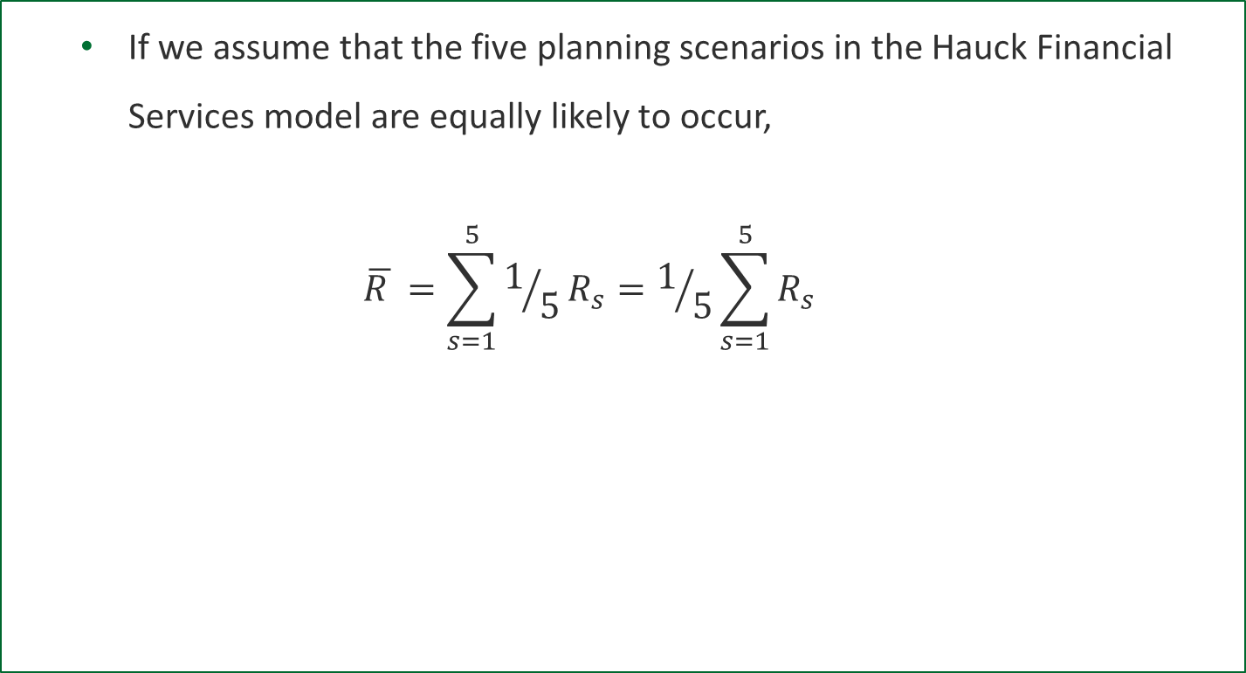
Markowitz portfolio Model
If we assume that the five planning scenarios in the Hauck Financial Services model are equally likely to occur,
$$\overline{R }=\sum_{s=1}^{5}{1/5R_{s}}=1/5\sum_{s=1}^{5}{R_{s}}$$

Slide 12
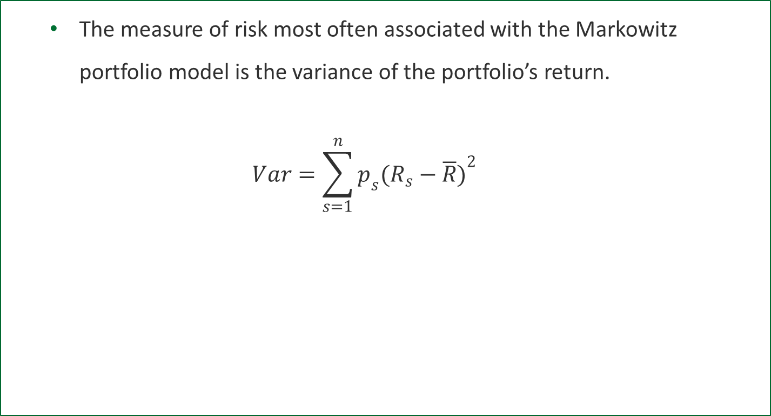
Markowitz portfolio Model
The measure of risk most often associated with the Markowitz portfolio model is the variance of the portfolio’s return.
$$Var=\sum_{s=1}^{n}{p_{s}({R_{s}−\overline{R})}^{2}}$$

Slide 13
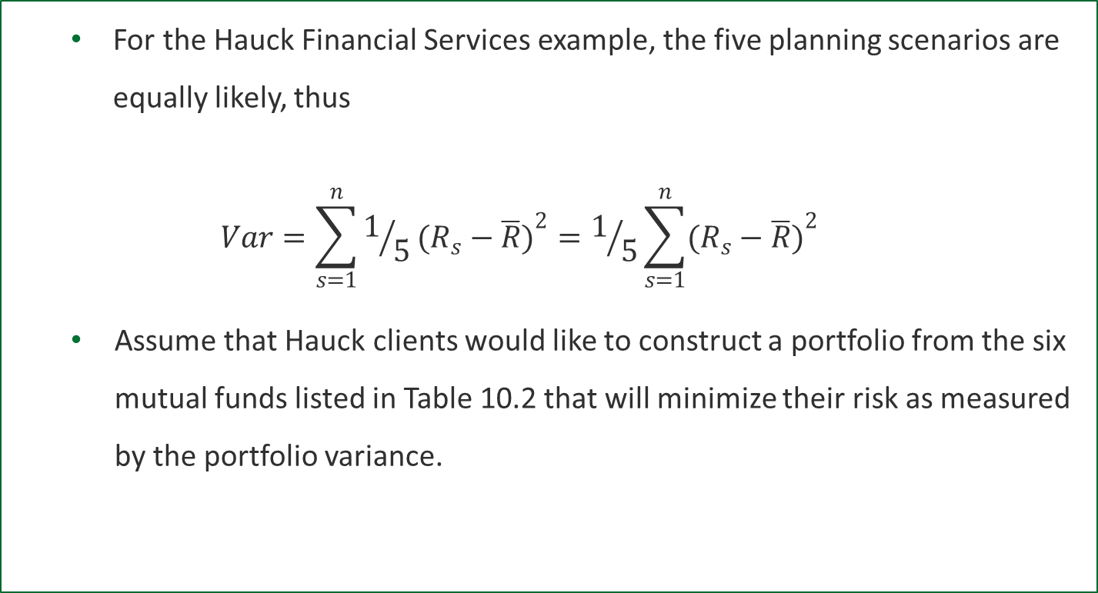
Markowitz portfolio Model
For the Hauck Financial Services example, the five planning scenarios are equally likely, thus
$$Var=\sum_{s=1}^{n}{1/5({R_{s}−\overline{R})}^{2}}=1/5\sum_{s=1}^{n}{({R_{s}−\overline{R})}^{2}}$$
Assume that Hauck clients would like to construct a portfolio from the six mutual funds listed in Table 10.2 that will minimize their risk as measured by the portfolio variance.

Slide 14
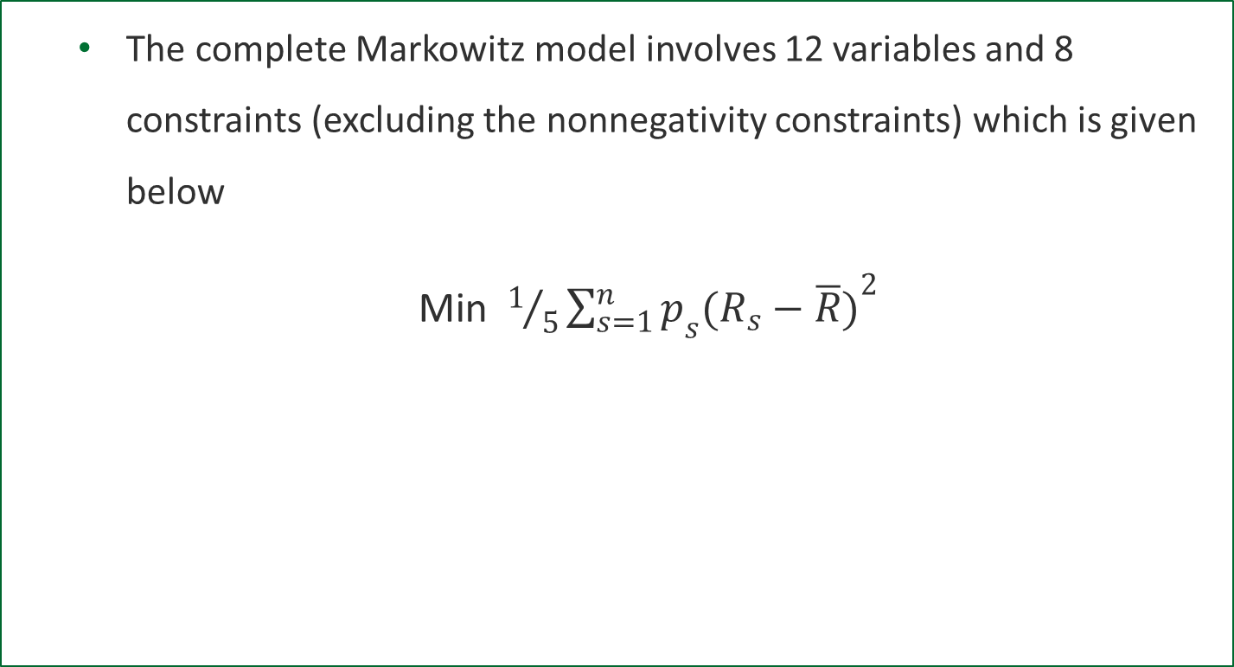
Markowitz portfolio Model
The complete Markowitz model involves 12 variables and 8 constraints (excluding the nonnegativity constraints) which is given below
Min $1/5\sum_{s=1}^{n}{p_{s}({R_{s}−\overline{R})}^{2}}$

Slide 15
Markowitz portfolio Model
s.t.
10.06FS + 17.64IB + 32.41LG + 32.36LV + 33.44SG + 24.56SV = R₁
13.12FS + 3.25IB + 18.71LG + 20.61LV + 19.40SG + 25.32SV = R₂
13.47FS + 7.51IB + 33.28LG + 12.93LV + 3.85SG - 6.70SV = R₃
45.42FS - 1.33IB + 41.46LG + 7.06LV + 58.68SG + 5.43SV = R₄
-21.93FS + 7.36IB - 23.26LG - 5.37LV - 9.02SG + 17.31SV = R₅
FS+ IB+ LG+ LV+ SG+ SV=1

Slide 16

Markowitz portfolio Model
$$1/5\sum_{S=1}^{5}{R_{s}=\overline{R}}$$
$$\overline{R}≥10$$
FS, IB, LG, LV, SG, SV $≥0$
The objective for the Markowitz model is to minimize portfolio variance.

Slide 17
Markowitz portfolio Model
The solution for this model using a required return of at least 10 percent appears in Figure 10.11.

Slide 18
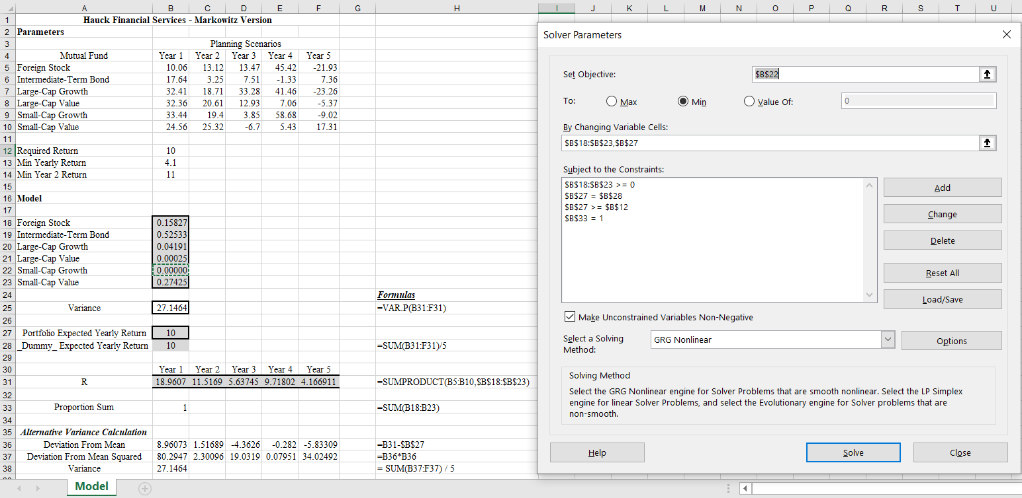
Figure 10.11 – Solution For The Hauck Minimum Variance Portfolio With A Required Return Of At Least 10 Percent
Note that regarding the starting point, a sub optimal solution can be obtained

Slide 19
Markowitz portfolio Model
The minimum value for the portfolio variance is 27.136.
This solution implies that the clients will get an expected return of 10 percent and minimize their risk as measured by portfolio variance by investing approximately
16 percent of the portfolio in the foreign stock fund (FS = 0.158)
53 percent in the intermediate bond fund (IB =0.525)
4 percent in the large-cap growth fund (LG = 0.042)
27 percent in the small-cap value fund (SV =0.274)

Slide 20
Markowitz portfolio Model
Figure 10.12 is a graph of the minimum portfolio variances versus required expected returns as required expected return is varied from 8 percent to 12 percent in increments of 1 percent.

Slide 21
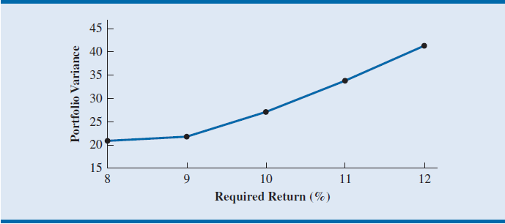
Figure 10.12 – An Efficient Frontier For The Markowitz Portfolio Model

Slide 22
Markowitz portfolio Model
In finance, this graph is called the efficient frontier. Each point on the efficient frontier is the minimum possible risk (measured by portfolio variance) for the given return.
By looking at the graph of the efficient frontier, investors can select the mean-variance combination with which they are most comfortable.

Slide 23
Local and Global Optima

Slide 24
Local and Global Optima
Local Optima: A feasible solution when there are no other feasible solutions with a better objective function value in the immediate neighborhood.
A local optimum may be either a local maximum or a local minimum.
Local maximum: A feasible solution when there are no other feasible solutions with a larger objective function value in the immediate neighborhood.
Notes:
The neighborhood of a solution is a mathematical concept that refers to the set of points within a relatively close proximity of the solution.

Slide 25
Local and Global Optima
Local minimum: A feasible solution when there are no other feasible solutions with a smaller objective function value in the immediate neighborhood.

Slide 26
Local and Global Optima
Global optimum: A feasible solution when there are no other feasible points with a better objective function value in the entire feasible region.
A global optimum may be either a global maximum or a global minimum.
Global maximum: A feasible solution when there are no other feasible points with a larger objective function value in the entire feasible region.
A global maximum is also a local maximum.

Slide 27
Local and Global Optima
Global minimum: A feasible solution when there are no other feasible points with a smaller objective function value in the entire feasible region.
A global minimum is also a local minimum.

Slide 28
Local and Global Optima
Concave function: It is a function that is bowl-shaped down.
For example, the following are concave functions
f(x)= -5x² - 5x
f(x, y) = -x² - 11y²
Consider the function f (X, Y) = -X² - Y². The shape of this function is illustrated in figure 10.5.

Slide 29
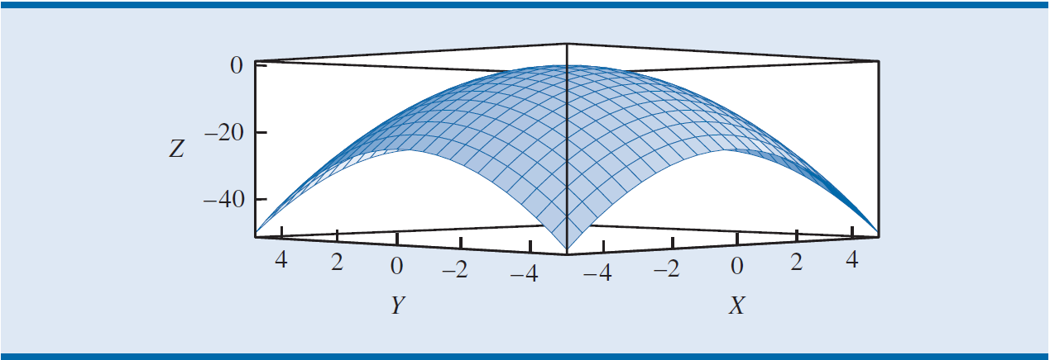
Figure 10.5 - A Concave Function f (X, Y)= -X² -Y²

Slide 30
Local and Global Optima
The maximum value for this particular function is 0, and the point (0, 0) gives the optimal value of 0.
The point (0, 0) is a local maximum; but it is also a global maximum because no point gives a larger function value.
In general, if all the squared terms in a quadratic function have a negative coefficient and there are no cross-product terms, such as xy, the function is a concave quadratic function.

Slide 31
Local and Global Optima
Convex function: It is a function that is bowl-shaped up.
For example, the following are concave functions
f(x)= x² - 5x
f(x, y) = x² + 5y²
Consider the function f (X, Y) = X² + Y². The shape of this function is illustrated in figure 10.6.

Slide 32
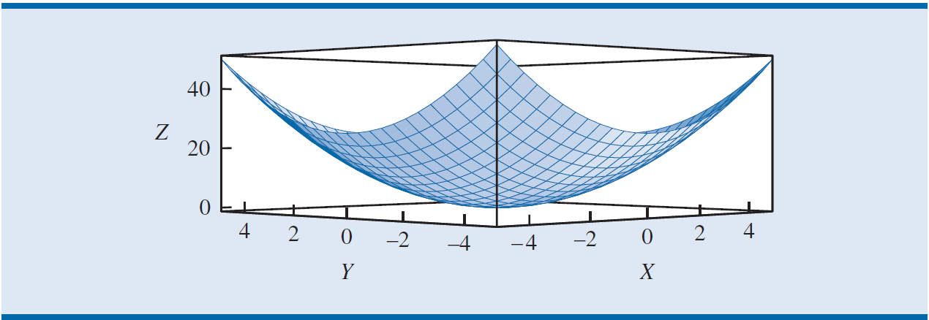
Figure 10.6 - A Convex Function f (X, Y)= X² +Y²

Slide 33
Local and Global Optima
Figure 10.6 is bowl-shaped up and called a convex function.
The minimum value for this particular function is 0, and the point (0, 0) gives the minimum value of 0.
The point (0, 0) is a local minimum and a global minimum because no values of X and Y give an objective function value less than 0.
For a convex function, we know that if our computer software finds a local minimum, it has found a global minimum.

Slide 34
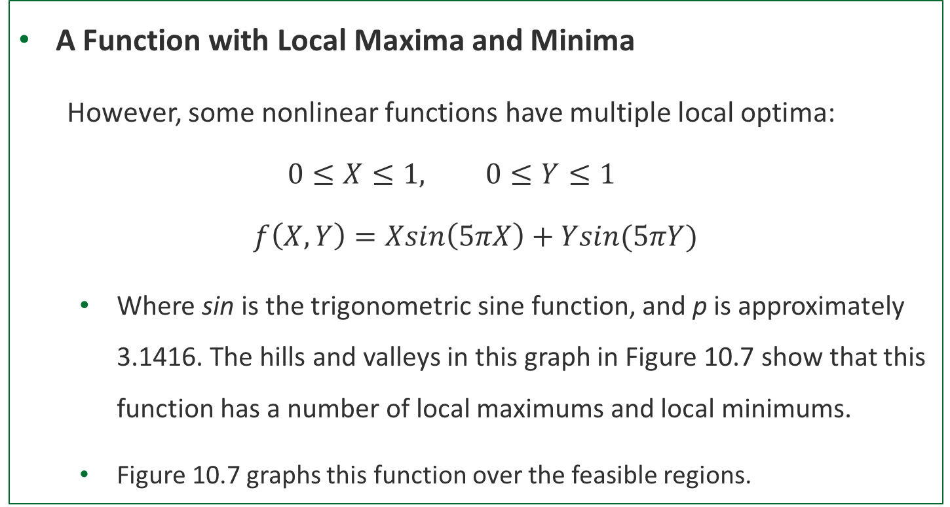
Local and Global Optima
A Function with Local Maxima and Minima
However, some nonlinear functions have multiple local optima:
$$0≤X≤1, 0≤Y≤1$$
$$f\left(X,Y\right)=Xsin\left(5πX\right)+Ysin(5πY)$$
Where sin is the trigonometric sine function, and p is approximately 3.1416. The hills and valleys in this graph in Figure 10.7 show that this function has a number of local maximums and local minimums.
Figure 10.7 graphs this function over the feasible regions.

Slide 35
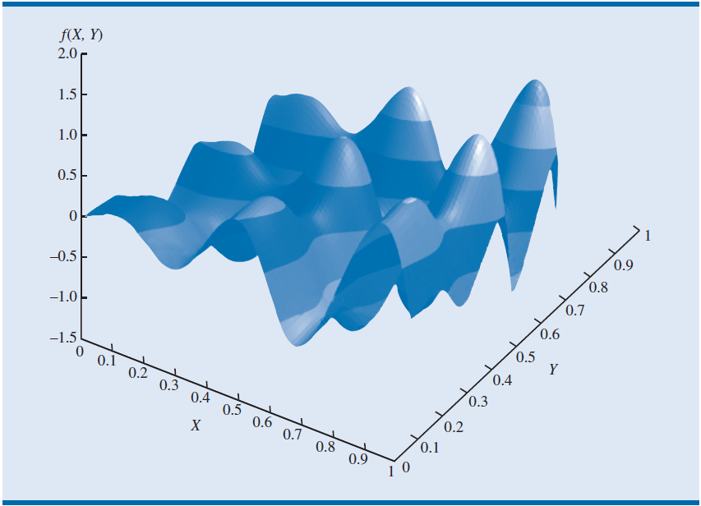
Figure 10.7 - A Function with Local Maxima and Minima

Slide 36
Local and Global Optima
Overcoming Local Optima with Excel Solver
First we should know when multiple local optima exists
The mathematical ways to determine this are beyond the scope of this text.
From a practical point of view, if the solution obtained by optimization software depends on the starting point, then there are multiple local optima.

Slide 37

Local and Global Optima
Let us consider the problem shown in Figure 10.7
$$Max f\left(X,Y\right)=Xsin\left(5πX\right)+Ysin(5πY)$$
s.t.
$$0≤X≤1$$
$$0≤Y≤1$$

Slide 38
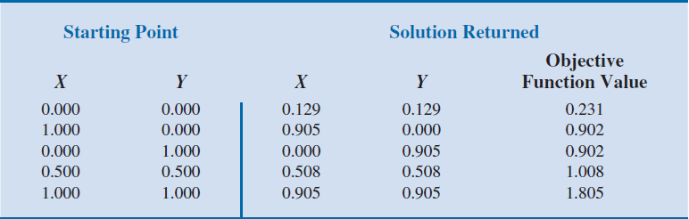
Table 10.6 -Solutions From Excel Solver For A Problem With Multiple Local Optima

Slide 39
Local and Global Optima
Table 10.1 shows the results returned from Excel Solver for different starting points (values in the decision variable cells when Solver is invoked).
In each of the five cases in Table 10.1, Solver returns with the message, “Solver has converged to the current solution. All constraints are satisfied.”

Slide 40
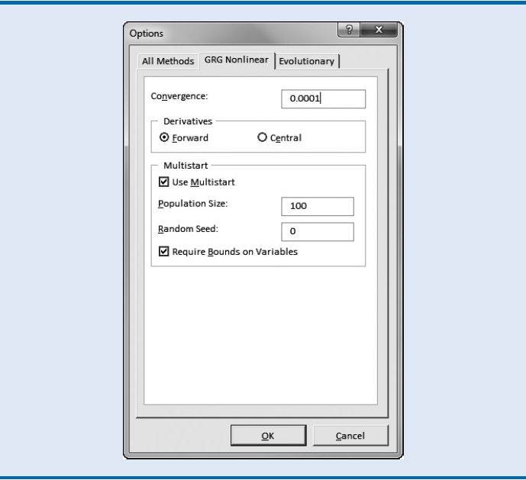
Figure 10.8 -The GRG Nonlinear Tab In Solver Options

Slide 41
Local and Global Optima
Excel Solver does provide an option that allows you to increase the confidence that you have found a global optimal solution.
Clicking Options on the Solver Parameters dialog box and then selecting the GRG Nonlinear tab results in the dialog box shown in Figure 10.8.
Clicking the Use Multistart option in the Multistart section causes Solver to use multiple starting solutions and report the best solution found from all of the starting points.

Slide 42
Local and Global Optima
The Population Size is the number of starting points used.
Solver selects starting points randomly using the Random Seed (an integer value) such that the points are within the bounds specified.
Although providing simple lower and upper bounds is not required (unless they require Bounds on the Variables option is selected), the procedure is much more effective when bounds are provided.
For selecting the Require Bounds on the Variables checkbox and providing bounds before you use the Multistart option.

Slide 43
Local and Global Optima
In Figure 10.8, randomly generated starting points will be used and simple bounds of 0 and 1 have been specified as constraints in the Solver dialog box.
The result reported by Solver is X= 0.90447, Y= 0.90447, with objective function = 1.804.
The message provided by Solver is, “Solver converged in probability to a global solution.”

