Slide 1
Spring 2021
DATS 501 Fundamentals of Data Science
Hasan Demirtaş
hasan.demirtas@yeditepe.edu.tr
hdemirtas.academic@gmail.com
Cumhur Baştürk
basturkc.academic@gmail.com

Slide 2
Variance-bias Trade-off

Slide 3
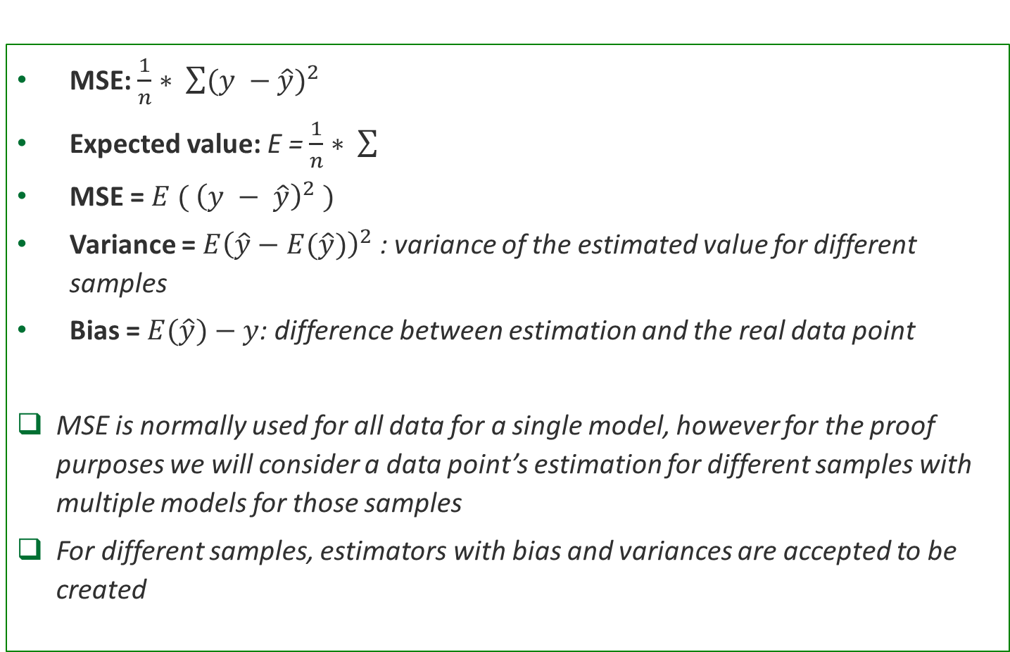
Mean Square Error to Variance-Bias
MSE: $\frac{1}{n}∗ \sum{{(y −\hat{y})}^{2}}$
Expected value: E = $\frac{1}{n}∗ \sum{ }$
MSE = $E ( {\left(y − \hat{y}\right)}^{2} )$
Variance = ${E\left(\hat{y}−E(\hat{y})\right)}^{2}$ : variance of the estimated value for different samples
Bias = $E(\hat{y})−y$: difference between estimation and the real data point
MSE is normally used for all data for a single model, however for the proof purposes we will consider a data point’s estimation for different samples with multiple models for those samples
For different samples, estimators with bias and variances are accepted to be created

Slide 4
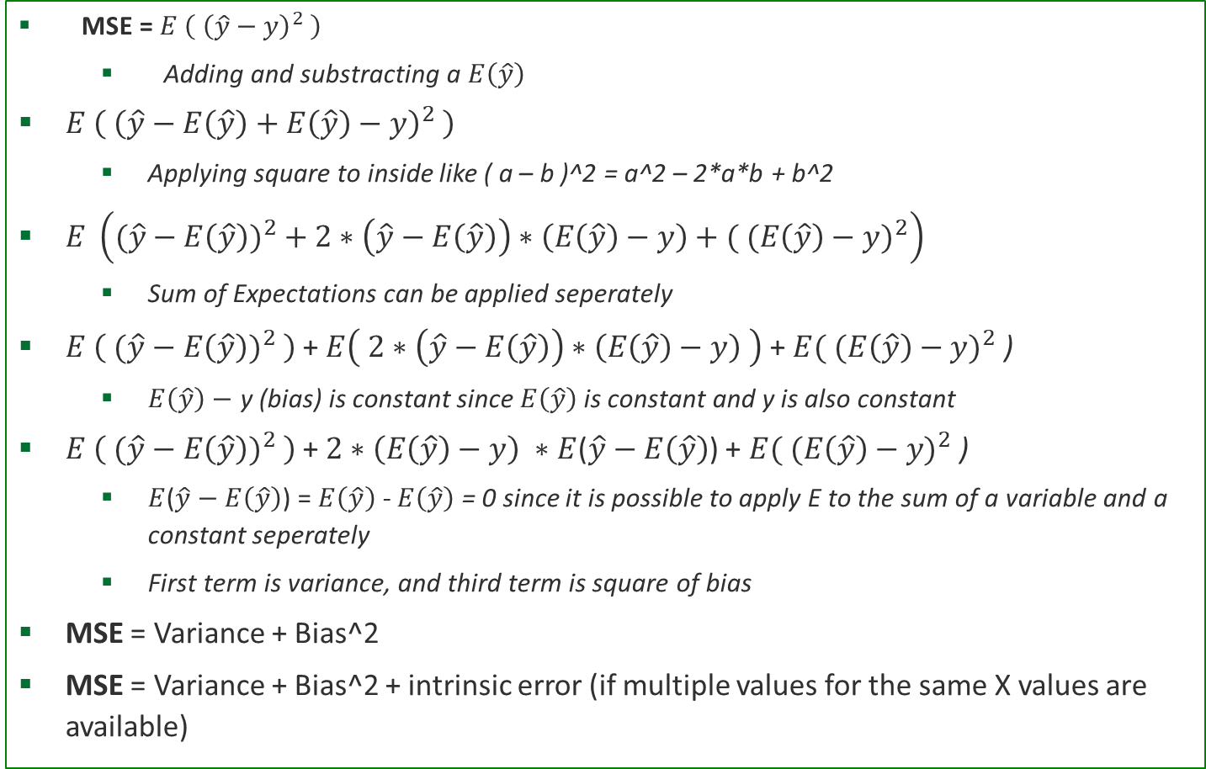
Mean Square Error to Variance-Bias cont.
MSE = $E \left( {\left(\hat{y}−y\right)}^{2} \right)$
Adding and substracting a $E\left(\hat{y}\right)$
$E \left( {\left(\hat{y}−E\left(\hat{y}\right)+E\left(\hat{y}\right)−y\right)}^{2} \right)$
Applying square to inside like ( a – b )^2 = a^2 – 2*a*b + b^2
$E \left({(\hat{y}−E\left(\hat{y}\right))}^{2} + 2∗\left(\hat{y}−E\left(\hat{y}\right)\right)∗\left(E\left(\hat{y}\right)−y\right)+( {(E\left(\hat{y}\right)−y)}^{2}\right)$
Sum of Expectations can be applied seperately
$E \left( {(\hat{y}−E\left(\hat{y}\right))}^{2} \right)$+ $E\left( 2∗\left(\hat{y}−E\left(\hat{y}\right)\right)∗\left(E\left(\hat{y}\right)−y\right) \right)$ + $E({ (E\left(\hat{y}\right)−y)}^{2}$ )
$E\left(\hat{y}\right)−$ y (bias) is constant since $E\left(\hat{y}\right)$ is constant and y is also constant
$E \left( {(\hat{y}−E\left(\hat{y}\right))}^{2} \right)$+ $2∗\left(E\left(\hat{y}\right)−y\right) ∗$ $E$($\hat{y}−E\left(\hat{y}\right)$) + $E({ (E\left(\hat{y}\right)−y)}^{2}$ )
$E$($\hat{y}−E\left(\hat{y}\right)$) = $E\left(\hat{y}\right)$ - $E\left(\hat{y}\right)$ = 0 since it is possible to apply E to the sum of a variable and a constant seperately
First term is variance, and third term is square of bias
MSE = Variance + Bias^2
MSE = Variance + Bias^2 + intrinsic error (if multiple values for the same X values are available)

Slide 5
Mean Square Error to Variance-Bias cont.
Why so math?
It helps to show the variance – bias trade-off concept
Other explainations?
Available

Slide 6
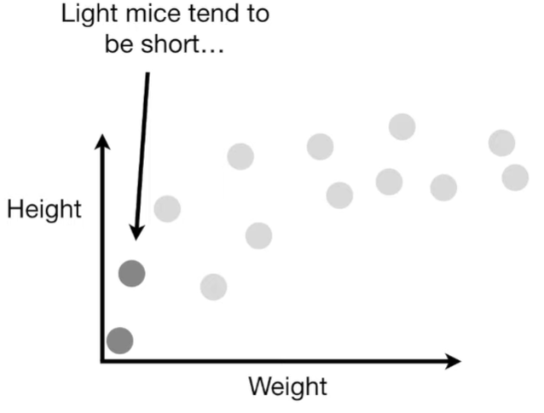
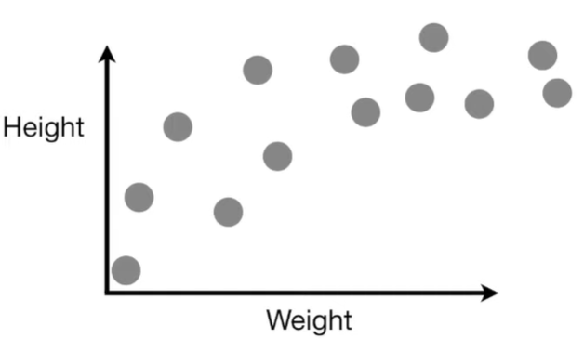
Variance-Bias Example
The weight and height of a bunch of mice are plotted

Slide 7
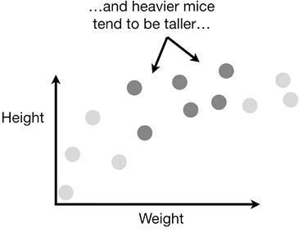
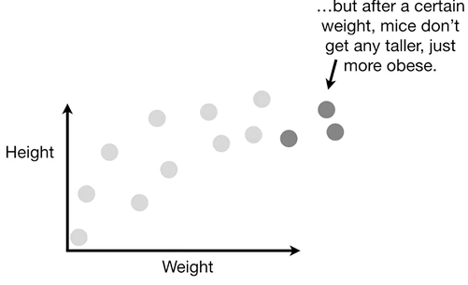
Variance-Bias Example
The weight and height of a bunch of mice are plotted

Slide 8
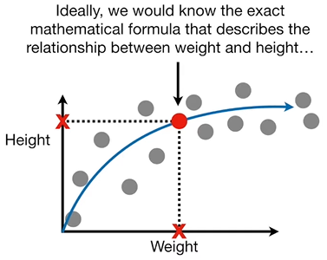
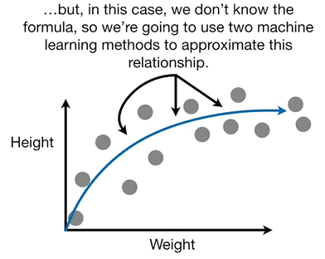
Variance-Bias Example
A model that can represent the data is tried to be found

Slide 9
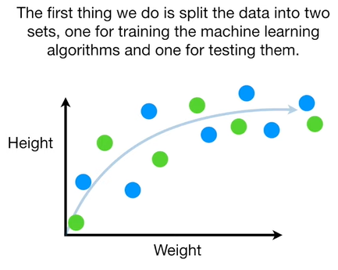
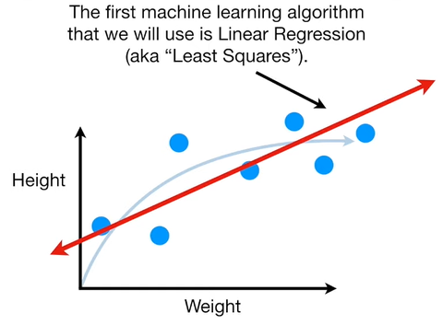
Variance-Bias Example
Train – test split & a simple model

Slide 10
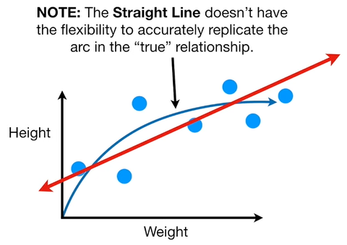
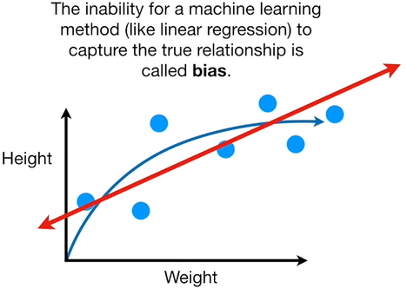
Variance-Bias Example
Bias – simple model

Slide 11
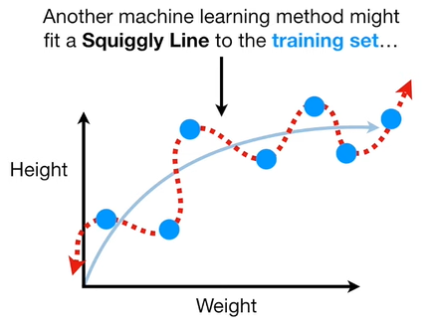
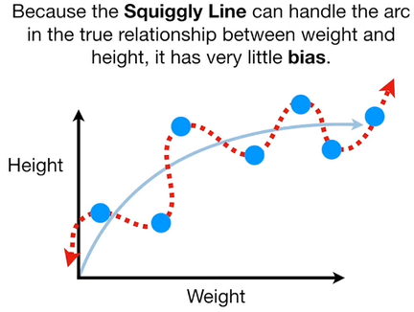
Variance-Bias Example
Bias – complex model

Slide 12
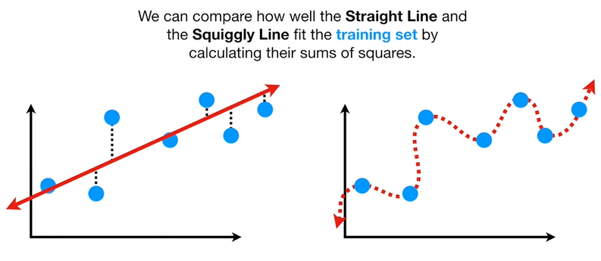
Variance-Bias Example
Fit comparison by error

Slide 13
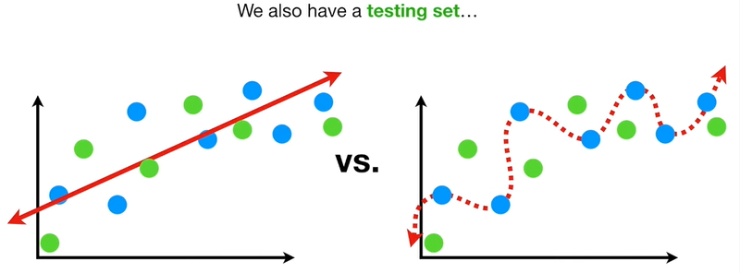
Variance-Bias Example
Unseen data performances

Slide 14
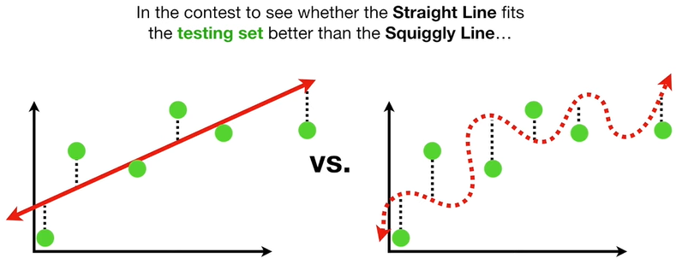
Variance-Bias Example
Unseen data performances

Slide 15
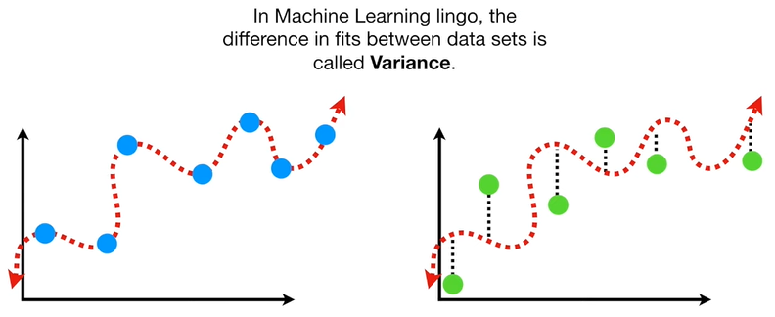
Variance-Bias Example
Variance – complex model

Slide 16
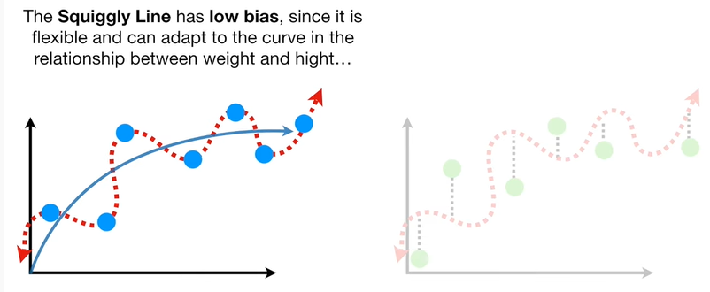
Variance-Bias Example
Training – bias – complex model

Slide 17
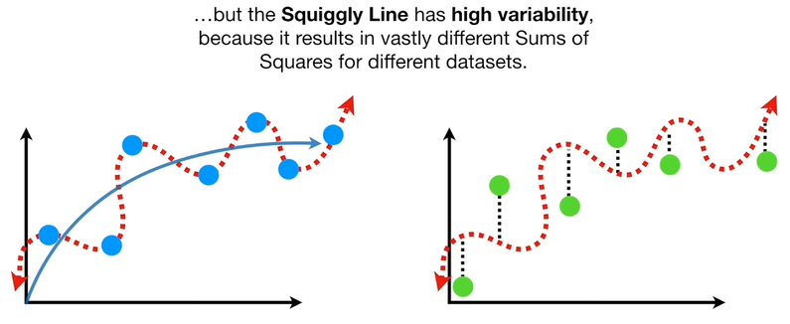
Variance-Bias Example
Test – variance – overly complex model

Slide 18
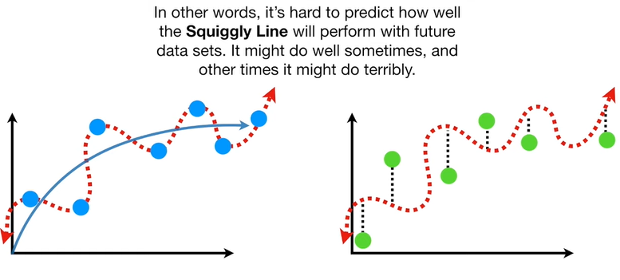
Variance-Bias Example
Test – variance – overly complex model

Slide 19
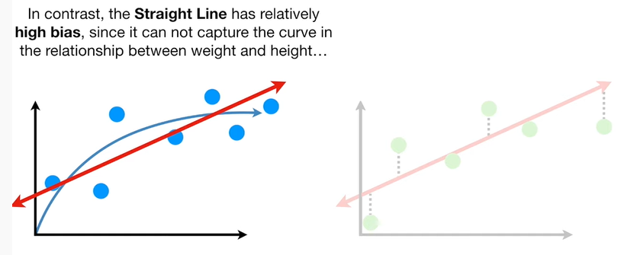
Variance-Bias Example
Train – bias – simple model

Slide 20
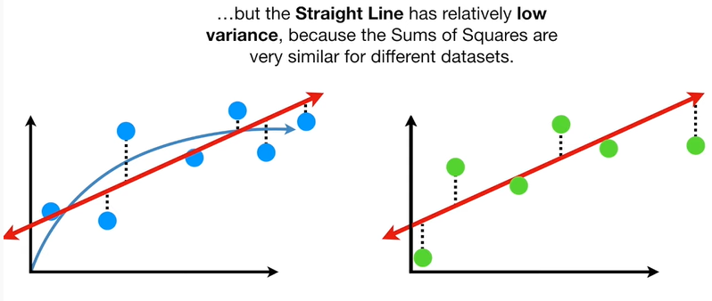
Variance-Bias Example
Test – variance – simple model

Slide 21
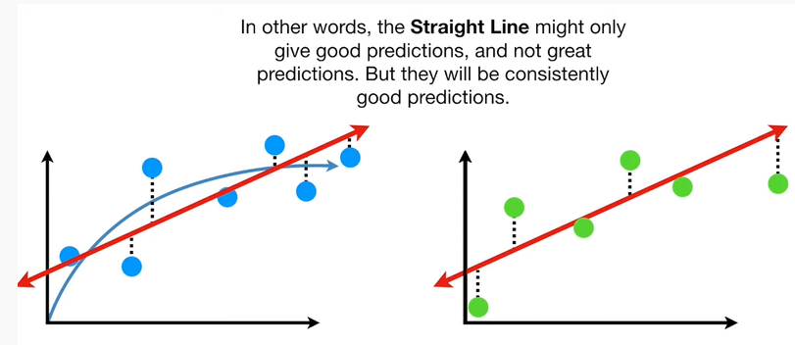
Variance-Bias Example
Test – variance – simple model

Slide 22
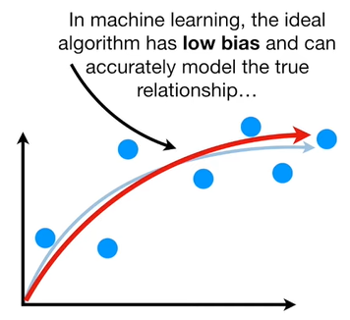
Variance-Bias Example
Ideal case

Slide 23
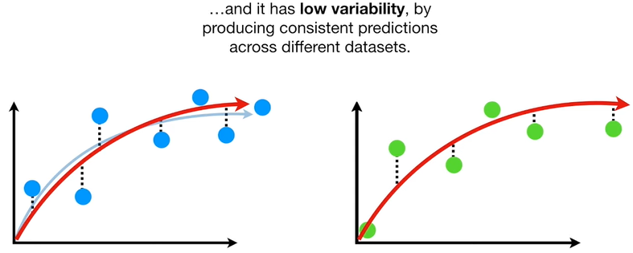
Variance-Bias Example
Ideal case

Slide 24
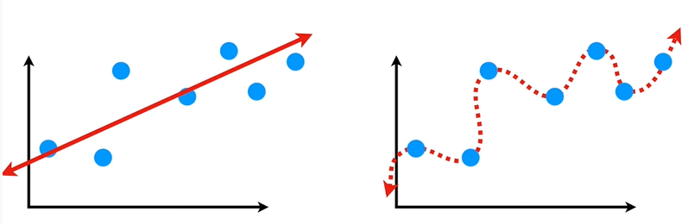
Variance-Bias Example
Finding a sweet spot between a basic and complex model is desired

