Slide 1
Spring 2021
DATS 501 Fundamentals of Data Science
Hasan Demirtaş
hasan.demirtas@yeditepe.edu.tr (hdemirtas.academic@gmail.com)
Cumhur Baştürk
cbasturk.academic@gmail.com (basturkc@gmail.com)

Slide 2
Course Information
1 | Introduction | Concepts
2 | Decision Theory | Biases
3 | Descriptive Analytics | Statistics
4 |  | Graphs in Excel, Python, Power BI
5 | Unsupervised Learning | Clustering Algorithms
6 | Predictive Analytics | Introduction to Supervised Learning
7 |  | Linear Regression
8 |  | Linear Models
9 |  | Tree-based Models
10 | Prescriptive Analytics | Optimization & Simulation
11 | Statistical Tests | Numeric Data, Categorical Data
12 | Database | Sql Server
13 | Forecasting | Time Series

Slide 3
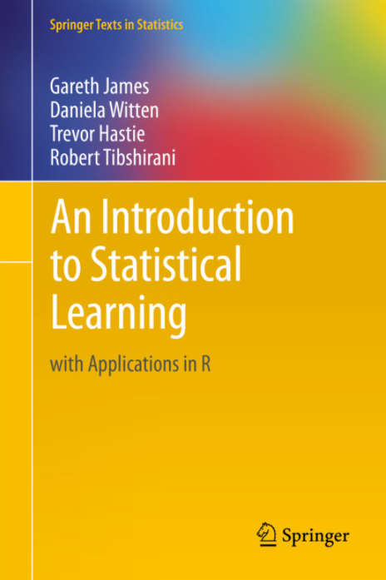
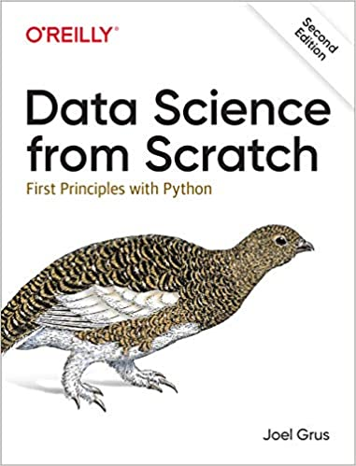
Course Information
http://faculty.marshall.usc.edu/gareth-james/
Textbooks are optional to use however, studying to ISLR is strongly recommended

Slide 4
Course Information
Grading
4 Homeworks (20%)
2 Midterm Exams (40%)
1 Project (20%) (battle royale fashion)
4 quizes (20%)
Programs
Microsoft Excel
Python Spyder or Jupyter IDE
Microsoft SQL Server
Microsoft Power BI

Slide 5
Additional References
ISLR slides and videos: https://www.r-bloggers.com/2014/09/in-depth-introduction-to-machine-learning-in-15-hours-of-expert-videos/
Practical data science lecture videos: https://scs.hosted.panopto.com/Panopto/Pages/Sessions/List.aspx#folderID=%22618ea253-ca45-4b14-9f1d-aab501543bd2%22
Probability and statistics: https://ocw.mit.edu/courses/mathematics/18-05-introduction-to-probability-and-statistics-spring-2014/
Data science for business: http://www.leonidzhukov.net/hse/2020/datascience/

Slide 6
A Word on Plagiarism…
Every paper you submit individually or as a group should be an original piece of writing, presenting your or your group’s ideas in your own words unless otherwise noted. Everything you borrow from books, articles, visual material or web sites (including those in the syllabus) should be properly cited. You are free to use sources outside of the course material as long as you cite them. You are also free (in fact, encouraged) to discuss your papers and research ideas with others (including your friends in the class), but it is important that you do not share your writing with anyone until it has been graded. Plagiarism is a very serious misdeed that can result in a reduced grade or an F (for the paper and/or the course). Please pay utmost attention to avoid this accusation.

Slide 7
Credit to
In these lecture notes, lecture notes of Sabancı University Business School’s Introduction to Business Analytics and Descriptive Analytics courses are partially used for educational purposes

Slide 8

Quiz is coming

Slide 9
Introduction

Slide 10
Introduction
Three developments spurred recent explosive growth in the use of analytical methods in business applications:
First development:
Data generation
Second development:
Modelling
Third development:
Computational power
Notes:
Technological advances such as improved point-of-sale scanner technology and the collection of data through e-commerce.

Slide 11
Introduction
Three developments spurred recent explosive growth in the use of analytical methods in business applications: (contd.)
First development:
Technological advances, Internet social networks, and data generated from personal electronic devices, produce incredible amounts of data for businesses.
Businesses want to use these data to improve the efficiency and profitability of their operations, better understand their customers, price their products more effectively, and gain a competitive advantage.
Notes:
Technological advances such as improved point-of-sale scanner technology and the collection of data through e-commerce.

Slide 12
Introduction
Three developments spurred recent explosive growth in the use of analytical methods in business applications: (contd.)
Second development:
Ongoing research has resulted in numerous methodological developments, including:
Advances in computational approaches to effectively handle and explore massive amounts of data
Faster algorithms for optimization and simulation, and
More effective approaches for visualizing data.

Slide 13
Introduction
Three developments spurred recent explosive growth in the use of analytical methods in business applications: (contd.)
Third development:
The methodological developments were paired with an explosion in computing power and storage capability.
Better computing hardware, parallel computing, and cloud computing have enabled businesses to solve big problems faster and more accurately than ever before.
Notes:
Cloud computing, the more recent development, is the remote use of hardware and software over the Internet.

Slide 14
Decision Making

Slide 15
Decision Making
Target:
Making decisions based on data

Slide 16
Decision Making
Managers’ responsibility:
To make strategic, tactical, or operational decisions.
Strategic decisions:
Involve higher-level issues concerned with the overall direction of the organization.
These decisions define the organization’s overall goals and aspirations for the future.

Slide 17
Decision Making
Tactical decisions:
Concern how the organization should achieve the goals and objectives set by its strategy.
They are usually the responsibility of midlevel management.
Operational decisions:
Affect how the firm is run from day to day.
They are the domain of operations managers, who are the closest to the customer.

Slide 18
Decision Making
Decision making can be defined as the following process
Identify and define the problem
Determine the criteria that will be used to evaluate alternative solutions
Determine the set of alternative solutions
Evaluate the alternatives
Choose an alternative
Notes:
Consider the case of the Thoroughbred Running Company (TRC). Historically, TRC had been a catalog-based retail seller of running shoes and apparel. TRC sales revenue grew quickly as it changed its emphasis from catalog-based sales to Internet-based sales.
Recently, TRC decided that it should also establish retail stores in the malls and downtown areas of major cities. This is a strategic decision that will take the firm in a new direction that it hopes will complement its Internet-based strategy.
TRC middle managers will therefore have to make a variety of tactical decisions in support of this strategic decision, including how many new stores to open this year, where to open these new stores, how many distribution centers will be needed to support the new stores, and where to locate these distribution centers.
Operations managers in the stores will need to make day-to-day decisions regarding, for instance, how many pairs of each model and size of shoes to order
from the distribution centers and how to schedule their sales personnel.

Slide 19
Decision Making
Common approaches to making decisions
Tradition
Intuition
Rules of thumb
Using the relevant data available

Slide 20
Data Analytics for Business
Business Analytics

Slide 21
Business Analytics
Business analytics:
Scientific process of transforming data into insight for making better decisions.
Used for data-driven or fact-based decision making, which is often seen as more objective than other alternatives for decision making.

Slide 22
Business Analytics
Tools of business analytics can aid decision making by:
Creating insights from data
Improving our ability to more accurately forecast for planning
Helping us quantify risk
Yielding better alternatives through analysis and optimization

Slide 23
A Categorization of Analytical Methods and Models

Slide 24
A Categorization of Analytical Methods and Models
Descriptive analytics: It encompasses the set of techniques that describes what has happened in the past.
Examples - data queries, reports, descriptive statistics, data visualization (data dashboards), data-mining techniques, and basic what-if spreadsheet models.
Data query - It is a request for information with certain characteristics from a database.

Slide 25
A Categorization of Analytical Methods and Models
Data dashboards - Collections of tables, charts, maps, and summary statistics that are updated as new data become available.
Uses of dashboards
To help management monitor specific aspects of the company’s performance related to their decision-making responsibilities.
For corporate-level managers, daily data dashboards might summarize sales by region, current inventory levels, and other company-wide metrics.
Front-line managers may view dashboards that contain metrics related to staffing levels, local inventory levels, and short-term sales forecasts.

Slide 26
A Categorization of Analytical Methods and Models
Predictive analytics: It consists of techniques that use models constructed from past data to predict the future or ascertain the impact of one variable on another.
Survey data and past purchase behavior may be used to help predict the market share of a new product.

Slide 27
A Categorization of Analytical Methods and Models
Techniques used in Predictive Analytics: contd.
Data mining
Simulation
Used to find patterns or relationships among elements of the data in a large database; often used in predictive analytics.
It involves the use of probability and statistics to construct a computer model to study the impact of uncertainty on a decision.
Notes:
Example for Data Mining:
A large grocery store chain might be interested in developing a new targeted marketing campaign that offers a discount coupon on potato chips.
By studying historical point-of-sale data, the store may be able to use data mining to predict which customers are the most likely to respond to an offer on discounted chips by purchasing higher-margin items such as beer or soft drinks in addition to the chips, thus increasing the store’s overall revenue.
Example for Simulation:
Banks often use simulation to model investment and default risk in order to stress test financial models.
Used in the pharmaceutical industry to assess the risk of introducing a new drug.

Slide 28
A Categorization of Analytical Methods and Models
Prescriptive Analytics: It indicates a best course of action to take
Models used in prescriptive analytics:
Optimization models
Simulation optimization
Decision analysis
Models that give the best decision subject to constraints of the situation.
Combines the use of probability and statistics to model uncertainty with optimization techniques to find good decisions in highly complex and highly uncertain settings.
Used to develop an optimal strategy when a decision maker is faced with several decision alternatives and an uncertain set of future events.
It also employs utility theory, which assigns values to outcomes based on the decision maker’s attitude toward risk, loss, and other factors.

Slide 29
A Categorization of Analytical Methods and Models
Optimization models
Model | Field | Purpose
Portfolio models | Finance | Use historical investment return data to determine the mix of investments that yield the highest expected return while controlling or limiting exposure to risk.
Supply network design models | Operations | Provide the cost-minimizing plant and distribution center locations subject to meeting the customer service requirements.
Price markdown models | Retailing | Uses historical data to yield revenue-maximizing discount levels and the timing of discount offers when goods have not sold as planned.

Slide 30
Big Data Term
Is it used correctly or to impress?

Slide 31
Big Data
Big data: A set of data that cannot be managed, processed, or analyzed with commonly available software in a reasonable amount of time.
Big data represents opportunities.
It also presents analytical challenges from a processing point of view and consequently has itself led to an increase in the use of analytics.
More companies are hiring data scientists who know how to process and analyze massive amounts of data.
Notes:
Walmart handles over one million purchase transactions per hour.
Facebook processes more than 250 million picture uploads per day.

Slide 32
From Correlation to Causation
Notes:
Reading: From Correlation to Causation

Slide 33
Correlation vs. Causation

Slide 34
Correlation vs. Causation
https://tylervigen.com/spurious-correlations

Slide 35
Correlation vs. Causation
https://tylervigen.com/spurious-correlations

