Slide 1
Spring 2021
DATS 501 Fundamentals of Data Science
Hasan Demirtaş
hasan.demirtas@yeditepe.edu.tr (hdemirtas.academic@gmail.com)
Cumhur Baştürk
cbasturk.academic@gmail.com (basturkc@gmail.com)

Slide 2
Covariance

Slide 3
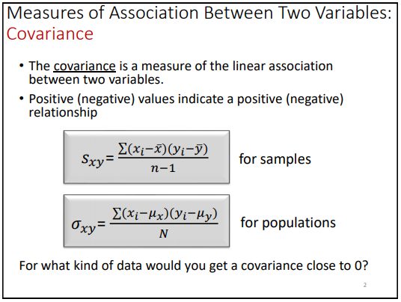
Covariance

Slide 4
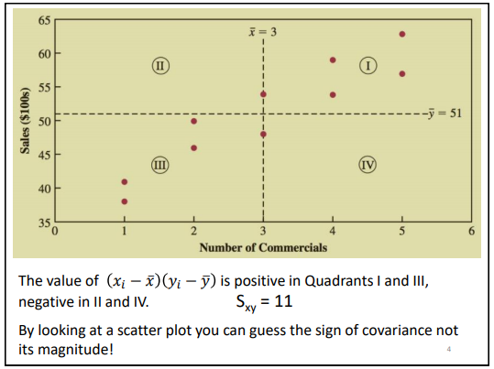
Covariance

Slide 5
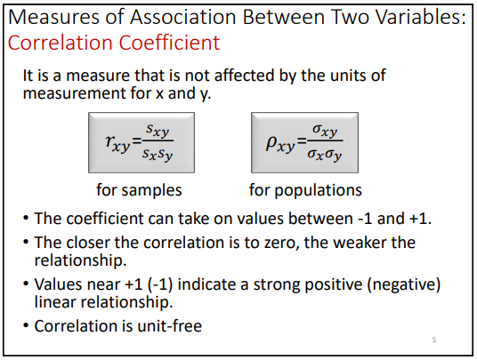
Correlation Coefficient

Slide 6
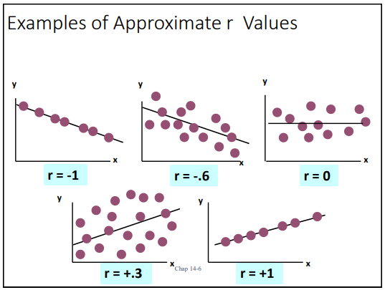
Correlation Coefficient

Slide 7
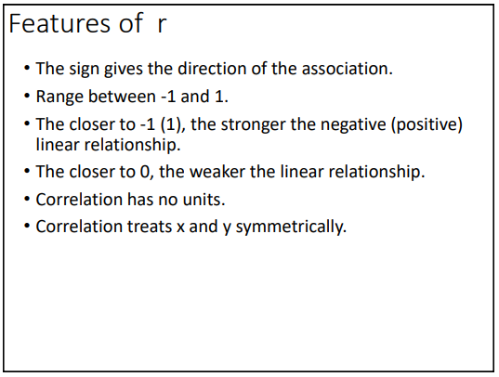
Correlation Coefficient

Slide 8
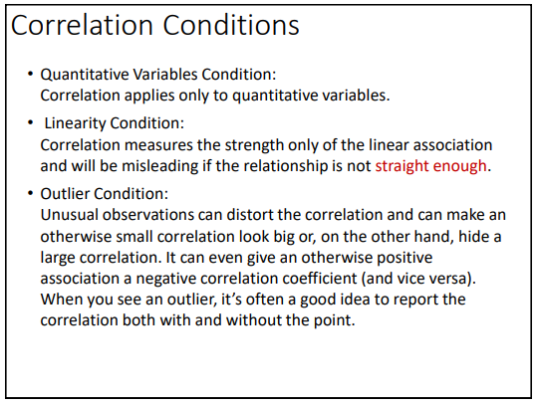
Correlation Coefficient

Slide 9
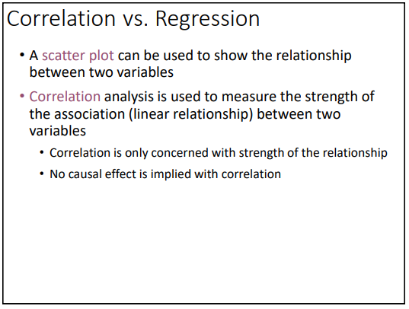
Correlation Coefficient

