Slide 1
Applied Programming in Python
Let the coding begin...

Slide 2
What’s a program?
Sequence of instructions specifying how to perform a computation
Something mathematical or logical
Implementation of an algorithm
Using a specific programming language
Formal constructed language to communicate instructions to a machine
To execute on specific platforms

Slide 3
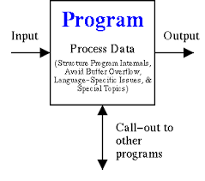
What’s a program?
Basic instructions appear in about every programming language
input Get data from keyboard, file, etc.
output Display data on screen, file, etc.
math Perform basic mathematical operations (+, *, etc.)
conditional execution Check for certain conditions & run the appropriate code
repetition Perform some action repeatedly, usually with some variation

Slide 4
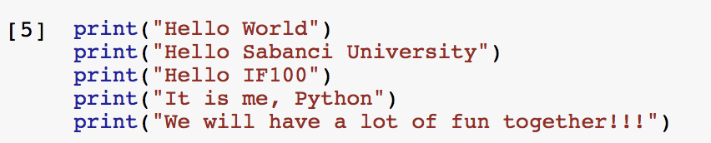
A Longer Program in the editor...
Every code is on a separate line.
Every line starts at column 1 (i.e. no space at the beginning of the lines)
Code lines are executed in the given order!

Slide 5
Estimate Population
We are going to estimate the population of Turkey based on the following data
79.51 million in 2016
Every 7 seconds, a birth happens
Every 13 seconds, a death happens
Every 35 seconds, a new immigrant comes
What will the population be in 2020?

Slide 6
Estimate Population
Let’s break our problem into pieces (decomposition)
Calculate the time difference in seconds
Calculate the number of births in that period
Calculate the number of deaths in that period
Calculate the number of immigrants in that period
Calculate the new population
Print the new population
Pseudocode actually!

Slide 7
Estimate Population
Find the time elapsed between 2020 and 2016 in seconds e = (2020-2016)*365*24*60*60
Consider the rates p = 79510000 + ⎣e/7⎦ - ⎣e/13⎦ + ⎣e/35⎦
We are going to estimate the population of Turkey based on the following data
79.51 million in 2016
Every 7 seconds, a birth happens
Every 13 seconds, a death happens
Every 35 seconds, a new immigrant comes
What will the population be in 2020?

Slide 8
Estimate Population
Find the time elapsed between 2020 and 2016 in seconds e = (2020-2016)*365*24*60*60
Consider the rates p = 79510000 + ⎣e/7⎦ - ⎣e/13⎦ + ⎣e/35⎦
We are going to estimate the population of Turkey based on the following data
79.51 million in 2016
Every 7 seconds, a birth happens
Every 13 seconds, a death happens
Every 35 seconds, a new immigrant comes
What will the population be in 2020?

Slide 9
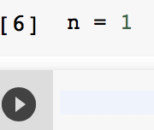
Assignment
We can assign a value to a variable using an assignment statement
variable = value
ALWAYS ON THE RIGHT
ALWAYS ON THE LEFT
When an assignment statement is executed, the value on the right hand side (of the equality sign) is assigned as the value of the variable on the left hand side
Nothing happened?

Slide 10

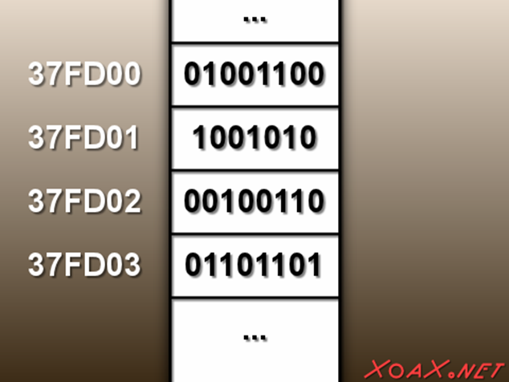

Computer Memory

Slide 11
Assignment Statement & Computer Memory
MEMORY
n
1

Slide 12
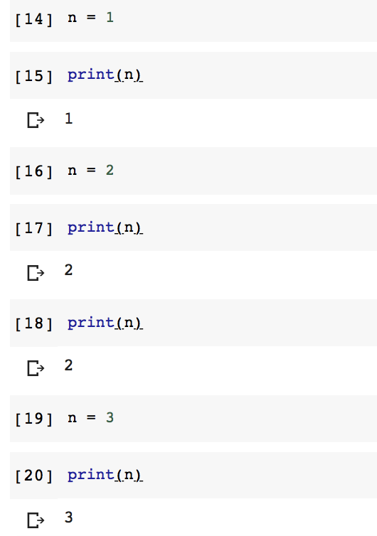
Assignment Statement & Computer Memory
MEMORY

Slide 13
Assignment Statement & Computer Memory
MEMORY
n
1

Slide 14
Assignment Statement & Computer Memory
MEMORY
n
1
n
2

Slide 15
Assignment Statement & Computer Memory
MEMORY
n
2

Slide 16
Assignment Statement & Computer Memory
MEMORY
n
2
n
3

Slide 17
Assignment Statement & Computer Memory
MEMORY
n
3

Slide 18
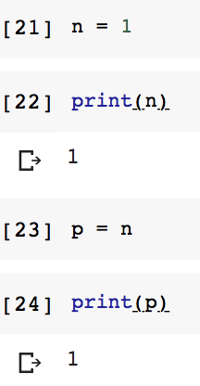
Another way to refer to a variable
Recall the syntax for the assignment statement
DOESN’T HAVE TO BE CONSTANT
If a variable is used on the right hand side of an assignment, then this is a reference to the current value of that variable
variable = value
ALWAYS ON THE RIGHT
ALWAYS ON THE LEFT

Slide 19
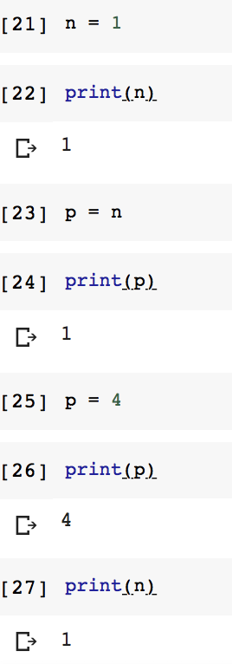
Assignment Statement & Computer Memory
MEMORY

Slide 20
Assignment Statement & Computer Memory
MEMORY
n
1

Slide 21
Assignment Statement & Computer Memory
MEMORY
n
1
p

Slide 22
Assignment Statement & Computer Memory
MEMORY
n
1
p
4

Slide 23
Estimate Population
Find the time elapsed between 2020 and 2016 in seconds e = (2020-2016)*365*24*60*60
Consider the rates p = 79510000 + ⎣e/7⎦ - ⎣e/13⎦ + ⎣e/35⎦
We are going to estimate the population of Turkey based on the following data
79.51 million in 2016
Every 7 seconds, a birth happens
Every 13 seconds, a death happens
Every 35 seconds, a new immigrant comes
What will the population be in 2020?

Slide 24
Assignment
Recall the syntax for the assignment statement
DOESN’T HAVE TO BE A SINGLE VALUE
The right hand side of an assignment statement does not need to be single value
It can consist of an expression
variable = value
ALWAYS ON THE RIGHT
ALWAYS ON THE LEFT

Slide 25
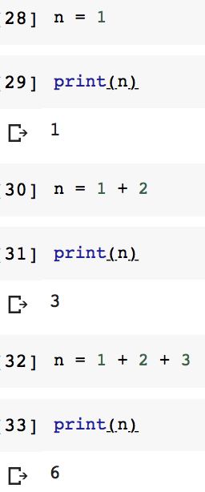
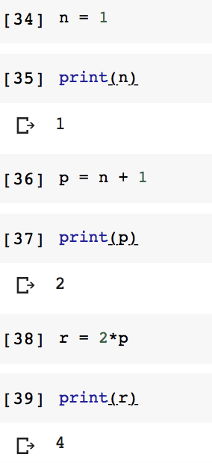
Statements &
Expressions
Statement is an instruction that Python can execute
Unit of code that has an effect
Expression is a combination of values, variables & operators
Need to be evaluated
Instructions to do calculations
Arithmetic, boolean, etc.

Slide 26
Arithmetic Operators
OPERATOR | MEANING
+ | Add two operands
- | Subtract right operand from the left operand
* | Multiply two operands
/ | Divide left operand by the right operand (always results in float)
% | Modulus - remainder of the division of left operand by the right operand
// | Floor division - division that results into a cut off the part after the period
** | Exponent - left operand is raised to the power of the right operand

Slide 27
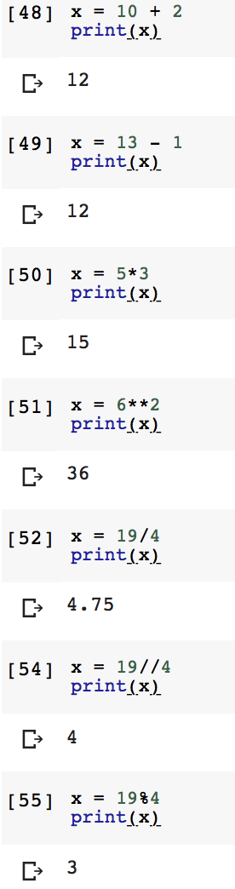
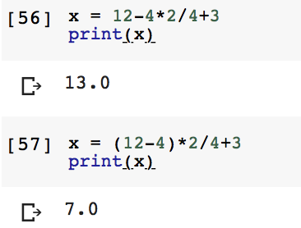
Arithmetic Operations
Just like we have precedence of arithmetic operators in math, Python applies a certain order of evaluation

Slide 28
Precedence - Order of Operations
PEMDAS
Parenthesis
Exponentiation (right to left for multiple consecutive occurrences)
Multiplication & Division (left to right for multiple consecutive occurrences)
Addition & Subtraction (left to right for multiple consecutive occurrences)
highest
lowest

Slide 29


Estimate Population
Find the time elapsed between 2020 and 2016 in seconds e = (2020-2016)*365*24*60*60
Consider the rates p = 79510000 + ⎣e/7⎦ - ⎣e/13⎦ + ⎣e/35⎦
We are going to estimate the population of Turkey based on the following data
79.51 million in 2016
Every 7 seconds, a birth happens
Every 13 seconds, a death happens
Every 35 seconds, a new immigrant comes
What will the population be in 2020?

Slide 30
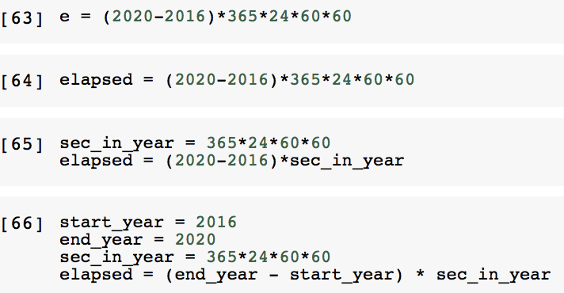

Slide 31
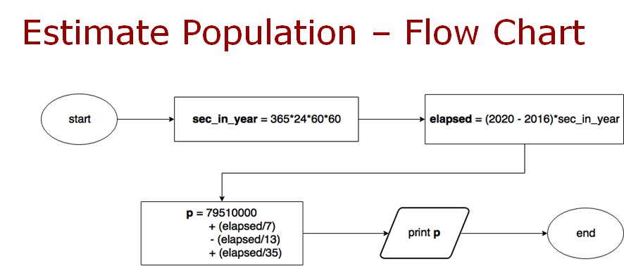

Slide 32

Comments
Hard to read larger & complicated programs
Adding notes is a good idea - comments
To explain in natural language what the program is doing
Use of #
Everything from the symbol # to the end of the line is ignored - no effect on execution

Slide 33
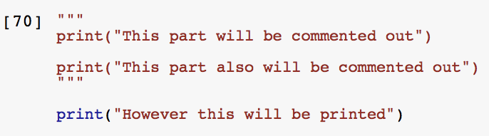
Comments
It is also possible to comment multiple lines at the same time
You can use triple-quotes (''' or """)
Everything between triple-quotes will be commented out as below

Slide 34

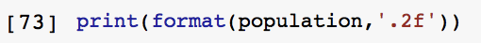

Outputs in Python
We can also print it in a specific format (for instance, with only two decimal points)

Slide 35
Assignment Operators
OPERATOR | EXAMPLE | EQUIVALENT TO
= | x = 5 | x = 5
+= | x+=5 | x = x + 5
-= | x-=5 | x = x - 5
*= | x*=5 | x = x * 5
/= | x/=5 | x = x / 5
%= | x%=5 | x = x % 5
//= | x//=5 | x = x // 5
**= | x**=5 | x = x ** 5

Slide 36
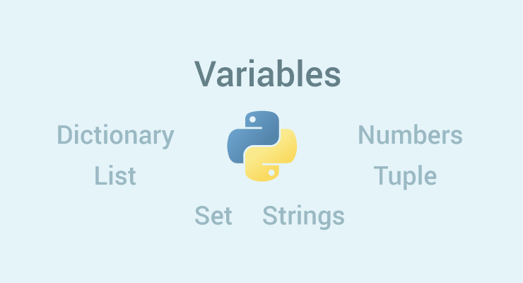
Values & Types
A value is one of the basic things a program works with
Like a letter or a word
Each value belongs to a type
int - integer
float - floating point (real numbers)
str - string

Slide 37
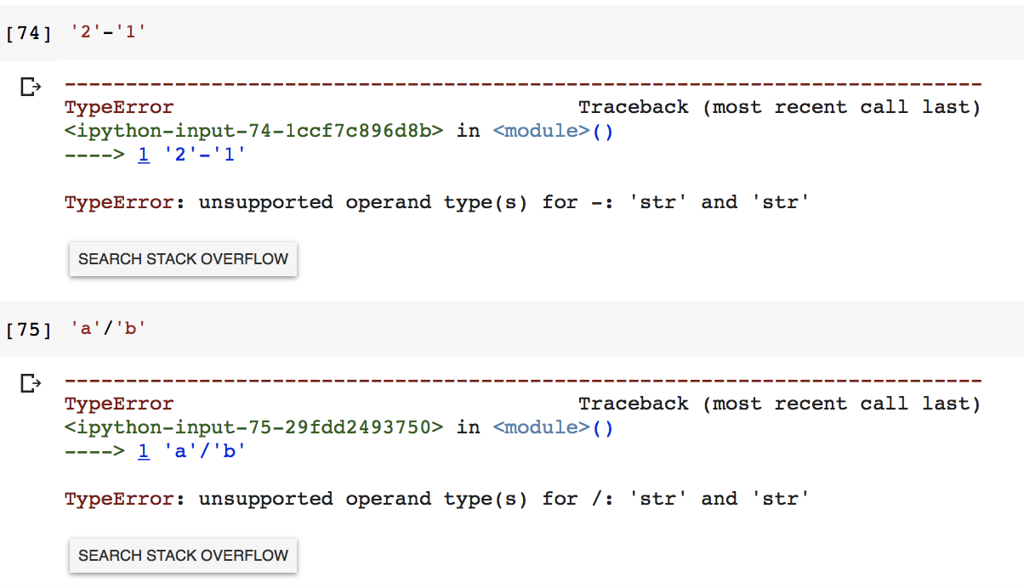
String as a Type
Cannot perform subtraction and division!
INVALID
INVALID

Slide 38
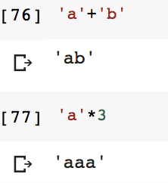
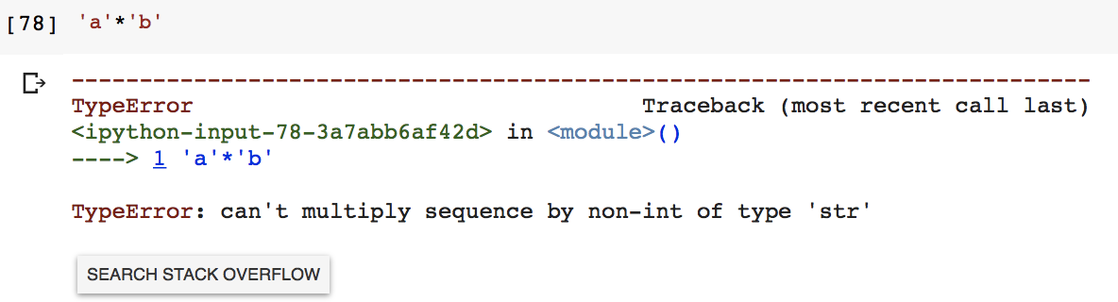
String as a Type
Can perform addition and multiplication!
Indeed, concatenation and repetition!
VALID
INVALID

Slide 39
Estimate Population
Outputs in Python
You have two variables at the end with the following values:
end_year = 2020
population = 91431301
How would you print "The estimated population will be 91431301 in 2020."
We are going to estimate the population of Turkey based on the following data
79.51 million in 2016
Every 7 seconds, a birth happens
Every 13 seconds, a death happens
Every 35 seconds, a new immigrant comes
What will the population be in 2020?

Slide 40
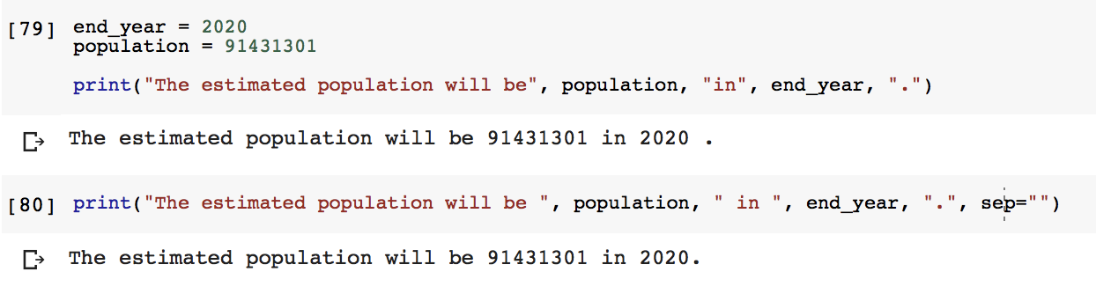
"The estimated population will be 91.43 million in 2020."
Any difference among the outputs?

Slide 41
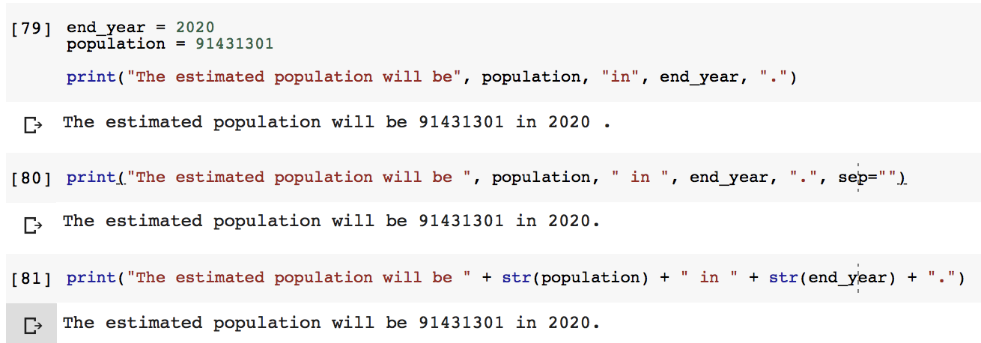
"The estimated population will be 91.43 million in 2020."
You can only sum (or append) same data types
See population2.py

Slide 42
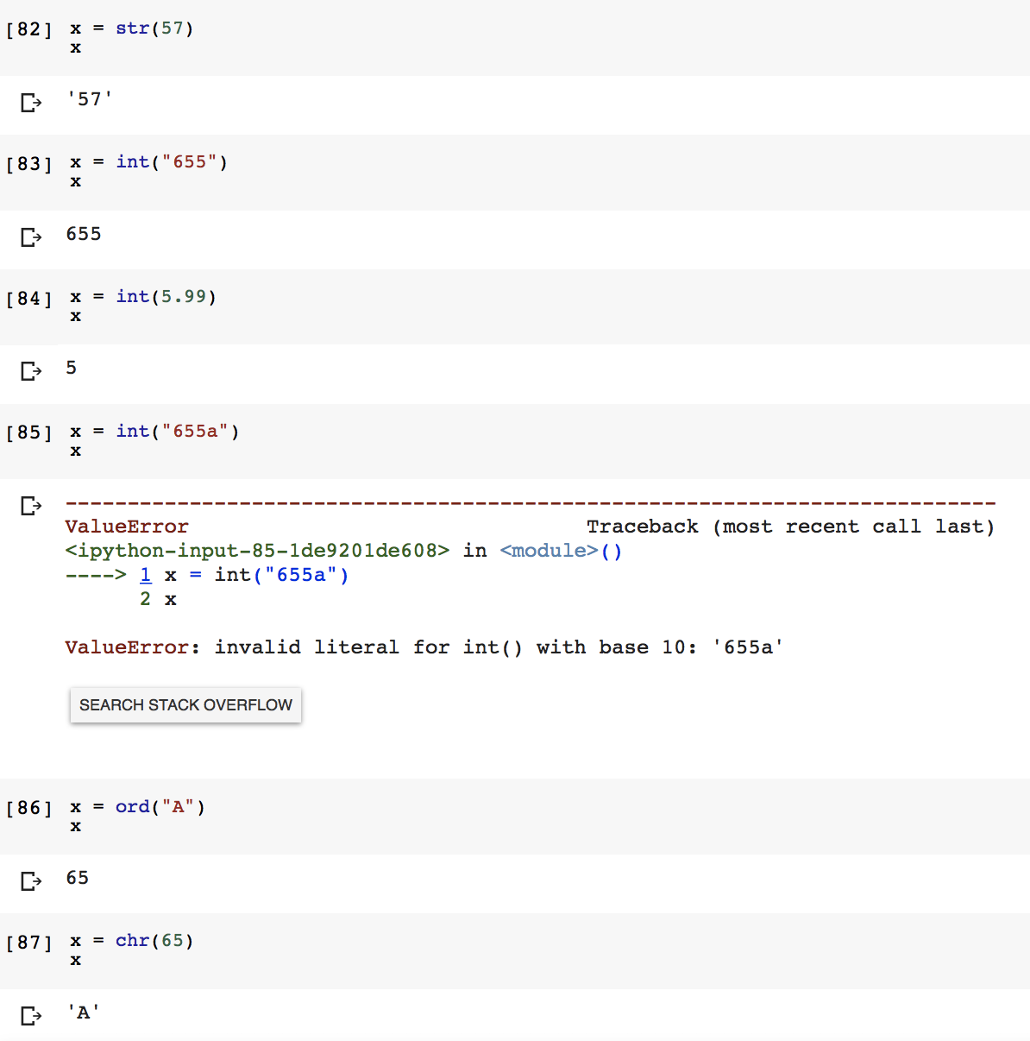
Type Casting (Type Conversion)
To convert between types you simply use the type name as a function
The value should be convertible
ord() is inverse of chr()

Slide 43
Estimate Population
Inputs in Python
We are going to estimate the population of Turkey based on the following data
79.51 million in 2016
Every 7 seconds, a birth happens
Every 13 seconds, a death happens
Every 35 seconds, a new immigrant comes
What will the population be in 2020?
What about getting the end_year variable from the user?

Slide 44
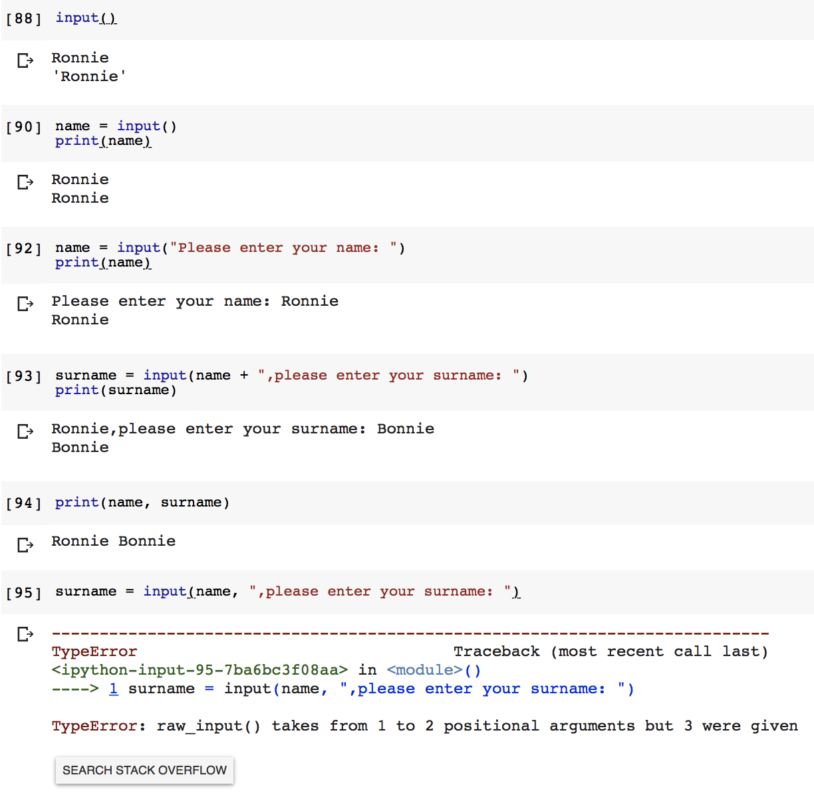
Inputs in Python
What if we want to get the value of the variable end_year from the user?
input() is used to get the info from user
If input() is called, the program flow will stop until the user has given an input
The text of the optional parameter, i.e. prompt, will be printed on screen
input() takes only 1 parameter - of type string

Slide 45
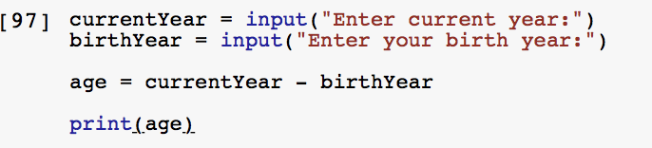
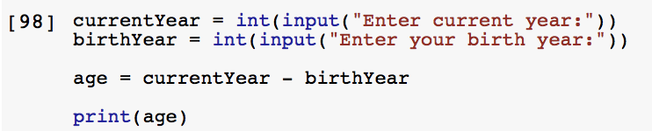
Inputs in Python
User input will be returned as a string without any changes
We need to use type casting when input is required to be transformed into another type
INVALID
You cannot subtract one string from another !!!
VALID

Slide 46
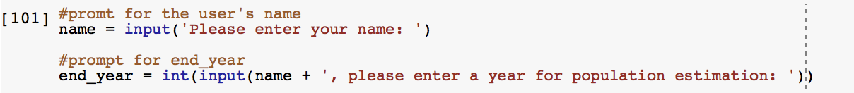
Estimate Population
Inputs in Python
Now, we are capable of getting the value of variable end_year from the user
See population3.py

Slide 47
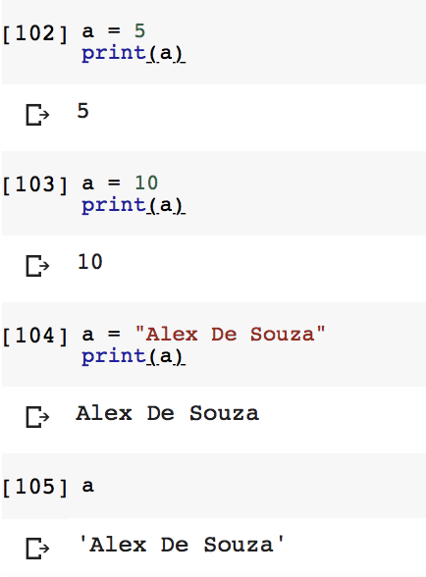
More on variables
You can always overwrite the value of a variable
even with different data types
Whenever you want to use a variable, the latest value of the variable will be used

