Slide 1
COMPUTATIONAL APPROACHES
TO PROBLEM SOLVING
To Be or Not To Be: Making Decisions

Slide 2
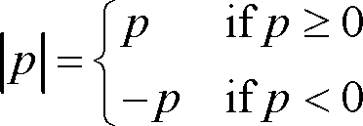
Absolute Value
Find the absolute value of a number, which is the distance of this number from zero on the number line.
Input a number & print out the absolute value of that number.

Slide 3
Boolean Operators
OPERATOR | MEANING
and | True if both the operands are true
or | True if either of the operands is true
not | True if operand is false (complements the operand)

Slide 4
Truth Table
x | y | x and y | x or y | not x
True | True | True | True | False
True | False | False | True | False
False | True | False | True | True
False | False | False | False | True

Slide 5

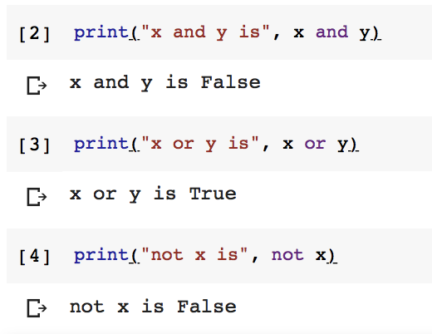
Boolean Operations

Slide 6
Comparison Operators
OPERATOR | MEANING
> | Greater than - True if left operand is greater than the right
< | Less than - True if left operand is less than the right
== | Equal to - True if operands are equal
!= | Not equal to - True if operands are not equal
>= | Greater than or equal to
<= | Less than or equal to

Slide 7
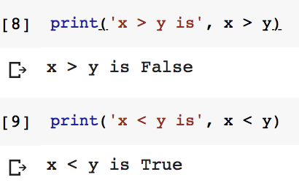

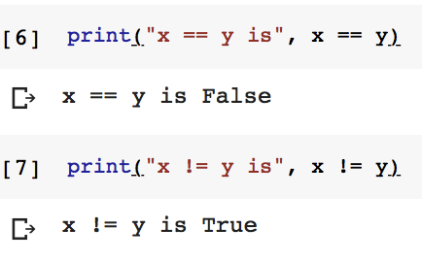
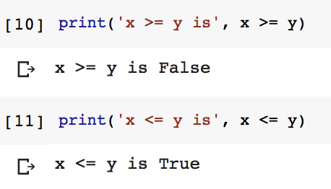
Comparison Operations

Slide 8
Precedence Table
OPERATOR | OPERATOR TYPE | EXPLANATION
- | Sign Operators | plus and minus signs
** | Arithmetic Operators | exponentiation
* / // % |  | multiplication, (floor) division and modulus
- |  | addition and subtraction
in not in < <= > >= == != | Comparison and Membership Operators | membership, relational, equality and inequality
not | Logical Operators | logical NOT
and |  | logical AND
or |  | logical OR
= += -= *= /= //= %= | Assignment Operators | assign values to variables
highest
lowest

Slide 9
Absolute Value
Input number
If number < 0
number = number * -1
Print number
Input a number & print out the absolute value of that number.

Slide 10

If Syntax
if <condition>:
<statement_true_1>
…
<statement_true_N>

Slide 11
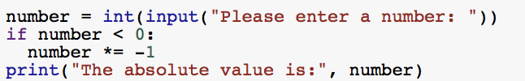
Absolute Value
Input number
If number < 0
number *= -1
Print number
See absolute_value.py

Slide 12
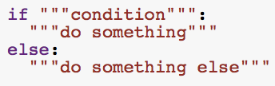
If-Else Syntax
if <condition>:
<statement_true_1>
…
<statement_true_N>
else:
<statement_false_1>
…
<statement_false_N>

Slide 13
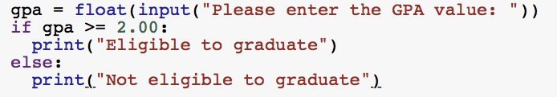
Graduation Policy
Input GPA
If GPA ≥ 2.00
Print “Eligible to graduate”
Else
Print “Not eligible to graduate”
See graduation_policy.py

Slide 14
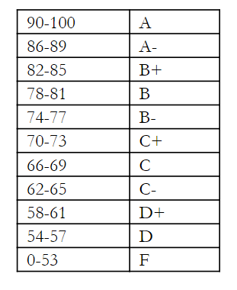
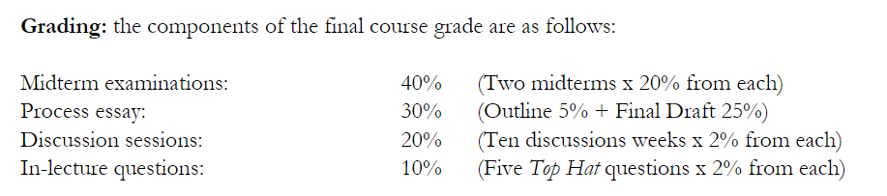
SPS Grade Calculation
Input the points earned from each grading component and output both the resulting overall grade and the resulting letter grade for the course

Slide 15
SPS Grade Calculation
Let’s break our problem into pieces (decomposition)
Get the points earned from the user
Calculate and display the overall grade
Find and display the corresponding letter grade

Slide 16
SPS Grade Calculation
A | 86-100
B | 74-85
C | 62-73
D | 54-61
F | 0-53
Input the points earned from each grading component and output both the resulting overall grade and the resulting letter grade for the course

Slide 17
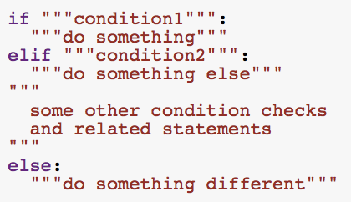
If-Elif-Else Syntax
if <condition1>:
<statements_1true>
elif <condition2>:
<statements_2true>
…
elif <conditionN>:
<statements_Ntrue>
else:
<statements_ALLfalse>

Slide 18
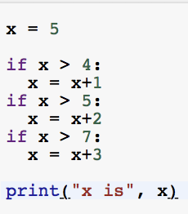

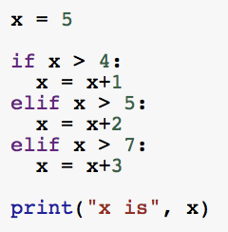

More on Decision Making

Slide 19
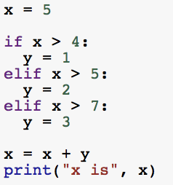

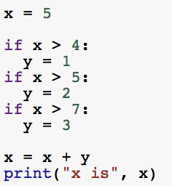
More on Decision Making

Slide 20
Is it a leap year?
Most years have 365 days. However, the time required for the Earth to orbit the Sun is actually slightly more than that. As a result, an extra day, February 29, is included in some years to correct this difference. Such years are referred to as leap years.
The rules for determining whether or not a year is a leap year follow:
Leap years are any year that can be evenly divided by 4 (such as 2012, 2016, etc)
Write a program that reads a year from the user and displays a message indicating whether or not it is a leap year.
Except if it can be evenly divided by 100, then it isn't (such as 2100, 2200, etc)
Except if it can be evenly divided by 400, then it is (such as 2000, 2400)

Slide 21
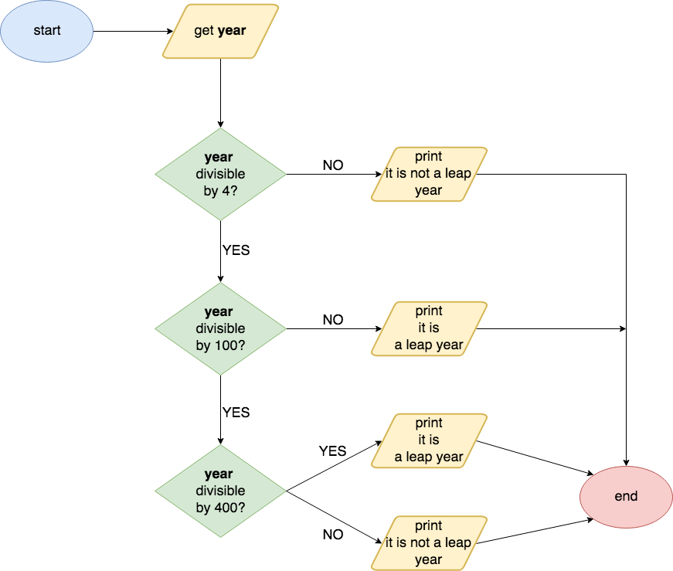
Flowchart

Slide 22
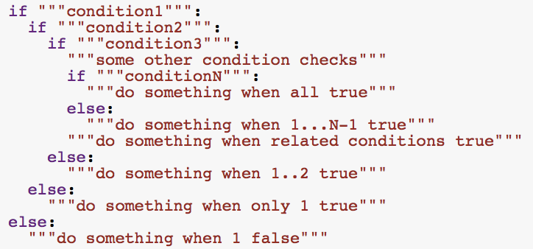
Nested If Syntax
if <condition1>:
if <condition2>:
...
if <conditionN>:
<statements_ALLtrue>
else:
<statements_1toN-1true>
...
else:
<statements_only1true>
else:
<statements_1false>

