Slide 1
Spring 2021
DATS 501 Fundamentals of Data Science
Hasan Demirtaş
hasan.demirtas@yeditepe.edu.tr (hdemirtas.academic@gmail.com)
Cumhur Baştürk
basturkc.academic@gmail.com (basturkc@gmail.com)

Slide 2
Conditional Probability

Slide 3
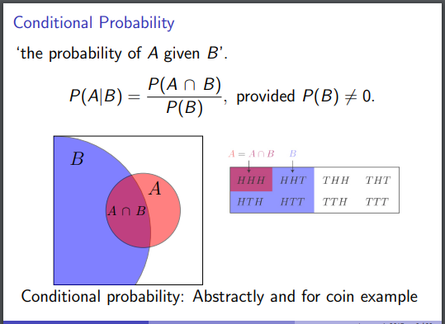
Conditional Probability

Slide 4
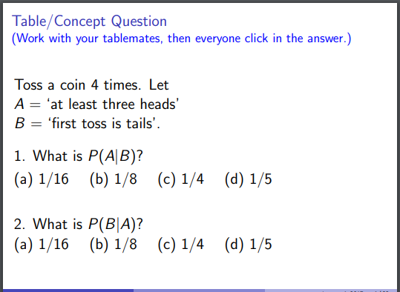
Conditional Probability

Slide 5
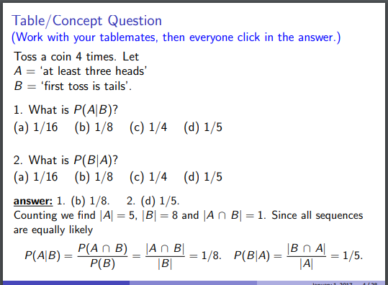
Conditional Probability

Slide 6
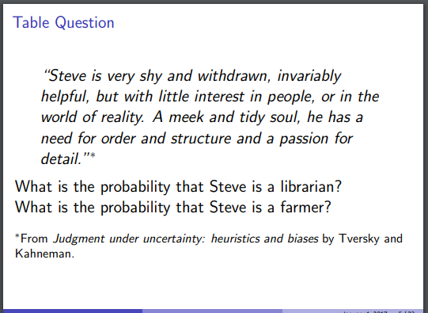
Importance of prior probability

Slide 7
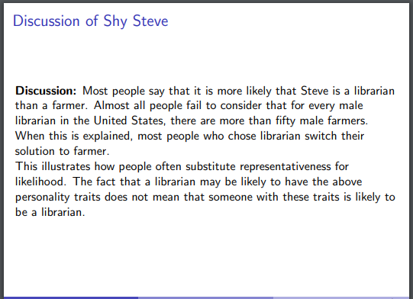
Importance of prior probability

Slide 8
A Quick Glance on Probability Distribution Function & Cumulative Distribution Function

Slide 9
Density vs Mass
When the distribution is continuous, density is used
When the distribution is discrete, mass is used

Slide 10
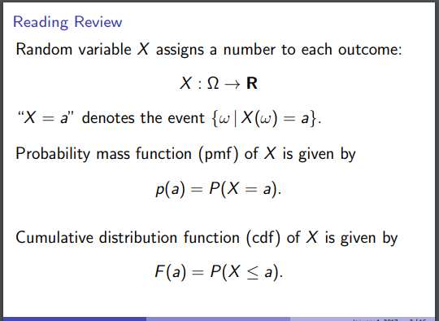
Probability Mass Function & Cumulative Distribution Function

Slide 11

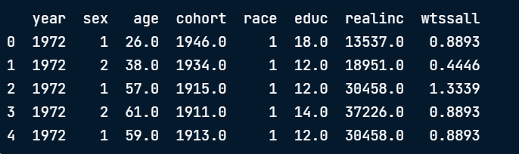
Probability Mass Function & Cumulative Distribution Function
Our Data Set is :GSS
Educ is # of years of education of each respondent

Slide 12
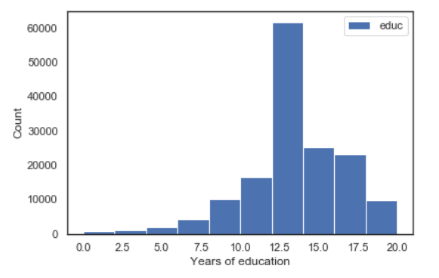
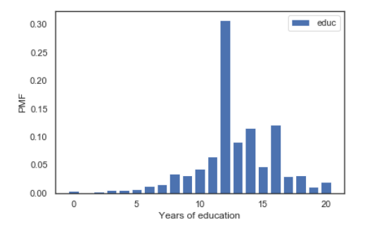
Probability Mass Function & Cumulative Distribution Function
Distribution of educ (histogram)
Distribution of educ (PMF)
PMF shows all UNIQUE values, so we can see exactly where the peaks are.
Because Histogram puts values into bins, it obscures some details. e.g. 14 and 16 years
PMF represents the possible values in a distribution and their probabilities.
Python Tip: You can access Pmf and Cdf classes via the empiricaldist library

Slide 13
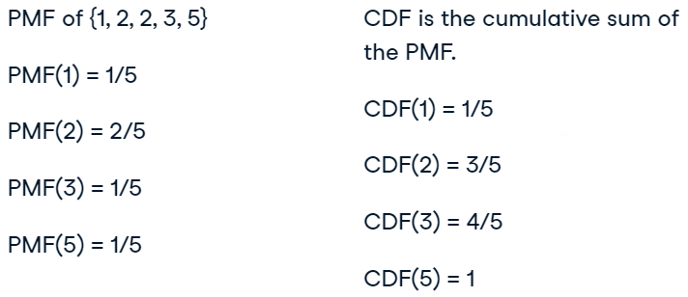
Probability Mass Function & Cumulative Distribution Function
From Pmf to Cdf
If you draw a random element from a distribution:
Pmf is the probability that you get exactly x
Cdf is the probability that you get a value <= x
for a given value of x
Example

Slide 14

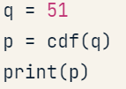
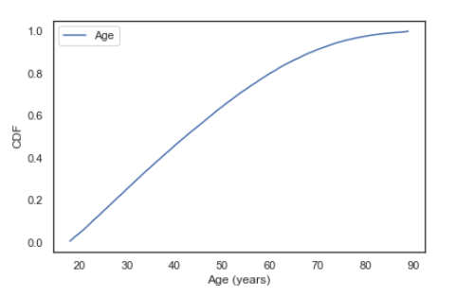

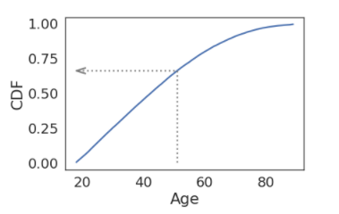
Probability Mass Function & Cumulative Distribution Function
Cdf of Age (from GSS dataset)
Evaluating Cdf

Slide 15


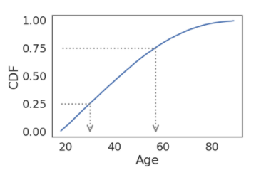
Probability Mass Function & Cumulative Distribution Function
Evaluating the inverse Cdf
How about IQR?

Slide 16
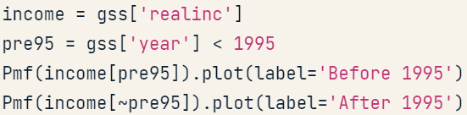

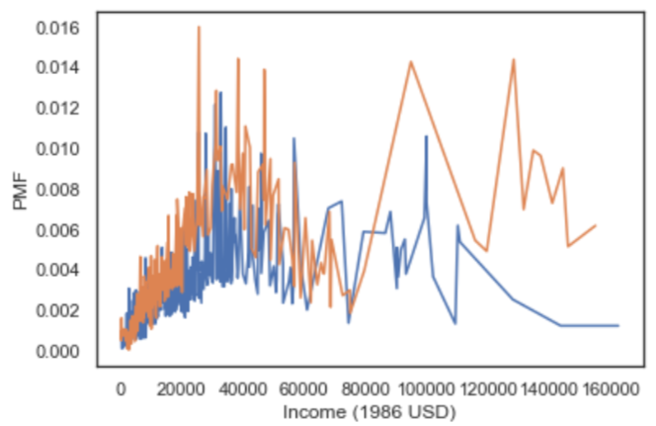
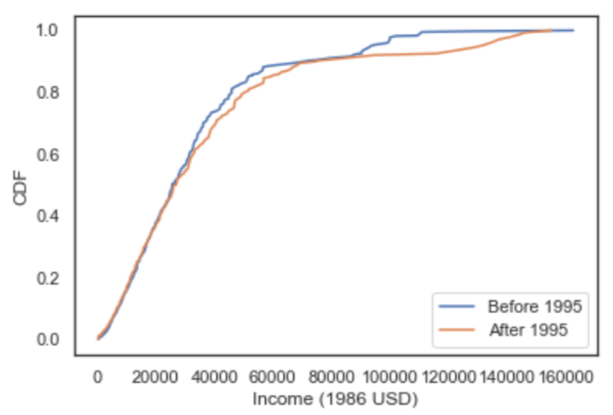
Probability Mass Function & Cumulative Distribution Function
Comparing Distributions
Pmf does not work very well when data has LARGE NUMBER of UNIQUE VALUES.

Slide 17
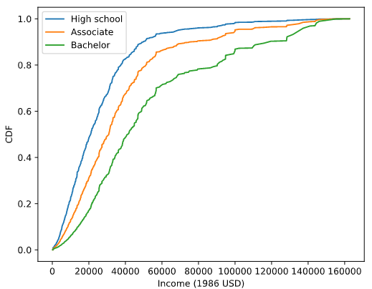
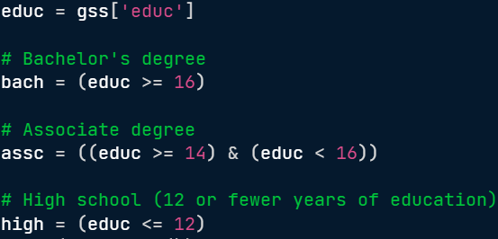
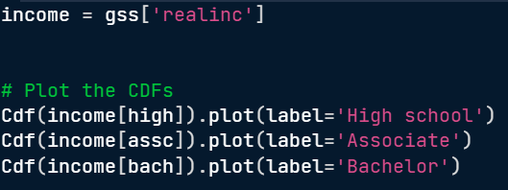
Probability Mass Function & Cumulative Distribution Function
In the U.S, 12 years of education usually means the respondent has completed high school (secondary education).
A respondent with 14 years of education has probably completed an associate degree
(two years of college);
someone with 16 years has probably completed a bachelor's degree
(four years of college).

Slide 18
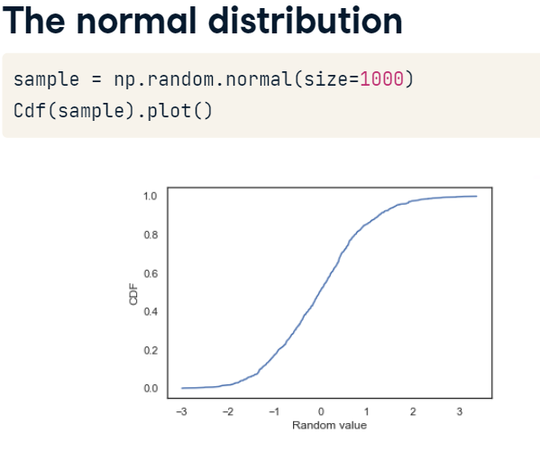

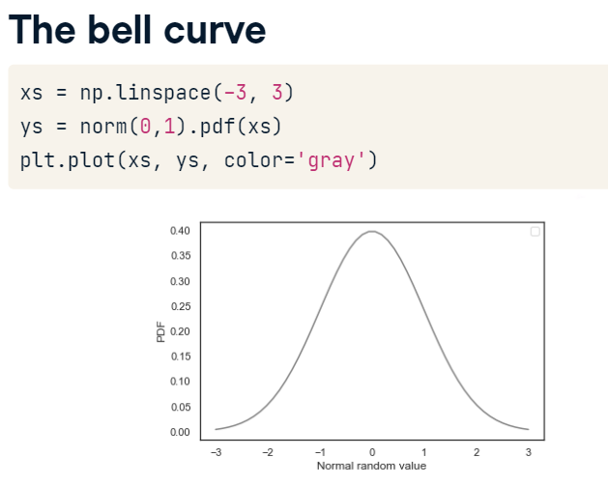
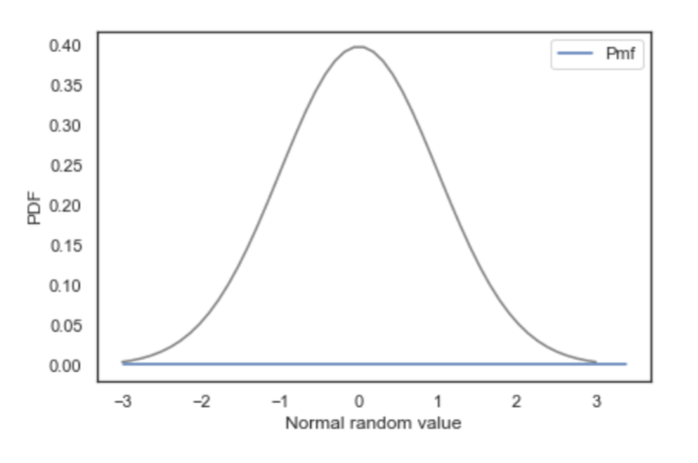
Probability Mass Function & Cumulative Distribution Function

Slide 19
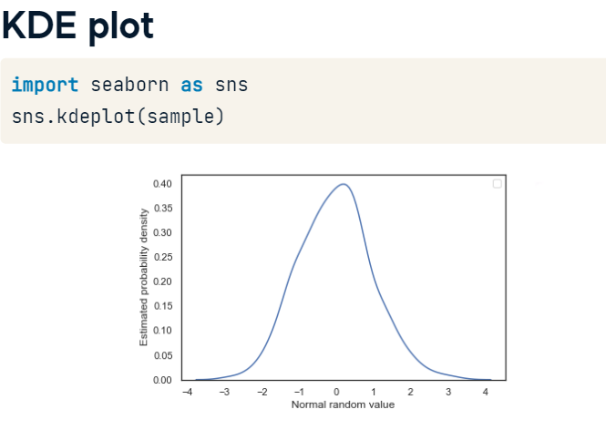
Probability Mass Function & Cumulative Distribution Function
From Pmf To Pdf
PMF, CDF, KDE
Use CDFs for exploration
Use PMFs if there are a small number of unique & discrete values
Use KDE if there are a lot of (continuous) values.

Slide 20
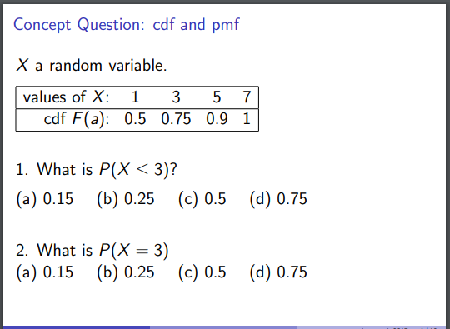
An example

Slide 21
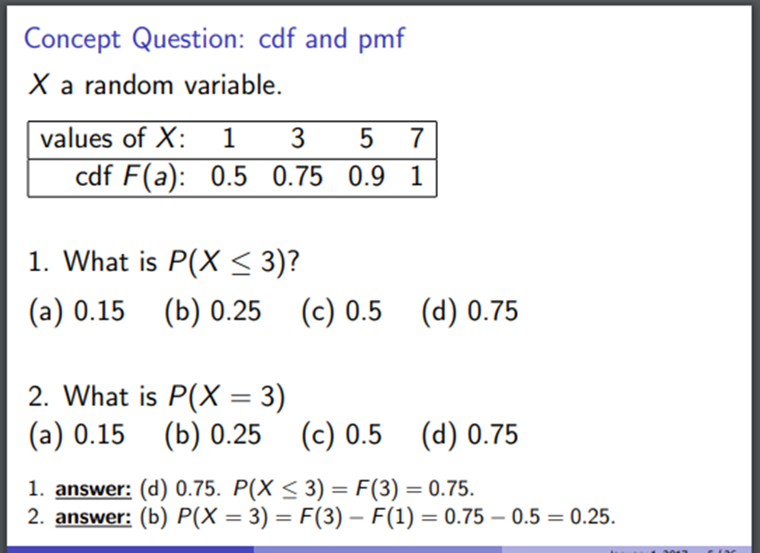
Solution

Slide 22
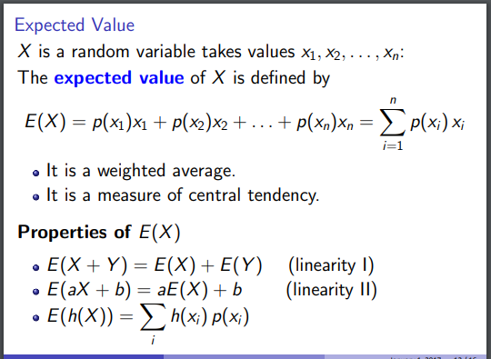
Expected value and pmf connection

Slide 23
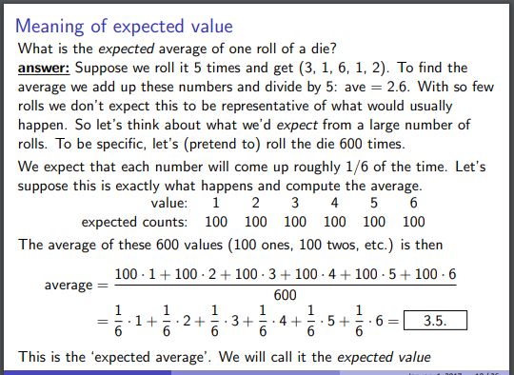
Expected value and pmf connection

Slide 24
Expected value and pmf connection

Slide 25
A Quick Glance on Variance and PMF Relation

Slide 26
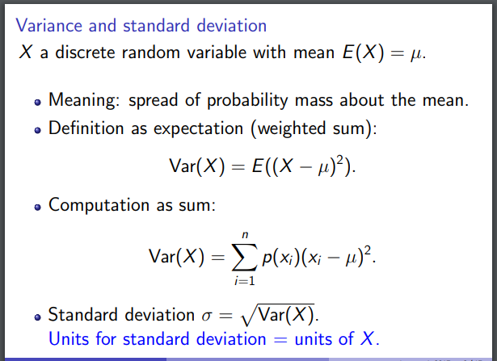
Formulas

Slide 27
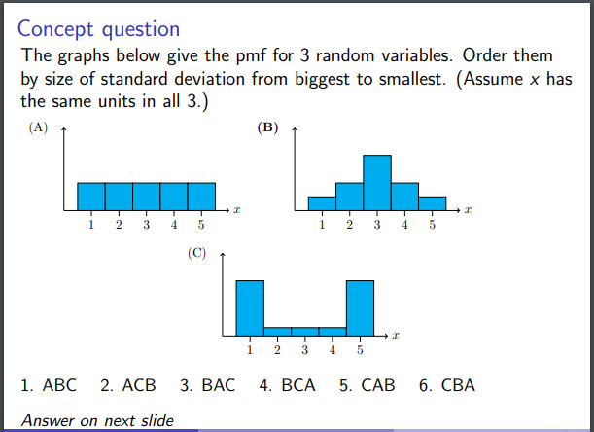
An example

Slide 28
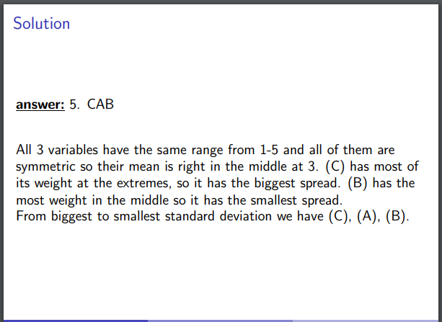
The Solution

Slide 29
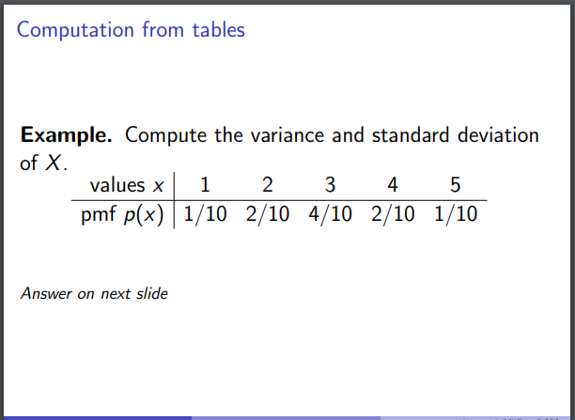
An example

Slide 30
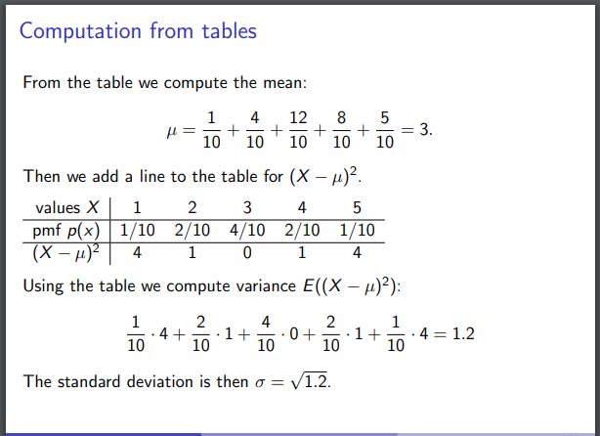
The Solution

Slide 31
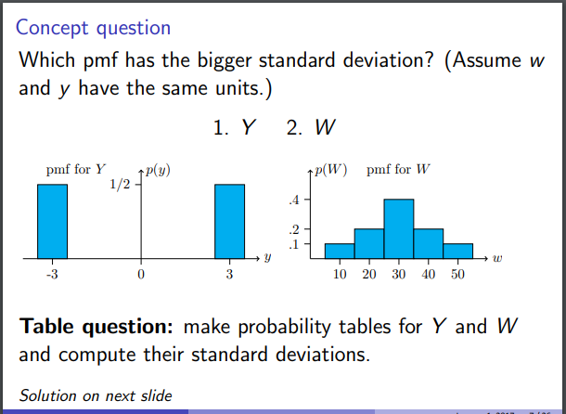
An example

Slide 32
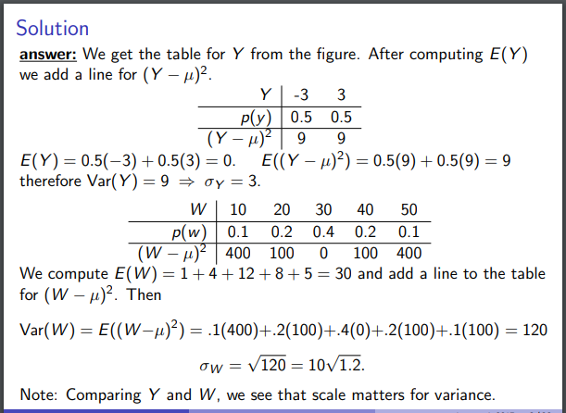
The Solution

Slide 33
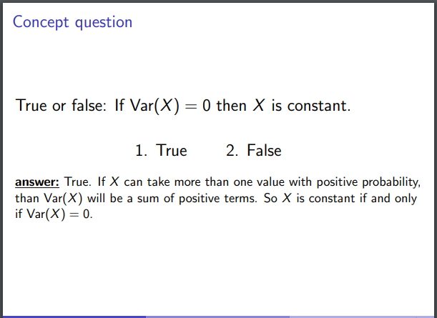
The Solution

Slide 34
Covariance

Slide 35
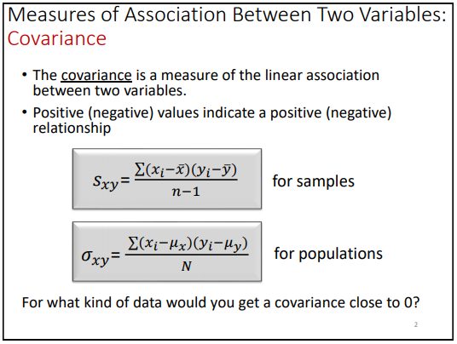
Covariance
Similar to variance, but variance tells you how a single variable varies whereas covariance tells you how two variables vary together.

Slide 36
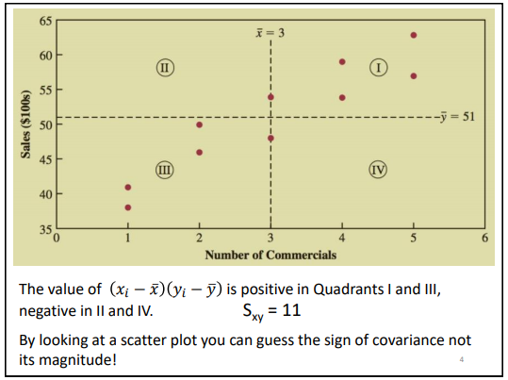
Covariance

Slide 37
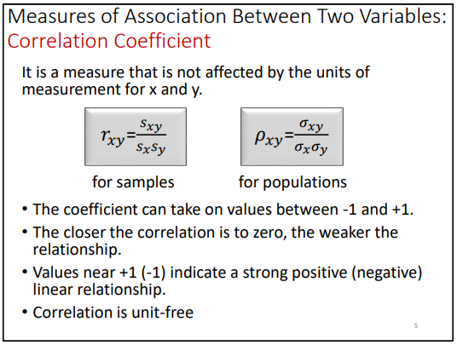
Correlation Coefficient

Slide 38
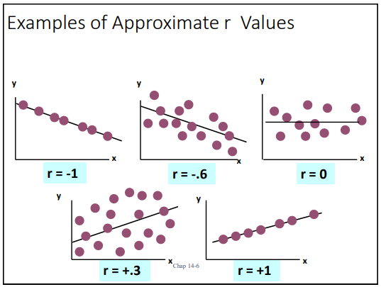
Correlation Coefficient

Slide 39
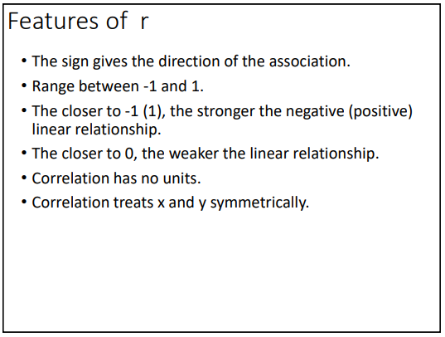
Correlation Coefficient

Slide 40
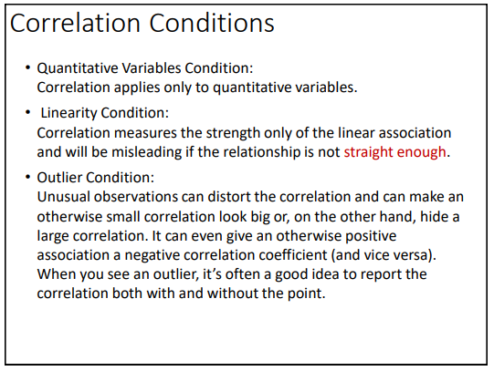
Correlation Coefficient

Slide 41
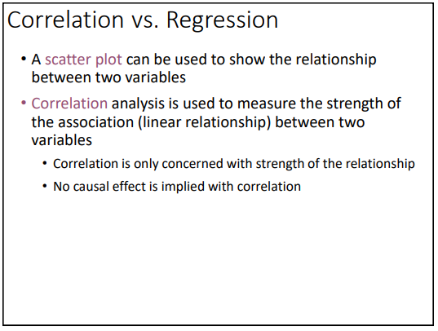
Correlation Coefficient

