Slide 1
COMPUTATIONAL APPROACHES
TO PROBLEM SOLVING
String Like a Bee: Sequences

Slide 2
Memorizing All Passwords
Facebook
Gmail
Facebook → 8 characters
okFa8eight(
Fa ok
okFa
Gm il
ilGm
Gmail → 5 characters
ilGm5five%
Different passwords for each website with just one algorithm
Do not try to hack me ☺
You may assume that the number of characters will be between 5 and 9

Slide 3
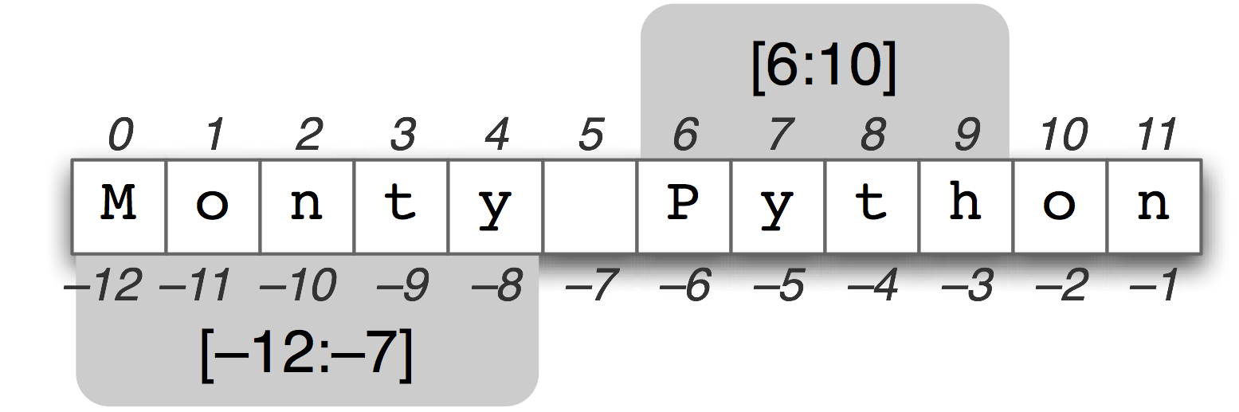
Sequences
String
List
Range

Slide 4


Slide 5
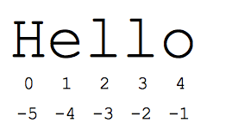
Strings
Contiguous set of characters represented in quotation marks
Python allows for either pairs of single or double quotes
name = 'Messi'
name = "Messi"
Subsequence of strings can be taken using the slice operator ([ ] and [:] ) with indexes starting at 0 in the beginning of the string

Slide 6
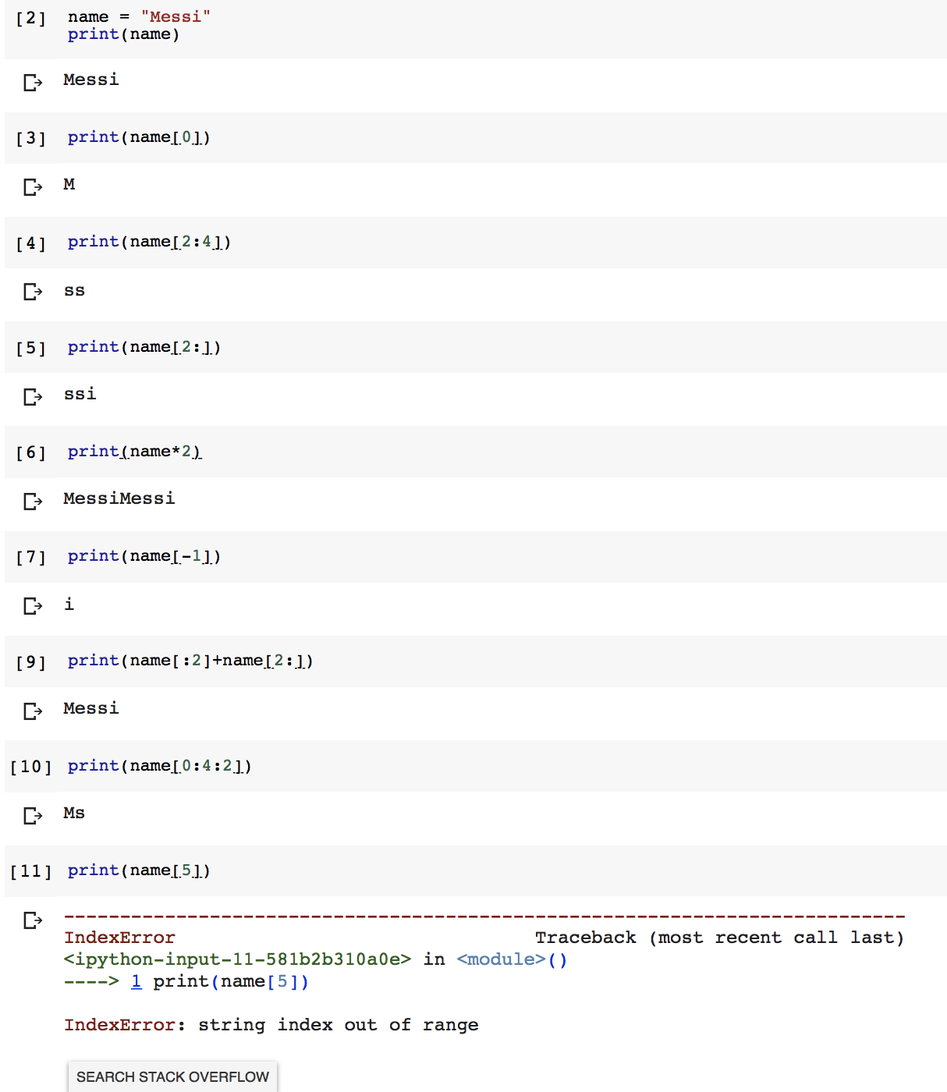
Slices of Strings
name[2:4] → index 2 is inclusive, but index 4 is exclusive
name[2:] → all characters starting from the index 2
name[-1] → the last character name[-2:] → characters from the second-last (included) to the end
name[0:5:2] → elements from index 0 (included) to index 5 (excluded) with a step size of 2 Attempting to use an index that is too large will result in an error

Slide 7
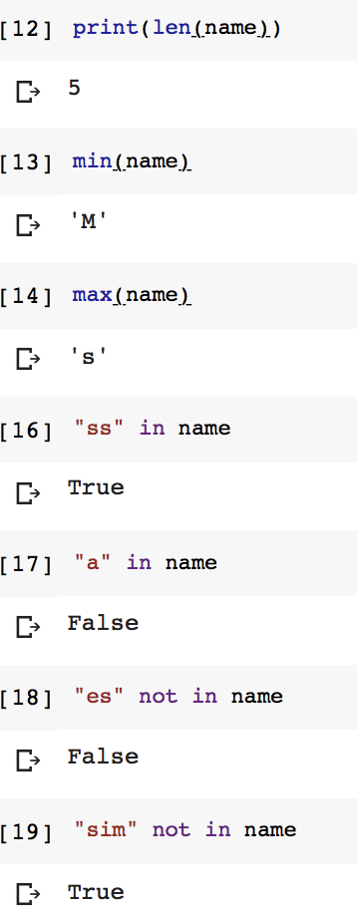
Operation on Strings
Assume name is “Messi” again.
len() returns the length of the string
min() returns the minimum element
ASCII representation (Alphabetical order)
max() returns the maximum element
ASCII representation (Alphabetical order)
x in name → True if x exists in name, else False
x not in name → True if x does not exists in name,
else False

Slide 8
Memorizing All Passwords
Facebook
Gmail
Facebook → 8 characters
okFa8eight(
Fa ok
okFa
Gm il
ilGm
Gmail → 5 characters
ilGm5five%
Different passwords for each website with just one algorithm
Do not try to hack me ☺
You may assume that the number of characters will be between 5 and 9

Slide 9
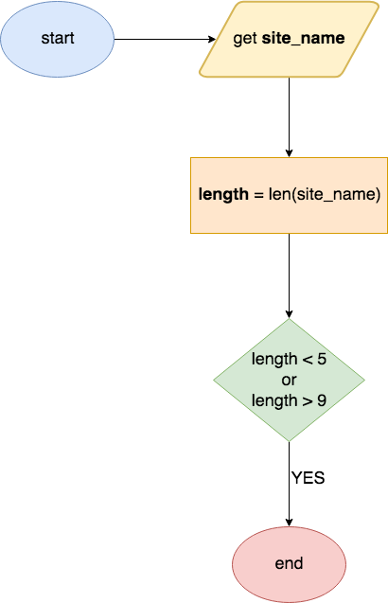
Flowchart

Slide 10
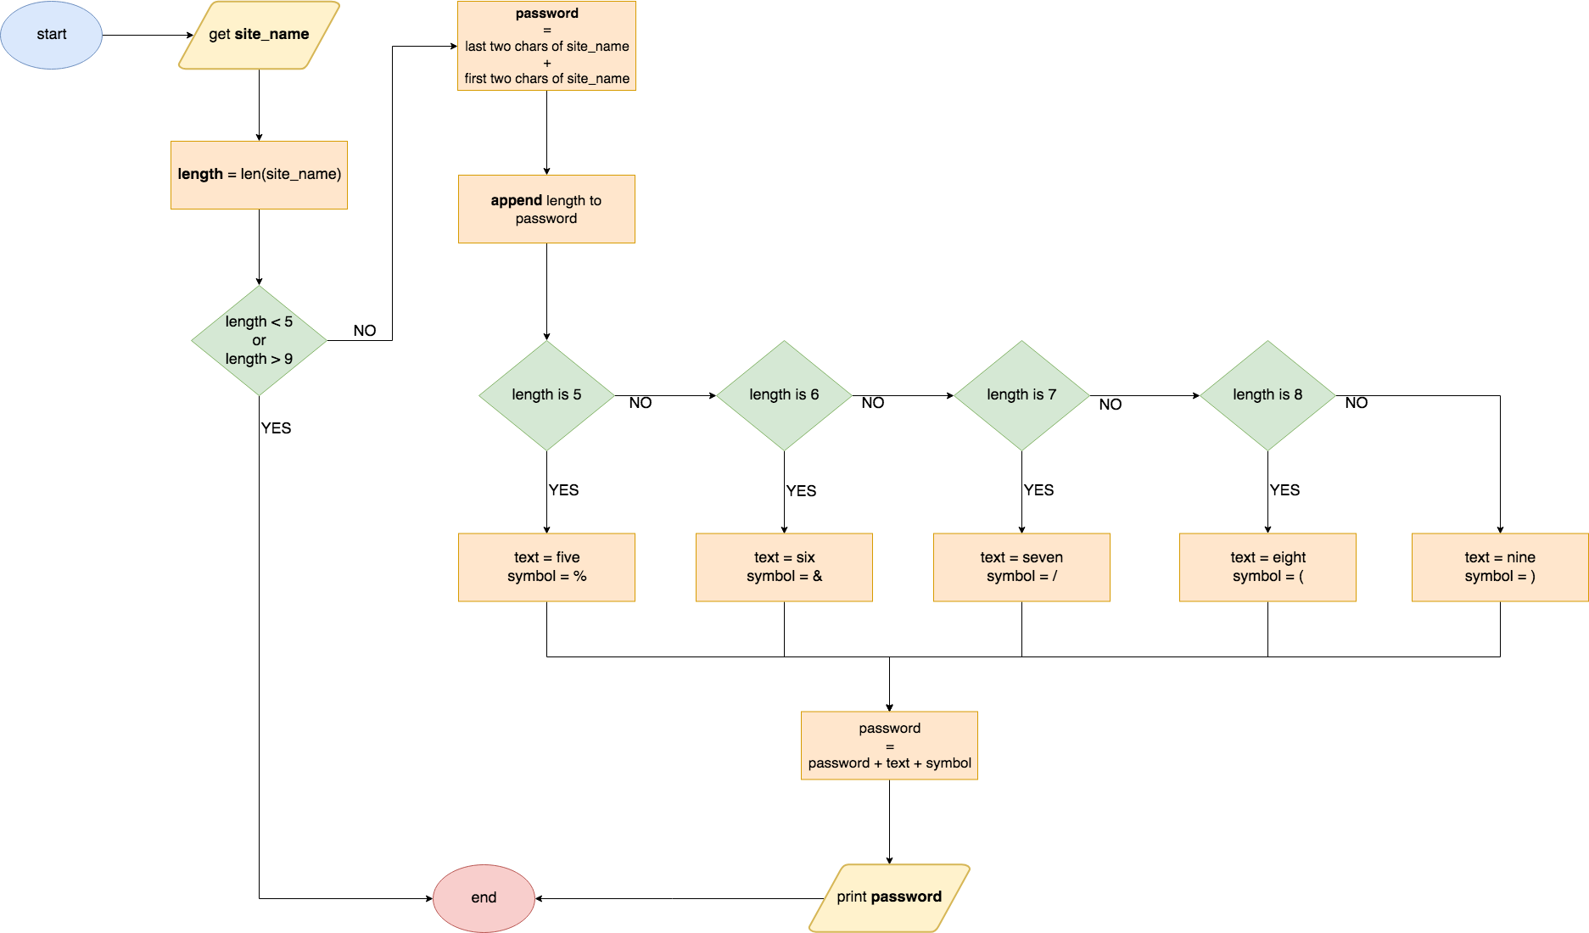

Slide 11
website_password.py

Slide 12
OPERATION | RESULT
x in s | True if an item of s is equal to x, else False
x not in s | False if an item of s is equal to x, else True
s + t | the concatenation of s and t (not applicable to range)
s*n or n*s | equivalent to adding s to itself n times (not applicable to range)
s[i] | i ^{th} item of s, origin 0
s[i:j] | slice of s from i to j
s[i:j:k] | slice of s from i to j with step k
len(s) | length of s
min(s) | smallest item of s
max(s) | largest item of s
Common Sequence
Operations

Slide 13
Car Colour Distribution in SU FASS Parking Area
One of your TAs recorded the colours of the cars parked at SU FASS parking area last Friday. Following are the results:
COLOUR | NUMBER OF CARS
White | 12
Black | 18
Red | 8
Blue | 5

Slide 14
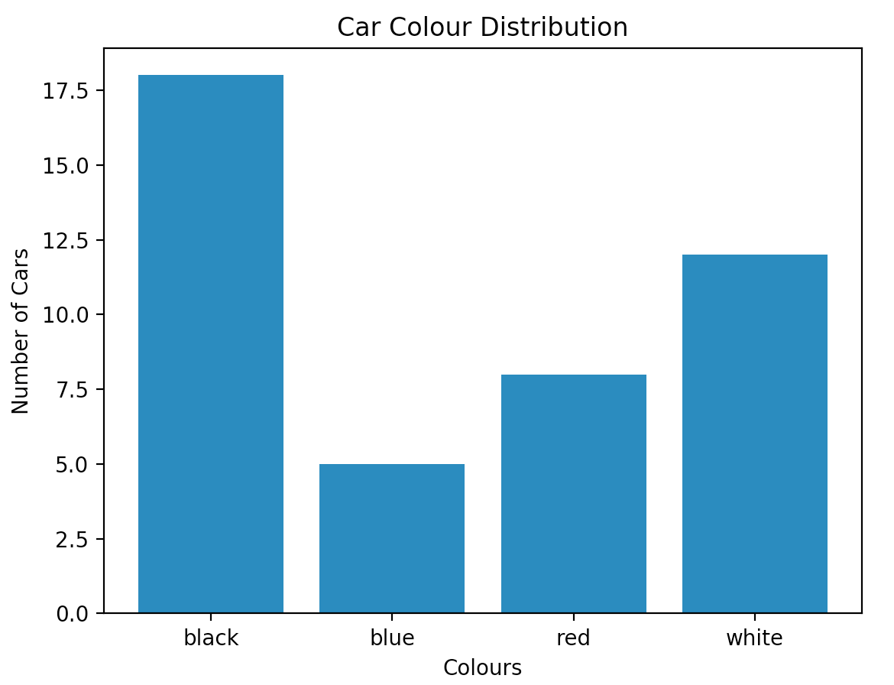
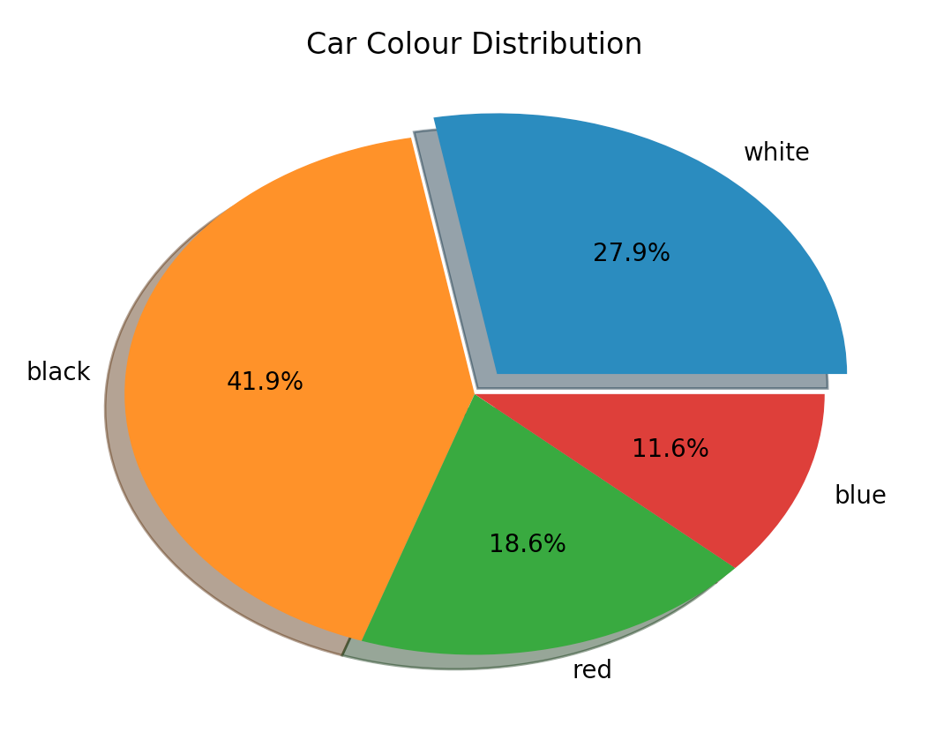
Car Colour Distribution Bar/Pie Chart
Plot the car colour distribution in SU FASS parking area on 16.03.2018
We need to learn two new concepts to do that:
list → A data type to hold group of information
matplotlib → Python 2D plotting library

Slide 15
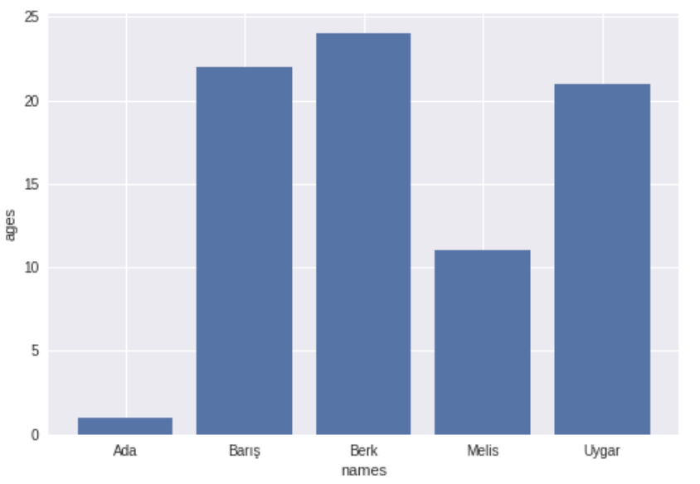
Car Colour Distribution Bar/Pie Chart
Plot the car colour distribution in SU FASS parking area on 16.03.2018
We need to learn two new concepts to do that:
list → A data type to hold group of information
matplotlib → Python 2D plotting library

Slide 16

Lists
List is the most versatile data type available which can be written as a list of comma-separated values (items) between square brackets
Lists might contain items of different types, but usually all the items have the same type

Slide 17
Car Colour Distribution Bar/Pie Chart
Plot the car colour distribution in SU FASS parking area on 18.03.2018
We need to learn two new concepts to do that:
list → A data type to hold group of information
matplotlib → Python 2D plotting library

Slide 18
Car Colour Distribution Bar/Pie Chart
Plot the car colour distribution in SU FASS parking area on 16.03.2018
We need to learn two new concepts to do that:
list → A data type to hold group of information
matplotlib → Python 2D plotting library

Slide 19
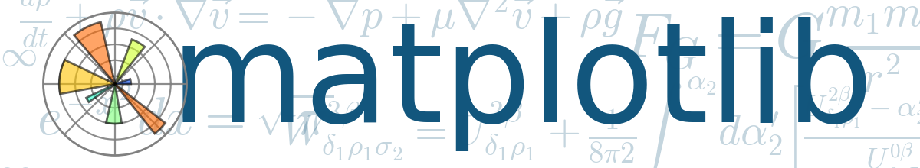
Matplotlib
A Python 2D plotting library

Slide 20
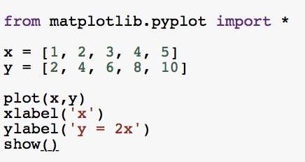
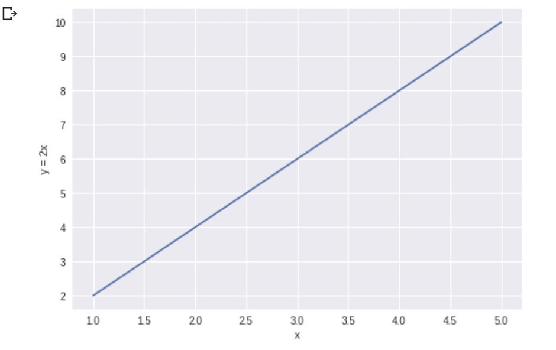
How to use Matplotlib
We add following line to the beginning of the program in order to be able to use the matplotlib library in the program:
from matplotlib.pyplot import *

Slide 21
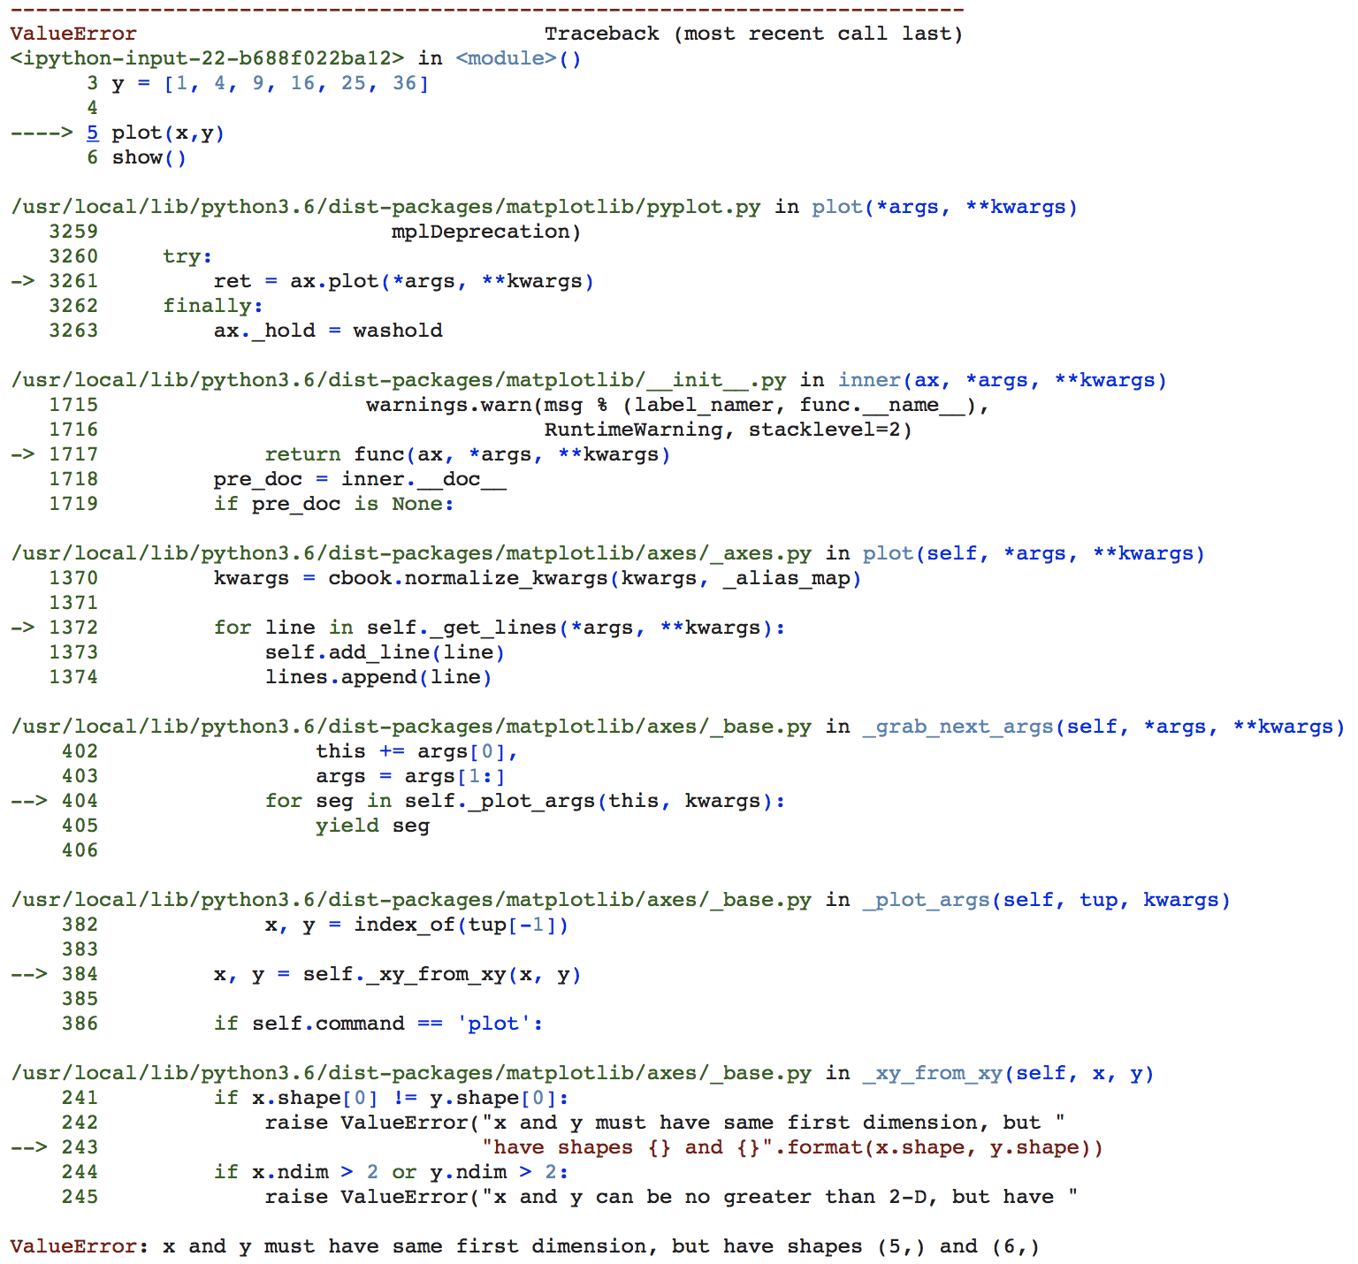
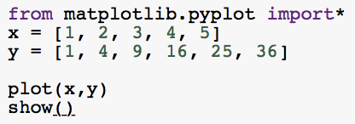
How to use Matplotlib
List sizes must be equal!

Slide 22
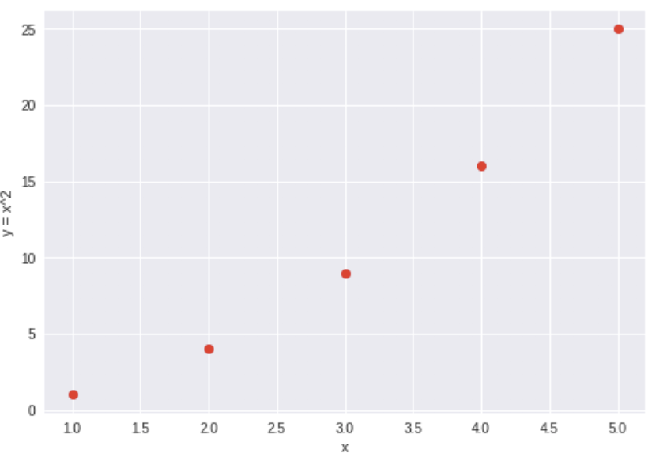
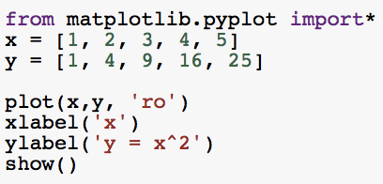
How to use Matplotlib

Slide 23
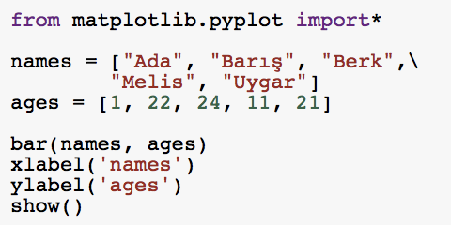
How to use Matplotlib

Slide 24
Car Colour Distribution in SU FASS Parking Area
One of your TAs recorded the colours of the cars parked at SU FASS parking area last Friday. Following are the results:
COLOUR | NUMBER OF CARS
White | 12
Black | 18
Red | 8
Blue | 5

Slide 25
car_colour_dist.py

Slide 26
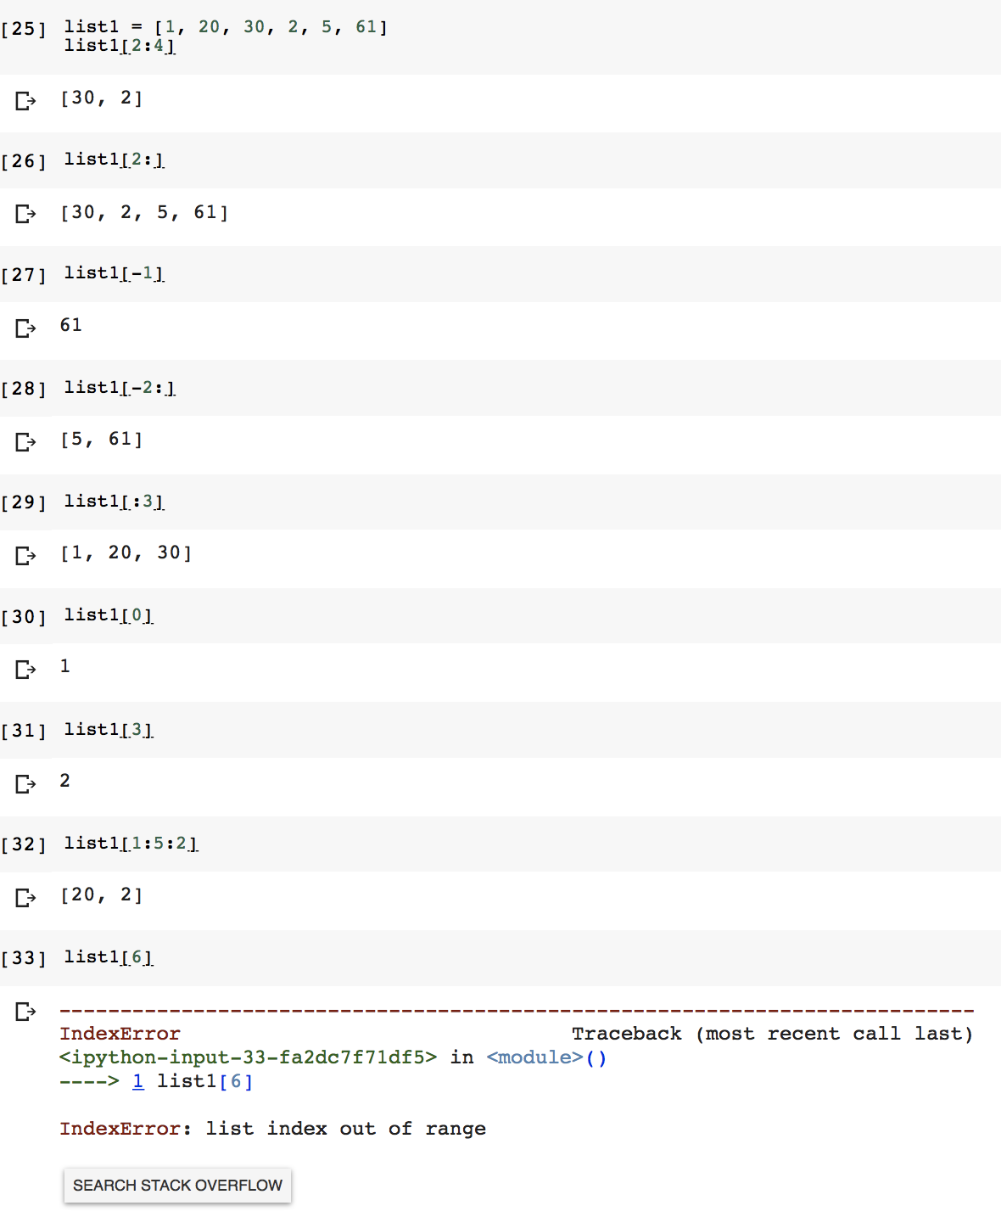
Slices of Lists
list1[2:4] → index 2 is inclusive, but index 4 is exclusive
list1[2:] → all elements starting from the index 2
list1[-1] → the last element
list1[-2:] → elements from the second-last (included) to the end
list1[:3] → elements from index 0 (included) to index 3 (excluded)
list1[1:5:2] → elements from index 1 (included) to index 5 (excluded) with a step size of 2
Attempting to use an index that is too large will result in an error
All slice operations return a new list with the requested elements
This means that list1[:] returns a new copy of list1

Slide 27
TOP HAT

Slide 28
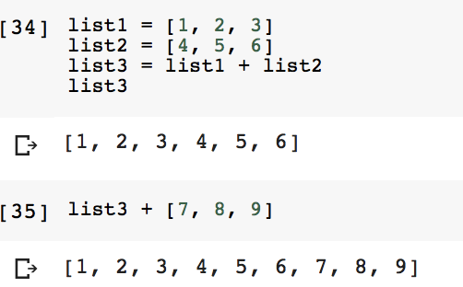
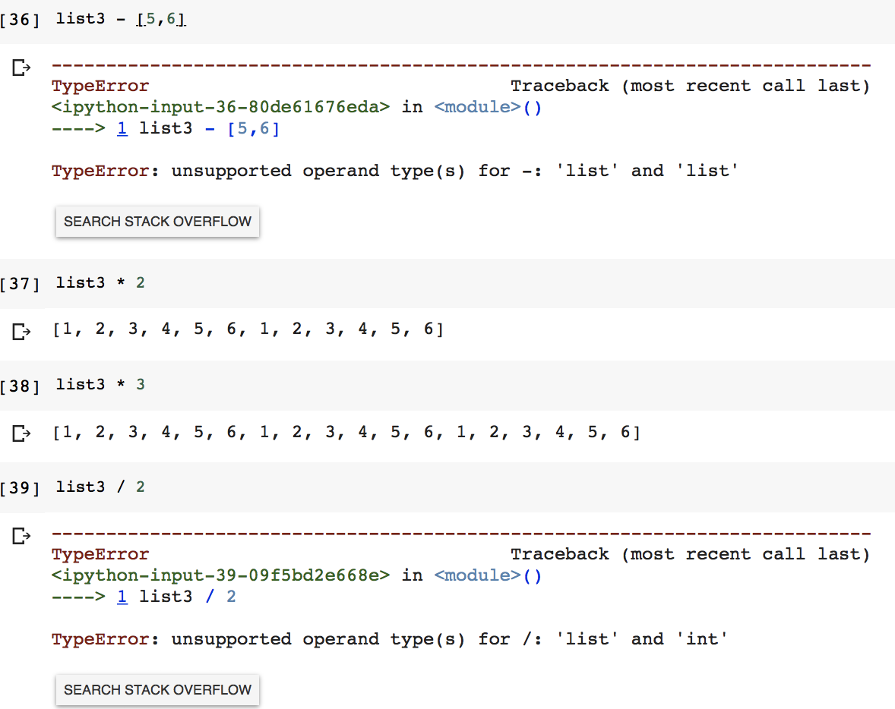
Operations on Lists
Lists also support operations like concatenation (+)
Multiplication operator (*) means repetition of the list
However, subtraction & division operators are NOT valid for lists

Slide 29
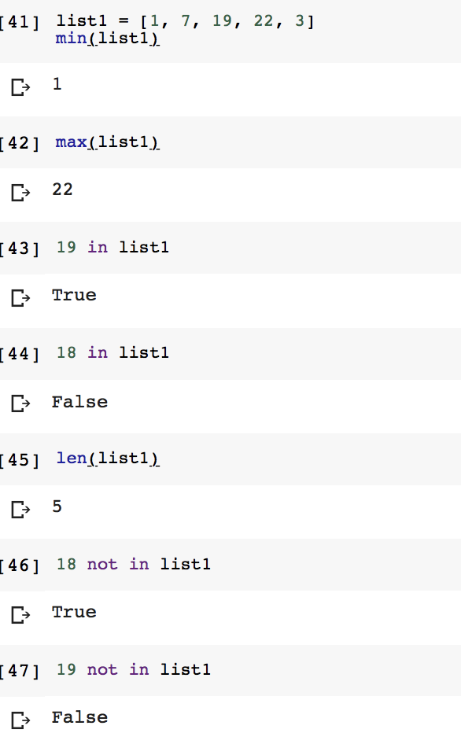
Operations on Lists
There are some built-in operations for lists: len(list1) → the number of elements in list1 min(list1) → the minimum element in list1 max(list1) → the maximum element in list1 x in list1 → True if an item of list1 is equal to x, else False x not in list1 → False if an item of list1 is equal to x, else True

Slide 30
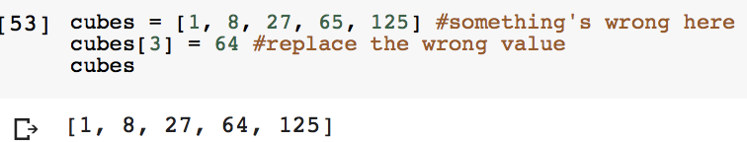
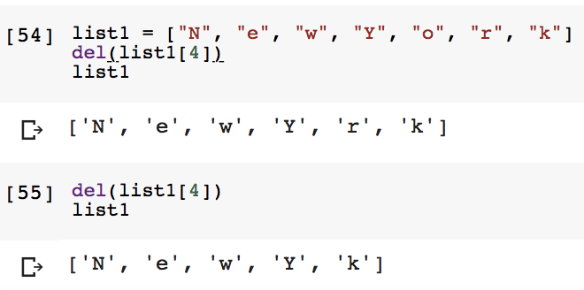
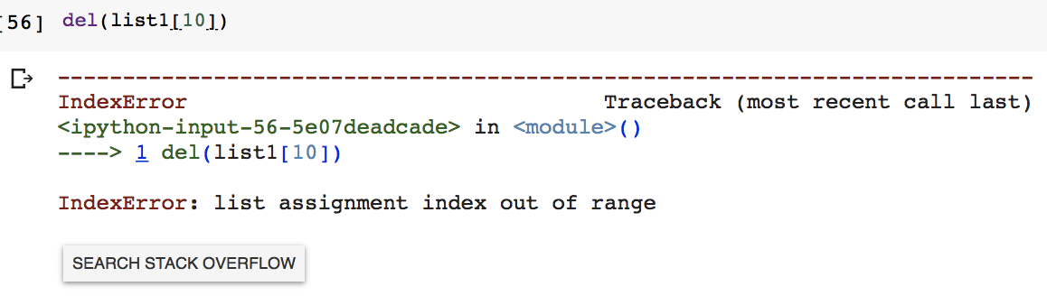
Updating & Deleting Elements of a List
Lists are mutable (i.e. updatable) → elements of lists can be updated
Elements of a list can be deleted by the built-in del() function
This function takes the the list with the index to be deleted as parameter
del(list1[4]) → the element in the index 4 of list1 will be deleted
It is an error to attempt to delete an element that does not exist

Slide 31
TOP HAT

Slide 32
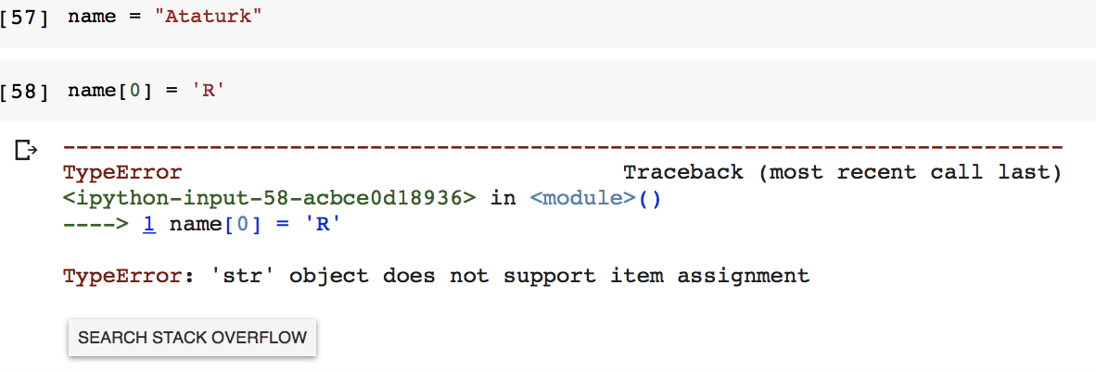
Updating Characters of String
Remember that lists are mutable → elements of lists can be updated
On the other hand, strings are immutable

Slide 33
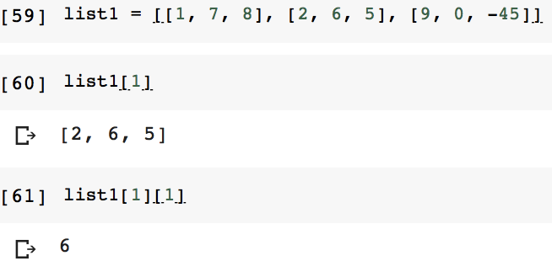
Nested List
An element of a list can be another list
list1[1] → returns the index 1 of list1, which is [2,6,5]
list1[1][1] → returns the index 1 of [2,6,5], which is 6

Slide 34
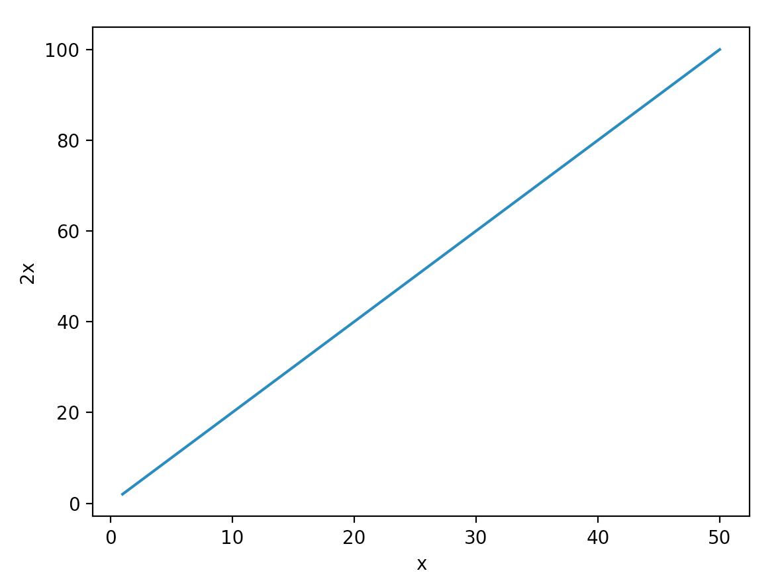
Plot y=2x for x={1, 2, 3, 4, …, 50}
We need to learn another new concept to do that:
range → A data type to hold list of numbers
Notes:
Shorter notation to write a large list of numbers

Slide 35
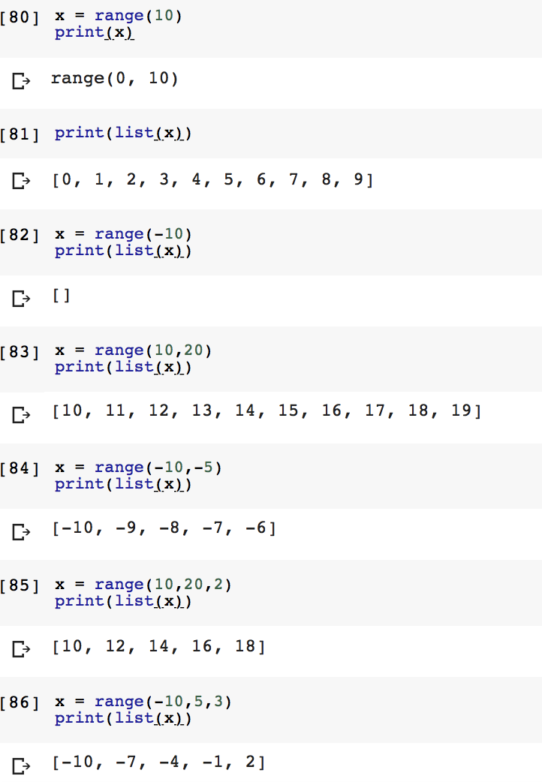
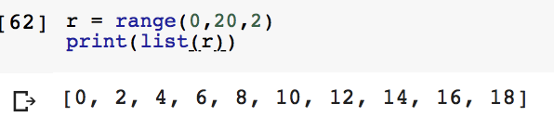
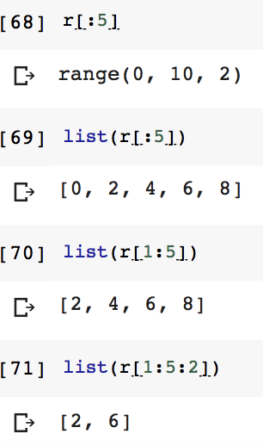
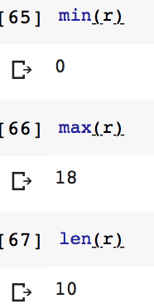
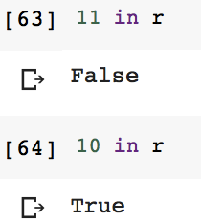
range(start, stop, step)
0 by default
1 by default

Slide 36
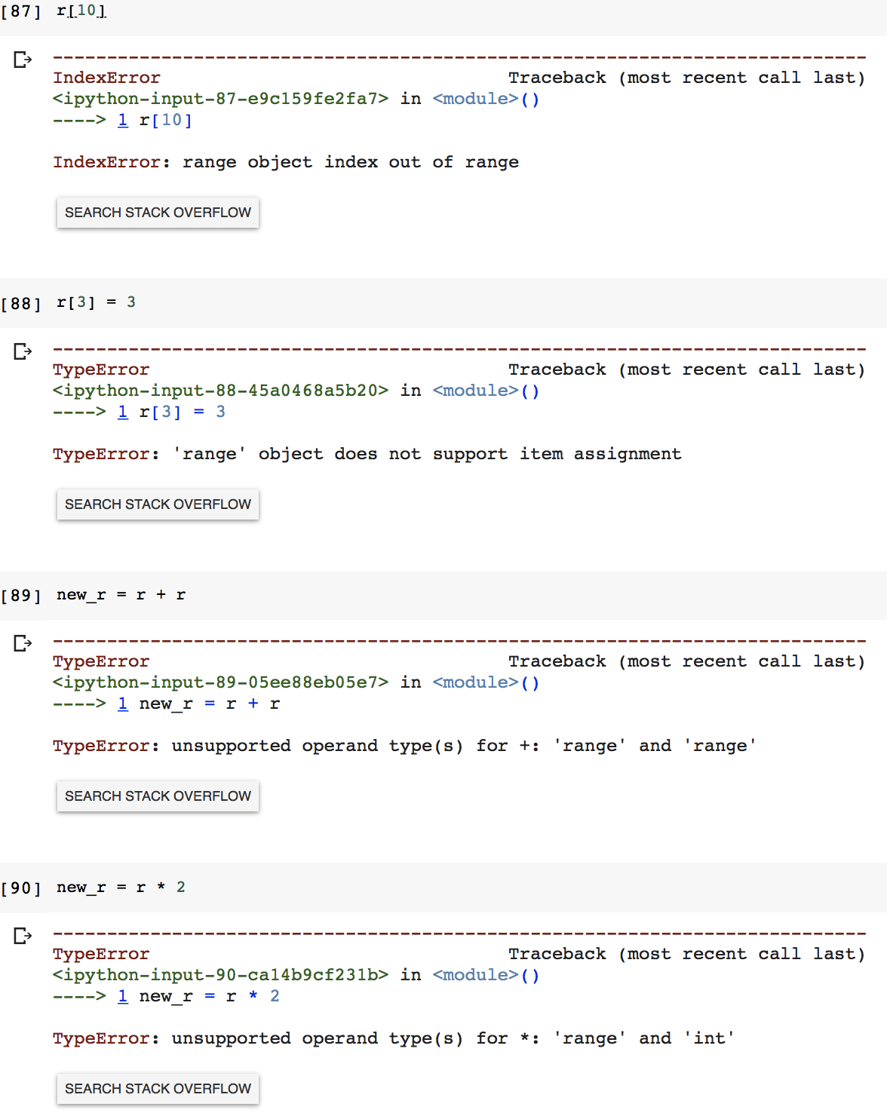
range(start, stop, step)
Attempting to use an index that is too large will result in an error
Immutable sequence
Don’t support sequence concatenation or repetition!

Slide 37
Plot y=2x for x={1, 2, 3, 4, …, 50}

Slide 38
plot_range.py

Slide 39
Values versus References
Every variable references a location in the memory & its value is stored in that location
If you assign a value to a variable, then it has a new location in the memory
If you assign another variable to a variable, they share the same location (reference)
x = 5
Memory
x
5

Slide 40
Values versus References
Every variable references a location in the memory & its value is stored in that location
If you assign a value to a variable, then it has a new location in the memory
If you assign another variable to a variable, they share the same location (reference)
x = 5
Memory
y = 3
x
5
y
3

Slide 41
Values versus References
Every variable references a location in the memory & its value is stored in that location
If you assign a value to a variable, then it has a new location in the memory
If you assign another variable to a variable, they share the same location (reference)
x = 5
Memory
y = 3
x
5
z = x
z
y
3

Slide 42
Values versus References
Every variable references a location in the memory & its value is stored in that location
If you assign a value to a variable, then it has a new location in the memory
If you assign another variable to a variable, they share the same location (reference)
x = 5
Memory
y = 3
x
5
z = x
z
7
z = 7
y
3

Slide 43
Values versus References
Every variable references a location in the memory & its value is stored in that location
If you assign a value to a variable, then it has a new location in the memory
If you assign another variable to a variable, they share the same location (reference)
x = 5
Memory
y = 3
x
5
y += 1
z = x
z
7
z = 7
y
3
y
4

Slide 44
Values versus References
Every variable references a location in the memory & its value is stored in that location
If you assign a value to a variable, then it has a new location in the memory
If you assign another variable to a variable, they share the same location (reference)
list1 = [4,3,2,1]
list1
Memory
4
3
2
1

Slide 45
Values versus References
Every variable references a location in the memory & its value is stored in that location
If you assign a value to a variable, then it has a new location in the memory
If you assign another variable to a variable, they share the same location (reference)
list1 = [4,3,2,1]
list1
Memory
4
3
2
1
list2 = list1
list2

Slide 46

Values versus References
Every variable references a location in the memory & its value is stored in that location
If you assign a value to a variable, then it has a new location in the memory
If you assign another variable to a variable, they share the same location (reference)
list1 = [4,3,2,1]
list1
Memory
4
3
2
1
list2 = list1
list2
print("list1:", list1) print("list2:", list2)

Slide 47
Values versus References
Every variable references a location in the memory & its value is stored in that location
If you assign a value to a variable, then it has a new location in the memory
If you assign another variable to a variable, they share the same location (reference)
list1 = [4,3,2,1]
list1
Memory
4
3
7
1
list2 = list1
list2
print("list1:", list1) print("list2:", list2)
list1[2] = 7

Slide 48

Values versus References
Every variable references a location in the memory & its value is stored in that location
If you assign a value to a variable, then it has a new location in the memory
If you assign another variable to a variable, they share the same location (reference)
list1 = [4,3,2,1]
list1
Memory
4
3
7
1
list2 = list1
list2
print("list1:", list1) print("list2:", list2)
list1[2] = 7
print("list1:", list1) print("list2:", list2)

Slide 49
Values versus References
Every variable references a location in the memory & its value is stored in that location
If you assign a value to a variable, then it has a new location in the memory
If you assign another variable to a variable, they share the same location (reference)
list1 = [4,3,2,1]
list1
Memory
4
3
7
1
list2 = list1
print("list1:", list1) print("list2:", list2)
list1[2] = 7
print("list1:", list1) print("list2:", list2)
list2
"a"
"b"
list2 = ["a", "b"]

Slide 50

Values versus References
Every variable references a location in the memory & its value is stored in that location
If you assign a value to a variable, then it has a new location in the memory
If you assign another variable to a variable, they share the same location (reference)
list1 = [4,3,2,1]
list2 = list1
list1
Memory
4
3
7
1
print("list1:", list1) print("list2:", list2)
list1[2] = 7
print("list1:", list1) print("list2:", list2)
list2
"a"
"b"
list2 = ["a", "b"]
print("list1:", list1) print("list2:", list2)

Slide 51
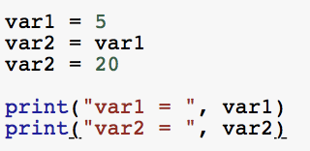
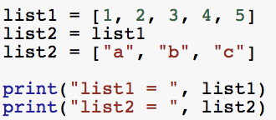
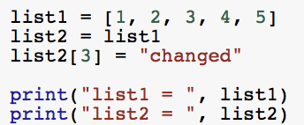



Values versus References

