Slide 1
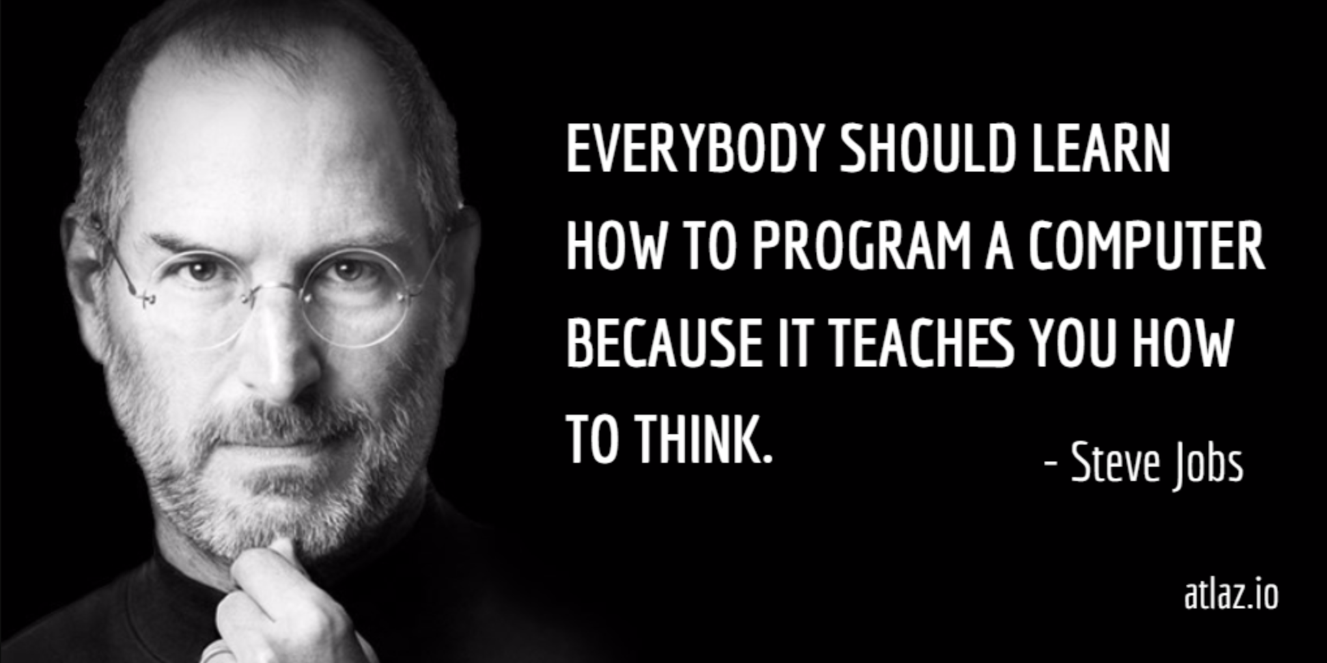

Slide 2
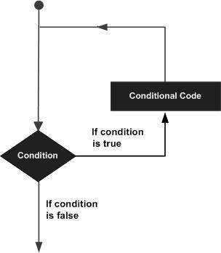
Loops
A loop statement allows us to execute a statement or a group of statements multiple times
2 types of loop statements:
for statement
while statement
Loop control statement:
break

Slide 3
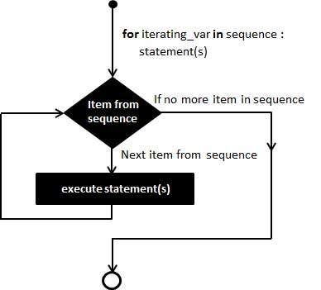
For
Statement
Executes a set of statements multiple times & abbreviates the code that manages the loop variable
Brush your teeth 3 times a day
If you are a cashier, for each item that the customer wants to buy, add the price of that item to the bill
Has the ability to iterate over the items of any sequence (list/string/range)

Slide 4
For
Statement
for iterating_var in sequence:
<statement_true_1>
…
<statement_true_N>

Slide 5
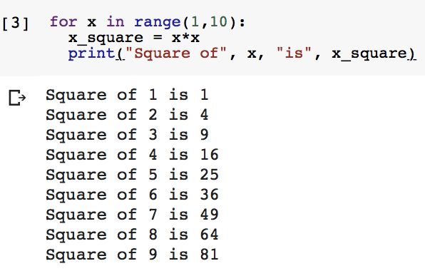

For Loop Example
Sequence (can be a range)
iterating_var
loop body statements

Slide 6
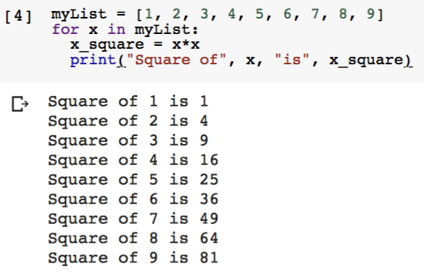
For Loop Example
Sequence (can be a list)

Slide 7
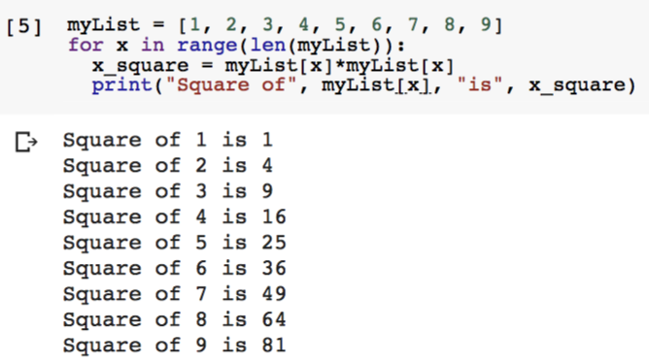
For Loop Example
Going over the indices of a list
range(len(myList)) -> range(0,9)

Slide 8
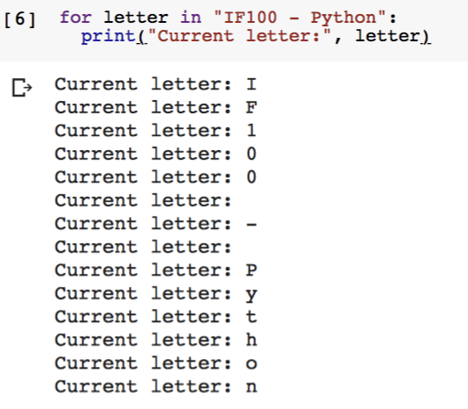
For Loop Example
iterating_var
Sequence (can be a string)
loop body statement

Slide 9
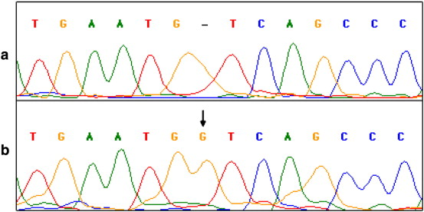
DNA Sequence Alignment
Sequence alignment describes the way of aligning DNA, RNA, or protein sequences to highlight or identify similarities between these sequences.
Assume that you will write a program to align two input DNA strings. But first, you have to check whether the input strings indeed correctly define DNA sequences or not, meaning that they consist only of the letters “A”, “C”, “G”, and “T”, either lowercase or uppercase (i.e. case-insensitive).

Slide 10
DNA Sequence Alignment
There are 4 different bases in a DNA, that are nucleotides whose names are abbreviated as A, C, G and T. In the human genome, there are about 3 billions bases if you go from the beginning to the end.
Let’s assume that we find an invalid nucleotide in some point.
Do we need to check the remaining nucleotides? (There maybe millions or billions more)

Slide 11
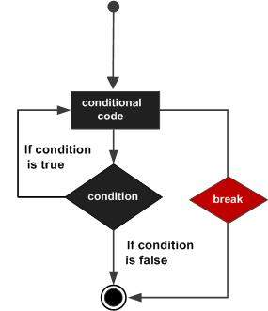
Break
Statement
Break statement terminates the innermost loop statement & transfers execution to the statement immediately following the loop
Break statement can be used in both while and for loops

Slide 12




Break Example

Slide 13

Guess the Secret Number
The computer will pick a secret number between 1 and 100, and we will try to guess what number it is. If our guess is too high or too low, the computer will give us a hint and ask for another guess until it is correct. At the end, the computer will inform us on how many attempts we guessed the secret correctly.

Slide 14
Decomposition: Guess the Secret Number
Computer will pick a secret between 1 & 100
User will enter a guess, which will be checked against the secret and relevant output will be displayed (smaller/bigger/equal)
User will enter guesses continuously until the correct guess is made
The number of attempts will be counted & displayed in the output

Slide 15
Loops
A loop statement allows us to execute a statement or a group of statements multiple times
2 types of loop statements:
for statement
while statement
Loop control statement:
break

Slide 16
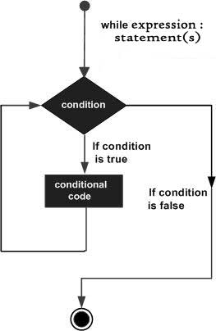
While Statement
Repeats a statement or a group of statements while a given condition is True
When you come across the red light in traffic, stop and wait while the color of the light is red
To buy a coffee from Starbucks, wait in the line while you are not in the front
You cannot graduate until the graduation criteria are met
Works with a condition
Tests condition before executing loop body
Perform task until condition is no longer true
Key point is that the loop might not ever run
When the test condition is false, the loop body will be skipped

Slide 17
While Statement
condition initialization
while <condition>:
<statement_true_1>
…
<statement_true_N>
condition update
Condition update is crucial to terminate the loop at some point; otherwise, it may turn into an infinite loop

Slide 18
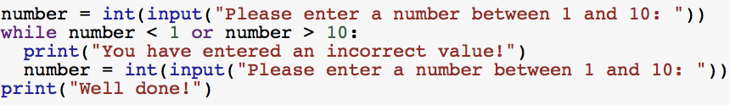
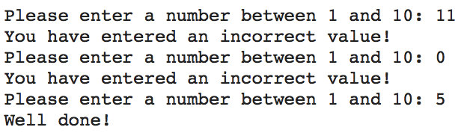
While Loop Example
condition initialization
Forcing the user to enter an integer value in range [1,10]
condition
loop body statements
condition update

Slide 19
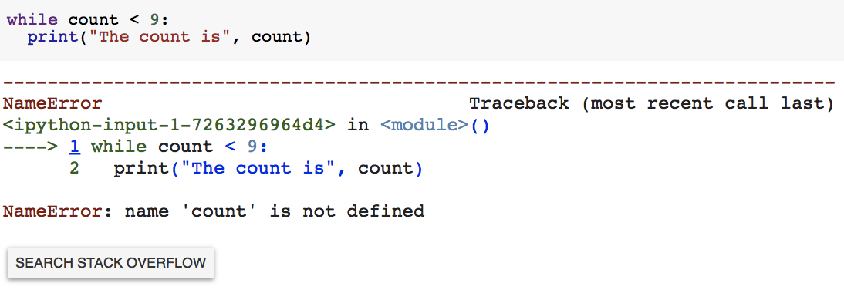
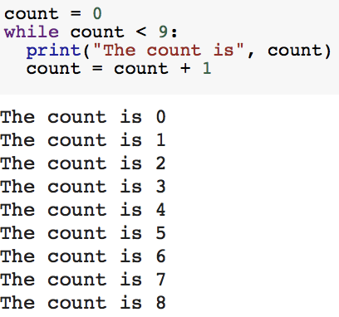
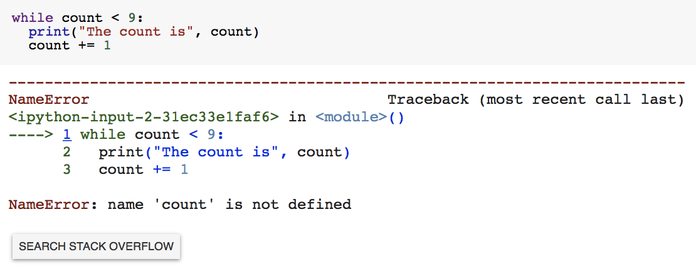
More on While Loops

Slide 20

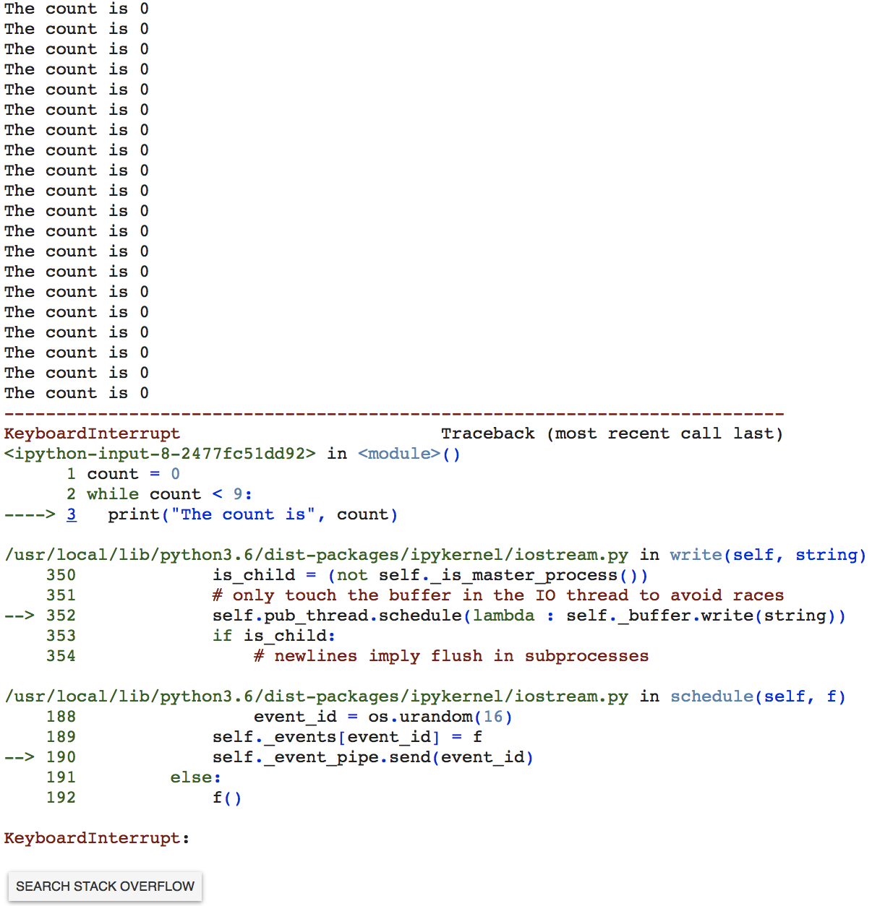
More on While Loops
KeyboardInterrupt to terminate an infinite loop
ctrl+c for Windows
kntrl+c for MacOS

Slide 21
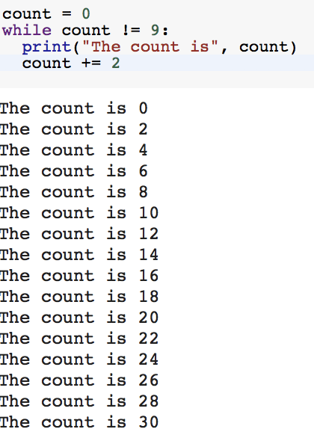
More on While Loops
You should be careful about the condition update
The condition may never be False, so the loop may iterate forever (infinite loop)

