Slide 1
Spring 2021
DATS 501 Fundamentals of Data Science
Hasan Demirtaş
hasan.demirtas@yeditepe.edu.tr (hdemirtas.academic@gmail.com)
Cumhur Baştürk
cbasturk.academic@gmail.com (basturkc@gmail.com)

Slide 2
Regression

Slide 3
Simple (Univariate) LinearRegression

Slide 4
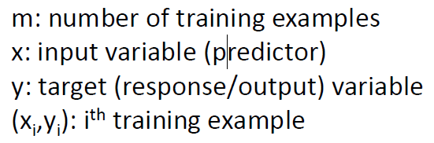
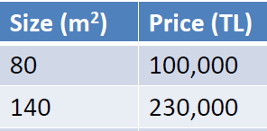


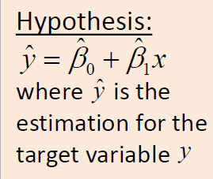
-A supervised learning problem
-Provides a numerical prediction for the target variable

Slide 5
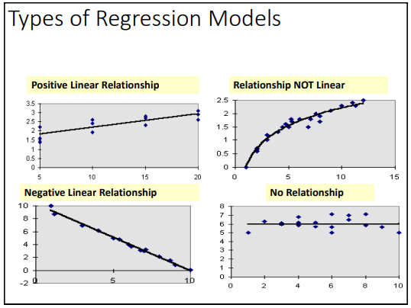

Slide 6
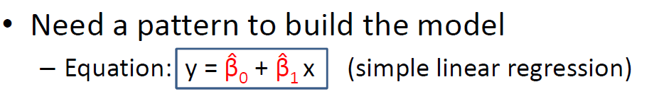
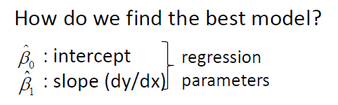
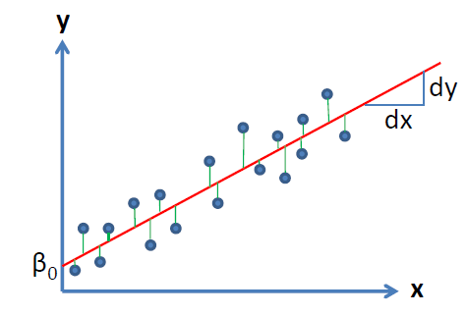


Slide 7
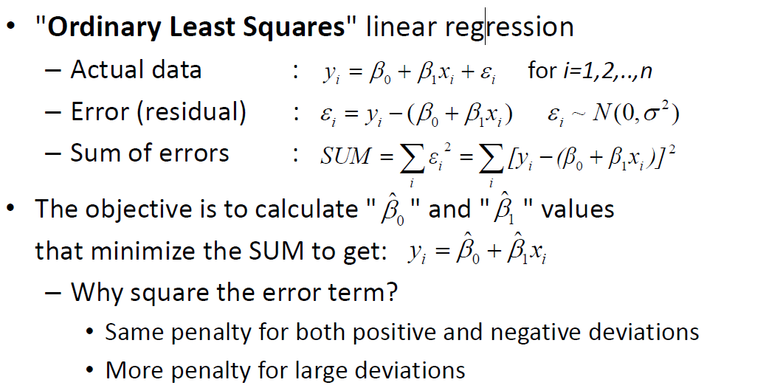
Best fit line

Slide 8
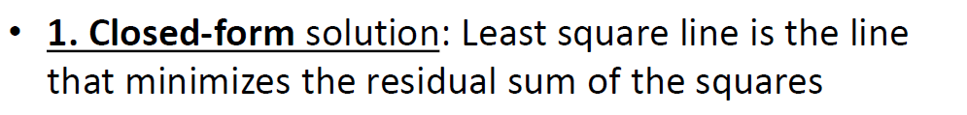

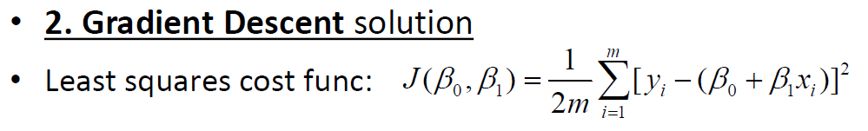

Slide 9
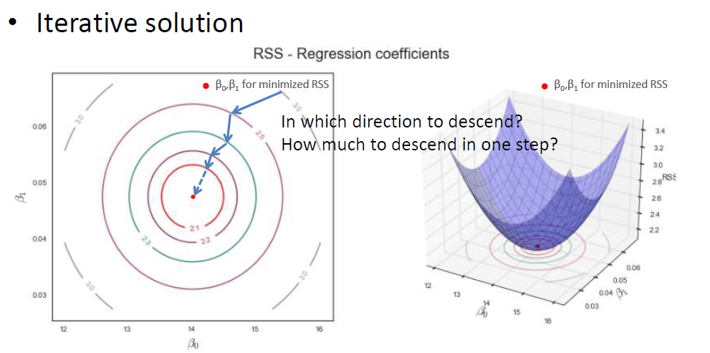

Slide 10
Multiple (Multivariate) LinearRegression

Slide 11
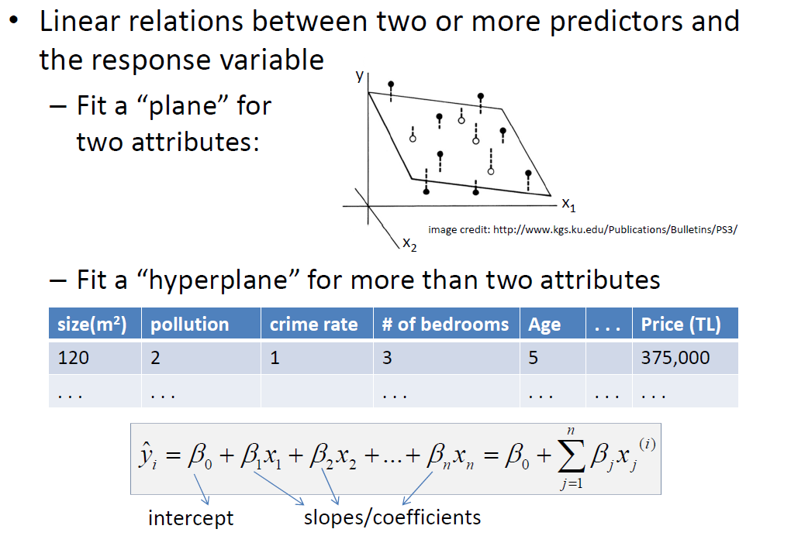

Slide 12
Having more than one variable introduces some important issues that have to be dealt with:
1. Overfitting
• As we add more variables, we get better fit for the current data. The regression model, however,
may turn out to be too tailored to the current data, and may not generalize well enough for new data.
2. Correlation among variables (multicollinearity)
• Severe multicollinearity might be a problem that has to be dealt with
3. Interaction among variables
• y = α + β1x1 + β2x2 + β3x1x2
4. Different scales among variables
• Centering/scaling may be needed

Slide 13
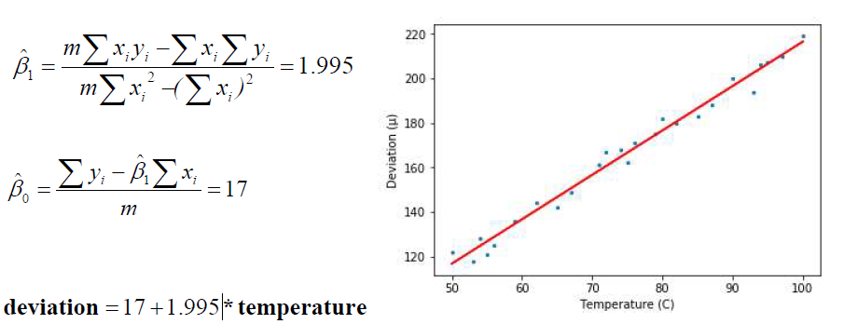
Example
A machine produces high-precision parts with some deviation (in μ) from the specs as temperature (oC) changes.
Fit a least squares line for the data given below.
deviation = [122,118,128,121,125,136,144,142,149,161,167,168,162,
171,175,182,180,183,188,200,194,206,207,210,219]
temperature = [50,53,54,55,56,59,62,65,67,71,72,74,75,76,79,80,82,85,87,90,93,94,95,97,100]

Slide 14
Interpretation of coefficients
• Regression coefficients (slopes) represent the mean variation in the target variable for one unit of change in the predictor while keeping all other predictors constant. In this example, a 1oC increase in temperature increases the deviation (μ) by 2.
• Intercept is the value you would predict if x=0. However, this is only meaningful if a zero value for x and the corresponding value for y make sense.
• Different units and scales among the predictors make a direct comparison impossible. So larger coefficients don’t necessarily identify more important predictors.
• Standardizing coefficients and bringing them to same scale might help, but one has to be careful with this approach.

Slide 15
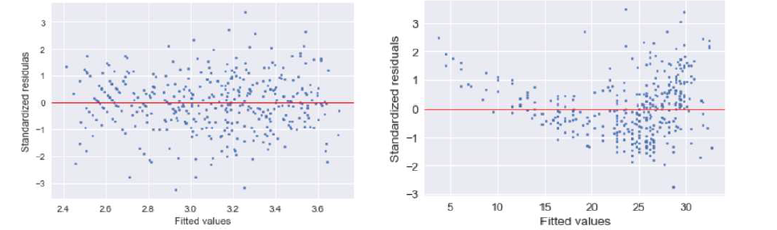
Residuals
• The difference between the observed value of the dependent variable (y) and the predicted value (ŷ) is called
the residual (e). Each data point has one residual. Both the sum and the mean of the residuals are equal to zero.
• The residual plot is a very useful tool for diagnostic purposes. A nonlinear behavior in the residuals, for example, tells you that the regression solution wasn't able to capture nonlinearity in the data.

Slide 16
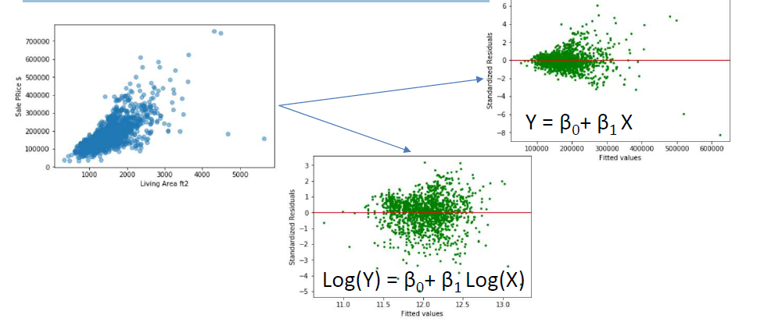
Residuals
Residuals should be randomly distributed with no sign of any trend. If it does, it means:
i. Nonlinearity not captured in regression
ii. Omission of a variable that should be there
Fix: Variable transformation might help

Slide 17
Model quality
• How do we measure the model performance, how do we know that we have a good fit?
• There are a number of parameters we can check to assess the accuracy of our model.
– F-statistic (of overall significance)
– p-value (for every predictor)
– Coefficient of determination: R2 value
– Adjusted R2 value
– Root mean squared error: RMSE
– Standard error of the regression: S
– Predicted R2 value (leave-one-out) or AIC/BIC

Slide 18
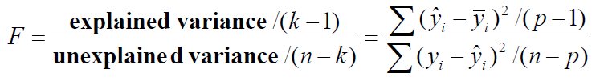
• F-statistic:
– where n is the total number of observations and p is the number of predictors + 1 (for intercept)
• If p-value for Fstat ≤ .05 => overall addition of predictors significantly improves the model
p-value
• Null hypothesis (for every predictor): predictor has no effect on the target variable.
• So a low p-value (< 0.05) indicates that we can reject the Null hypothesis
i.e., a change in the predictor with a low p-value is likely to relate to changes in the target variable.
There are few reasons to remove insignificant predictors and many reasons not to:
– The predictor may affect other aspects of model
– As you remove a non-significant predictor, others that are correlated may become significant
(makes you think how important it is to have orthogonal predictors in designing the experiment)
• There are no p-values for variables in nonlinear regression

Slide 19
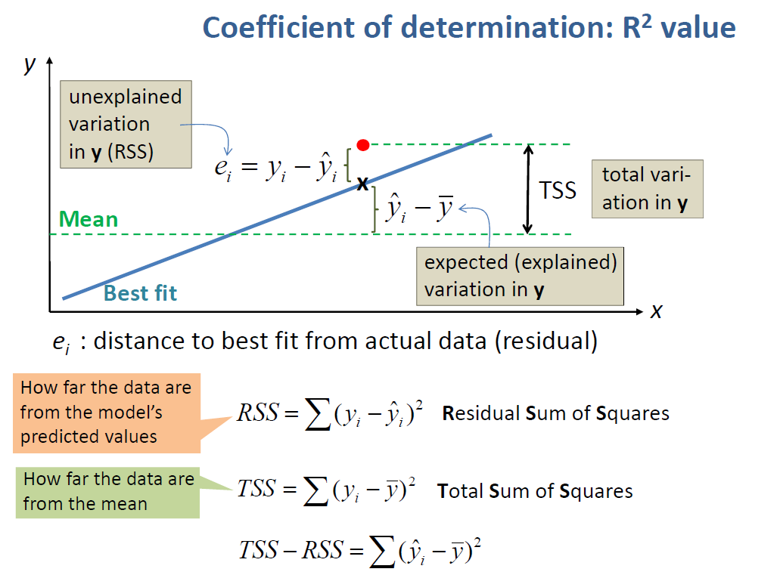

Slide 20
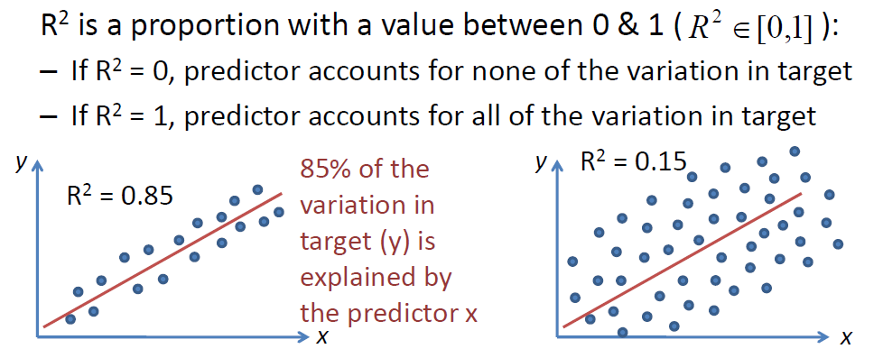
– Overfitting produces a high value for R2.
– R2 is sensitive to outliers
– R2 increases as you add more predictors to the model

Slide 21
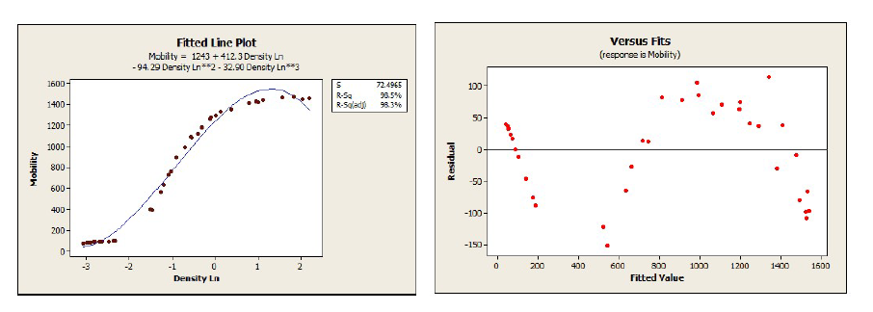
• Is a high value of R2 really good?
– It’s always a good idea to check the residuals!

Slide 22
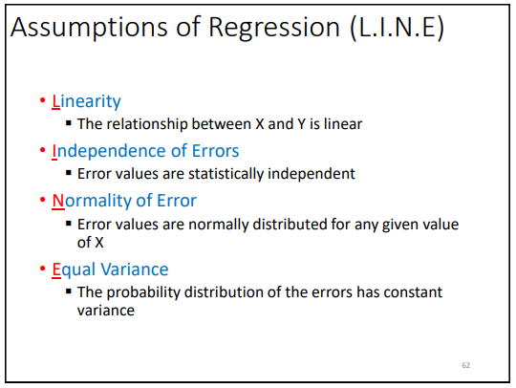
RMSE: Root mean squared error
• RMSE measures the standard deviation of the residuals (the spread of the points about the fitted regression line)
• Lower values of RMSE indicate a better fit as a measure of model accuracy
• Comparisons of RMSE among different models should be made percentagewise.
Assumptions
• Linear Regression’s success depends on the following five assumptions
1. There is a linear additive relationship between the dependent (DV) and independent variables (IV)
2. Errors have zero mean and constant variance
3. Errors are normally distributed (however, no assumption of normality imposed upon DV & IV’s)
4. Errors are independent (no correlation between consecutive errors) random variables
5. IVs are not correlated with each other (very little or no multicollinearity)

Slide 23
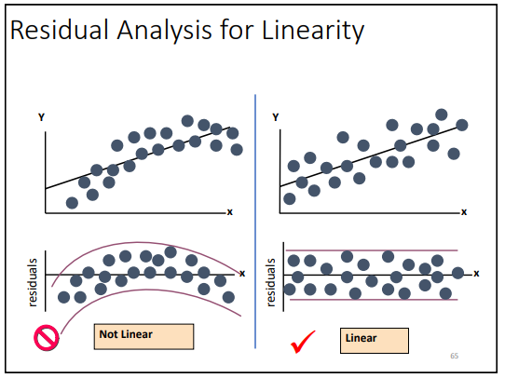
Assumptions (1): Linearity

Slide 24
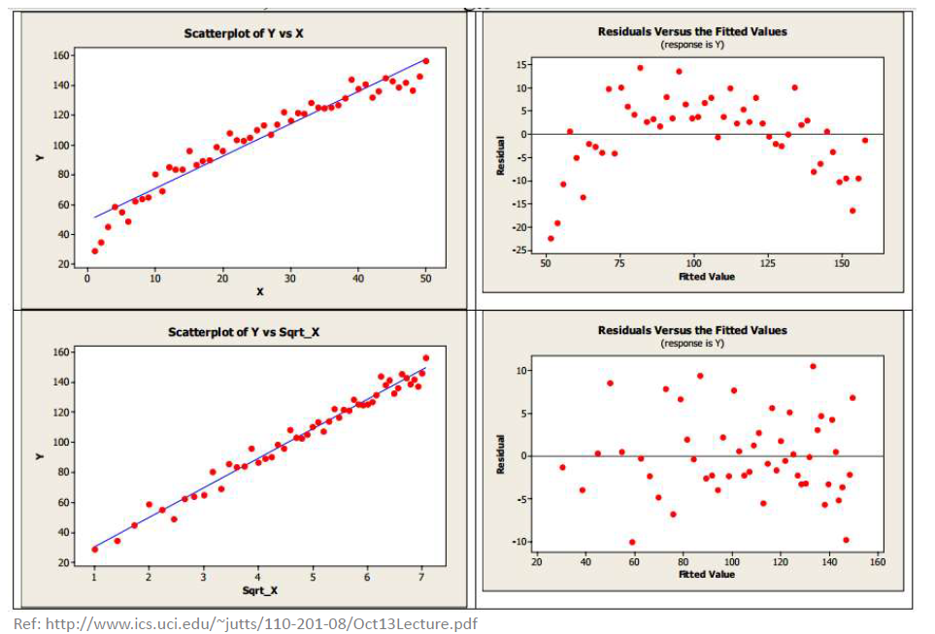
Assumptions (1): Linearity
• If residuals are inverted U, use x1/2 or log(x) for x

Slide 25
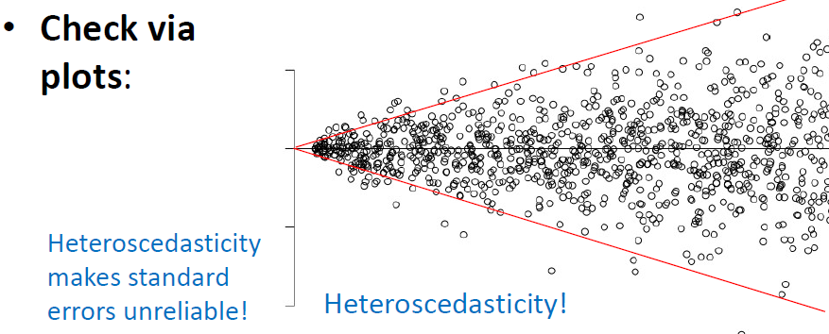
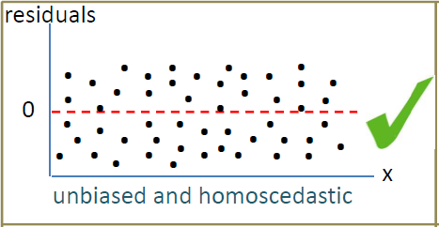
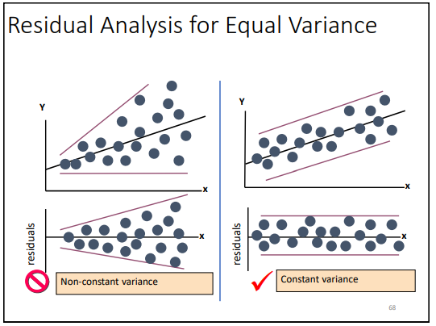
Assumptions (2): 0 mean & fixed variance
• Residuals have zero mean
• Residuals have constant variance (homoscedasticity)
• Unbiased: Has an average value of zero in a thin
vertical strip
• Homoscedastic: Spread (variance) of residuals are the
same in a thin vertical strip

Slide 26
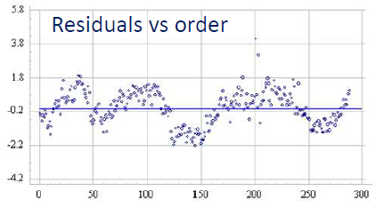

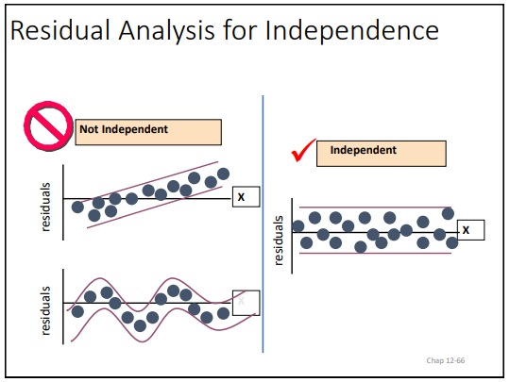
Assumptions (3): Independence of errors
• Errors are independent of one another (no correlation between consecutive errors):
Correlation of the errors is called autocorrelation or serial correlation.
– Investigating omitted variables might help in fixing it.

Slide 27
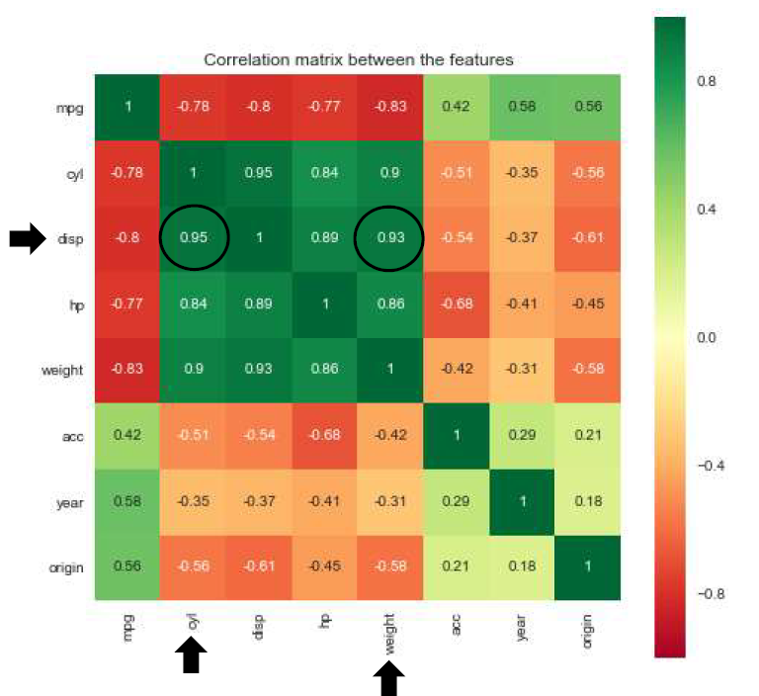
Assumptions (4): No multicollinearity
• In regression, “Multicollinearity (MC)” refers to predictors that are correlated with other predictors (not a problem with a single predictor regression). Correlation between 2 predictors leads to collinearity (or MC if more than 2).
• Effect of multicollinearity?
– A small amount of MC may not be a huge problem. But severe MC could make the coefficients fluctuate wildly
increasing the variance (or std error) of the regression coefficients, making them unstable. Coefficients might
change sign.
• How to check for little or no MC:
– You can check the correlation matrix

Slide 28
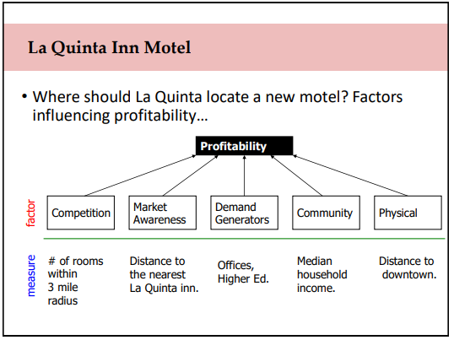
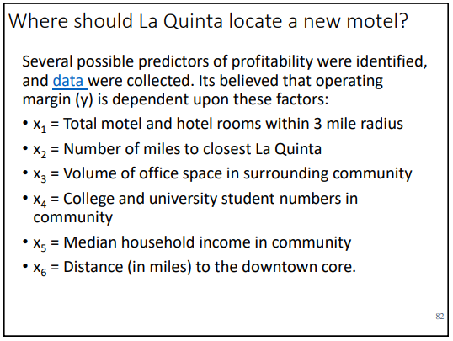
4.1
21

Slide 29
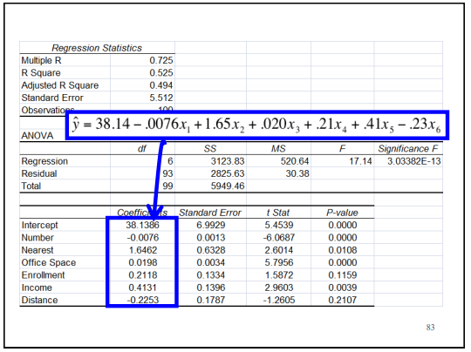
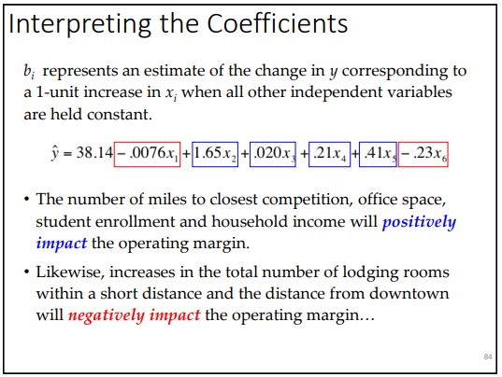
4.1
21

Slide 30
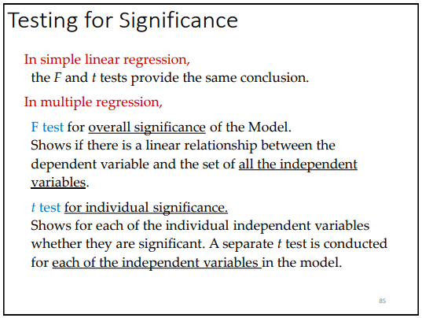
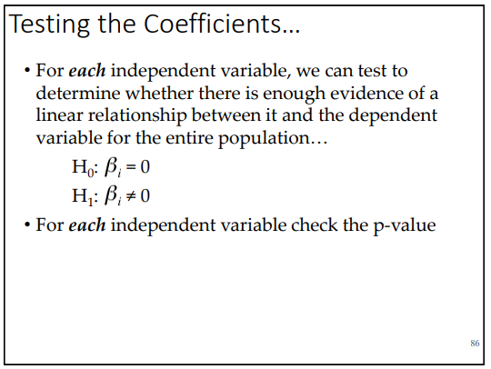
4.1
21

Slide 31
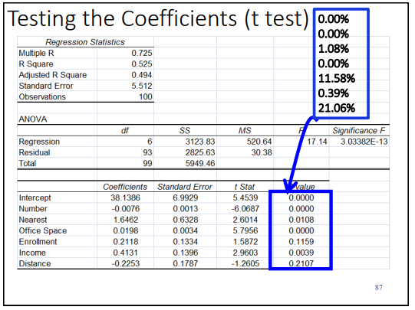
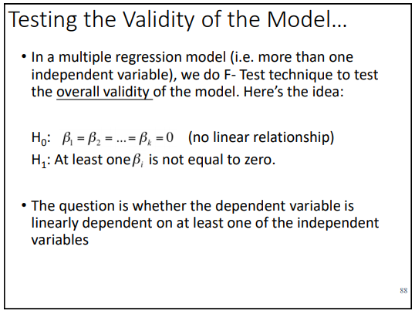
4.1
21

Slide 32
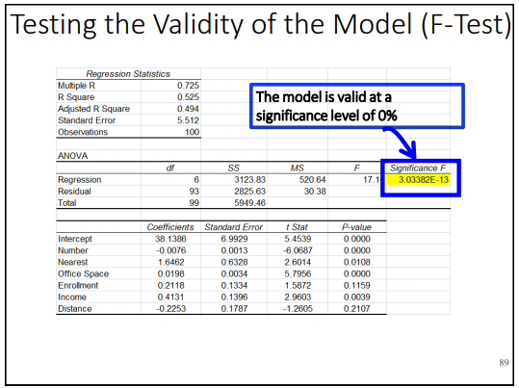
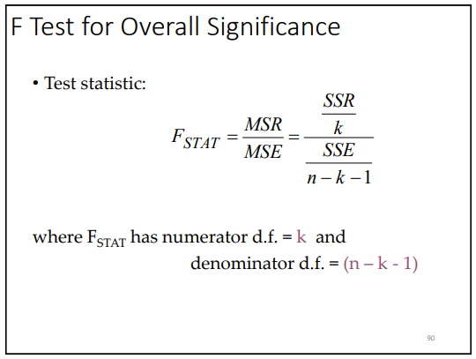
4.1
21

Slide 33
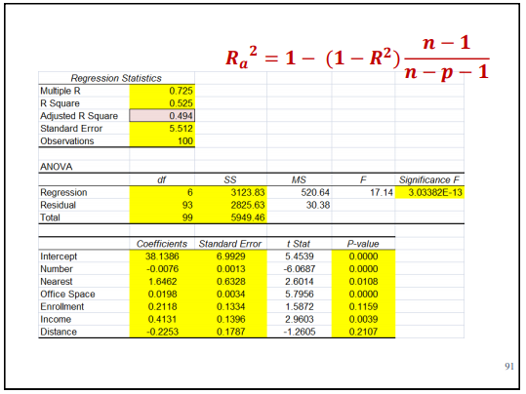
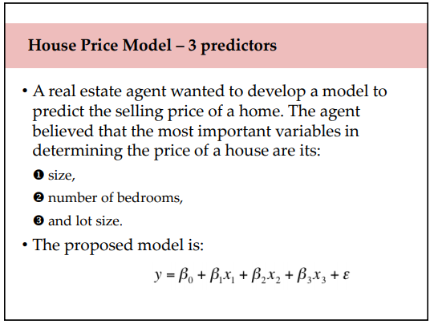
4.1
21

Slide 34
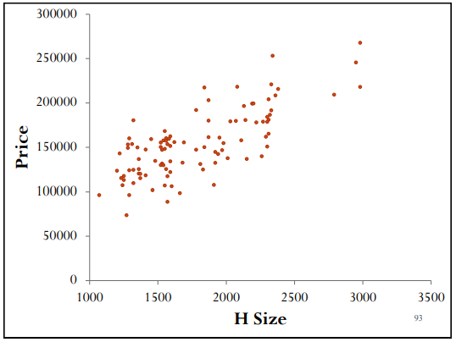
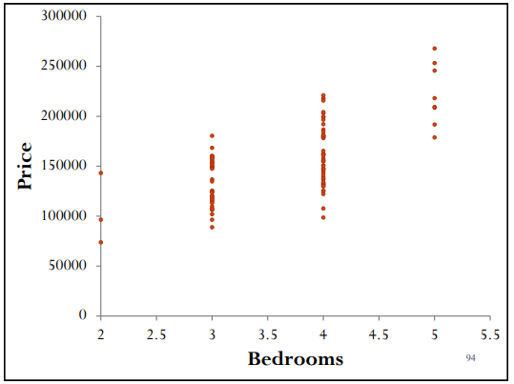
4.1
21

Slide 35
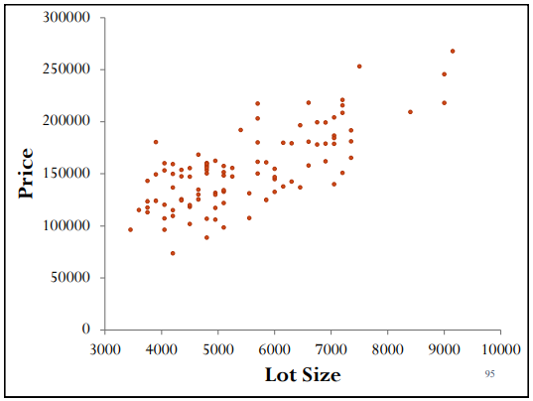
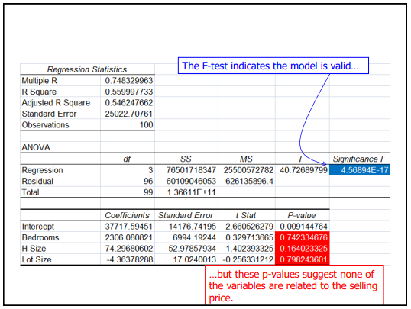
4.1
21

Slide 36
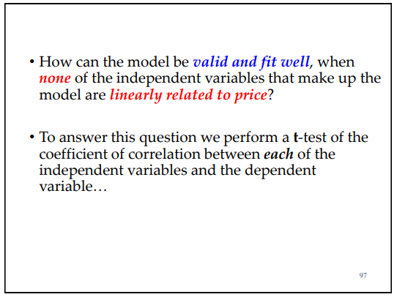
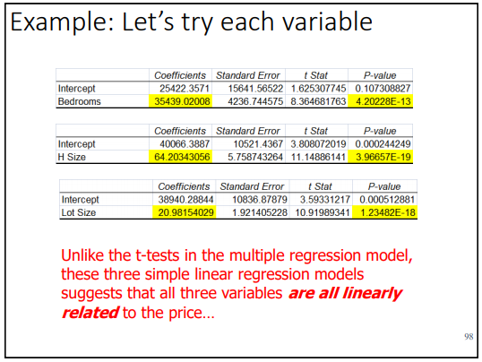
4.1
21

Slide 37
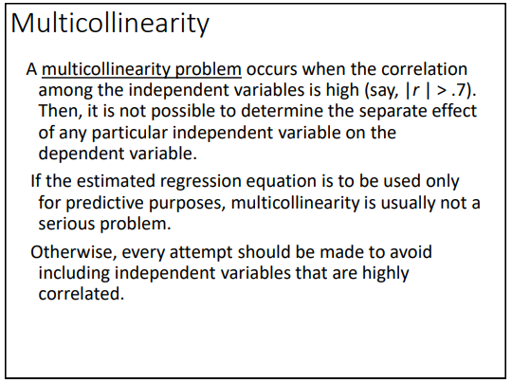
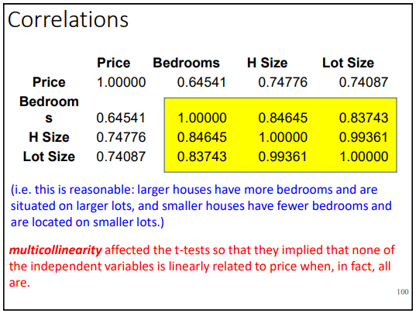
4.1
21

Slide 38
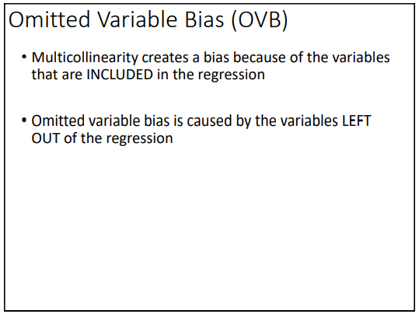
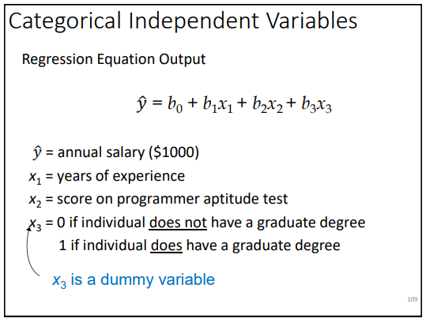
4.1
21

Slide 39


4.1
21

Slide 40


4.1
21

Slide 41


4.1
21

Slide 42


4.1
21

Slide 43

4.1
21

