Slide 1
Coastal Temperature Prediction
Can current-season climate indices predict next-season coastal temperature anomalies?
Main result
The signal is limited, but clearer for the West Coast. Warm test seasons are often underpredicted.
We compare the West Coast and East Coast with the same simple lagged regression setup.
2
3
263
coastal target regions
climate predictors
one-season-ahead rows
Research question
STAT 152 final project | Topic 2
01

Slide 2
SETUP
We test a one-season-ahead prediction problem
A same-season model would mostly describe co-movement. Here the predictors must carry information forward, so the question is harder.
Current season
Lag by one season
Next season
Nino 3.4
PDO
AO
West Coast temp anomaly
East Coast temp anomaly
current predictors -> next target
The target is an anomaly, so we predict departures from each coast's normal seasonal pattern.
Prediction setup
STAT 152 final project | Topic 2
02

Slide 3
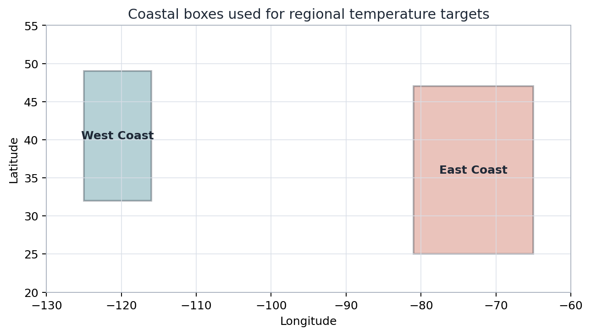
TARGETS
The two coast boxes give comparable regional targets
Data used
ERA5 monthly 2m temperature
1 x 1 degree grid, 1959-2024
Climate indices:
Nino 3.4, PDO, AO
Each season becomes one row.
The boxes are broad regional proxies, not exact land-only coastal masks.
Data
STAT 152 final project | Topic 2
03

Slide 4
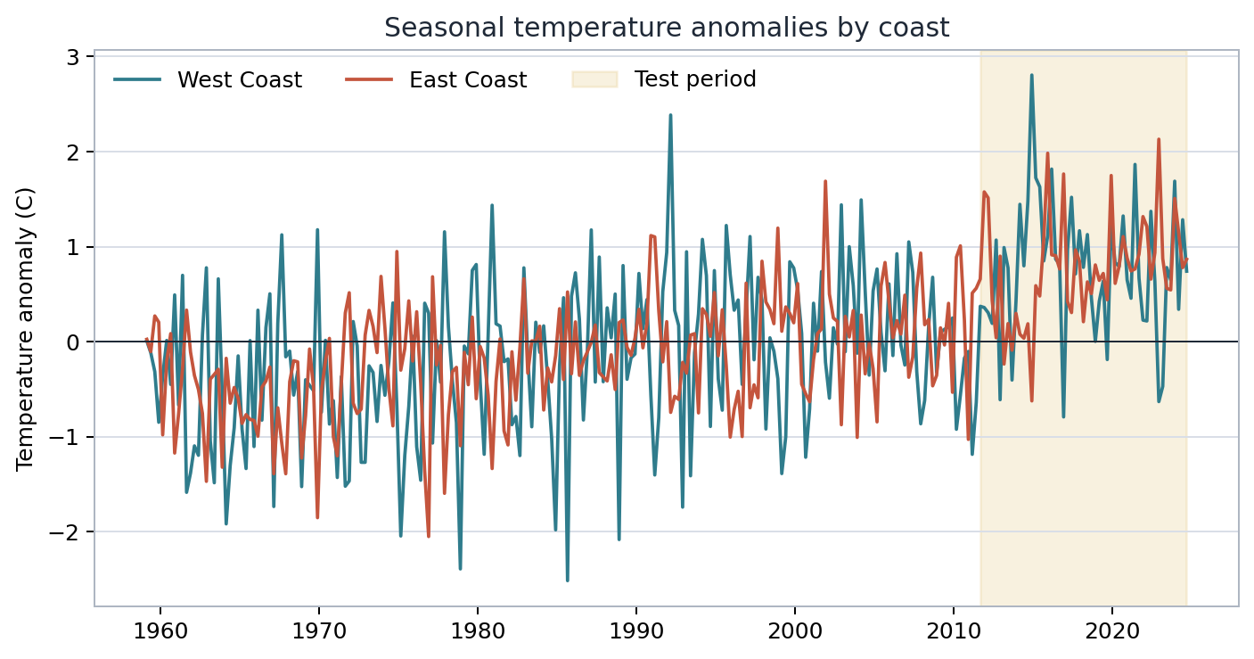
PREPROCESSING
Seasonal anomalies reveal a warmer held-out period
Why anomalies?
We remove each coast's usual seasonal mean.
This keeps winter and summer from being compared as raw temperatures.
The test period has many warm anomalies, so it is a useful stress test.
Targets
STAT 152 final project | Topic 2
04

Slide 5
CLIMATE INDICES
The predictors describe different parts of climate variability
Nino 3.4
PDO
AO
Tropical Pacific SST anomalies
North Pacific sea-surface pattern
Northern Hemisphere circulation
Current-season mean
Current-season mean
Current-season mean
All three predictors use seasonal means. We keep the timing aligned with the temperature targets.
Predictors
STAT 152 final project | Topic 2
05

Slide 6
METHODS
The models stay simple so the comparison is clear
Baseline
Nino-only
Nino + PDO
Full
training mean
Nino 3.4
Nino 3.4, PDO
Nino 3.4, PDO, AO
Time-ordered split
1959 MAM to 2024 SON
Train: 210 rows
Test: 53 rows
We fit the same four models for both coasts. This keeps the focus on timing and regional differences.
Models
STAT 152 final project | Topic 2
06

Slide 7
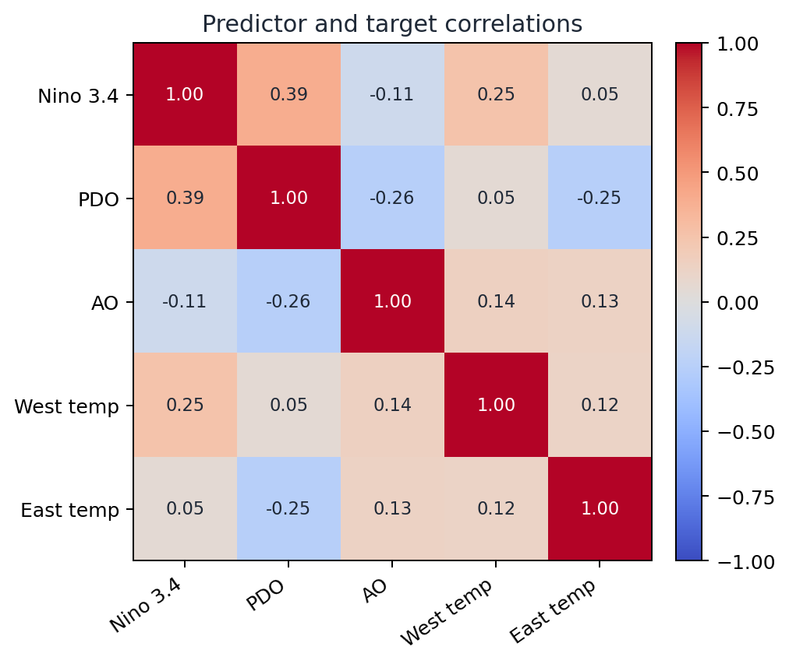
COLLINEARITY
Predictors are related, but collinearity is not severe
Variance inflation factors
Predictor
VIF
Nino 3.4
1.18
PDO
1.25
AO
1.07
VIF is close to 1 for every predictor, so collinearity is low.
Regression checks
STAT 152 final project | Topic 2
07

Slide 8
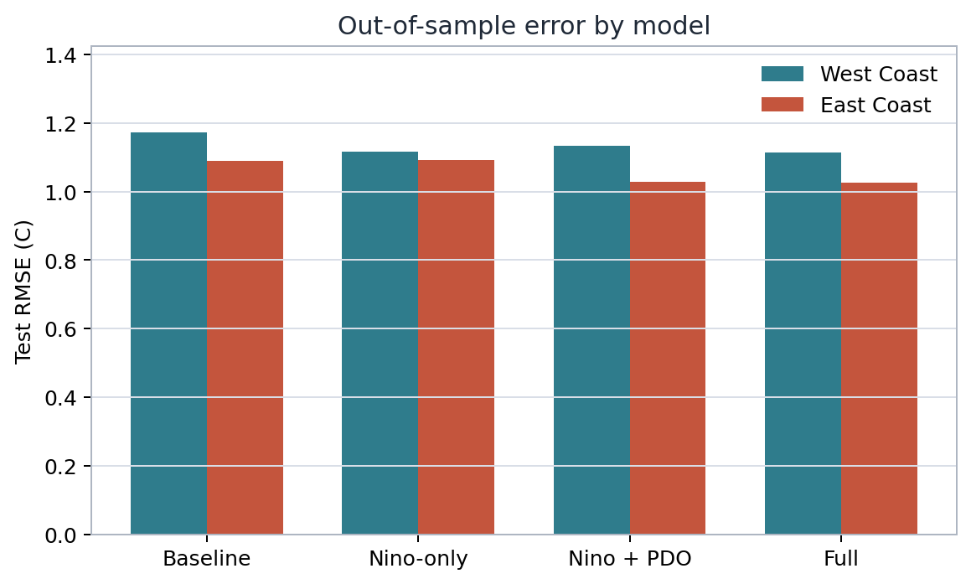
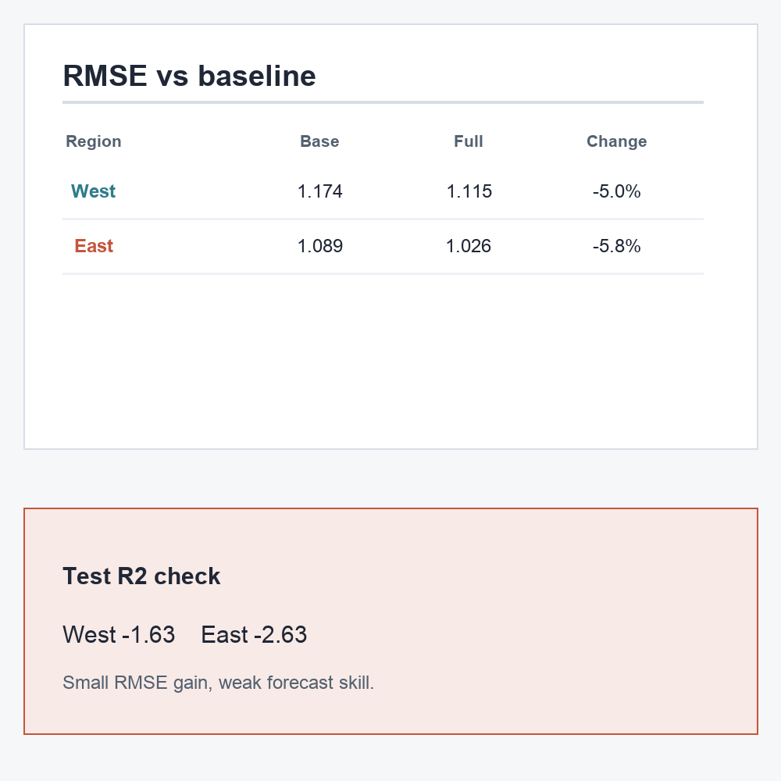
MODEL SKILL
Out-of-sample prediction skill is limited
Full-model RMSE
1.115 C
1.026 C
Test R2 is negative for both coasts: -1.629 west, -2.625 east.
The indices add some signal, but the held-out forecast is still weak.
Out-of-sample results
STAT 152 final project | Topic 2
08

Slide 9
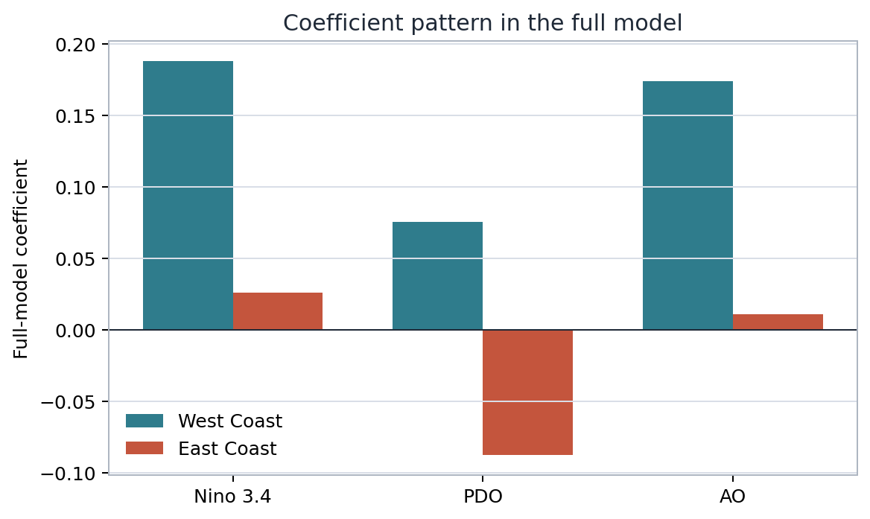
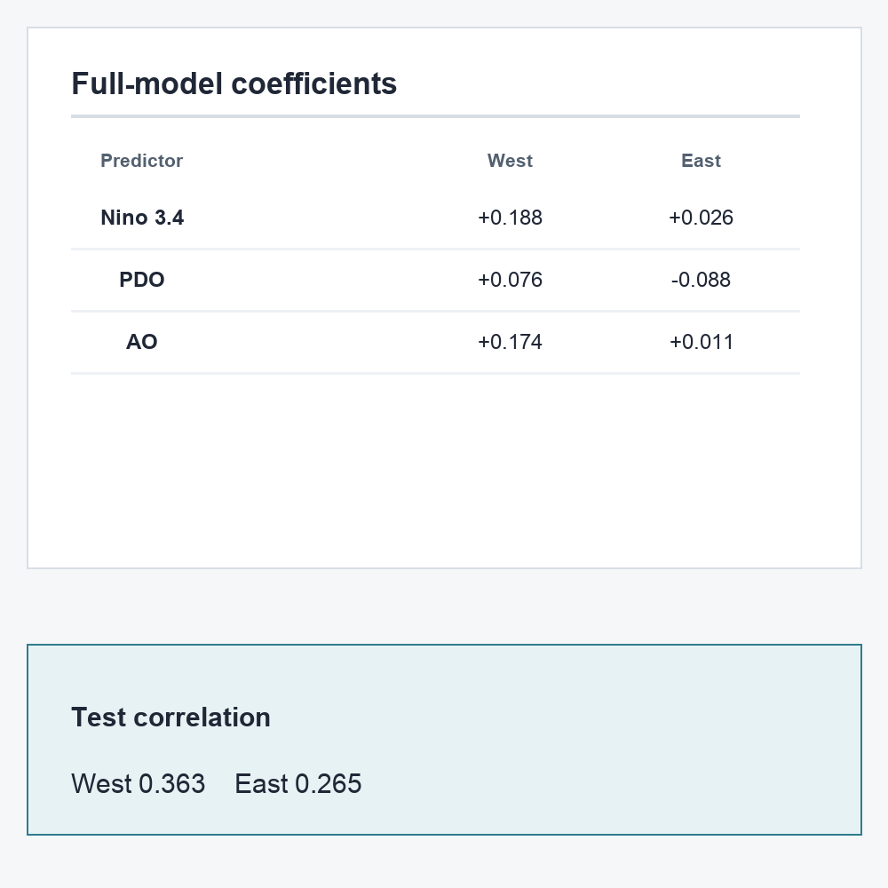
REGIONAL CONTRAST
The West Coast signal is clearer than the East Coast signal
Test correlation
0.363
West Coast
0.265
East Coast
The West Coast keeps a clearer Nino 3.4 signal, matching its closer link to the Pacific.
Regional interpretation
STAT 152 final project | Topic 2
09

Slide 10
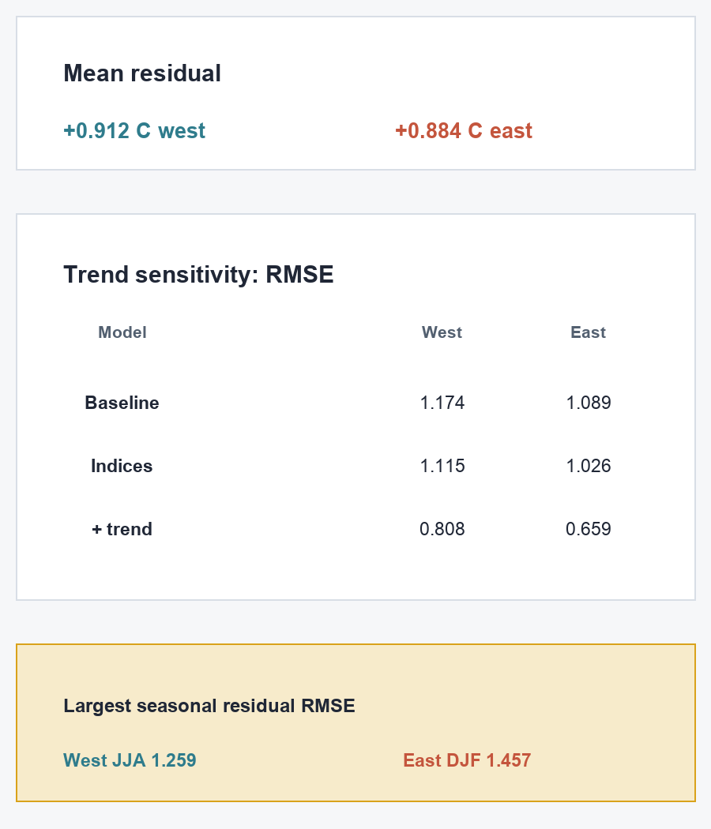
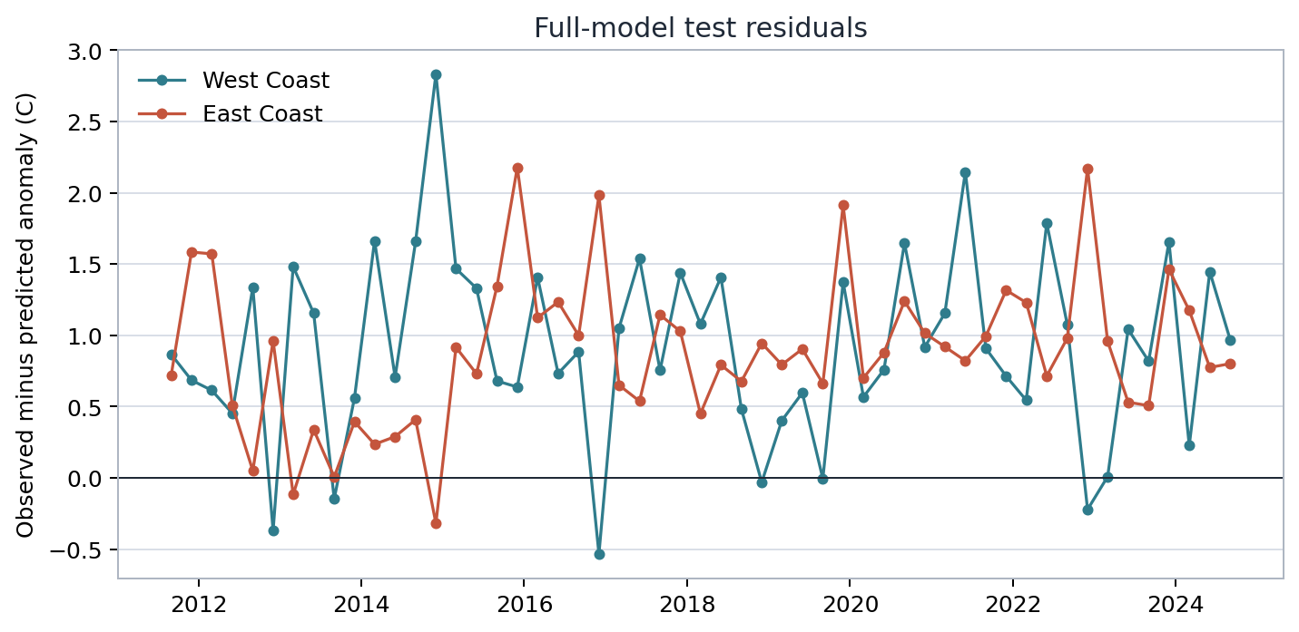
RESIDUALS
The model misses many warm test-period anomalies
Mean residual
+0.912 C
+0.884 C
Positive residual means observed > predicted. The model often predicts too cold.
Bottom line: useful signal, weak forecast. The residuals show where the simple model breaks down.
Takeaway
STAT 152 final project | Topic 2
10

