Slide 1
RxEPL: ReactiveX EPL
Aka: Observables
Richard Peach
Industry Solutions Team

Slide 2
IntroDuction
Assumptions:
You know some basic EPL
Things that may help:
Having seen some functional programming before:
[1,2,3,4,5]
.filter(x => x < 5)
.map(x => x * 10)
.reduce((sum, x) => sum + x, 0)
= 10 + 20 + 30 + 40 = 100

Slide 3
What is ReactiveX?
http://ReactiveX.io
Data Source
Modify /
Filter /
Group /
Etc…
Subscriber
Subscriber
Data Source

Slide 4

What Might you want to DO?
1
2
4
3
5
15
15
4
>= 4
Sum
6
5
Print it
6
Notes:
Take some data
Filter, to find the data that meets some condition
Perform a reduction on that set of data (also know as aggregation)
Do something with the data

Slide 5
What’s Your Data Source?
1
Sequence: [1,2,3,4,5,6]
2
Channels:
monitor.subscribe(ChannelName);
on all MyEvt() as e { ... }
3
Stream: from myStream as value { ... }
4
Iterators: iterator.next();
5
Clock ticks: on all wait(1.0) { ... }
6
Notes:
Starting with the first part of the problem... The data.
There are several sources of data in Apama...
Ones that we might consider are: sequences, channels, streams, iterators and clock ticks

Slide 6
What are your operators?
action isGreaterThanEq4(integer x) returns boolean {
return x >= 4;
}
>= 4
integer sum := 0;
for value in seq {
sum := sum + value;
}
Sum
How do I apply those to all of my different sources of data...?

Slide 7
Where is YOUR data going?
15
log value.toString() at INFO;
send value to channelName;
Print it

Slide 8

Have I received All of my data yet?
Sequence:
for value in seq { ... }
done();
Are we there yet?
Channel:
on data() -> data() -> completed data() {
done();
}
Iterator:
while (true) {
any value := iterator.next();
ifpresent value { ... } else {
done();
break;
}
}

Slide 9
What would this look like in Native EPL?
For a sequence:
For an timer?
action process(sequence<integer> seq) {
integer sumGtEq4 := 0;
integer value;
for value in seq {
if value >= 4 {
sumGtEq4 := sumGtEq4 + value;
}
}
done();
log sumGtEq4.toString() at INFO;
}
For a stream?
For a iterator?
For a channel?

Slide 10
Another way to think about the problem
1
2
3
4
5
Time
.filter(x => x >= 4)
4
5
Time

Slide 11
An Example data process
1
2
3
4
5
Time
.filter(x => x >= 4)
.map(x => x * 2)
4
5
Time
8
10
Time

Slide 12
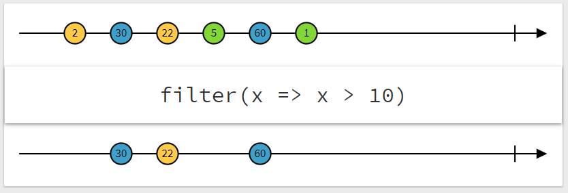
The Standard ReactiveX representation
http://rxmarbles.com

Slide 13
That’s where RxEpl comes in...
ISubscription s := Observable.fromValues([1,2,3,4,5,6])
.filter(isGreaterThanEq4)
.sum()
.subscribe(Subscriber.create().onNext(printValue).onComplete(done));
ISubscription s := Observable.fromChannel("data_channel").take(6)
.filter(isGreaterThanEq4)
.sum()
.subscribe(Subscriber.create().onNext(printValue).onComplete(done));
ISubscription s := Observable.fromIterator(iterator.next)
.filter(isGreaterThanEq4)
.sum()
.subscribe(Subscriber.create().onNext(printValue).onComplete(done));
ISubscription s := Observable.interval(0.1).take(6)
.filter(isGreaterThanEq4)
.sum()
.subscribe(Subscriber.create().onNext(printValue).onComplete(done));

Slide 14
Combining data sources
1
1
1
2
1, 1
3
2
2
4
2, 2
3
3
5
Or
3, 3
Or
...
4
4
6
1
4, 4
5
5
2
5, 5
6
6
3
4
6, 6
5
6

Slide 15
Combining Data Sources
IObservable x := Observable.fromStream(...);
1
2
IObservable y := Observable.create(...);
A
B
x.concat([y])
1
2
A
B
x.zip([y], combiningFunction)
// Or
x.zipToSequence([y])
1,A
2,B
A
B
x.merge([y])
1
2
1,A
2,A
2,B
x.combineLatest([y], combiningFunction)
x.withLatestFrom([y], combiningFunction)
...
1,A
2,A

Slide 16
What else can it do?
Grouping
Counting
Defaulting
Throttling
Mapping
Calculating Aggregating
Timeouts
Reducing
Filtering
Combining
Delaying
Sorting
Awaiting Debouncing
And a lot more!...

Slide 17
Errors
Data Source
Modify /
Filter /
Group /
Etc…
Subscriber
Errors / Exceptions

Slide 18
Error Handling
action multiplyBy10(integer value) returns integer {
throw Exception("ahh", "RuntimeException");
}
Observable.fromValues([1,2,3,4,5,6])
.map(multiplyBy10)
.catchError(Observable.fromValues([7,8,9]))
Observable.fromStream(someStream)
.map(multiplyBy10)
.retry(2)
Observable.fromValues([1,2,3,4])
.map(multiplyBy10)
.subscribe(Subscriber.create().onError(failGracefully));

Slide 19
Something we skimmed over
Javascript
RxEPL
[1,2,3,4,5,6]
.filter(x => x >= 4)
.map(x => x * 10)
.reduce((sum, x) => sum + x)
Observable.fromValues([1,2,3,4,5,6])
.filter(isGreaterThanEq4)
.map(multiplyBy10)
.reduce(sum)
...
action isGreaterThanEq4(integer x) returns boolean {
return x >= 4;
}
action multiplyBy10(integer x) returns integer {
return x * 10;
}
action sum(integer sum, integer x) returns integer {
return sum + x;
}

Slide 20
Something we skimmed over
Javascript
RxEPL
[1,2,3,4,5,6]
.filter(x => x >= 4)
.map(x => x * 10)
.reduce((sum, x) => sum + x)
Observable.fromValues([1,2,3,4,5,6])
.filter( )
.map(multiplyBy10)
.reduce(sum)
...
action isGreaterThanEq4(integer x) returns boolean {
return x >= 4;
}
action multiplyBy10(integer x) returns integer {
return x * 10;
}
action sum(integer sum, integer x) returns integer {
return sum + x;
}
isGreaterThanEq4

Slide 21
Something we skimmed over
+ Lambdas
Javascript
RxEPL
[1,2,3,4,5,6]
.filter(x => x >= 4)
.map(x => x * 10)
.reduce((sum, x) => sum + x)
Observable.fromValues([1,2,3,4,5,6])
.filter( )
.map(multiplyBy10)
.reduce(sum)
...
action isGreaterThanEq4(integer x) returns boolean {
return x >= 4;
}
action multiplyBy10(integer x) returns integer {
return x * 10;
}
action sum(integer sum, integer x) returns integer {
return sum + x;
}
Lambda.predicate("x => x >= 4")

Slide 22
Something we skimmed over
+ Lambdas
Javascript
RxEPL
[1,2,3,4,5,6]
.filter(x => x >= 4)
.map(x => x * 10)
.reduce((sum, x) => sum + x)
Observable.fromValues([1,2,3,4,5,6])
.filter( )
.map( )
.reduce(sum)
...
action isGreaterThanEq4(integer x) returns boolean {
return x >= 4;
}
action multiplyBy10(integer x) returns integer {
return x * 10;
}
action sum(integer sum, integer x) returns integer {
return sum + x;
}
Lambda.predicate("x => x >= 4")
Lambda.function1("x => x * 10")

Slide 23
Something we skimmed over
+ Lambdas
Javascript
RxEPL
[1,2,3,4,5,6]
.filter(x => x >= 4)
.map(x => x * 10)
.reduce((sum, x) => sum + x)
Observable.fromValues([1,2,3,4,5,6])
.filter( )
.map( )
.reduce( )
...
action isGreaterThanEq4(integer x) returns boolean {
return x >= 4;
}
action multiplyBy10(integer x) returns integer {
return x * 10;
}
action sum(integer sum, integer x) returns integer {
return sum + x;
}
Lambda.predicate("x => x >= 4")
Lambda.function1("x => x * 10")
Lambda.function2("sum, x => sum + x")

Slide 24
Something we skimmed over
+ Lambdas
Javascript
RxEPL
[1,2,3,4,5,6]
.filter(x => x >= 4)
.map(x => x * 10)
.reduce((sum, x) => sum + x)
Observable.fromValues([1,2,3,4,5,6])
.filter( )
.map( )
.reduce( )
action isGreaterThanEq4(integer x) returns boolean {
return x >= 4;
}
action multiplyBy10(integer x) returns integer {
return x * 10;
}
action sum(integer sum, integer x) returns integer {
return sum + x;
}
Lambda.predicate("x => x >= 4")
Lambda.function1("x => x * 10")
Lambda.function2("sum, x => sum + x")
.map(Lambda.function1("x => x > 5 ? 'big' : 'small'"))

Slide 25
ReactiveX is a Polyglot
Java: RxJava
JavaScript: RxJS
C#: Rx.NET
C#(Unity): UniRx
Scala: RxScala
Clojure: RxClojure
C++: RxCpp
Lua: RxLua
Ruby: Rx.rb
Python: RxPY
Go: RxGo
Groovy: RxGroovy
JRuby: RxJRuby
Kotlin: RxKotlin
Swift: RxSwift
PHP: RxPHP
Elixir: Reaxive
Dart: RxDart
Netty: RxNetty
Android: RxAndroid
Cocoa: RxCocoa
Apama: RxEPL

Slide 26
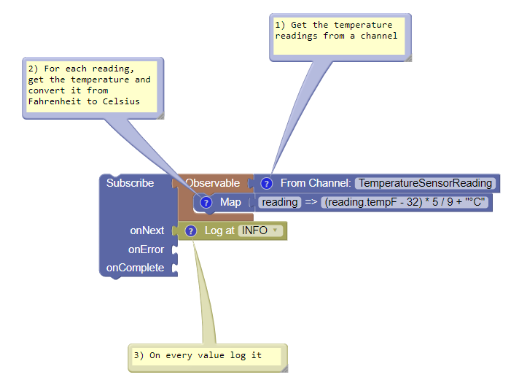
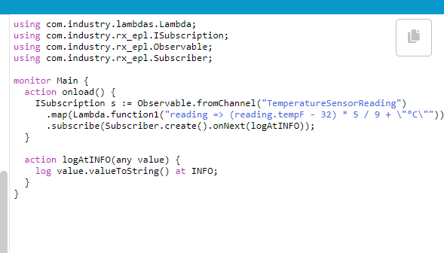
Ok but... I’m new here
https://softwareag.github.io/apama-rxbuilder/

Slide 27
Using with Streams
stream<Data> dataStream := all Data();
Observable.fromStream(from d in dataStream select <any> d)
.skip(5)
.take(2)
.toStream();

Slide 28
Using with Streams
stream<Data> dataStream := all Data();
DisposableStream d :=
stream<any> s := d.getStream();
stream<Data> result := from d in s select <Data> d;
d.dispose();
Observable.fromStream(from d in dataStream select <any> d)
.skip(5)
.take(2)
.toStream();

Slide 29
Where to get started
RxEPL - https://github.com/SoftwareAG/apama-rxepl
Lambdas - https://github.com/SoftwareAG/apama-lambdas
The Builder - https://softwareag.github.io/apama-rxbuilder/
More info about ReactiveX - http://reactivex.io

Slide 30
A side Note
Automated Testing - Travis
Test coverage – Coveralls
https://github.com/SoftwareAG/apama-rxepl
Problems? Raise issues on GitHub! ☺

