Slide 1
TechTalk Log parsing with Pyjeet
Julien Fortin, Alexandre Renard
November 5, 2014
Cumulus Networks and Partner Confidential
Notes:
Delivery Notes
Audience: Cumulus Networks and Partner Technical Sales
This is a technical-oriented deck covering how to sell and position Cumulus Linux.
See the CL-Sales deck on a business-oriented introduction.

Slide 2
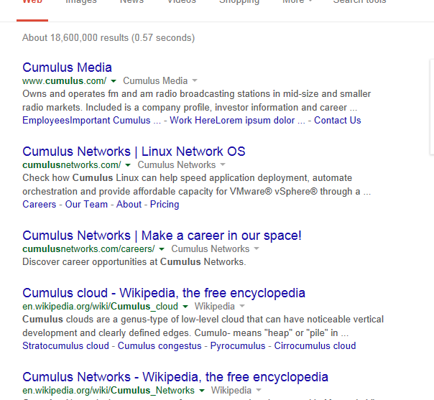
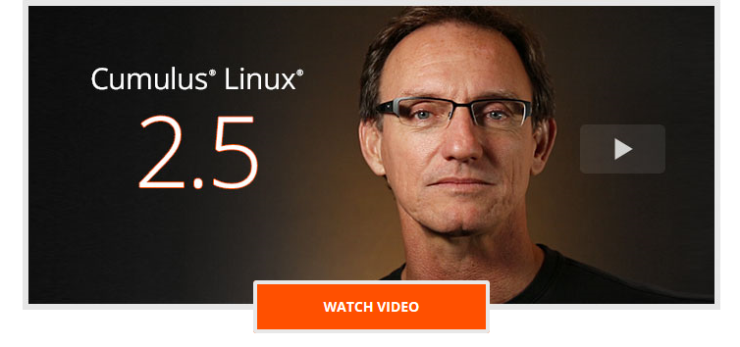
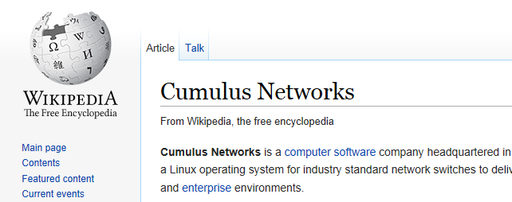
Issues to solve
Parsing logs with grep can be painful
No going back and forth like in Cscope or Google
Need to get the line number, open the file at this line…
Need to untar/unzip rotated logs or cl-support

Slide 3
Issues to solve
No use of network configutation files to establish links between logs
→ Same interface object appears under different names in Logs
A
B
C
.
.
.
10.0.1.2
.
.
.
Link swp1 down
.
.
.
.
.
.
.
.
.
.
.
xe0 down
.

Slide 4
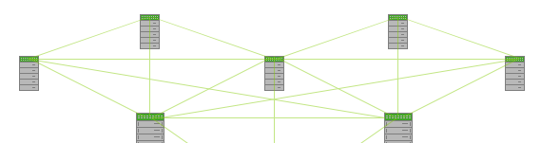
Issues to solve
No easy way to analyse logs distributed on several boxes
No real standard for log lines formatting and sometimes no Timestamp → Hard to get logs at given interval of time
Might need information such as log frequency

Slide 5
Libraries used
python-zmq → Python bindings for ZeroMQ library
ZeroMQ \zero-em-queue\, \ØMQ\: Ø Connect your code in any language, on any platform. Ø Carries messages across inproc, IPC, TCP, TPIC, multicast. Ø Smart patterns like pub-sub, push-pull, and router-dealer. Ø High-speed asynchronous I/O engines, in a tiny library. Ø Backed by a large and active open source community. Ø Supports every modern language and platform. Ø Build any architecture: centralized, distributed, small, or large. Ø Free software with full commercial support.

Slide 6
Libraries used
python-logsparser
LogsParser → opensource python library used as core
mechanism for logs tagging and normalization
Uses normalization definition files written in XML
Definition file → list of log patterns, each composed of many keywords
Keyword → placeholder associated to tag name and tag type
Common tag types:
Anything : any character chain of any length.
EpochTime : an EPOCH timestamp of arbitrary precision
syslogDate : syslog formatted date (example : Mar 12 20:13:23)
MACAddress
IP
ZuluTime : a "Zulu Time“ timestamp (example : 2012-12-21T13:45:05)
Interface
…

Slide 7
Libraries used
Also…
python-tz → Accurate and cross platform timezone calculations using Python 2.4 or higher
python-lxml → XML processing library
Summary: libs to install through apt-get when dapackaging pyjeet-deb:
python-zeromq
python-logsparser
Python-tz
Python-lxml → All part of wheezy

Slide 8
Network configuration files/commands used
Network Object | Host | Cl-support (at archive root)
Interface | $> ip link show /var/lib/cumulus/porttab | ./support/ip.link ./support/porttab
Bridge | $> brctl show | ./support/brctl.show
Vlan | $> ip link show | ./support/ip.link
Bond | /etc/network/interfaces | ./etc/network/interfaces

Slide 9
Building the “Database”
User chooses hosts and/or cl-support and/or Standalone mode
→ Automatically untars & cleans up on leaving
User chooses log files/folders per Host with host granularity
→localhost:switchd.log clsupport:syslog auth.log
User chooses interval of time
→2 dates or 1 date + interval of time
Gives logs files/folder/cl-support as first input
Can choose to unzip associated rotated files, verbose mode, gui… →All corresponding log lines given to logsparser with network conf files
→ Extract dates, ip, interface…
→ Only stays in memory while programme running

Slide 10
Interface
Interface presentation

Slide 11
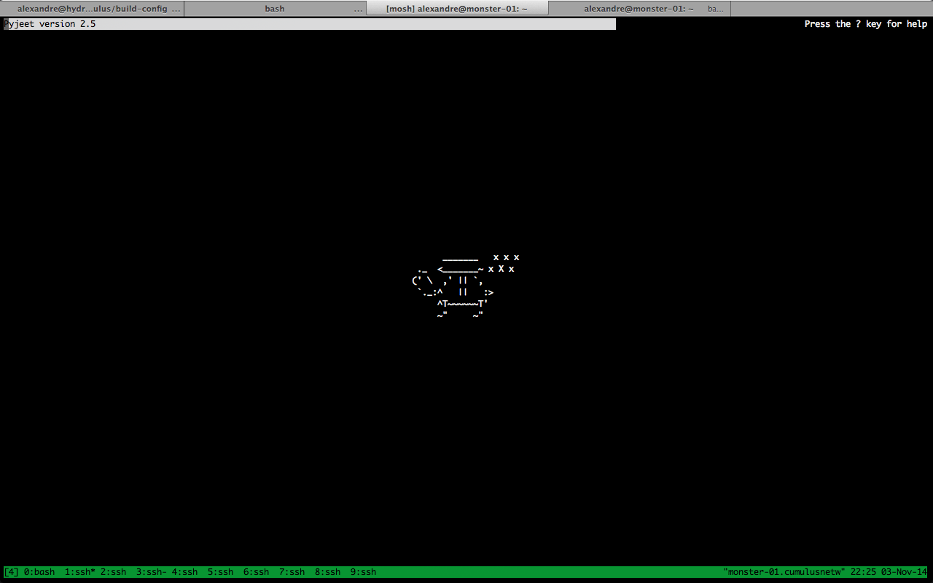

Slide 12
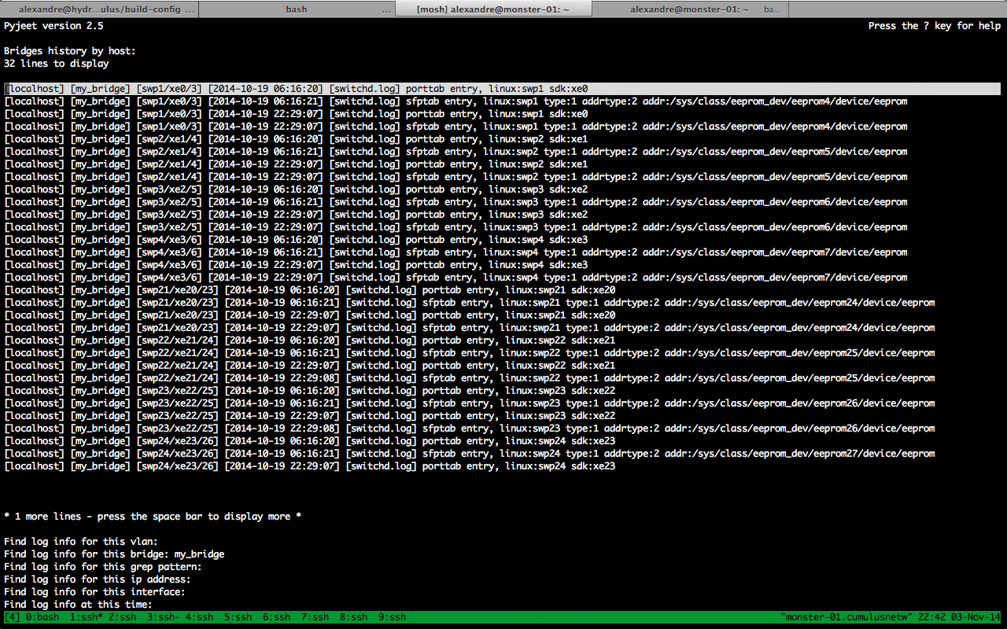

Slide 13
Cscope style menu – navigate with arrows

Slide 14
Remaining lines– space/backspace to move pages

Slide 15
Captured tags: host/bridge/interface/date/file

Slide 16
Logs body

Slide 17
Info lines

Slide 18
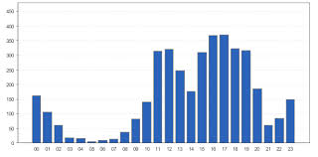
Log frequency
Try to find frequency for a log line type → hitting ‘f’ on a line
Pick a line
Find similar lines → ratio of difflib.SequenceMatcher > 0.65 → based on longest contiguous matching subsequence
Cut time into intervals of 1000 seconds
Count number appearances of one of similar log lines
Aggregate → display number for each interval

Slide 19

Demo

Slide 20
Questions
?

Slide 21
Bringing the Linux Revolution to Networking

