Slide 1
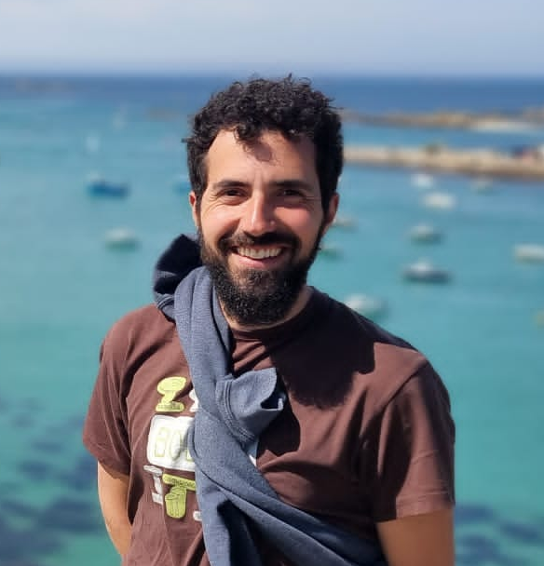
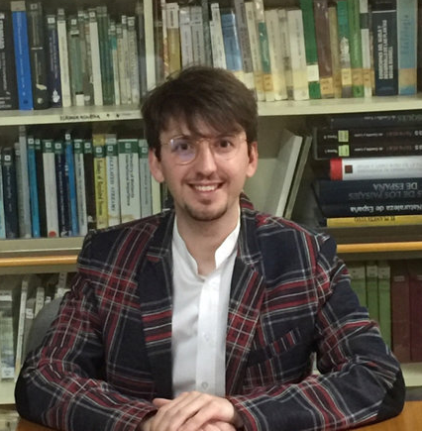


Course Things
David Cunillera-Montcusí
MSCA Fellow at the HUN-REN, OK-VOI
Jorge García-Girón
Ayudante doctor – Universidad de León

Slide 2
Monday | Tuesday | Wednesday | Thursday
Llegamos! Nous sommes arrivés! Megérkeztünk Iritsi gara Chegamos Ja som aquí Vardık Nós chegamos | Session 1 Metacommunities By DCM | Session 4 How to biogeography By JGG | Session 7 Hot to go common and therapy session By JGG & DCM
 | Session 2 How to make them NULL! By DCM & How to traits By Aurelién Boyé | Session 5 How to add a “paleo” and go full Paleobiogeographic By JGG
 | Session 3 Further beyond the sky! or just some CATS and CTA Still with DCM | Session 6 How to Graná! NOT by JGG | GO AWAY! By “el conserje”
Session 0 | JAIL! NOT by DCM

Slide 3
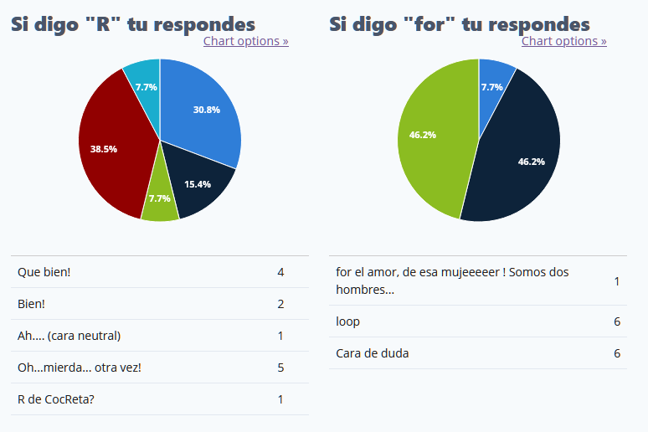

Slide 4
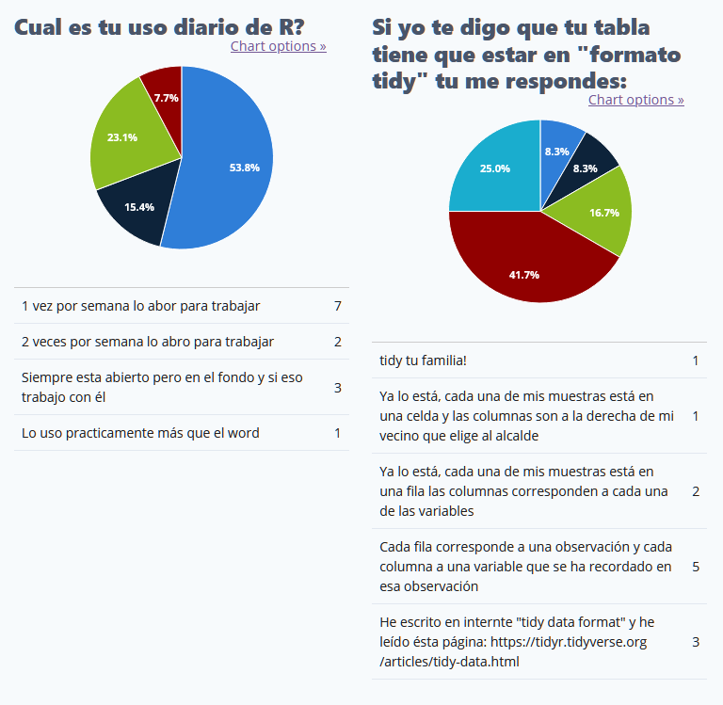

Slide 5
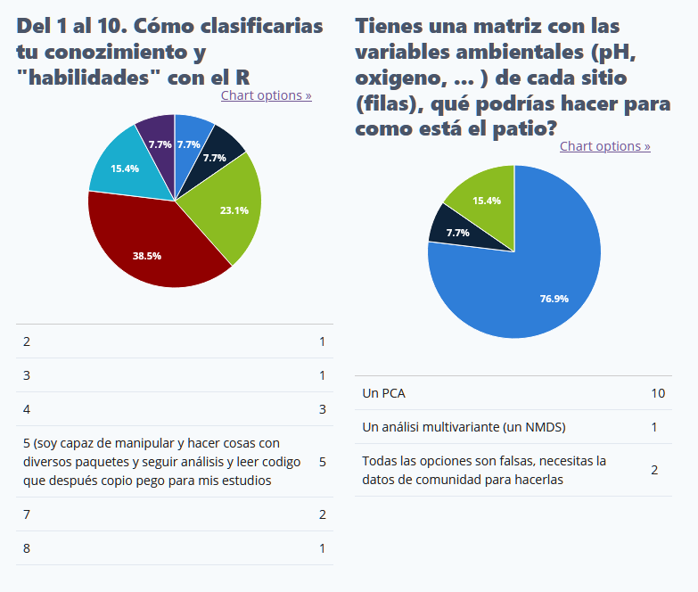

Slide 6
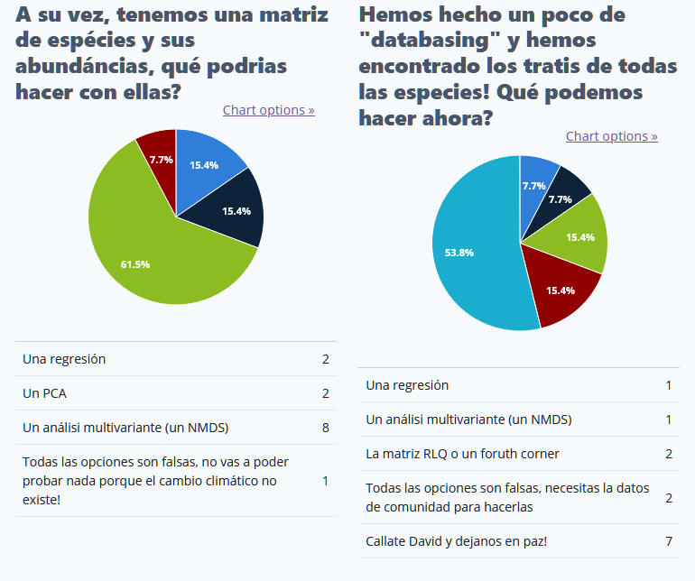

Slide 7
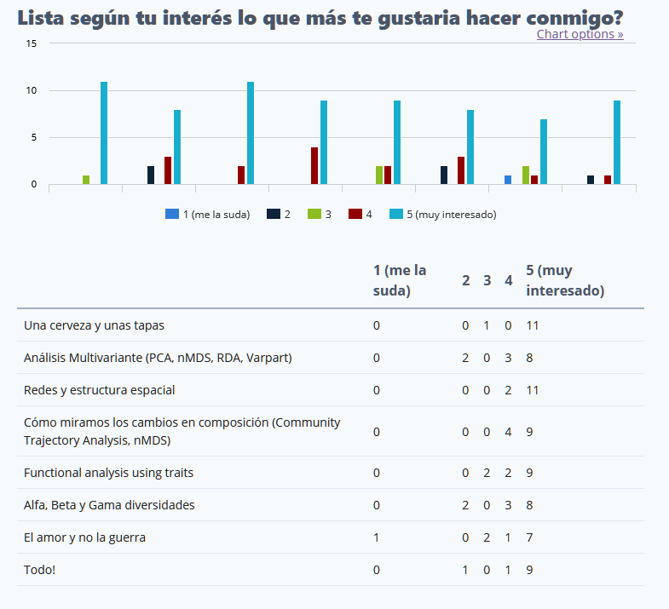

Slide 8
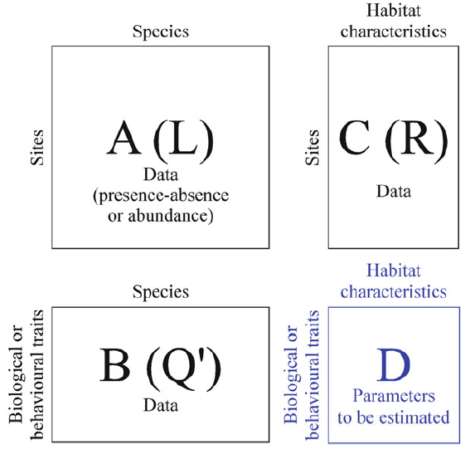
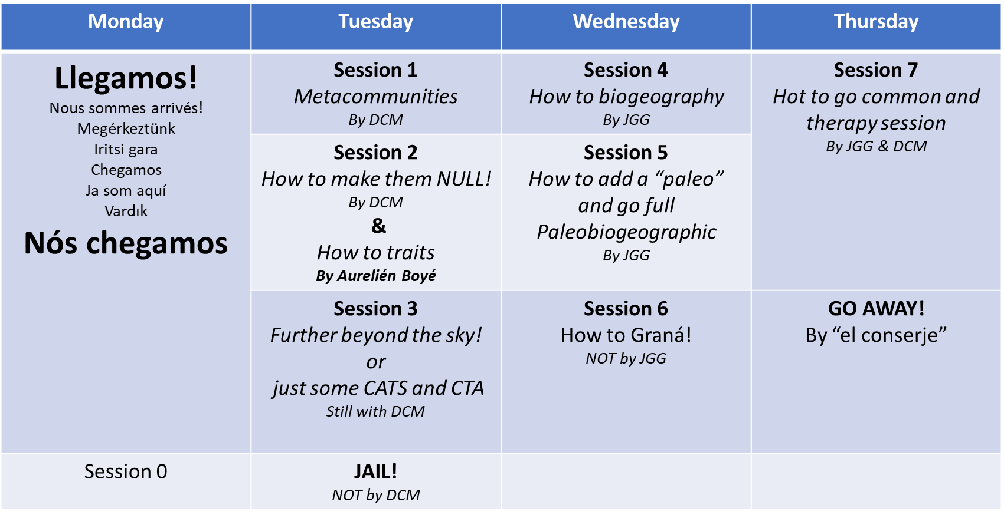

Slide 9

ENOUGH!
Let’s open R

Slide 10
Logistics
R version 4.2.2 (2022-10-31 ucrt)
Platform: x86_64-w64-mingw32/x64 (64-bit)
Running under: Windows 10 x64 (build 19042)
https://github.com/Cunillera-Montcusi/Intermeeting_AIL
Install_Packages.R
CESTES dataset
Session_0

