Slide 1

Basics of the Flipped Classroom
Sarah Eichhorn
January 4, 2017
https://curatedcourses.org/
Notes:
Cover Page

Slide 2
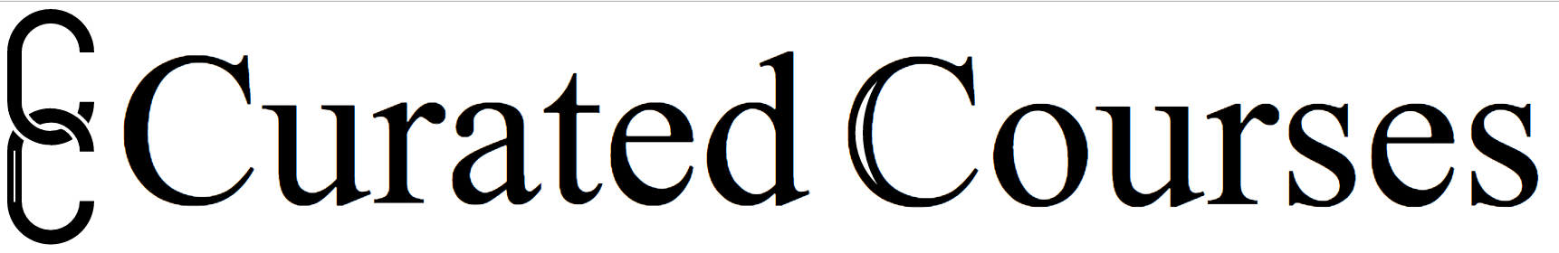
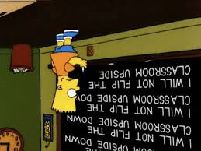

Definition of Flipped Course
“The flipped classroom is a pedagogical model in which the typical lecture and homework elements of a course are reversed. Short video lectures are viewed by students at home before the class session, while in-class time is devoted to exercises, projects, or discussions.”
(Things you Should Know About Flipped Classroom, Educause)
https://curatedcourses.org/

Slide 3
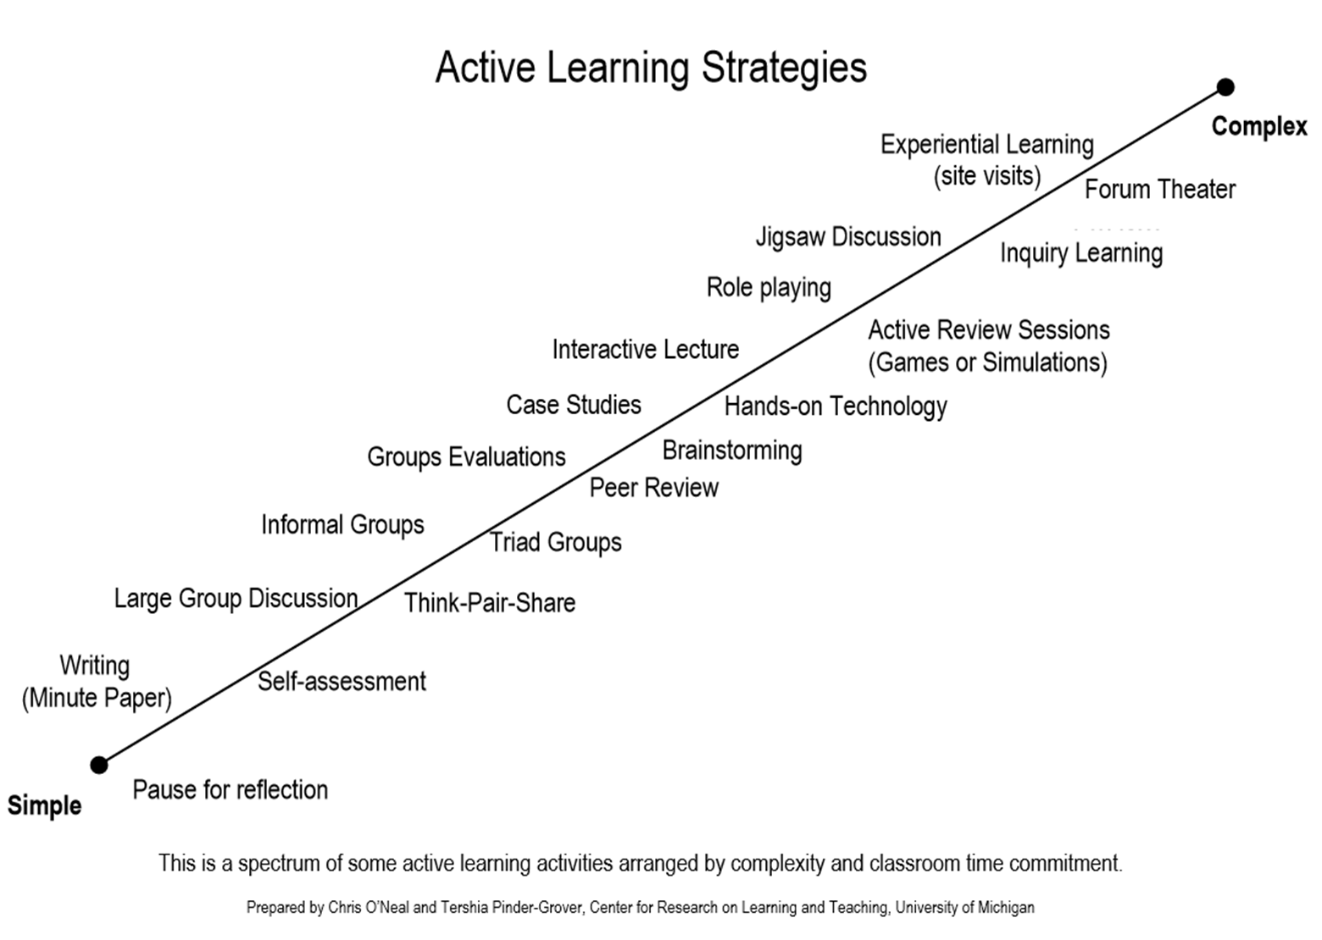
https://curatedcourses.org/

Slide 4
Evidence for Active Learning
“Active learning increases student performance in science, engineering, and mathematics.” S. Freeman, et. al. Proc Natl Acad Sci, June 2010.
https://curatedcourses.org/

Slide 5
Abstract
To test the hypothesis that lecturing maximizes learning and course performance, we metaanalyzed 225 studies that reported data on examination scores or failure rates when comparing student performance in undergraduate science, technology, engineering, and mathematics (STEM) courses under traditional lecturing versus active learning. The effect sizes indicate that on average, student performance on examinations and concept inventories increased by 0.47 SDs under active learning (n = 158 studies), and that the odds ratio for failing was 1.95 under traditional lecturing (n = 67 studies). These results indicate that average examination scores improved by about 6% in active learning sections, and that students in classes with traditional lecturing were 1.5 times more likely to fail than were students in classes with active learning. Heterogeneity analyses indicated that both results hold across the STEM disciplines, that active learning increases scores on concept inventories more than on course examinations, and that active learning appears effective across all class sizes--although the greatest effects are in small (n ≤ 50) classes. Trim and fill analyses and fail-safe n calculations suggest that the results are not due to publication bias. The results also appear robust to variation in the methodological rigor of the included studies, based on the quality of controls over student quality and instructor identity. This is the largest and most comprehensive metaanalysis of undergraduate STEM education published to date. The results raise questions about the continued use of traditional lecturing as a control in research studies, and support active learning as the preferred, empirically validated teaching practice in regular classrooms.
https://curatedcourses.org/

Slide 6
Abstract
To test the hypothesis that lecturing maximizes learning and course performance, we metaanalyzed 225 studies that reported data on examination scores or failure rates when comparing student performance in undergraduate science, technology, engineering, and mathematics (STEM) courses under traditional lecturing versus active learning. The effect sizes indicate that on average, student performance on examinations and concept inventories increased by 0.47 SDs under active learning (n = 158 studies), and that the odds ratio for failing was 1.95 under traditional lecturing (n = 67 studies). These results indicate that average examination scores improved by about 6% in active learning sections, and that students in classes with traditional lecturing were 1.5 times more likely to fail than were students in classes with active learning. Heterogeneity analyses indicated that both results hold across the STEM disciplines, that active learning increases scores on concept inventories more than on course examinations, and that active learning appears effective across all class sizes--although the greatest effects are in small (n ≤ 50) classes. Trim and fill analyses and fail-safe n calculations suggest that the results are not due to publication bias. The results also appear robust to variation in the methodological rigor of the included studies, based on the quality of controls over student quality and instructor identity. This is the largest and most comprehensive metaanalysis of undergraduate STEM education published to date. The results raise questions about the continued use of traditional lecturing as a control in research studies, and support active learning as the preferred, empirically validated teaching practice in regular classrooms.
https://curatedcourses.org/

Slide 7
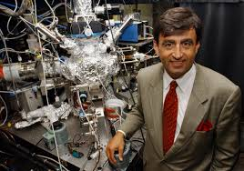
“This is a really important article – the impression I get is that it’s almost unethical to be lecturing if you have this data.”
“It’s good to see such a cohesive picture emerge from their meta-analysis – an abundance of proof that lecturing is outmoded, outdated, and inefficient.”
- Eric Mazur
Balkanski Professor of Physics and Applied Physics
Harvard University

Slide 8



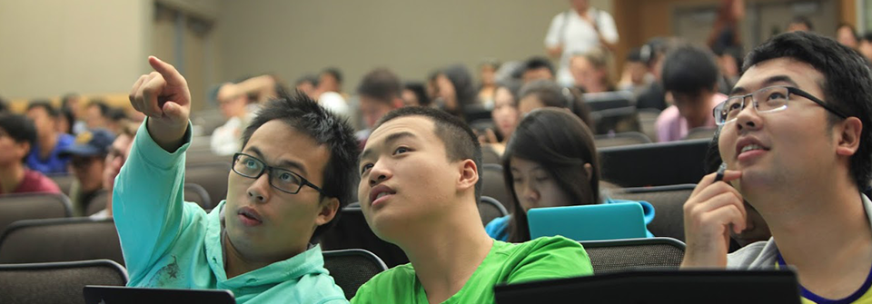
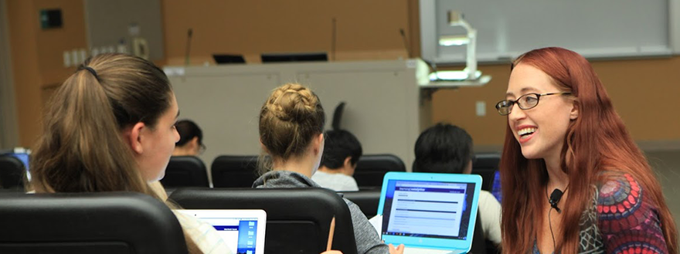

Core Principles
Communicate expectations
Give appropriate pre-class content
Use knowledge checks
Actively engage students in class
Provide expert guidance
Clearly connect pre-class and in-class learning

Slide 9

Syllabus Review Activity
What expectations about the course format are communicated to students?
What do students do before class?
What knowledge checks or accountability for pre-class learning are used?
How is class time utilized?
https://curatedcourses.org/

