Slide 1

Linear Algebra using Curated Courses Open Educational Resources
Sarah Eichhorn, University of Texas at Austin
Petra Bonfert-Taylor, Dartmouth College
David Farmer, American Institute of Mathematics
Jim Fowler, The Ohio State University
Joint Mathematics Meeting
January 11, 2018
Funding from NSF DUE-1505246
https://curatedcourses.org/
Notes:
Cover Page

Slide 2

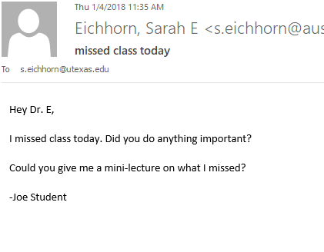

Scenario 1:
https://curatedcourses.org/

Slide 3
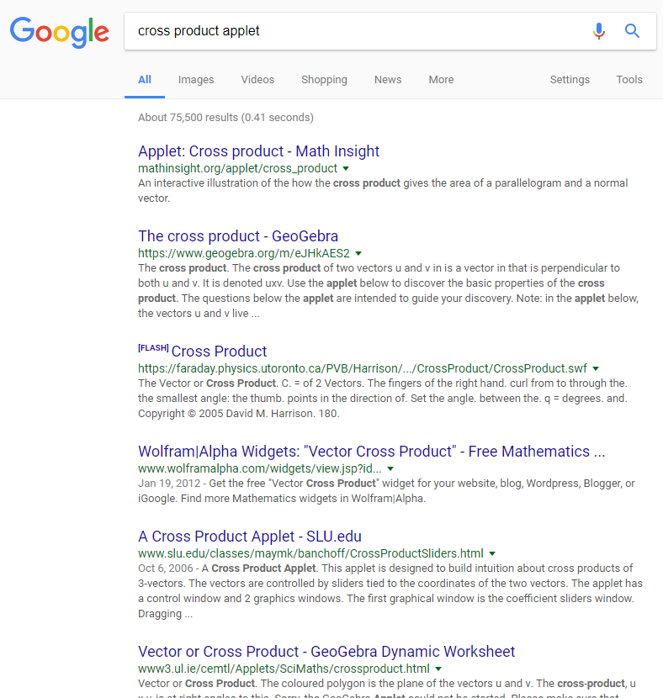
Scenario 2:
https://curatedcourses.org/

Slide 4


Scenario 3:
https://curatedcourses.org/

Slide 5
Outline
What is Curated Courses?
How can Curated Courses improve Linear Algebra instruction?
What have we learned about making Linear Algebra content usable in variety of instructional settings?
https://curatedcourses.org/

Slide 6
What is Curated Courses?
Project to create and curate high quality online open educational mathematics resources.
Curate = gather, tag, organize, review, make available
https://curatedcourses.org/

Slide 7
What is Curated Courses?
Website: https://curatedcourses.org
Curated Courses currently contains resources for Linear Algebra
Types of resources available:
Videos
Worksheets
Quizzes
Lesson plans
Clicker questions
Applets
Etc.
https://curatedcourses.org/

Slide 8
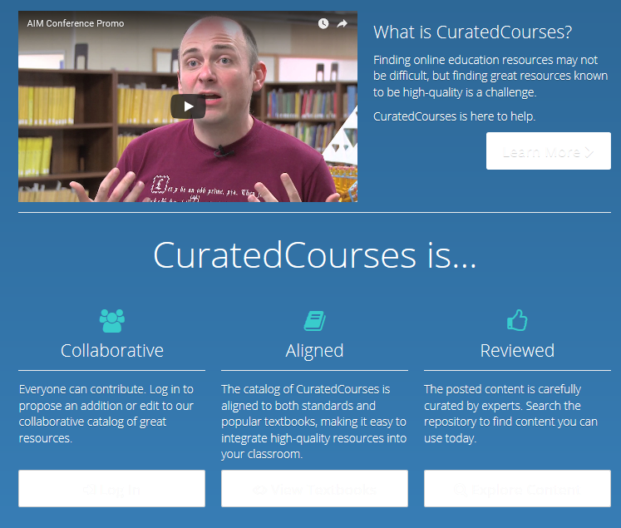
What is Curated Courses?
https://curatedcourses.org/

Slide 9
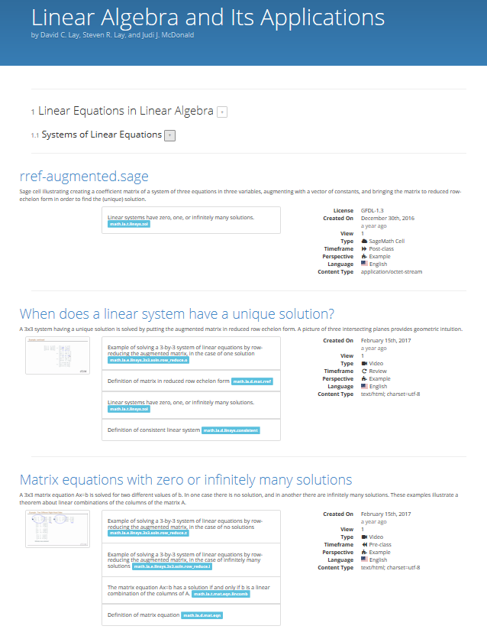
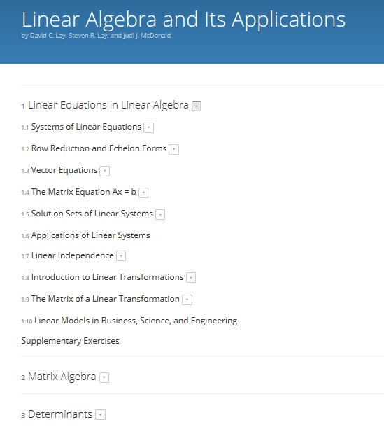
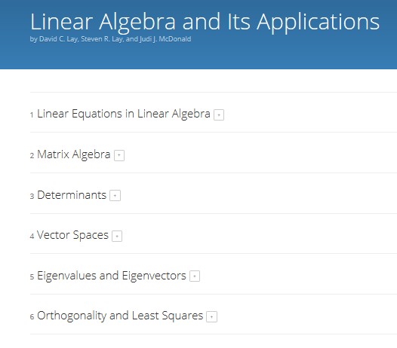
What is Curated Courses?
https://curatedcourses.org/

Slide 10
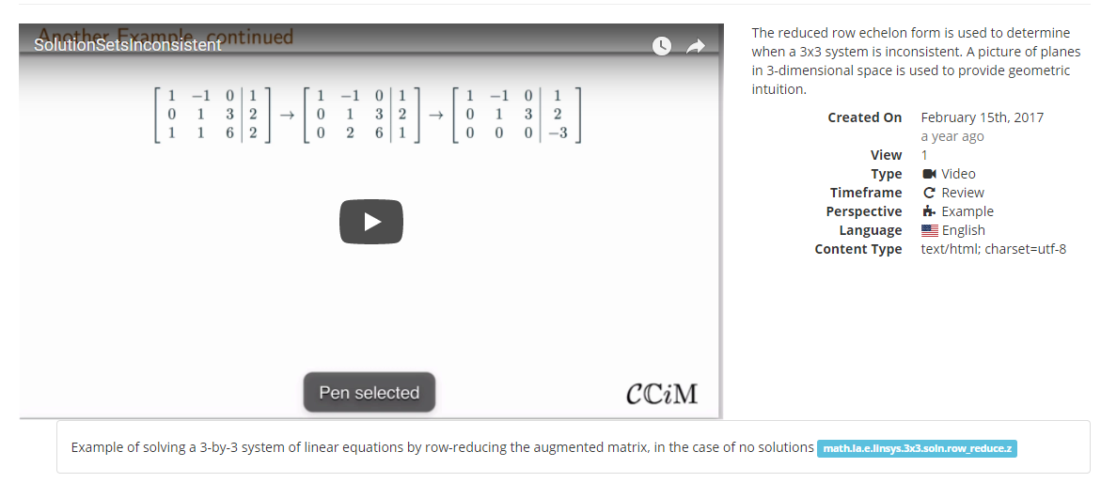

Slide 11
Improving Instruction
For students…
Alternative explanations of concepts
Additional worked examples
Textbook aligned materials for exam preparation review
Interactive applets and visualizations
https://curatedcourses.org/

Slide 12
Improving Instruction
For faculty…
Flipped or online course materials
In-class activities
Pre-class preparation
Post-class review
Interactive applet activities
Make-up lectures
Review materials for other classes relying on Linear Algebra content
https://curatedcourses.org/

Slide 13
Content Versatility
Adopt consistent, common notation scheme
Avoid numbering (theorems, definitions, equations, etc.)
Identify required prerequisite content
Review previous content as needed
Provide source files
Use standard formats
Modularize
Use open licensing
https://curatedcourses.org/

Slide 14
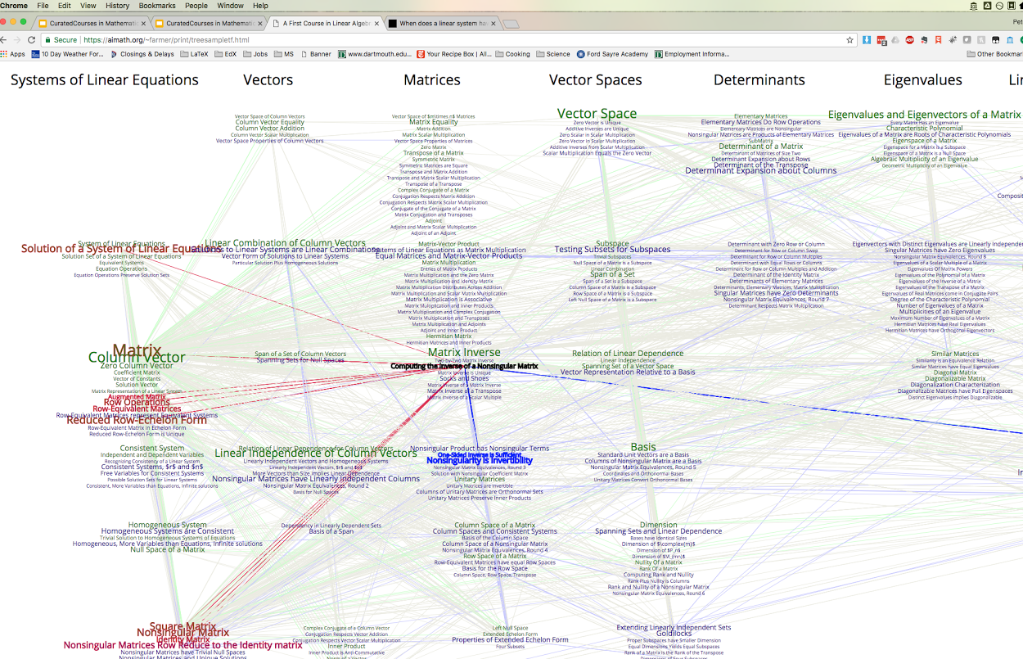
https://curatedcourses.org/

Slide 15
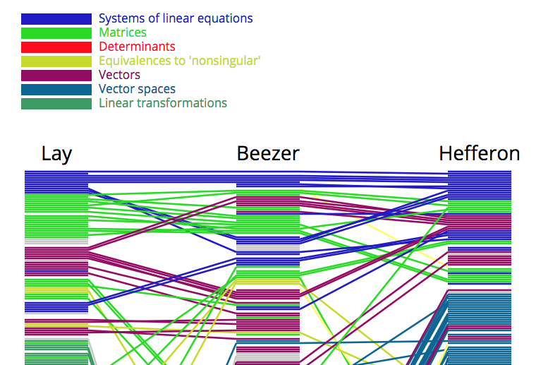
Content Versatility
https://curatedcourses.org/

Slide 16
Getting Involved
Curated Courses welcomes…
Uploads of Linear Algebra content to curatedcourses.org
Feedback from content users via curatedcourses.org/contact
Volunteer content reviewers
Developers to help expand Curated Courses beyond Linear Algebra (next targets: Differential Equations and Abstract Algebra)
Contact: Sarah Eichhorn (s.eichhorn@austin.utexas.edu)
https://curatedcourses.org/

Slide 17
Thank you!

