Slide 1






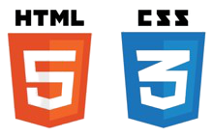

PC649: MSc (IT) Summer Internship
Guide: Prof. Shruti Bhilare
Team: Krima Shah (201912001), Nidhi Patel (201912046),
Shivi Sanadhya(201912084)
Tools and Technologies
Introduction
This Project was made for Appointment Booking for offline as well as online for getting treatment from home which can be very helpful in this Pandemic situation.
Here we provide a platform for doctor to view the issues and prescribe the treatment accordingly.
We also provide feasible payment method using Paytm developer platform.
Objectives
This Project ensures reliable Doctors.
People will be able to consult to the Doctor without moving out of their House.
Patients who booked online Appointment can download the prescription pdf at any point of time.
Below is shown the flow of our project in short:
Register
Download Prescription
Login
Write Prescription
Browse Doctor
Doctor checks issues
Online or Offline?
Choose Mode
Payment
Book Appointment
Write Issue
Lessons Learned
Using Javax API for mailing, which is really easy to use.
How to manage the slots of Doctor appointments based on availability.
PDF generation using itextPdf API for generating Prescription pdf.

