Slide 1

Paper reading report on
“A Network Airline Revenue Management
Framework Based on Decomposition
by Origins and Destinations”
田瑞锋
杨馨雨
任泽华

Slide 2

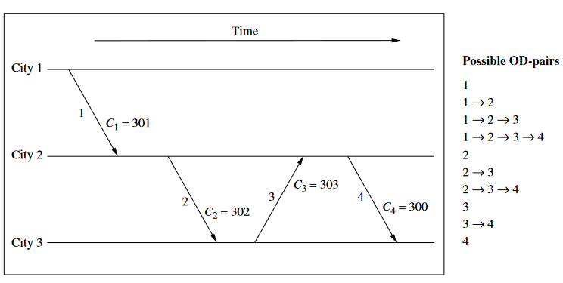
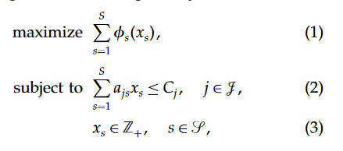


Slide 3
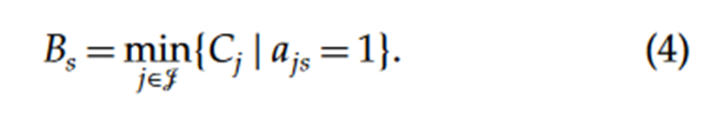




Slide 4
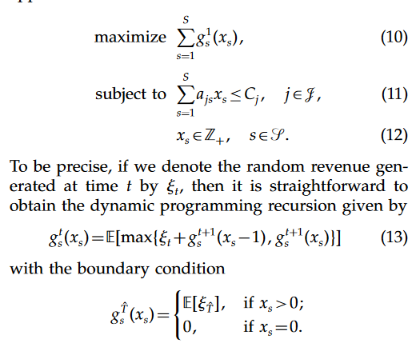
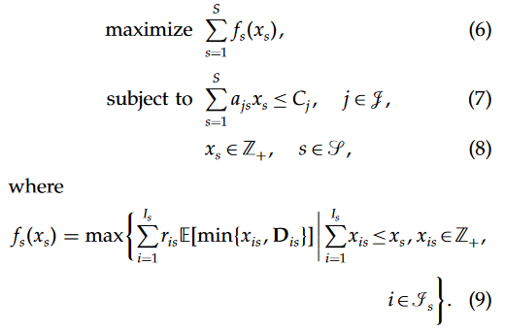

Slide 5
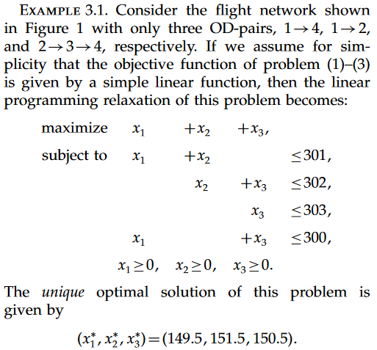

Slide 6

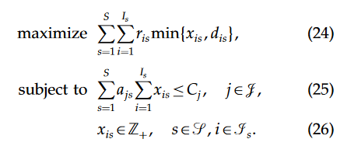
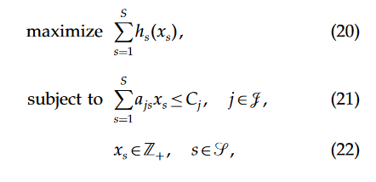
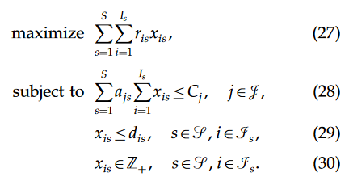
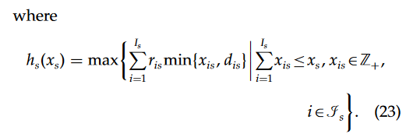

Slide 7

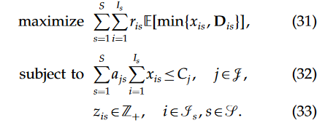

Slide 8
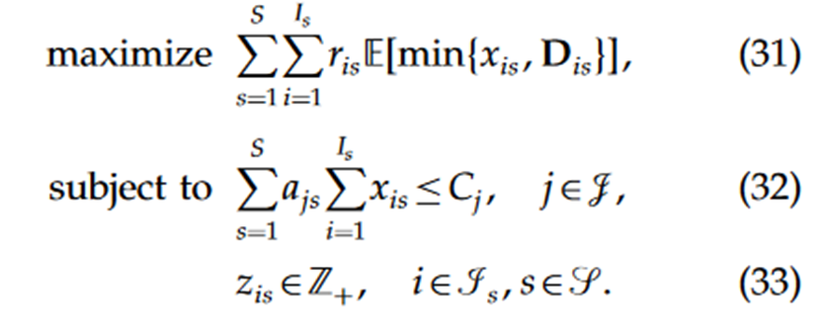
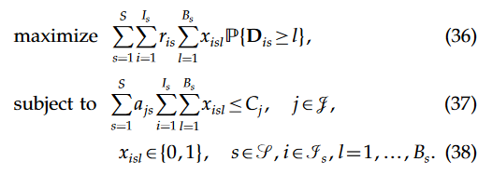
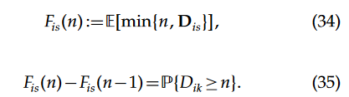


Slide 9

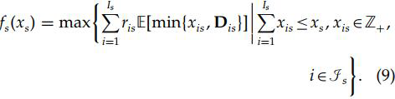




Questions
1.At the page of 318,by relation and the definition of xis, we can obtain
,but (9) is inconsistent with the obtainment, why is the sum of xis less than xs?
2.
we supposed that
is a constant, why there is "max" in the formula?
3. The dynamic model (6)-(8)：What’s the property random revenue ？How to understand (13)?
The length of period T ? Can only allow one person to buy a ticket during this period?
4. What’s the relationship between dual problem and shadow price?
5. what is the definition of
，is it the probability of ？
6. After applying a straightforward reformulation to the piecewise-linear objective function, the number of variables in the resulting linear program is doubled and the number of constraintsis increased by the number of itineraries.why the variables doubled and the constraints increased？

Slide 10
Next step
1.Read other papers which are cited by this paper and those who cite it.
2.Search papers about the proper noun in this paper, such as shadow price, proper noun and NP hard problem.
3.Get a better understanding on this model.
4.Try to define a simple problem and use this model to solve it.
5.Read another paper that is about the pricing policy.

Slide 11
THANK YOU
2019

