Slide 1
ECommerce

Slide 2
Basics
What is a website?
Parts of a website URL
Where is your site?
Ensure site is registered on the search engine:
site:diycomputerscienceandelectronics.wordpress.com – gives results then it is.
Done automatically.
What does a search engine do?
Crawls
Indexes
Serves with the data
Add your website on “Google search console” to get indexed

Slide 3
Technology
Front end
Server side
Back end
Agnostic ones would need something different

Slide 4
Why Ecommerce?
Send mails of orders and advertising material around the world
Mailchimp – marketing automation for ecommerce businesses
Create a store front –
The front end themes are easy and free, there are many paid ones too
On the internet
So available 24*7 and to anybody
Better information and service
Track orders
Cancel orders
Put a process for all the products sold and reduce management costs.

Slide 5
Exercise: Why Ecommerce?
See amazon and other ecommerce sites and list the features
Check other ecommerce sites you know

Slide 6
Some more
Keep in touch with customers
Buy and sell on the internet
Payment and returns
Wholesalers track
Stock (inventory) maintenance.
Track of sales
Cut short the middle man
No real estate cost
Cost for website maintenance and construction
Tax compliance is automatic –
all transactions are online and there is a record

Slide 7
Some more
Is the database also maintained by them and do you have power on it
Credit card payment have Indian payment systems

Slide 8
Self hosting
Points to consider:
Shared computer
Individual hosting
OS hosting – linux or windows?
Virtual private servers
The fee

Slide 9
Many options
Host your website
Self hosting – use godaddy or raspberrypi or a computer at home
Hosted by the ecommerce site
Use internet banking for all your banking, tax etc. to start online
Have an online catalogue – set off products ready
About me, product history etc. information ready
Layout, how many pages

Slide 10
Exercise: Set up a web server
LAMP server
XAMPP server
WAMP server
http://www.instructables.com/id/Turning-your-Raspberry-Pi-into-a-personal-web-serv/

Slide 11
Four types
Business - to - Business (B2B)
Business - to - Consumer (B2C)
Consumer - to - Consumer (C2C)
Consumer - to - Business (C2B)
Business - to - Government (B2G)
Government - to - Business (G2B)
Government - to - Citizen (G2C)

Slide 12
Exercise:
Search for examples of each
Business - to - Business (B2B)
Business - to - Consumer (B2C)
Consumer - to - Consumer (C2C)
Consumer - to - Business (C2B)
Business - to - Government (B2G)
Government - to - Business (G2B)
Government - to - Citizen (G2C)

Slide 13
B2B
Wholesaler orders from the website
The other business supplies to the website

Slide 14
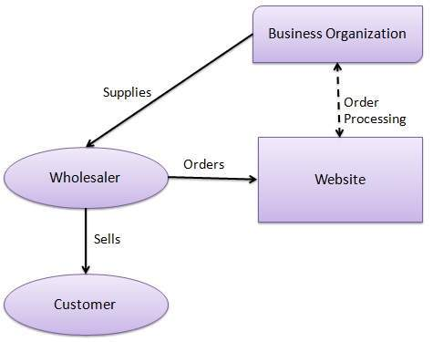
B2B – not directly visible but there

Slide 15
New age
RFID tags on each product so that sales and inventory is handled automatically at the ware house
https://www.youtube.com/watch?v=rBXJ9Razofw

Slide 16
Payment through one interface
Received from sales
Purchasing raw material
Manufacturing payment
Logistics payment
Handling all the finance

Slide 17
Payment methods
Credit cards
Debit cards
Bitcoins
Smart cards – gift coupons

Slide 18
Bitcoins
Own, send and mine (make) them
https://www.youtube.com/watch?v=Lx9zgZCMqXE
Everyone knows about every one else’s
Don’t trust anybody
https://www.youtube.com/watch?v=Lx9zgZCMqXE

Slide 19
Digital signature
A letter with your own signature
Public key algorithm
https://www.youtube.com/watch?v=Lx9zgZCMqXE – peek into data structures
Bitcoin transaction – traverse and check all previous conversations

Slide 20
Exercise: Bitcoin server
http://www.raspberrypifullnode.com/
http://www.instructables.com/id/Bitcoin-Mining-using-Raspberry-Pi/

Slide 21
Shopify store
https://business.tutsplus.com/articles/how-to-set-up-your-first-shopify-store--fsw-41823

Slide 22
Exercise:
Try a woocommerce website

